Slide 1
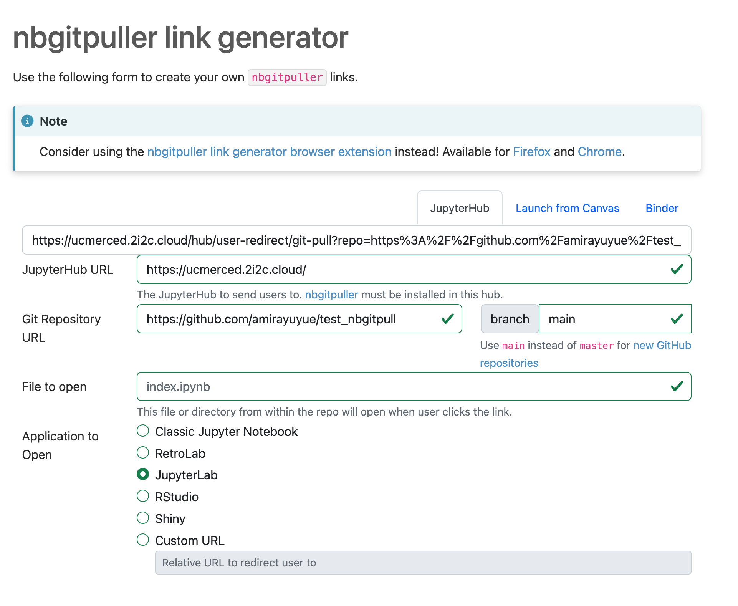
Generated URL
UCMerced JupyterHub URL
Github Repo URL

