Slide 1



Anime Data Mining and Analysis

Slide 2


About me
Sai Vamshi Burugu
(B.E - 2023 )
I am an aspiring Data Scientist and I enjoy finding patterns behind real-world problems. I’m excited about how data can tell stories, improve processes, and drive innovation. Building these skills will also help me grow towards my larger goal of contributing to AI and machine learning.
I have 1.5 years of professional experience working at TCS.
https://github.com/SaiVamshiBurugu
https://www.linkedin.com/in/saivamshiburugu/

Slide 3
🎯 Problem Statement
Despite the massive growth of the anime industry, limited analysis exists on how factors like genre, studio, duration, and release year influence anime success.
Audiences and creators often lack insights such as:
Which studios consistently produce top-rated anime?
How have genres like Adventure, Comedy, and Action evolved in popularity over the years?
Do newer animes tend to perform better than older ones in terms of ratings?
What is the relationship between episodes, duration, and ratings?
There is a need to explore patterns, correlations, and evolution in anime data to understand what drives success.
Goal: Provide insights that help in audience understanding, studio decisions, and future recommendation systems.

Slide 4
🎯 Objectives
Analyse anime data to uncover trends, patterns, and correlations.
Identify top-performing studios and genres based on ratings.
Explore how anime genres evolved over the years (e.g., rise of Adventure, Comedy, Action).
Study the impact of episode count and duration on ratings.
Compare older vs. newer releases to understand changes in audience preferences.
Highlight outliers and unique cases (e.g., longest anime, highest/lowest rated).
Provide insights that could guide both viewers (in discovering quality anime) and creators/studios (in producing successful content).

Slide 5

🌍 Web Scraping
Website Scraped :
https://www.anisearch.com/
Example Anime Card
Process Followed:
Identified Target Pages – Anime list pages containing title, genre, studio, rating, etc.
Fetched HTML Content – Using requests library while handling status codes.
Parsed HTML – With BeautifulSoup to extract structured data (titles, ratings, episodes, duration, genres, studios).
Used time library to add delays between requests while web scraping (to avoid server blocking and ensure smooth data extraction).

Slide 6

📊 Data Summary
Aspect | Details
Total Records | 4,393 anime entries
Time Period Covered | 1963 – 2025
Key Features | Title, Genre, Studio, Rating, Year of Release, Episodes, Duration, Source, Description
Categorical Data | Genres, Studios, Adaptation, Verbal Ratings
Numerical Data | Ratings, Episodes, Duration, Year of Release
Text Data | Descriptions
Cleaning Performed | Removed duplicates, handled missing values, converted data types

Slide 7
🧹Data Cleaning Steps
Data Contained Question mark(?) as missing value , replaced the “?” with nan value to handle.
Removed duplicate anime records.
Rating column contained Both numerical rating and verbal rating so separated the single column to 2 different columns for easy analysis.
Handled missing values (e.g., ratings, duration, genres)
Converted columns to proper data types (e.g., year → integer, rating → float)
Stripped unwanted characters in title column.

Slide 8
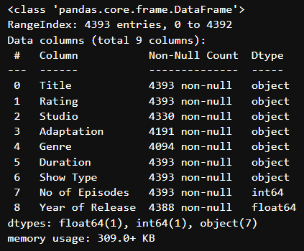
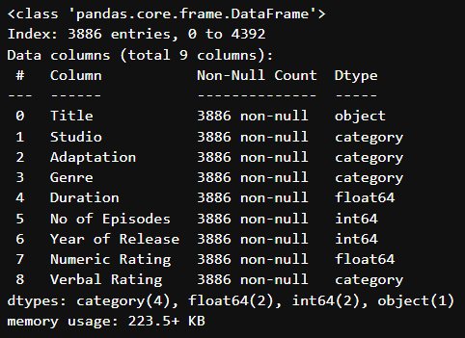
Data Manipulation
Below two images show the info about data before and after data manipulation.
Before
After

Slide 9
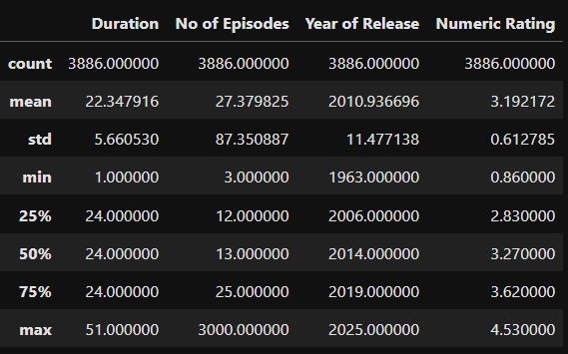
Data Description

Slide 10
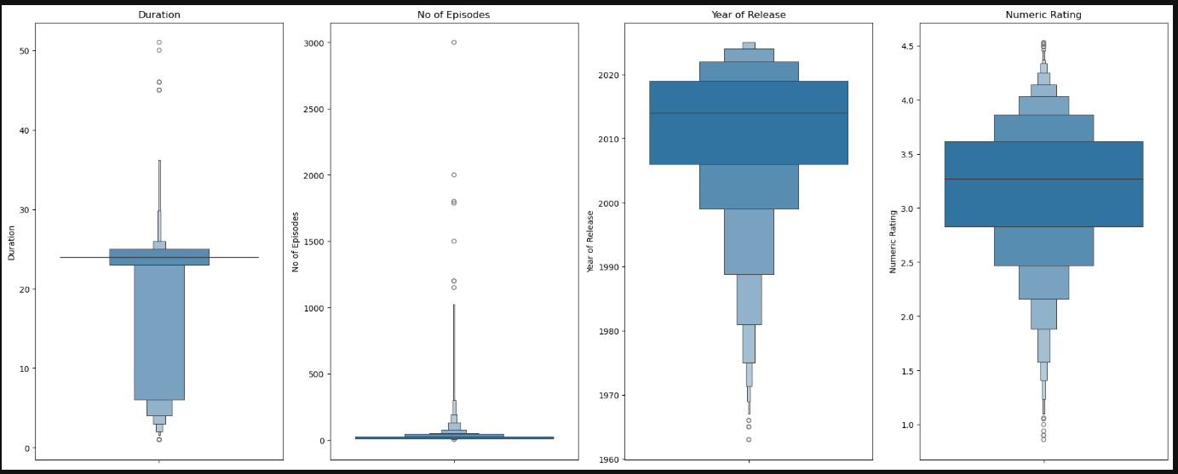
Univariate Analysis
Boxen Plots for Numerical Columns :
Insights :
All numeric columns show few outliers.
Year of release column is left skewed indicating more number of animes are produced in recent times

Slide 11
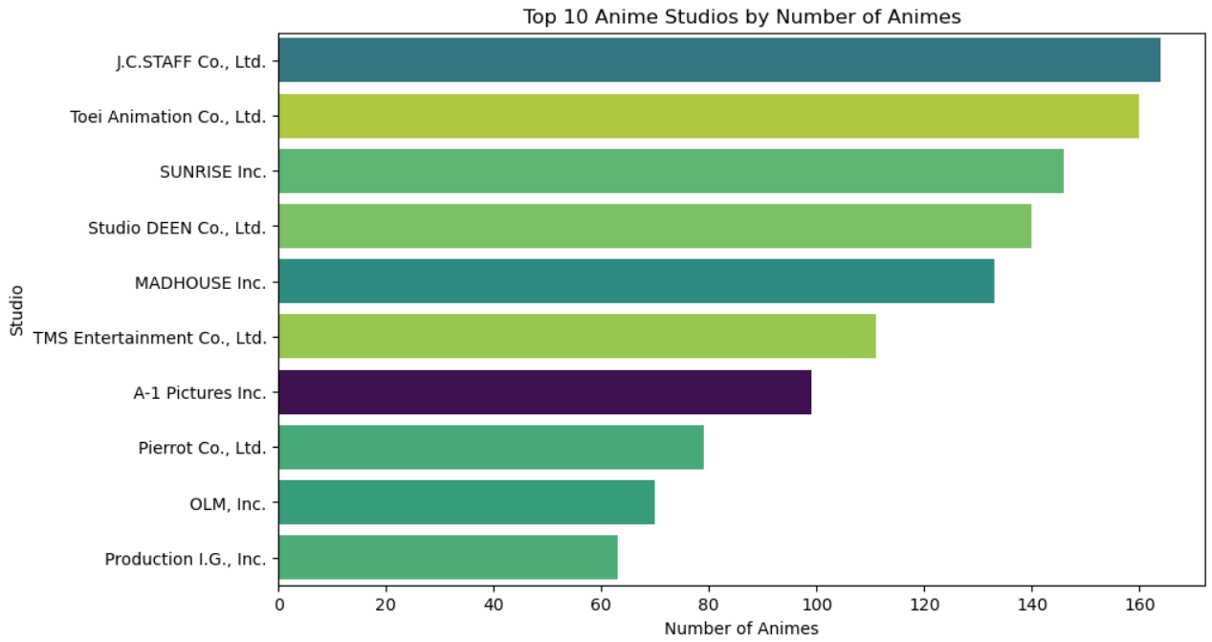
Univariate Analysis
Count Plots for Categorical Columns :
Insights :
JC Staff Studio has produced more number of animes. Followed by Toei Animations and sunrise Studio.

Slide 12
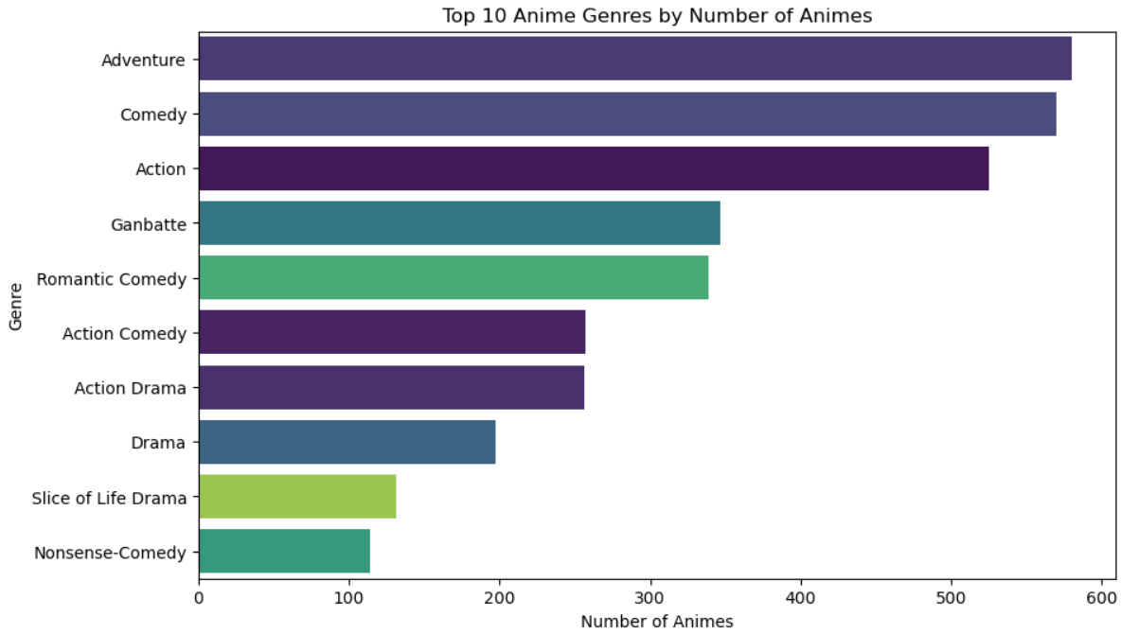
Univariate Analysis
Count Plots for Categorical Columns :
Insights :
There are More animes on Adventure Genre and followed by Comedy and Action.

Slide 13
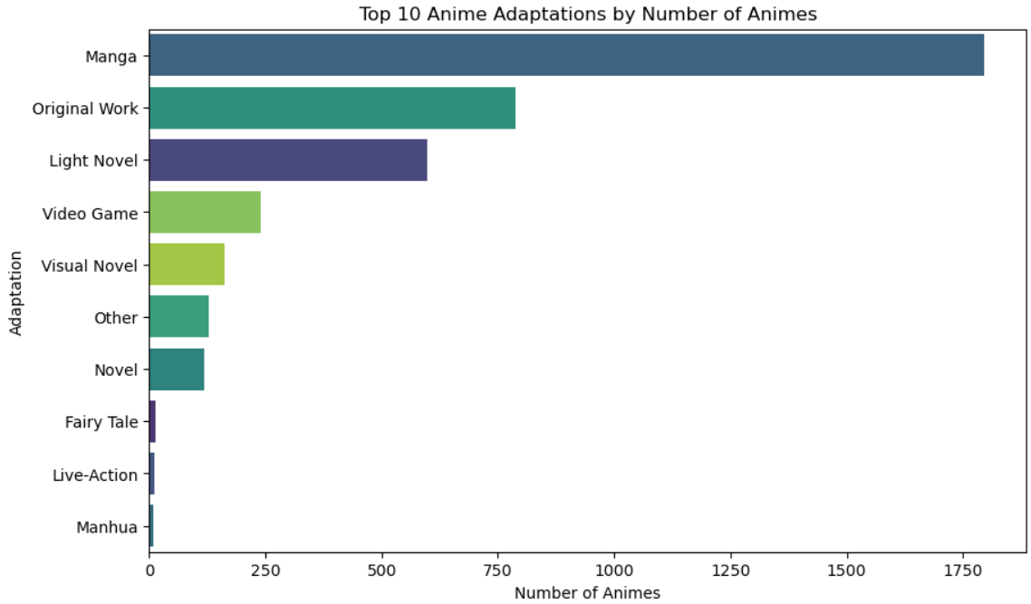
Univariate Analysis
Count Plots for Categorical Columns :
Insights :
Many Animes took inspiration/Adaptation from manga by a lot margin. Followed by some of the original Works and Light Novel.

Slide 14
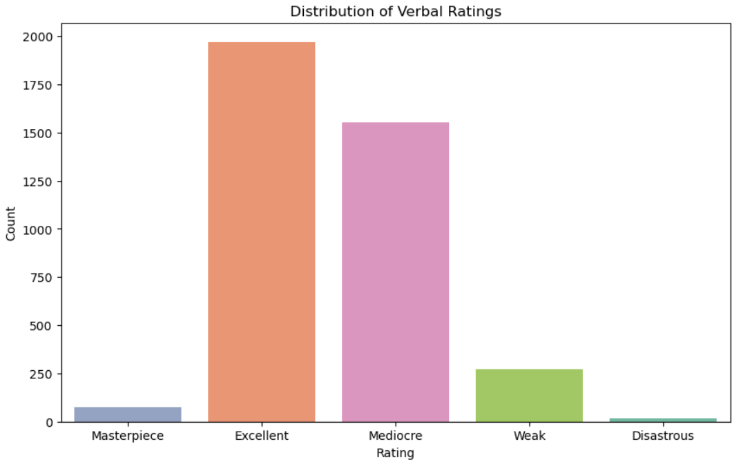
Univariate Analysis
Count Plots for Categorical Columns :
Insights :
Many animes are excellent and some are mediocre and very few weak , masterpiece and disastrous.

Slide 15
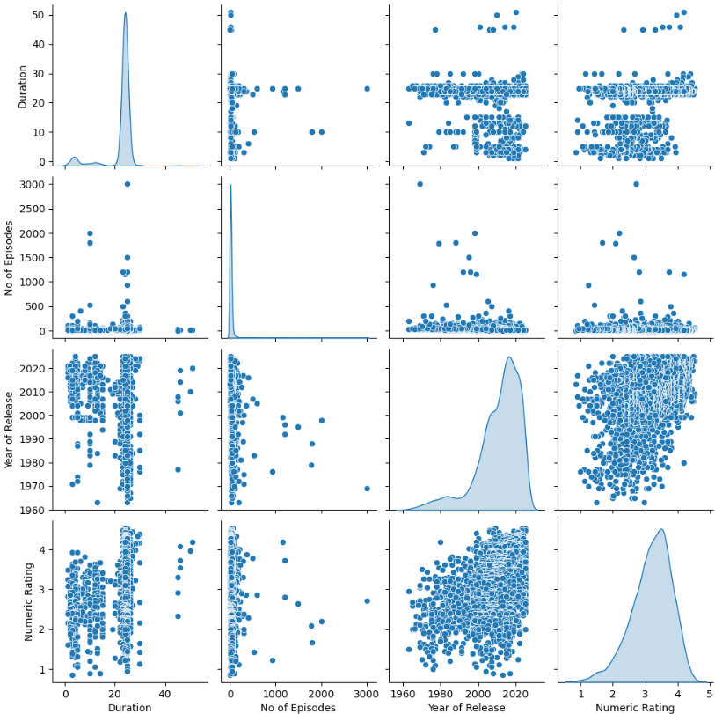
Bivariate Analysis
Pair Plot for Numerical Columns :
Insights :
Most anime episodes are 20–30 minutes long.
Most anime series have less than 200 episodes.
Recently released anime tend to have higher ratings, which is also confirmed in the trend analysis later.
Year of release KDE is left skewed.
Duration and No of Episodes KDE plots have high Kurtosis
Numeric rating column is normally distributed.

Slide 16
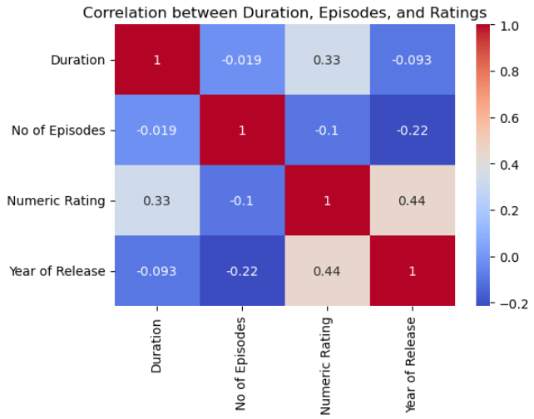
Bivariate Analysis
Pair Plot for Numerical Columns :
Insights :
Only Rating and Year of Release show a noticeable (weak) positive correlation.

Slide 17
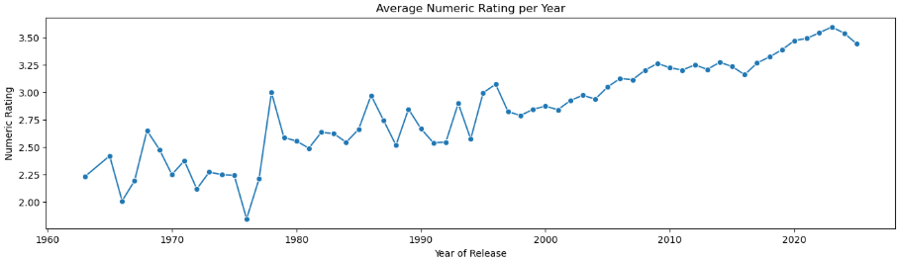
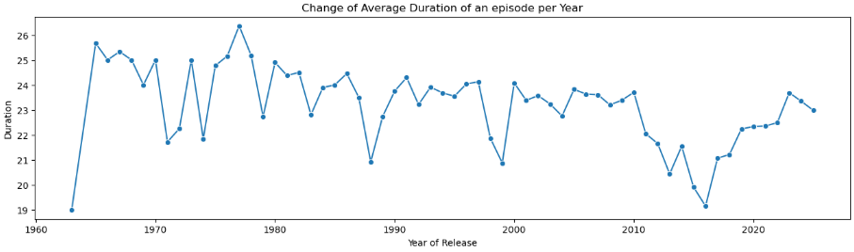
Bivariate Analysis
Trend Analysis of numerical columns wrt to the release Year :
Insights :
Average rating of the animes seems to increase with time, implies we are getting good animes in recent times.
Around 2016 many animes have less duration for an episode.

Slide 18
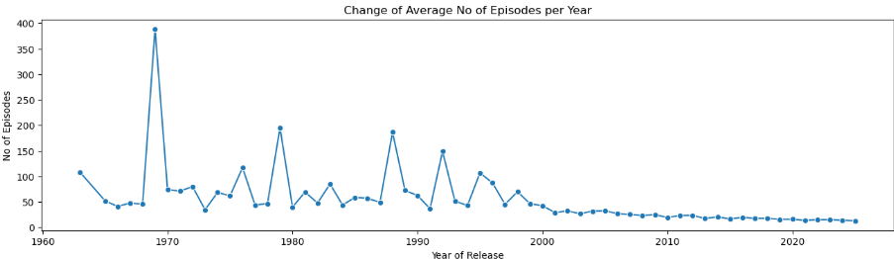
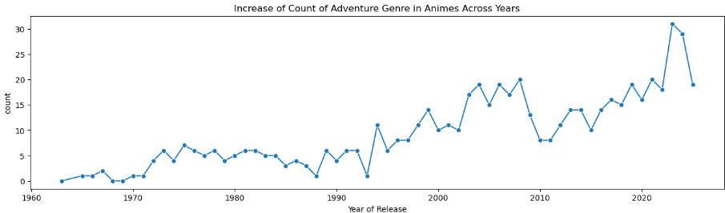
Bivariate Analysis
Trend Analysis of numerical columns wrt to the release Year :
Insights :
Lot of recent animes are short seasons with less episodes.
The popular genre Adventure has got peaked from 1994.

Slide 19
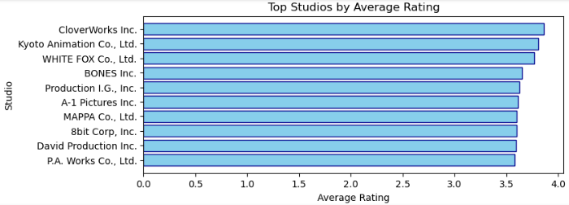
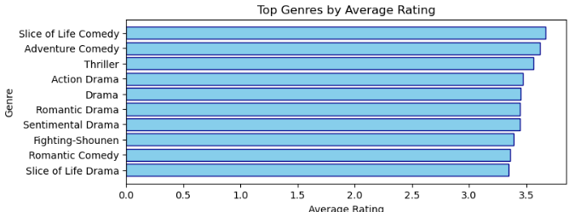
Bivariate Analysis
Categorical Columns Vs Rating column
Insights :
Cloverworks Studio has best average rating for their animes.
Slice of life genre has best average rating compared to other genres.

Slide 20
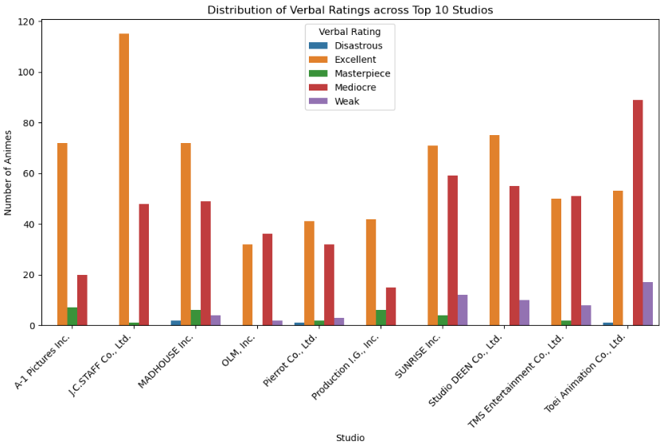
Bivariate Analysis
Categorical Columns Vs Categorical column
Insights :
Jc Staff studios has most number of excellent animes but very less masterpiece.

Slide 21
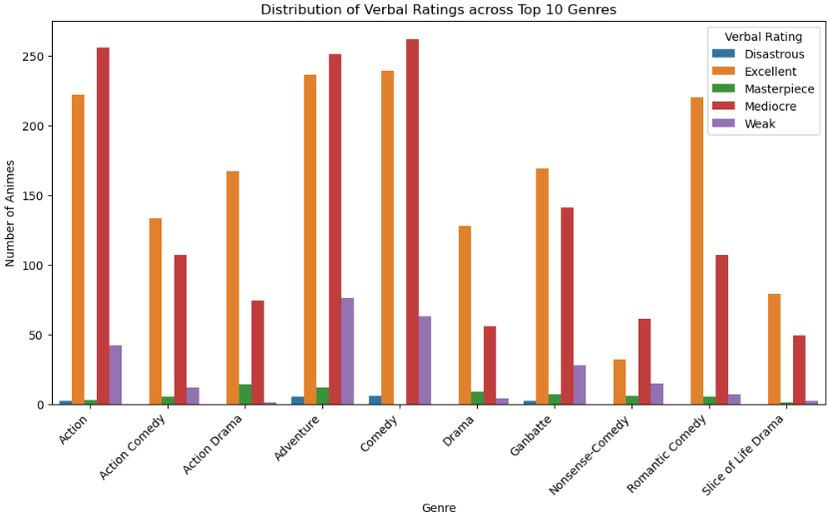
Bivariate Analysis
Categorical Columns Vs Categorical column
Insights :
Romcom genre has good excellent and mediocre ratio compared to other genres.

Slide 22
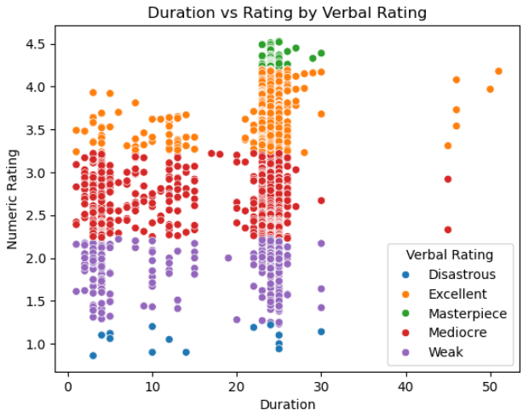
MultiVariate Analysis
Scatter Plot with Hue as Rating
Insights :
All Masterpiece-rated anime have episode durations between 20–30 minutes.

Slide 23
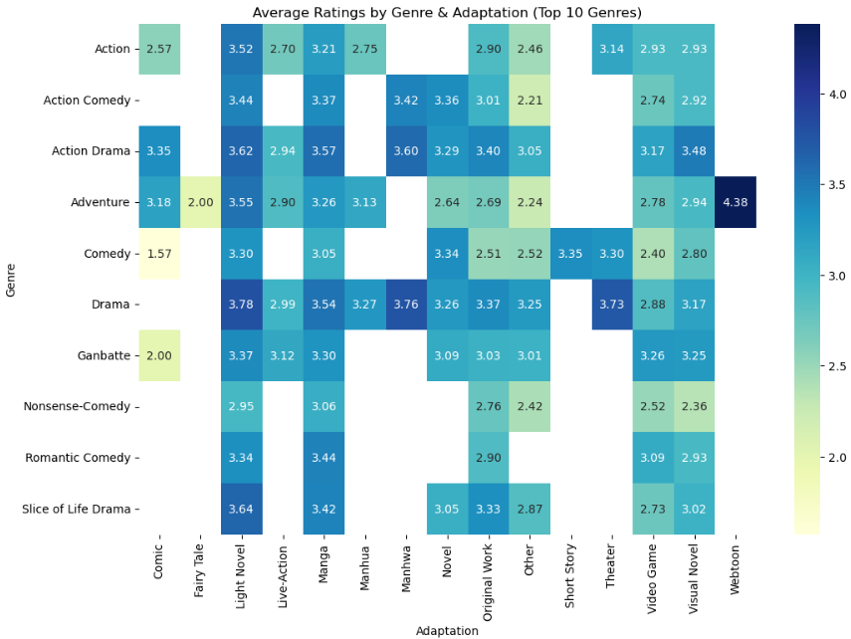
MultiVariate Analysis
HeatMap of ratings b/w Genre and Adaptation
Insights :
Webtoon adaptations with adventure genre animes have high rating.
Light Novel or Manhwa adaptation with Drama genre has good rating.

Slide 24
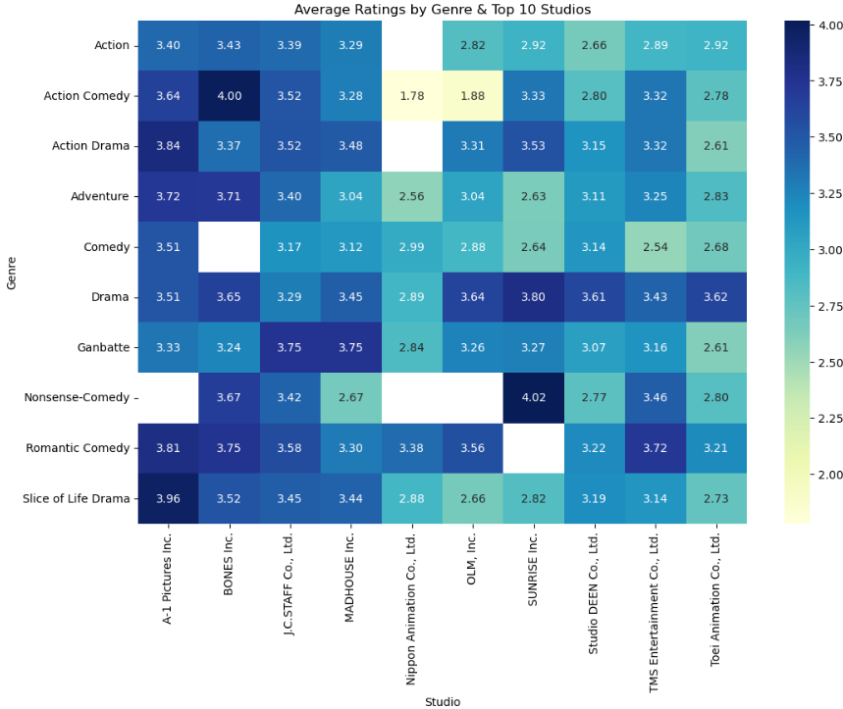
MultiVariate Analysis
HeatMap of ratings b/w Genre and Studio
Insights :
Sunrise studio has produced high rated Nonsense comedy animes.
Bones studio seems to produce good animes with Action Comedy Animes.
A1 Pictures produce good Slice of life drama Animes.

Slide 25
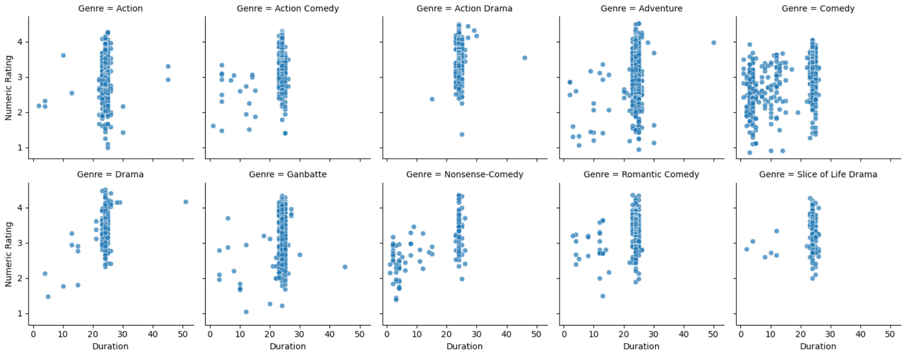
MultiVariate Analysis
Facet grid of Top 10 genres comparing rating and duration of each episode
Insights : Comedy genre has some animes with less duration episodes.

Slide 26
❓Key Business Questions:
Ratings & Quality
Which studios consistently produce high-rated anime?
What genres are most associated with higher ratings?
Do newer animes get better ratings compared to older ones?
Production Strategy
How many episodes should a typical anime season have to maximise audience appeal?
What is the ideal episode duration preferred by audiences?
Trends & Popularity
How have different genres evolved over time (e.g., when did Adventure or Comedy boom)?
What source material (Manga, Light Novel, Original) inspires most successful animes?
Which decades produced the most critically acclaimed anime?
Benchmarking
Who are the top-performing studios in terms of both quantity and quality?
Which anime holds the record for highest rating, lowest rating, and longest duration?

Slide 27
🔎 All Insights :
J.C. Staff produced the highest number of anime, followed by Toei Animation and Sunrise.
The most frequent genres are Adventure, Comedy, and Action.
Most anime are adapted from Manga, followed by Original works and Light novels.
The average rating of anime has increased over time.
The average episode duration has stayed roughly the same over the years.
Anime with large episode counts have decreased over time, with modern anime usually having shorter seasons.
The Adventure genre started to grow significantly around 1992.
The top-rated studios are:
CloverWorks , b. Kyoto Animation , c. White Fox
The top-rated genres are:
Slice of Life Comedy , b. Adventure Comed , c. Thriller
Fighting Shounen anime tend to have more episodes on average.
Highest-rated anime: Fullmetal Alchemist: Brotherhood
Lowest-rated anime: Glass no Kamen Desu ga, which is also the shortest anime with only 3 episodes.
Longest anime: Sazae-san with an incredible 3000+ episodes.
Webtoon adaptations combined with the Adventure genre show higher ratings.
Light Novel or Manhwa adaptations in the Drama genre also receive good ratings.

Slide 28
Conclusion :
The analysis shows that Adventure, Comedy, and Action dominate anime genres, while Manga is the main adaptation source. Ratings have improved over time, though modern anime have shorter seasons. Top-rated studios include CloverWorks and Kyoto Animation, with standout titles like Fullmetal Alchemist: Brotherhood and long-runners like Sazae-san.

Slide 29
🧑‍💻 Experience : ⚡Challenges :
Gained hands-on practice in Web Scraping (BeautifulSoup, time library).
Worked on Data Cleaning & Manipulation for large datasets.
Explored multiple EDA techniques (univariate, bivariate, trend analysis).
Applied visualisation (Seaborn, Matplotlib, WordCloud) to extract insights.
Finding a proper website for scrapping.
Incomplete / inconsistent values in ratings, episodes, and genres
Outliers (e.g., Sazae-san with 3000 episodes) skewed results
Website restrictions → faced 403/529 errors, solved with time.sleep() delays
Too many categories (studios/genres) made plots cluttered → solved with filtering & horizontal plots

Slide 30


Slide 31

THANK YOU

