Slide 1
MINI PROJECT
GRIEVANCE REDRESSAL SYSTEM
K. Sai Vamshi(160118737042)
Guide : Dr.B.Veera Jyothi

Slide 2
CONTENTS
INTRODUCTION
TECHNOLOGIES
EXISTING SYSTEM
PROPOSED SYSTEM
SOFTWARE AND HARDWARE REQUIREMENT SPECIFICATIONS
IMPLEMENTATION OF PROJECT
CONCLUSION & FUTURE SCOPE

Slide 3
INTRODUCTION
Grievance Redressal is a management and governance related process used commonly in India.
Usually a Public Relations Officer(PRO) is designated with the role of receiving complaints, but this mechanism often fails on account of lack of authority vested in the PRO over offices of various capacities.
Therefore Grievance Redressal mechanism is mandated in government agencies and departments that are directly involved with serving citizens and organizations.
The main motive of this project is to bridge the gap between the people and the authority.

Slide 4
Existing System
The existing model is a pen and paper based system. It doesn’t give any assurance of confidentiality and reliability.
The existing model doesn’t implement visibility of the problems effectively. That is, if a person posts a problem it would not be visible to other users.
As it involves manual intervention, it is error prone.
An increase in the number of problems would increase, it would be difficult to manage.

Slide 5
PROPOSED SYSTEM
The proposed system has a user interface, which addresses the following:
Voting for the already existing problems.
Posting their problems.
Voting for the posted problems.

Slide 6
PROPOSED SYSTEM vs EXISTING SYSTEM
Confidentiality and reliability is achieved by maintaining the anonymity of the user who votes for a problem.
Any user can view all the problems posted and can vote accordingly, thereby ensuring visibility
It is a computerized model which doesn’t require manual intervention
It avoids manipulation and duplication of votes to the problems

Slide 7
SOFTWARE REQUIREMENT SPECIFICATIONS
Software Requirements:
Operating systems: Windows* 7 or later, mac OS, and Linux.
Included development tools : Dev C++, Notepad

Slide 8
HARDWARE REQUIREMENT SPECIFICATIONS
Hardware Requirements:
Processors: Intel Atom® processor or Intel® Core™ i3 processor.
64 bit processor
Hard Disk Space: 1 GB
Input device (mouse /keyboard) to select options
Sufficient RAM to run the program (Minimum 2GB)

Slide 9
IMPLEMENTATION
The system uses C++ files extensively to store the user login details , already existing problems with their votes , posted problems with their votes , etc
The various operations that can be performed on files are:
Create a new file
Change the access permissions and attributes of a file
Open a file, which makes the file contents available to the program
Read data from a file
Write data to a file
Close a file, terminating the association between it and the program

Slide 10
Random Access of Files
If the amount of data stored in a file is fairly large, the use of random access will allow you to search through it quicker.
A random access file lets you jump directly to the target address where data is located.
A random access file lets you jump directly to the target address where data is located.
Data has been stored in files in the form records i.e using objects and thus random access is performed using read() and write() functions.

Slide 11
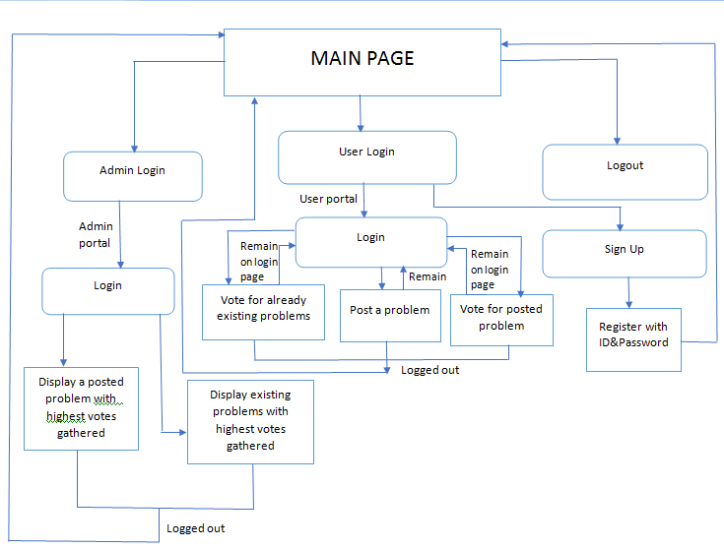
Proposed system

Slide 12
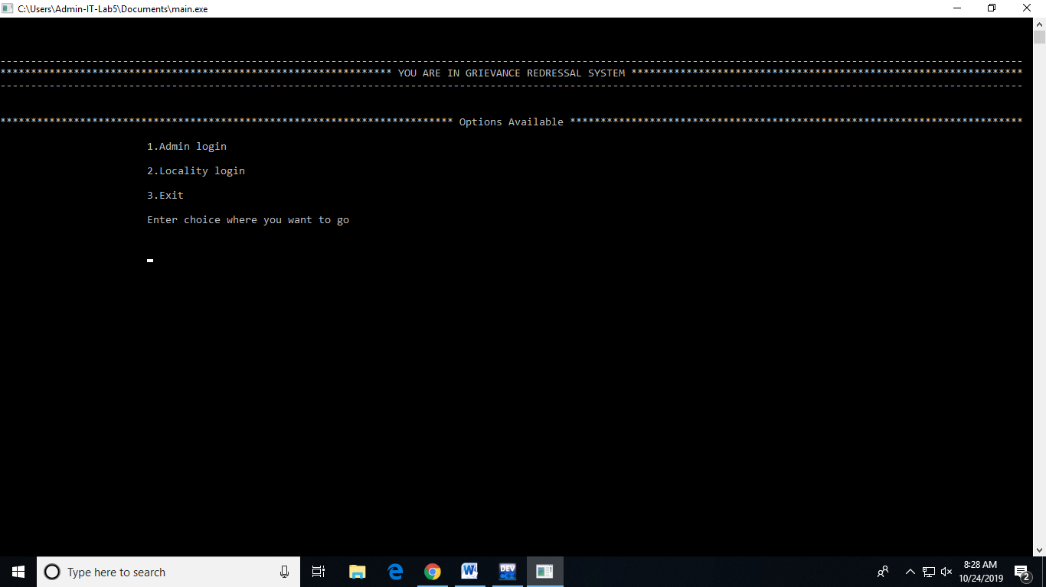
Main portal

Slide 13
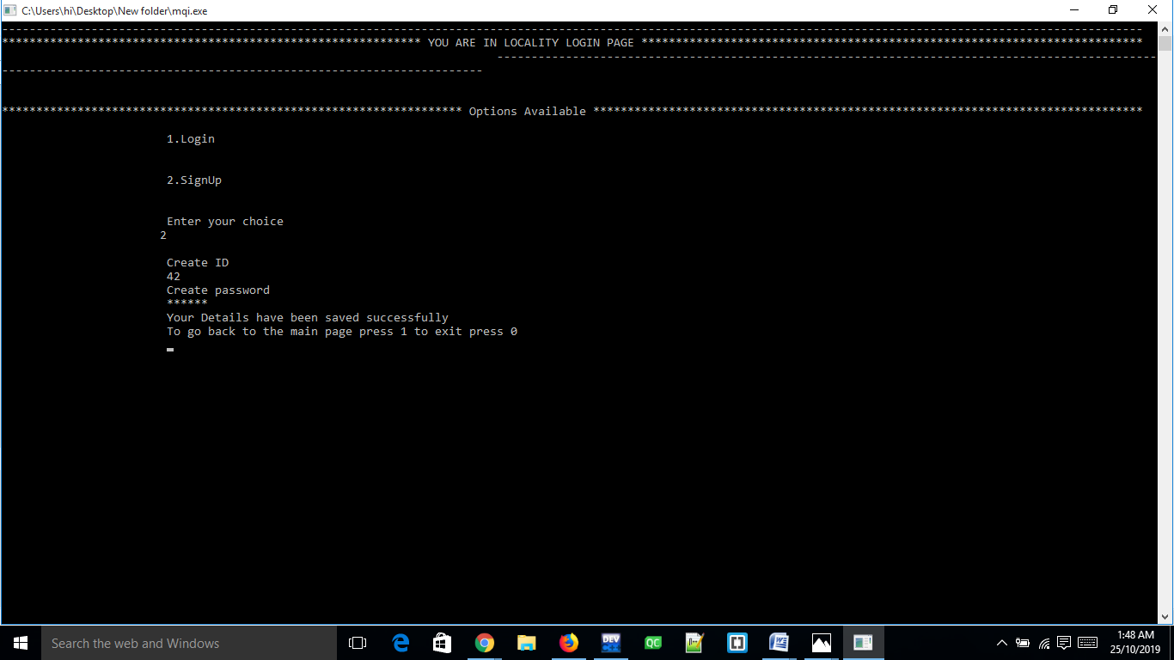
User Registration

Slide 14
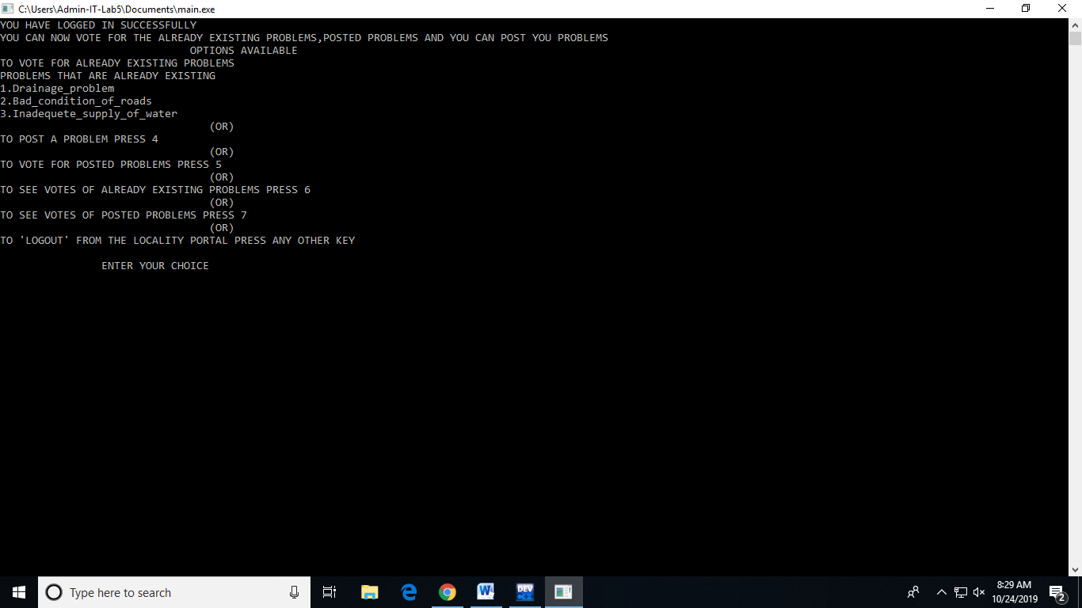
User Login Main Page

Slide 15
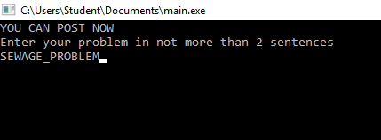
Posting a Problem

Slide 16
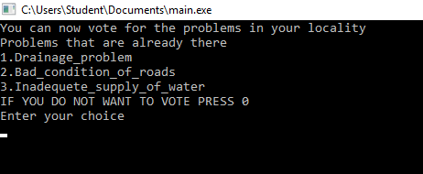
Vote for already existing problems:

Slide 17
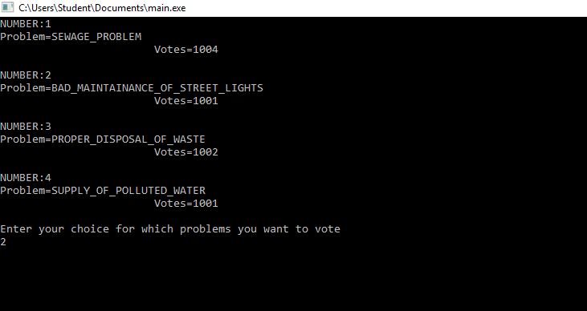
Voting for posted problems

Slide 18
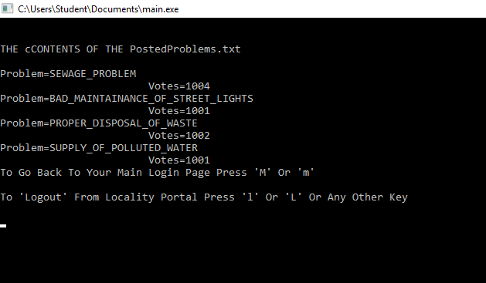
Votes of posted problems

Slide 19
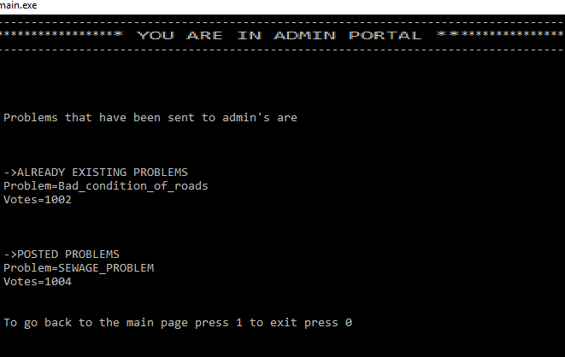
Admin Portal

Slide 20
CONCLUSION & FUTURE SCOPE
This project is developed using object oriented programming styles and files. It has succeeded in providing an interface between user and admin which lets the admin to track the highest voted problem and allows to look into it.
A website having all the features can make it easy to access for the users. Website also has the advantage of storing large data if the number of the users is high. Similarly an android app can also be developed for the problem statement mentioned.

Slide 21
Any Questions ??

Slide 22
Thank You

