Slide 1

KHO KHO | खो खो
India's Ground Game
From Red-Clay Roots to the 2025 World Cup & Global Olympic Ambition
27m × 16m Ground
Strict Direction Rule
2025 World Champions
8 seated chasers facing alternate sides with 2 teak poles.
Never turn back mid-lane without taking a post or giving Kho.
India Men & Women swept inaugural double gold in New Delhi.
Scan for 3D Experience
Presented by: Polimera Sai Vatsal (ID: 2500040224), KL Deemed to be University | https://khokho-india.org/
Notes:
Welcome to this presentation on Kho Kho, one of India's most exhilarating indigenous sports. Unlike casual tag, Kho Kho is high-speed tactical chess played at thirty kilometers an hour across a twenty-seven by sixteen-meter pitch. Today we will examine its court geometry, strict direction rules, documented history from the 1914 Deccan Gymkhana to the 2025 World Cup in New Delhi, and collegiate talent pipelines including KL University.

Slide 2
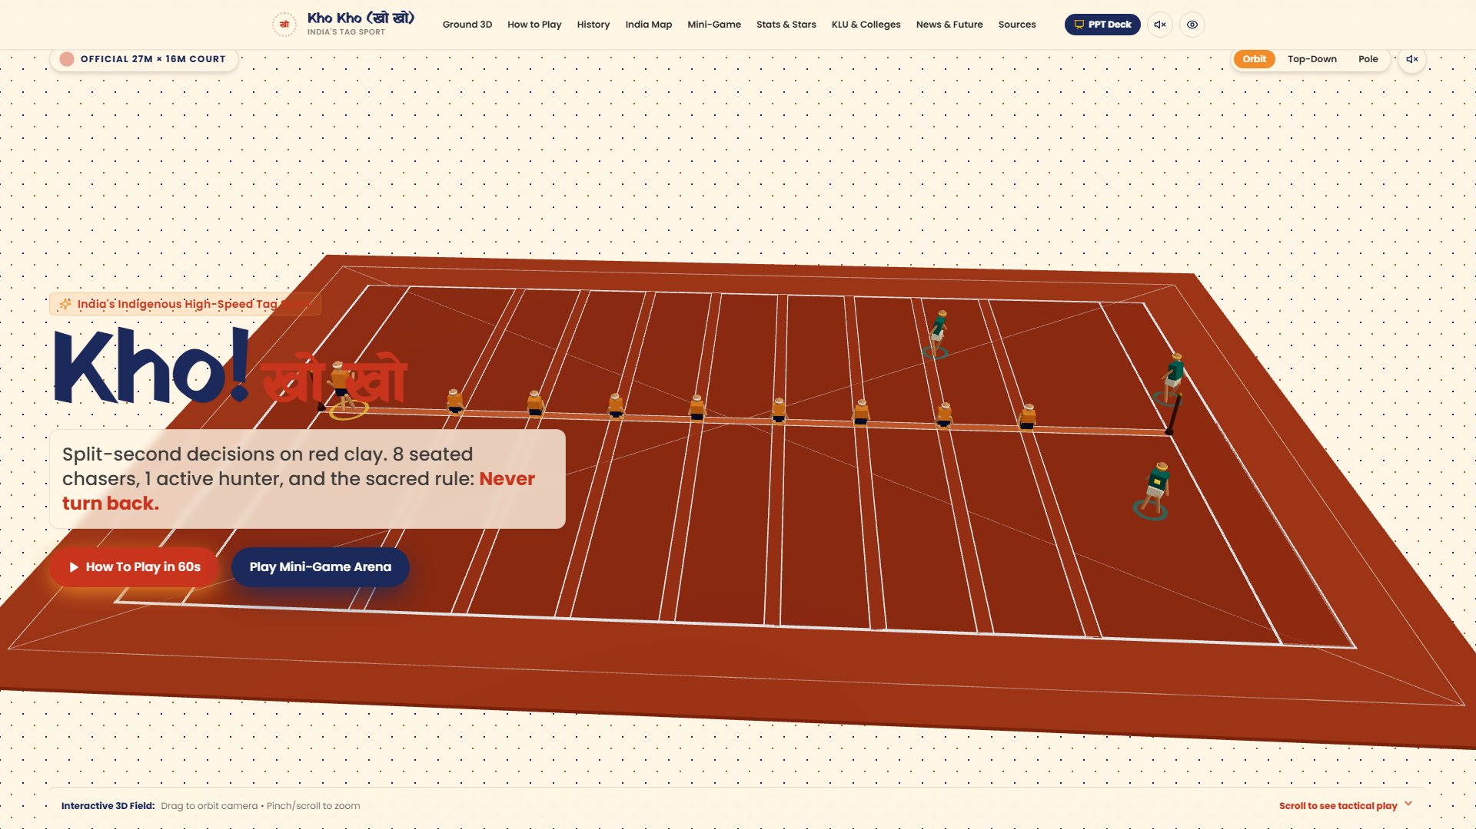
THE SPORTING THESIS
Why Kho Kho Matters: Anaerobic Speed & Strategic Feints
A 30 km/h Mind Game on Earthen Clay
https://khokho-india.org
Peak Velocity: Chasers accelerate to 32 km/h across short 2.3m sprint bursts.
Instant Reflexes: Defenders dodge direction cuts with sub-0.20s reaction times.
Zero Gear Barrier: Pure physical willpower; requires only earth, lime chalk, and two posts.
Massive Scale: 164 Million viewers watched Ultimate Kho Kho Season 1.
Kho Kho: India's Ground Game | Official KKFI & IKKF Data
Slide 2
Notes:
Kho Kho strips away expensive athletic equipment and elevates pure human athleticism. A chaser must sprint at top speed while making split-second tactical calculations. The screenshot on the right showcases our real-time 3D simulation of the official court, showing the eight seated chasers in alternate directions and the two teak posts that anchor the legal turning zones.

Slide 3
PITCH SPECIFICATIONS
The Ground & The Players: Official Court Dimensions
27m Overall Length (Incl. 1.5m Free Zones)
Playing Area
Lobby Margin
27m × 16m
1.5m perimeter
Central Lane
8 Cross Lanes
24m × 30cm
16m × 35cm each
16m Width
Lane Interval
Wooden Posts
2.30m spacing
120–125cm height
Sitting Blocks
Squad Roster
35cm × 30cm
12 (9 on court)
Kho Kho: India's Ground Game | Official KKFI & IKKF Data
Slide 3
Notes:
Here we see the official court dimensions codified by the Kho Kho Federation of India. The field measures twenty-seven meters by sixteen meters. The central lane is twenty-four meters long and thirty centimeters wide, anchored by two teak poles. Notice the eight cross-lanes spaced at two-point-three-meter intervals where the seated chasers sit facing alternate directions.

Slide 4
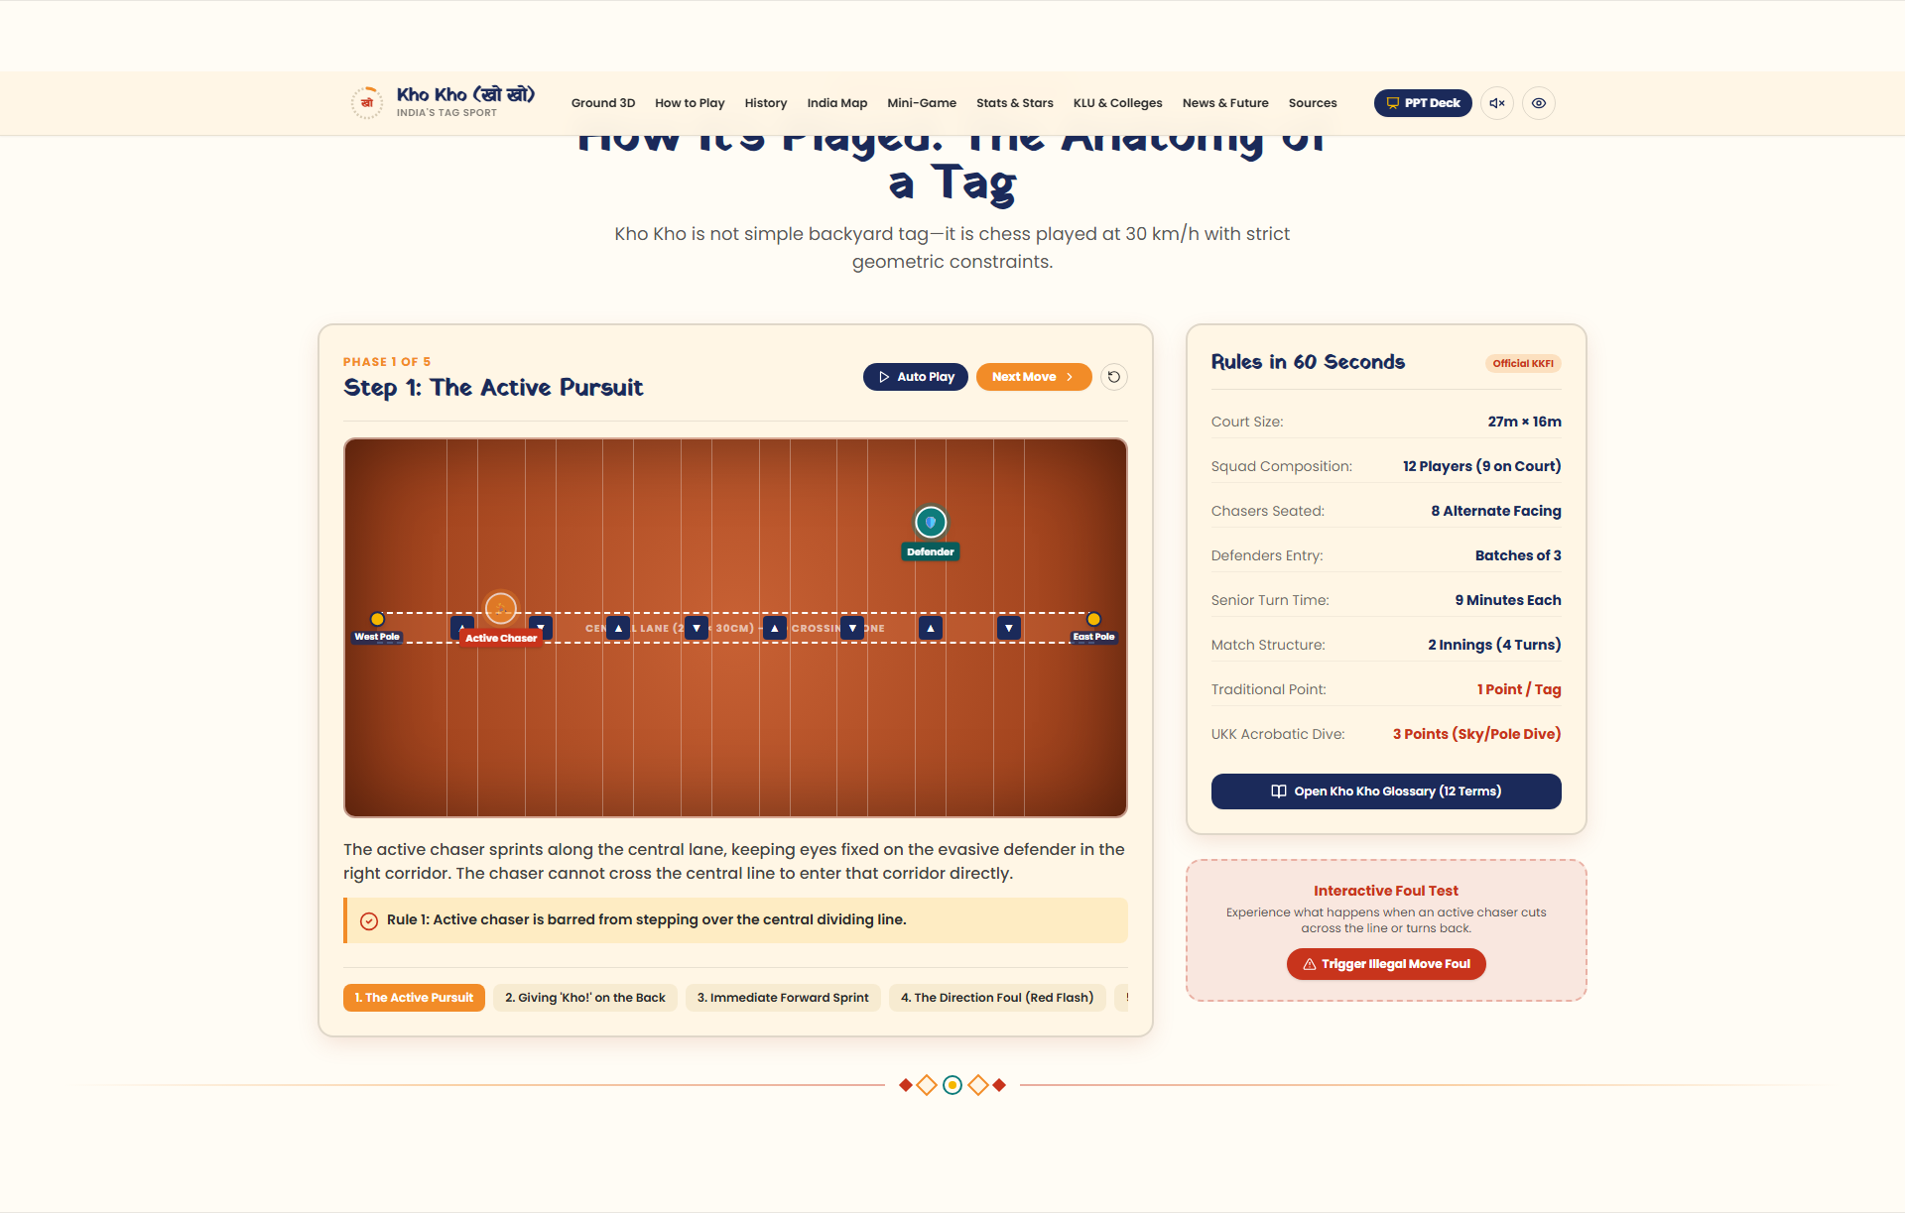
THE CORE MECHANICS
Rules in 60 Seconds: Chase, Vocal Call, Direction & Tag
01
02
03
04
Pursue & Feint
Give 'Kho!'
Explosive Swap
Legal Dismissal
Active chaser runs along central lane without crossing it.
Tap seated teammate on back and shout 'Kho!' simultaneously.
Tapped chaser stands and sprints in seated direction.
Clean touch tags defender out. No reversing mid-lane!
https://khokho-india.org
Kho Kho: India's Ground Game | Official KKFI & IKKF Data
Slide 4
Notes:
Kho Kho's tactical gameplay revolves around four core steps. First, the active chaser pursues defenders along the central corridor. Second, they tap a seated teammate on the back while shouting 'Kho!'. Third, that teammate immediately charges forward in their seated direction. Fourth, if the chaser touches a defender cleanly, that defender is dismissed. Any attempt to reverse backward mid-lane triggers an immediate red foul.

Slide 5
SCORING SYSTEMS
How Points Work: Traditional Tagging vs. Acrobatic Dives
Traditional KKFI Official Scoring
Ultimate Kho Kho (UKK) League Scoring
• 1 Point per defender touched cleanly by hand.
★ 2 Points: Standard running touch.
• 1 Point if a defender steps out-of-bounds.
★ 3 Points: Sky Dive (full aerial acrobatic dive).
• Match Duration: 2 Innings of 2 turns each.
★ 3 Points: Pole Dive (body flung outward holding post).
• Turn Duration: 9 minutes for Seniors, 7 mins for Juniors.
★ Dream Run Bonus: 1 Pt for surviving over 2m 30s.
• Winner: Team with highest cumulative dismissals.
★ Wazir Rule: Designated attacker moves in both directions.
Kho Kho: India's Ground Game | Official KKFI & IKKF Data
Slide 5
Notes:
Scoring in Kho Kho has evolved dramatically. In traditional federation matches, each touch or boundary dismissal awards one point across two nine-minute turns. In the modern Ultimate Kho Kho league, points are tiered: a basic touch is worth two points, while an acrobatic Sky Dive or Pole Dive earns three points, rewarding high-risk aerial athleticism.

Slide 6
HISTORIOGRAPHICAL SEPARATION
Legend vs. Documented History: Respecting the Record
TRACK A: ORAL TRADITION & FOLKLORE
TRACK B: DOCUMENTED MODERN HISTORY
Ancient Chariot Tactics (Rathachera)
Codified Governance (1914–Present)
Folk narratives link evasive drills to the Mahabharata chariot maneuvers (breaking the Chakravyuha). Medieval Maharashtra Akhadas in Pune, Baroda, and Satara practiced agility tagging to condition soldiers. These stories reflect cultural heritage but lack written rulebooks from antiquity.
1914: Deccan Gymkhana (Pune) drafts the first formal written rules.
1955: Kho Kho Federation of India (KKFI) established.
1959–60: Inaugural National Championship in Vijayawada (AP).
1970: First Arjuna Award to Sudhir Parab.
Jan 2025: 1st World Cup in New Delhi with 24 nations.
Kho Kho: India's Ground Game | Official KKFI & IKKF Data
Slide 6
Notes:
Rigorous sports scholarship demands separating ancient folklore from verifiable history. While traditions cherish links to Mahabharata chariot warfare and rural gymnasiums, the codified sport began in 1914 when Pune's Deccan Gymkhana club formed a committee to standardize court boundaries and refereeing protocols.

Slide 7
HISTORICAL MILESTONES
Chronology of the Red Clay: 1914 to 2025
1914
1955
1959
1970
2022
2025
Deccan Gymkhana
KKFI Founded
1st Nationals
Arjuna Award
Ultimate Kho Kho
World Cup Gold
First formal codified rules standardized in Pune.
Apex national federation established across Indian states.
Men's Championship hosted in Vijayawada, Andhra Pradesh.
Sudhir Parab wins first-ever civilian national award.
Televised franchise league launched with 164M viewers.
India Men & Women win inaugural World Cup in New Delhi.
Kho Kho: India's Ground Game | Official KKFI & IKKF Data
Slide 7
Notes:
This timeline tracks over a century of sporting evolution. From Pune's Deccan Gymkhana in 1914 to the establishment of the KKFI in 1955, the first national tournament in Vijayawada in 1959, Sudhir Parab's Arjuna Award in 1970, and the modern renaissance with Ultimate Kho Kho and the 2025 World Cup.

Slide 8
SPORTS ADMINISTRATION
Governing Bodies: Tiered Governance From District to World
KKFI — Kho Kho Federation of India
AKKF — Asian Kho Kho Federation
National Apex Body (Est. 1955)
Continental Body (Est. 1987)
• Governs national championships and referee standards.
• Organizes Asian Championships.
• Affiliated with 30+ state associations.
• Championed inclusion in Asian Games roadmap.
• Recognized by Ministry of Youth Affairs and Sports.
• Member federations: India, Nepal, Sri Lanka, Bangladesh, Korea.
IKKF — International Kho Kho Federation
AIU — Association of Indian Universities
Global Governing Federation
Collegiate Sports Board
• Organized the 2025 World Cup in New Delhi.
• Conducts All India & South Zone Inter-University Meets.
• Promotes global expansion across 40+ countries.
• Talent pipeline for colleges like KL University (KLU).
• Directs Olympic Charter alignment.
• Feeder for Khelo India University Games.
Kho Kho: India's Ground Game | Official KKFI & IKKF Data
Slide 8
Notes:
Administrative governance operates in four tiers. At the national level, the KKFI sets rules and certifies referees. At the continental level, the Asian Kho Kho Federation drives Asian Games inclusion. Globally, the International Kho Kho Federation expands national federations worldwide. And crucially, the Association of Indian Universities manages the collegiate tournaments that nurture talent.

Slide 9
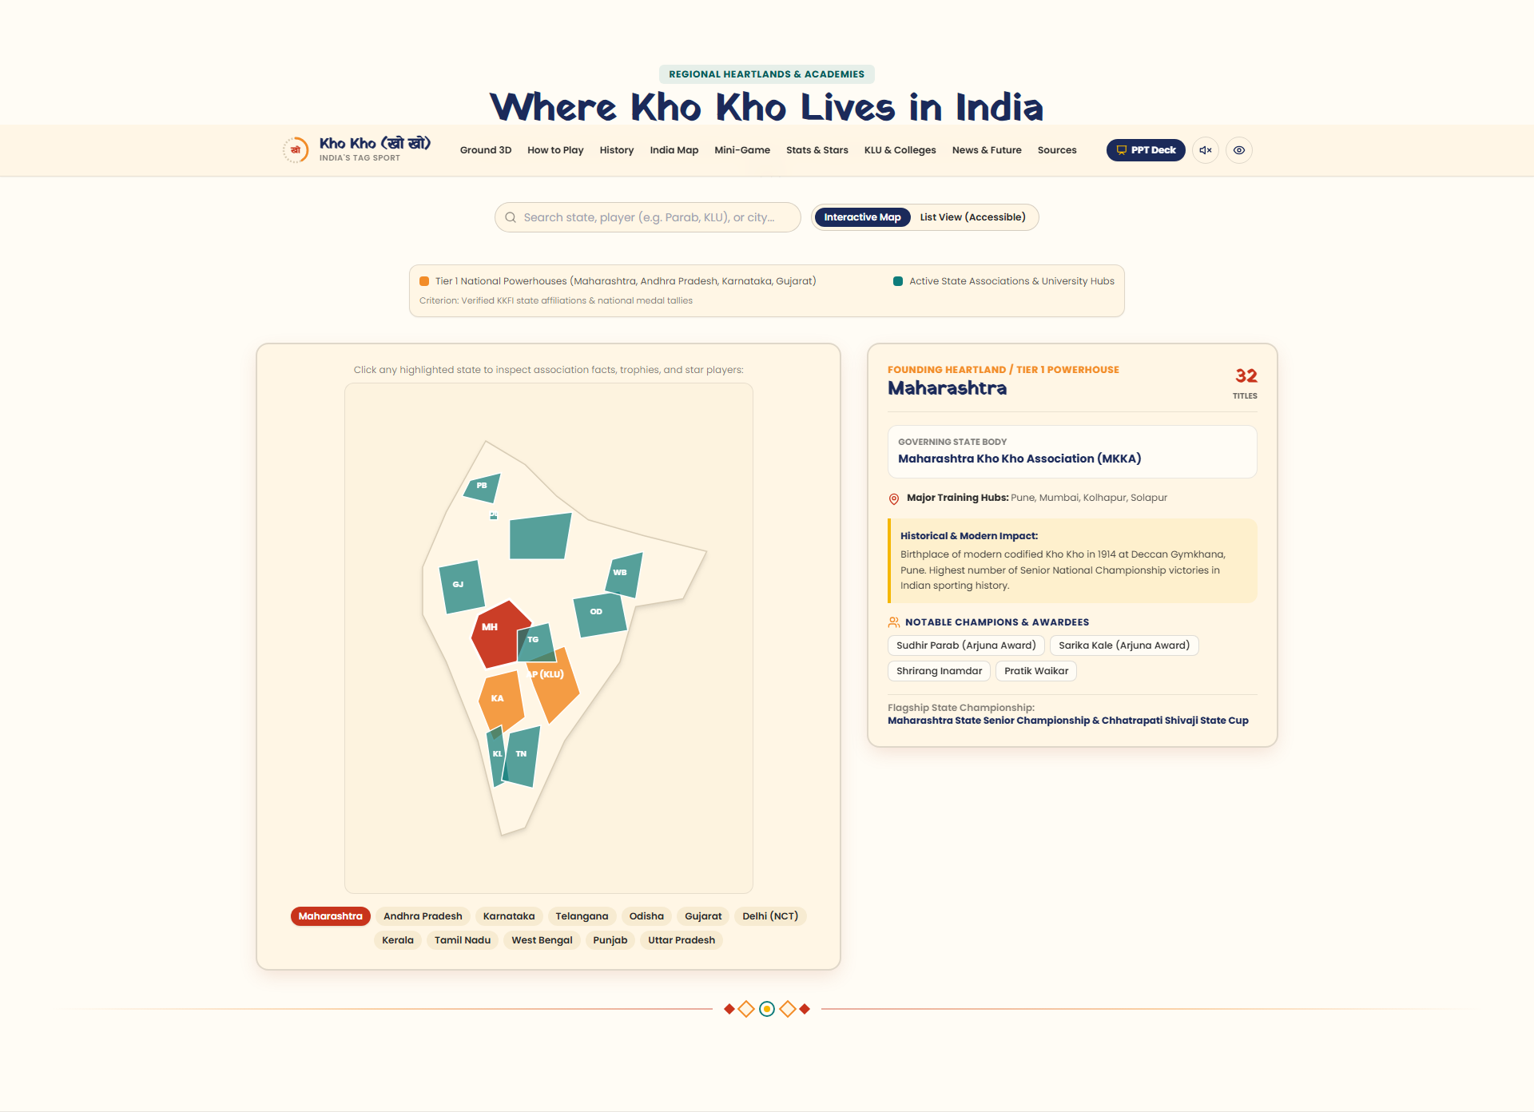
GEOGRAPHIC STRONGHOLDS
Where Kho Kho Lives: Regional Heartlands & Powerhouses
https://khokho-india.org
Maharashtra (Founding Heartland)
32+ Senior National titles. Birthplace of modern rules at Deccan Gymkhana (1914). Produced Arjuna awardees Sudhir Parab and Sarika Kale.
Andhra Pradesh (KLU Hub & 1959 Host)
Hosted 1st Senior Nationals in Vijayawada (1959). Home to KL University (KLEF) sports academy producing South Zone & All India Inter-University medalists.
Karnataka & Odisha (Franchise Leaders)
Karnataka powers South Zone university titles. Odisha Juggernauts won the inaugural UKK title; Cuttack hosted UKK Season 2.
Kho Kho: India's Ground Game | Official KKFI & IKKF Data
Slide 9
Notes:
Geographically, Kho Kho is celebrated across India. Maharashtra remains the undisputed historic heartland with over thirty-two national titles. Andhra Pradesh holds special distinction as the host of the very first national championship in 1959 and is home to KL University's powerhouse collegiate academy. Meanwhile, Karnataka and Odisha have dominated recent franchise and university circuits.

Slide 10
LEAGUE MODERNISATION
Ultimate Kho Kho: Transforming Earthen Play for Prime-Time
The 'Wazir' Super-Attacker
3-Point Acrobatic Dives
Unlike traditional chasers locked into forward direction, the Wazir can sprint in BOTH directions freely, keeping defenders on high alert.
Sky Dives and Pole Dives award 3 points instead of 1, rewarding aerial acrobatic lunges on high-density foam mats.
164 Million Viewers
Franchise Champions
Season 1 broadcast on Sony Sports reached 164M viewers, proving traditional Indian games command massive commercial television audiences.
Season 1 (2022): Odisha Juggernauts edged Telugu Yoddhas 46–45. Season 2 (2024): Gujarat Giants defeated Chennai Quick Guns 31–26.
Kho Kho: India's Ground Game | Official KKFI & IKKF Data
Slide 10
Notes:
Ultimate Kho Kho has modernized the sport for the twenty-first century. By introducing the 'Wazir' who can move in both directions, awarding three points for acrobatic sky-dives, and laying professional synthetic mats, the league attracted 164 million viewers in its first season. Odisha Juggernauts won Season 1 in a 46-45 thriller, while Gujarat Giants claimed Season 2.

Slide 11
GLOBAL TOURNAMENT DATA
2025 Kho Kho World Cup, New Delhi: Double Gold Triumph
Undefeated Campaign in New Delhi
• Dates: January 13–19, 2025 at Indira Gandhi Indoor Stadium.
• 24 Nations participated across 5 continents.
• Men's Final: India 54 – 36 Nepal (+18 pts victory margin).
• Women's Final: India 78 – 40 Nepal (+38 pts victory margin).
• Captains: Pratik Waikar (Men) & Nasreen Shaikh (Women) led both squads undefeated.
Kho Kho: India's Ground Game | Official KKFI & IKKF Data
Slide 11
Notes:
The native chart on the left illustrates the final results of the historic inaugural Kho Kho World Cup, held at the Indira Gandhi Indoor Stadium in New Delhi in January 2025. Twenty-four nations competed. In the Men's final, India defeated Nepal 54 to 36. In the Women's final, India triumphed 78 to 40. Both Indian teams completed the tournament completely undefeated.

Slide 12
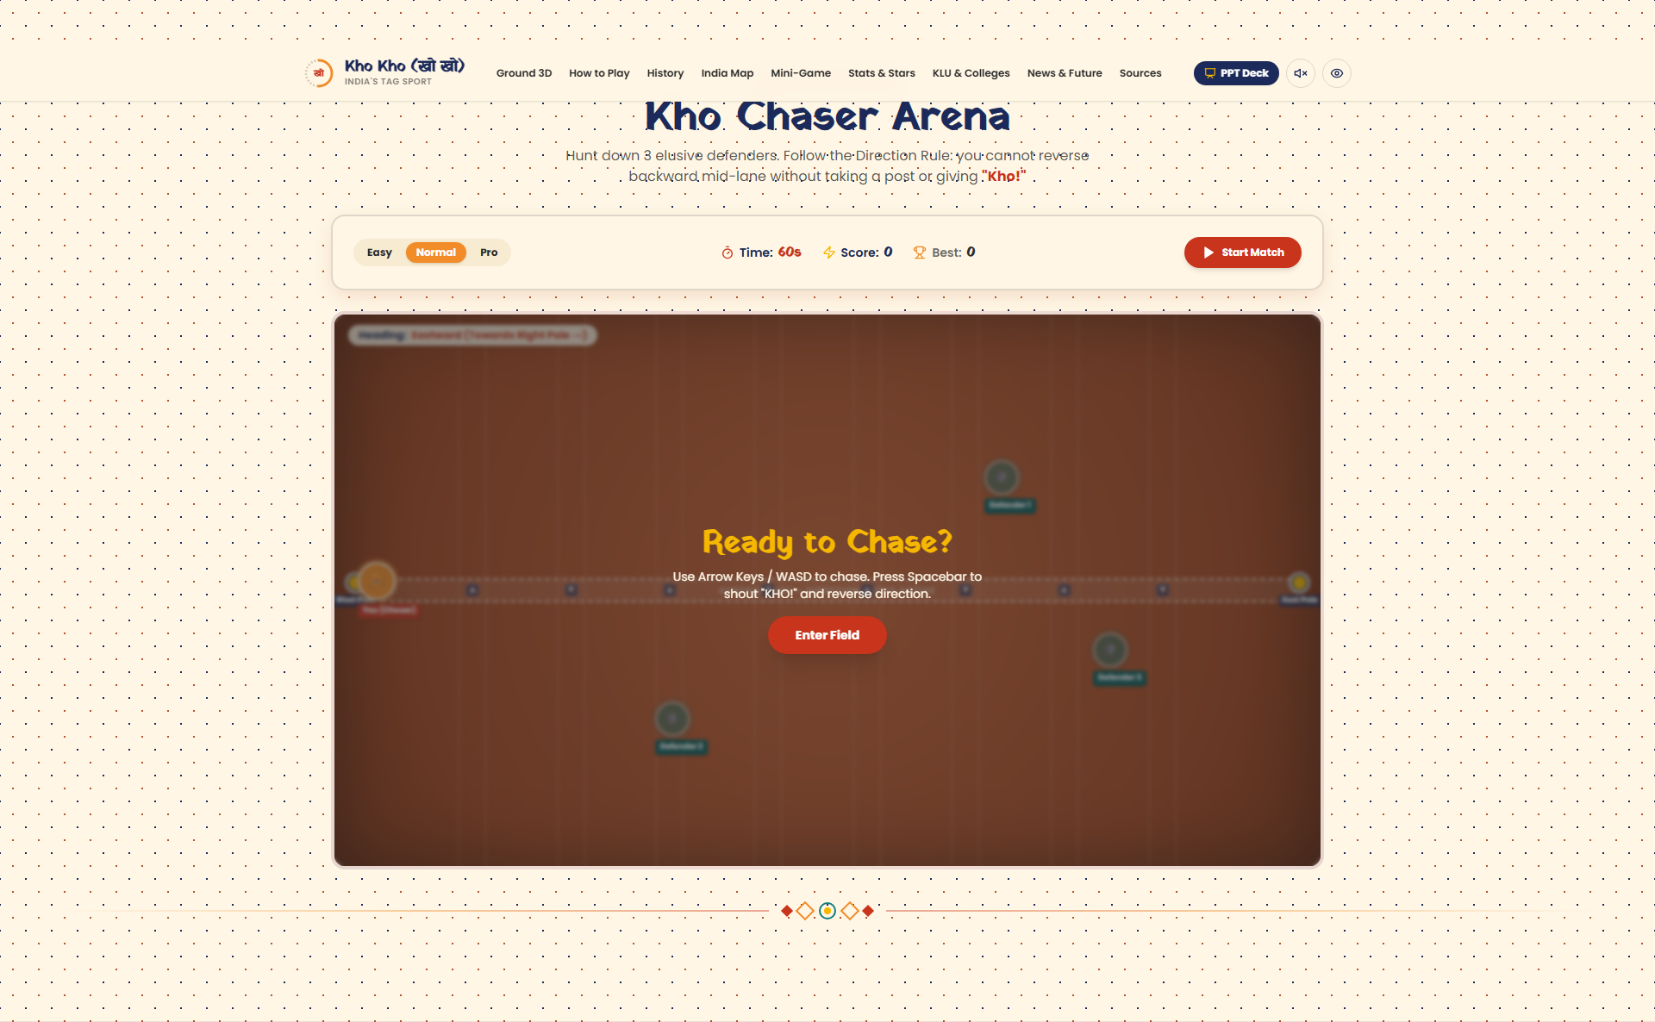
GAMIFIED LEARNING
Interactive Mini-Game: Test Your Tactical Agility
Kho Chaser Arena: 60-Second Challenge
https://khokho-india.org
Role: You control the active chaser on the 27m × 16m pitch.
Objective: Tag 3 dodging defenders before the 60-second turn expires.
Real Constraint: Reversing backward mid-lane causes an immediate foul!
Controls: Arrow keys / WASD + Spacebar to shout 'KHO!'
Mobile Friendly: On-screen touch joystick + Kho button.
Kho Kho: India's Ground Game | Official KKFI & IKKF Data
Slide 12
Notes:
To help students understand the unique constraints of the sport, we built an interactive top-down mini-game directly in code. Players control the chaser and must tag three defenders within sixty seconds. Crucially, the code enforces the authentic direction rule: trying to reverse backward mid-lane triggers a buzzer and red foul flash.

Slide 13
STRATEGIC ROADMAP
Challenges & The Road to the Olympics
Infrastructure Transition
2026 Aichi-Nagoya Asian Games
Transitioning rural talims and district school grounds from uneven dust to standardized synthetic foam mats.
IKKF and OCA evaluating Kho Kho for full medal inclusion following demonstration status.
Global Federation Spread
Collegiate Athlete Sponsorship
Expanding active national federations across 50+ countries to satisfy International Olympic Committee charter criteria.
Providing university scholarships and corporate sponsorships to ensure athletes like those at KLU sustain professional careers.
Kho Kho: India's Ground Game | Official KKFI & IKKF Data
Slide 13
Notes:
Looking forward, Kho Kho has clear strategic hurdles on its Olympic roadmap. First, expanding indoor synthetic mats to rural schools. Second, securing full medal status at the 2026 Asian Games in Aichi-Nagoya. Third, meeting the IOC requirement of active competitive federations across fifty nations. And fourth, supporting collegiate athletes with sports science and scholarships.

Slide 14
धन्यवाद | Thank You
Kho Kho: India's Indigenous Tag Sport on the Global Stage
Project Architect: Polimera Sai Vatsal (ID: 2500040224) • KL Deemed to be University. Explore the 3D interactive court and test your skills in the Kho Chaser Arena.
VERIFIED PRIMARY CITATIONS & REPOSITORIES
1. Kho Kho Federation of India (KKFI): khokhoindia.in (Rules & Courts)
2. Asian Kho Kho Federation (AKKF): asiankhokhofederation.com (1914 Deccan Gymkhana)
3. Olympics.com: 2025 World Cup New Delhi Match Results & Scores
4. Ministry of Youth Affairs & Sports (MYAS): yas.nic.in (Arjuna Awards Archive)
5. KL University (KLEF): kluniversity.in (Directorate of Physical Education Archives)
Scan to Launch Web Experience
https://khokho-india.org/
Kho Kho: India's Ground Game | Official KKFI & IKKF Data
Slide 14
Notes:
Thank you for your attention. Kho Kho is not merely a traditional game; it is an enduring cultural heritage that embodies India's athletic spirit, tactical ingenuity, and community pride. We invite you to scan the QR code to experience the live 3D web application, play the mini-game, and explore our verified records.

