Slide 1

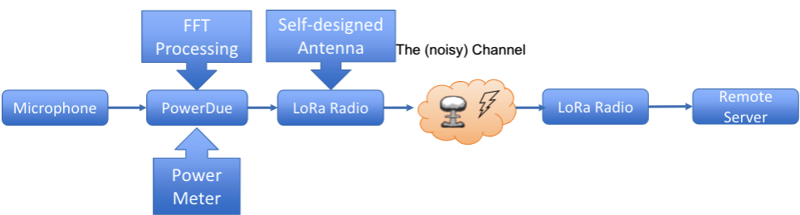
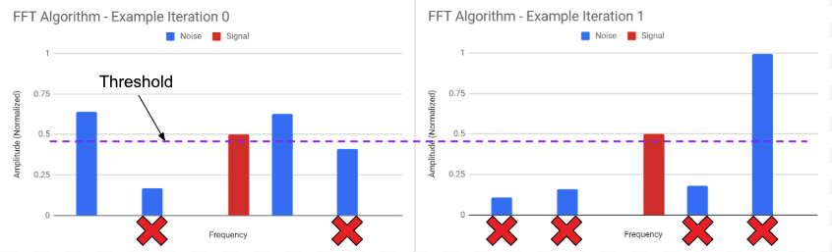
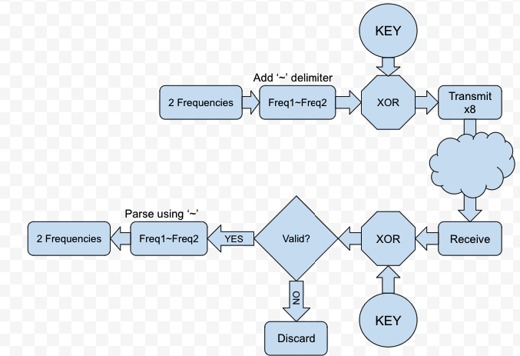
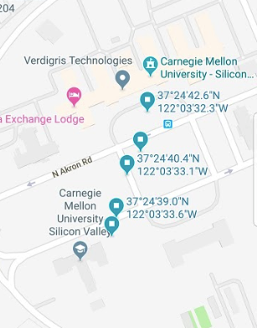
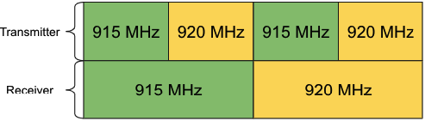
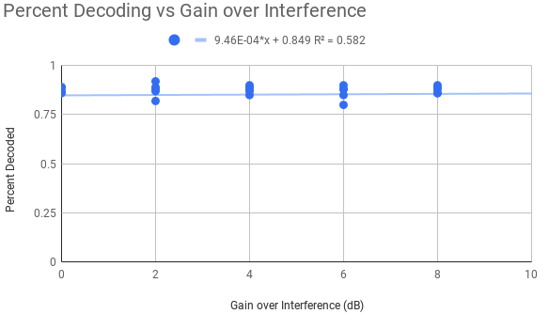
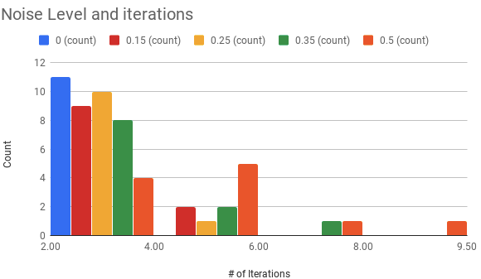
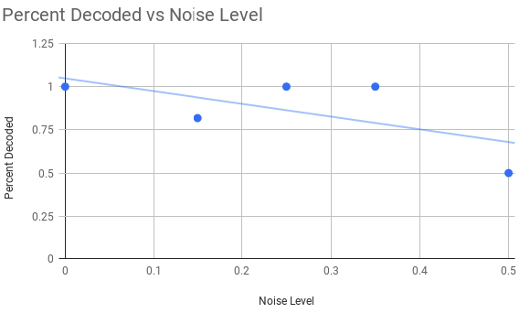
Design and analysis of low power audio surveillance system
Joseph Liba, Jamal Davis, Sai Vineeth K.S. and Bob Iannucci
Problem Statement
Goals
As the number of nodes in an Wireless Sensor Network increases, the channel interference increases.
It becomes more challenging for each node to reliably transmit the data.
The problem also involves balancing the trade-off between energy consumed and latency that can be tolerated.
Problem: Peak two frequencies from noisy audio input and transmit the data wirelessly to the receiver using LoRa protocol in the presence of an interferer.
Reliably transmit data across non-ideal wireless channel
Prioritize low power consumption on the transmitter end.
Minimize overall latency for transmission
Reliability and Robustness in audio processing.
Low operational cost.
Proposed Solution
Uses thresholding algorithm to eliminate noisy frequency components.
Threshold calculated in each iteration.
Rule out frequencies that drastically change in magnitude.
Analysis
Fig 2: From above FFT diagram we can notice that the blue(noise) frequencies are eliminated after each iteration.
Hypothesis: Improved antenna gain would yield better packet decoding.
Premise: Antenna gain can be simulated by reducing distance between Tx and Rx, thereby reducing FSPL.
Experiment: Mimicked the effect of antenna gain by placing Tx closer to Rx at set locations.
Reducing frequency data from float to short data type.
Add delimiter ‘~’ and XOR the packet with a key to ensure validity.
A total of 4 bytes of data is transmitted with redundancy.
Time the packets: slip through the interferer packets.
Asynchronously hop between two allowed frequencies.
Fig 4 : (Lat,Long) pairs of positions providing 2db, 4db, 6db, 8db and 10db advantage.
Fig 3: The Tx hops at 2x frequency over Rx. Packets are received when frequencies overlap.
Contribution highlights
Fig 5: Trendline showing zero slope of improvement in increasing the gain.
Developed a Robust FFT algorithm that could work in noisy environments of up to 100dB.
Designed an asynchronous frequency hopping scheme for highly reliable data transmission.
Performed quantitative analysis to rule out the use of antenna within the context of the project.
Developed a packet validation scheme that could tolerate and eliminate invalid/corrupted packets.
The Thresholding algorithm uses within 2-4 iterations for 70% of the cases.
The algorithm can dynamically choose the number of iterations required for a given noise level.
Performs better even at higher noise levels.
At high noise, algorithm converges to required frequency values 81% of the time.
Trials | Energy usage(J) | Time Taken(s)
First round | 0.642 | 3.304
Final round | 0.521 | 2.42

