Slide 1
AI-Powered Wearable Health Monitor
Sai Vineeth Paladugu – Hardware design
Dharani Kondapally - Machine Learning and Firmware design

Slide 2
Project Overview
Purpose: Design a wearable health monitor using ESP32-S3 and various sensors for continuously monitoring the health status of patients.
Components:
- Xiao ESP32-S3 (Microcontroller)
- MAX30102 (Heart Rate and SpO₂ sensor)
- MLX90614 (Body Temperature sensor)
- MPU6050 (IMU - Accelerometer and Gyroscope)
- OLED Display (128x64 I²C)
- TP4056 Module (LiPo battery charging)
- LiPo Battery (3.7V)

Slide 3
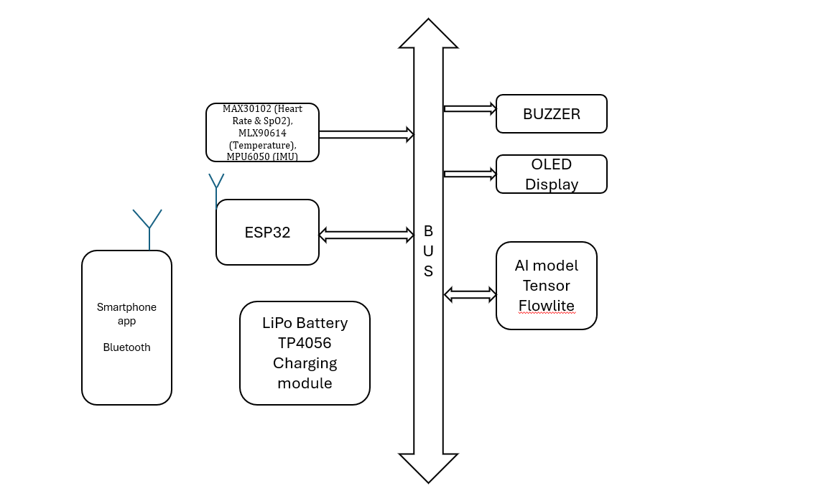
System Hardware Block Diagram
Visual representation of hardware components and their connections:
- ESP32-S3 as the microcontroller
- MAX30102, MLX90614, MPU6050, OLED Display connected via I²C
- Power source from 3.7V LiPo regulated to 3.3V

Slide 4
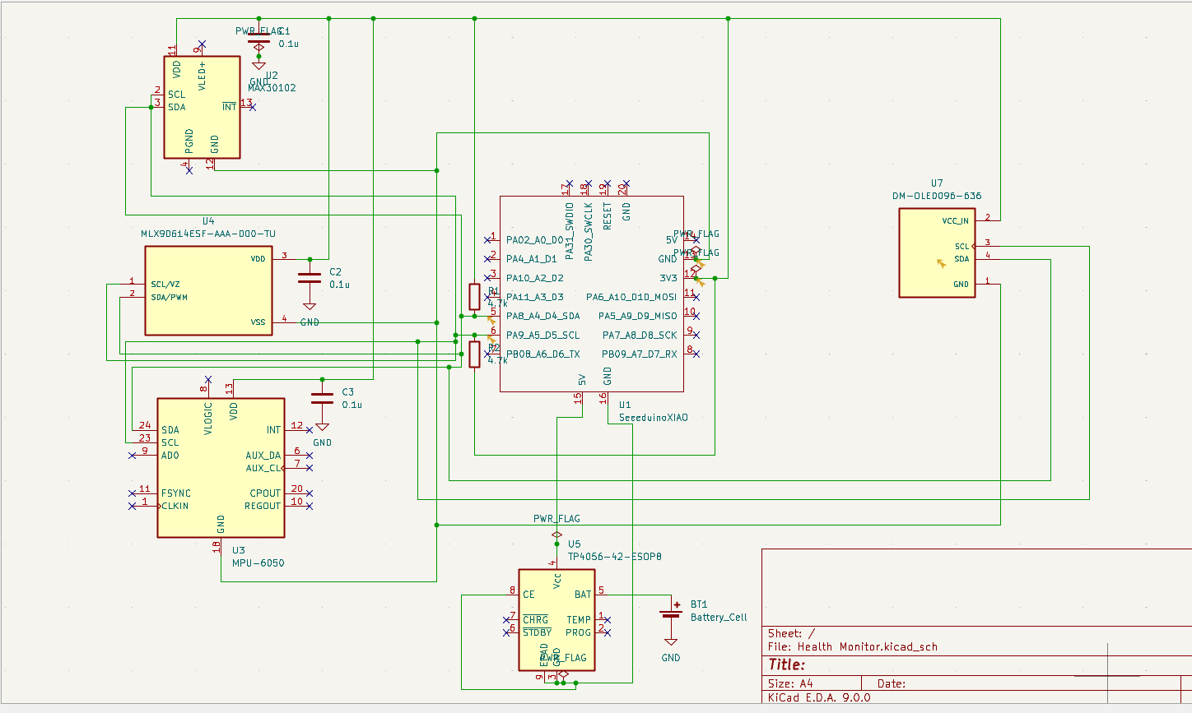
Pin Mapping and Electrical Connections
Pin assignments for the Xiao ESP32-C3 and connected components:
- I²C SDA and SCL shared among the sensors and OLED
- Power and ground connections for all components

Slide 5
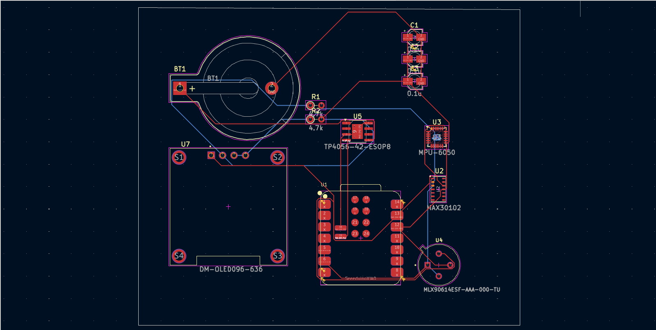
PCB Shield Design with KiCad
Custom PCB designed for the project:
- Xiao ESP32-S3 footprint and breakouts for I²C, GND, and 3.3V
- 3 sensors and the oled

Slide 6
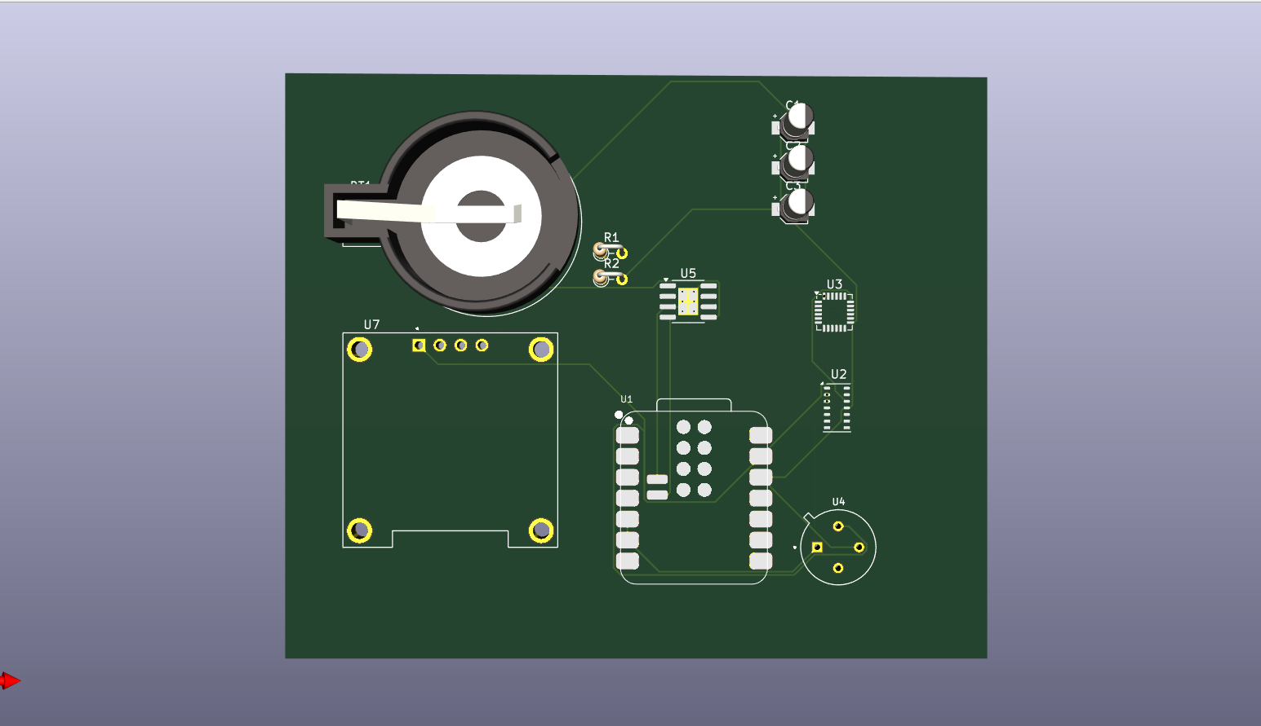
The 3D view of PCB

Slide 7
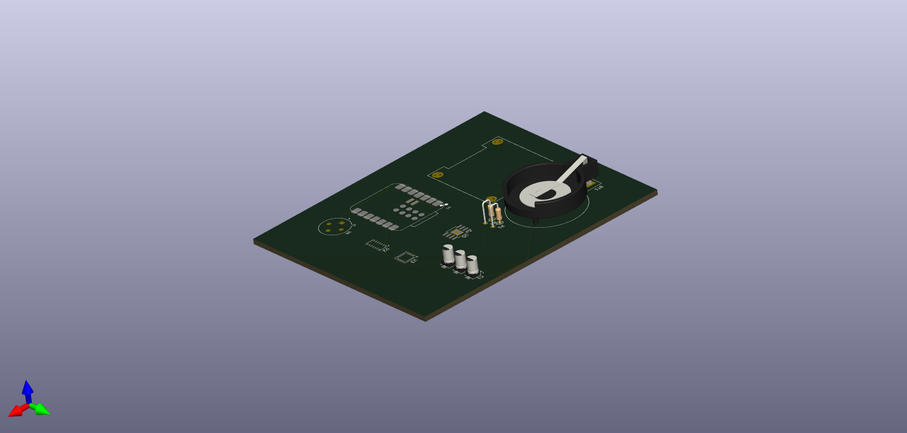

Slide 8
Machine learning model training
Classification model to detect abnormality (normal/abnormal)
FEATURES:
Heart rate
Oxygen levels
Body temperature

Slide 9
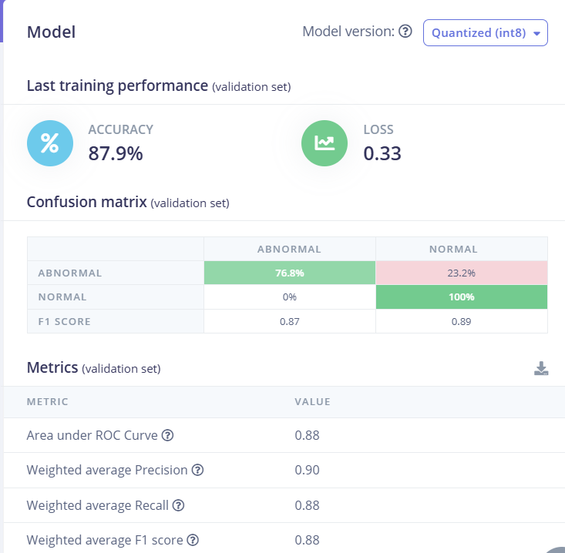
Edge Impulse model training

Slide 10
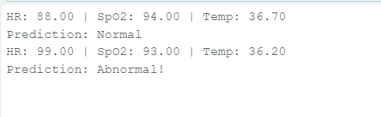
The model testing using random data

Slide 11
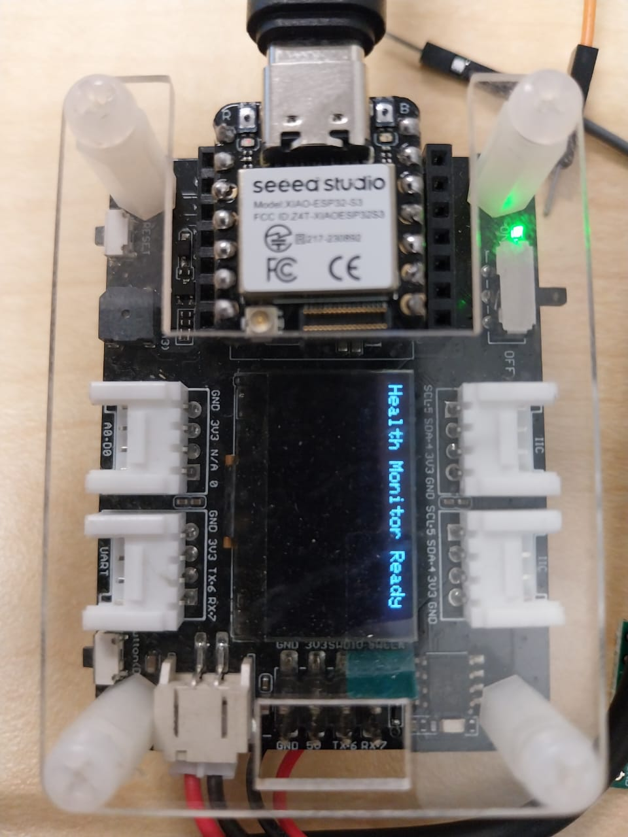
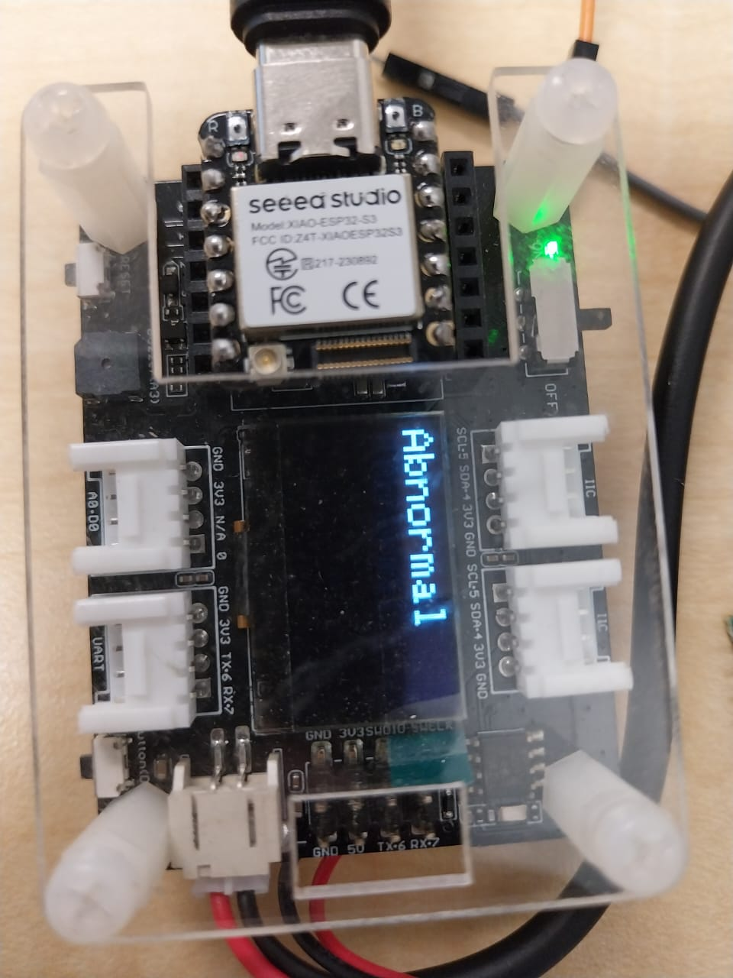
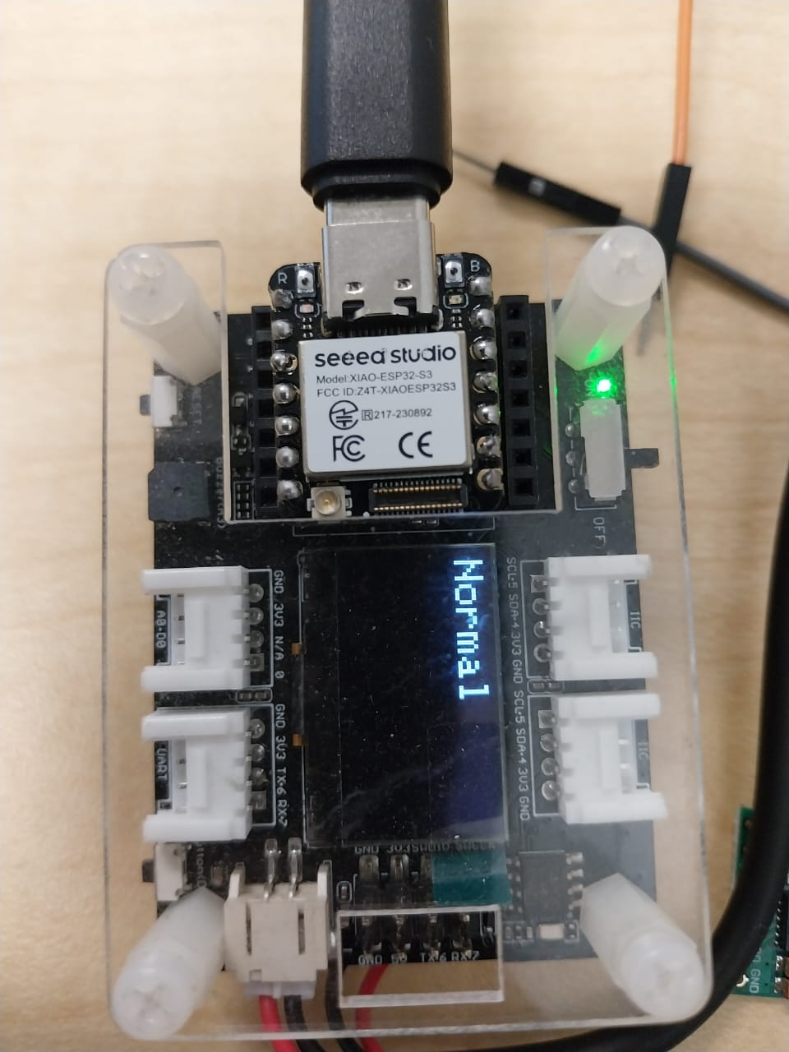

Slide 12
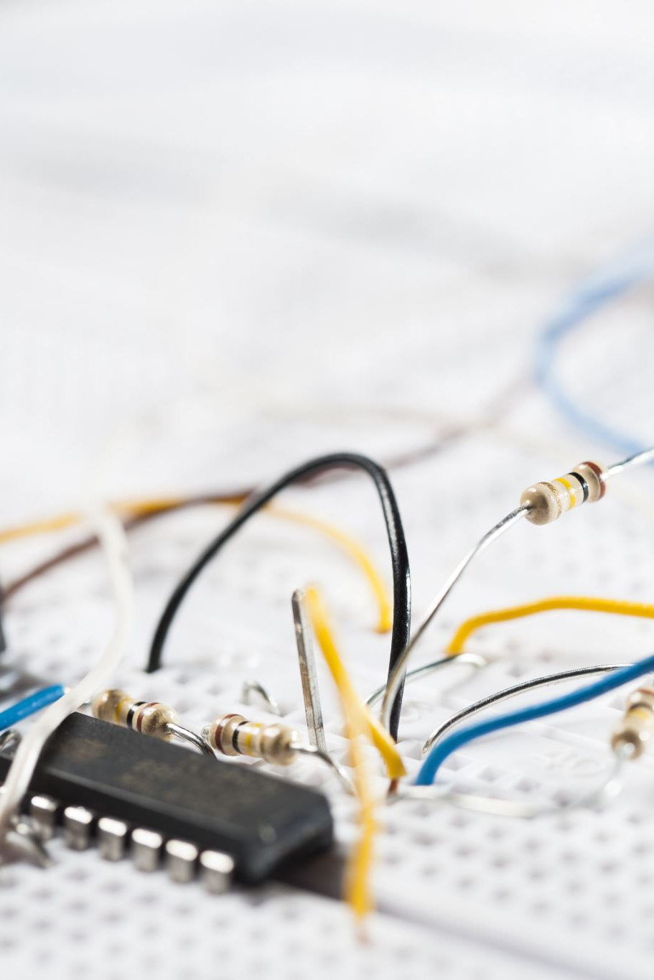
Future Work
Waiting for PCB from the FAB
Integrate and solder the components on the PCB board
Test the working of sensors and other components.
Working on a mobile application using MIT app inventor.

Slide 13
Thank you

