Slide 1
AI-Powered Wearable Health Monitor For Chronic Disease Management CSCE 5612 - Embedded Hardware/Software Design
Sai Vineeth Paladugu
Dharani Kondapally

Slide 2
Project Overview
Chronic conditions such as heart disease, diabetes, and respiratory diseases need continuous health monitoring to detect anomalies before they escalate into complications. Existing health monitoring systems either do not incorporate real-time alerts, necessitate bulky medical instruments, or rely on patient's input, leading to delayed intervention.
This project proposes an Artificial Intelligence-based wear-and-forget health monitor. The device is expected to measure heart rate, SpO₂ (percentage of oxygen in the blood), body temperature, and movement. Machine learning-based algorithms will detect abnormal health conditions and notify the user or caregivers through a mobile app connected by Bluetooth.

Slide 3
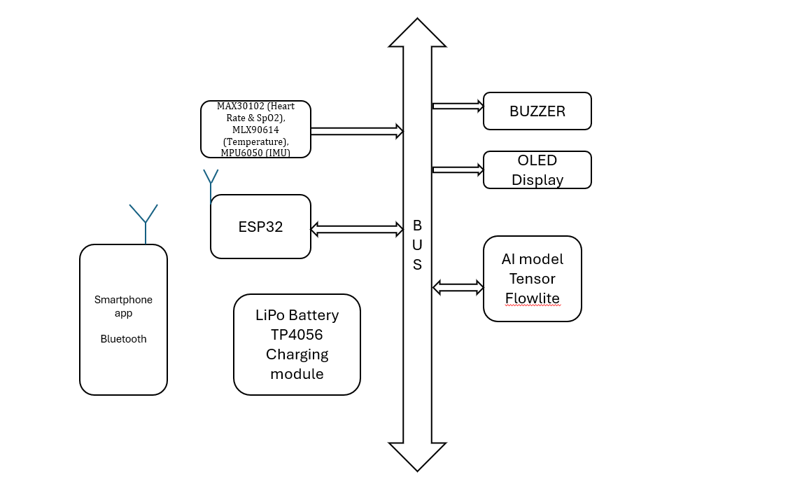
System Architecture Diagram

Slide 4
Hardware Component Selection
- ESP32 (Microcontroller, BLE/Wi-Fi)
- MAX30102 (Heart Rate, SpO₂ Sensor)
- MLX90614 (Temperature Sensor)
- MPU6050 (IMU - Motion & Fall Detection)
- OLED Display
- Vibration Motor / Buzzer
- Li-Po Battery + TP4056 Charging Module

Slide 5
Power Consumption Analysis
Estimated Power Usage:
ESP32: ~80-200mA
MAX30102: ~4-6mA
MLX90614: ~1.5mA
MPU6050: ~3.5mA
OLED: ~20mA
Buzzer: ~30-50mA (short bursts)
Total Estimated Power: ~120-300mA
Power Strategy: Deep Sleep, Event-Driven Wakeups

Slide 6
Communication and Data Flow
Sensor Data via I2C
Data Processing on ESP32 with Tensorflow
BLE Communication to Mobile App
Anomaly Detection Triggers Alerts (Buzzer/Vibration)
Live Data Display in Mobile App

Slide 7
System Integration Challenges & Solutions
Sensor Noise/Interference: Software Filtering, Placement Optimization
Power Management:
ESP32 Sleep Modes, Optimized
Sampling
Component Compatibility:
Level Shifters, I2C Pull-ups
Compact Design:
Custom PCB

Slide 8

THANK YOU

