Slide 1
Edge Computing

Slide 2
INTRODUCTION :
This model should be deployed at the edge-sever which avoids latency in cloud processing.
So, we have built a web application called “Kirana Product Billing” which is present in the edge server and an Optimized ML model is deployed in it.
If the customer keeps the product in front of the camera, it will detect the product by it’s size.
Then it will generate the bill based on the product brand and type.

Slide 3
PROBLEM DOMAIN :
According to the problem statement, we have to build a Machine Learning model for product detection for Kirana retail store.
This model should able to detect the product based on the size, type using camera.
Based on the observations, it should automatically take the cost of the product to make a bill of material at checkout.

Slide 4
DETAILS OF TECHNOLAGY USED :
We have used HTML , Bootstrap 4 and JavaScript for creating the front end of the Web Application.
The edge server is running in a Laptop on localhost (127.0.0.1) at port 5500 with Flask framework as server side script.
The ML model is deployed in the server which will be triggered upon receiving request(Product image taken from the camera) on the specific route.
The model is trained using Google Colab of 25.51 GB RAM and 358.27 GB of GPU.
We have used Visual Studio Code for editing the scripts and running the server.

Slide 5
REQURIED HARDWARE OR SOFTWARE :
A System or laptop with windows operating system or Linux -Ubuntu 18.04 Bionic Beaver distribution with 4GB of RAM and at least 50 GB of HDD.
The system should have python3 pre-installed and a text editor to run the Flask server. This setup will act as a Edge server to which customers can make request by sending the Product images through the “Kirana Product Billing” Web Application.
A Google account which can be used to login to the Google Colab which offers free basic Runtime of 25.51 GB of RAM and 358.27 GB of GPU.
The model is trained in Colab using python3 Google Compute Engine Backend.

Slide 6
ACHIEVED COST SAVING :
As it was trained using Google Colab, it is free of cost. Styles for the web application were given using Bootstrap framework, it reduces lengthy CSS files and improves the look and feel of the user interface.
We have used Flask framework of python which is light weight in nature when compared to Django. It makes Flask suitable for Edge server.
As Edge server should not depends on Internet, the Product details are stored in local database which avoids latency and allows faster response for Bill generation.

Slide 7
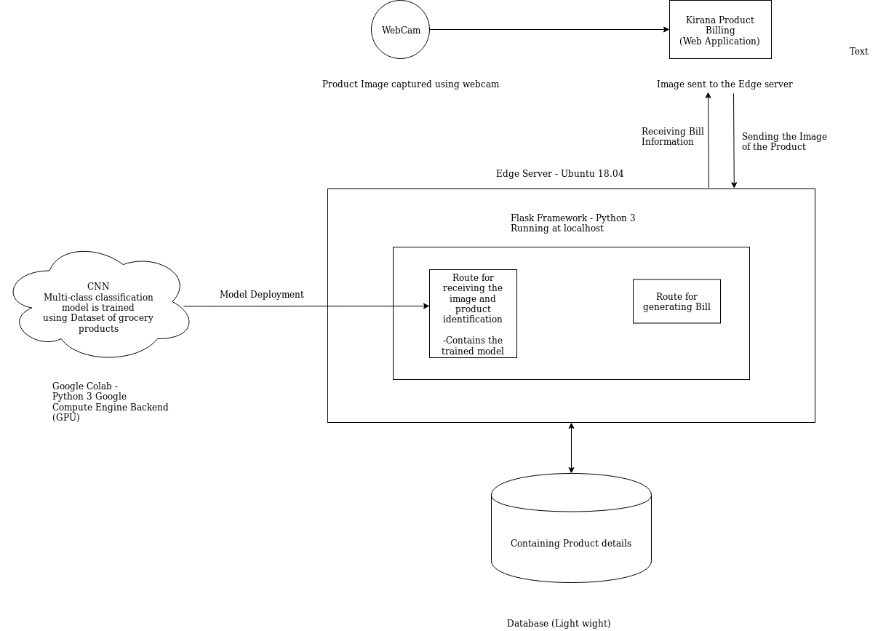
ARCHITECTURE :

Slide 8
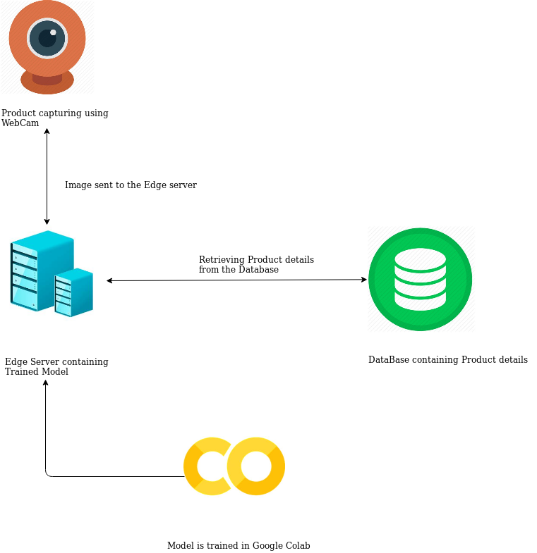
PICTORIAL REPRESENTATION :

Slide 9
WORKING :
The architecture contains a client side web application, an edge server and a trained model for identifying the product. The web application is developed using HTML, JavaScript and Bootstrap 4.
We are using our laptop running on windows or Linux -Ubuntu 18.04 as a Edge server. We have also used Flask as a server side framework for running the "Kirana Product Billing" web application and generating the bill.
The trained model is placed in a route to which the captured image from the web application is sent. The web application contains a capture button for taking picture of the product from the laptop/system webcam. The Image is stored as a canvas object in JavaScript and is sent to the flask server as a multi-part form data.
Then, at the server side the image of the product is pre-processed and is given to the CNN model. The model predicts the product type and size.

Slide 10
Based on the result the bill will be generated. The Bill contains the Products' IDs, costs, no of items on each type and the total amount to pay. Then, The generated Bill is sent to the client.
Since the identification of product is done locally, it gives the results quicker, which avoids latency as in the case of cloud processing.
It will be helpful for retail stores at remote locations where there will be some network delay and it will give a better customer satisfaction and also helpful for Quicker billing process.

Slide 11
ML MODEL :
The images of various grocery items are collected and are normalized. The images are pre-processed and resized into 500 x 500 pixels in size, with channel size as 1(grey scale). Then the images are labeled with integers starting from number 0, each of which belongs to particular category.
Then the extracted features and labels are stored using 'pickle' library for future use. We have used Convolutional Neural network for image processing and identification. Because a CNN effectively uses adjacent pixel information to effectively downsample the image by convolution and then uses a prediction layer at the end.
Also, CNNs are trained to identify and extract the best features from the images. A typical CNN has an input layer, an output layer and any number of hidden layers. We have used one input layer, and a output layer and five hidden layers.

Slide 12
As the number of neurons required for a single layer and the total number of layers required for a model, can't be defined by any rule of thumb, we chose the right combination of layers and neurons after background research which gives best result with optimized model structure.
It's VGG- like architecture, which has a single sequential layer, and two convolutional layers of each 64 perceptrons which acts as a initial filter. Then another two 2-Dimentional CNN of each 128 perceptrons are used as inner filters. Then a Flatten layer is added which converts the 2D output of the CNN into 1Dfeature vector that the Dense layer want. Then it is sent to the Dense layer of 256 neuron with 'relu' as an activation function, this is the part at which the model learns.
Then at the output layer, a Dense layer of n nodes which gives probability of the image belongs to each category. Here 'n' denotes the number of the Product classes. The class at which the probability is high taken as the predicted output from the model.
The model is trained for 50 epoches and gave a validation accuracy of 81.23%.

Slide 13
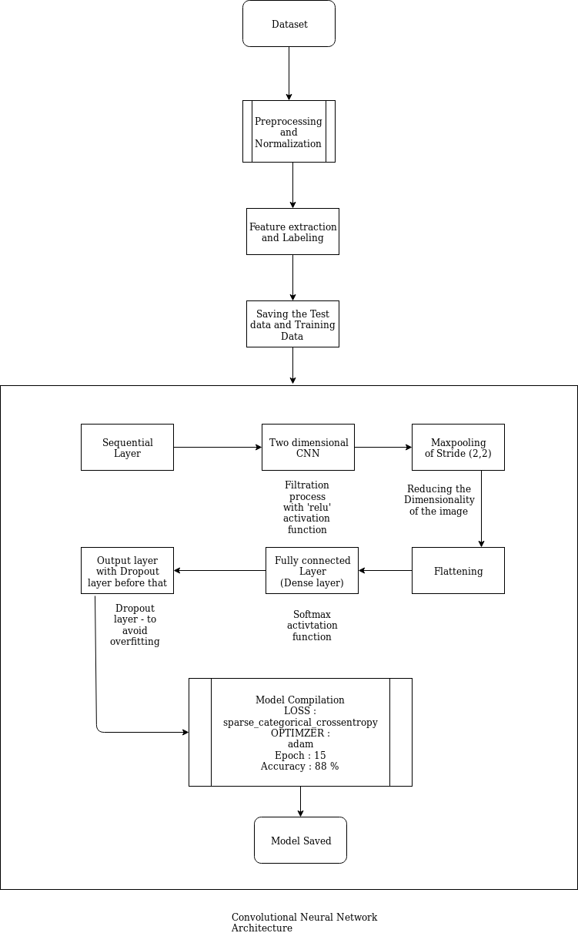
ML MODEL :

Slide 14
SIZE DETECTION :
After identifying the product class (Name) using the machine learning model, the images are processed by applying binary threshold.
Then dilation after erosion is applied to detect the edges present in the image.
Contour detection is done by applying morphological transformation over the image.
Then the largest group of continuous points are found by eliminating the window size.
After extracting the contour of the product, midpoint of the bounding box is found.
The Euclidean distance between the midpoint is calculated, which gives the size of the product.
Then the size is compared with the predefined values and based on the result the size of the product and the product bill be generated.

Slide 15
ADVANTAGES :
Scope of Automation:
It automates the process of billing in super markets and also helpful for places where there is no internet connectivity. Because it does not uses Internet for the for identifying the product and bill generation.
CONCLUSION :
Edge computing helps to organizations to break beyond the limitations imposed by Cloud-based networks.
As Edge computing reduces network latency, we get can results even at remote places of earth. This project implements Edge computing in the product billing department which improves company’s profit and give better customer satisfaction by reducing the billing time.

