Slide 1
LENDING CLUB CASE STUDY
SUBMITTED BY :
1. Sai Viswanadh Kintali
2. Sanskriti Agarwal

Slide 2
PROBLEM STATEMENT
AIM
OBJECTIVE
APPROACH
Based on historic data, identify strong indicators of loan default. Using these driving variables at the time of loan application will help in understanding the risks involved.
Utilise EDA to undertake risk analytics in consumer finance by understanding different consumer attributes as well as loan attributes that influence the tendency of loan default.
To identify the patterns which indicates if a person is likely to default a loan.

Slide 3
ANALYSIS APPROACH
CLEAN DATA
Drop columns with null values, random values or single valued columns.
UNIVARIATE ANALYSIS
Check distributions and frequencies of various numerical and categorical variables. Create derived variables.
BIVARIATE ANALYSIS
Do correlation analysis. Check how two variables affect each other or a third variable. Analyse joint distributions.
SUMMARISE RESULTS
Publish insights and observations.
SEGMENTED UNIVARIATE ANALYSIS
Analyse variables against segments of the final variable.

Slide 4
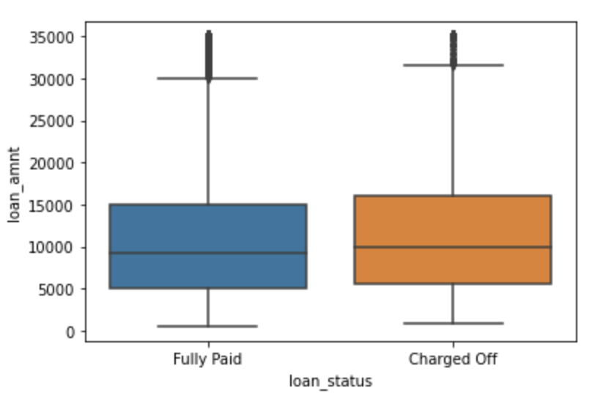
ANALYSIS – LOAN AMOUNT DISTRIBUTION
There is no variation between loan amounts in Fully Paid/ Charged Off loans.
The loan amount varies up to ~35,000 & have a mean of 10,000 in both loan status.

Slide 5
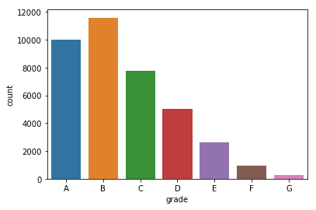
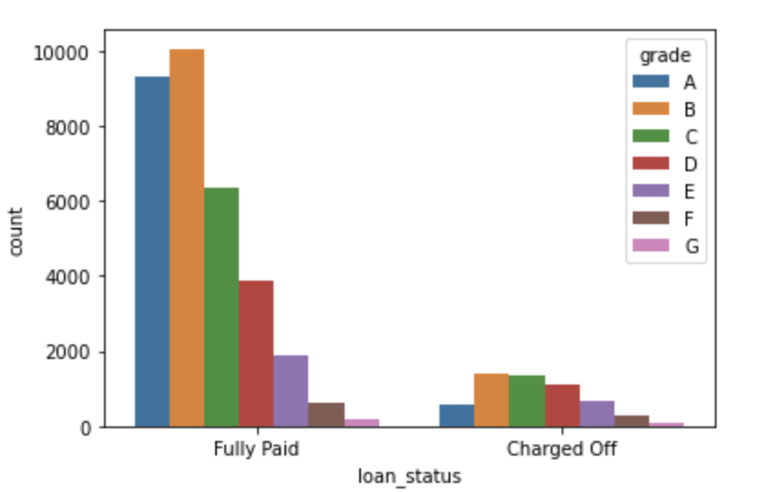
ANALYSIS – GRADES
Most of the loans are high graded (grade of A and B) loans, about > 50%.
Majority of the Charged Off loans are from B, C, D Grades

Slide 6
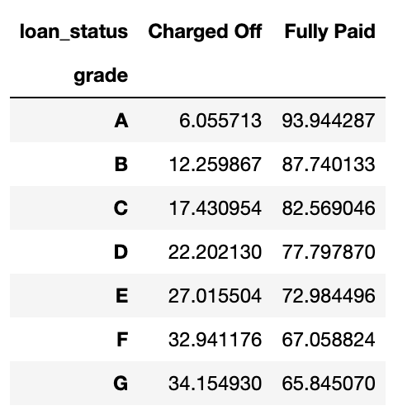
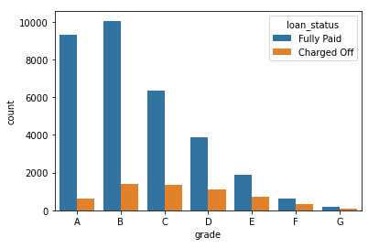
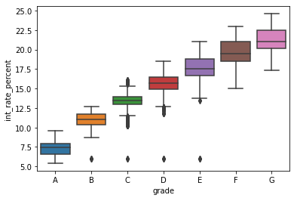
ANALYSIS – GRADES (continued)
Change of rate is increasing with the increase in Grade (from A to G).
Interest Rate is also increasing from Grade A to G, which is in parity with the increase in Charged off rate.

Slide 7
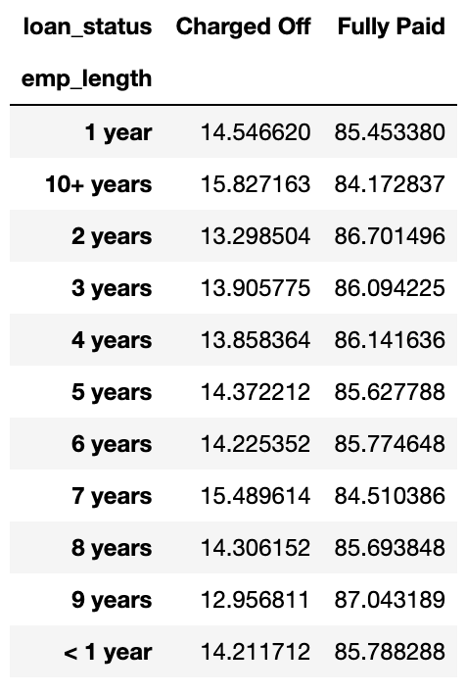
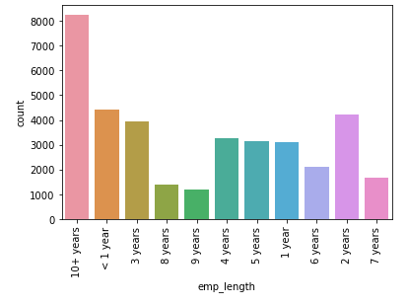
Analysis – Employee Experience
Most of the loans are taken by employees with more than 10 years exp (~25%).
But Charge-off rate across all the categories is same.

Slide 8
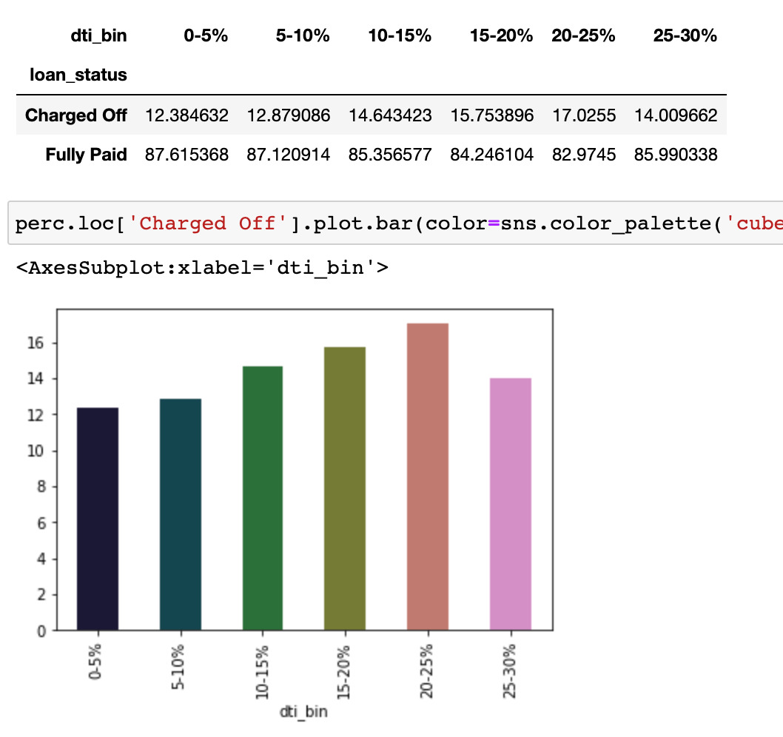
ANALYSIS – DTI (Debt to Income Ratio)
Charge-off Percentage is increasing with the increase in DTI

Slide 9
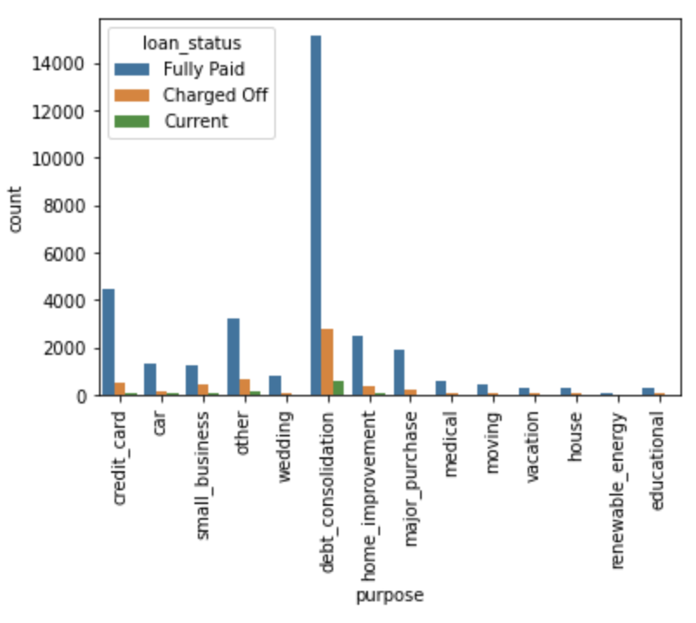
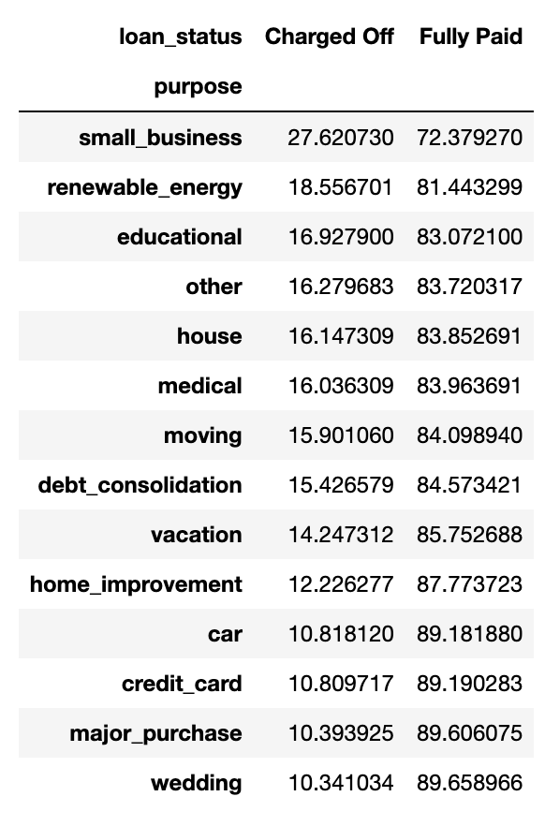
ANALYSIS – Loan Purpose
Majority of the loans (40-50%) are for Debt Consolidation but Charged-Off loan percentage is not comparative high. Loans for Small business/ Renewable Energy have high charge-off rate.

Slide 10
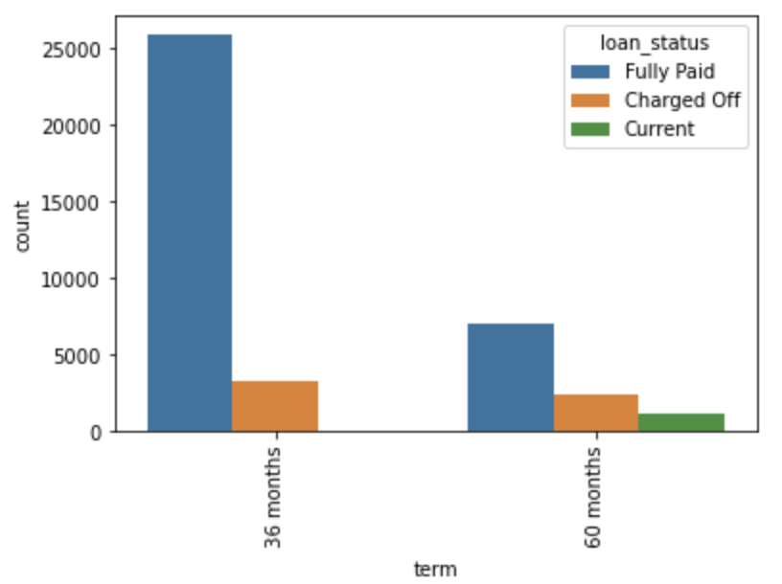
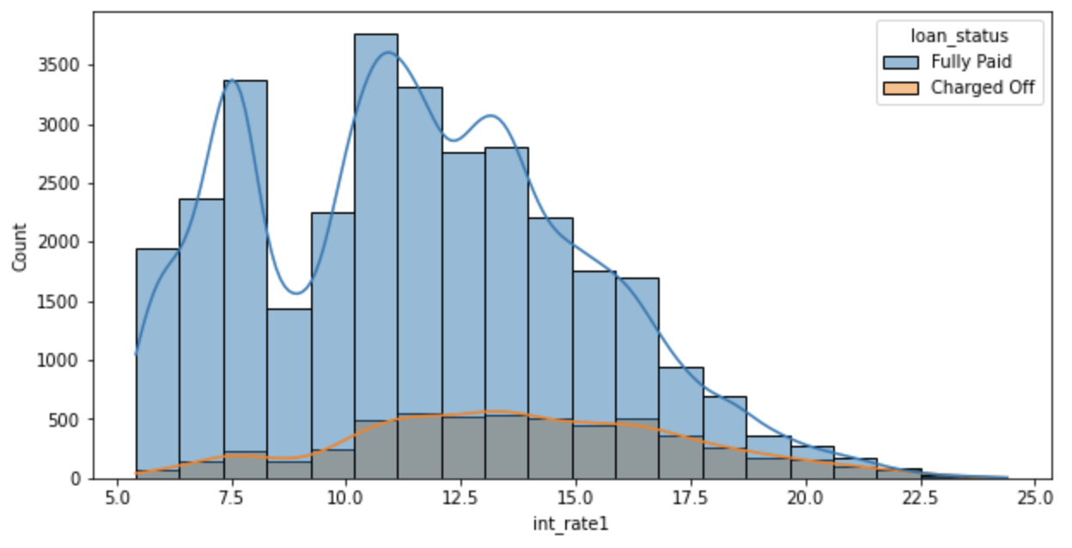
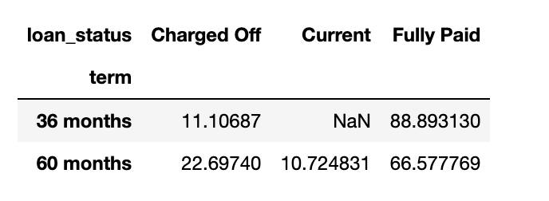
Analysis – Term & Interest
There is a spike in Charged off cases when interest rates between 11%-17%.
Majority of the loans are short-term (36 months) but the charged-off rate is very high in long-term loans (60 months).

Slide 11
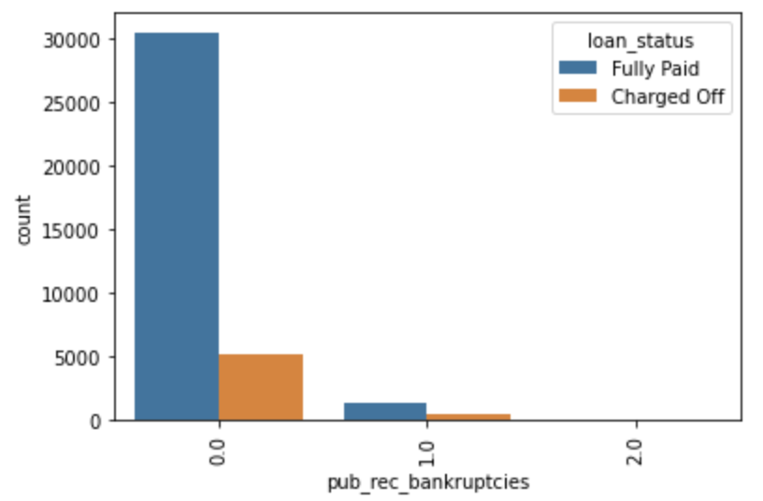
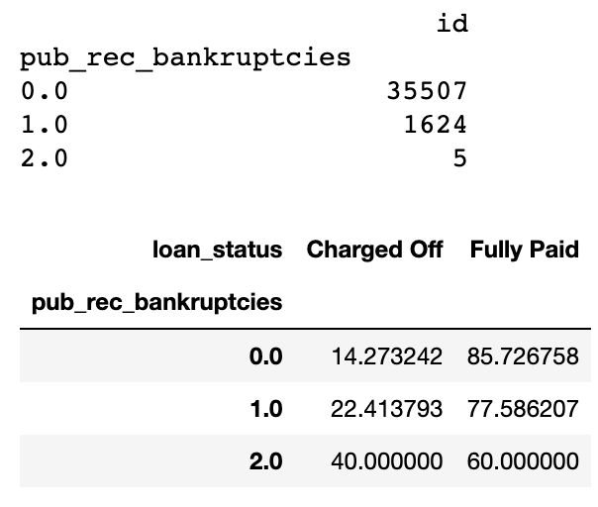
Analysis – Public Bankruptcies
Majority of the clients have 0 Bankruptcies (~96%) but clients with Bankruptcies have a high chance of default/ Charged-off loan.

Slide 12
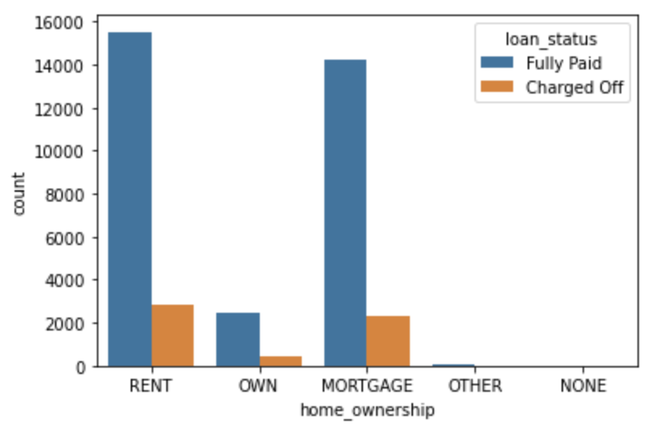
Analysis – Home Ownership
Majority of the clients are lacking own properties and are on Rent, Mortgage. These type of clients have high Charge-off rate.

Slide 13
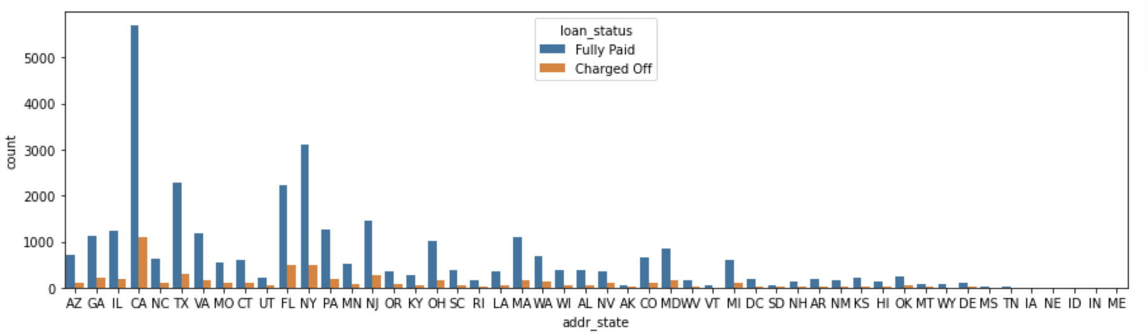
Analysis - Location
Most of the loans are form CA. Charge-Off Rate from CA is also one of highest compared to other states.

Slide 14
Observation & Conclusion
Lending club Should consider/ focus more on DTI during the loan process. As Charge-off loan% is increasing with the increase in DTI ratio.
Majority of the loans which are defaulted are from grades B, C ,D. So loans under these categories need more focus.
Loans for Small business/ Renewable Energy have high charge-off rate. So loans for these purposes need more focus.
Loans having higher interest rates have more defaulters. Hence, check the background of applicant thoroughly , if the interest rate is high.
Cities like CA, NY which high number of loans as well as high charged-off/ defaulted loans.
The charged-off rate is very high in long-term loans (60 months), almost double to short-term loans. So Long term loans have high risk.
Clients with Bankruptcies have a high chance of default/ Charged-off loan.

