Slide 1
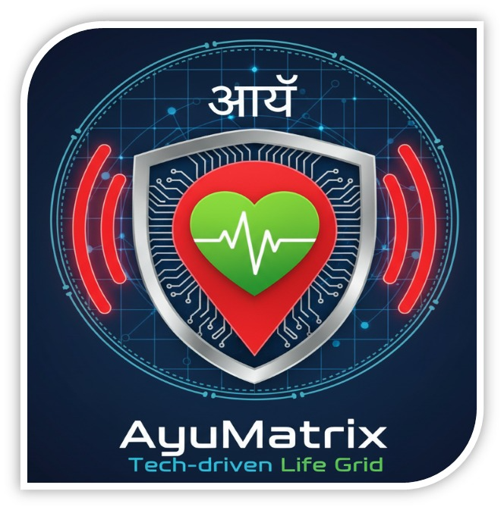
AYUMATRIX

Slide 2
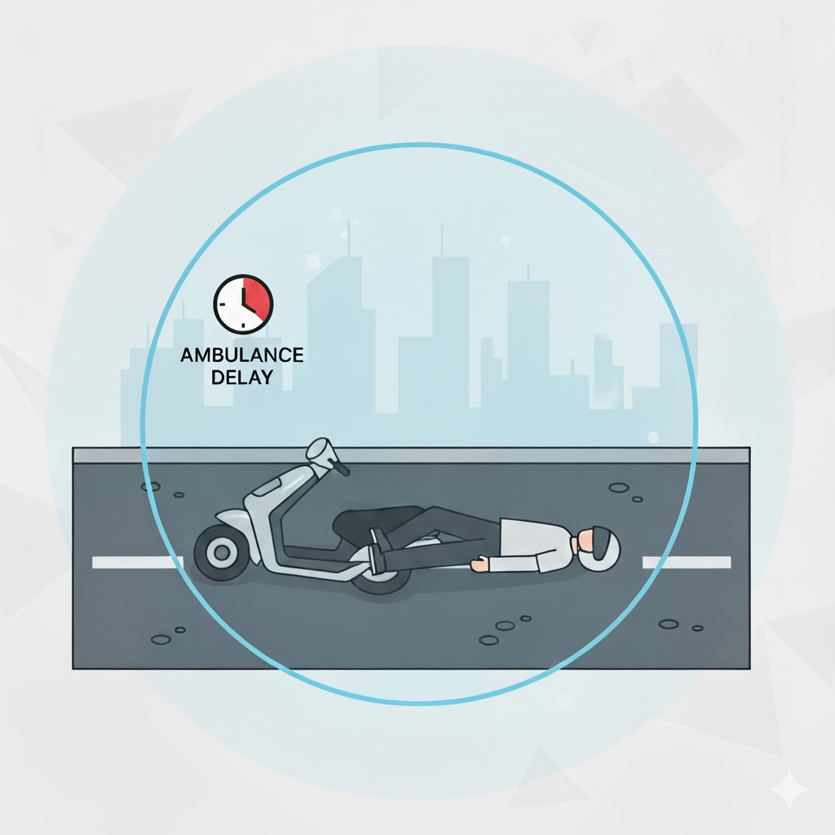
PROBLEM STATEMENT
Two-wheeler accidents become deadly mainly due to delayed medical help, the victim’s inability to call for assistance, and the lack of reliable emergency alert systems.
Key Issues :
High Vulnerability:
Two-wheeler riders are more exposed to accidents.
Delayed Medical Help:
Many lives are lost due to slow emergency response.
Communication Gap:
Victims often cannot call for help, and bystanders may not respond quickly
Privacy Concerns:
Existing alert systems broadcast widely, risking user privacy

Slide 3
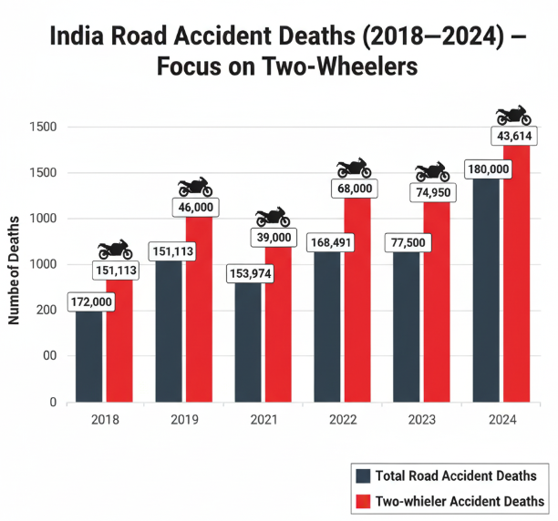
SCOPE
Most victims cannot raise an alarm after an accident .
Two-wheelers form the backbone of daily transport, yet they account for the largest share of road accident deaths.
Relevance :
Threatens millions of daily riders, especially in developing countries.
Causes avoidable deaths and disabilities due to late treatment.
Creates social and economic losses for families and communities
Global reference :
In 2024, India reported ~180,000 total road accident deaths.
Scope :
Two-wheelers accounted for 45% of total road accident deaths in India
A study reported by the Indian Road Transport Minister that
nearly 30% of road‐accident deaths are due to delay in getting
medical care during the “golden hour”
This makes two-wheelers the most vulnerable and highest contributor
to accident fatalities compared to cars and other vehicles

Slide 4
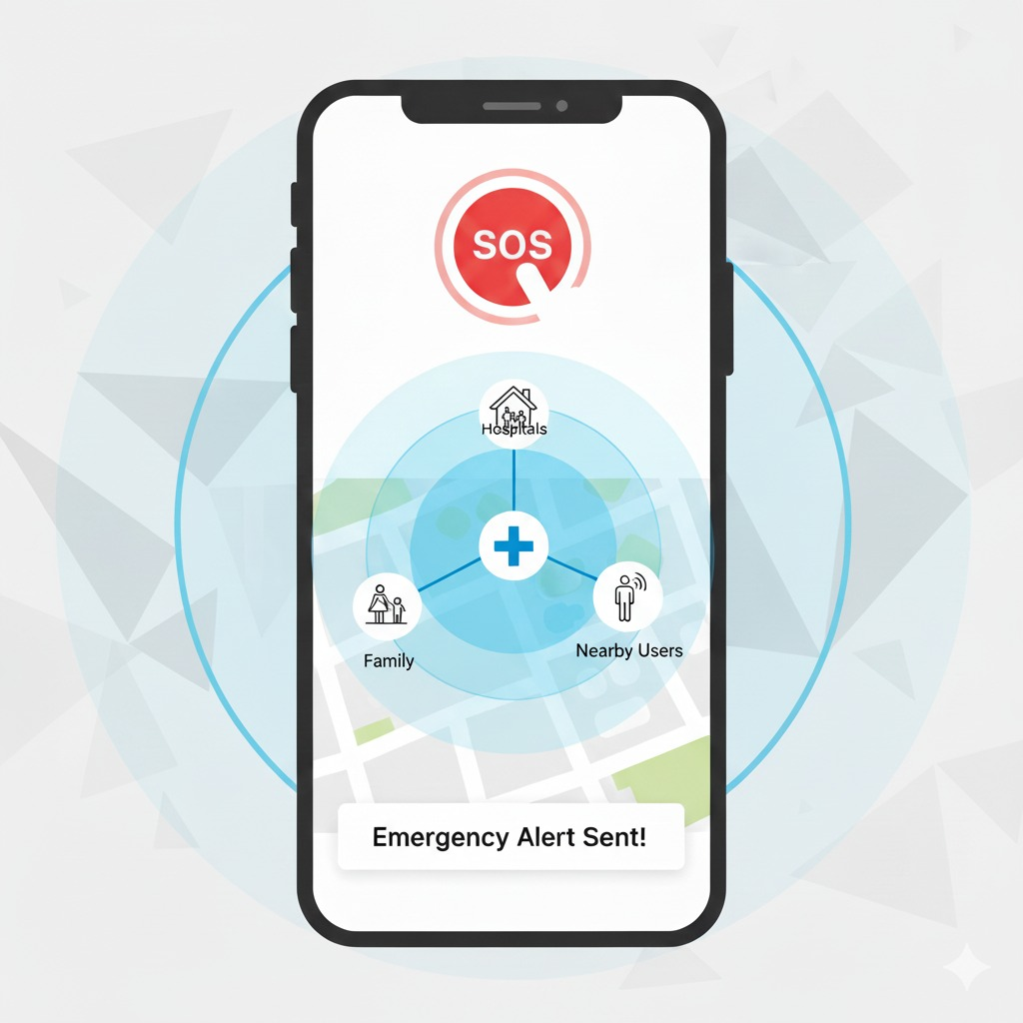
Innovation
A safety device for two-wheelers that can detect accidents automatically.
It uses sensors and esp32 to check impact, bike tilt, sudden stop, heartbeat, and pulse rate .
When an accident happens, it immediately sends an alert with location to:
Family & friends
Nearby hospitals
Blood banks
Other app users
Emergency number
If the phone is broken or missing,
Or the device uses GSM to send an SMS.
This ensures help always reaches on time,
and improving survival chances.

Slide 5
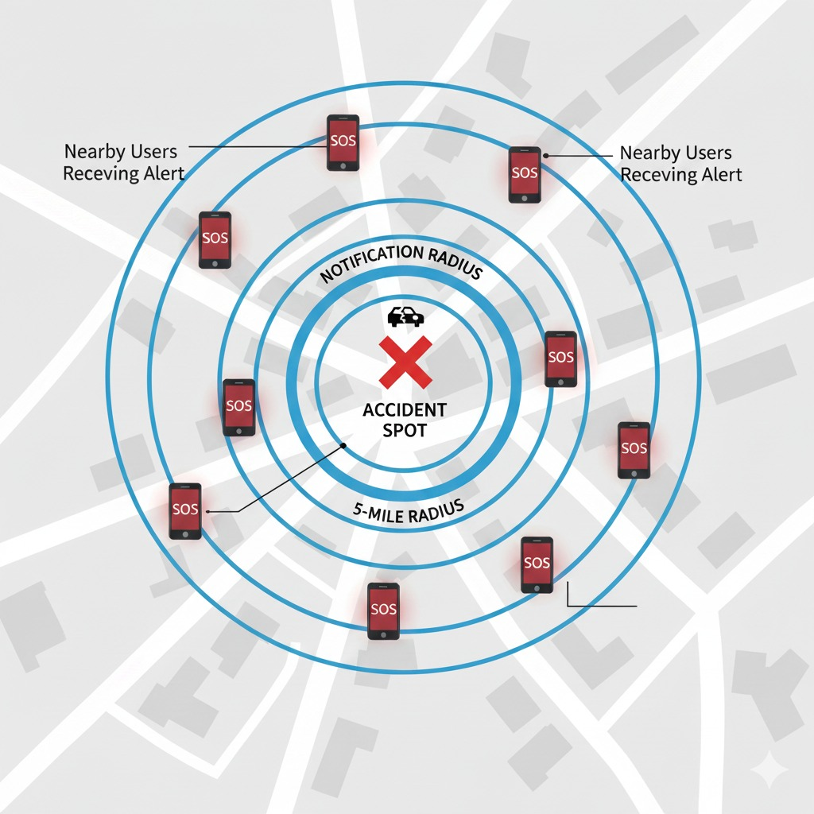
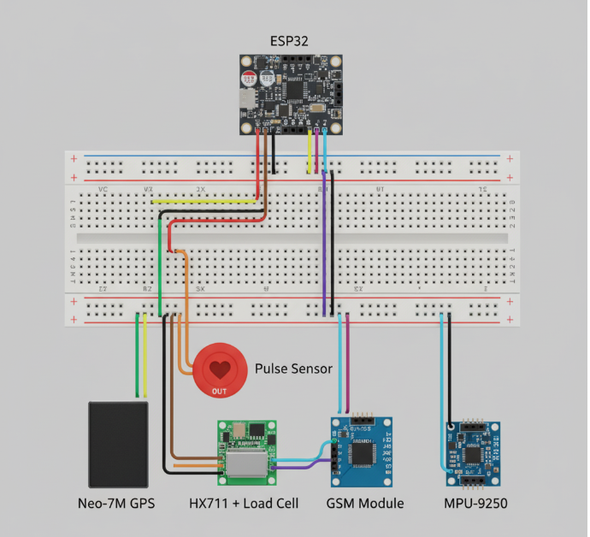
TECHNICAL APPROACH
Technologies & Methods
Hardware
Sensors:
Accelerometer, Gyroscope, Heartbeat & Pulse, load sensor
Microcontroller:
ESP32 for processing data and triggering alerts.
GSM Module:
For SMS alerts when phone is unavailable.
GPS Module:
To track and share live location.
Software
Mobile App: Receives alerts, shares location, notifies family & hospitals.
IoT Integration:
Real-time communication between device, app, and servers.
Data Processing:
Accident severity analysis using sensor inputs.
Methodology
Accident detection → Data analysis → Automatic alert → Emergency response.
Focus on real-time action, reliability, and scalability.

Slide 6
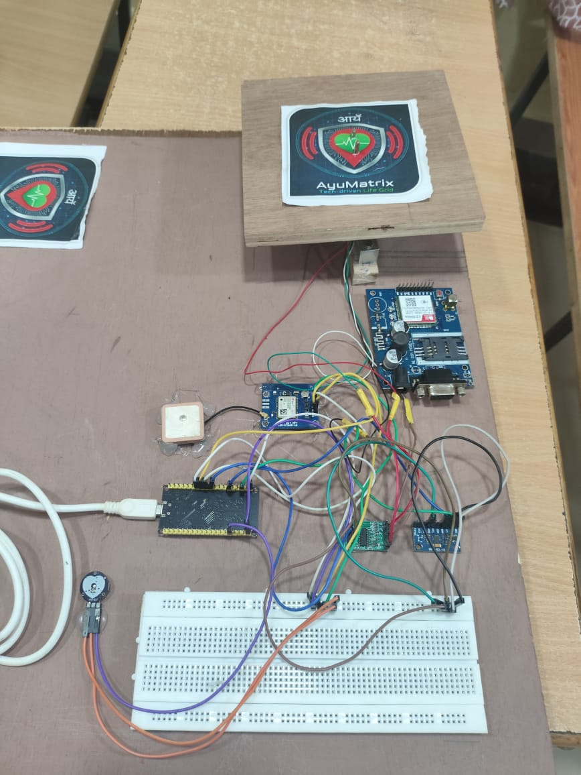
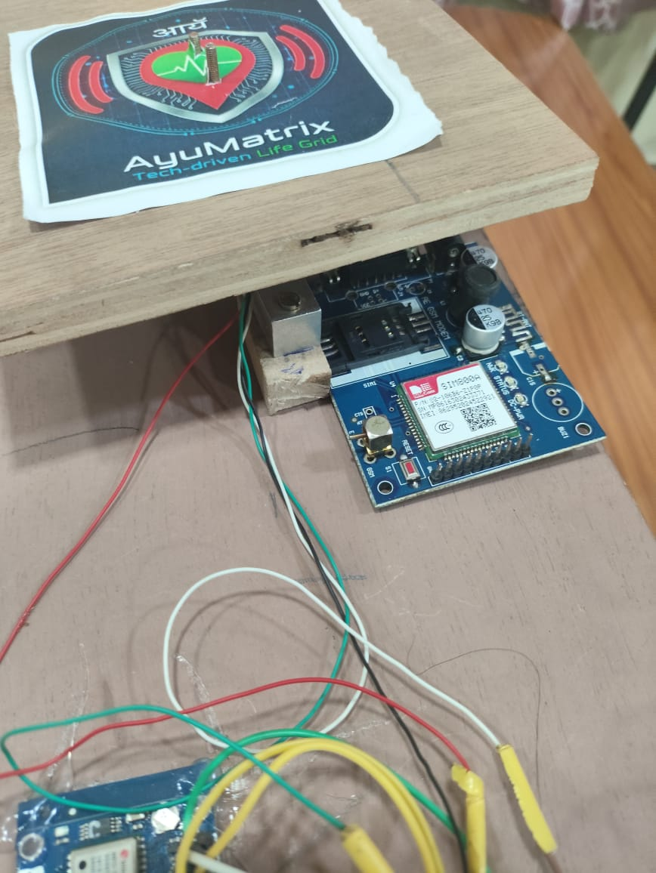
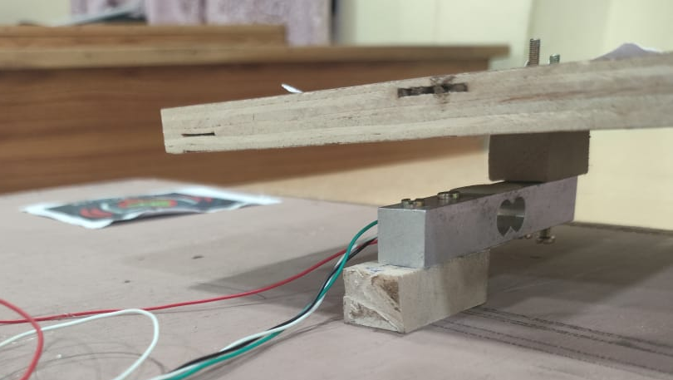
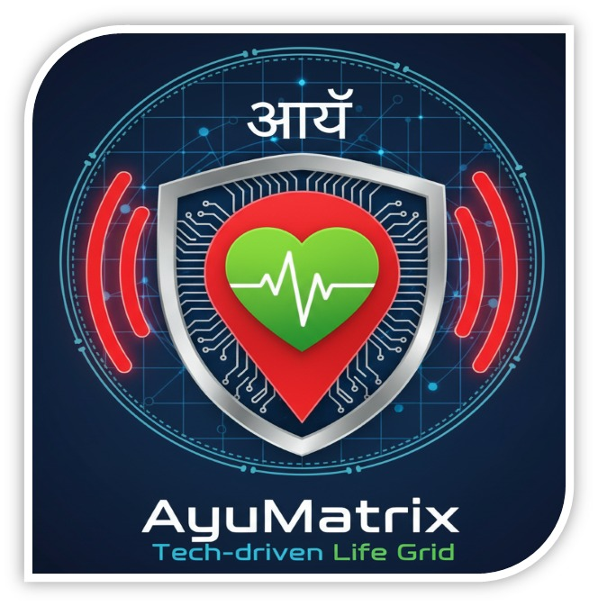
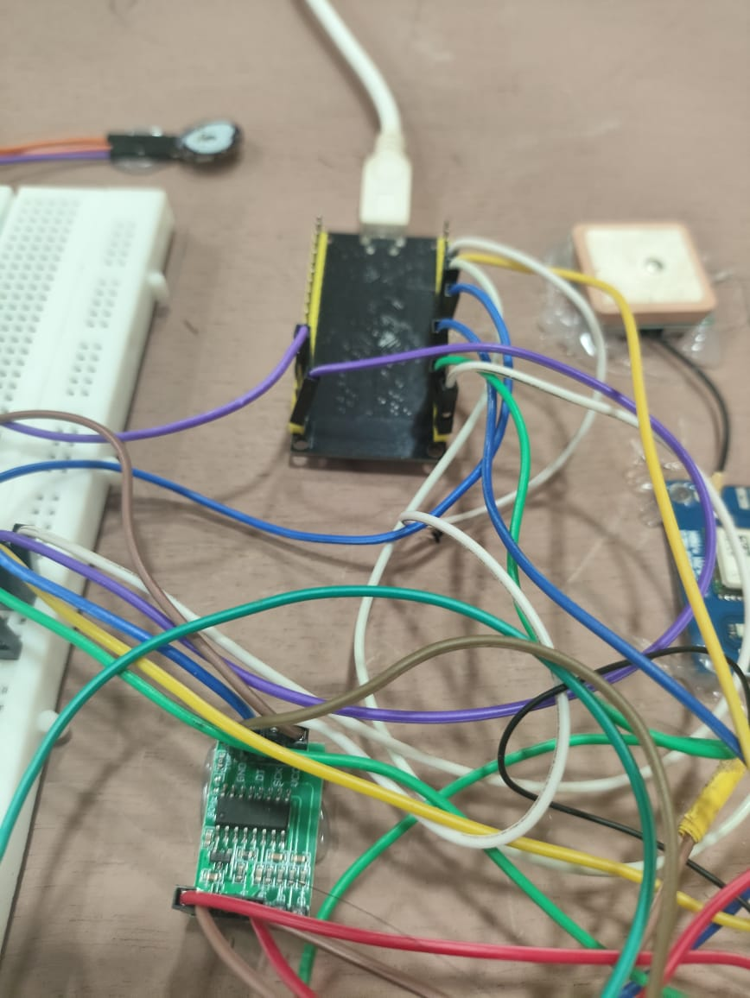
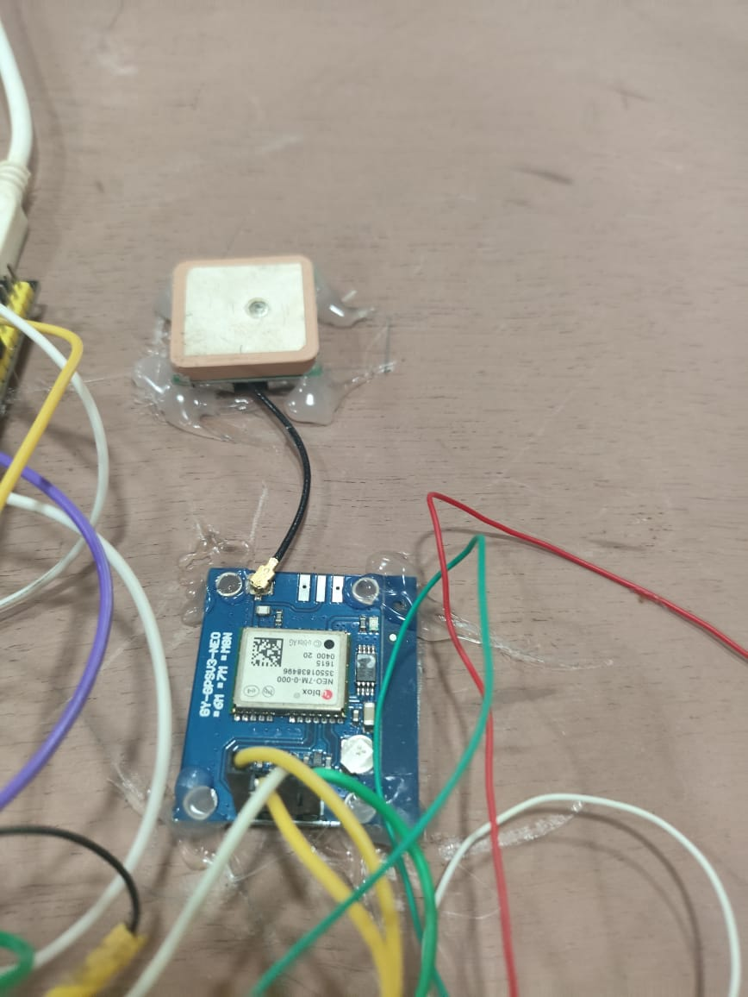
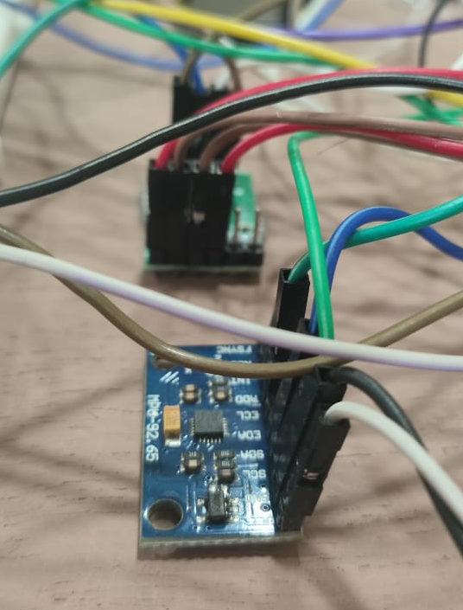
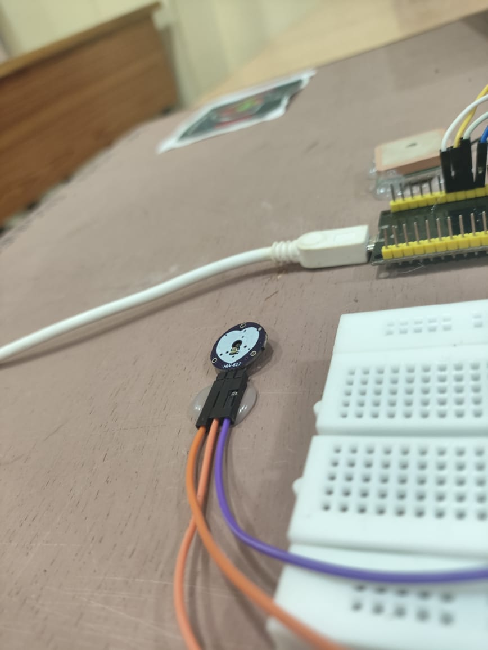

Slide 7
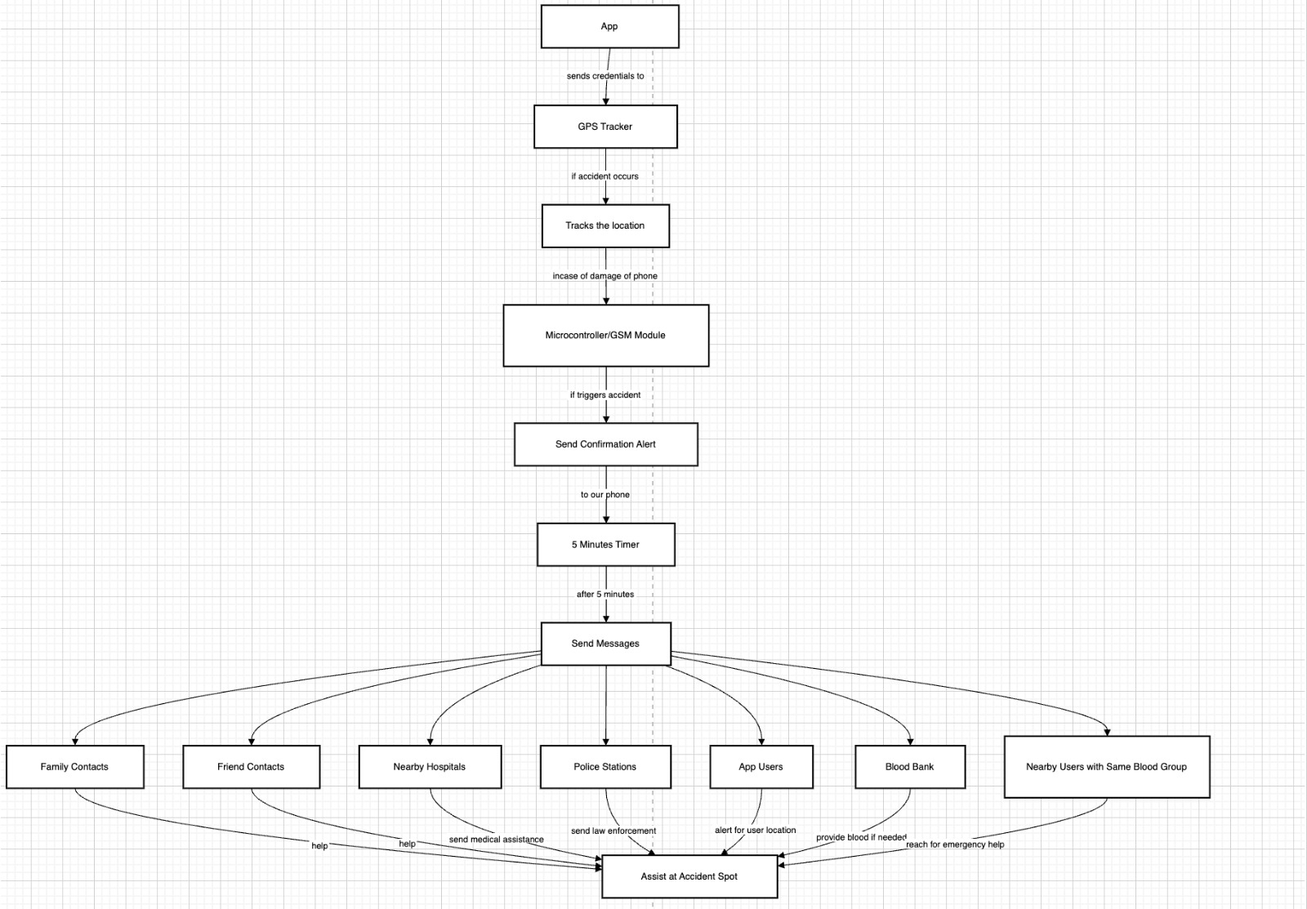
WORK FLOW

Slide 8
IMPACT AND BENEFITS
IMPACT
Two-wheeler riders- Directly protected by automatic accident alerts.
Families- Receive quick updates about their loved ones.
Hospitals & responders- Get early information, improving rescue efficiency.
BENEFITS
Social Benefits-
Saves lives by reducing delays.
Improves road safety awareness.
Economic Benefits-
Reduces long-term treatment costs.
Prevents productivity loss
Environmental Benefits-
Fewer accident-related traffic jams = less fuel waste & emissions.

Slide 9
CONCLUSION
How Our Solution Addresses the Core Problem
Instant Detection & Alerts → Sends real-time location and rider’s health status.
No Rider Dependency → Works even if the victim is unconscious.
Journey Safety App → Family & friends can track rides and get instant alerts.
Critical Blood Support → Connects to nearby blood banks and notifies matching donors during severe blood loss.
Backup System → If no phone, GSM sends SMS alerts to ensure help is always notified.
Potential for Scaling & Future Scope Scaling
Adoptable for all two-wheelers, ride-sharing, and long-distance travel.
Future Improvements
AI-based accident severity grading.
Direct integration with blood bank networks & donor platforms.
Link with hospitals and emergency helplines (108/112).
Broader Applications
Extendable to cars, trucks, buses, and logistics fleets.
Vital for elderly travelers, delivery riders, and accident-prone regions.

