Slide 1
BLUESTOCK MUTUAL FUND ANALYTICS
Data-Driven Analysis of Mutual Fund Performance, Risk and Investor Behaviour
Final Capstone Project
Prepared by:
B.C.Sai Vyshnavi

Slide 2
Problem Statement
Mutual fund data contains information about schemes, NAV, performance, investor transactions, SIP activity, fund houses and portfolio holdings. Analysing these datasets together can help identify fund performance, risk characteristics and investor behaviour.

Slide 3
Objectives
Build a reliable data ingestion and cleaning pipeline.
Analyse mutual fund performance using CAGR, Sharpe, Alpha and Beta.
Evaluate risk using drawdown and VaR/CVaR metrics.
Analyse investor transactions and SIP behaviour.
Develop an interactive Power BI dashboard.
Generate advanced analytics and risk-based fund recommendations.
Keep this slide to these points. Don't paste a long paragraph from the report.

Slide 4
Data Sources
Dataset | Purpose
Fund Master | Scheme details, category and risk information
NAV History | Daily NAV and return analysis
AUM by Fund House | Assets under management
Monthly SIP Inflows | SIP investment trends
Category Inflows | Category-level investor flows
Folio Count | Growth in investor folios
Scheme Performance | Returns and performance metrics
Investor Transactions | Investor behaviour analysis
Portfolio Holdings | Sector concentration and HHI
Benchmark Indices | Benchmark comparison
40 schemes | 10 fund houses | 46,000 NAV records

Slide 5
Architecture
Raw CSV Data
Data Ingestion
Data Cleaning & Validation
Processed Datasets
Final Reports & Recommendations
Power BI Dashboard
Analytics & Risk Metrics
SQLite Database
Tools Used
Python | Pandas | NumPy | SciPy | Matplotlib | SQLite | SQL | Power BI

Slide 6
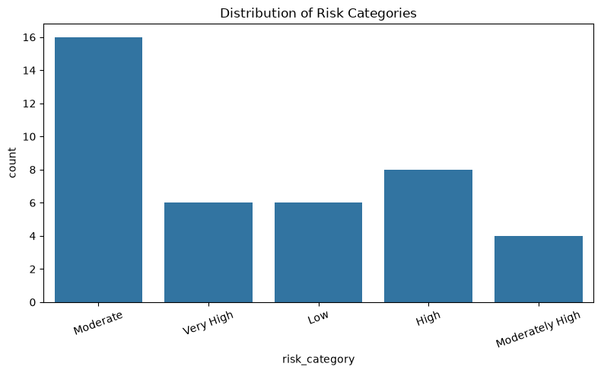
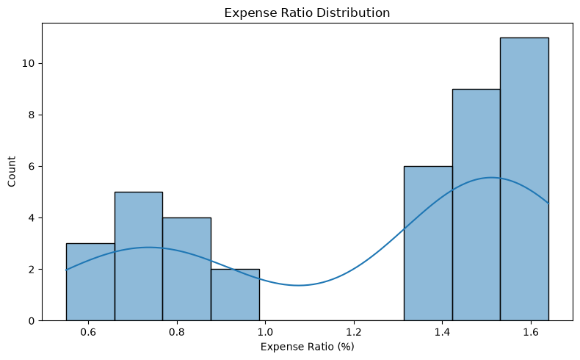
EDA Highlights — Fund Universe
The dataset contains 40 mutual fund schemes.
The schemes belong to 10 fund houses.
Equity and Debt are the major fund categories.
Moderate-risk funds form a significant portion of the analysed schemes.
Average expense ratio is approximately 1.237%.
Maximum expense ratio is 1.64%.

Slide 7
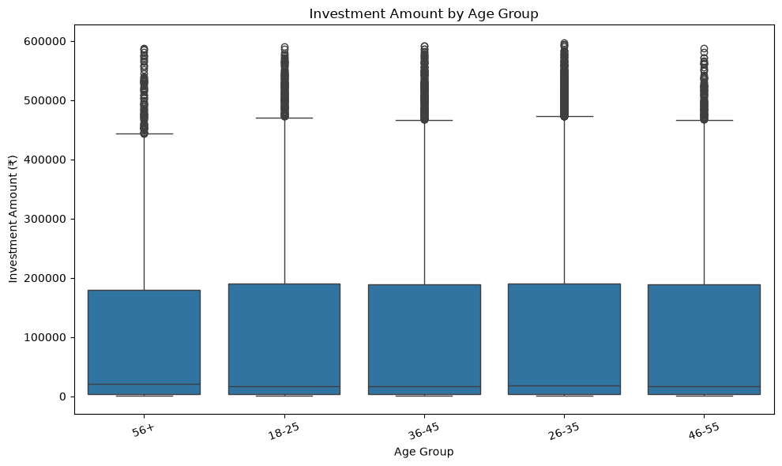
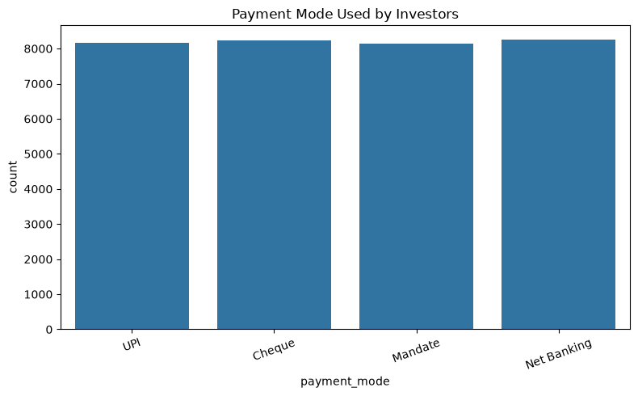
EDA Highlights — INVESTOR BEHAVIOUR
Investment activity varies across different investor age groups.
The analysis shows differences in the amount invested across age segments.
Investors use multiple payment modes for mutual fund transactions.
Understanding age and payment preferences can help improve investor targeting and engagement strategies.
Investor behaviour analysis provides additional context for understanding participation in mutual funds.

Slide 8
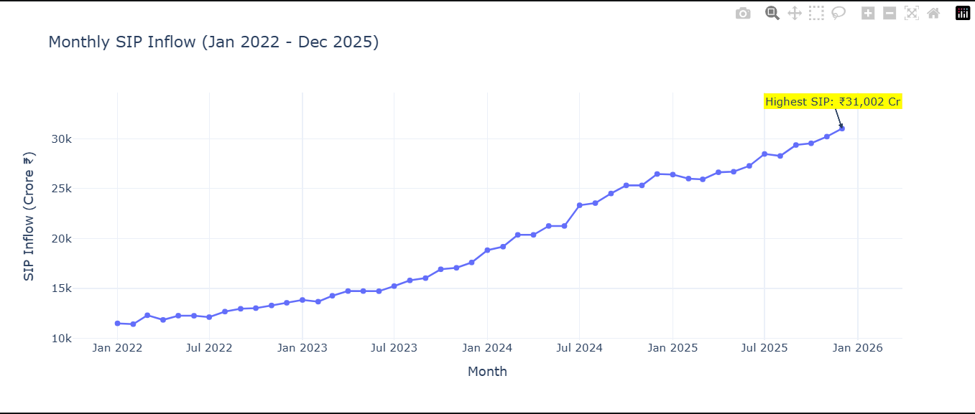
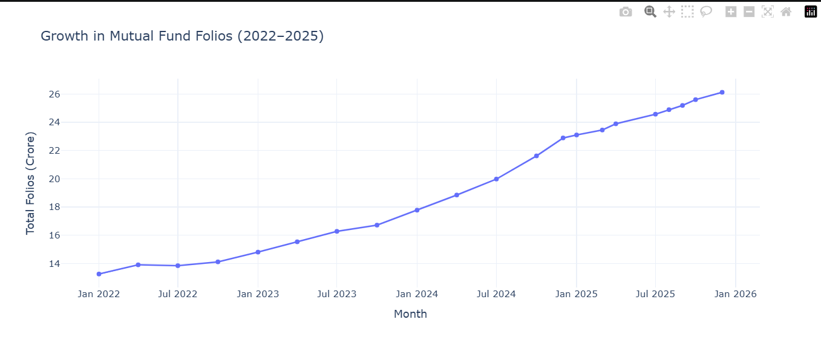
EDA HIGHLIGHTS: MARKET & INVESTMENT TRENDS
Monthly SIP inflows show changes in investor contribution levels over the analysed period.
Mutual fund folios show an overall change in investor participation between 2022 and 2025.
SIP activity provides an indication of recurring investment behaviour.
Growth in folios reflects changes in the number of investor accounts over time.

Slide 9
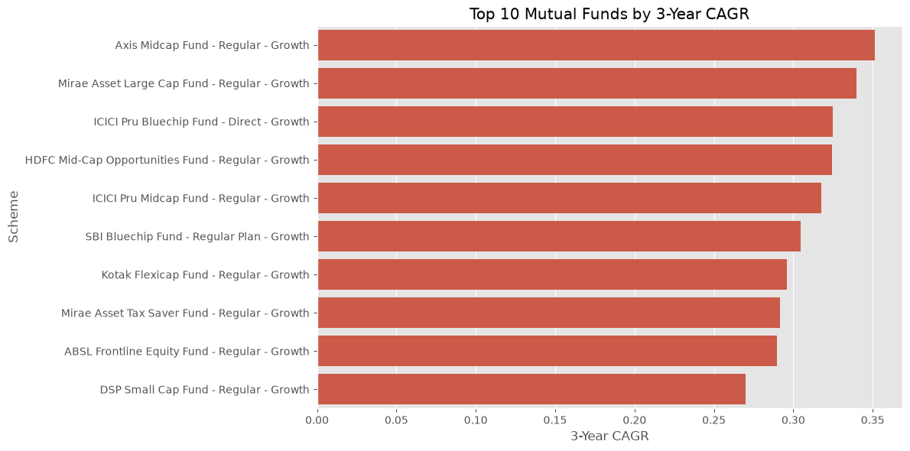
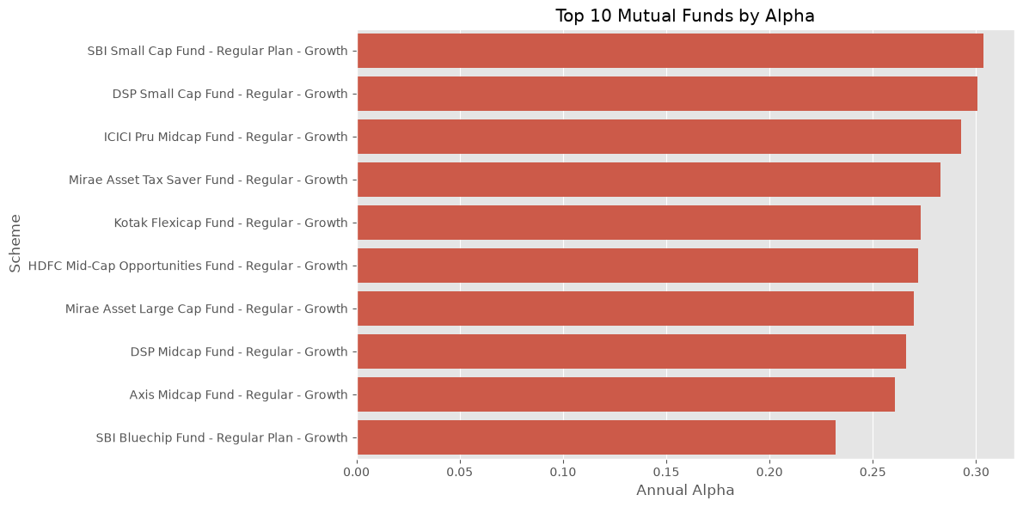
PERFORMANCE METRICS: RETURNS
The 3-Year CAGR comparison identifies funds with stronger annualised historical growth.
Alpha analysis highlights funds that generated stronger performance relative to their benchmarks.
Fund performance varies significantly across schemes.
Evaluating both return and benchmark-relative performance provides a more complete view of fund quality.
Historical performance should be considered together with risk before making investment decisions.

Slide 10
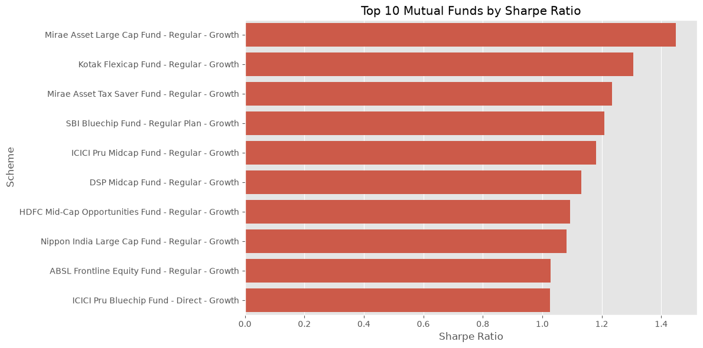
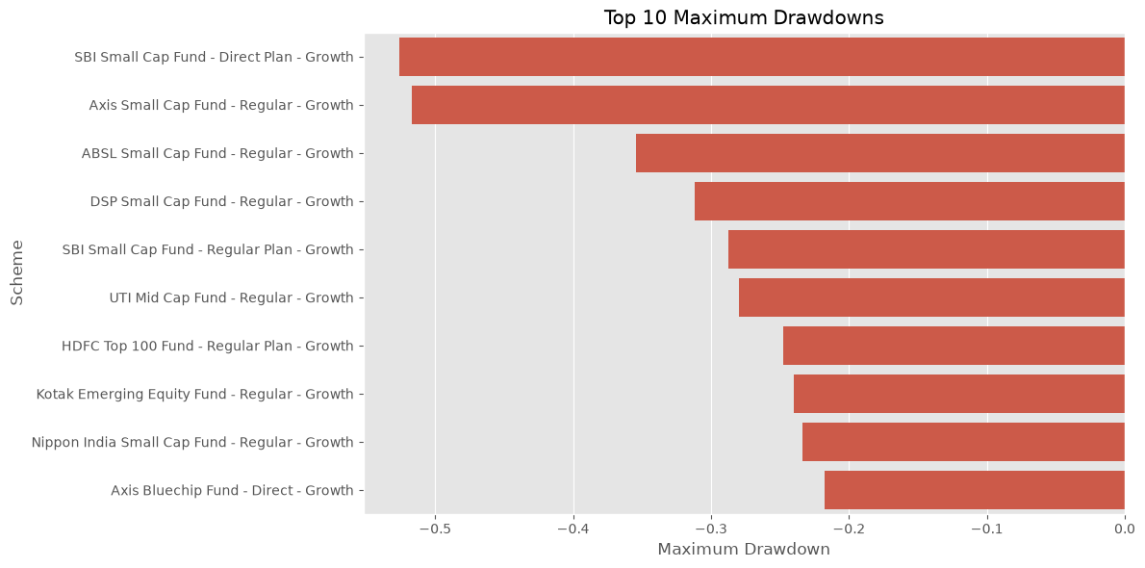
METRICS: RISK-ADJUSTED PERFORMANCE
Sharpe ratio measures return relative to volatility.
Maximum drawdown measures the largest decline from a previous portfolio peak.
Funds with higher returns may also experience higher downside risk.
Risk-adjusted metrics provide a better comparison than returns alone.
The highest historical Sharpe ratio in the analysed dataset was 13.6559, recorded by ICICI Pru Liquid Fund - Regular - Growth.

Slide 11
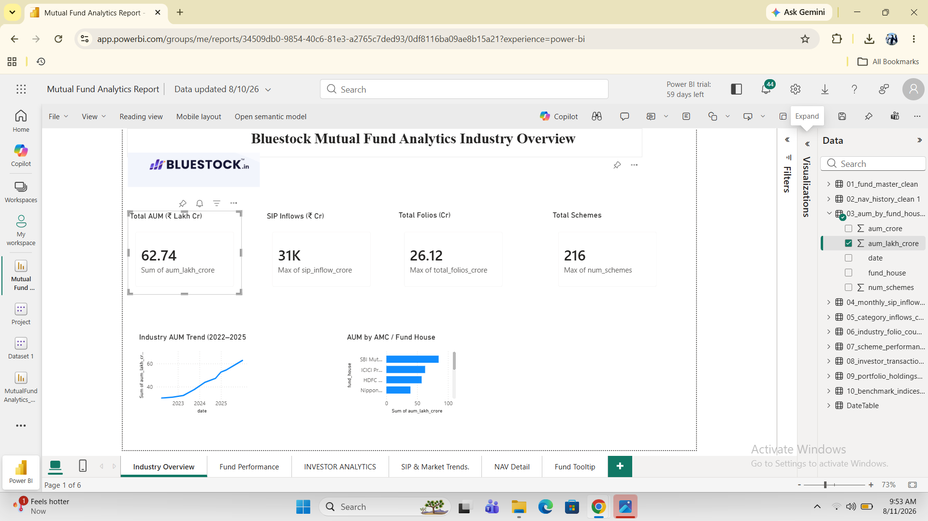
POWER BI DASHBOARD
Fund house and AUM overview
Fund category analysis
Interactive slicers and filters

Slide 12
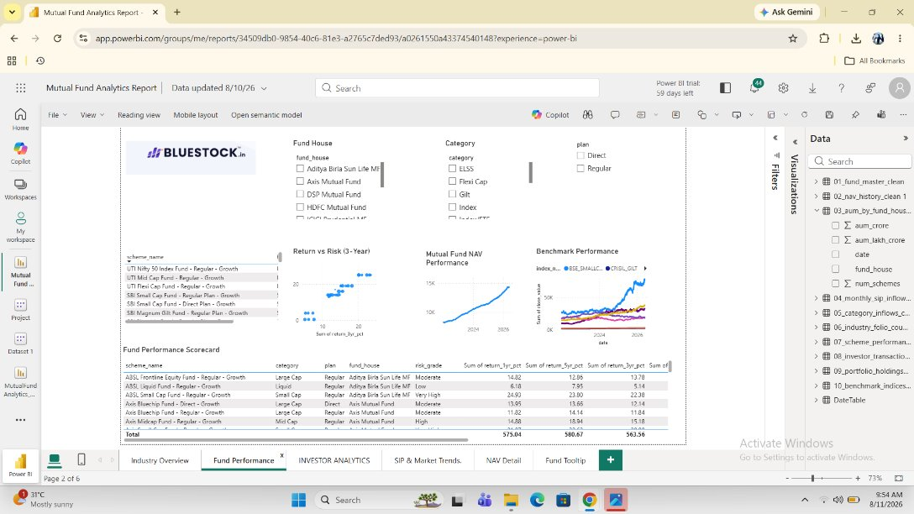
Performance comparison
Risk and return analysis
Interactive fund analysis
Scheme-level comparison

Slide 13
ADVANCED ANALYTICS & KEY FINDINGS
Fund Downside Risk
Highest VaR: SBI Small Cap Fund - Direct Plan - Growth
95% VaR: approximately -2.69%
Highest CVaR: ABSL Small Cap Fund - Regular - Growth
95% CVaR: approximately -3.25%
Investor Cohort Behaviour
Highest total investment cohort: 2024
Total investment: approximately ₹21.50 crore
Highest average SIP cohort: 2025
Average SIP: approximately ₹13,505.21
SIP Continuity
Regular SIP rate: 2.2%
At-risk SIP rate: 97.8%
At-risk investors were identified using the 35-day average SIP-gap threshold.
Portfolio Concentration
Highest HHI: Axis Bluechip Fund — 0.2968
Lowest HHI: UTI Mid Cap Fund — 0.1240
Key Takeaway
Advanced analytics combines risk, investor behaviour and portfolio concentration to provide deeper insights beyond basic performance analysis.

Slide 14
THANK YOU

