Slide 1
WEEK 07
System Design, Architecture
& Project Proposal
Transforming requirements into a technical system design
Dr. Aftab Alam Janisar · BC362916 + BC362914

Slide 2
01 · SESSION ROADMAP
Three Hours — From Requirements to Proposal
Hour 1
Hour 2
Hour 3
System Architecture
System Models & UI/UX
Complete Project Proposal
Components, inputs, processing, outputs, storage, interfaces, APIs
Diagrams that matter + wireframes and mockups
Integrating all prior work into one coherent document
Week 7 · System Design & Project Proposal · Dr. Aftab Alam Janisar
2

Slide 3
01 · THEME
Theme of the Week
Transforming requirements into
a technical system design
Week 7 · System Design & Project Proposal · Dr. Aftab Alam Janisar
3

Slide 4
01 · LEARNING OBJECTIVES
By the end of this session you will be able to
01
Describe system architecture in terms of components and flows (inputs, processing, outputs, storage, interfaces, APIs)
02
Select and produce meaningful system models and UI artefacts (only diagrams that support the design + basic wireframes)
03
Assemble a complete Project Proposal that integrates problem, requirements, architecture, stack, timeline, risks and continuation plan
Week 7 · System Design & Project Proposal · Dr. Aftab Alam Janisar
4

Slide 5
BRIDGE FROM WEEK 5
Where We Are in the Project Journey
1
2
3
4
5
Self-assessment &
Domain interest
Problem formulation
& objectives
Feasibility
analysis
Requirements
& scope
Design &
Architecture
Today we move from Requirements & Scope (step 4) into Design & Architecture (step 5).
You will produce the complete Project Proposal that becomes the baseline for implementation.
Week 7 · System Design & Project Proposal · Dr. Aftab Alam Janisar
5

Slide 6
HOUR 1
System Architecture
Components, flows, interfaces and boundaries

Slide 7
HOUR 1 · ARCHITECTURE CONCEPTS
Core Architecture Concepts
System components
Inputs
Major building blocks of the solution
Data or events that enter the system
Processing
Outputs
Logic that transforms inputs into results
What the system produces for users or other systems
Data storage
Communication
Where information is persisted and retrieved
How components exchange information
Interfaces
APIs & external services
Points of interaction with users or systems
Programmatic access and third-party capabilities
Week 7 · System Design & Project Proposal · Dr. Aftab Alam Janisar
7

Slide 8
HOUR 1 · WEB APPLICATION
Example Architecture — Web Application
User
Frontend
Backend
Database
Browser or mobile client
UI, forms, client-side logic
Business rules, APIs, auth
Persistent storage of records
User → Frontend → Backend → Database
Week 7 · System Design & Project Proposal · Dr. Aftab Alam Janisar
8

Slide 9
HOUR 1 · AI APPLICATION
Example Architecture — AI Application
Data
Preprocessing
Model
Prediction
User Interface
Raw inputs / datasets
Clean, transform, feature
Training / inference engine
Output scores or labels
Present results to users
Data → Preprocessing → Model → Prediction → UI
Week 7 · System Design & Project Proposal · Dr. Aftab Alam Janisar
9

Slide 10
HOUR 1 · IOT APPLICATION
Example Architecture — IoT Application
Sensor
Device
Network
Server / Cloud
Application
Physical measurement
Edge processing / gateway
Transmit data securely
Store, process, analyse
Dashboards & alerts
Sensor → Device → Network → Server/Cloud → Application
Week 7 · System Design & Project Proposal · Dr. Aftab Alam Janisar
10

Slide 11
HOUR 1 · COMPONENTS
Thinking in Components
Presentation layer
Application / business layer
Data layer
Screens, forms, dashboards, mobile views
Rules, workflows, validation, orchestration
Databases, files, caches, message stores
Integration layer
Security layer
Infrastructure
APIs, message queues, external connectors
Auth, authorisation, encryption, logging
Servers, containers, cloud services, networks
Week 7 · System Design & Project Proposal · Dr. Aftab Alam Janisar
11

Slide 12
HOUR 1 · INTERFACES & APIs
Interfaces and APIs
User interfaces
How humans interact (web, mobile, kiosk)
System interfaces
How software components talk to each other
APIs
Defined contracts for requesting and receiving data/services
External services
Third-party capabilities you depend on (email, maps, payments)
Week 7 · System Design & Project Proposal · Dr. Aftab Alam Janisar
12

Slide 13
HOUR 2
System Models and UI/UX
Diagrams that matter + wireframes and mockups

Slide 14
HOUR 2 · CHOOSING DIAGRAMS
Use Only Diagrams That Support Your Design
Not every project needs every diagram. Choose what clarifies your system.
Use Case Diagram
Activity / Flowchart
ER Diagram / Schema
Actors and major system goals
Step-by-step process logic
Data entities and relationships
Architecture Diagram
Data Flow Diagram
Wireframes / Mockups
Major components and connections
How data moves through processes
Screen layout and user flow
Week 7 · System Design & Project Proposal · Dr. Aftab Alam Janisar
14

Slide 15
HOUR 2 · USE CASE DIAGRAM
Use Case Diagram — Purpose
Shows actors
Shows use cases
Who interacts with the system
Major goals the system supports
Shows relationships
Keeps scope visible
Which actor performs which use case
Helps detect missing or extra behaviour
Good for most projects
Keep it simple
Especially those with clear user roles
Focus on the main use cases for Project I
Week 7 · System Design & Project Proposal · Dr. Aftab Alam Janisar
15

Slide 16
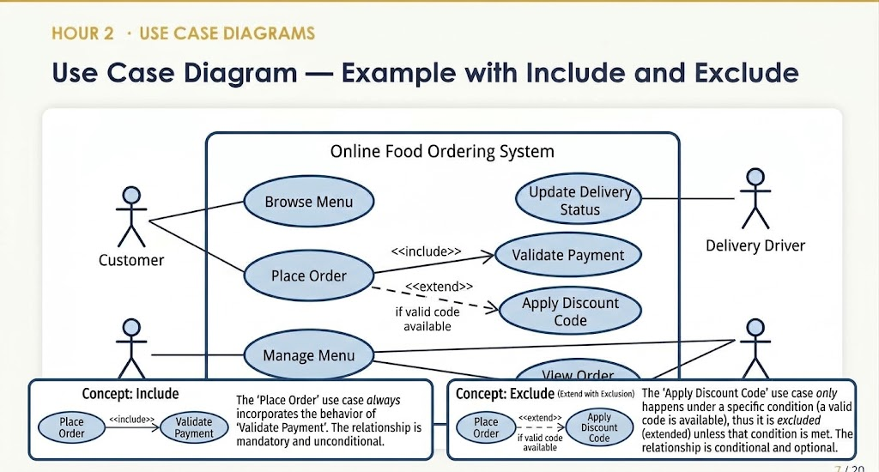

Slide 17
HOUR 2 · DATA MODELS
ER Diagram and Database Schema
Entities
Attributes
Main things the system stores (User, Booking, Slot…)
Properties of each entity
Relationships
Keys
How entities connect (1:1, 1:N, M:N)
Primary and foreign keys for integrity
Why it matters
Project I expectation
Bad data design creates long-term problems
Clear schema for the core data the prototype uses
Week 7 · System Design & Project Proposal · Dr. Aftab Alam Janisar
16

Slide 18
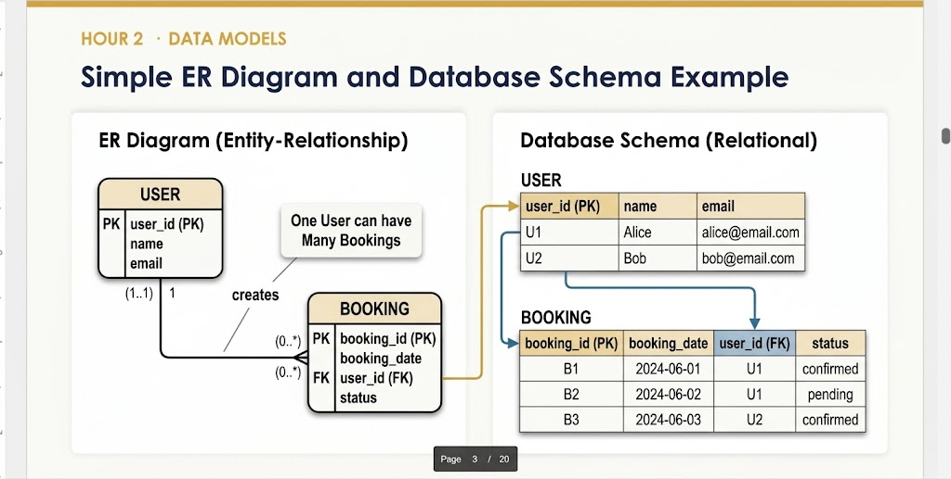
1. 1:1 (One-to-One)
Notation: (1..1) to (0..1)
Example: One User has exactly one User Profile (or one Person has one Passport).
2. 0:N / 0.. (Zero-to-Many / Optional Many)*
Notation: (0..*) or Crow's Foot with an outer circle
Example in Diagram: A newly registered USER can have 0 bookings, or accumulate many (*) bookings over time.
3. 1:N (One-to-Many)
Notation: USER (1..1) —— (0..*) BOOKING
Example in Diagram: "One User can have Many Bookings" — One USER creates multiple BOOKING entries, but every BOOKING must link back to exactly 1 USER.

Slide 19
HOUR 2 · ARCHITECTURE DIAGRAM
System Architecture Diagram
Show major components
Show direction of flow
Frontend, backend, database, external services
Who calls whom; request/response paths
Label technologies
Keep it readable
Where the stack will sit (optional but useful)
Prefer clarity over exhaustive detail
Match your project type
Update as design evolves
Web, AI, IoT patterns differ
Architecture is not frozen on day one
Week 7 · System Design & Project Proposal · Dr. Aftab Alam Janisar
17

Slide 20
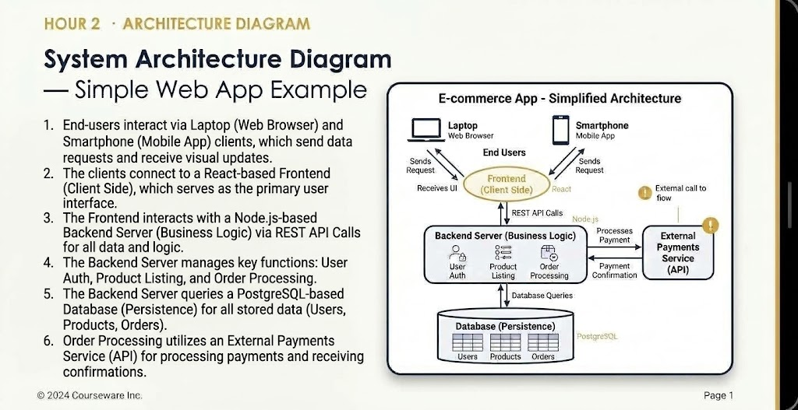

Slide 21
HOUR 2 · UI/UX
Wireframes and UI Mockups
Wireframes
Mockups
Low-fidelity structure — layout and flow, not final visual design
Higher-fidelity screens — closer to the intended look
Why they help
How many
Reveal missing fields, unclear steps, and navigation problems early
Key screens for the core user journeys (not every possible page)
Tools
Link to requirements
Paper, Figma, draw.io, PowerPoint, or simple sketches
Each important screen should support a requirement or user story
Week 7 · System Design & Project Proposal · Dr. Aftab Alam Janisar
18

Slide 22
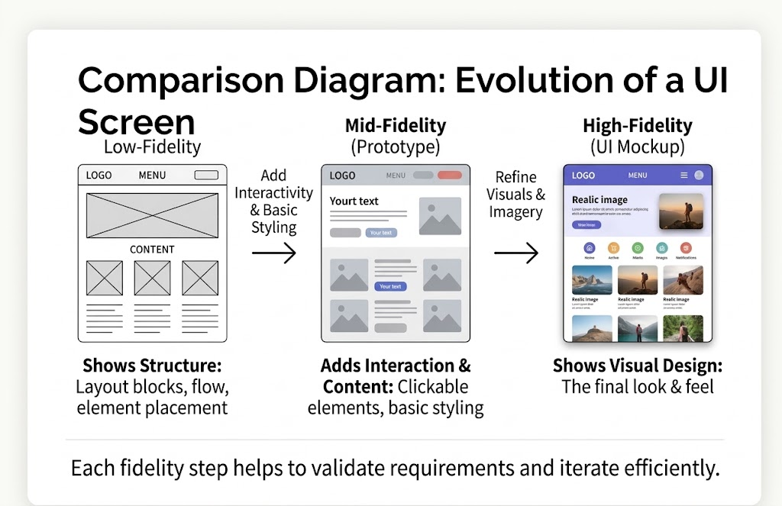

Slide 23
HOUR 2 · PROCESS MODELS
Activity Diagrams and Flowcharts
When useful
Show decisions
Complex business rules or multi-step processes
Branching based on conditions
Show parallel work
Keep focus
Where activities can happen together
Model the core flows that implement key requirements
Avoid over-detail
Pair with use cases
Not every button click needs a box
Use cases describe goals; flows show how steps unfold
Week 7 · System Design & Project Proposal · Dr. Aftab Alam Janisar
19

Slide 24
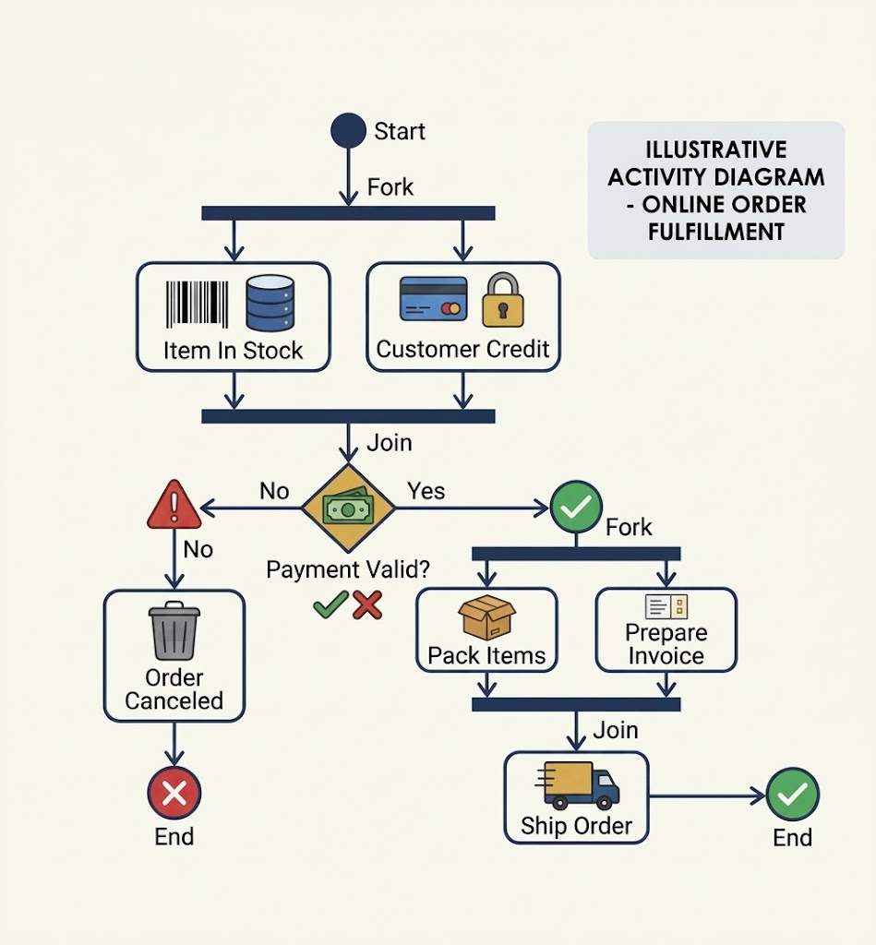

Slide 25
HOUR 3
Complete Project Proposal
Integrating all prior work into one coherent document

Slide 26
HOUR 3 · PROPOSAL PURPOSE
Why a Complete Project Proposal?
Integrates all prior work
Problem, requirements, design into one coherent story
Creates a shared baseline
Team and instructor agree on what will be built
Supports assessment
Demonstrates understanding before coding accelerates
Guides implementation
Architecture and models reduce ad-hoc decisions
Defines success for Project I
Clear deliverables and continuation into Project II
Week 7 · System Design & Project Proposal · Dr. Aftab Alam Janisar
21

Slide 27
HOUR 3 · PROPOSAL STRUCTURE (1–9)
Suggested Proposal Structure (Part 1)
1. Project title
6. Stakeholders
2. Background
7. Requirements (functional + non-functional)
3. Problem statement
8. Scope (in / out, constraints, assumptions)
4. Objectives (general + specific)
9. Proposed solution (high-level description)
5. Target users
Week 7 · System Design & Project Proposal · Dr. Aftab Alam Janisar
22

Slide 28
HOUR 3 · PROPOSAL STRUCTURE (10–17)
Suggested Proposal Structure (Part 2)
10. Architecture (components and major flows)
11. System models (selected diagrams + short explanation)
12. Technology stack (languages, frameworks, tools, hosting)
13. Development methodology (e.g. iterative / Agile practices)
14. Project timeline (milestones for remaining weeks)
15. Risks (technical, schedule, data, team) and mitigations
16. Project I deliverables (what will be demonstrated)
17. Project II continuation plan (what remains and why)
Week 7 · System Design & Project Proposal · Dr. Aftab Alam Janisar
23

Slide 29
HOUR 3 · TECHNOLOGY STACK
Technology Stack — What to Document
Frontend
Backend
Framework / library, language, key UI tools
Runtime, framework, API style (REST, etc.)
Database
Hosting / deployment
Type and product (relational / NoSQL)
Where the prototype will run
Supporting tools
External services
Git, project board, design tools, testing tools
Any third-party APIs or platforms
Week 7 · System Design & Project Proposal · Dr. Aftab Alam Janisar
24

Slide 30
HOUR 3 · METHOD & TIMELINE
Development Methodology and Timeline
METHODOLOGY
TIMELINE
• Iterative or lightweight Agile
• Major milestones only
• Short cycles with visible progress
• Link to remaining course weeks
• Regular stand-ups / check-ins
• Include design, build, test phases
• Backlog of features prioritised
• Leave buffer before final demo
• Definition of done for each item
• Show Project I vs Project II boundary
Week 7 · System Design & Project Proposal · Dr. Aftab Alam Janisar
25

Slide 31
HOUR 3 · RISKS
Risks Section — Be Specific
Technical risk
Unfamiliar technology, integration difficulty — mitigation: spikes, learning plan
Schedule risk
Underestimated effort — mitigation: prioritised backlog, early cuts
Data / access risk
Delayed or denied data — mitigation: synthetic data plan
Team risk
Uneven contribution — mitigation: clear ownership, visible progress
Scope risk
Feature creep — mitigation: written out-of-scope list
User risk
Low feedback participation — mitigation: early scheduling of sessions
Week 7 · System Design & Project Proposal · Dr. Aftab Alam Janisar
26

Slide 32
HOUR 3 · PROJECT I DELIVERABLES
Project I Deliverables (What You Will Demonstrate)
1
Approved problem, objectives and requirements
2
Architecture and selected system models
3
Working prototype of core features
4
Evidence of version control and structured development
5
Initial testing results
6
Technical documentation and progress records
7
Clear Project II continuation plan
Week 7 · System Design & Project Proposal · Dr. Aftab Alam Janisar
27

Slide 33
HOUR 3 · PROJECT II PLAN
Project II Continuation Plan
Remaining features
Integration & hardening
What was deferred and why
Full system behaviour and quality improvements
Deeper testing
Evaluation with users
Broader cases, usability, performance where relevant
Feedback collection and analysis
Deployment / pilot (if appropriate)
Final documentation
Realistic environment if feasible
Complete technical report and reflection
Week 7 · System Design & Project Proposal · Dr. Aftab Alam Janisar
28

Slide 34
STUDENT DELIVERABLE
Complete Project Proposal
A single document that integrates work from Weeks 4–7 and provides a clear baseline for implementation.
☐ All 17 suggested sections (or equivalent complete structure)
☐ Architecture diagram and selected system models
☐ Technology stack with justification
☐ Timeline with milestones
☐ Risks with mitigations
☐ Explicit Project I deliverables and Project II plan
Week 7 · System Design & Project Proposal · Dr. Aftab Alam Janisar
29

Slide 35
DESIGN QUALITY
Signs of a Strong Design Section
Traceable to requirements
Clear boundaries
Major components exist to satisfy stated needs
What is inside the system vs external
Realistic for the team
Readable diagrams
Stack and complexity match skills and time
Someone new can understand the big picture
Room for Project II
Honest limitations
Architecture can grow without a full rewrite
Known constraints are stated, not hidden
Week 7 · System Design & Project Proposal · Dr. Aftab Alam Janisar
30

Slide 36
COMMON DESIGN MISTAKES
Common Design & Proposal Mistakes
Architecture that ignores requirements
Every possible diagram forced in
Pretty diagram, weak link to needs
Noise instead of clarity
Technology list without rationale
Timeline that is only a wish list
Why these choices?
No buffer, no priorities
Risks that are generic
No Project II path
“Something might go wrong” is not useful
Prototype becomes a dead end
Week 7 · System Design & Project Proposal · Dr. Aftab Alam Janisar
31

Slide 37
COURSE CONNECTION
How Week 7 Supports Course Outcomes
CLO 9
Design an appropriate IT system architecture and supporting models
CLO 10
Select suitable technologies, tools, platforms and development methods
CLO 8
Solidifies scope, constraints and expected outcomes in the proposal
CLO 14
Documentation of design decisions and continuation plan
Week 7 · System Design & Project Proposal · Dr. Aftab Alam Janisar
32

Slide 38
KEY TAKEAWAYS
Remember These Points
1
Architecture explains components, flows and boundaries — not just technology names
2
Choose diagrams that clarify your design; skip those that do not
3
UI artefacts (wireframes/mockups) expose problems before coding
4
The proposal integrates everything from problem to continuation plan
5
A strong proposal becomes the baseline for implementation and assessment
Week 7 · System Design & Project Proposal · Dr. Aftab Alam Janisar
33

Slide 39
NEXT STEPS
What to Do After This Session
1
Draft the architecture diagram — components, major flows, external services
2
Select and produce 2–4 meaningful models (use case, ER/schema, flow, or architecture)
3
Create wireframes for core screens — key user journeys only
4
Assemble the full proposal — all sections from prior weeks + design + stack + plan
5
Review against the quality checklist — traceability, realism, clarity, continuation path
Week 7 · System Design & Project Proposal · Dr. Aftab Alam Janisar
34

Slide 40
Requirements become real when they are
expressed as architecture, models and
a coherent proposal.
That proposal is your contract with the rest of the semester.
Thank You
Questions & Discussion · Dr. Aftab Alam Janisar · Week 7 · BC362916 + BC362914

Slide 41
APPENDIX · NOTES
Additional Design & Proposal Notes
• Label every diagram clearly and keep legends simple.
• Technology choices should support the requirements, not the other way around.
• A short rationale for the stack is more valuable than a long list of tools.
• Timeline milestones should be checkable, not vague phases.
• Risks without mitigations are incomplete.
• The proposal is a living baseline — update it when major decisions change.
Week 7 · System Design & Project Proposal · Dr. Aftab Alam Janisar
36

