Slide 1
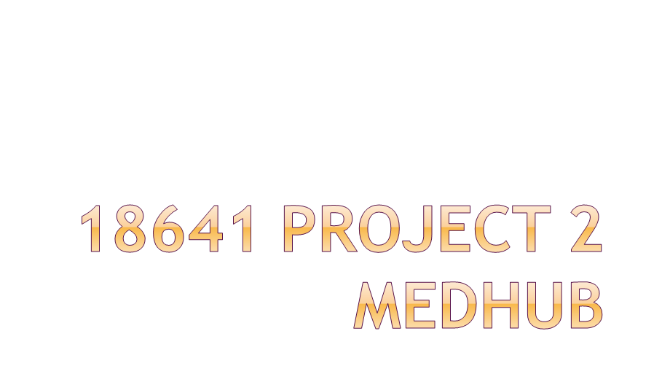
Sairam Krishnan (sbkrishn)
Meghna Thakur (mthakur)

Slide 2

Introduction
  Motivation
  Overview of Proposed Solution
  MedHub’s Value Proposition
  10 Major Features
Design
  UI Walkthrough (w/ screenshots)
  Package Structure
Lessons Applied and Learned

Slide 3


Slide 4


Problem : high latency of setting up an appointment with the doctor
High latency makes the overall process of getting treatment very mechanical (not very interpersonal, lots of waiting).
There is also a lot of paperwork!

Slide 5

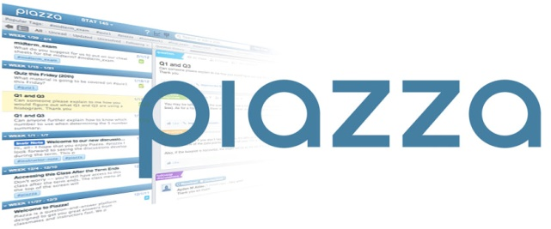

Android app that will serve as a Piazza or StackOverflow for medical issues.
  Allow patients to post symptoms to a public forum
  Other users can respond with possible solutions.
  Ensure high-quality solutions through response ranking system.

Slide 6


We believe that while doctors have a good deal of expertise with medical issues, ordinary people can also be invaluable to the medical process (thanks to the power of Google).
As such, MedHub expedites the diagnostic process through crowdsourcing, bringing many minds to bear on a problem at the same time and place.

Slide 7


Average response time to students’ posts can be as low as 8 minutes.
With ranking system or support for moderators, we can ensure high-quality responses.
Imagine if we could translate this low latency over to the medical field.....

Slide 8

1. Email - share medical bio with doctor
2. SMS - password recovery
3. Accelerometer - used to detect shake intensity
4. Pressure sensor
5. Gyroscope
6. Location - Network and GPS
7. Swiping, scrolling
8. Clicking sound on login
9. Touchscreen
10. Database

Slide 9


Slide 10

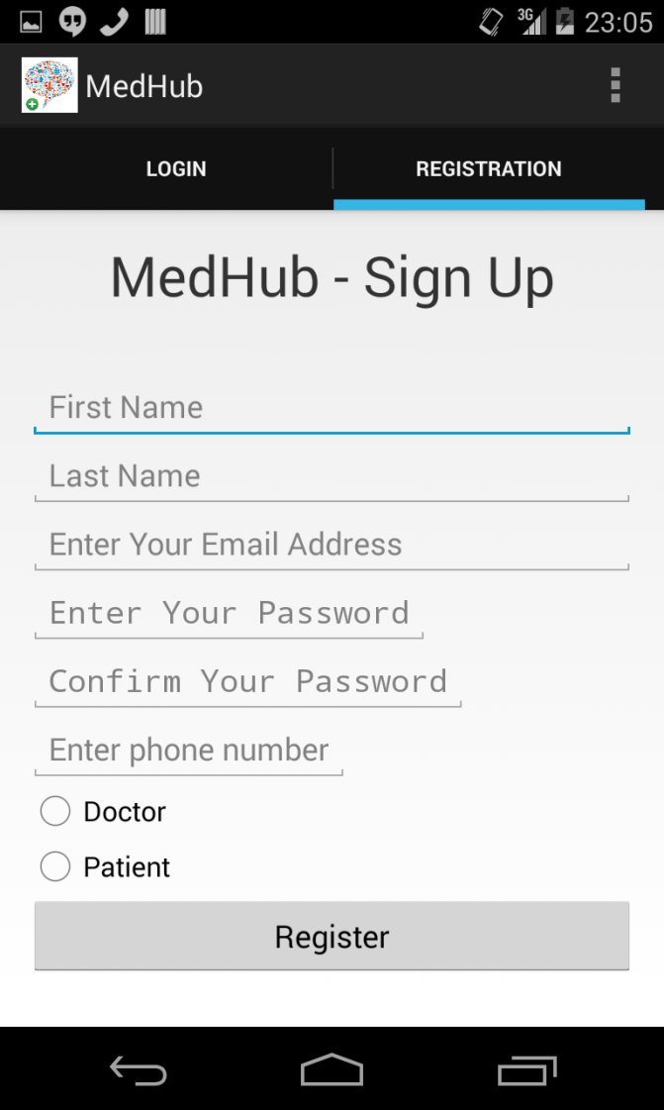
New users can go to the sign-up page to create a profile.
2 types of users: doctor and patient
Users will be automatically logged in upon successful registration.

Slide 11
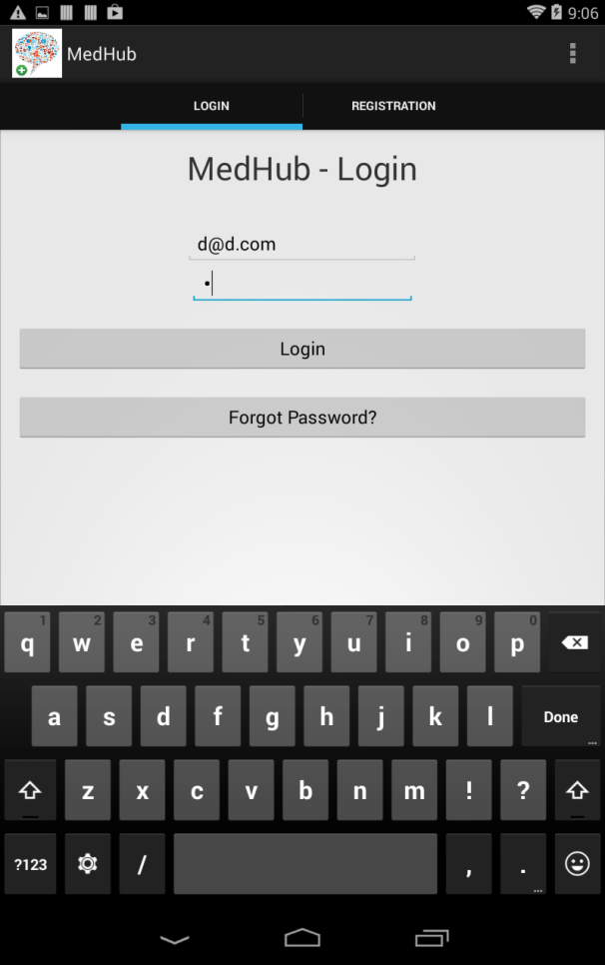
Existing users can simply log in using their credentials.

Slide 12

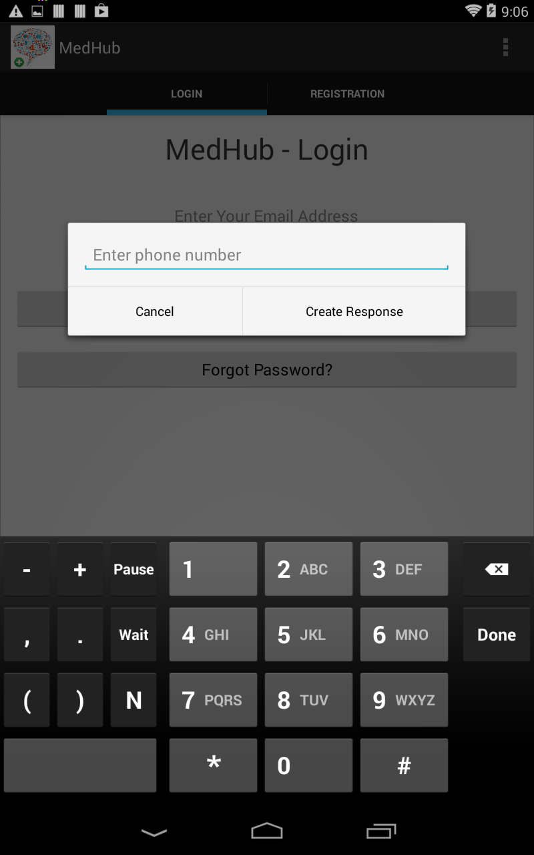
If registered users have forgotten their password, they can request a password reset via SMS.
We will send them a random number with which they can temporarily login.
Aftewards, they can change the password.

Slide 13
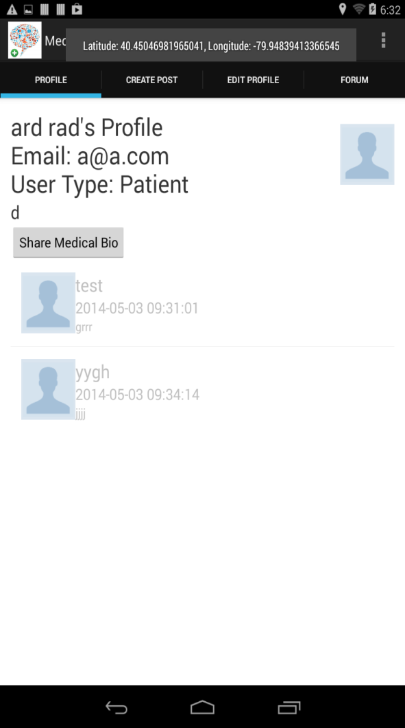
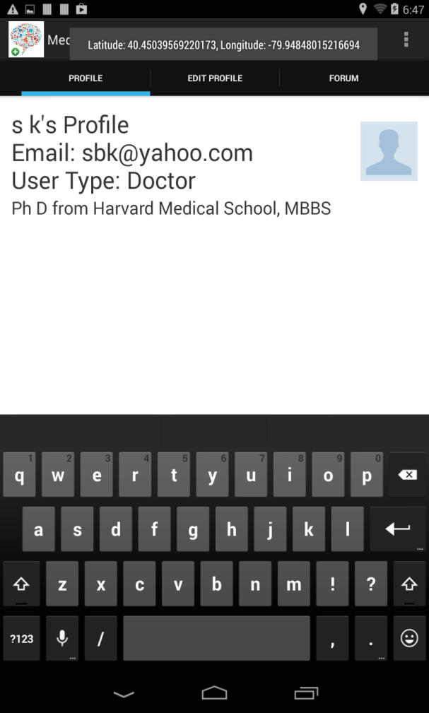
Depending on the user type, the app will redirect the user to the Patient Profile page or Doctor Profile page.
Doctor Profile
Patient Profile

Slide 14
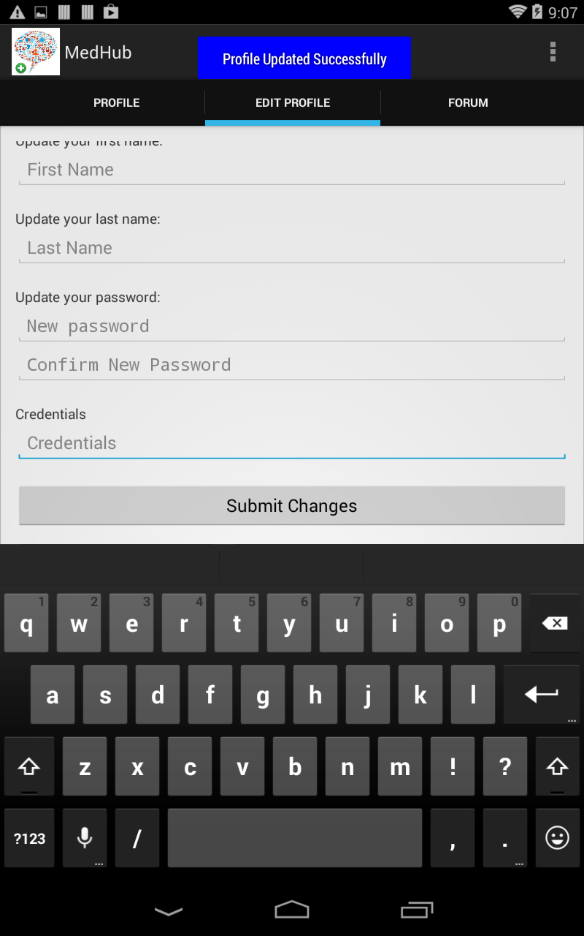
Users can edit their profile. A toast message will notify them of successful updates.
Patient can edit medical bio, doctor can edit credentials.

Slide 15
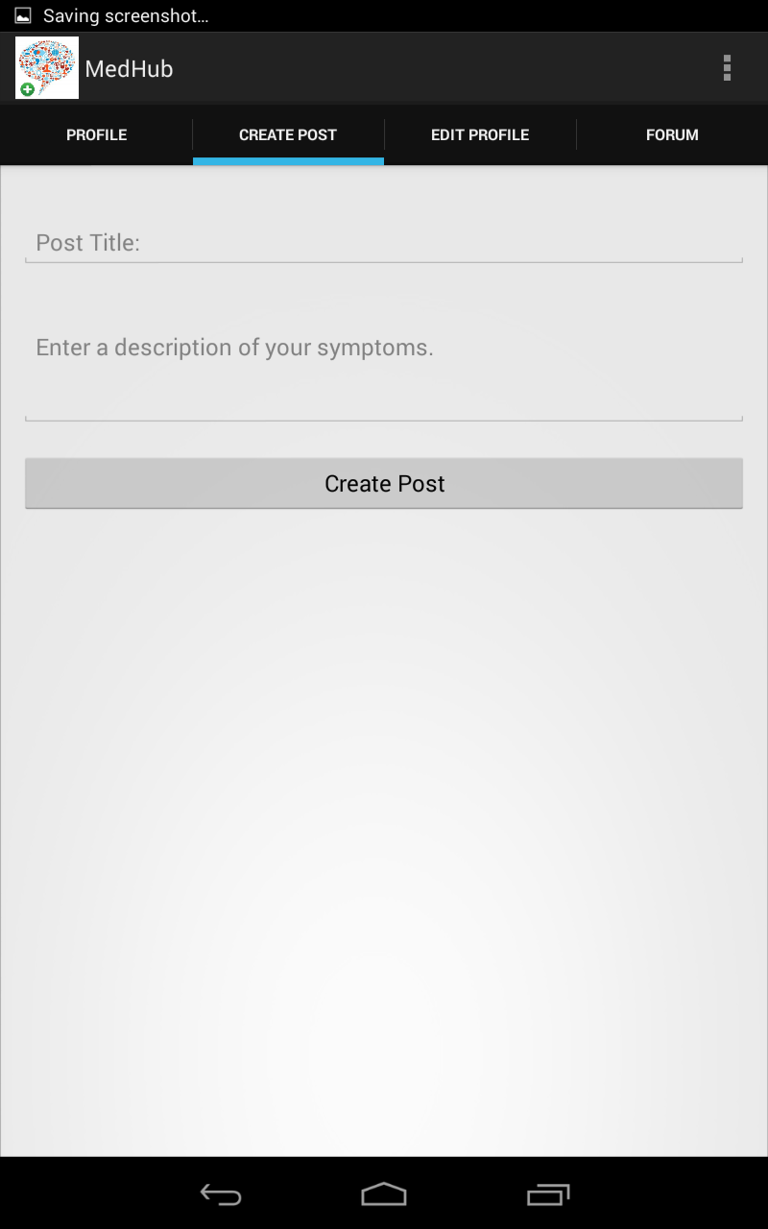
Patients can also post symptoms to the public forums.

Slide 16
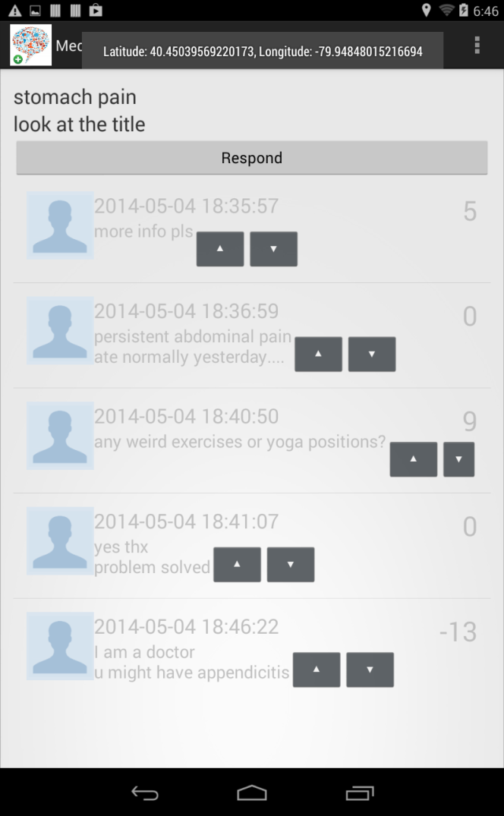
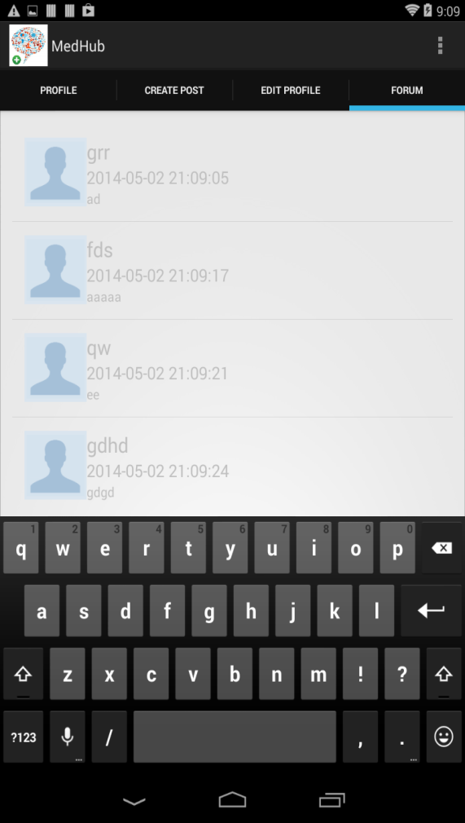
Afterwards, patients can go to the public forum page to check responses to their queries.

Slide 17
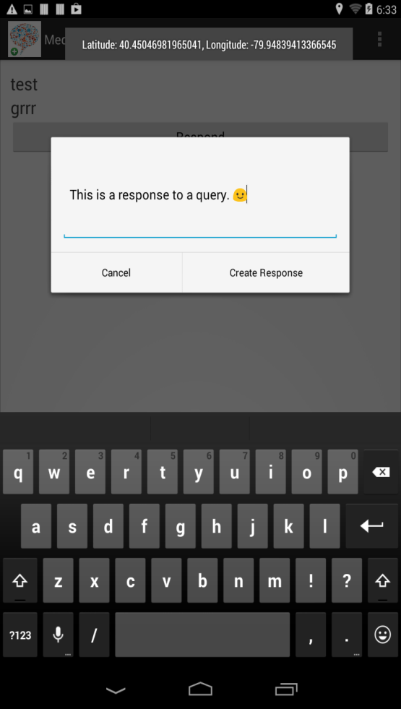

Users (doctors and patients) can respond to posts in the public forum.

Slide 18
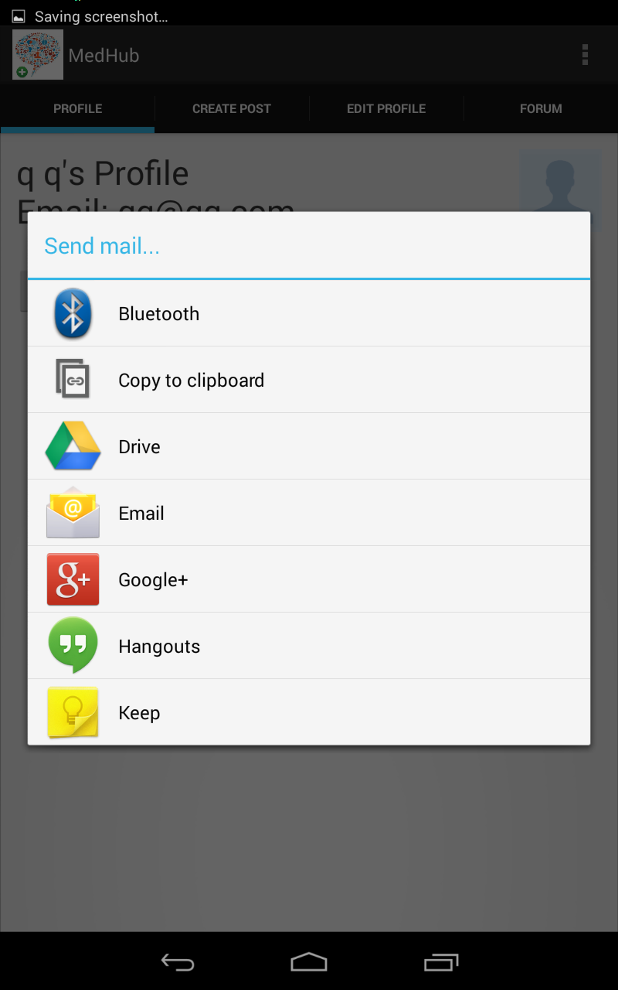
In addition, patients can choose to share their medical bio with a doctor privately via email

Slide 19

All users can rank responses to posts using the “UpVote” and “DownVote” buttons.

Slide 20
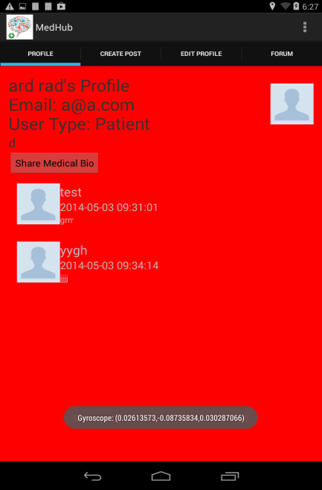
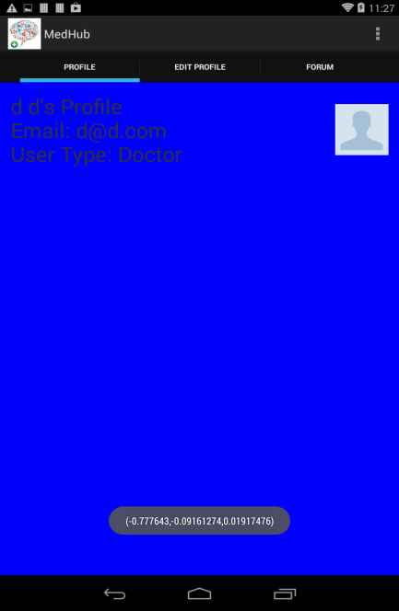
Accelerometer detects shake intensity. This would ideally indicate level of physical activity.
Red background = light activity, blue = moderate, green = intense
Works w/ gyroscope

Slide 21


Slide 22

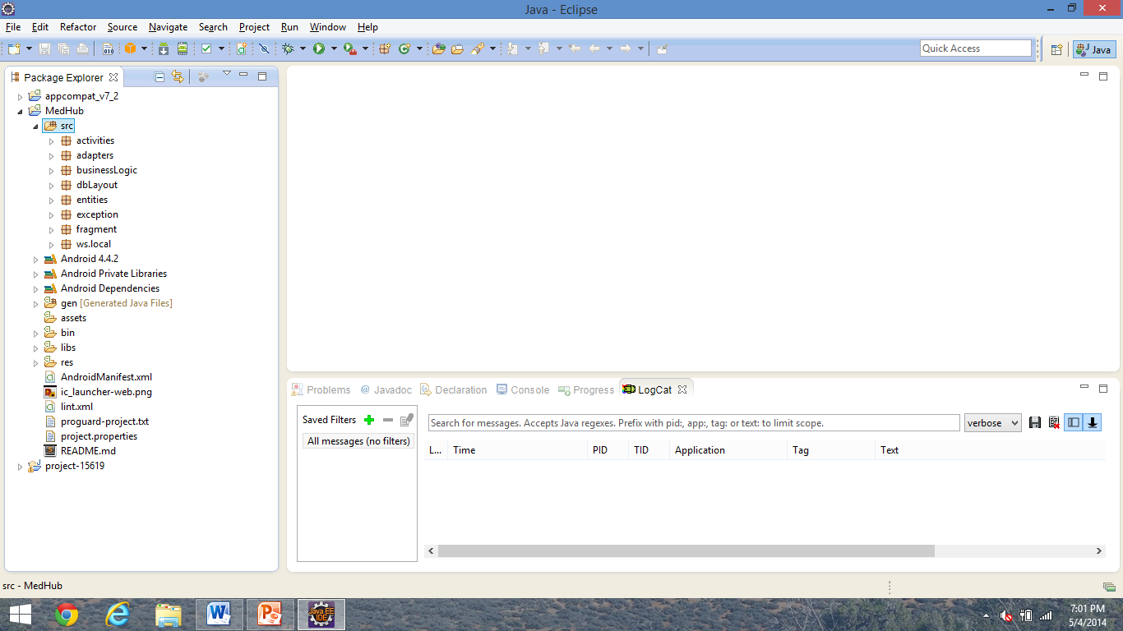

Slide 23

activities – the Activities (screens)
adapters – interact with Activities to bring UI to life (tabs, custom list items in list view)
fragments – Fragments within the Activities
exception – Custom exception handling class
entities – Local containers to store information to/fro the database
dbLayout – TableManagers to mediate db interactions
businessLogic – handlers that actually deal with UI interactions
ws.local – interface with Sensors and Location services (all local services); also includes SMSManager

Slide 24

Encapsulation – All of the activities and fragments generally forward requests for action to the handlers, which do the real work.
  Similar to how our calls to BuildAuto’s methods actually got ProxyAutomobile to do the real work
Interfaces and abstract classes
  Use interfaces to plan out method structure within classes and summarize them.
  Use abstract classes to specify partial implementations for methods common to all children while leaving others open to interpretation.

Slide 25

Avoid static variables, inner classes, and strong composition.
  Weak composition is better.
  Want to avoid unnecessary dependencies between Objects – can make code harder to understand and maintain.
Observer pattern
Facade pattern
  encapsulation at its finest

Slide 26

Questions?

