Slide 1

BioPathNet++ for Autoimmune Diseases
UE23CS441A– Capstone Project Phase – 3
Project Progress Review 3
Project Title: BioPathNet++ for Autoimmune Diseases: Path-Based Transfer Learning for Rare Disease Drug Repurposing
Project ID: PW26_PH_03
Project Guide: Dr. Priyanka H, Associate Professor
Project Team: TVNS Yatin (PES1UG23CS643), Srijan Jha (PES1UG23AM316),
A Charan KR (PES1UG23CS101), Praveen Kumar Yadav (PES1UG23CS449)
Notes:
Introduce the team and the project. One sentence: we rank existing drugs for rare autoimmune diseases whose treatments a model has never seen, and we made sure the evaluation is leakage-free.

Slide 2
BioPathNet++ for Autoimmune Diseases
Outline
1
Abstract
7
Applicability to other domains
2
Suggestions from Review 2 and key changes
8
Timeline and report status
3
Implementation details
9
Conclusion and future work
4
Project demonstration
10
IEEE drafts and target venues
5
Test plan and strategy
11
References
6
Results and discussion

Slide 3
BioPathNet++ for Autoimmune Diseases
Abstract
Problem. Rare autoimmune diseases (PBC, systemic sclerosis, Sjögren, autoimmune hepatitis, myasthenia gravis, Crohn) have few approved drugs. Repurposing must work zero-shot: rank existing drugs for a disease whose treatments the model has never seen.
Approach. BioPathNet++: a path-based graph neural network (Neural Bellman-Ford) on PrimeKG (129,375 nodes, 4 million edges) plus a leakage-free transfer channel, trained on free Kaggle T4 GPUs.
Rigour. An audit showed our earlier near-perfect scores came from leakage. We rebuilt everything: strict-family hold-out, full ranking of all 7,957 drugs, six baselines, 3 seeds, paired tests, TxGNN head-to-head, five validation layers.
Scope. Ranked hypotheses for expert review, not treatment advice.
76%
unseen test diseases with an approved drug in the top 10
best baseline 57%, random 0.8%
0.501 vs 0.392
MRR vs best baseline (68 test diseases)
p = 0.003, 3 seeds
7,957
drugs ranked for every disease
Notes:
Key message: a leakage-controlled, path-based model that beats every baseline on diseases it has never seen.

Slide 4
BioPathNet++ for Autoimmune Diseases
Suggestions from Review - 2
Panel remarks (Review 2)
Key changes made in Phase 3
[Add the panel's remarks from Review 2 and our response to each.]
Audited the earlier pipeline: its AUPRC 0.935-0.999 came from leakage (277/277 test pairs were graph edges; a no-learning degree rule scored AUROC 0.972). Those numbers are withdrawn.
Rebuilt on PrimeKG with a strict-family zero-shot protocol and full ranking.
Added six baselines, 3 seeds, paired tests and a selection-free test split.
Head-to-head with TxGNN on TxGNN's own split; five validation layers.
IEEE conference and journal drafts; college Turnitin similarity 0%.
Notes:
Fill in the panel's actual Review-2 remarks in the yellow box before presenting.

Slide 5
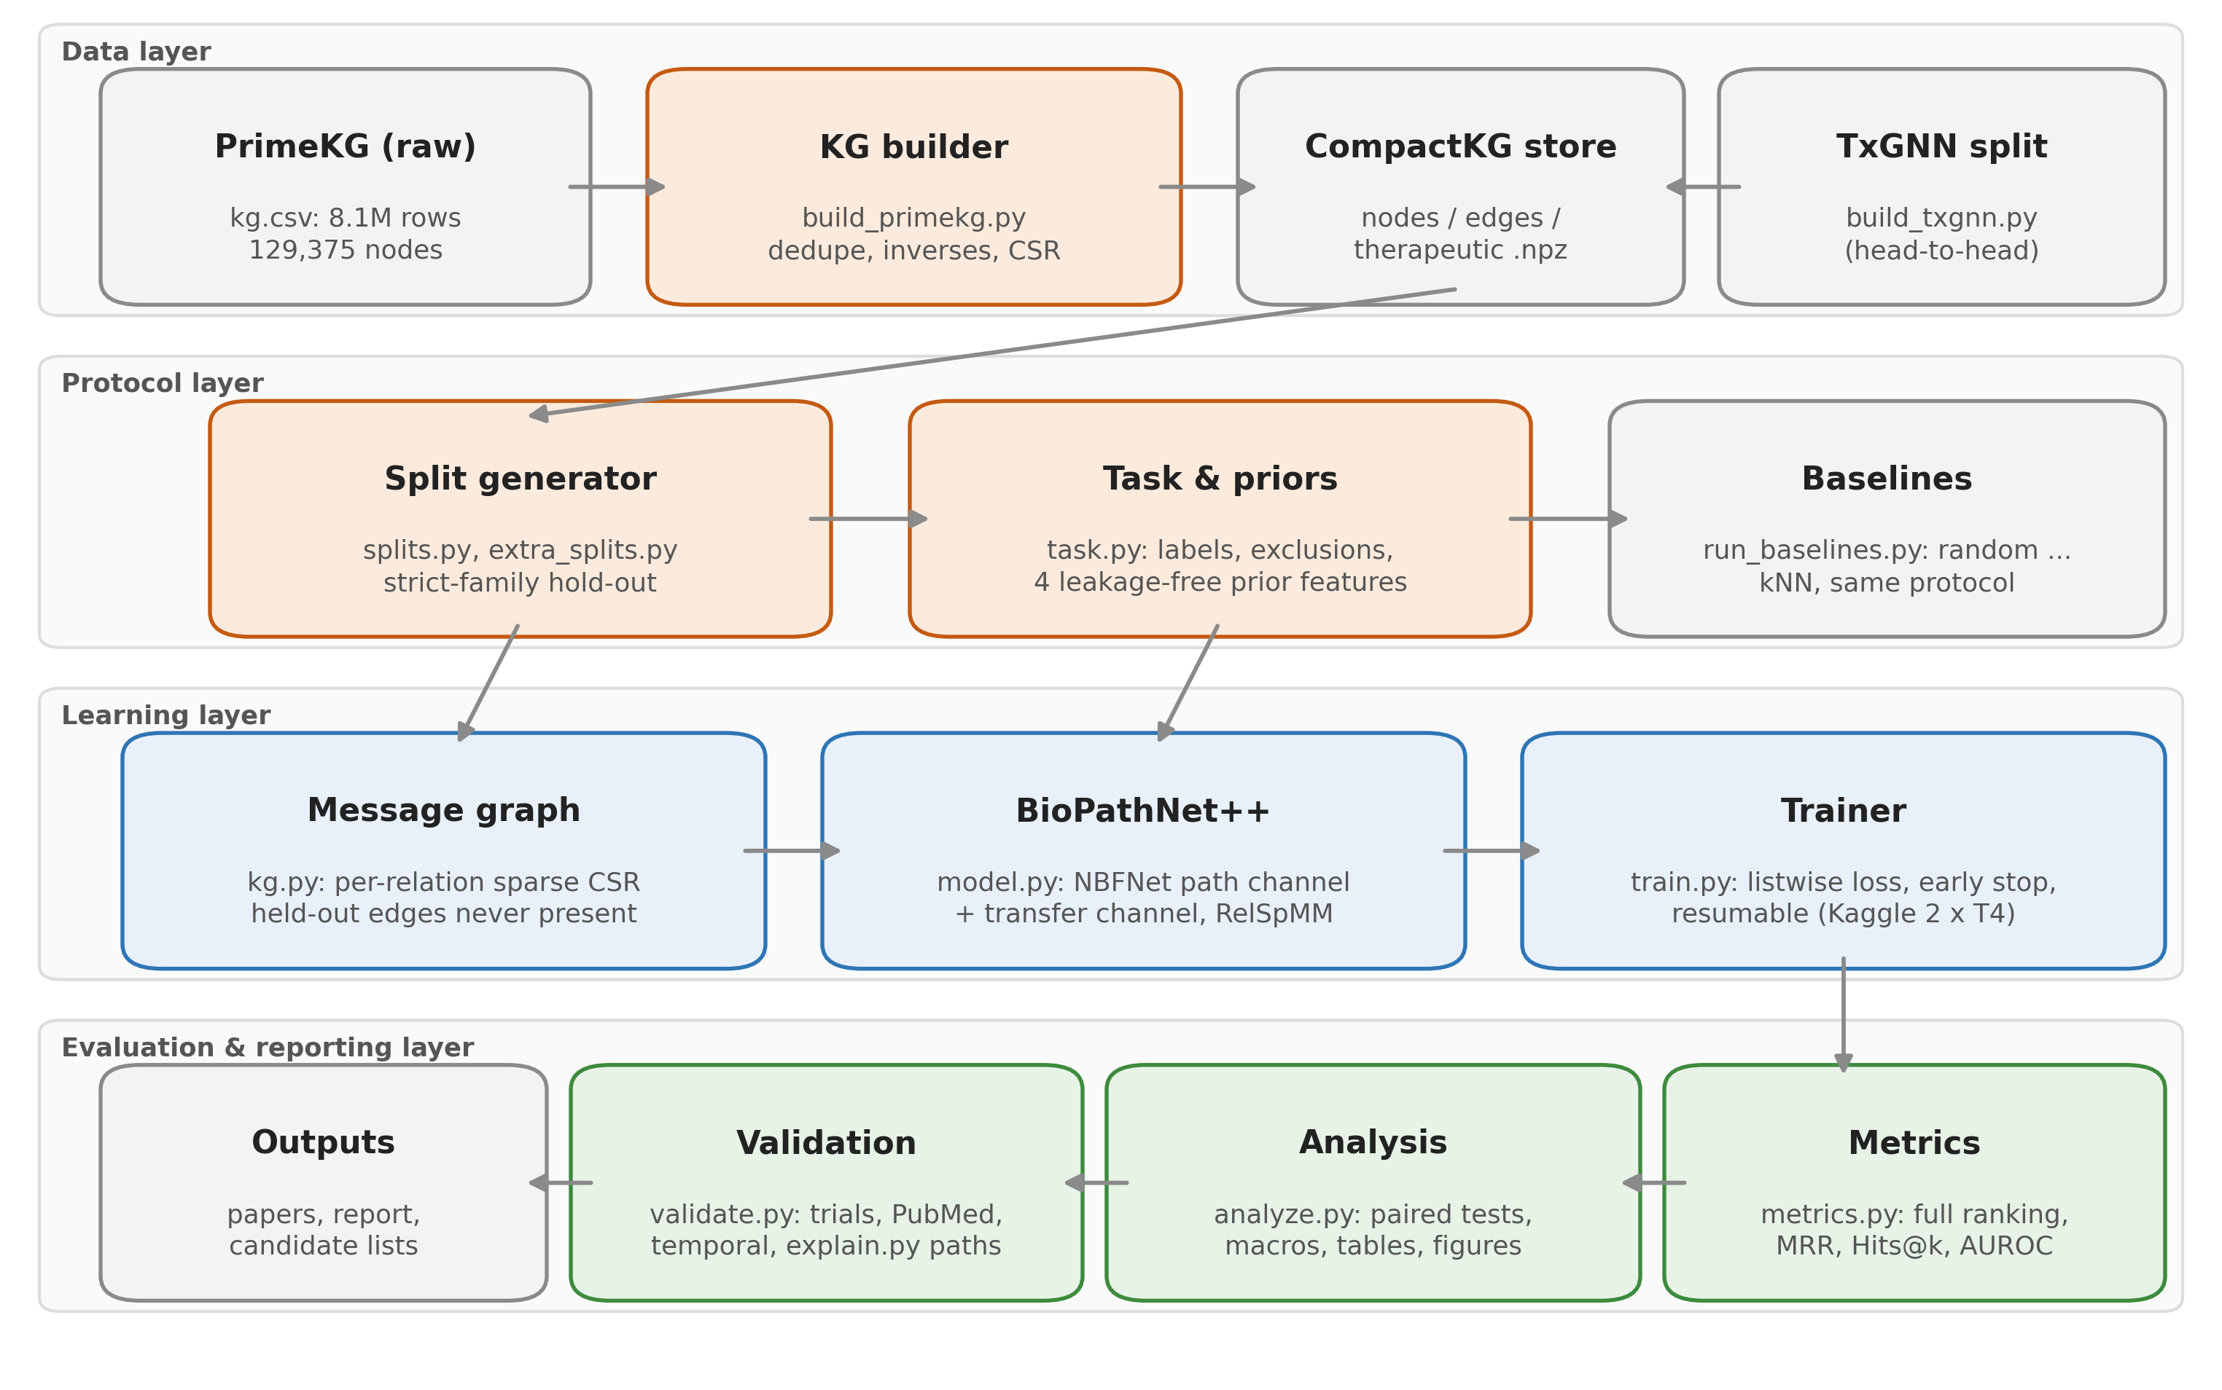
BioPathNet++ for Autoimmune Diseases
Implementation Details: System Architecture
Technology
Python 3.13, PyTorch sparse CSR
PrimeKG knowledge graph (Harvard)
Kaggle notebooks, 2 x NVIDIA T4
pytest, Git / GitHub
DGL 2.4 in a separate env (TxGNN)
ClinicalTrials.gov and PubMed APIs
Package bpp: 19 modules, about 3,900 lines; every paper number is generated from run logs.
Notes:
Four layers: data, protocol (what is held out), learning, evaluation and reporting.

Slide 6
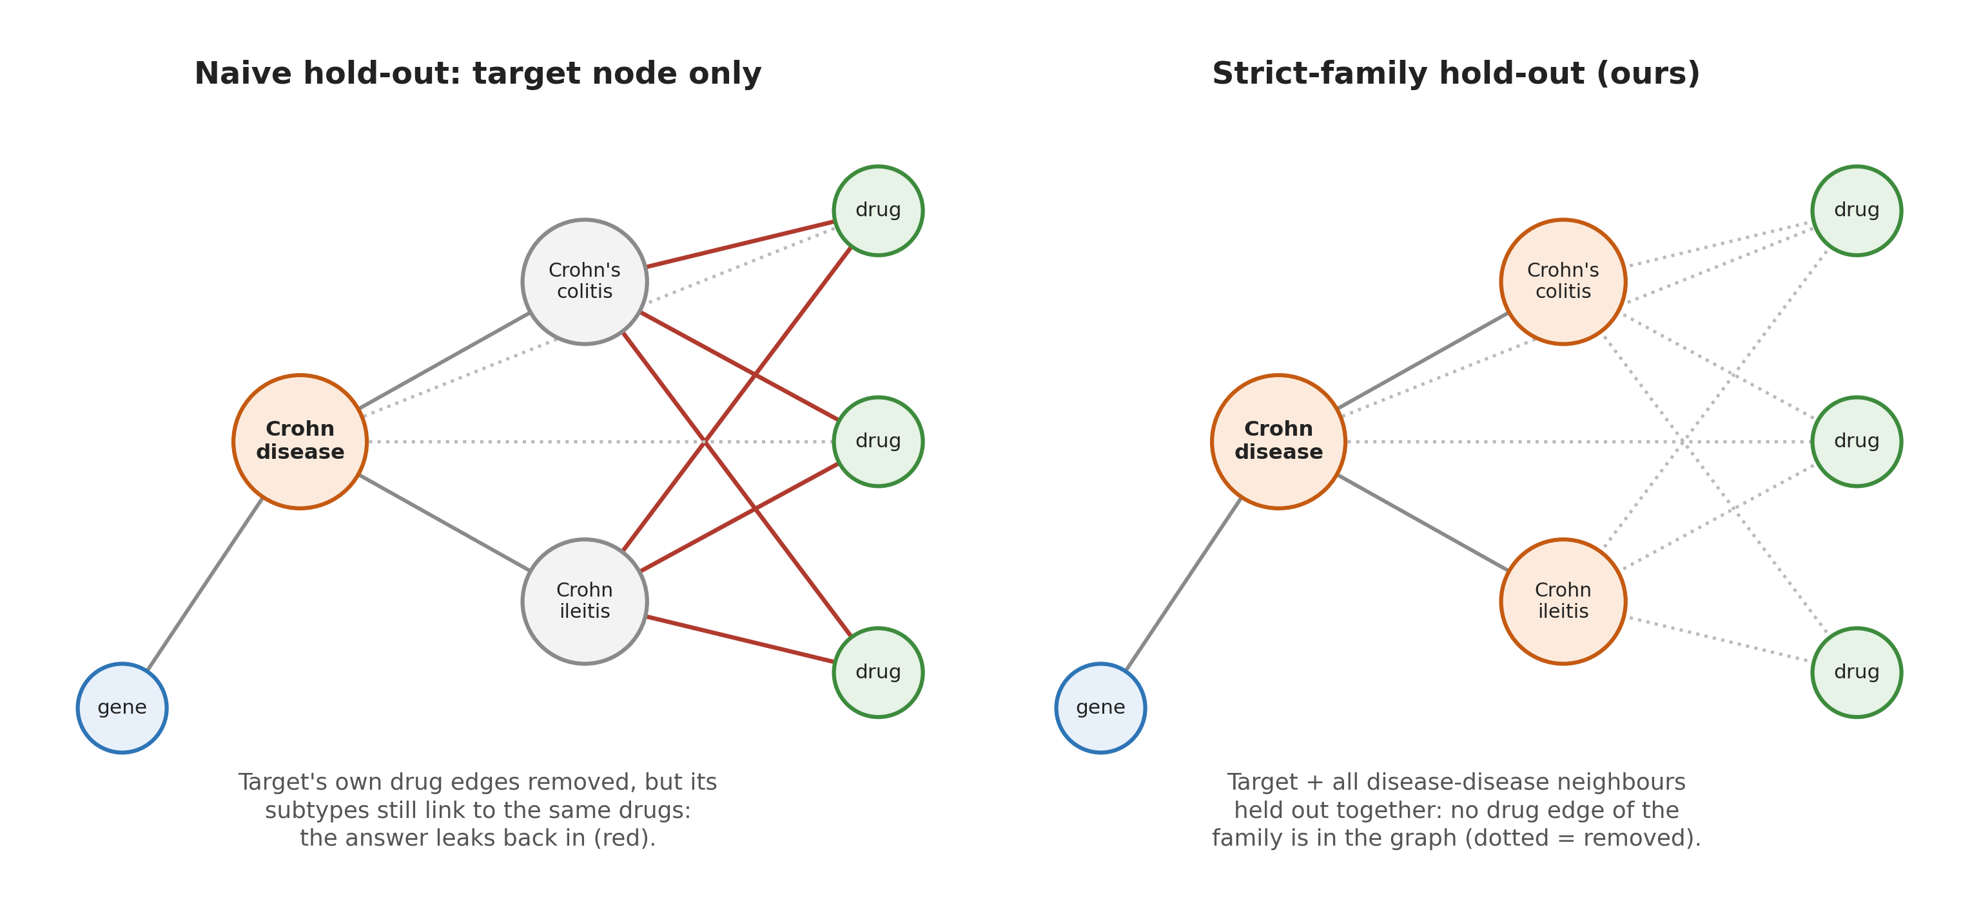
BioPathNet++ for Autoimmune Diseases
Implementation Details: Leakage-Free Protocol
Why: audit of the old pipeline
277 / 277
test pairs were edges of the graph
0.972
test AUROC of a no-learning degree rule (model 0.941)
5 / 6
A disease is held out together with its whole family (disease-disease neighbours). Without this, all 16 Crohn drugs stayed reachable via "Crohn's colitis".
targets unreachable: same drug ranked first everywhere
Notes:
This is the most important design decision: the evaluation, not the model, is what makes results trustworthy.

Slide 7
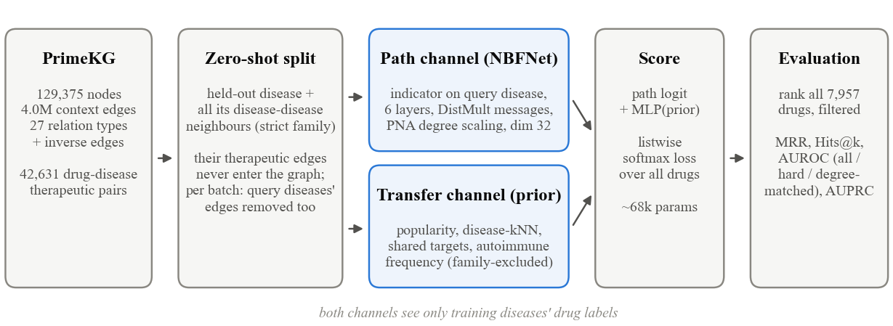
BioPathNet++ for Autoimmune Diseases
Implementation Details: Model
Path channel (NBFNet)
Memory trick (RelSpMM)
Transfer channel + loss
Starts at the query disease, 6 layers
Relation-specific DistMult messages
Scores all 7,957 drugs in one pass
Needs no embedding of the disease
60 sparse relation matrices
Recompute A_r H in backward pass
Memory O(V x B x d), not O(E x B x d)
Full 4M-edge graph: peak 5.8 GB on a T4
4 leakage-free priors (popularity, kNN,
shared targets, autoimmune frequency)
Listwise softmax over all drugs
68,226 parameters in total
Notes:
Path reasoning is inductive: a disease never seen in training is handled exactly like any other node.

Slide 8
BioPathNet++ for Autoimmune Diseases
Implementation Details: Algorithm and Modules
Training loop (pseudocode)
Module | Role
build_primekg.py | graph + splits (35 s)
splits.py | strict-family hold-out
task.py | labels, priors, baselines
model.py | RelSpMM, NBF layers
train.py | training, resume, early stop
metrics.py | full ranking, bootstrap
analyze.py | paired tests, paper numbers
validate.py | trials, PubMed, temporal
explain.py | path explanations
build_txgnn.py | TxGNN split converter
for epoch in 1..20:
for batch U of 8 training diseases:
G_b <- graph without drug edges of families(U)
h <- indicator on each u in U
for t in 1..6: h <- NBFLayer_t(h, G_b)
s <- MLP(h at all drugs) + g(prior(U))
loss <- listwise softmax(s, known drugs)
backward; clip; Adam step
validation MRR -> best.pt; last.pt
stop after 6 epochs without gain
Notes:
Each batch removes its own diseases' drug edges, so training mirrors the zero-shot test condition.

Slide 9
BioPathNet++ for Autoimmune Diseases
Project Demonstration
Example output: Myasthenia gravis (never seen in training)
Why pyridostigmine? (path explanation)
Rank | Drug | Evidence
1 | Ambenonium | ★ known (PrimeKG)
2 | Neostigmine | ★ known
3 | Pyridostigmine | ★ known, phase 3/4 trials
4 | Distigmine | ★ known
5 | Prednisolone | ★ known
7 | Amifampridine | new: phase-3 trial NCT03304054
myasthenia gravis → MUSK gene → neuromuscular junction disease → pyridostigmine
Gradient x input on every edge, then beam search for the strongest paths.
Live demo (laptop GPU)
python -m bpp.score --run <run> --out scores.npz
python -m bpp.explain --run <run> --out paths.json
Scoring reproduces the Kaggle top-10 lists on the laptop (17 of 18; one exact tie).
★ = drug PrimeKG lists for MG; ranks averaged over 3 seeds. The model saw none of MG's drug links.
Notes:
Show the ranked list and one explanation path. Training itself runs on Kaggle (2 to 4 hours per model), so the live part is scoring and explanation with a saved checkpoint.

Slide 10
BioPathNet++ for Autoimmune Diseases
Test Plan and Strategy
Test activity | What it checks
Unit tests (pytest, 9) | gradcheck, edge removal, reachability
Leakage assertions | no test pair reaches training
Reproducibility checks | Kaggle code = repo; resumed runs
Statistical testing | 3 seeds, bootstrap CI + Wilcoxon
Selection-free test split | 68 diseases never used to tune
Local rehearsal | TxGNN pipeline on mini PrimeKG
External validation | trials, PubMed, later approvals
Why this approach
A research model fails silently: leakage gives great numbers, so tests target leakage and statistics.
Environment
Laptop (RTX 3050) for build, tests, analysis; Kaggle 2 x T4 for training.
Team roles
[Fill in each member's testing role]
Drawback
Small rare-disease sets give low statistical power.
Notes:
Every downloaded Kaggle result was verified against the repository code and logs before use.

Slide 11
BioPathNet++ for Autoimmune Diseases
Results and Discussion: Accuracy on Unseen Diseases
Gain over the best baseline: +0.109 MRR (95% CI +0.044 to +0.180, p = 0.003, 3 seeds). Validation diseases agree: 0.394 vs 0.281 (p < 0.001). Median rank of a known drug: 2 of 7,957.
Notes:
These 68 test diseases were never used for training or for choosing the stopping epoch.

Slide 12
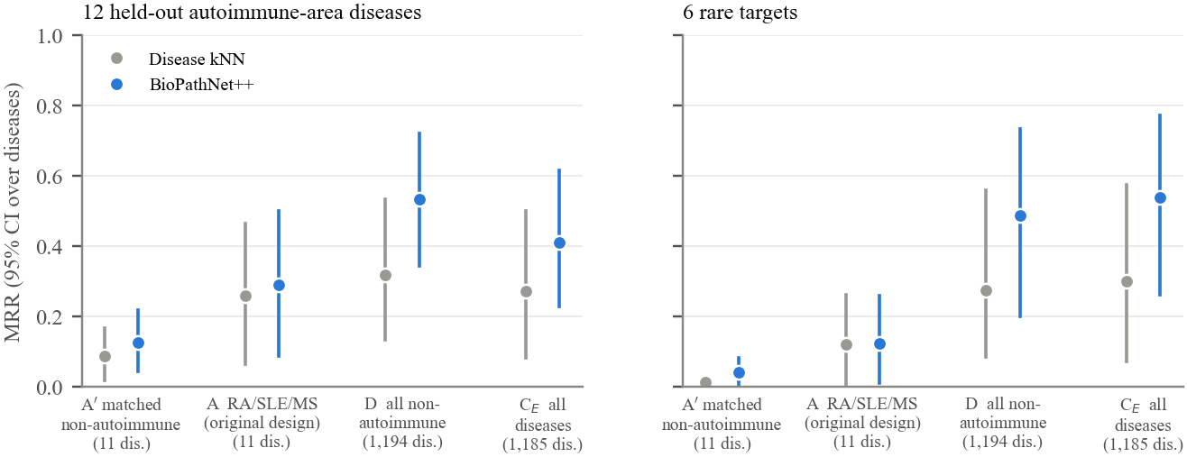
BioPathNet++ for Autoimmune Diseases
Results and Discussion: Source of Transfer (Aim 1)
Scarce data
RA/SLE/MS: 0.290 vs matched controls 0.126 (p = 0.016).
But paths alone: 0.007 vs 0.010, so the gain is a drug-class prior.
Full scale
Adding autoimmune data lowers MRR: 0.410 vs 0.532 (p = 0.010, 3 seeds).
Rare targets unchanged without them (0.487 vs 0.475).
MRR on 12 held-out autoimmune diseases (left) and the 6 rare targets (right) by training data. A' = 11 non-autoimmune diseases matched on number of labels.
Notes:
Answer to Aim 1: related autoimmune diseases help only when data is scarce; at full scale the broad graph is the better source, and adding autoimmune diseases even lowers MRR on E. Disease kNN drops the same way, and both conditions stop on the same validation set.

Slide 13
BioPathNet++ for Autoimmune Diseases
Results and Discussion: Component Analysis (Aim 3)
Path reasoning carries the accuracy: without it MRR drops to 0.306 (p < 0.001).
Transfer channel = stability: mean unchanged (p = 0.15), target sd 0.087 → 0.017 across seeds.
Loss choice is a tie: BCE 0.378 vs listwise 0.394 (p = 0.34).
72% of edges are redundant: 4.0M → 1.1M edges, same MRR, 11% faster.
Notes:
Honest reading: the ++ adds stability, not accuracy. Paths-only versus full model is a statistical tie.

Slide 14
BioPathNet++ for Autoimmune Diseases
Results and Discussion: Head-to-Head with TxGNN
TxGNN's own split and code, 13 test diseases, 3 seeds each; our model trained only on edges TxGNN also trains on. Why the protocols disagree: only 23% of TxGNN's top-100 drugs have any indication (ours 99%); TxGNN's protocol filters those drugs out.
Notes:
Our re-implementation of TxGNN's evaluation reproduces TxGNN's own numbers exactly. One split, 13 diseases: a first data point, not a final ranking.

Slide 15
BioPathNet++ for Autoimmune Diseases
Results and Discussion: Case Studies (Top 5 per Target)
Rank | PBC | SSc | Sjögren | AIH | MG | Crohn
1 | Ursodeoxycholic acid★ | Benzoic acid★ | Propylene glycol★ | Prednisolone | Ambenonium★ | Hydrocortisone★
2 | Cholic acid | Aminobenzoic acid★ | Lifitegrast | Triamcinolone | Neostigmine★ | Cortisone acetate★
3 | Doripenem | Prednisolone [B] | Povidone★ | Hydrocortisone acetate | Pyridostigmine★ | Triamcinolone★
4 | Homatropine | Triamcinolone | Povidone K30★ | Sulfacetamide | Distigmine★ | Prednisolone★
5 | Ampicillin | Betamethasone | Prednisolone★ | Hydrocortisone | Prednisolone★ | Ofloxacin
★ known in PrimeKG; [A]/[B] phase 3-4 / phase 2 trial that tests the drug in the disease; rank averaged over 3 seeds
PBC
First-line drug ursodeoxycholic acid ranked #1 in every seed.
MG
4 cholinesterase inhibitors at #1-4; amifampridine (#7) has a phase-3 MG trial.
AIH
Label gap: model's #1 prednisolone is standard therapy, but PrimeKG lists one other drug.
Notes:
Full top-10 lists with trial grades are in the report (Tables 8.7 and 8.8). Corticosteroids dominate: a known popularity bias we report.

Slide 16
BioPathNet++ for Autoimmune Diseases
Results and Discussion: Validation of New Candidates
Temporal check
6 drugs approved after the data snapshot rank at a median of 1,104 / 7,957 (top 14%); risankizumab for Crohn ranks #37. Not significant (p = 0.11).
Honest reading
Candidates are plausible (13% have a trial testing the drug vs 0% for random drugs) but only modestly ahead of popular drugs. Clinician review is the next step.
Notes:
Trials count only if they test the drug (title or some-but-not-all arms), so background steroids are excluded. Literature labels were AI-assisted and checked against abstracts; a clinician has not reviewed them.

Slide 17
BioPathNet++ for Autoimmune Diseases
Applicability to Other Domains
Domain | Common problem | What changes | Data source
Other rare disease areas | few known drugs per disease | only the held-out set | PrimeKG
Drug side effects | predict unseen drug-effect links | query relation | SIDER / PrimeKG
Drug-target discovery | new targets for a drug | source = drug node | DrugBank / PrimeKG
Clinical decision support | rank options with reasons | add path explanations UI | hospital KG
Auditing other KG models | leakage in evaluation | reuse protocol + baselines | any KG
Benefits: inductive (works for unseen nodes), explainable, fits on free GPUs. Feasibility: only the query relation and split change; code is relation-agnostic. Limits: needs a curated knowledge graph; incomplete labels lower measured accuracy.
Notes:
The method is general link prediction over a knowledge graph; the strict-family protocol is reusable anywhere.

Slide 18
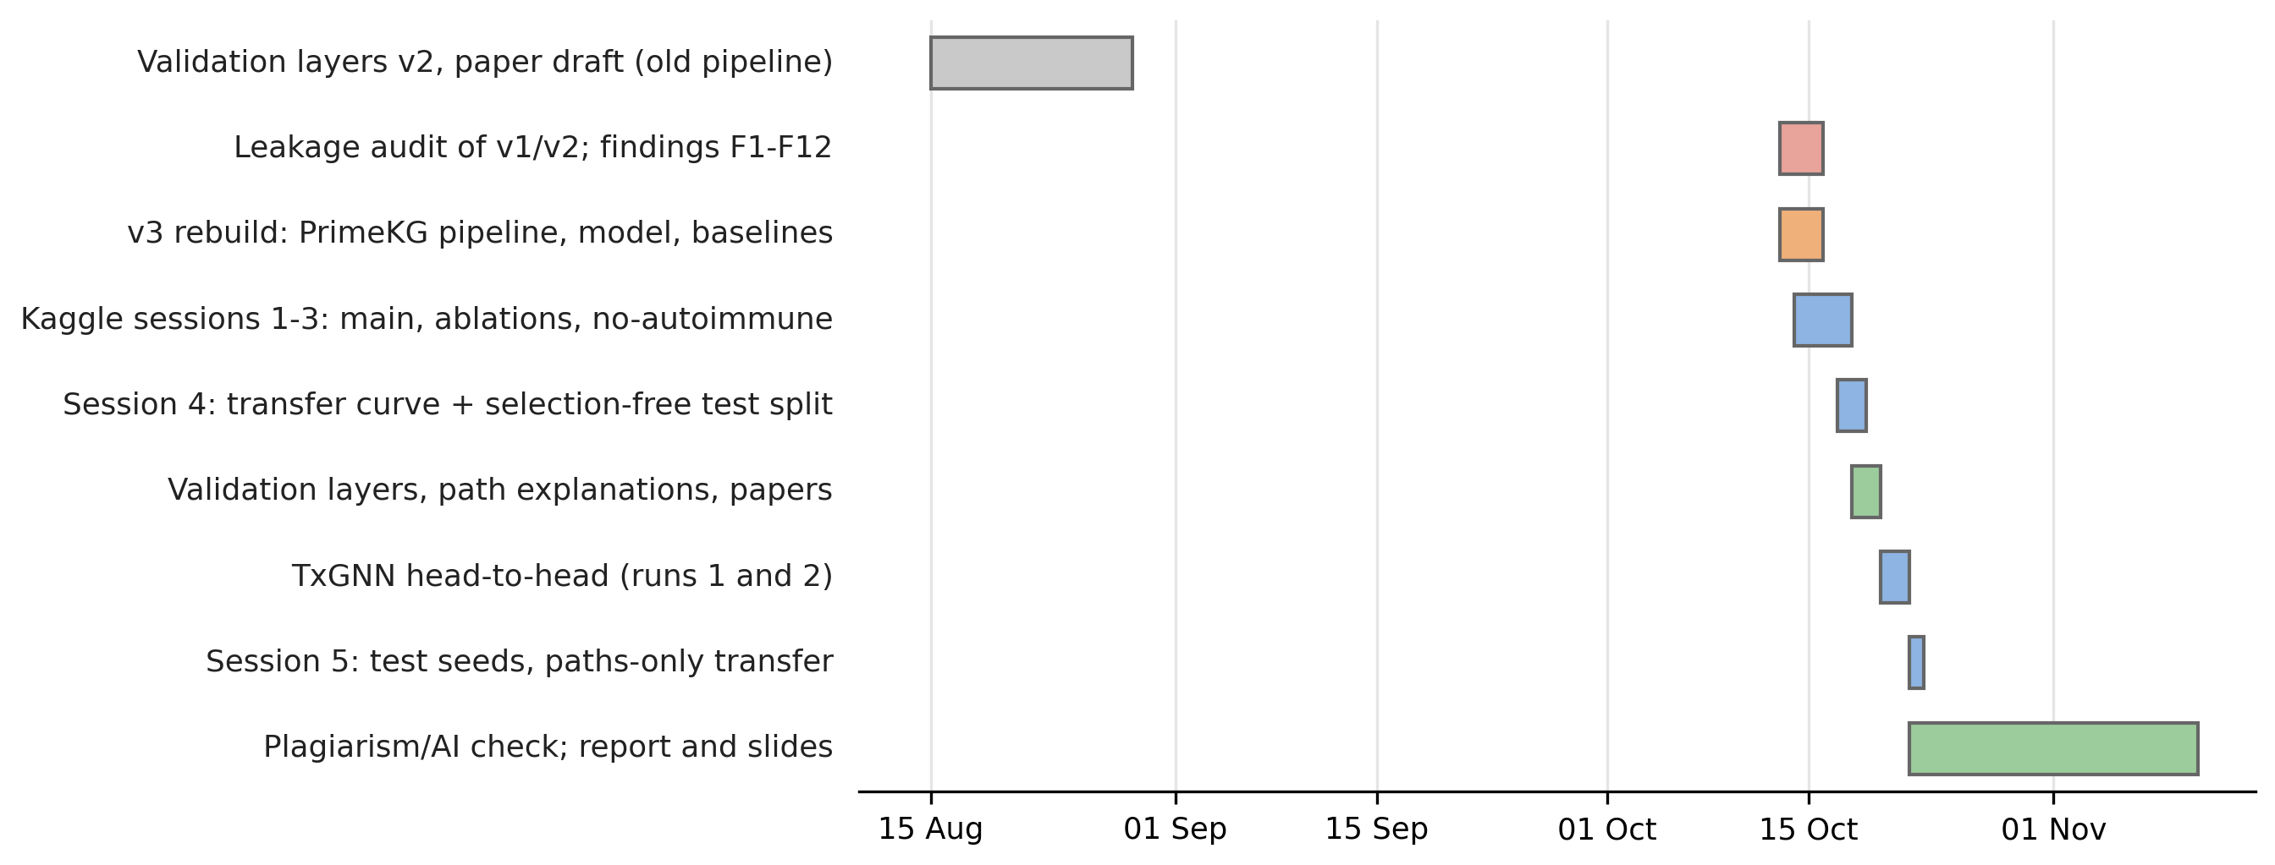
BioPathNet++ for Autoimmune Diseases
Timeline: Update on Tasks
Status
All planned experiments complete (7 Kaggle sessions)
Project report complete (56 pages, Phase-3 format)
IEEE conference paper: final draft
Journal manuscript: complete draft
Pending: clinician review of candidates
Notes:
Show the report to the panel here.

Slide 19
BioPathNet++ for Autoimmune Diseases
Conclusion and Future Work
Aim 2: accuracy
Beats every baseline on unseen diseases: 76% vs 57% approved drug in top 10.
Aim 1: transfer
Autoimmune data helps only when data is scarce; at full scale it even lowers MRR.
Aim 3: components
Paths carry accuracy; transfer channel adds stability; 72% of edges redundant.
Future work
Clinician review of top candidates with the prepared review sheet
KG-embedding baselines and BioPathNet's official code on the same split
TxGNN comparison on more disease areas; reduce the corticosteroid bias
Notes:
One line to close: rigorous evaluation turned an impressive but invalid result into a modest, trustworthy one.

Slide 20
BioPathNet++ for Autoimmune Diseases
IEEE Draft and Target Venues
Status of the drafts
Conference paper (IEEE, 5 pages): final draft
Journal manuscript (IEEE, about 11 pages): complete draft
College Turnitin check: 0% similarity; AI score below the reporting threshold
Every number generated from run logs
Title: BioPathNet++ for Autoimmune Diseases: Path-Based Transfer Learning for Rare Disease Drug Repurposing
Targeted venues (CFPs to be confirmed)
Conferences: IEEE CONECCT, IEEE INDICON, ICCCNT, InCoB 2027
Journals: Computers in Biology and Medicine, Journal of Biomedical Informatics, BMC Bioinformatics, IEEE Access, Scientific Reports
Notes:
Venue deadlines and indexing must be checked before submission.

Slide 21
BioPathNet++ for Autoimmune Diseases
References
[1] E. Y. Hu et al., "Enhancing link prediction in biomedical knowledge graphs with BioPathNet," Nature Biomedical Engineering, vol. 10, pp. 1747-1769, 2026.
[2] K. Huang et al., "A foundation model for clinician-centered drug repurposing," Nature Medicine, vol. 30, pp. 3601-3613, 2024.
[3] P. Chandak, K. Huang and M. Zitnik, "Building a knowledge graph to enable precision medicine," Scientific Data, vol. 10, p. 67, 2023.
[4] Z. Zhu, Z. Zhang, L.-P. Xhonneux and J. Tang, "Neural Bellman-Ford networks: A general graph neural network framework for link prediction," in NeurIPS, 2021.
[5] S. Kapoor and A. Narayanan, "Leakage and the reproducibility crisis in machine-learning-based science," Patterns, vol. 4, p. 100804, 2023.
[6] G. Brière, T. Stosskopf, B. Loire and A. Baudot, "Benchmarking the impact of data leakage on the performance of knowledge graph embedding models for biomedical link prediction," Bioinformatics, vol. 42, p. btag608, 2026.
[7] D. S. Himmelstein et al., "Systematic integration of biomedical knowledge prioritizes drugs for repurposing," eLife, vol. 6, p. e26726, 2017.
[8] S. Pushpakom et al., "Drug repurposing: progress, challenges and recommendations," Nature Reviews Drug Discovery, vol. 18, pp. 41-58, 2019.
Notes:
The full list of 34 references is in the report.

Slide 22
Thank You

