Slide 1
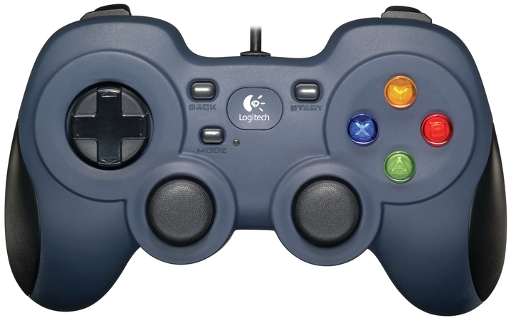
Instructions for Robot Platform Driver
Left Trigger
Left Bumper
Right Trigger
Right Bumper
Left Trigger, Right Trigger & A is to move robot into Substation Pickup (*** robot has to stay close to your alliance zone for auto positioning)
Left Trigger, Right Trigger & X is to stop both platform & Tophat
Left Stick X&Y and Right Stick X is for Platform Navigation Manually
Left Bumper, Right Bumper, Left Trigger, Right Trigger & X is Robot Reset
Left Trigger, Right Trigger & Y to put robot Tophat in navigation mode
Left Trigger, Right Trigger & B is to turn robot left into 180 degrees
Left Trigger, Right Trigger & DPADUP is to increase the Tophat Speed
Left Trigger, Right Trigger & DPADDOWN is to decrease the Tophat Speed
Left Bumper & A is for left ground junction position
Right Bumper & A is for right ground junction position
Left Bumper & X is for left low junction position
Right Bumper & X is for right low junction position
Left Bumper & B is for left medium junction position
Right Bumper & B is for right medium junction position
Left Bumper & Y is for left high junction position
Right Bumper & Y is for right high junction position
Right Bumper, Left Bumper & A is for center ground junction/intake position
Right Bumper, Left Bumper & B is for center medium junction position
Right Bumper, Left Bumper & X is for center low junction position
Right Bumper, Left Bumper & Y is for center high junction position
DPAD
UP
Y
X
LEFT
RIGHT
B
DOWN
+Y
+Y
A
-X
+X
-X
+X
-Y
-Y
Left Stick
Right Stick

Slide 2
Instructions for Robot Top Hat Driver - Basic
Left Trigger
Left Bumper
Right Trigger
Right Bumper
Left Trigger – Move Turn Table Left
Right Trigger – Move Turn Table Right
Left Stick Y – Move Arm Up & Down
Right Stick Y – Move Elbow Up & Down
DPAD UP – Move Wrist Up
DPAD DOWN – Move Wrist Down
DPAD LEFT – Close Claw
DPAD RIGHT – Open Claw
Left Bumper & X is for left ground junction position
Right Bumper & X is for right ground junction position
Left Bumper & A is for left low junction position
Right Bumper & A is for right low junction position
Left Bumper & B is for left medium junction position
Right Bumper & B is for right medium junction position
Left Bumper & Y is for left high junction position
Right Bumper & Y is for right high junction position
DPAD
UP
Y
X
LEFT
RIGHT
B
DOWN
+Y
+Y
A
-X
+X
-X
+X
-Y
-Y
Left Stick
Right Stick

Slide 3
Instructions for Robot Top Hat Driver - Advanced
Left Trigger
Left Bumper
Right Trigger
Right Bumper
Left Trigger & X to substation pickup to drop in High Junction
Right Trigger & X to substation pickup to drop in Medium Junction
Left Trigger, Right Trigger & X to substation pickup and ready for Navigation
Left Bumper, Right Bumper & Y is to pickup from substation and preset for high junction drop
Left Trigger, Right Trigger & Y is to pickup from substation and drop in high junction continuously
Left Bumper, Right Bumper & B is to pickup from substation and preset for medium junction drop
Left Trigger, Right Trigger & B is to pickup from substation and drop in medium junction continuously
DPAD
UP
Y
X
LEFT
RIGHT
B
DOWN
+Y
+Y
A
-X
+X
-X
+X
-Y
-Y
Left Stick
Right Stick

