Slide 1
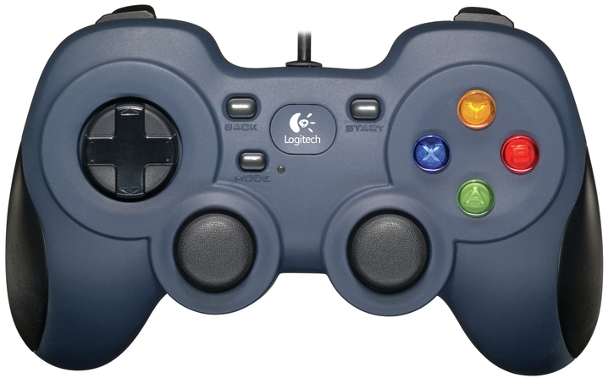
Instructions for Robot Platform Driver
Left Trigger
Left Bumper
Right Trigger
Right Bumper
Left Trigger – Robot Backward
Right Trigger – Robot Forward
Left Bumper & Left Stick +Y – Robot to Left Diagonal Up
Left Bumper & Left Stick -Y – Robot to Left Diagonal Down
Right Bumper & Right Stick +Y – Robot to Right Diagonal Up
Right Bumper & Right Stick +Y – Robot to Right Diagonal Down
Right Stick +X – Robot to Right
Right Stick -X – Robot to Left
Left Stick +X – Robot to Right Turn
Left Stick -X – Robot to Left Turn
B – Enable Turbo Speed Mode
X – Disable Turbo Speed Mode
Y – Red Alliance Carousel
A – Blue Alliance Carousel
DPAD
UP
Y
X
LEFT
RIGHT
B
DOWN
+Y
+Y
A
-X
+X
-X
+X
-Y
-Y
Left Stick
Right Stick

Slide 2
Instructions for Robot Top Hat Driver
Left Trigger
Left Bumper
Right Trigger
Right Bumper
Right Stick –X – Intake Low Speed
Right Stick +X – Outtake Low Speed
Y – Set arm to drop at Shipping Hub - Top Level
B – Set arm to drop at Shipping Hub - Middle Level
A – Set arm to drop at Shipping Hub - Bottom Level
X – Set arm for freight collection in warehouse & Shared Shipping Hub delivery
DPAD DOWN – Set arm for Intake height
DPAD LEFT – Turn robot arm to the left
DPAD RIGHT – Turn robot arm to the right
DPAD UP – Turn robot arm to the front
DPAD UP & Left Bumper – Shipping Hub - Top Level
DPAD RIGHT & Left Bumper – Shipping Hub - Middle Level
DPAD LEFT & Left Bumper – Shipping Hub - Lowest Level
DPAD DOWN & Left Bumper – Shared Shipping Hub
DPAD
UP
Y
X
LEFT
RIGHT
B
DOWN
+Y
+Y
A
-X
+X
-X
+X
-Y
-Y
Left Stick
Right Stick

Slide 3
Instructions for Robot Platform Driver – Manual Overrides
Left Trigger
Left Bumper
Right Trigger
Right Bumper
Left Bumper & Left Stick +X – Manual Carousel Left
Left Bumper & Left Stick -X – Manual Carousel Right
DPAD UP – Reset Wheel, Arm, Turn Table & IMU Encoders
Left Bumper, Right Bumper, Left Trigger & Right Trigger – Reset Position
DPAD
UP
Y
X
LEFT
RIGHT
B
DOWN
+Y
+Y
A
-X
+X
-X
+X
-Y
-Y
Left Stick
Right Stick

Slide 4
Instructions for Robot Top Hat Driver - Configuration
Left Trigger
Left Bumper
Right Trigger
Left Trigger – Move Arm Forward
Right Trigger – Move Arm Backward
Right Stick –X – Intake Low Speed
Right Stick +X – Outtake Low Speed
Y – Set Arm to drop at Shipping Hub Top Shelve
B – Set Arm to drop at Shipping Hub Middle Shelve
A – Set Arm to drop at Shipping Hub Bottom Shelve
X – Set Arm for warehouse clearance & Ready for Intake
DPAD DOWN – Set Arm for Intake height
DPAD LEFT – Turn on Auto Intake with Touch Sensor
DPAD RIGHT – Turnoff Auto Intake with Touch Sensor
Left Trigger & Bumper – Turn Table Left
Right Trigger & Bumper – Turn Table Right
Left Bumper & DPAD Up – Shipping Hub Lower Shelf
Left Bumper & DPAD Left – Shipping Hub Middle Shelf
Left Bumper & DPAD Right – Shipping Hub Intake Shelf
Left Bumper & DPAD Down – Shipping Hub Top Shelf & Shared Hub
Right Stick +X and Right Bumper – Tune Intake Box
Right Bumper
DPAD
UP
Y
X
LEFT
RIGHT
B
DOWN
+Y
+Y
A
-X
+X
-X
+X
-Y
-Y
Left Stick
Right Stick

