Slide 1
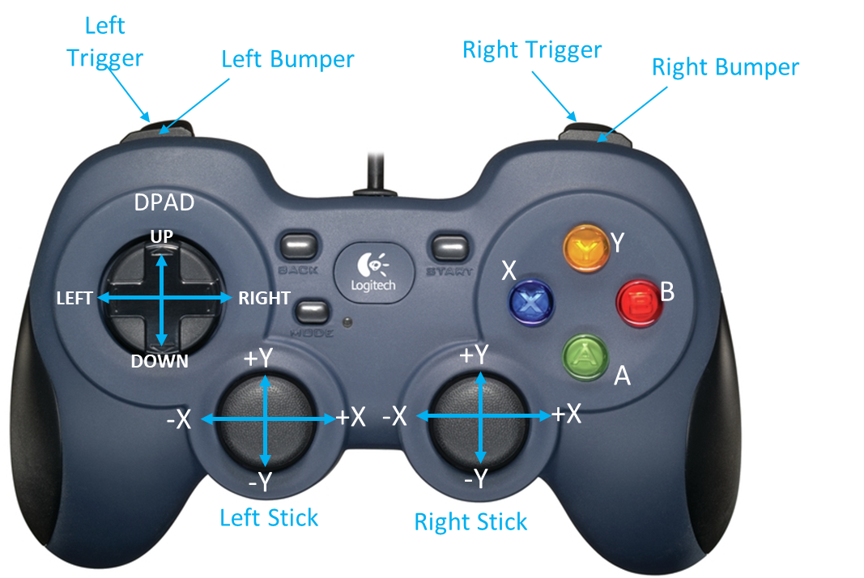
Instructions for Robot Platform Driver
Left Stick X&Y and Right Stick X is for Platform Navigation Manually
Left Trigger, Right Trigger & A is to move robot into Substation Pickup
Left Trigger, Right Trigger & X is to kill both platform & Tophat
Left Bumper, Right Bumper, Left Trigger, Right Trigger & X is Robot Reset
Left Trigger, Right Trigger & Y to put robot Tophat in navigation mode
Left Trigger, Right Trigger & B is to turn robot left into 180 degrees
Left Bumper & X is for left low junction position
Right Bumper & X is for right low junction position
Left Bumper & A is for left ground junction position
Right Bumper & A is for right ground junction position
Left Bumper & B is for left medium junction position
Right Bumper & B is for right medium junction position
Left Bumper & Y is for left high junction position
Right Bumper & Y is for right high junction position
Left Bumper, Right Bumper & X is for center ground junction/intake position
Left Bumper, Right Bumper & A is for center low junction position
Left Bumper, Right Bumper & B is for center medium junction position
Left Bumper, Right Bumper & Y is for center high junction position

Slide 2
Instructions for Robot Top Hat Driver
Left Bumper, Right Bumper and Left Trigger – Move Turn Table Left
Left Bumper, Right Bumper and Right Trigger – Move Turn Table Right
Left Bumper, Right Bumper and Left Stick Y – Move Arm Up & Down
Left Bumper, Right Bumper and Right Stick Y – Move Elbow Up & Down
Left Bumper, Right Bumper and DPAD UP – Move Wrist Up
Left Bumper, Right Bumper and DPAD DOWN – Move Wrist Down
Left Bumper, Right Bumper and DPAD LEFT – Close Claw
Left Bumper, Right Bumper and DPAD RIGHT – Open Claw
Left Trigger & X to substation pickup to drop in High Junction
Right Trigger & X to substation pickup to drop in Medium Junction
Left Trigger, Right Trigger & X to substation pickup and ready for Navigation
Left Bumper, Right Bumper & Y is to pickup from substation and preset for high junction drop
Left Trigger, Right Trigger & Y is to pickup from substation and drop in high junction continuously
Left Bumper, Right Bumper & B is to pickup from substation and preset for medium junction drop
Left Trigger, Right Trigger & B is to pickup from substation and drop in medium junction continuously
Left Trigger, Right Trigger & DPADUP is to increase the Tophat Speed
Left Trigger, Right Trigger & DPADDOWN is to decrease the Tophat Speed

