Slide 1

DEPARTMENT OF CSE (ARTIFICIAL INTELLIGENCE AND MACHINE LEARNING) ACADEMIC YEAR 2025 - 2026 SEMESTER III ARTIFICIAL INTELLIGENCE LABORATORY MINI PROJECT REVIEW EXAM SEAT ARRANGEMENT SYSTEM
REGISTER NUMBER | 2117240030123
NAME | SAI ADITI. P
YEAR | II
SECTION | C
FACULTY IN-CHARGE | Mrs.M. BHAVANI

Slide 2
PROBLEM STATEMENT
The project applies core Artificial Intelligence concepts such as automation, rule-based reasoning, and Constraint Satisfaction Problems (CSP) to solve real-world allocation challenges.
In educational institutions, arranging exam seating manually is time-consuming and prone to errors like seat duplication and same-subject students sitting together.
This project develops an AI-based Exam Seat Arrangement System using the CSP concept to automatically assign seats based on defined constraints.
system allocates seats by considering room capacity, seat uniqueness, and subject separation.
It aims to reduce manual workload, ensure fairness, and generate organized seating plans efficiently.
The expected result is an automated, error-free, and intelligent system that simplifies exam management.
Future improvements may include database connectivity, automatic report generation, and scalability for larger institutions.

Slide 3
THEORETICAL BACKGROUND
Theoretical background:
The project uses AI concepts like rule-based reasoning and Constraint Satisfaction Problem (CSP) for seat allocation.
In a CSP, students, rooms, and seats are variables with constraints such as room capacity, seat uniqueness, and subject separation.
AI automation reduces manual effort, avoids duplication, and ensures fair and organized seating.
Literature Survey:
Previous works used rule-based and CSP techniques for exam timetabling and scheduling.
Heuristic algorithms (like Genetic or Simulated Annealing) are used for larger systems, but CSP suits smaller datasets due to its simplicity and accuracy.
Justification:
CSP was chosen because it directly handles multiple constraints logically.
It provides accurate, conflict-free results and is easy to implement.
Algorithm Explanation (with Example):
Take student and room details as input.
Assign each student a unique (Room, Seat) based on constraints.
Use backtracking to reassign if any rule is violated.
Generate a final seating plan.

Slide 4
IMPLEMENTATION AND CODE
Link to code in Git-hub Repository
List | Git-hub Repository Links
Implementation of Code Link | https://github.com/Saiaditip/AI_CODE
Word Document Report Link | https://github.com/Saiaditip/AI_MINIPROJECT/blob/main/EXAM%20SEAT%20ARRANGEMENT%20SYSTEM.pdf
PPT Link | https://1drv.ms/p/c/E7234B53F91C622A/EXVMzdbjy8JDnV-xDwDA-FMBcC6iRdWpXnE_O3gTvxO0uA?e=xus24N

Slide 5
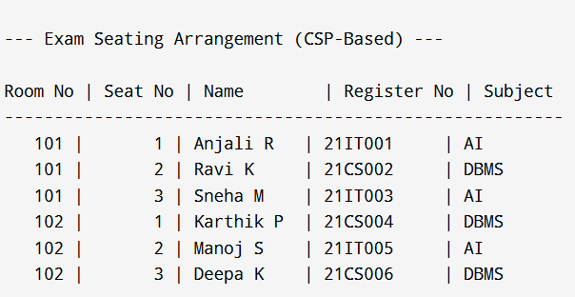
OUTPUT AND RESULTS
OUTPUT :
EXPLANATION:
This shows the program executed (python exam_seat_csp.py) inside a VSCode terminal. The table below is the final seating plan: columns are Room No, Seat No, Name, Register No, and Subject. exit code 0 indicates successful run.

Slide 6
OUTPUT AND RESULTS
RESULTS:
The Exam Seat Arrangement System was successfully implemented using Constraint Satisfaction Problem (CSP) logic.
The system automatically assigns seats to students based on constraints such as room capacity, seat uniqueness, and subject separation.
The output clearly displays the seating plan in a tabular format showing Room Number, Seat Number, Student Name, Register Number, and Subject.
The results prove that the system can efficiently reduce manual work, eliminate seat duplication, and maintain fairness during exam arrangements.
Execution in VS Code shows successful seat allocation with no constraint violations and exit code 0, confirming accurate functionality.
FUTURE ENHANCEMENT:
Integrate with a database (MySQL or SQLite) to store and fetch student and room data dynamically.
Develop a Graphical User Interface (GUI) or Web Dashboard for easy data entry and visual seat layout.
Add PDF/Excel export options for printing or sharing seating charts.
Include automatic reallocation in case of absentees or last-minute changes.
Implement advanced AI optimization algorithms like Genetic Algorithms or Heuristic Search for large-scale institutions.
Enable cloud-based access so multiple staff members can manage seating simultaneously.

Slide 7
REFERENCES
Russell, S., & Norvig, P. (2020). Artificial Intelligence: A Modern Approach (4th Edition). Pearson Education. — A standard textbook explaining AI concepts, including rule-based reasoning and CSP applications.
Kumar, R., & Singh, A. (2019). “Automated Examination Seat Allocation using AI-based Constraints.” International Journal of Computer Applications, Vol. 178, No. 34. — A journal paper on automation in exam management using AI algorithms.
IBM Cloud Education. (2023). What is Artificial Intelligence (AI)? Retrieved from: https://www.ibm.com/topics/artificial-intelligence — Online resource providing a conceptual overview of AI and its real-world applications.
GeeksforGeeks. (2022). Constraint Satisfaction Problems in Artificial Intelligence. Retrieved from: https://www.geeksforgeeks.org/constraint-satisfaction-problems-in-ai — Educational article explaining CSP and backtracking algorithms in AI.
TutorialsPoint. (2023). Python – Backtracking Algorithm and Applications. Retrieved from: https://www.tutorialspoint.com/python/python_backtracking.htm — Practical guide on implementing backtracking and constraint-based logic in Python.

