Slide 1
CREDIT CARD DEFAULT PREDICTION
Sneha Aluguvelly
Sai Chowdary Aluri

Slide 2
AIM
The goal of this project is predict whether a customer will default on the credit card for next month
To minimize the financial risk

Slide 3
INTRODUCTION
$LIMIT\_BAL$: Amount of the given credit (NT dollar): it includes both the individual consumer credit and his/her family (supplementary) credit.
SEX: (1 = male; 2 = female).
EDUCATION: (1 = graduate school; 2 = university; 3 = high school; 4 = others).
MARRIAGE: (1 = married; 2 = single; 3 = others).
AGE: (year).
PAY_0- PAY_6: History of past payment. We tracked the past monthly payment records (from April to September, 2005) as follows: PAY_0 = the repayment status in September, 2005; PAY_1 = the repayment status in August, 2005; . . .; The measurement scale for the repayment status is: -1 = pay duly; 1 = payment delay for one month; 2 = payment delay for two months; . . .; 8 = payment delay for eight months; 9 = payment delay for nine months and above.

Slide 4
INTRODUCTION
BILL_ATM1-BILL_ATM6: Amount of bill statement (NT dollar). BILL_ATM1= amount of bill statement in September, 2005; BILL_ATM2= amount of bill statement in August, 2005; . . .; BILL_ATM6= amount of bill statement in April, 2005.
PAY_ATM1-PAY_ATM6: Amount of previous payment (NT dollar). PAY_ATM1 = amount paid in September, 2005; PAY_ATM2 = amount paid in August, 2005; . . .;PAT_ATM6 = amount paid in April, 2005.

Slide 5
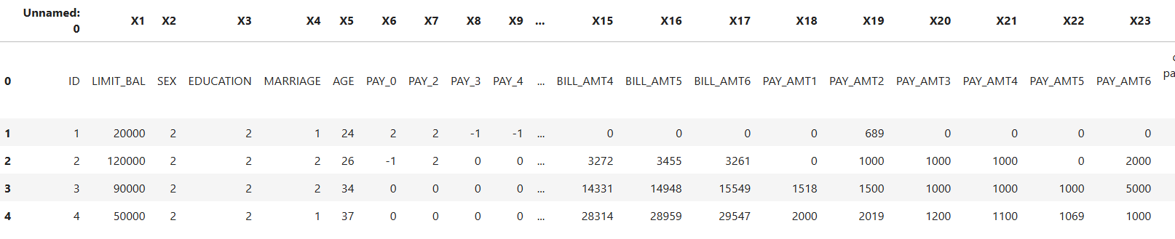
SAMPLE DATA
The given dataset consist of 30001 rows and 25 columns

Slide 6
DATA CLEANING
Inconsistent column names
Data exploration
Null values
Duplicate

Slide 7
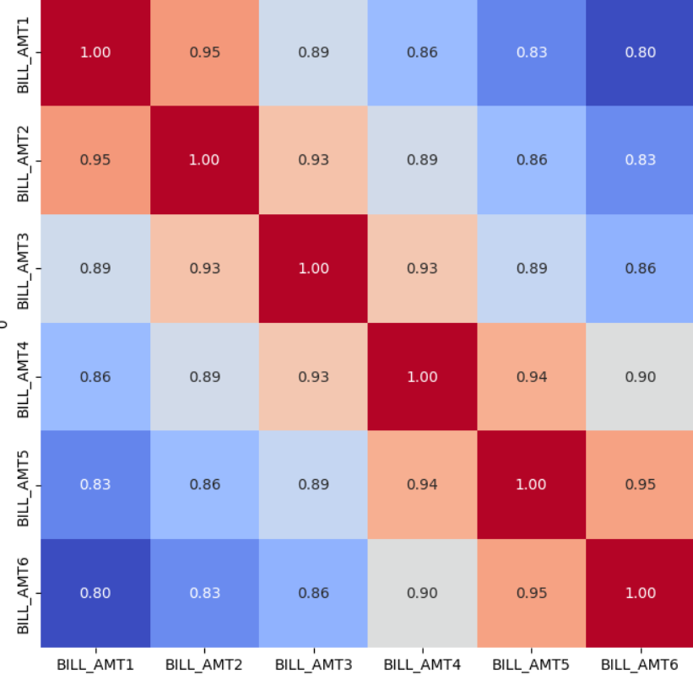
FEATURE SELECTION
Remove or group Undocumented values
Drop the columns which has higher correlation(>0.9)

Slide 8
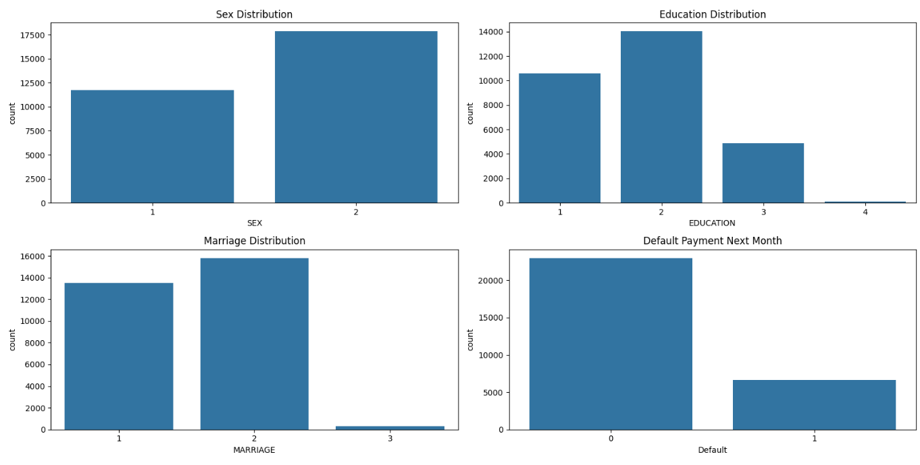
VISUALIZATION
Distribution of categorical variables

Slide 9
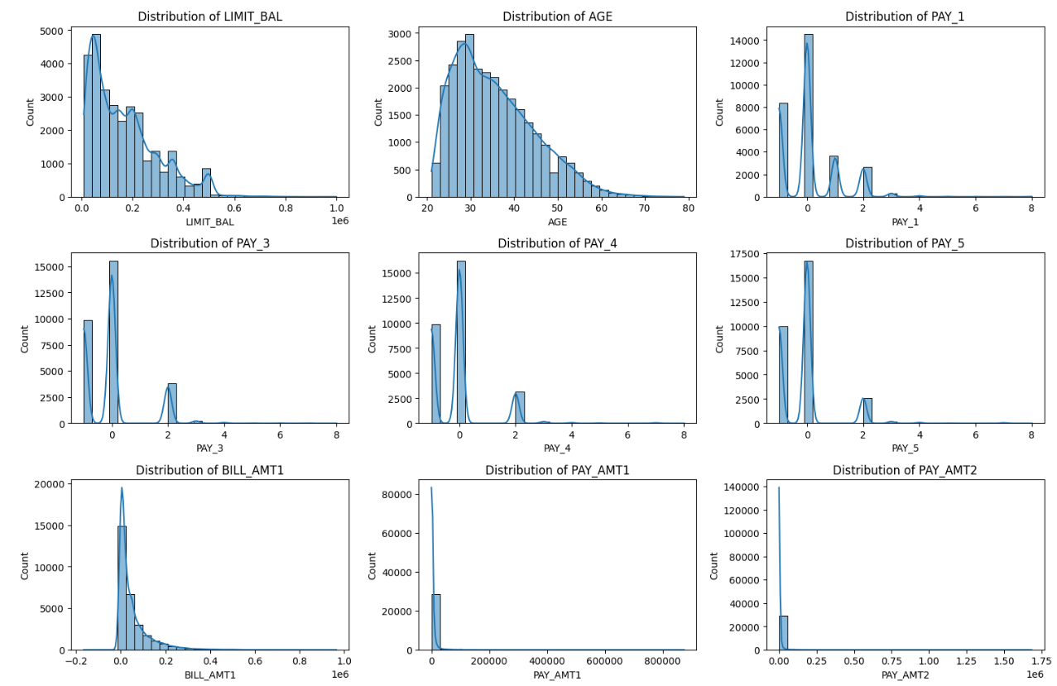
VISUALIZATION
Histograms for numerical variables

Slide 10
ENCODING
One-hot encoding:
For SEX and MARRIAGE(nominal features)
Label encoding
For EDUCATION(ordinal features)

Slide 11
TRANSFORMATION OF DATA
To scale the data into a uniform format that would allow us to utilize the data in a better way
For performing fitting and applying different algorithms to it.
The basic goal was to enforce a level of consistency or uniformity to the dataset.

Slide 12
SPLITTING DATA
Data splits into training dataset and testing dataset.
Training dataset is for making algorithm learn and train model.
Test dataset is for testing the performance of train model.
Here 80% of data taken as training dataset & remaining 20% of dataset used for testing purpose.

Slide 13
FITTING DIFFERENT MODEL
Logistic Regression
Random forest Classifier

Slide 14
CROSS VALIDATION & HYPERPARAMETER TUNNING
It is a resampling procedure used to evaluate machine learning models on a limited data sample.
Basically, Cross Validation is a technique using which Model is evaluated on the dataset on which it is not trained that is it can be a test data or can be another set as per availability or feasibility.
Tuning the hyperparameters of respective algorithms is necessary for getting better accuracy and to avoid overfitting.

Slide 15
LOGISTIC REGRESSION
Logistic regression is a machine learning algorithm for classification problem.
In this algorithm, the probabilities describing the possible outcomes of a single trial are modelled using a logistic function.
It is most useful for understanding the influence of several independent variables on a single outcome variable.

Slide 16
RANDOM FOREST CLASSIFIER
Random forest classifier is a meta-estimator that fits a number of decision trees on various sub-samples of datasets and uses average to improve the predictive accuracy of the model and controls over-fitting.
The sub-sample size is always the same as the original input sample size but the samples are drawn with replacement

Slide 17
CONCLUSION
Random Forest classifier shows highest test accuracy of 81% and F1 score and AUC.
Final model Random Forest classifier is implemented as an app using Gradio platform

