Slide 1

BACHELOR OF TECHNOLOGY
IN
Artificial Intelligence and Machine Learning
Section :Theta
Project Title : Assistive Vision
An Intelligent Mobility Assistant for Visually Impaired Pedestrians
Batch Number:163
Roll Numbers :2211CS020676
2211CS020684
2211CS020692
2211CS020693
Project Guide :Asst.Prof.SK.Mujafar Ahmed
Department of AIML, School of Engineering
Malla Reddy University

Slide 2
CONTENTS:
Introduction
Abstract
Objectives of the Project
Scope of the Project
Project Planning and Research
Software Requirements
Hardware Requirements
Model Selection and Architecture

Slide 3
INTRODUCTION:
Visually impaired people face challenges in navigating safely due to lack of real-time environmental awareness.
Existing assistive tools offer limited support in detecting dynamic obstacles and traffic conditions.
This project, “Assistive Vision – An Intelligent Mobility Assistant for Visually Impaired Pedestrians”, uses AI and Computer Vision to address this challenge.
And converts this information into voice-based guidance through a lightweight, low-latency, mobile-friendly system, thereby improving the safety and independence of visually impaired users.

Slide 4
ABSTRACT:
Visually impaired individuals lack real-time awareness of surrounding obstacles, vehicles, and pedestrians.
Traditional assistive tools provide limited range and no contextual or directional information.
Existing intelligent systems suffer from high latency, poor adaptability, and limited real-time accuracy.
Hence, there is a need for a lightweight, low-latency AI-driven assistive system capable of real-time object detection and audio guidance for visually impaired pedestrians.

Slide 5
OBJECTIVE OF THE PROJECT:
To develop an AI-based assistive mobility system that enables safe and independent navigation for visually impaired individuals.
To enable real-time detection and classification of obstacles, vehicles, pedestrians, and road elements using deep learning–based computer vision models.
To provide accurate, timely, and context-aware audio guidance by converting detected visual information into meaningful voice feedback.
To design an accessible, multilingual, and user-friendly system that enhances safety and confidence of users.

Slide 6
SCOPE OF THE PROJECT:
The scope of this project includes to design and implement an AI-powered assistive mobility system aimed at helping visually impaired individuals navigate safely in outdoor and indoor environments.
It includes real-time visual perception using a camera-based input system to detect obstacles, pedestrians, vehicles, and common road elements.
The system integrates text-to-speech–based audio guidance, providing users with meaningful, directional, and context-aware voice feedback.
The scope involves performance evaluation based on accuracy, response time, and usability to ensure reliable real-time operation.
Future extensions such as GPS-based navigation, wearable integration, and expanded object categories are identified but lie outside the current implementation scope.

Slide 7
PROJECT PLANNING AND RESEARCH
Studied challenges faced by visually impaired pedestrians and reviewed existing assistive technologies to identify the need for real-time object detection with audio guidance
Researched AI and computer vision techniques and selected YOLOv8 for real-time object detection due to its speed, accuracy, and suitability for assistive applications
Planned and created a custom dataset using Roboflow, including pedestrians, vehicles, and obstacles, with preprocessing and augmentation to improve model performance
Designed an agile-based plan to integrate object detection, text-to-speech audio feedback, and a web-based interface in iterative phases
Planned systematic testing to reduce latency, improve accuracy, and ensure usability, followed by final deployment and complete project documentation

Slide 8
SOFTWARE REQUIREMENTS
Deep Learning Models: YOLOv8, ResNet
Programming Languages: Python, JavaScript
Frameworks: TensorFlow, OpenCV, PyTorch
Audio Engine: gTTS , SpeechRecognition
APIs: Web Speech API (SpeechRecognition & SpeechSynthesis)

Slide 9
HARDWARE REQUIREMENTS
Processor: Intel i5 or equivalent processor or higher
RAM: Minimum 8 GB
Storage: At least 20 GB of free disk space
Display: Minimum screen resolution of 1024 × 768 pixels
Internet: Required for downloading datasets, libraries, and dependencies

Slide 10
MODEL SELECTION AND PLANNING
Model Evaluation and Comparison:
Different object detection models such as SSD, Faster R-CNN, and YOLO were studied and compared based on accuracy, speed, and real-time performance.
Selection of YOLO Model:
YOLOv8 was selected as the most suitable model because of its high detection accuracy, low latency, and ability to perform real-time object detection for pedestrian environments.
Planning Dataset Requirements:
The model planning included identifying relevant object classes such as pedestrians, vehicles, obstacles, and signals, and preparing a balanced dataset for training.
Training and Optimization Strategy:
Planned multiple training iterations with data augmentation, hyperparameter tuning, and validation to improve detection accuracy under different lighting and environmental conditions.
Integration and Deployment Planning:
The model was planned to be integrated with a text-to-speech system and a web-based interface to provide real-time audio feedback for visually impaired users.

Slide 11
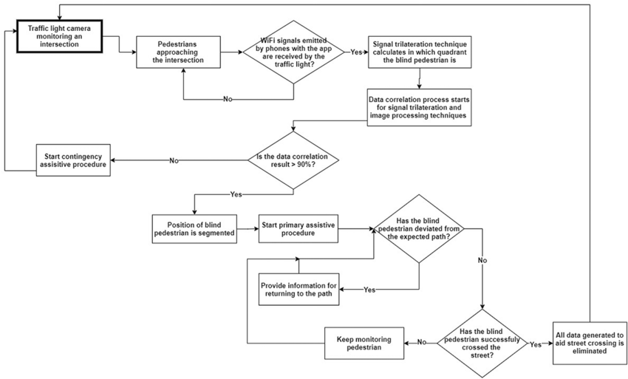
MODEL ARCHITECTURE

