Slide 1
ECG Monitoring System using AD8232 and Arduino UNO
Course Instructor: Dr. SIBASANKAR PADHY
Group Members:-
G.Hasitha – 24BEC012
M.Lakshmi Prasanna – 24BEC022
P.Bashitha – 24BEC037
P.Sarupya – 24BEC039

Slide 2
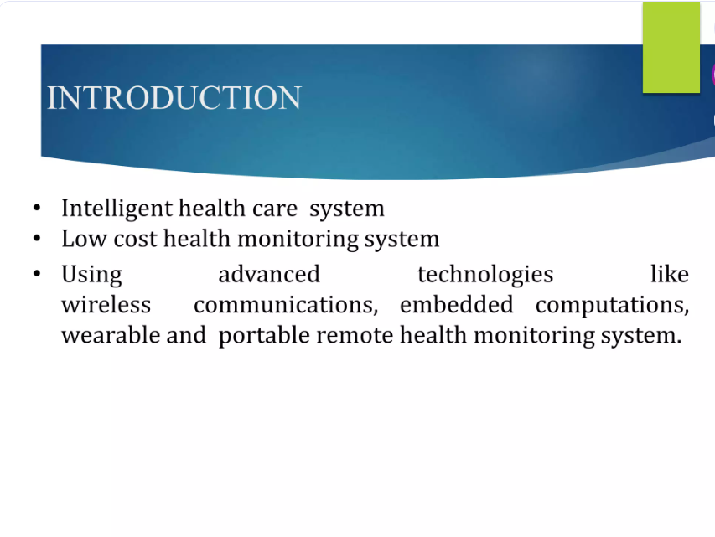

Slide 3
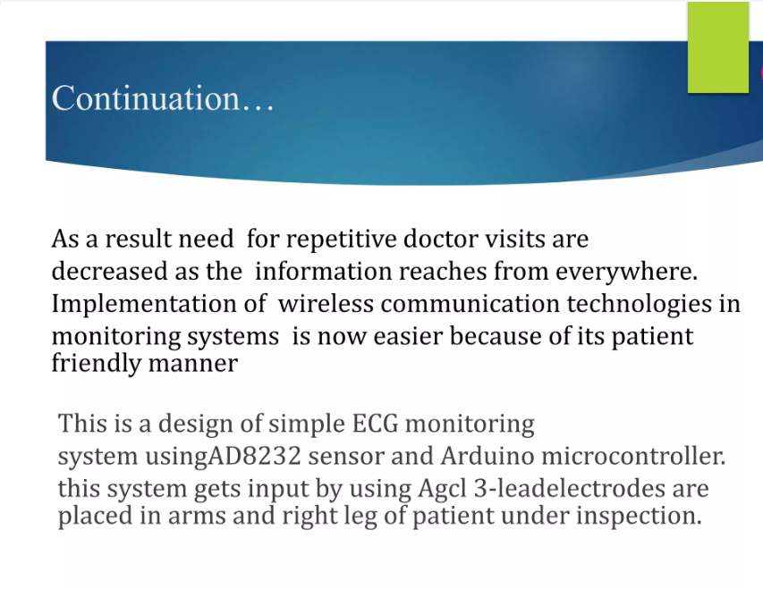

Slide 4
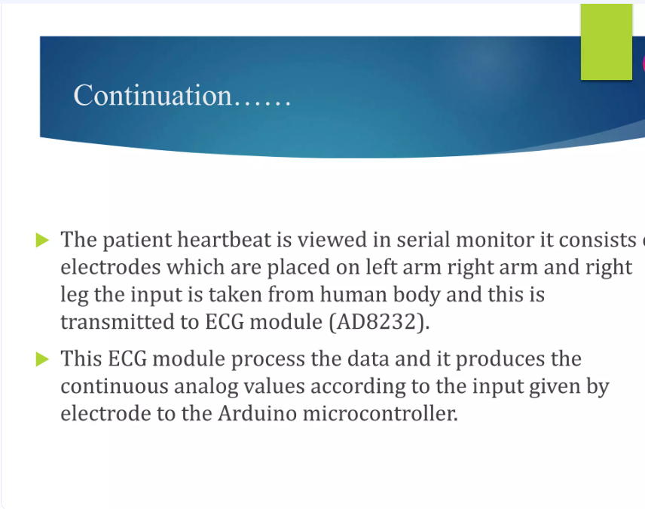

Slide 5
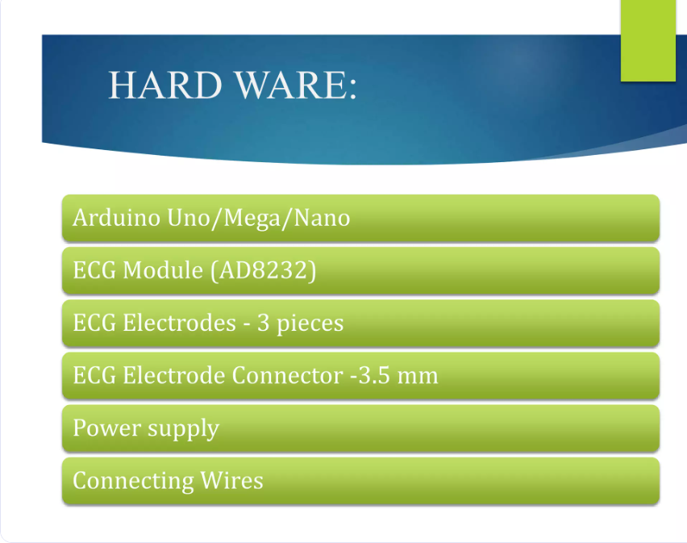

Slide 6
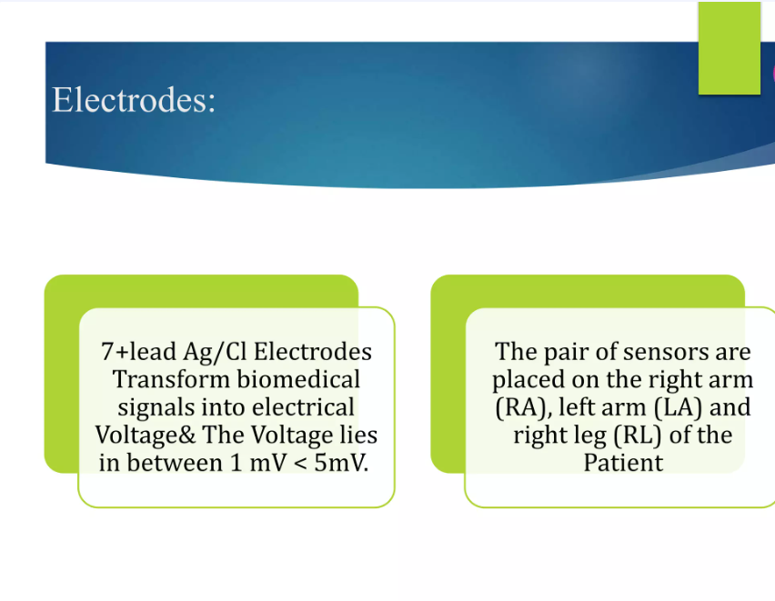

Slide 7
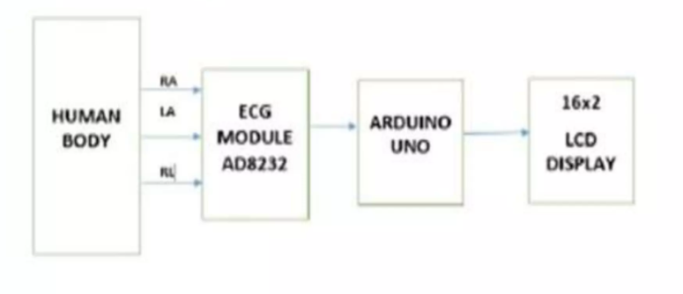
BLOCK DIAGRAM

Slide 8
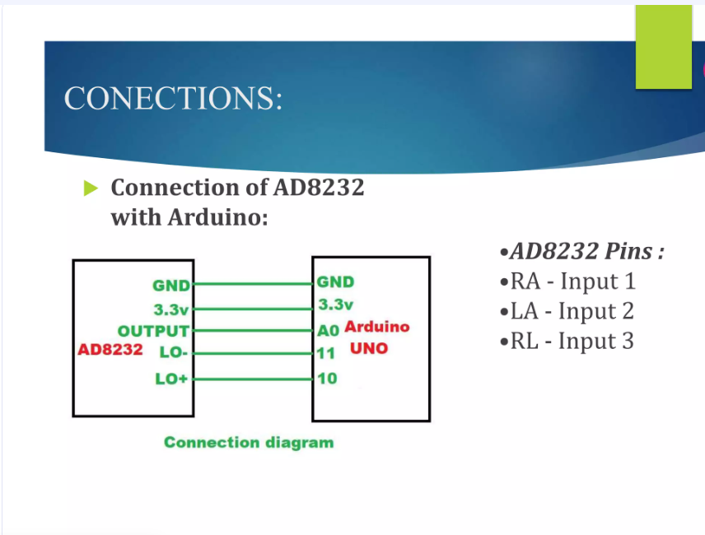

Slide 9
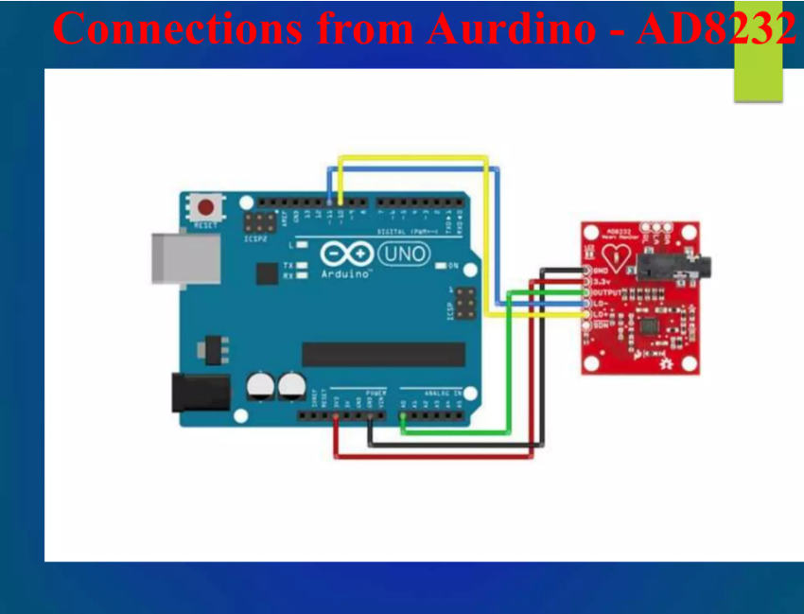

Slide 10
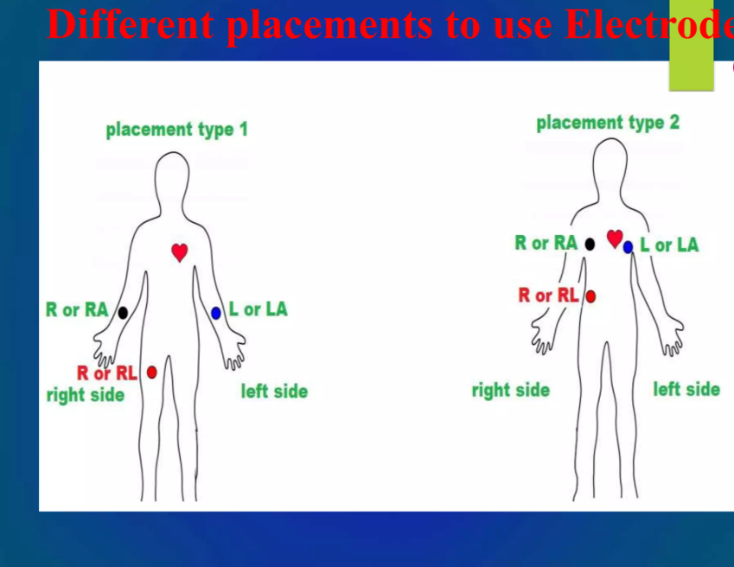

Slide 11
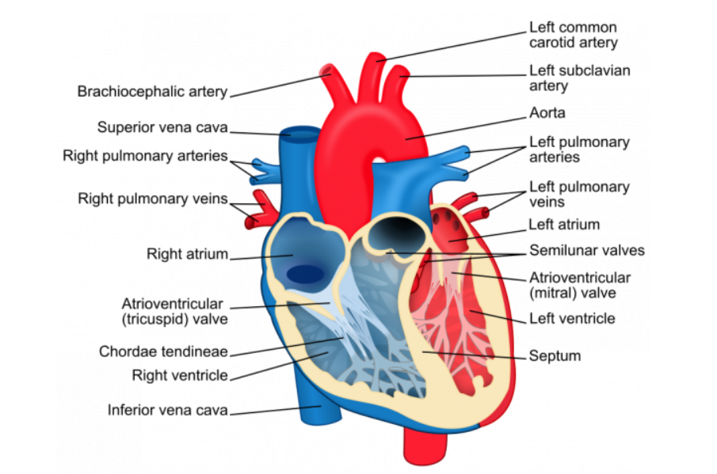
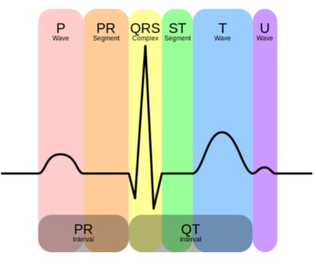
The P wave, which represents depolarization of the atria.
The QRS complex, which represents depolarization of the ventricles.
The T wave, which represents repolarization of the ventricles.

Slide 12
Electrical Activity of the Heart
The red dot represents the SA Node (Sinoatrial Node), the natural pacemaker of the heart.
It generates an electrical impulse that starts in the right atrium.
The impulse spreads across both atria, causing them to contract (P wave).
It then travels to the AV node and moves down to the ventricles.
This causes the ventricles to contract (QRS complex) and pump blood.
Finally, the heart muscles relax (T wave), completing one cardiac cycle.

Slide 13
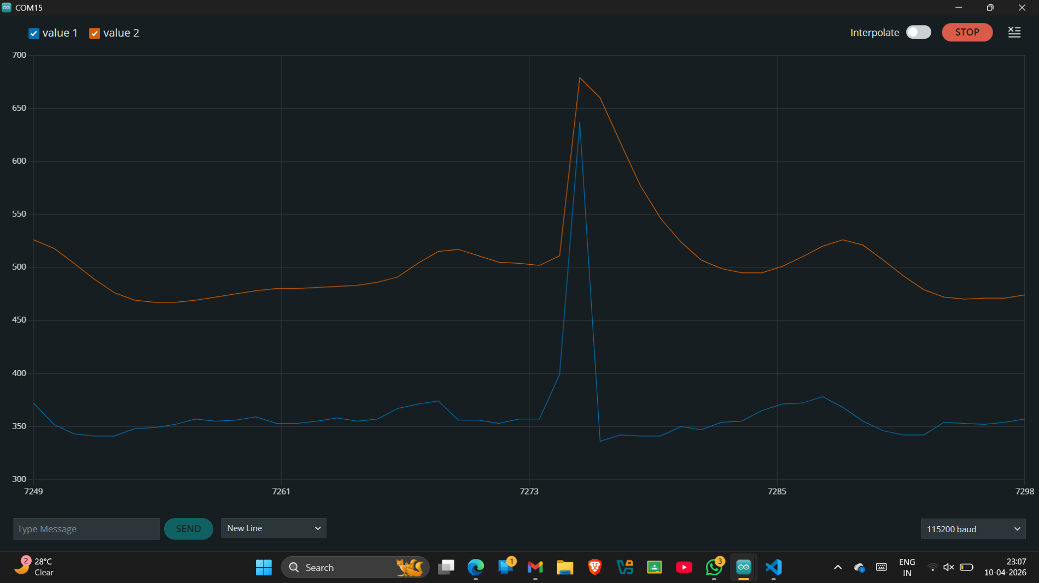

Slide 14
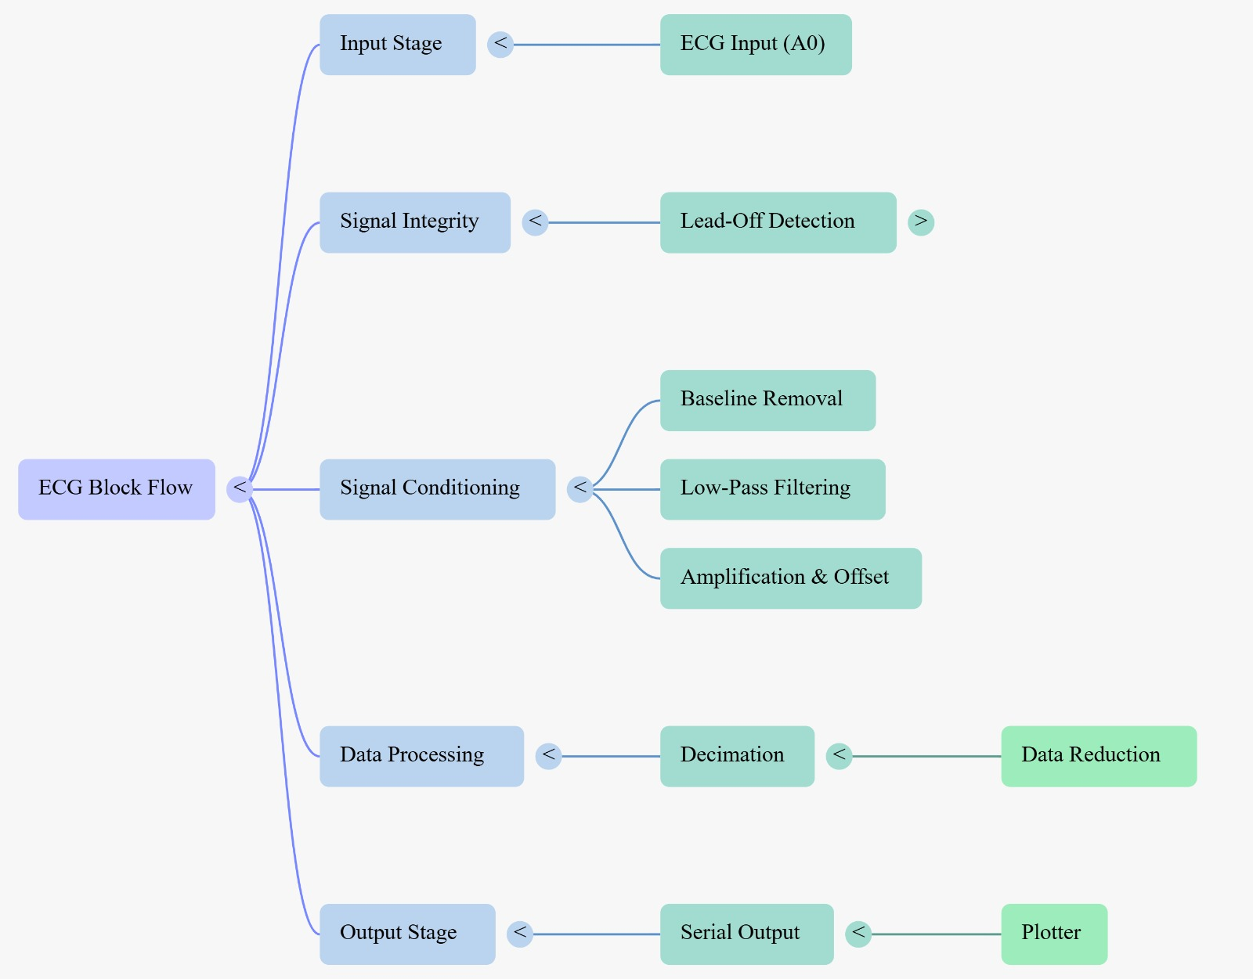
CODE EXPLANATION:

Slide 15
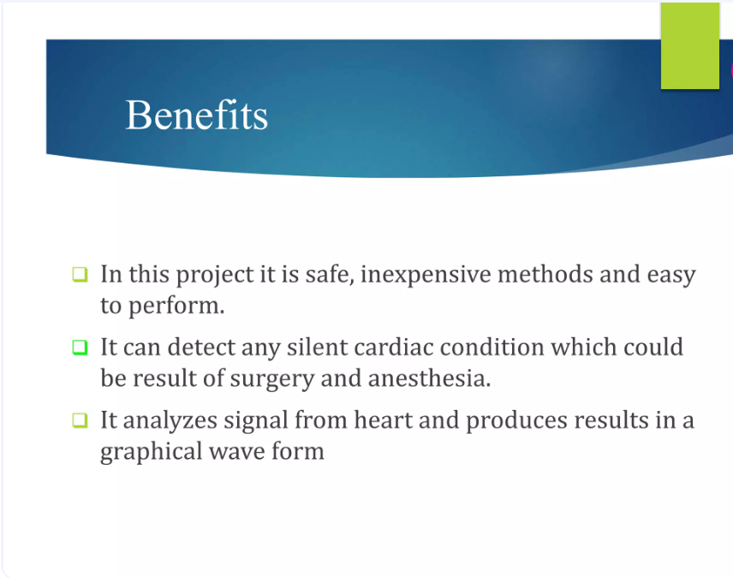

Slide 16
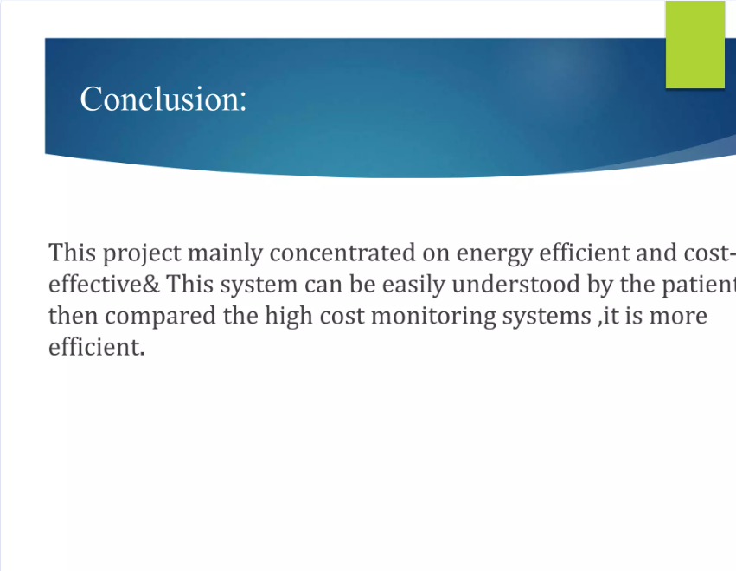

Slide 17
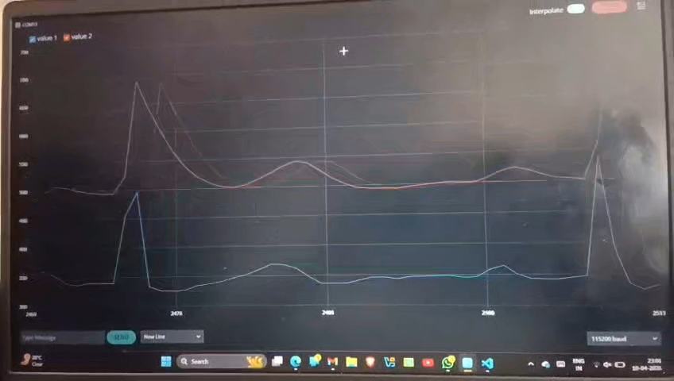
Video Demonstration

