Slide 1
The Impact of Road Conditions and Traffic Patterns on Accident Severity.

Slide 3
Domain
Road accidents are a major concern worldwide, with devastating consequences. Urban traffic congestion is also on the rise, affecting everything from travel times to economic costs. This presentation examines these issues through two case studies.
The first set of data provides detailed traffic information, including factors such as crash severity, weather conditions and road characteristics. The second data set provides traffic volume data for different connections at different times.
Through data visualization and analysis, we will explore how road conditions and traffic patterns may relate to road crash severity.

Slide 4
Data Abstraction
Attributes:
Year (from traffic accident data): Year of accident (statistics) .
Month (from traffic accident data): Month in which the accident occurred (calculation).
Date (from traffic accident data): Date of accident (calculation) .
The day of the week? (from traffic data): weekend or weekday record (categorical) .
Hours (from Car Crash data): Hour of the day (statistics) .
Collisions (from traffic accident data): Collisions (classified: e.g., 2 vehicles, 1 vehicle);
Type of injury (from motor vehicle crash data): Severe injury (classified: e.g., no/unknown injury, disability);

Slide 5
Underlying cause (from traffic data): The underlying cause of the crash (classified: e.g., failure to yield the right of way);
Reported_Location (from Car Crash data): Text description of the accident location
Latitude (from Car Crash data): Latitude coordinates (statistics) .
Longitude (from Car Crash data): Longitude coordinates (statistics) .
DateTime (from Traffic Congestion data): Date and time (datetime) at which traffic information was collected.
Junction (from Traffic Congestion data): name of the junction where traffic data was collected (categorical).
Vehicles (from traffic law data): Number of vehicles observed at the time (statistics).
ID (from Traffic Congestion data, optional): Unique identifier for each traffic data point (not used in the analysis).

Slide 6
Number of Records:
Procedure for merging the resulting data sets
Location and time matching: If clustering was done based on location and time windows, this could be a smaller dataset that could highlight crashes associated with specific traffic patterns
Traffic data enhancement: If traffic matching data were added based on the penalty time window, this method may not match exactly for every traffic accident, but it provides traffic data is great for further research

Slide 7
Data Transformation
To facilitate integration, the following adjustments were made to the data.
Removing attributes from DateTime: Objects such as year, month, day, and hour were removed from the DateTime attribute of traffic data in order to match traffic data timestamps
Matching logic definition: Logic was defined to match entries based on location (reported location vs junction names) and time window selected.
Processing of missing traffic data: We processed the probability of missing traffic data for locations/times of traffic accidents (depending on the route taken).

Slide 8
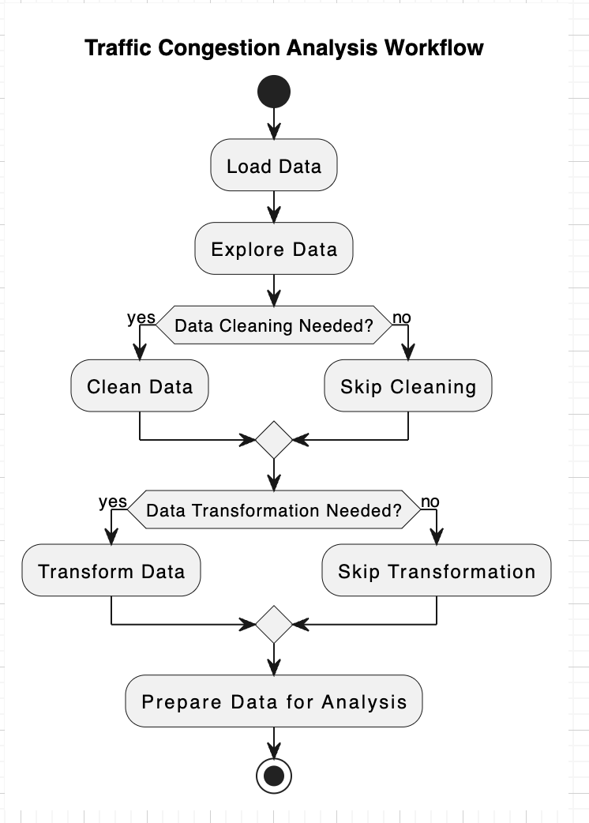

Slide 9
Target: Develop a combination of data suitable for examining the relationship between traffic accidents.
Actions:
Data entry .
Export traffic data from its native format (e.g., CSV) to the analysis environment.
Export traffic accident data from its native format (e.g., CSV) to the analysis environment.
Data search : .
Find the structure of both data types (properties, data types).
Identify missing or inconsistent values ​​in any data set.
Understand the distribution of key variables (e.g., time of day, location) of each data set.

Slide 10
Data cleaning :
Missing address values ​​in the data set .
Handle inconsistent formatting .
outliers in the data .
Data conversion :
Depending on the integration method chosen, this can be:
To extract attributes from the "DateTime" attribute of traffic data (e.g., year, month, day, hour) to match the timestamp of traffic data
Definition matching based on location (reported location vs session name) and selected time window.
For traffic enhancement: to create new colors to maintain any matching traffic

Slide 11
Location and time matching: Match entries based on location (report location vs session name) with the selected time window. This may result in a smaller data set focused on the types of crashes that can be associated with particular traffic conditions.
Enhancing the traffic data: Set the traffic data as primary data and add a new column indicating the number of vehicles (number of vehicles) based on the intersection and the closest time window from the traffic accident

Slide 12
Implementation using tools
Appropriate:
Basic analytical graphics such as scatter plots, histograms, and bar charts.
we create bespoke images that are visually powerful.
Power BI Online:
Interactive dashboards and reports with various chart formats.
Easy data mining and filtering to identify trends.

Slide 13
D3.js (JavaScript): .
Great interactivity and customizable images.
producing complex images not readily available in other tools.

Slide 14
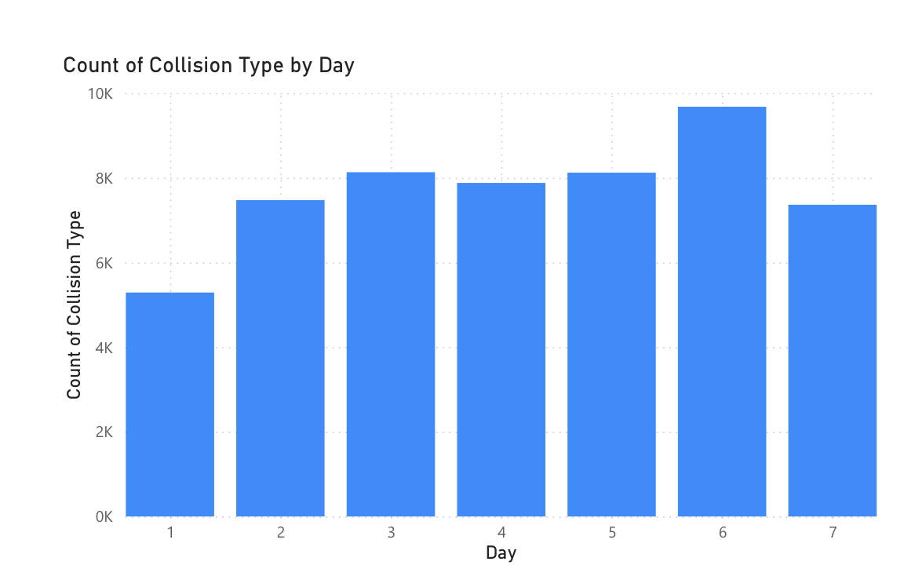
We look at a bar chart, it’s very obvious. The horizontal axis (X-axis) represents days, and the horizontal axis (Y-axis) represents numeric characteristic counts. Multiple lines can form per day, meaning different collisions (e.g., 2 cars, 1 car, hit-and-run). The height of each bar indicates the creation rate on that day.

Slide 15
Interpretation of data:
By looking at the height of the bars, we can see the days that had the greatest and least overlap in each direction. We can also see patterns in the data, e.g.
Are there specific days of the week when the number of patrons is higher?
Are particular meetings (e.g. car 2) more frequent than others during the week?
Are there any trends or extremes in the data that warrant further investigation?

Slide 16
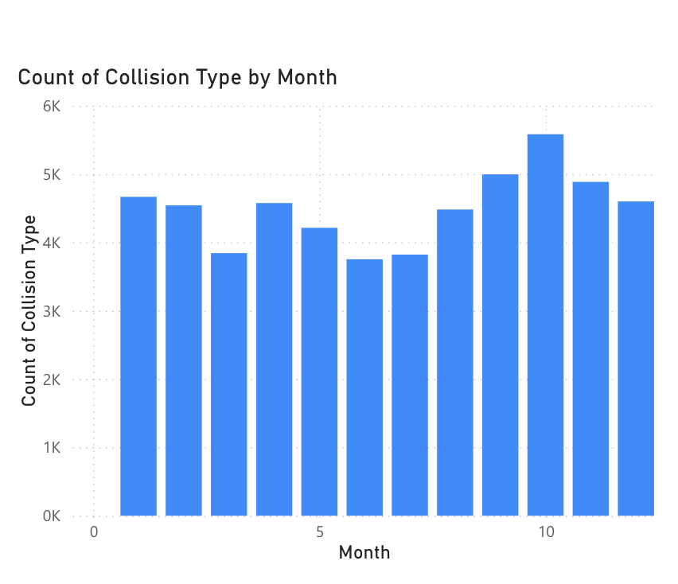
The x-axis (horizontal) represents the month, possibly abbreviated (e.g., January, February, March).
The y-axis (vertical) represents the count of sessions.
There are multiple bands for each month, representing different conflicts (possibly indicated in the legend to the right). The tradition uses different colors (blue, orange, green) to distinguish between different encounters.

Slide 17
Key findings:
Based on the overall trend in penalties for that entire month, we have found that some months are generally hitter than others.
By looking at the height of each color in a month, we can see the typical rallies for each month. For example, in the month labeled "Jul" (July), blue is obviously longest, followed by orange and green. This indicates that the encounters represented in blue were more common in July.

Slide 18
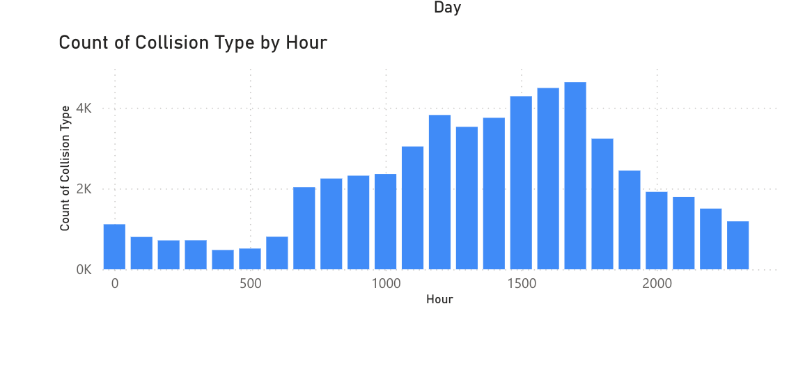
The X-axis (horizontal) probably represents the hour of the day (0-23 or 12 AM - 11 PM).
The y-axis (vertical) represents the count of sessions.
In any given hour there may be several rods, representing different conflicts (indicated by legend, color, or pattern).

Slide 19
Key Findings:
We can see at what hours of the day in general there is maximum and minimum beat based on the total height of all rods at that hour.
If we look at the height of each color over an hour, we can see which rallies were more pronounced at different times of the day. For example, a clock marked "5" should have a long green to indicate that it has been struck

Slide 20
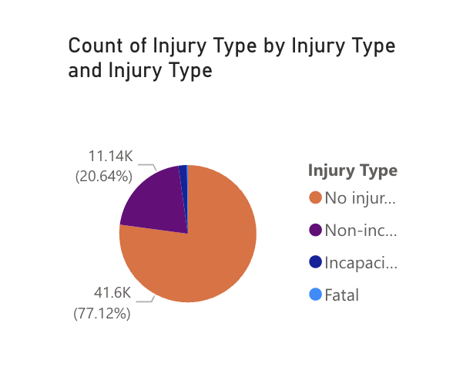
The pie chart is divided into slices representing possibly different types of injury (e.g., no injury, minor injury, major injury, death).
The size (angle) of each slice must be proportional to the number of accidents resulting from its injury type in the total number of accidents.

Slide 21
Possible explanations:
The pie chart shows the distribution of injury severity among the reference traffic crashes in the data set.
The largest slice will indicate the most common accidental injury. For example, a larger slice of "No Injury" may indicate a larger number of minor fender benders.

Slide 22
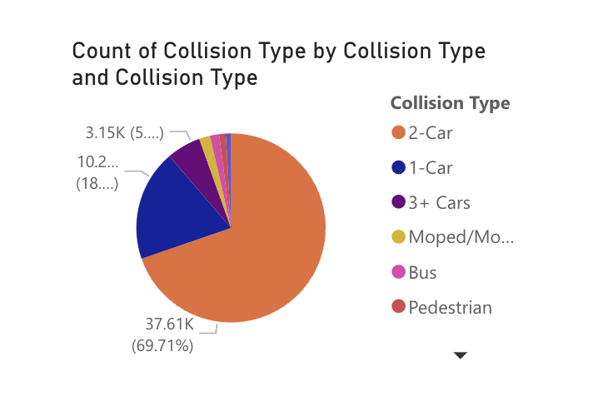
The pie chart may be divided into slices representing different types of intersections (e.g., 1 car, 2 cars, 3+ cars, moped/motorcycle, pedestrian, bus).
The size (angle) of each slice must correspond to the number of accidents in that particular intersection.

Slide 23
Possible Interpretation:
The pie chart shows the distribution of accidents by type of accidents in the data set.
The largest slice would determine the frequency of collisions. For example, a large "2-Car" slice may indicate that most accidents involve two cars.

Slide 24
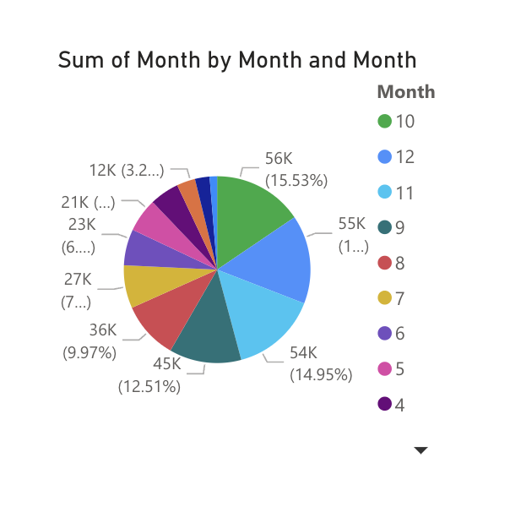

Slide 25
Total scores per month: If the cumulative bar represents the number of encounters divided by a particular factor (e.g., encounter type, intensity, location), the total height of each stack will represent the cumulative number of encounters at that month in coincidences we can see in this case whether there are any seasonal factors.
Number of vehicles in the month: If the stack represents different types of vehicles that contribute to traffic volume (e.g., cars, trucks, buses), the total height of each stack will reflect the number of vehicles in that stack during the month This may reflect seasonal patterns of traffic by location.

Slide 26
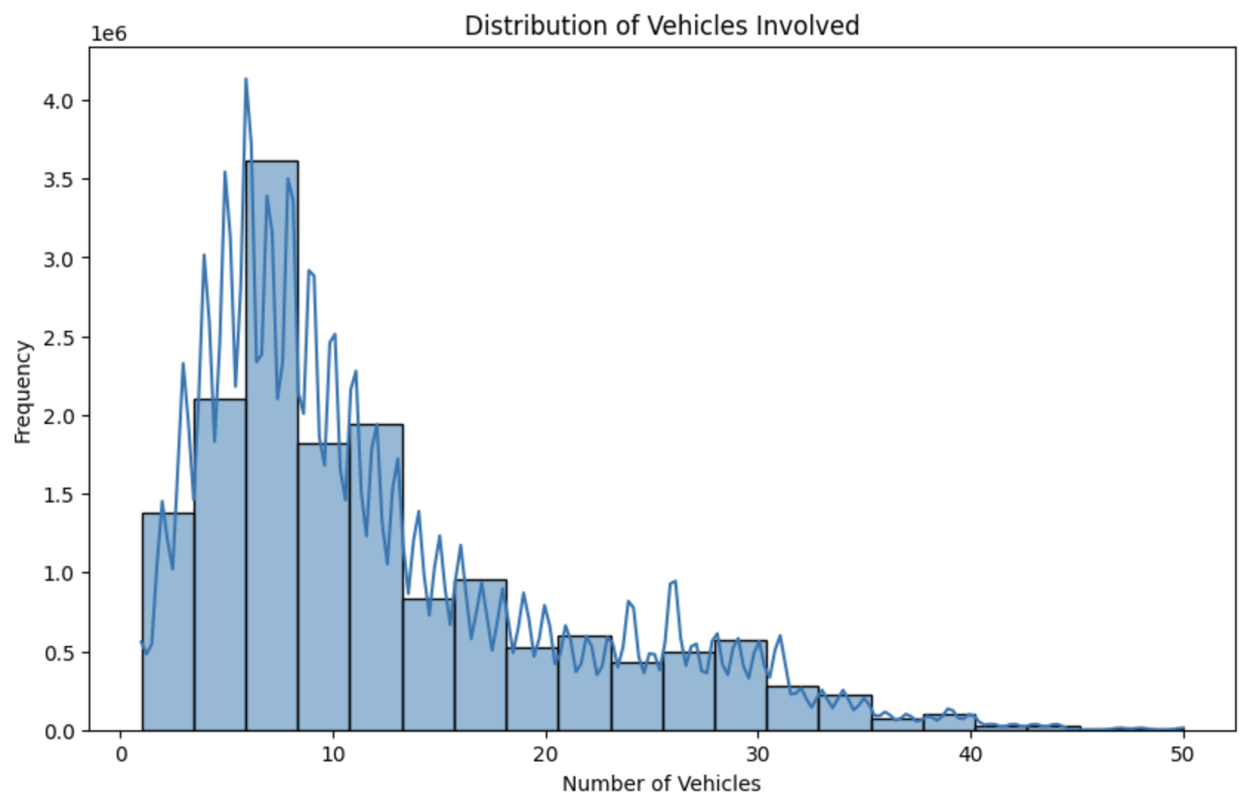
Data for visualization:
The x-axis (horizontal) represents the number of vehicles involved in traffic accidents.
The y-axis (vertical) represents the frequency (count) of multivehicle crashes.

Slide 27
Special Features:
The graph shows the bands at different positions along the X-axis. The height of each bar represents the number of accidents (frequency) involving that particular number of vehicles (e.g. if a bar has X=2 and Y=10 it means that 2 out of 10 accidents involve vehicles).
Distribution description:
By looking at the height of the bars, we can see accidents involving a number of vehicles. The number of cars involved will represent the highest level.
The distribution of the frames indicates whether most accidents involve a small number of vehicles (single-vehicle accidents), multiple vehicles (pileups), or somewhere in between

Slide 28
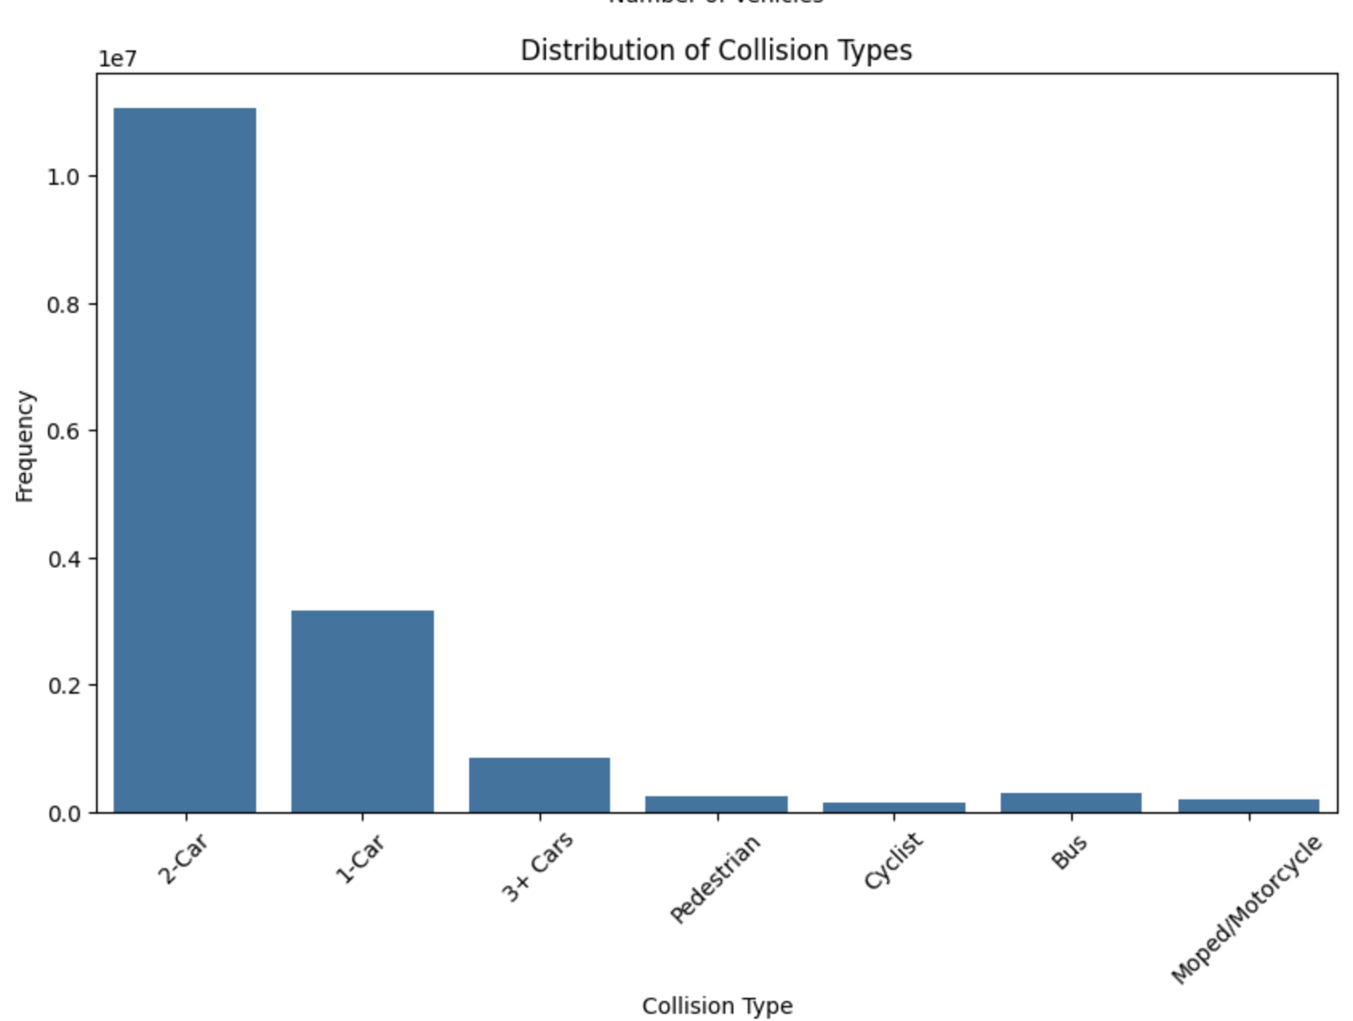

Slide 29
Collision months and severity are counted: If the Y-axis represents the total number of collisions, and the stacks represent severe collisions (e.g., minor, major, fatal), we can determine how accidental and the number of fractures are all as the severity varies in different months. This may reflect seasonal trends in fall accidents and their severity.
Collisions are counted by month and vehicle type: If the Y-axis shows the total number of collisions, and the stacks represent the type of vehicle involved (e.g., car, truck, motorcycle), we can see each pattern in the total number of accidents and traffic between months.

Slide 30
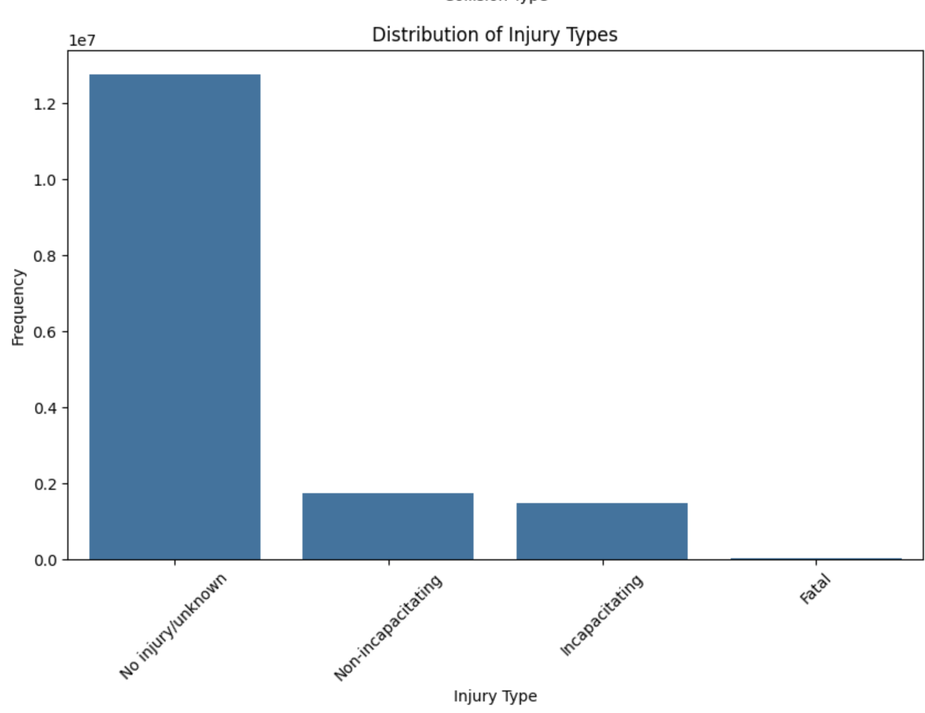

Slide 31
The compiled bar chart shows the distribution of serious injuries occurring for different types of accidents. For each accident (X-axis), the height of each colored bar segment represents the number of accidents resulting from that particular injury severity
By looking at the height of each color in a bar (accident type), we can see the most common injuries associated with each accident. For example, an accident with a straight piece of red tape (representing a potentially fatal injury) can be a cause for concern.

Slide 32
Work Management

Slide 33
References
https://www.kaggle.com/datasets/jacksondivakarr/car-crash-dataset
https://www.kaggle.com/code/tharanitharanm/urban-traffic-safety-pulse
https://www.geeksforgeeks.org/matplotlib-tutorial/#plotting-histogram-in-matplotlib
https://www.kaggle.com/code/alhsan/car-crash-exploratory-data-analysis

