Slide 1
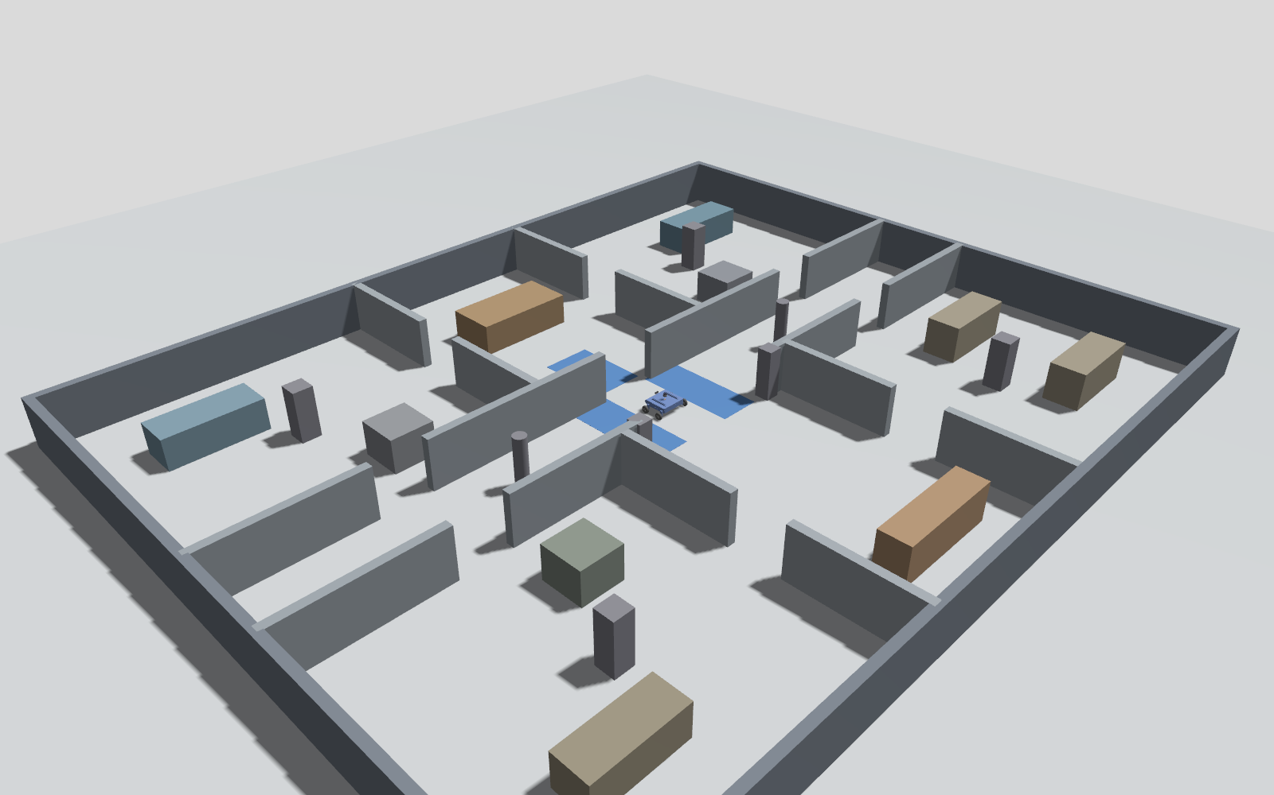
AgileX Scout Mini in ROS 2
Autonomous navigation, wheel-slip simulation and slip control
Blue areas in the picture are the three low-friction patches
Second Review | ROS 2 Jazzy, Gazebo Harmonic, Nav2
1
Notes:
Open with the 30-second pitch: Review 1 assumed perfect grip; Review 2 removes that assumption with a slip world, a slip controller and nine measured runs.

Slide 2
The project in one minute
The problem
The idea
The evidence
On a slippery floor the wheels spin. Wheel odometry reports distance never travelled, the EKF believes it, and the robot ends up in the wrong place.
Do not trust the wheels alone. Estimate real ground speed from the IMU, detect slip, limit the wheel command and correct the odometry.
Nine measured patrol runs of 20 legs: normal floor, slip with correction on, slip with correction off.
Simulated in Gazebo Harmonic | Nav2 navigation | PyQt5 Ground Station
2
Notes:
Say: a four-wheel skid-steer robot in a 20 x 16 m civil building with six rooms. On a slippery floor the wheels spin, odometry lies, and the robot gets lost. The idea: compare wheel speed with an IMU speed estimate and react.

Slide 3
Review 1 and Review 2
 | Review 1 | Review 2
Floor | Always good grip | Three patches, friction 0.04 vs wheel 0.25
Odometry | Raw wheel odometry into the EKF | IMU-corrected /odom_corrected
Click routing | Door-aligned waypoints | One direct goal, shortest path
Patrol | 23 legs, one recorded run | 20 legs, nine planned runs plus two extra
Nav2 cost | cost_travel_multiplier 2.0 | 1.0 (planner minimises distance)
Same robot, facility, localisation and Nav2 stack. New: floor, slip control, click routing, measurements.
3
Notes:
Keep Review 1 to one minute. Review 2 is the new work.

Slide 4
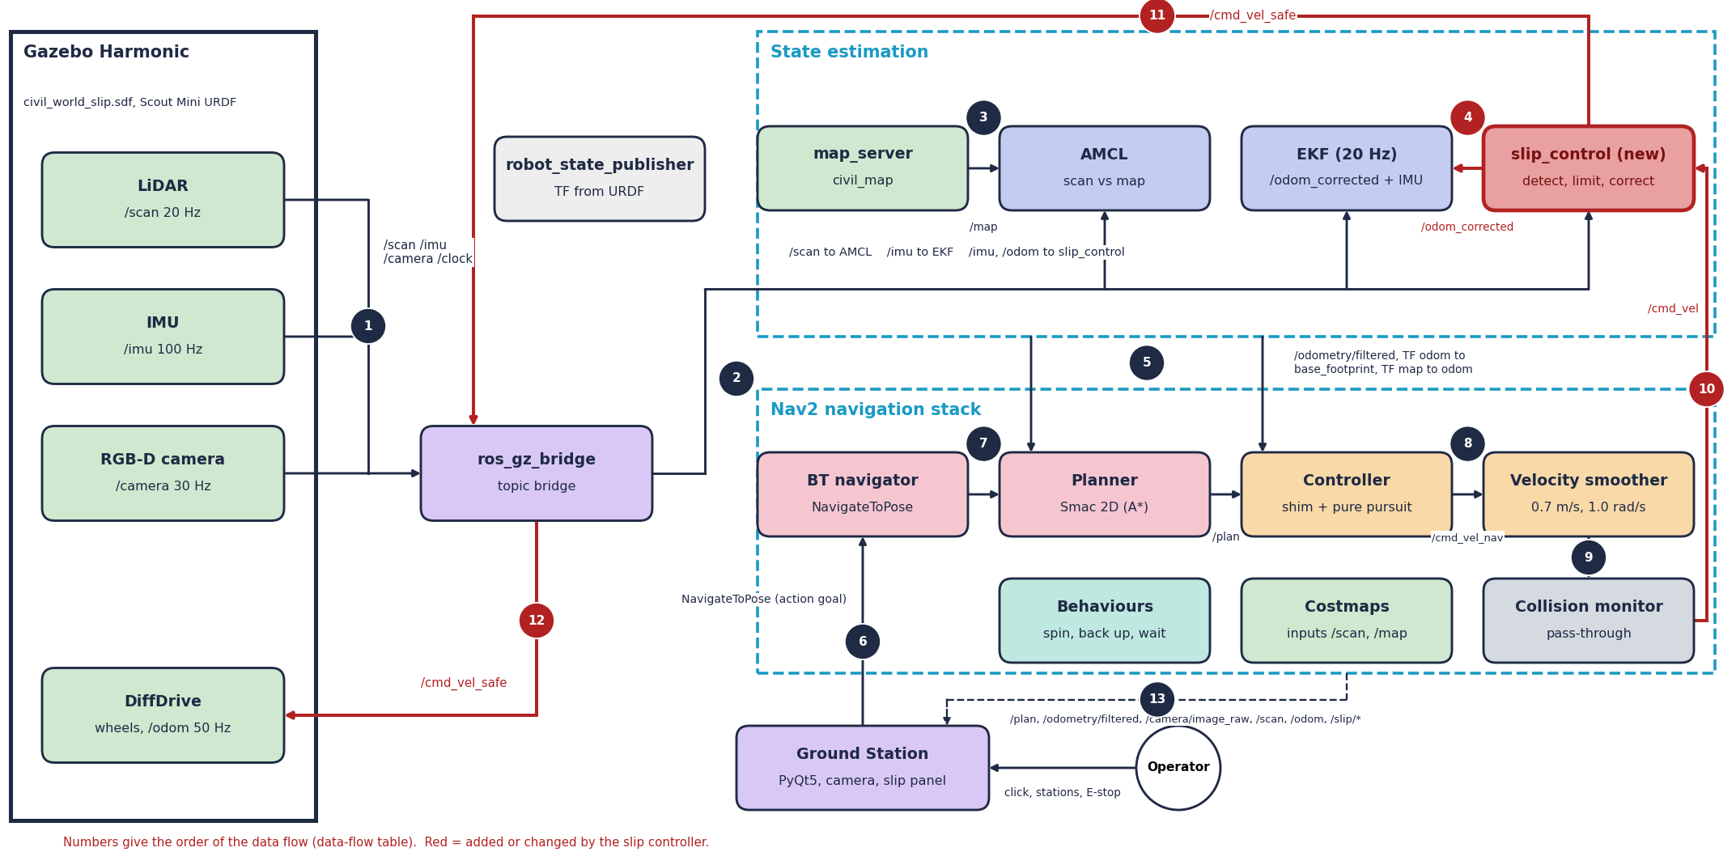
System architecture
4
Notes:
Walk the command path: Nav2 writes /cmd_vel; slip_control limits it to /cmd_vel_safe; the bridge sends it to Gazebo. The corrected odometry /odom_corrected goes to the EKF instead of raw /odom.

Slide 5
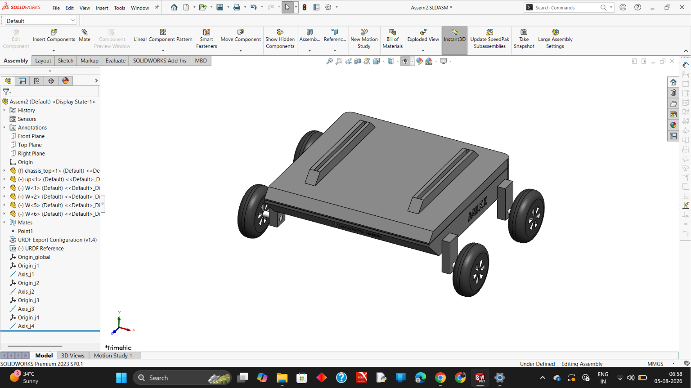
The robot and its actuators
Skid-steer, four wheels
28 kg URDF model, wheel radius 0.08 m, track 0.612 m. Gazebo DiffDrive turns speed v and turn rate ω into wheel speeds.
Limits and friction
±2.5 m/s, ±3.5 rad/s, 0.5 s command timeout. Wheel friction μ = 0.25; no motor current or battery model, so slip comes from the floor.
SolidWorks CAD assembly of the Scout Mini model
5
Notes:
Be honest: motors are not modelled electrically; wheels follow the command. Real Scout Mini specs are published values, not measured.

Slide 6
Sensors: what each one measures
Sensor | Topic, rate | Measures | Used for
2D LiDAR | /scan, 20 Hz | 720 ranges, 0.12–16 m | AMCL, costmaps, SLAM
IMU | /imu, 100 Hz | Gyro and accelerometer | EKF yaw rate; slip estimator
Wheel odometry | /odom, 50 Hz | Speed and pose from the wheels | EKF; compared with IMU
RGB-D camera | /camera, 30 Hz | 640 × 480 colour, depth to 10 m | Ground Station view only
EKF (20 Hz) fuses forward speed and IMU yaw rate; AMCL matches the scan to the map.
6
Notes:
Wheels can lie on ice, the IMU cannot. The disagreement between the two is the slip signal. LiDAR anchors the pose to the map.

Slide 7
Navigation algorithms (used unchanged)
AMCL
EKF
Smac 2D
Particle filter: guesses of the pose scored against the LiDAR scan
Fuses wheel speed and gyro into a smooth odometry
A* search on the costmap for the shortest path
RotationShim + RPP
Velocity smoother
Collision monitor
Rotate to the path, then chase a look-ahead point
Limits acceleration; cap 0.7 m/s
Last-line stop or slow-down from LiDAR
7
Notes:
Nav2 does the planning and following. I changed its parameters for shortest paths and added the slip layer around it.

Slide 8
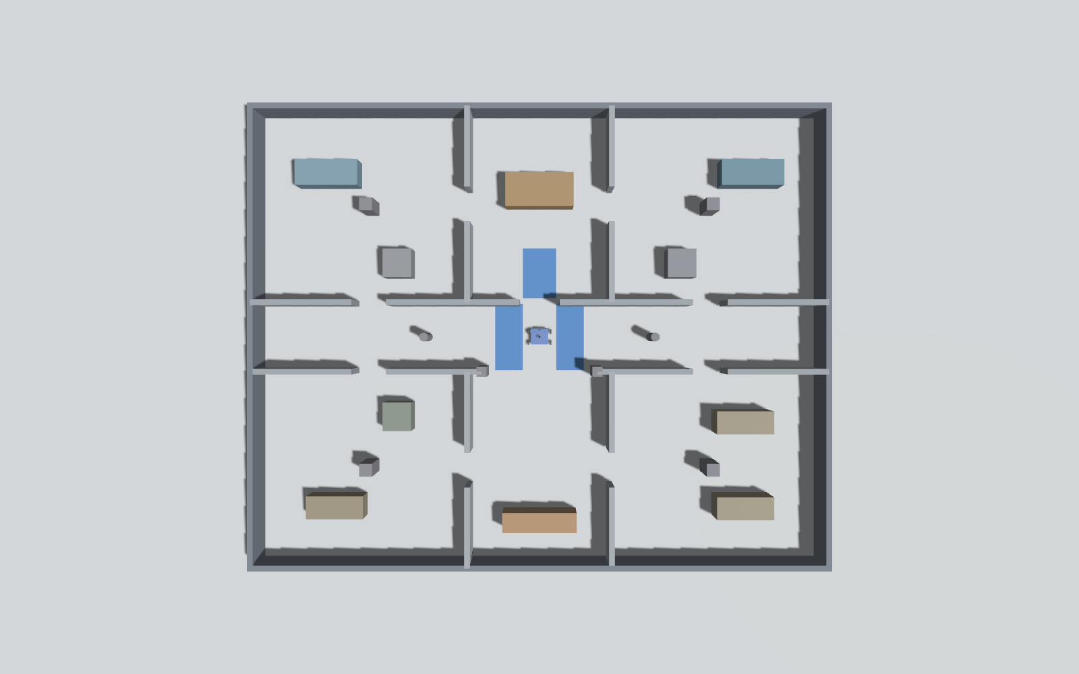
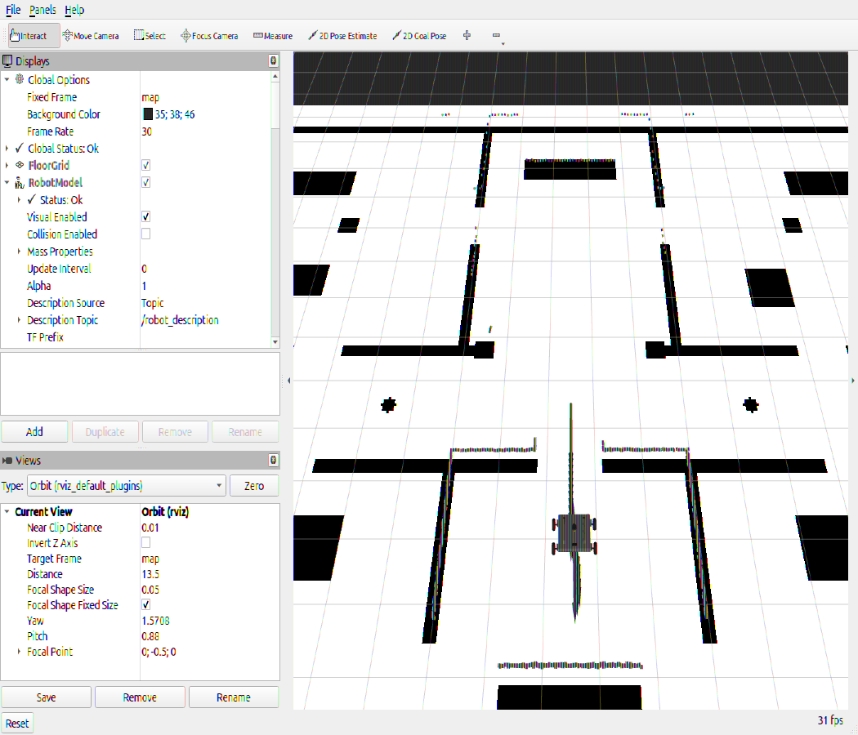
The slip world
Gazebo top view: blue = patches
RViz2: map, scan, robot, plan
Three patches, friction 0.04 against the wheel 0.25: north doorway, east corridor, west corridor.
8
Notes:
The patches are flush with the floor and not drawn in the map, so the robot cannot see them. Slip has to be detected from motion.

Slide 9
Slip controller: five steps
1
2
3
4
5
Estimate
Detect
Limit
Hold heading
Correct
IMU acceleration integrated, blended with wheel speed through a gate
|v_wheel − v_est| > 0.15 m/s for 0.05 s; off below 0.06
Command held to v_est ± 0.12 m/s for 0.6 s
Yaw-rate feedback, gain 0.4
/odom_corrected to the EKF
Topics published
/slip/active, /slip/ratio, /slip/traction_scale, /slip/ground_speed_est, /slip/correction_enabled (latched). Correction on or off is set at launch with slip_correction.
9
Notes:
This is the main contribution. Estimate the true speed, detect slip, limit the command, hold the heading, correct the odometry.

Slide 10
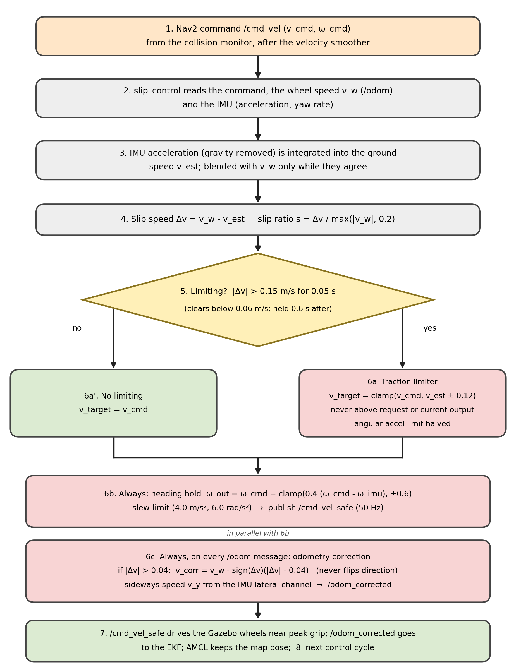
Control loop of slip_control
Honest notes
• Estimator protections: zero-velocity update, latch breaker, energy bound.
• Yaw-rate feedback is always on, even with correction off.
• Angular acceleration is halved while limiting.
• Parameter acc_slip (0.8) is declared but unused.
10
Notes:
Detection runs at 100 Hz, the command limiter at 50 Hz. acc_slip is declared in code but unused; say so if asked.

Slide 11
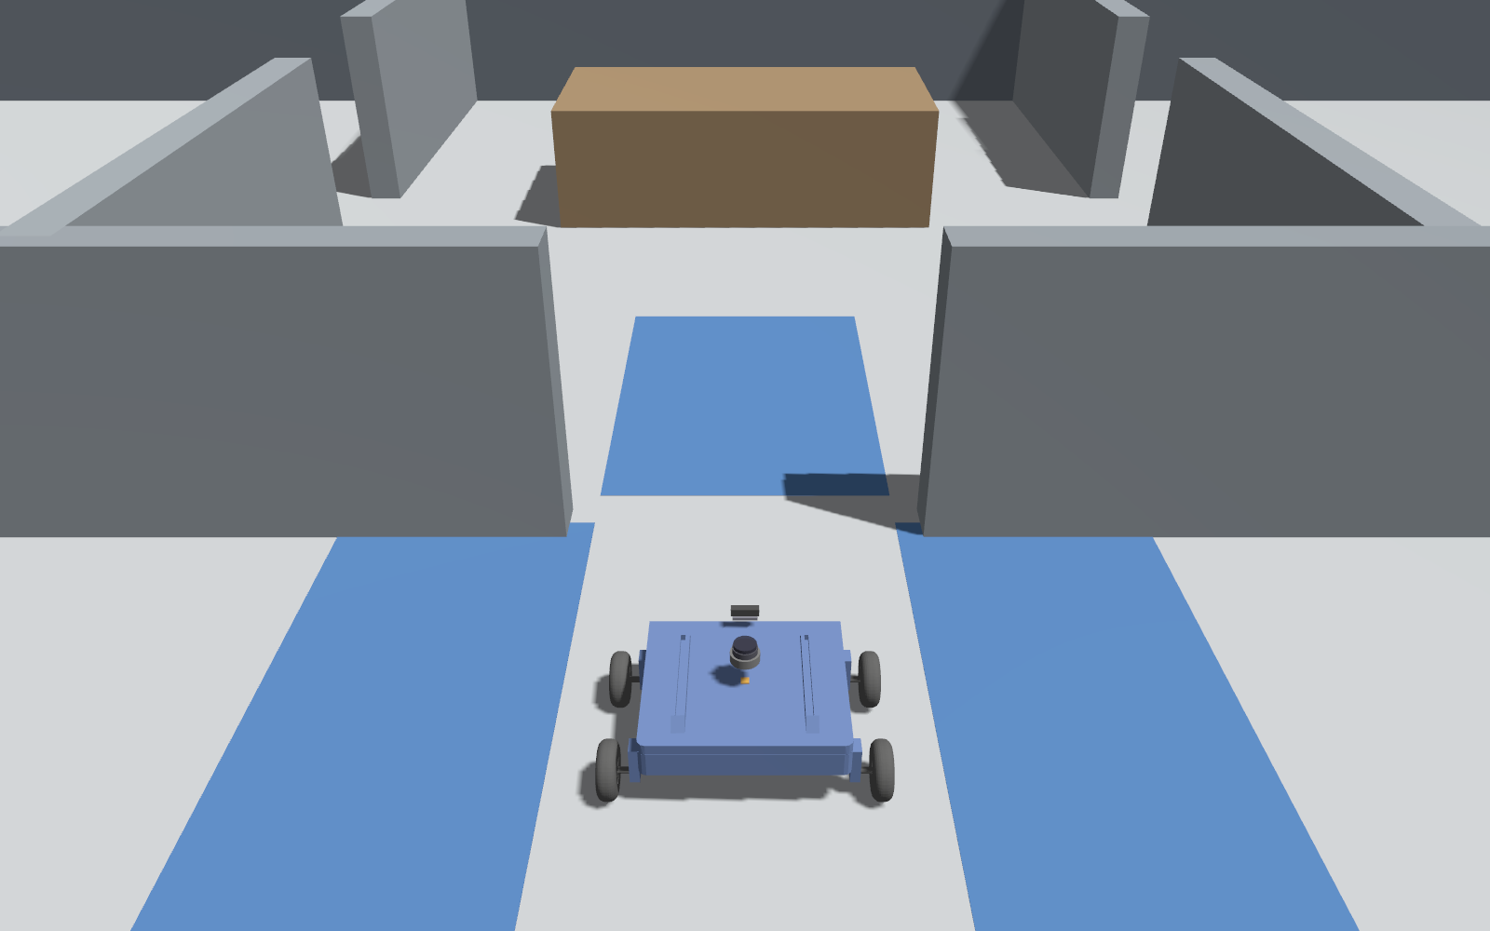
Ground Station and goal management
• PyQt5 app with camera view, map, telemetry and room buttons.
• Pre-emption: each click gets a route_id; the old route stops.
• Goal snap: moved at least 0.55 m from obstacles.
• Near-goal: within 0.30 m for 6 s counts as reached.
• Driven tours within +1.8 % (normal) and +2.2 % (slip) of the shortest path.
20 legs, not 23: the three removed legs were Review 1 corridor via-points.
11
Notes:
One click, one goal. The planner finds the shortest path; the station handles snapping, pre-emption and the emergency stop. The patrol has 20 legs because the three corridor via-points of Review 1 became redundant with direct goals.

Slide 12
Experiments and results
4 / 4
3 / 4
2 / 3
Normal floor
Slip, correction ON
Slip, correction OFF
worst error 0.37 m
one stop at leg 9: heading 45–46° vs 40° limit
overshoot 0.48–0.61 m; stop at leg 4
Runs completing all 20 legs. Position tolerance 0.45 m, heading tolerance 40° at stations. Without correction, the robot overshot the hub in all three runs.
12
Notes:
Say: with the correction the robot finished more runs and did not overshoot; its one failure was a heading-tolerance miss. Few runs per condition, so call it a trend.

Slide 13
Problems solved
Raised patches
Speed estimate drift
Raised tiles stopped the robot at a 3 mm edge; patches are now flush.
Gate, latch breaker and energy bound keep the IMU estimate honest.
Clicks ignored
Blocked screenshots
Direct goals with route_id pre-emption and goal snap.
Wayland blocks window capture: Gazebo via camera sensors, RViz2 via XWayland.
13
Notes:
Pick three to tell.

Slide 14
Limitations and next steps
Limitations
Next steps
Simulation only; no real-robot slip test.
Motors not modelled electrically.
Fixed friction on the patches.
Nine planned runs plus two extra: indicative, not statistical.
Leg-12 aborts on the slip floor not investigated.
Test on the real robot.
Vary the floor friction.
Tune the heading approach near goals.
Investigate the leg-12 aborts.
More runs per condition.
14
Notes:
State the limits yourself before they ask.

Slide 15
Thank you
Questions?
Code: GitHub branch slip-simulation | Report: ROS_Report_Review2_Sailakshmi.pdf
15
Notes:
Close and take questions. Likely questions: why IMU, how slip is detected, IMU drift, why one ON run failed.

