Slide 1

Insights And Trends In Apparel Data
Group-3 :
Manideep Kotha- MXK230078
M. Sai Chakradhar – SXM230175
Omkar Gampala – OXG230006
Ankit Pathange – AXP230040

Slide 2

INTRODUCTION
In this project, we are going to analyze the apparel data from the online section of a department store. The dataset contains the sales record, production cost, rating and the selling price. We are going to use data visualization to present the data in a simple and understandable manner, using which we are going to draw a conclusion on the trends of the apparel data provided.

Slide 3
Project Summary
The project centers on a comprehensive analysis of apparel data sourced specifically from the online division of a department store.
The CSV file is generated from the inputs given from the pkl file for the further analysis and visualization.
Utilized Python libraries like pandas for data manipulation and Matplotlib for creating visualizations.
Drew conclusions based on observed trends and patterns in the apparel dataset, enabling informed decision-making for stakeholders.

Slide 4

DATA SET
The dataset contains the following columns:
Unique_id: An unique identifier for each record.
Date: The date associated with the record.
Name: Name of the apparel.
Category: Category of apparel (e.g., T-Shirt, Formal Shirt, Jeans).
Type: Type of apparel (e.g. shirt, pants).
Rating: Online rating of the apparel.
Price : The selling price of the apparel.
Poduction_Cost: Cost for manufacturing the apparel.

Slide 5
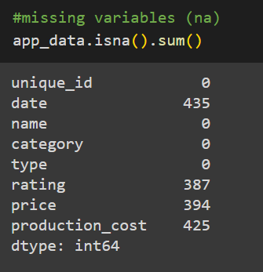
Handling Missing Values
Date (Time Series): Due to the time series nature of the 'date' column, conventional imputation methods such as mean or median are inappropriate. Depending on the analytical context, one may choose to exclude these rows or employ specialized time-series techniques to handle missing values.
Rating (Categorical): Given that 'rating' is a categorical variable, imputing missing values with the mode (most frequent value) is a suitable approach.
Price and Production_cost (Numerical): For 'price' and 'production_cost,' using the median for imputation is recommended. The median is less sensitive to outliers compared to the mean, making it a robust choice for numerical columns.

Slide 6
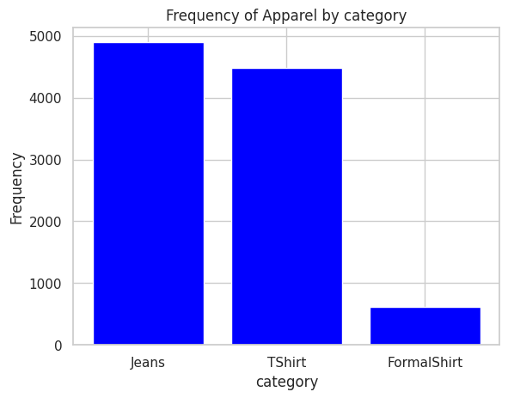
BAR CHARTS
The bar plot depicts the frequency of different apparel categories: Jeans, T-Shirts, and Formal Shirts.
Jeans and T-Shirts exhibit significantly higher frequencies, both approaching 5000.
In contrast, Formal Shirts have a much lower frequency, below 1000.
This data suggests that Jeans and T-Shirts are more commonly purchased compared to Formal Shirts.

Slide 7
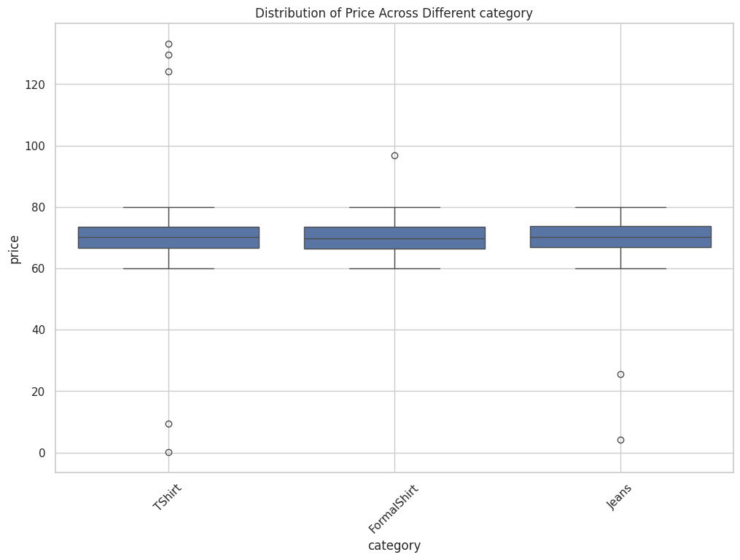
BOX PLOT
This box plot shows us the selling price distribution of 3 categories of apparel.
We can clearly see that much of the price point of all 3 categories lies between 60 and 80 with some outliers.

Slide 8
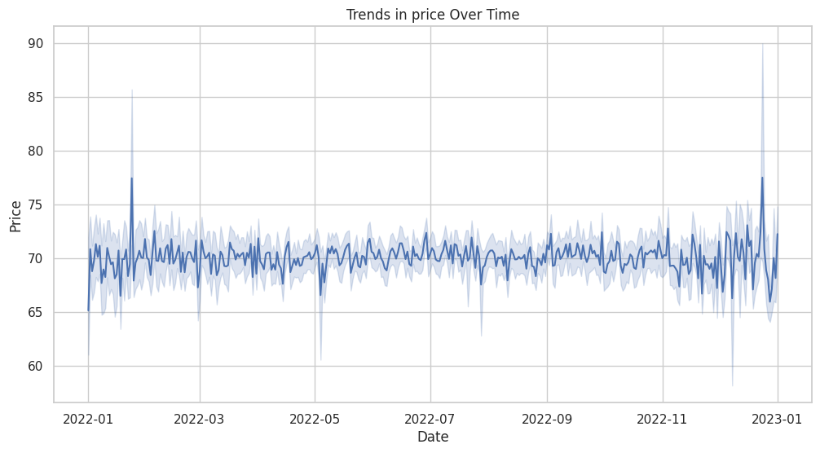
LINE PLOT
There is no clear upward or downward trend.
There are fluctuations within the data that could suggest any number of other factors.
The plot is right skewed.

Slide 9
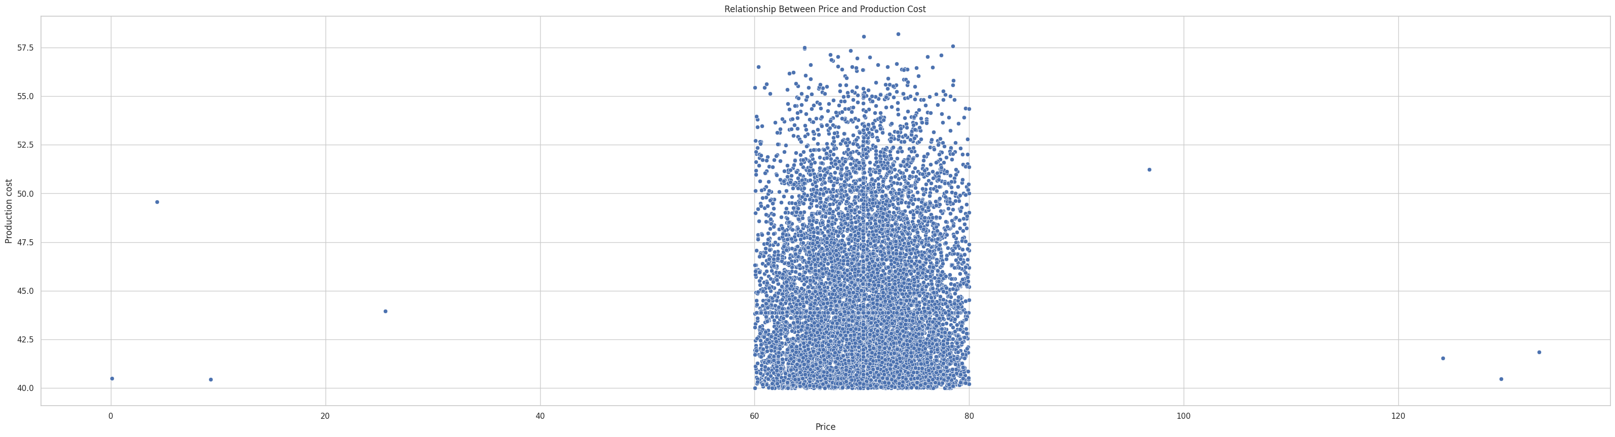
Scatter Plot
This scatter plot shows the relation between the production cost and selling price.

Slide 10
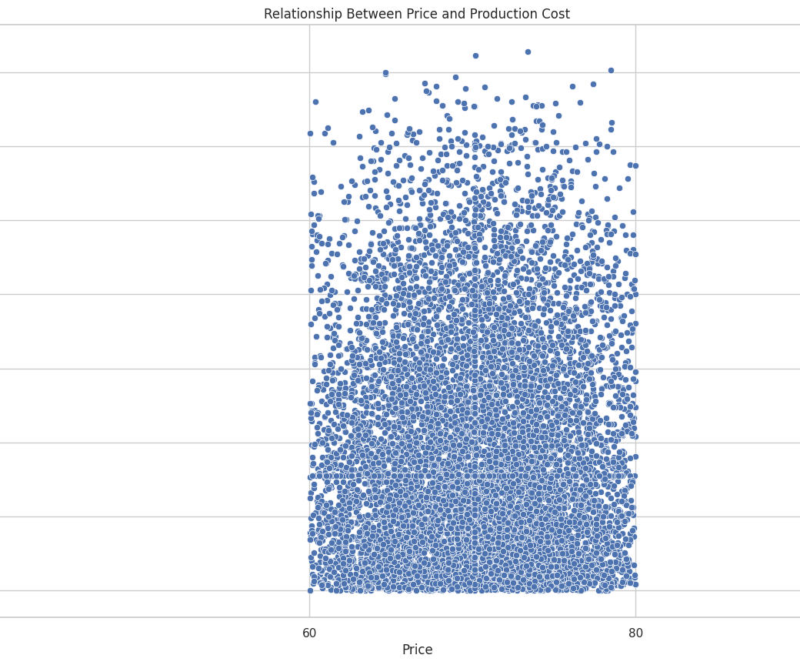
Scatter Plot
When we blow up the previous picture, we can clearly see that
Min cost of production of apparel is 47.5 with max cost of production is 57.5
Most of the apparel are being sold at the price range of 60 to 80 with some exceptions.
Based on the data from this scatter plot we can assume that this is profit making.

Slide 11
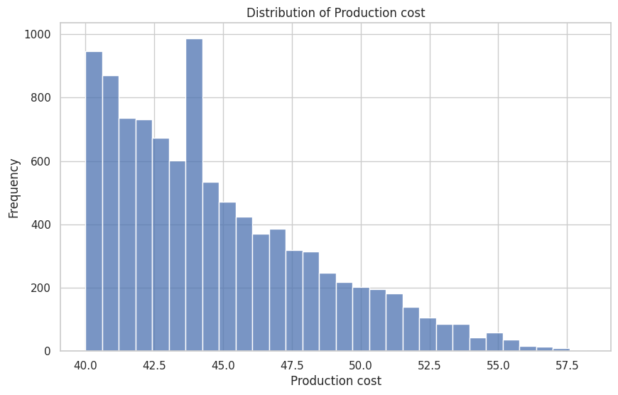
HISTOGRAM
From the graph we can conclude that the most frequent production cost is 44 with close to 1000 items and the least frequent production cost is 57.5 with less than 100 items.
The production cost for most of the items is between 40 and 45.

Slide 12
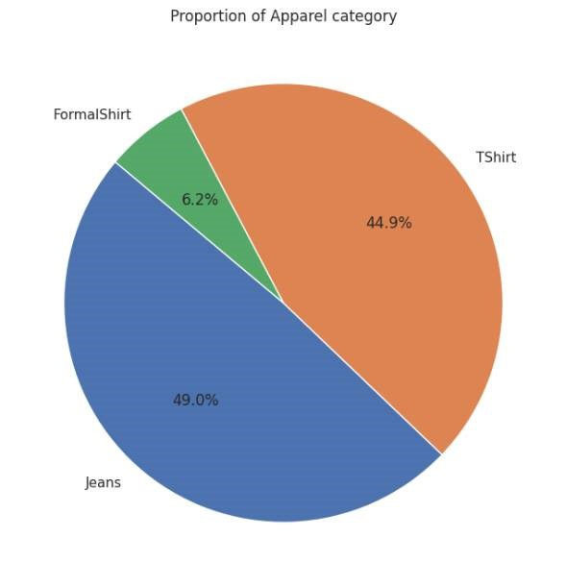

PIE CHARTS
Formal shirts
Formal shirts take up the least share of the sales at 6.2%
T-Shirts
T-shirts account for 44.9% of the total sales
Jeans
Jeans make up the larger portion of the sales at 49%.

Slide 13
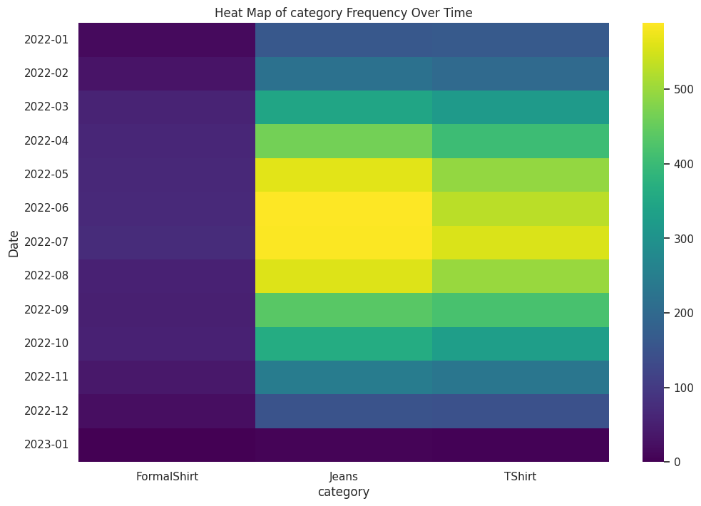
HEAT MAP
It covers data from January 2022 (2022-01) to March 2023 (2023-01).
Darker colors indicate higher frequencies.
Lighter colors correspond to lower frequencies.
In January 2022, Formal Shirts had a high frequency (dark color).
T-Shirts had a lower frequency during the same period (lighter color).
Jeans maintained a moderate frequency across most months.
STEP ONE
STEP TWO
STEP FOUR

Slide 14
CONCLUSION
Finally, based on our analysis, we found some deep insights regarding the production and selling of the apparel. We can conclude that the production cost of the apparel ranges from 40.0 to 57.5, while selling price for the same items ranges from 60 to 80. when we go deeper, we can find that most of sales are from jeans and t-shirts revealing that the buying habits of the consumer. The sales of formal shirts remain constant throughout the year irrespective of the local factors such as climates variations. While coming to the more casual type of apparel we can see that most of the sales of t-shirts and jeans are in the months of June through august , which is summer season suggesting that local factors such as climate and weather effect the buying habits of the consumers. So, we can conclude that, while the formal apparel category may not be making any profits but is sustainable. While coming to the category of casual apparel, it must be making profits as the production cost is never more than the selling cost of the apparel.

Slide 15
THANK YOU

