Slide 1


NEXT GEN EMPLOYABILITY PROGRAM
CREATING A FUTURE-READY WORKFORCE
Student Name :
Anukonti SaiChandu
Student ID :
STU63771b2ed42c81668750126
Mobile No:
8688620129
Mail ID:
anukontisaichandu@gmail.com
College Name :
Vaagdevi College of Engineering

Slide 2
CAPSTONE PROJECT SHOWCASE
Project Title:
Empowering Healthcare: Revealing Insights Through Data-Driven Decisions with Power BI
Abstract | Problem Statement | Project Overview | Proposed Solution | Technology Used | Modelling & Results | Conclusion | Q&A

Slide 3
Abstract
1
This highlights the transformative potential of leveraging data-driven insights in healthcare decision-making, emphasizing the empowerment of healthcare providers and administrators.
2
How healthcare professionals leverage Power BI to make smarter decisions backed by data, ultimately improving patient care.
3
Discover how Power BI streamlines processes and workflows in healthcare organizations, saving time and resources.
4
Understand the direct impact of data-driven decisions enabled by Power BI on enhancing patient outcomes and experiences.

Slide 4

Problem Statement
Finding number of Total Patients in the Health Care Dataset.
Finding number of Males Patients in the Health Care Dataset.
Finding number of Females Patients in the Health Care Dataset.
Finding number of Males Patients Percentage in the Health Care Dataset.
Finding number of Females Patients Percentage in the Health Care Dataset.
Finding the number of patients from rural or urban.

Slide 5

Project Overview
Data collection and Data cleaning.
Importing and Pre Processing.
Data Analysis Expression-DAX and New Measures.
Visualization and Dashboard and Slicers.
Formatting and Testing the Project.

Slide 6
Proposed Solution
I have used Power Query Editor for performing some operations like transforming,preprocessing the data.
I have used Visualization tools for making dashboard more efficient to understand
I have analyzed the Health Care Dataset using Power BI Dashboard.

Slide 7
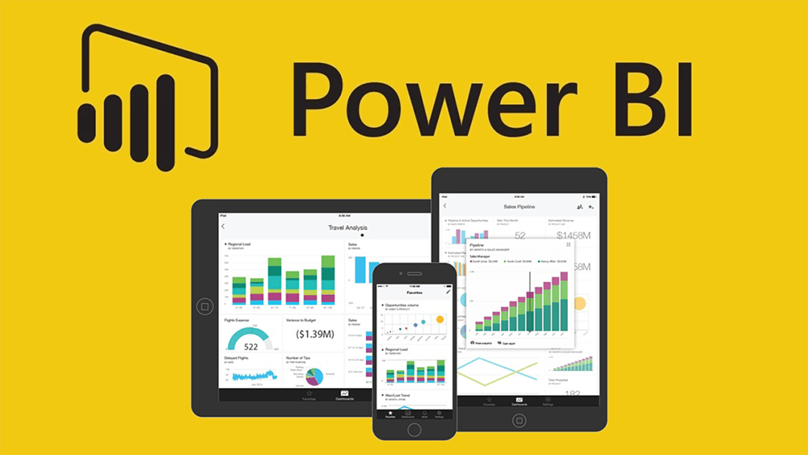
Technology used
Power BI

Slide 8
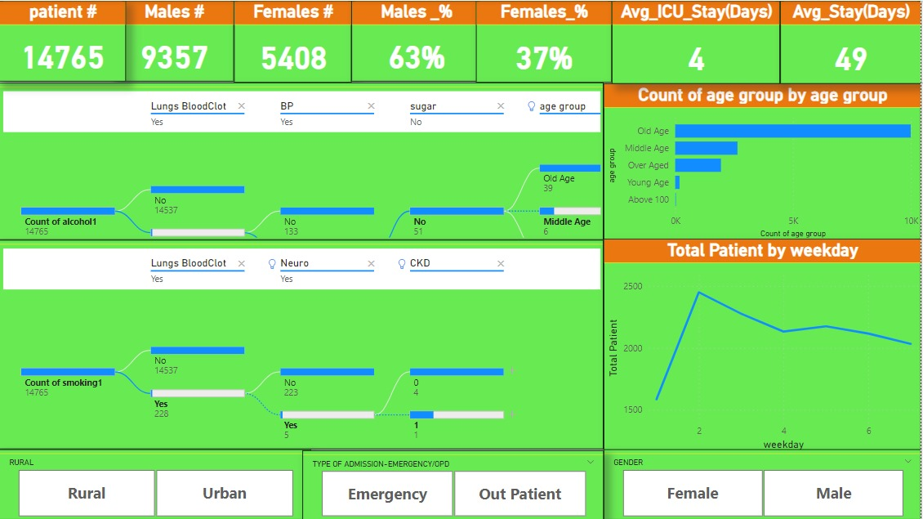
Modelling & Result

Slide 9
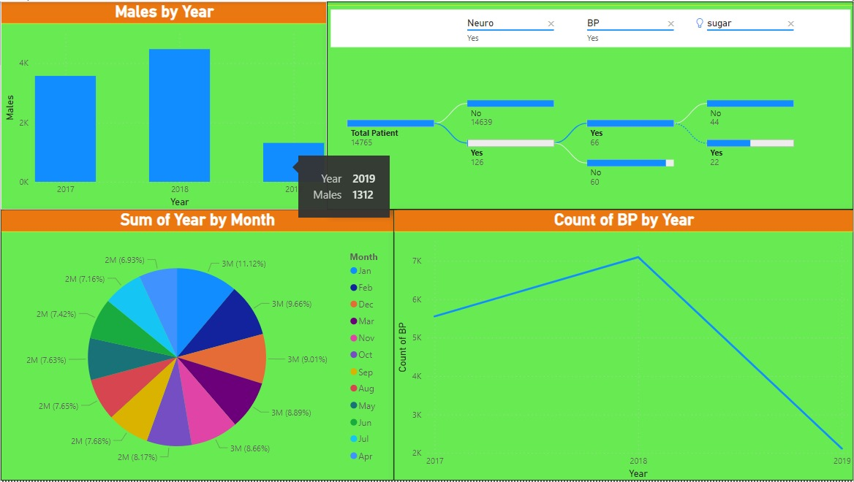
Modelling & Result

Slide 10

Conclusion
Power BI offers healthcare organizations a powerful tool for making data-driven decisions. By simplifying complex data and providing clear visualizations, Power BI helps healthcare professionals uncover insights to improve patient care and operational efficiency.The integration of Power BI can enhance the quality of care for better outcomes for both patients and healthcare providers.

Slide 11


Notes:
Thank You !!

