Slide 1

LEAP-VO: Long-term Effective Any Point Tracking for Visual Odometry
LENKALLAPALLY SAI CHARAN
GUDDU YADAV
AMRUTH REDDY NAGI REDDY PALLI
Notes:
Good Evening everyone! My name is Amruth Reddy,Nagi Reddy Palli They are my team members Lenkallapally Sai Charan, Guddu Yadav. Today, our team will be presenting our research on LEAP-VO, which stands for Long-term Effective Any Point Tracking for Visual Odometry. This work is aimed at improving how machines like robots and autonomous vehicles understand their motion through video frames. We’ve focused on overcoming some key limitations in current Visual Odometry systems, and we propose an innovative tracking module called LEAP to do that. (Transition) Let’s start by understanding the problem we’re addressing.

Slide 2
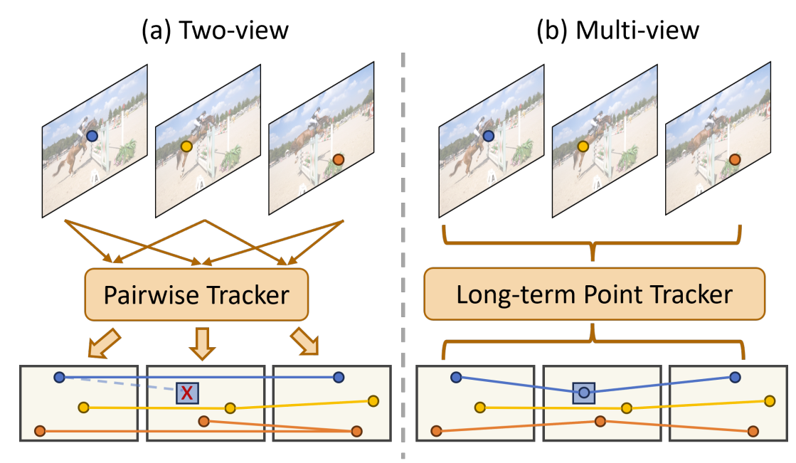
Introduction & Problem Statement
Visual Odometry is the process of estimating the position and orientation of a camera by analyzing the changes in the visual input it receives over time.
Real World Applications:
robotics, mixed reality, autonomous driving.
Limitations of Current Visual Odometry Approaches
Most existing methods focus on two-view point tracking
Ignore rich temporal context in image sequences
Lack global motion pattern capture
No assessment of full trajectory reliability
Poor performance in scenarios with:
Occlusions
Dynamic objects
Low-texture areas
Notes:
Visual Odometry, or VO, is the process of estimating a camera’s movement—both its position and orientation—using images captured over time. It’s widely used in robotics, augmented reality, and especially autonomous driving. However, traditional VO systems have several issues:
● They often look at only two views at a time, ignoring how the scene evolves over longer sequences.
● They fail to understand the global motion patterns or identify if the full trajectory makes sense.
● Most systems can’t handle real-world problems like occlusions, moving objects, or low-texture environments. (Emphasize) These challenges can lead to incorrect motion estimation and system failures in critical applications like self-driving cars. That’s the problem space where LEAP-VO steps in—with a system that’s more intelligent, robust, and context-aware.

Slide 3
Contributions
LEAP: Long-term Effective Any Point Tracking
Key Innovations:
Combines visual, inter-track, and temporal cues for robust tracking
Anchor-based dynamic track estimation
Identifies static vs. moving objects in the scene
Leverages mindfully selected anchor points for global motion analysis
Temporal probabilistic formulation
Reasons about point-wise uncertainty
Integrates distribution updates into iterative refinement
Notes:
So, what exactly are we bringing to the table with LEAP-VO? The LEAP module introduces three key innovations: 1. Multi-source tracking – It combines visual cues, temporal patterns, and relationships between points to better estimate movement. 2. Anchor-based dynamic tracking – This helps distinguish between moving and static objects, something VO systems usually struggle with. 3. Probabilistic temporal modeling – Instead of just guessing the camera's position, we also measure how confident we are about that guess.
Imagine if a system could not only tell where it moved, but also say, “I’m 90% confident in this estimate.” That’s a game changer.

Slide 4
Tracking Any Point- Background
Tracking Any Point (TAP) Formulation
Input: Image sequence I = [I₁, ..., Iₛ], query point x_q in frame s_q
Output: Trajectory X = [x₁, ..., xₛ] and visibility V = [v₁, ..., vₛ]
PIPs Approach
Feature extraction for each image Is → feature map Ys = F(Is)
Point features obtained via bilinear sampling
Iterative refinement process:
Compute local cost volumes around current estimates
Update point positions and features based on local evidence
Notes:
To better understand how LEAP works, we need to look at the concept of Tracking Any Point, or TAP. Here’s how it works:
● The input is a video sequence and a query point in one of the frames.
● The output is a trajectory showing where that point moved across the sequence, and whether it was visible in each frame. (Explain how it works) Using a deep learning model:
● Each frame is processed to extract features.
● The model predicts where the point is likely to be in each frame, and then iteratively refines those predictions. LEAP builds on this idea by making it smarter—incorporating uncertainty, motion context, and global structure to get more accurate results.

Slide 5
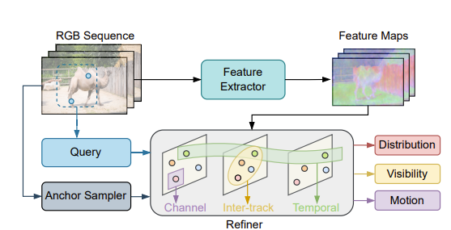
LEAP Module Architecture
Core Components:
Channel: Extracts visual cues from image features
Inter-track Attention: Leverages relationships between different tracks
Temporal Modeling: Captures motion patterns over time
Key Outputs:
Trajectory Distribution (with uncertainty)
Point Visibility
Dynamic Motion Estimation
Notes:
The LEAP module is designed to track objects in a video. It has a special way of picking points to track, which helps it follow objects more accurately than older methods.
The system has three main parts:
Channel Component – This part looks at the image and picks out important visual details.
Inter-track Attention – This helps different tracking points "talk" to each other, so the system understands how objects are moving as a whole.
Temporal Component – This part focuses on how things move over time, making tracking smoother.
All this information goes into a refiner, which keeps improving the tracking results. In the end, the system gives three key outputs:
Where objects are moving, along with how confident it is about those predictions.
Whether the tracked points are visible in each frame.
Labels that help identify different moving objects.

Slide 6
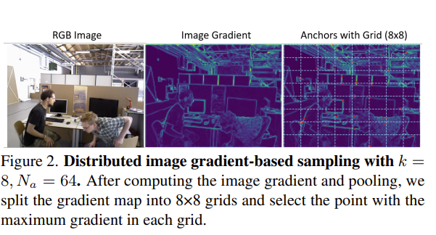
Anchor-based Dynamic Track Estimation
The Challenge
VO systems require static 3D point correspondences
Dynamic objects in the scene cause incorrect motion estimation
Need to distinguish between static and moving objects
Key Components:
Visual cues (appearance-based)
Temporal information (motion-based)
Inter-track relationships (anchor-based)
Combines strengths of segmentation and trajectory-based approache
Notes:
The Challenge
VO systems require static 3D point correspondences
VO (Visual Odometry) works by tracking points in an image that should stay in the same place in real life. This helps the system understand movement.
Dynamic objects in the scene cause incorrect motion estimation
If something moves, like a car or a person, the system might get confused and think the whole camera is moving differently than it actually is. This leads to mistakes.
Need to distinguish between static and moving objects
The system needs to figure out which objects are staying still (like buildings) and which ones are moving (like people or cars).
Key Components
Visual cues (appearance-based)
The system looks at how things look—their color, shape, and texture—to recognize and track them.
Temporal information (motion-based)
The system watches how things move over time to understand if something is moving or staying still.
Inter-track relationships (anchor-based)
The system picks important points (anchors) in the image to help compare movements. This helps in understanding how objects move in relation to each other.
Combines strengths of segmentation and trajectory-based approach
Segmentation-based methods help the system recognize different objects in an image.
Trajectory-based methods help the system understand how things move over time.
By using both, the system becomes better at tracking movement in a complex scene.

Slide 7
Temporal Probability Modeling
Why Model Uncertainty?
Trajectory estimation errors in challenging conditions:
Occlusions
Motion blur
Low-texture regions
Quality-sensitive tasks require reliability assessment
Our Approach: Probabilistic Formulation
Model trajectory distribution: p(X|I, xq)
Multivariate Cauchy distribution for X and Y coordinates
Heavy-tailed distribution for stability in optimization
Notes:
Why Model Uncertainty?
Trajectory estimation errors in challenging conditions:
When tracking objects, mistakes happen in difficult situations like:
Occlusions (When something blocks the view of an object).
Motion blur (When objects look blurry due to fast movement).
Low-texture regions (When the surface has little detail, making it hard to track).
Quality-sensitive tasks require reliability assessment
Some tasks, like visual odometry, need high accuracy. We must know which tracking predictions we can trust.
Our Approach: Probabilistic Formulation
Model trajectory distribution: p(X|I, xq)
Instead of predicting just one position, we estimate a range of possible paths based on the image and query point.
Multivariate Cauchy distribution for X and Y coordinates
We use a special probability model (Cauchy distribution) to predict movement in both horizontal (X) and vertical (Y) directions.
Heavy-tailed distribution for stability in optimization
The Cauchy distribution is good for handling difficult cases because it gives less importance to extreme errors, making predictions more stable.
KERNAL BASED ESTIMATION
Instead of predicting just one position, the model predicts a distribution of positions for better tracking.
To do this, it builds scale matrices using a kernel-based method to measure uncertainty.
These matrices are then refined using MLE and NLL loss to improve tracking accuracy.
ϕ(xs) represents the uncertainty about where a point is located in the tracking process.
The formula ϕ(xs) = Σa[s,s] + Σb[s,s] means that the total uncertainty (ϕ(xs)) is the sum of two parts:

Slide 8
Kernel-based Estimation
Instead of predicting just line position the model predicts a distribution of positions
Why we use kernel based estimation?
We need scale matrix to describe uncertinity
Its hard to generate coz it can be symmetric and positive definite
Point uncertainty:
ϕ(xs) = Σa[s,s] + Σb[s,s]
Refined through Maximum Likelihood Estimation

Slide 9
Loss Functions
Training Objective
Combined loss for trajectory, visibility, and dynamic label prediction
Main Trajectory Loss
Negative Log-Likelihood (NLL) loss based on predicted distribution
Applied at each iteration with exponential weighting
L_main = Σₖ γᴷ⁻ᵏ L_NLL(Xᵏ, X*, Σₐᵏ, Σₑᵏ)
Visibility Loss
Cross entropy loss for binary classification
L_vis = (1 - V*) log(1 - V) + V* log V
Dynamic Track Loss
L_dyn = (1 - m_d*) log(1 - m_d) + m_d* log m_d
Total Loss
L_total = w₁L_main + w₂L_vis + w₃L_dyn
Weights: w₁ = 1.0, w₂ = 0.5, w₃ = 0.5
Notes:
1. Combined Loss for Trajectory, Visibility, and Dynamic Label Prediction
The model learns by minimizing a total loss, which is a combination of three different losses:
Trajectory loss → Helps predict where the object is moving.
Visibility loss → Checks if the object is visible or hidden.
Dynamic label loss → Determines whether the object is moving or stationary.
2. Main Trajectory Loss (L_main)
What it does: Ensures the model accurately predicts the object's position over time.
How it works:
Uses Negative Log-Likelihood (NLL) to measure how well the predicted position matches the actual position.
Applies exponential weighting (γᵏ) → Gives more importance to recent predictions.
Formula:
L_main = Σₖ γᴷ⁻ᵏ L_NLL(Xᵏ, X*, Σₐᵏ, Σₑᵏ)
Xᵏ= predicted position at time step k
X*= actual position
Σₐᵏ, Σₑᵏ​ = uncertainty (scale) matrices
γ\gammaγ = weight factor for importance
3. Visibility Loss (L_vis)
What it does: Helps the model predict if the object is visible or hidden.
How it works:
Uses binary cross-entropy loss, a method commonly used for classification tasks.
Formula:
L_vis = (1 - V*) log(1 - V) + V* log V
V*= actual visibility (1 = visible, 0 = not visible)
V= predicted visibility
4. Dynamic Track Loss (L_dyn)
What it does: Helps the model determine if the object is moving or static.
How it works:
Uses binary cross-entropy loss, just like the visibility loss.
Formula:
L_dyn = (1 - m_d*) log(1 - m_d) + m_d* log m_d
md*= actual movement status (1 = moving, 0 = static)
md​ = predicted movement status
5. Total Loss (L_total)
What it does: Combines all three losses (trajectory, visibility, and dynamic tracking) to train the model effectively.
How it works:
Different losses are given different weights to control their importance:
w₁ = 1.0 → Main trajectory loss is most important.
w₂ = 0.5 → Visibility loss is half as important.
w₃ = 0.5 → Dynamic tracking loss is also half as important.
Formula:
Ltotal=w1Lmain+w2Lvis+w3LdynL_{\text{total}} = w_1 L_{\text{main}} + w_2 L_{\text{vis}} + w_3 L_{\text{dyn}}Ltotal​=w1​Lmain​+w2​Lvis​+w3​Ldyn​

Slide 10
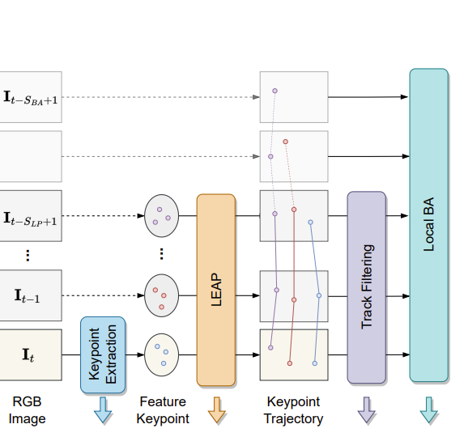
LEAP-VO System Overview
Core Components:
Keypoint Extraction: Gradient-based sampling for robust features
LEAP Tracking: Long-term tracking across multiple frames
Track Filtering: Removes uncertain, occluded, and dynamic points
Sliding Window Bundle Adjustment: Jointly optimizes camera poses and 3D points
Key Advantages:
Bidirectional tracking (forward and backward in time)
Leverages temporal context for occlusion handling
Effective in dynamic environments through explicit motion modeling
Notes:
Main Components
Keypoint Extraction
Identifies important and stable feature points in images.
These points help track movement over multiple frames.
LEAP Tracking
Follows keypoints as they move across frames.
Ensures consistency even when the scene changes.
Track Filtering
Removes keypoints that are unreliable due to blur, occlusion, or movement.
Ensures only high-quality points are used for tracking.
Sliding Window Bundle Adjustment
Optimizes camera motion and 3D point positions.
Keeps calculations efficient by focusing on a limited time window.
Key Advantages
Bidirectional Tracking – Tracks keypoints both forward and backward in time to improve accuracy.
Occlusion Handling – Can remember points even if they disappear temporarily and resume tracking when they reappear.
Dynamic Environment Adaptation – Works well in changing conditions with moving objects or shifting backgrounds.

Slide 11
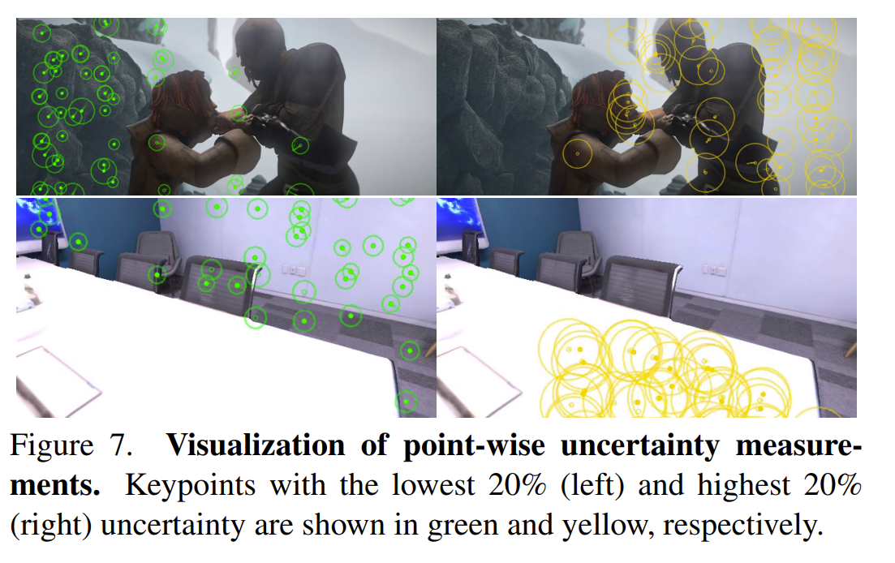
Track Filtering
Why Track Filtering?
Not all tracked points are suitable for visual odometry
Need to identify and remove problematic tracks
Three Filtering Criteria:
Visibility Filtering
Only use points marked as visible (v > γv)
Threshold: γv = 0.9
Dynamic Track Filtering
Remove points on moving objects (md < γd)
Threshold: γd = 0.9
Uncertainty Filtering
Filter out low-confidence tracks (Φ ≤ Q(γu))
Based on distribution uncertainty
Threshold: γu = 0.8
Notes:
Why is Track Filtering Needed?
Not all tracked points are useful for calculating movement from images.
Some points can cause errors if they are blurry, moving, or unreliable.
The system removes bad points to improve accuracy.
Three Ways the System Filters Points
Visibility Filtering
Keeps only clearly visible points.
If a point’s visibility is above 90% (0.9 threshold), it is kept.
Ensures tracking focuses on reliable points.
Dynamic Track Filtering
Removes points on moving objects (like people or cars).
If a point’s movement score is less than 90% (0.9 threshold), it is removed.
Prevents the system from getting confused by objects that don’t stay in place.
Uncertainty Filtering
Removes points if the system is not confident about tracking them.
Uses an uncertainty threshold of 0.8 to decide.
Ensures only high-confidence points are used.
What the Images Show
Left images (Green circles): These are the most reliable tracking points (lowest uncertainty).
Right images (Yellow circles): These are the least reliable tracking points (highest uncertainty).
In a scene with people, points on moving objects (like people) are often yellow (uncertain).
In a stable scene (like a room), background objects have more green points (reliable).

Slide 12
Experimental Setup
Datasets
Replica: 8 static indoor scenes, 16 camera trajectories, 900 frames each
Synthetic environments with challenging occlusions
MPI Sintel: Dynamic scenes from animated films
Complex object motion, motion blur, defocus effects
20-50 frames per sequence
TartanAir Shibuya: Real-world dynamic environments
"Standing Humans" and "Road Crossing" scenarios
100 frames per sequence, 30+ tracked moving humans
Evaluation Metrics
ATE: Absolute Translation Error (overall trajectory accuracy)
RPE trans: Relative Position Error (translation)
RPE rot: Relative Position Error (rotation)
Implementation Details
Training: 100,000 steps on TAP-VidKubric dataset
Hardware: 4 NVIDIA A100 GPUs
Notes:
Let me now describe the experimental setup.The authors evaluated LEAP-VO on three diverse datasets to test its performance across different scenarios.
First, Replica provides synthetic indoor environments with 16 camera trajectories. While these scenes are static, they include challenging occlusions to test tracking robustness.
Second, MPI Sintel contains dynamic scenes from animated films, featuring complex object motion alongside camera motion. These sequences also include realistic imaging effects like motion blur.
Third, TartanAir Shibuya presents real-world dynamic environments with multiple moving humans, making it the most challenging dataset for visual odometry.
For evaluation, they used three standard metrics: Absolute Translation Error measures overall trajectory accuracy, while Relative Position Error measures local accuracy in both translation and rotation.
Coming to implementation was trained on the TAP-VidKubric dataset for 100,000 steps using 4 NVIDIA A100 GPUs

Slide 13
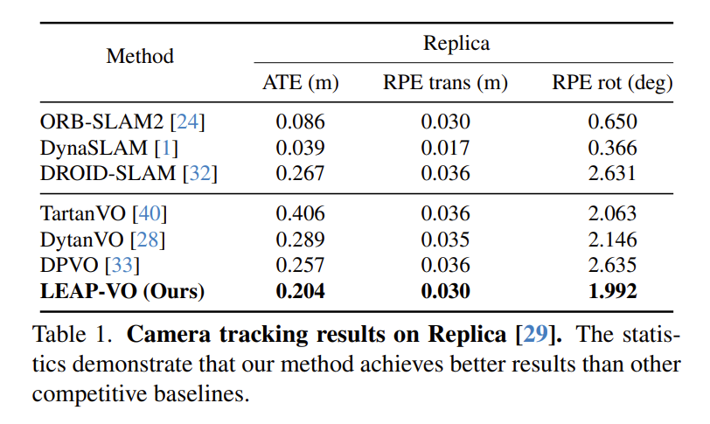
Results - Static Scenes
Key Observations
LEAP-VO outperforms other VO methods in all metrics
Traditional methods (ORB-SLAM2, DynaSLAM) benefit from relocalization
LEAP-VO's temporal context handling improves robustness to occlusions
Our method shows better performance without requiring loop closure
Notes:
Let's first look at the results on the Replica dataset, which features static indoor environments. As shown in the table, LEAP-VO outperforms other visual odometry methods across all metrics.
While traditional SLAM methods like ORB-SLAM2 and DynaSLAM show very good performance here because they incorporate relocalization and loop closure - essentially, they can recover from tracking loss by recognizing previously visited locations. This explains their low ATE values.
Among pure visual odometry methods without relocalization, our LEAP-VO achieves the best results with an ATE of 0.204 meters, significantly better than DROID-SLAM, TartanVO, and other recent approaches.
The key advantage of this method in these static scenes is the ability to handle occlusions.

Slide 14
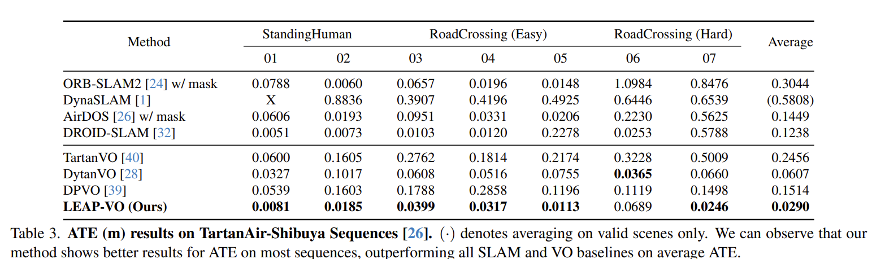
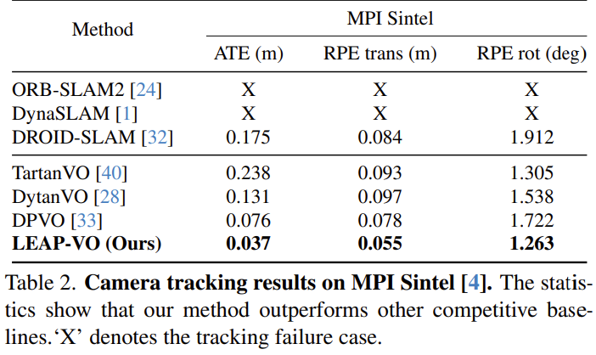
Results - Dynamic Scenes
Notes:
Moving to dynamic scenes, we see LEAP-VO's advantages really shine. On the MPI Sintel dataset, traditional methods like ORB-SLAM2 and DynaSLAM completely fail to track the camera due to moving objects. The 'X' marks in the table indicate tracking failure.
Our method achieves an ATE of just 0.037 meters, which is significantly better than all other approaches.
On the TartanAir-Shibuya dataset, which features multiple moving humans, this approach again demonstrates superior performance
Overall, LEAP-VO achieves an average ATE of 0.0290 meters across all TartanAir sequences.
These results clearly demonstrate that this approach to explicitly modeling dynamic objects and leveraging long-term temporal context leads to substantially more robust camera tracking in challenging real-world scenarios.

Slide 15
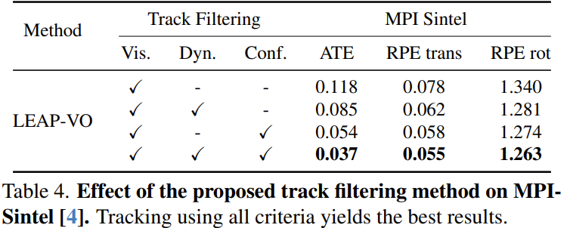
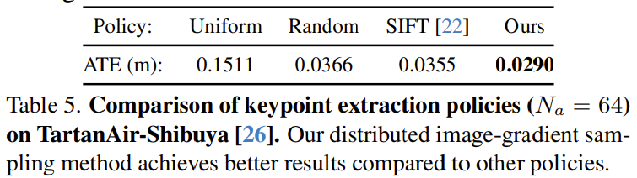
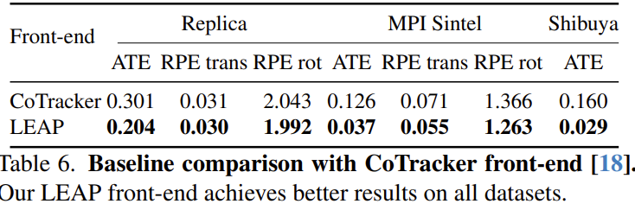
Ablation Studies
Notes:
The ablation studies validate the effectiveness of individual components to the system’s perfomance. First, they examined the impact of track filtering approach on the MPI Sintel dataset. Using only visibility filtering gives an ATE of 0.118 meters. Adding dynamic filtering improves this to 0.085, and adding confidence filtering further improves to 0.054. With all components combined, we achieve our best result of 0.037.
For keypoint extraction, the results show that the distributed gradient-based sampling method achieves the best performance at 0.029 meters ATE, significantly outperforming uniform sampling and slightly better than random sampling and SIFT keypoints.
When comparing LEAP with CoTracker as the front-end, LEAP significantly outperforms CoTracker across all datasets, with especially dramatic improvements on dynamic scenes.

Slide 16
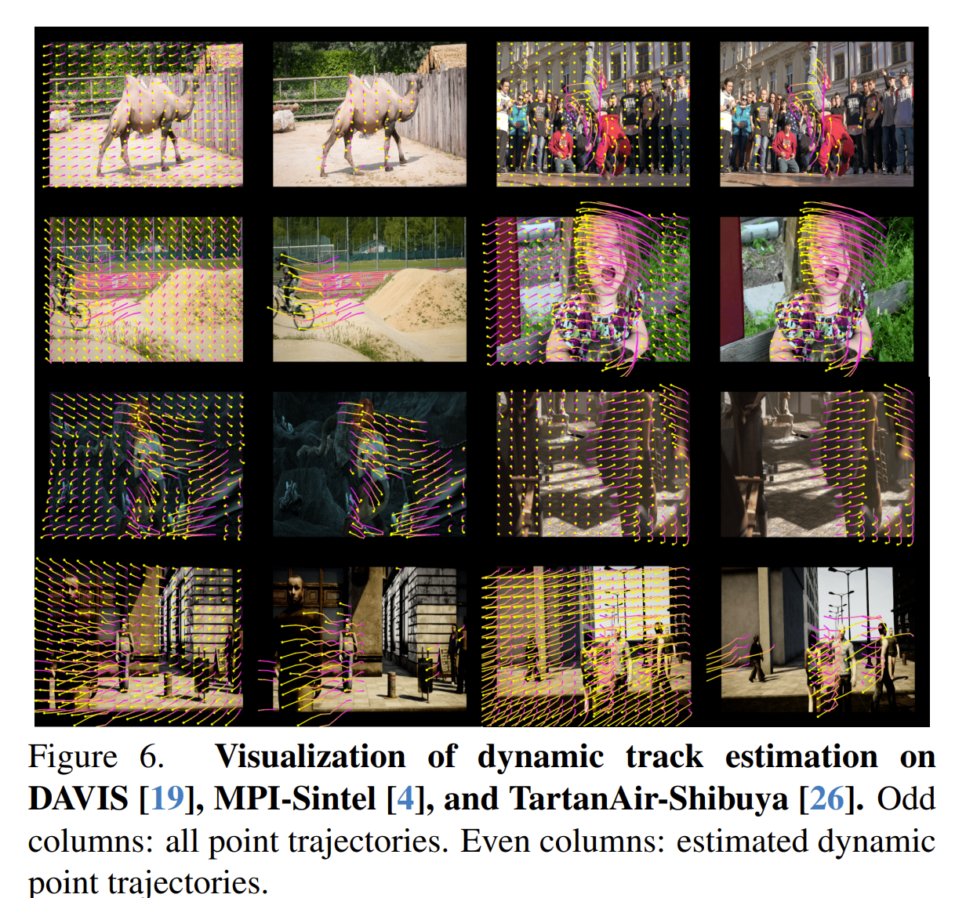
Dynamic Track Estimation Results
Performance Across Different Scenarios
DAVIS: Single object motion with clean background
MPI Sintel: Complex and rapid motion
TartanAir-Shibuya: Multiple moving objects with occlusion
Key Capabilities
Utilizes visual appearance cues
Captures motion patterns through temporal modeling
Leverages inter-object relationships via anchor points
Functions without requiring semantic segmentation labels
Identifies true motion state (not just object category)
Notes:
The dynamic track estimation is a key component of LEAP-VO. Here they present qualitative results across various datasets to demonstrate its effectiveness.
In Figure , we can see visualization results from three datasets. The odd columns show all point trajectories we track, while the even columns highlight only the points identified as dynamic by the model.
On the DAVIS dataset, this method accurately identifies the camel as a moving object while classifying the background as static. For MPI Sintel, which features more complex and rapid motion, this approach successfully captures the dynamic nature of characters and moving objects.
The TartanAir-Shibuya dataset presents the greatest challenge with multiple moving humans. Even here, this method reliably distinguishes between static and dynamic elements in the scene.
What's impressive is that this approach doesn't rely on semantic segmentation labels. Instead, it combines visual cues, temporal information, and inter-track relationships to determine the true motion state of each point. This means we can identify when objects that could move (like cars) are actually stationary, and conversely, when typically static objects are in motion.

Slide 17
Conclusion
Key Contributions
LEAP module combines visual, inter-track, and temporal cues for robust tracking
Temporal probabilistic formulation provides meaningful uncertainty estimates
Anchor-based dynamic track estimation enables effective performance in dynamic scenes
Novel integration of long-term point tracking as visual odometry front-end
Results Summary
Outperforms existing methods across static and dynamic environments
Replica: 20-30% improvement over other VO methods
MPI Sintel: 51% improvement over next best method
TartanAir-Shibuya: 52% reduction in ATE compared to previous state-of-the-art
Impact
Significantly advances visual odometry performance in challenging scenarios
Demonstrates effectiveness of long-term tracking for robust camera pose estimation
Notes:
In conclusion, LEAP-VO presents several significant contributions to the field of visual odometry. The LEAP module effectively combines visual, inter-track, and temporal cues to achieve robust point tracking even in challenging scenarios. The temporal probabilistic formulation provides meaningful uncertainty estimates that improve tracking reliability, while anchor-based approach enables effective handling of dynamic scenes.
What distinguishes this work is the novel integration of long-term point tracking as the front-end for visual odometry. This approach has proven highly effective, with our system significantly outperforming existing methods across various benchmarks. On Replica, we saw 20-30% improvement over other VO methods. On MPI Sintel with dynamic scenes, we achieved a 51% error reduction compared to the next best approach. Most impressively, on the challenging TartanAir-Shibuya dataset with multiple moving objects, we reduced the average trajectory error by 52%.
These results demonstrate that long-term tracking provides a powerful foundation for visual odometry, particularly in environments with occlusions and dynamic objects where traditional methods struggle.

Slide 18
THANK YOU

