Slide 1


B.TECH FINAL YEAR PROJECT PROPOSAL
Generative Three-Dimensional Reconstruction of Biomedical Tissues from Sparse 2D CT/MRI Slices using Conditional Diffusion Models
Student
Gudikandula Sai Charan chary, Ayush chaurasia, Chahanaa Sheth
Roll No: 23BAI1536, 23BAI1543, 23BAI1517
Project Guide
Dr. Sarita Kumari
Assistant Professor, SCOPE
Department of Computer Science & Engineering • VIT Chennai
Notes:
1

Slide 2




INTRODUCTION
From 2D Scans to 3D Anatomy
CT & MRI Imaging
Stacks of 2D Slices
Forming the 3D Volume
CT uses X-rays and MRI uses magnetic fields to capture detailed cross-sectional images of internal anatomy.
Scanners acquire a sequence of parallel 2D slices through the body, each a thin cross-section.
Stacking these slices along the depth axis reconstructs a continuous 3D anatomical volume.
The Challenge of Sparse Scans
To reduce scan time, radiation dose, and cost, clinical protocols often acquire only a sparse subset of slices — leaving gaps that must be reconstructed accurately.
3D Reconstruction of Biomedical Tissues — B.Tech Project Proposal
02 / 12
Notes:
2

Slide 3


PROBLEM STATEMENT
Why Existing Methods Fall Short
Missing slices reduce reconstruction quality
Gaps between acquired slices leave the 3D volume incomplete, lowering resolution and diagnostic reliability.
Existing interpolation techniques are inaccurate
Linear and cubic interpolation blur fine anatomical boundaries and cannot recover realistic tissue detail.
An AI-based reconstruction approach is needed
A learning-based generative model can infer anatomically consistent structure that classical methods miss.
3D Reconstruction of Biomedical Tissues — B.Tech Project Proposal
03 / 12
Notes:
3

Slide 4




OBJECTIVES
What This Project Aims to Achieve
Reconstruct Missing Slices
Recover Complete 3D Volume
Preserve Anatomical Consistency
Improve Visualization Quality
Generate anatomically plausible CT/MRI slices at unsampled positions between sparse inputs.
Assemble the generated and acquired slices into a dense, continuous 3D anatomical volume.
Ensure structural and spatial coherence of organs and tissue boundaries across slices.
Deliver clearer, higher-fidelity volumes for downstream diagnostic and clinical visualization.
3D Reconstruction of Biomedical Tissues — B.Tech Project Proposal
04 / 12
Notes:
4

Slide 5




PROPOSED METHODOLOGY
End-to-End Reconstruction Pipeline
Dataset
Preprocessing
Sparse Slice
Generation
Conditional
Diffusion Model
Missing Slice
Prediction
3D
Reconstruction
Evaluation
A modular pipeline: raw scans are preprocessed and artificially sparsified, then a conditional diffusion model predicts missing slices to reconstruct and evaluate the full 3D volume.
Key idea: reframe missing-slice recovery as a conditional generative modeling problem, not simple interpolation.
3D Reconstruction of Biomedical Tissues — B.Tech Project Proposal
05 / 12
Notes:
5

Slide 6
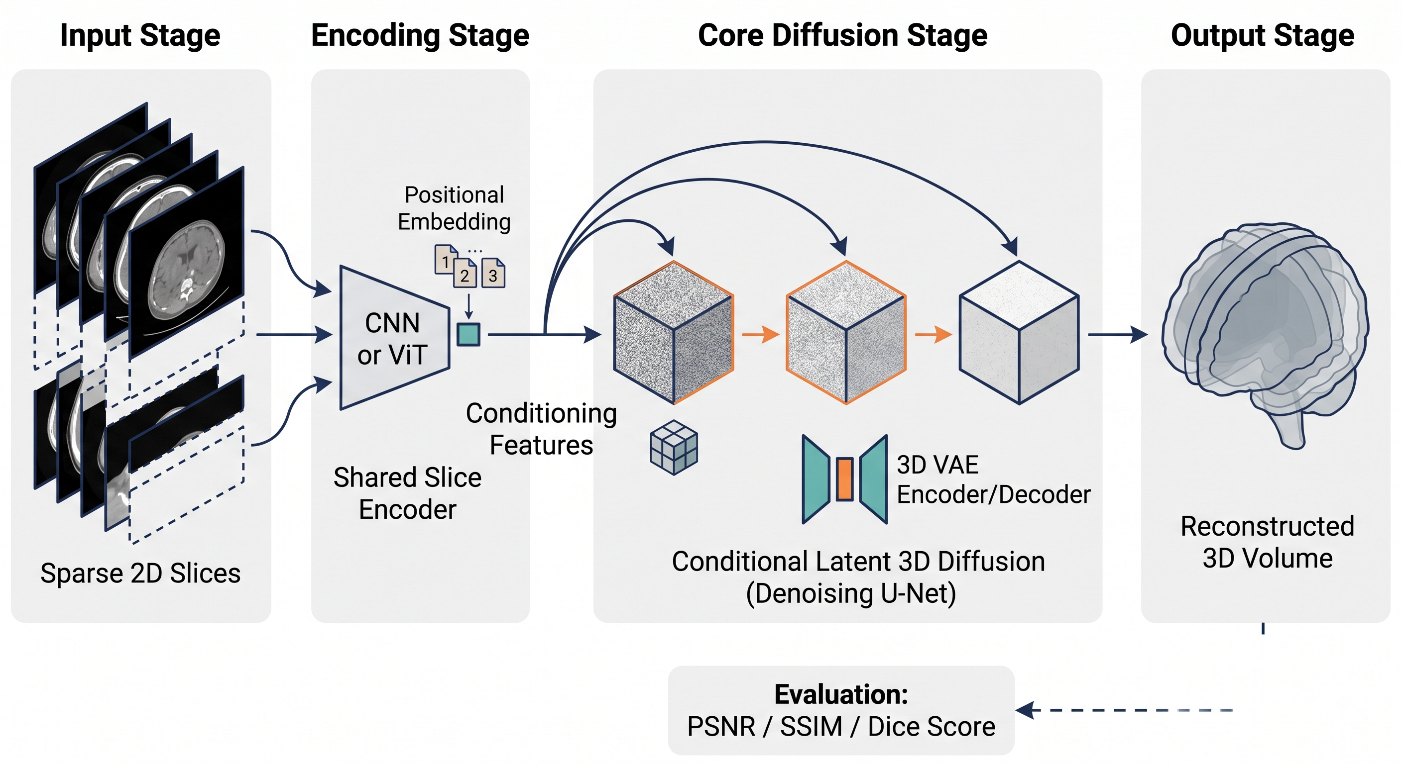

Slide 7



CORE TECHNIQUE
Conditional Diffusion Model
Gaussian Noise Addition
DENOISING PROCESS
A forward process gradually corrupts a clean slice with Gaussian noise over many steps.
Progressive Denoising
A learned reverse process removes noise step-by-step to recover a realistic slice.
Noisy → Denoising → Clean Slice
Conditioning on Neighboring Slices
Adjacent acquired slices guide generation to stay anatomically consistent.
Reverse process:
xT (noise) → xT-1 → … → x₀ (predicted slice), conditioned on neighboring slice context at every step.
U-Net Backbone
A U-Net with skip connections predicts noise at every denoising step.
3D Reconstruction of Biomedical Tissues — B.Tech Project Proposal
06 / 12
Notes:
6

Slide 8
DATASET
Candidate Public Medical Imaging Datasets
Dataset | Organ | Modality | Volumes | Purpose
BraTS | Brain (Tumor) | MRI (T1, T1c, T2, FLAIR) | ~2,000 volumes | Primary dataset — tumor segmentation & reconstruction
LIDC-IDRI | Lung | CT | 1,018 volumes | Nodule detection & sparse-CT benchmarking
ACDC | Heart (Cardiac) | MRI (Cine-MRI) | 150 volumes | Cardiac structure segmentation & motion analysis
Chosen Dataset: BraTS
Selected for its large volume count, multi-modal MRI sequences, and well-established benchmark status — ideal for training and validating the conditional diffusion reconstruction model.
3D Reconstruction of Biomedical Tissues — B.Tech Project Proposal
07 / 12
Notes:
7

Slide 9




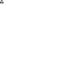




TECHNOLOGY STACK
Tools & Frameworks
Python
PyTorch
MONAI
Core language
Deep learning
Medical AI framework
NiBabel
OpenCV
NumPy
Volume I/O
Image processing
Numerical computing
CUDA
Open3D
PyVista
GPU acceleration
3D data processing
3D visualization
3D Reconstruction of Biomedical Tissues — B.Tech Project Proposal
08 / 12
Notes:
8

Slide 10



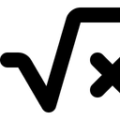
EVALUATION
Evaluation Metrics
PSNR
SSIM
MAE
MSE
Peak Signal-to-Noise Ratio
Structural Similarity Index
Mean Absolute Error
Mean Squared Error
Measures reconstruction fidelity relative to noise — higher values indicate cleaner, more accurate slices.
Compares luminance, contrast, and structure to assess perceptual and anatomical similarity.
Average absolute pixel-intensity difference between predicted and ground-truth slices.
Average squared pixel-intensity difference — penalizes larger errors more heavily.
3D Reconstruction of Biomedical Tissues — B.Tech Project Proposal
09 / 12
Notes:
9

Slide 11
EXPECTED OUTCOMES
Expected Results
Sparse Slices
Generated Slices
Complete 3D Volume
Incomplete input scan
Diffusion-predicted slices
Full anatomical reconstruction
Improved reconstruction quality across PSNR / SSIM / MAE / MSE
Anatomically consistent tissue boundaries preserved across the volume
3D Reconstruction of Biomedical Tissues — B.Tech Project Proposal
10 / 12
Notes:
10

Slide 12




IMPACT
Applications
Medical Diagnosis
Surgical Planning
Tumor Visualization
Medical Education
Low-Dose CT
Radiology
3D Reconstruction of Biomedical Tissues — B.Tech Project Proposal
11 / 12
Notes:
11

Slide 13

CONCLUSION
Conclusion & Future Scope
This project applies conditional diffusion models to reconstruct missing CT/MRI slices, recovering complete, anatomically consistent 3D volumes from sparse 2D scans, improving reconstruction quality over classical interpolation.
FUTURE SCOPE
3D Diffusion Models
Transformer Conditioning
Real-Time Clinical Deployment
Extend from slice-wise 2D diffusion to fully volumetric 3D diffusion architectures.
Incorporate transformer-based attention for richer cross-slice conditioning.
Optimize inference for real-time, clinically deployable reconstruction pipelines.
3D Reconstruction of Biomedical Tissues — B.Tech Project Proposal
12 / 12
Notes:
12

