Slide 1
CMR College of Engineering & Technology
(UGC Autonomous)
Accredited by NAAC with “A” Grade
Kandlakoya, Medchal Road, Hyderabad-501401
Department of Computer Science & Engineering
AGRICULTURAL CROP RECOMMENDATIONS BASED ON PRODUCTIVITY AND SEASON
Batch Number :47
Guide Name:
Mrs. P.Sumathi.
Asst.prof
P. Sai Charan 19H51A05E2
B.Karthik Reddy 19H51A0505
B.Rajesh 18H51A05F6
CMRCET - CSE

Slide 2
Contents
Abstract
Introduction
Literature survey
Existing systems
Proposed system architecture
Methods
Performance measure
Results
Conclusion
References
CMRCET-CSE

Slide 3
Abstract
As a coastal state, Tamil Nadu faces uncertainty in agriculture which decreases its production. With more population and area, more productivity should be achieved but it cannot be reached. Farmers have words-of-mouth in past decades but now it cannot be used due to climatic factors. Agricultural factors and parameters make the data to get insights about the Agri-facts. Growth of IT world drives some highlights in Agriculture Sciences to help farmers with good agricultural information. Intelligence of applying modern technological methods in the field of agriculture is desirable in this current scenario. Machine Learning Techniques develops a well-defined model with the data and helps us to attain predictions. Agricultural issues like crop prediction, rotation, water requirement, fertilizer requirement and protection can be solved. Due to the variable climatic factors o f the environment, there is a necessity to have a efficient technique to facilitate the crop cultivation and to lend a hand to the farmers in their production and management.
This may help upcoming agriculturalists to have a better agriculture. A system o f recommendations can be provided to a farmer to help them in crop cultivation with the help o f data mining. To implement such an approach, crops are recommended based on its climatic factors and quantity. Data Analytics paves a way to evolve useful extraction from agricultural database .Crop Dataset has been analyzed and recommendation of crops is done based on productivity and season.
CMRCET-CSE

Slide 4
INTRODUCTION
Agriculture
Tamilnadu being 7th largest area in India has 6th largest population. It is the leading producer of agriculture products. Agriculture is the main occupation of Tamilnadu people. Agriculture has a sound tone in this competitive world. Cauvery is the main source of water. Cauvery delta regions are called as rice bowl of Tamilnadu. Rice is the major crop grown in Tamil nadu. Other crops like paddy, sugarcane, cotton, coconut and groundnut are grown. Bio-fertilizers are produced efficiently. Many areas farming acts as major source of occupation
Agriculture makes a dramatic impact in the economy of a country. Due to the change of natural factors, Agriculture farming is degrading now-a days. Agriculture directly depends on the environmental factors such as sunlight, humidity, soil type, rainfall, Maximum and Minimum Temperature, climate, fertilizers, pesticides etc. Knowledge of proper harvesting o f crops is in need to bloom in Agriculture. India has seasons
1. Winter which occurs from December to March
2. Summer season from April to June
3. Monsoon or rainy season lasting from July to September and
4.Post-monsoon or autumn season occurring from october to november.
CMRCET-CSE

Slide 5
Literature Survey
Crop and prediction model by Shreya S. Bhanose
Traditional clustering algorithms such as k-Means, improved rough k-Means and-means++ makes the tasks complicated due to random selection of initial cluster center and decision of number of clusters.
Crop knowledge base:
The crop knowledge base consists of farm knowledge such as crop types, soil types, soil-ph value, crop disease and pesticides, seasonal parameter such as kharif, rabbi and summer crops. The knowledge-base also consists of zones as well as district information, environmental parameter such as maximum and minimum temperature value and average rainfall.
CMRCET-CSE

Slide 6
An Analysis of Agricultural Soils by using Data Mining Techniques by Ramesh Babu
Agriculture is the most basic function to accomplish food demand all over the globe it is a backbone particularly in the developing countries like India. The application of Data mining techniques in agriculture especially on soils can revise the situation of pledge making and improve cultivation yields in a better way. The analysis of soils plays an indispensable role for resolution making on several issues related to agriculture field. This paper presents about the role of data mining in perspective of soil analysis in the field of agriculture and also confers about several data mining techniques and their related work by several authors in context to soil analysis domain. The data mining techniques are of very up-to-the-minute in the area of soil analysis.
CMRCET-CSE

Slide 7
Web Based Recommendation System for Farmers by kiran shinde
Agriculture is India's biggest economic sector and employed 52.1% of total work force in 2009-10. Number of farmers in India is 23.4 crores in 2001. As of 2011, India had a large and diverse agricultural sector, accounting, on average, for about 16% of GDP and 10% of export earnings. Today in India agriculture is being neglected which has led to losing hope of farmers in agriculture which has led to rise in the number of farmer suicides.
There is no such universal system to assist farmers in agriculture. India’s population has been rising at 1.6% per annum, which means that the growth in agricultural production must also increase at this minimum rate to ensure that there are no supply bottle necks. Solutions are obvious India must invest in the agriculture sector, in R&D, in irrigation, intermediary-less sales of produce and effective information centres to provide answers to farmers’ queries.
CMRCET-CSE

Slide 8
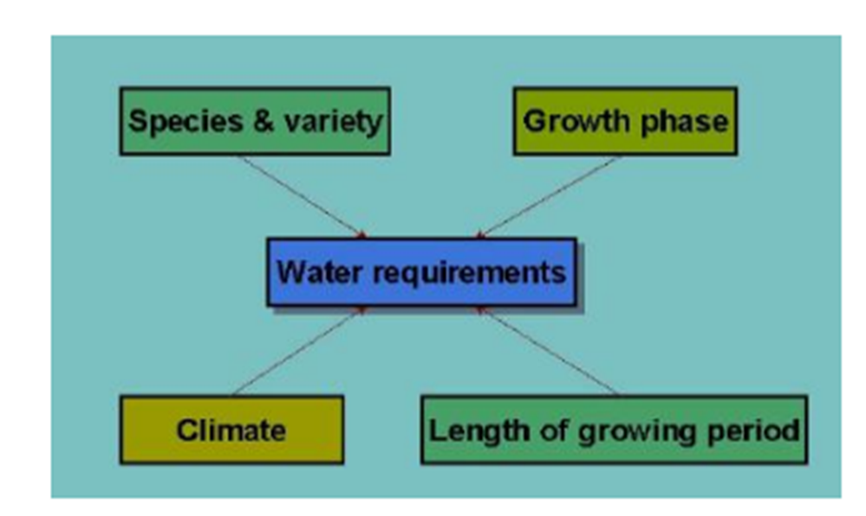
Existing Works
1) Crop and prediction model by Shreya S. Bhanose
Clustering Approaches:
The three clustering approaches is used such as k-Means, k- Means++ and traditional k-Means. The determined value of number of clusters and initial cluster centers is provided to modified k-Means clustering algorithm. Because of the number of clusters (k value) is required at starting for traditional k-Means and k- Means ++, the same calculated value of number of clusters is provided and initial cluster centers are uniformly choosen. All three approaches performed clustering and provide output in the form cluster number and centroid matrix
CMRCET-CSE

Slide 9
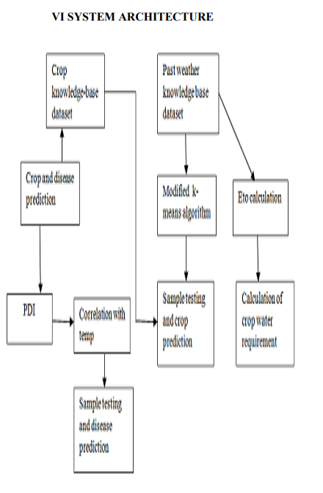


ARCHITECTURE DESIGN
CMRCET-CSE

Slide 10
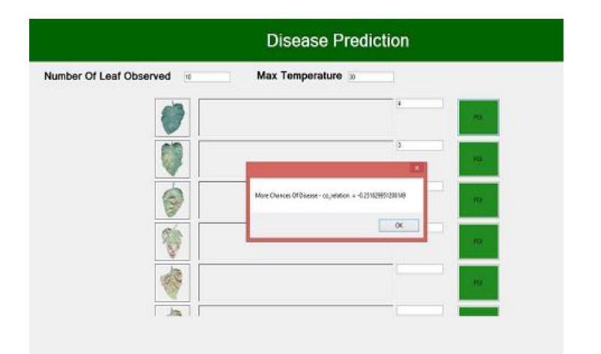
IMPLEMENTATION REPORT
CMRCET-CSE

Slide 11
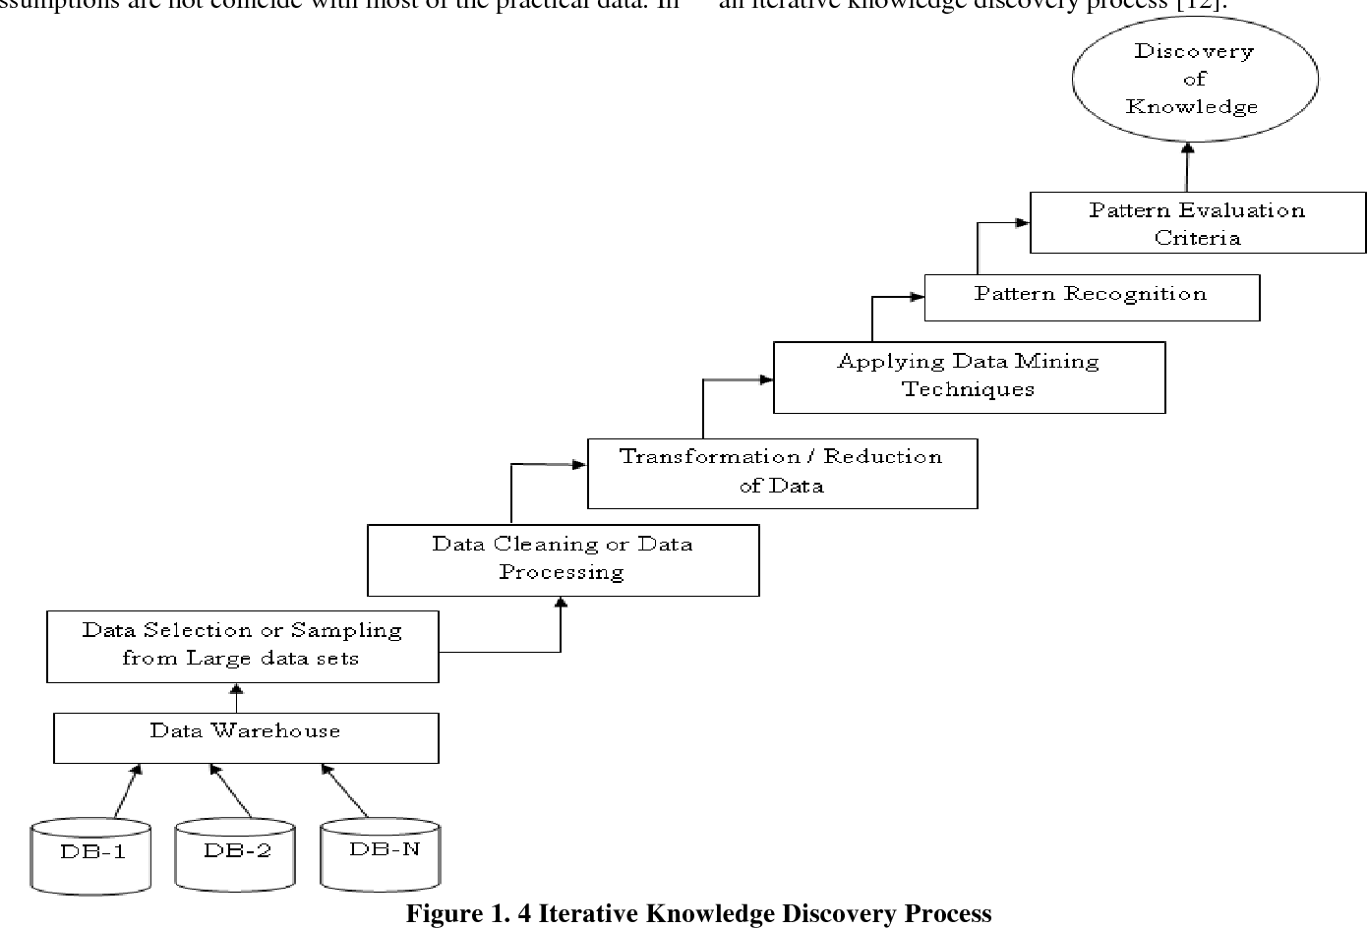
2)An Analysis of Agricultural Soils by using Data Mining Techniques by Ramesh Babu
CMRCET-CSE

Slide 12
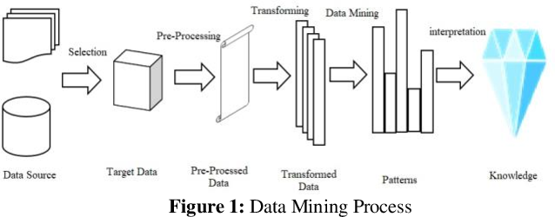
DATA MINING PROCESS
CMRCET-CSE

Slide 13
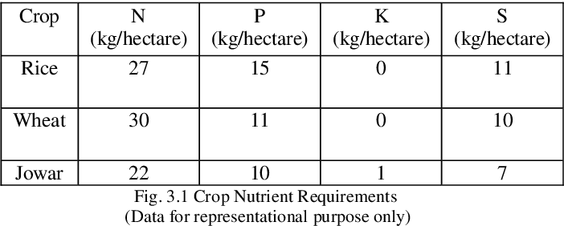
3)Web Based Recommendation System for Farmers by kiran shinde
CROP REQUIREMENTS
CMRCET-CSE

Slide 14
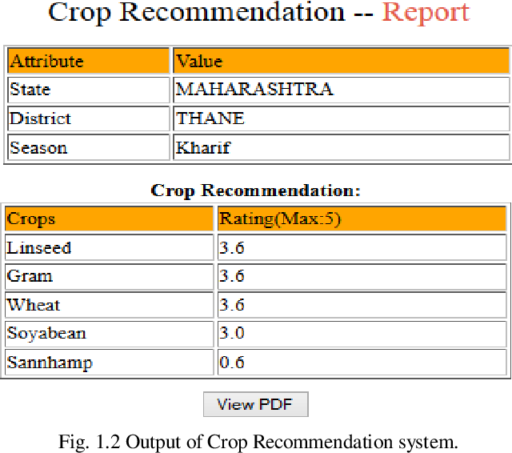

IMPLEMENTATION PROCESS
CMRCET-CSE

Slide 15
Results of Existing System
Parameter | EX-1 | EX-2 | EX-3
Accuracy | 60% | 70% | 75%
Precision | 70 | 80 | 72
Recall | 75 | 40 | 40
F-measure | 30.45 | 45 | 60
Specificity | 20 | 50 | 60
CMRCET-CSE

Slide 16
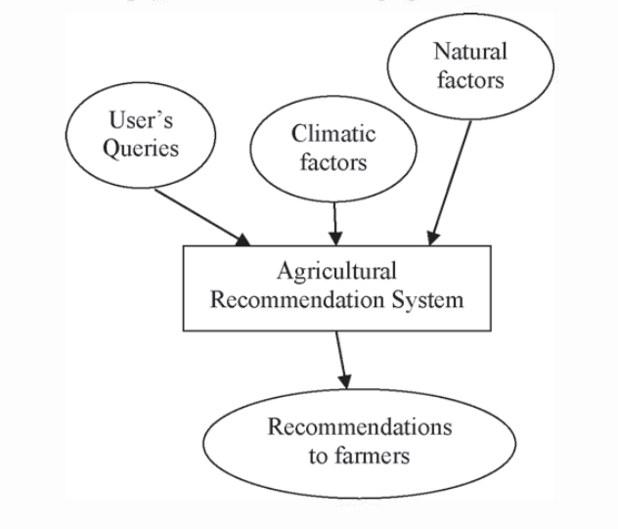
Proposed System
Based upon the factors of agriculture, farmers are given with ideas for their cultivation process. New techniques to increase crop cultivation can also be recommended. Pesticides, fertilizers can also be recommended. Hybrid Recommender system built to recommend agricultural products solves issues like serendipity, ratio diffusion and ramp-up.
CMRCET-CSE

Slide 17
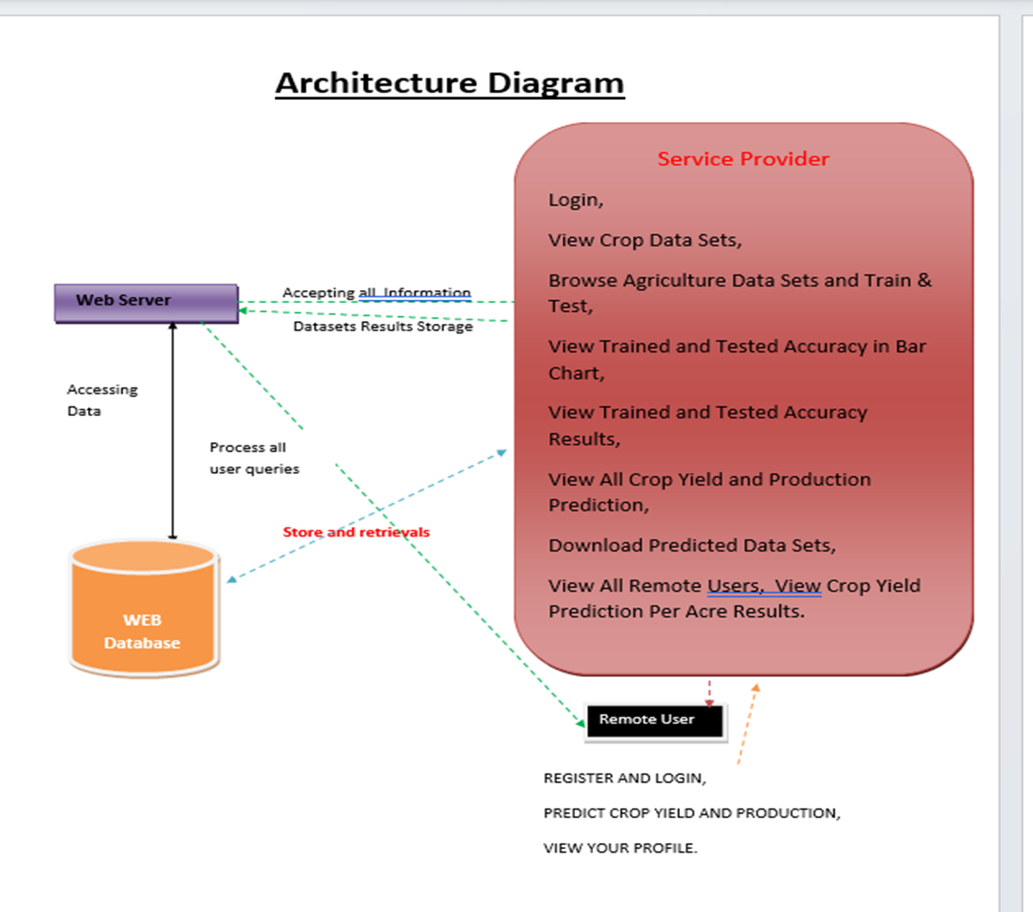
ARCHITECTURE
CMRCET-CSE

Slide 18
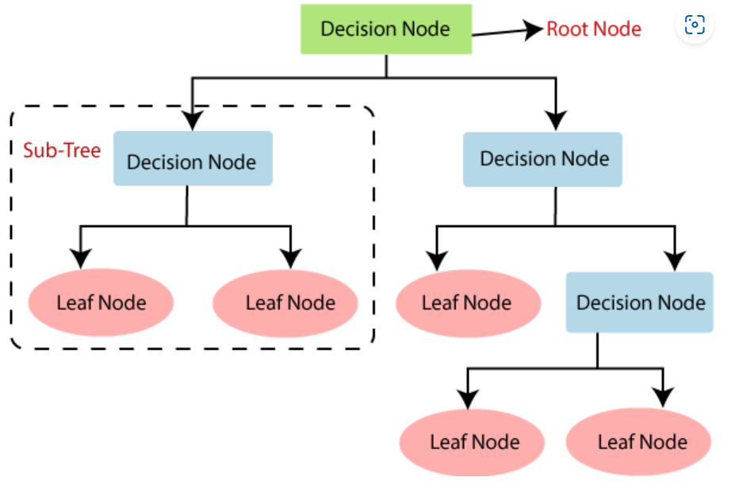
ALGORITHMS OR METHODS
DECISION TREE ALGORITHM
Decision Tree is a Supervised learning technique that can be used for both classification and Regression problems, but mostly it is preferred for solving Classification problems. It is a tree-structured classifier, where internal nodes represent the features of a dataset, branches represent the decision rules and each leaf node represents the outcome.
CMRCET-CSE

Slide 19
RANDOM FOREST ALGORITHM
Random Forest is a classifier that contains a number of decision trees on various subsets of the given dataset and takes the average to improve the predictive accuracy of that dataset.
Below are some points that explain why we should use the Random Forest algorithm:
It takes less training time as compared to other algorithms.
It predicts output with high accuracy, even for the large dataset it runs efficiently.
It can also maintain accuracy when a large proportion of data is missing.
CMRCET-CSE

Slide 20
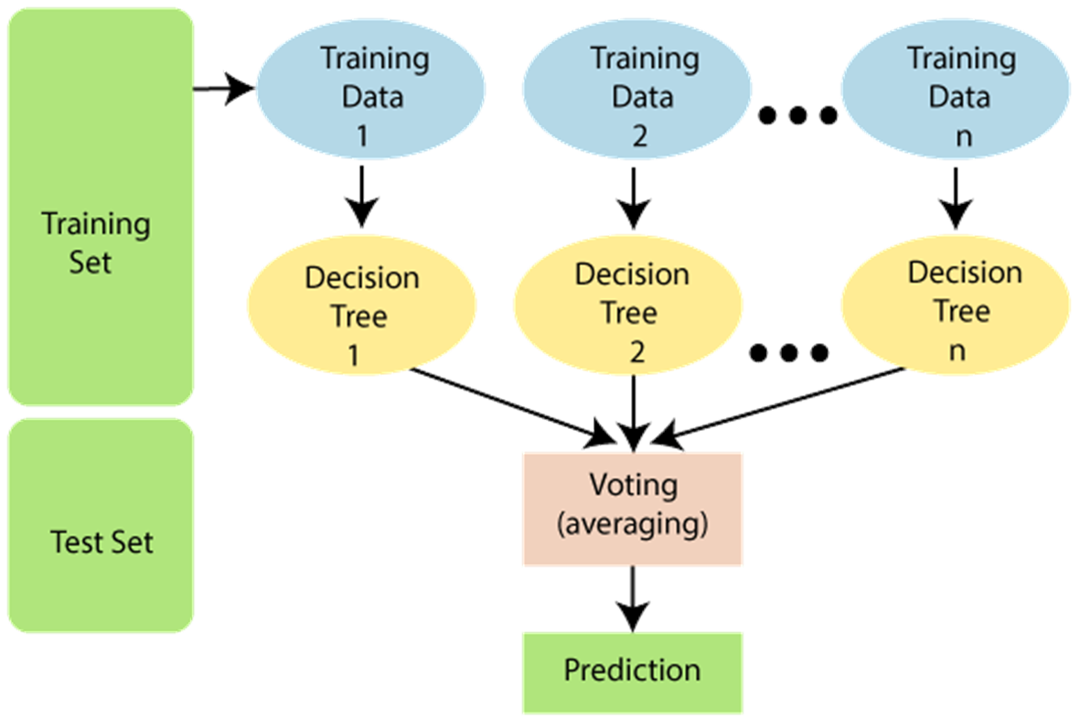
CMRCET-CSE

Slide 21
PASSIVE AGGRESSIVE ALGORITHM
Passive-Aggressive algorithms are generally used for large-scale learning. It is one of the online-learning algorithms. In online machine learning algorithms, the input data comes in sequential order and the machine learning model is updated sequentially, as opposed to conventional batch learning, where the entire training dataset is used at once.
CMRCET-CSE

Slide 22
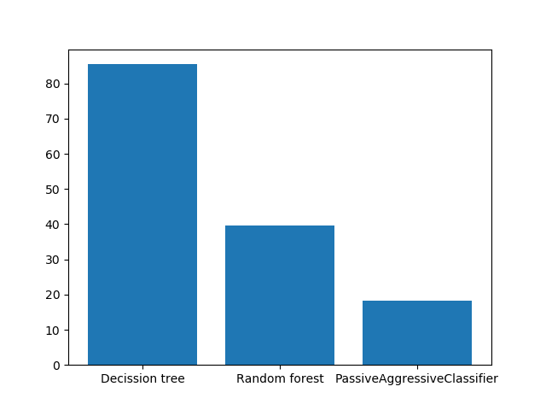
PERFORMANCE MEASURE
CMRCET-CSE

Slide 23
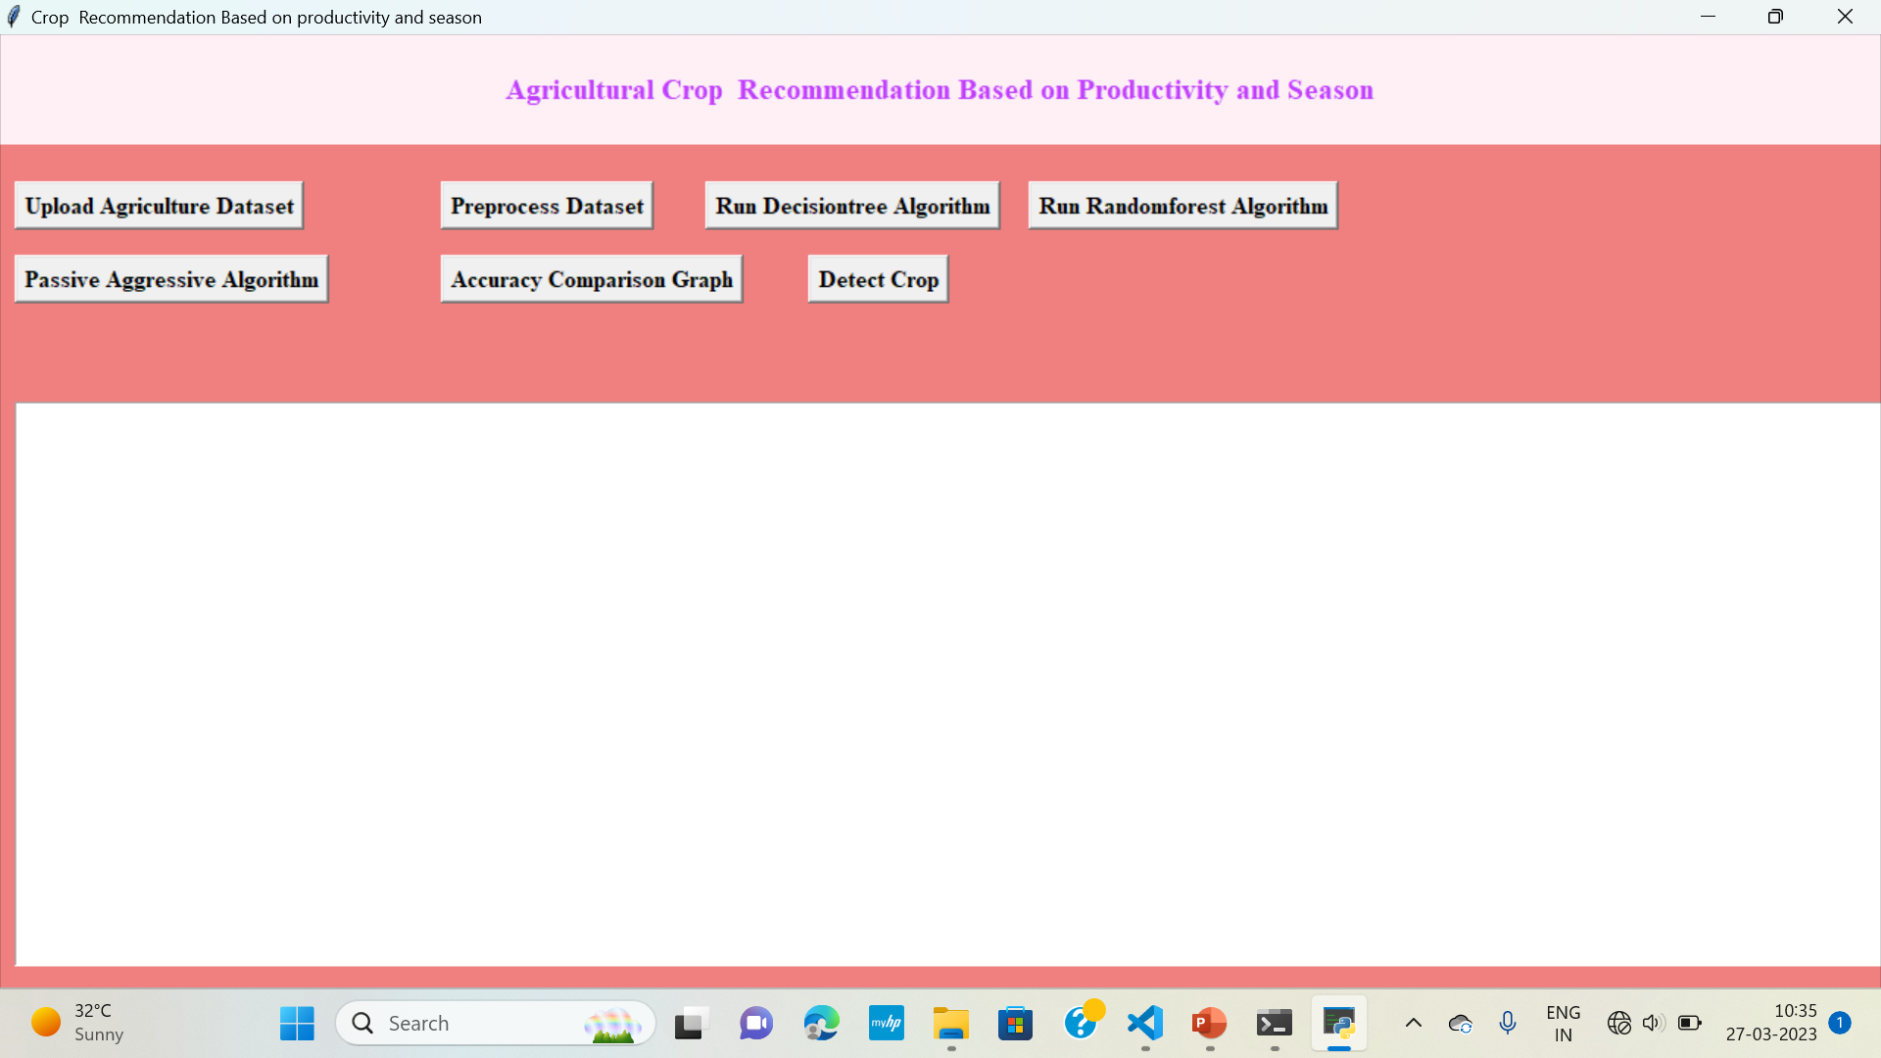
RESULTS
CMRCET-CSE

Slide 24
CONCLUSION
In this paper, significance o f management of crops was studied vastly. Farmers need assistance with recent technology to grow their crops. Proper prediction of crops can be informed to agriculturists in time basis. Many Machine Learning techniques have been used to analyze the agriculture parameters. Some o f the techniques in different aspects o f agriculture are studied by a literature study. Blooming Neural networks, Soft computing techniques plays significant part in providing recommendations. Considering the parameter like production and season, more personalized and relevant recommendations can be given to farmers which makes them to yield good volume of production
CMRCET-CSE

Slide 25
REFERENCES
[1] Shreya S. Bhanose, Kalyani A. Bogawar (2016) “Crop And Yield Prediction Model”, International Journal of Advance Scientific Research and Engineering Trends, Volume 1,Issue 1, April 2016
[2] Tripathy, A. K., et al.(2011) "Data mining and wireless sensor network for agriculture pest/disease predictions." Information and Communication Technologies (WICT), 2011 World Congress on IEEE.
[3] Ramesh Babu Palepu (2017) ” An Analysis of Agricultural Soils by using Data Mining Techniques”, International Journal of Engineering Science and Computing, Volume 7 Issue No. 10 October.
[4] Rajeswari and K. Arunesh (2016) “Analysing Soil Data using Data Mining Classification Techniques”, Indian Journal of Science and Technology, Volume 9, May.
[5] A.Swarupa Rani (2017), “The Impact of Data Analytics in Crop Management based on Weather Conditions”, International Journal of Engineering Technology Science and Research, Volume 4,Issue 5,May.
CMRCET-CSE

