Slide 1

Software Engineering Processes SOEN 6011
Prof. Dr. Kamthan Summer 2020
Github URL: https://github.com/Saicharanduduka/SOEN-6011-TEAM-D SESTOPIA URL: http://sestopia-d.epizy.com/?i=1
Team D - SESTOPIA

Slide 2
Introduction
SESTOPIA is an intensive and responsive web application to provide knowledge based technical and non-technical information for different skills that are desirable to software engineer to be skilled in particular area of software engineering and will be accessible to anyone from anywhere who connected to internet.
It has search functionality to find content with respect to the user input

Slide 3
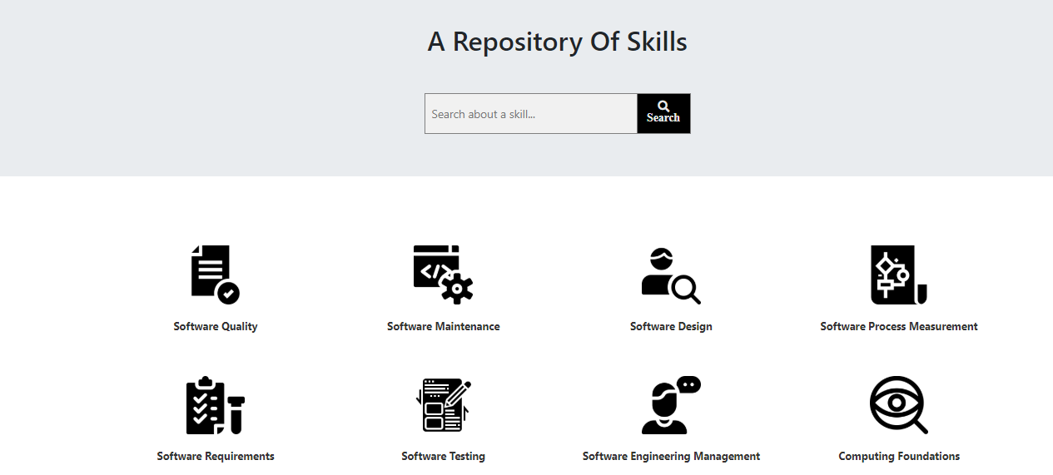
User Interface of SESTOPIA

Slide 4
Risks
Like all projects especially in software development, there are always some risks for stakeholders such as developers, or any person who involved in a project. In our project we have faced with some risks that are listed in below:
Misunderstanding about the scope of the project
Tools
Proper Technology
Compatibility

Slide 5
Risk Cont’d (Misunderstanding the Scope)
The first risk that we faced was about understanding the scope of the project and avoiding to have a misunderstanding about it.
For reducing this risk we held many meetings with all team members and followed the agile process to avoid any misleading during the project.
We kept discussion and the meeting every days for sharing any issues that we faced with and resolving them.

Slide 6
Risk Cont’d (Tools)
We have used some tools which are listed below, that help to introduce risk during developing and designing the project due to non-equivalent knowledge of all team members in working with:
PHP - it is one the powerful programming language for developing website.
MySQL - it is one of the popular database system.
Html - it is the standard markup language for designing document in a web browser [3].
CSS - it is a style sheet language that is used for designing and styling html documents.
JavaScript - it is a powerful programming language to make animation and good functionality in web development.
Bootstrap - a tool framework for responsive website design that is based on CSS and JavaScript.
Font Awesome - it is a tool for icon and font based on CSS [4].
Apache - it is a web server software platform.
GitHub - it is one of the common version control system.

Slide 7
Risk Cont’d (Technology)
One of our major concern for designing and developing website was about choosing proper and reliable technology based on our project scope.
At first we used JavaScript as a backend of website for handling search engine by adding all contents into one JavaScript file and retrieve them by another JavaScript file, that was risky for searching and unreliable, then we use most powerful technology like PHP and database (MySQL) to handle the search engine.
Risk (Compatibility)
The compatibility of our developed website with the most common browser such as Google Chrome, Mozilla Firefox, Safari, Internet Explorer (IE), was our concern during this project

Slide 8
Direction for potential improvement
Meeting: More frequent meetings.
Use of graphical tools, charts for representation of task updates.[2]
Change control managements[6] for reducing code conflicts, check in/check out.
Proper commit messages.
Setting up branching mechanism.
Completing work items on time.

Slide 9
Challenges
There are number of challenges which are listed in the following that we had during the project:
Responsive design - today it is very important to develop responsive website for all devices.
Navigability - it was challenging for us to use proper methods for having high navigability in our website.
Accessibility - it was challenging for us to meet the standard such as WCAG 2.0
User experience
Design - like all websites, it is always challenging to have interesting design for users
Quality - it is always challenging for any product especially in software development.
Time - one of the main challenge for us was time, especially during summer semesters.
Web developing knowledge - it was challenging for all member with difference knowledge in web development.
Testing - it is challenging for all developer to perform and use a proper testing tools.

Slide 10
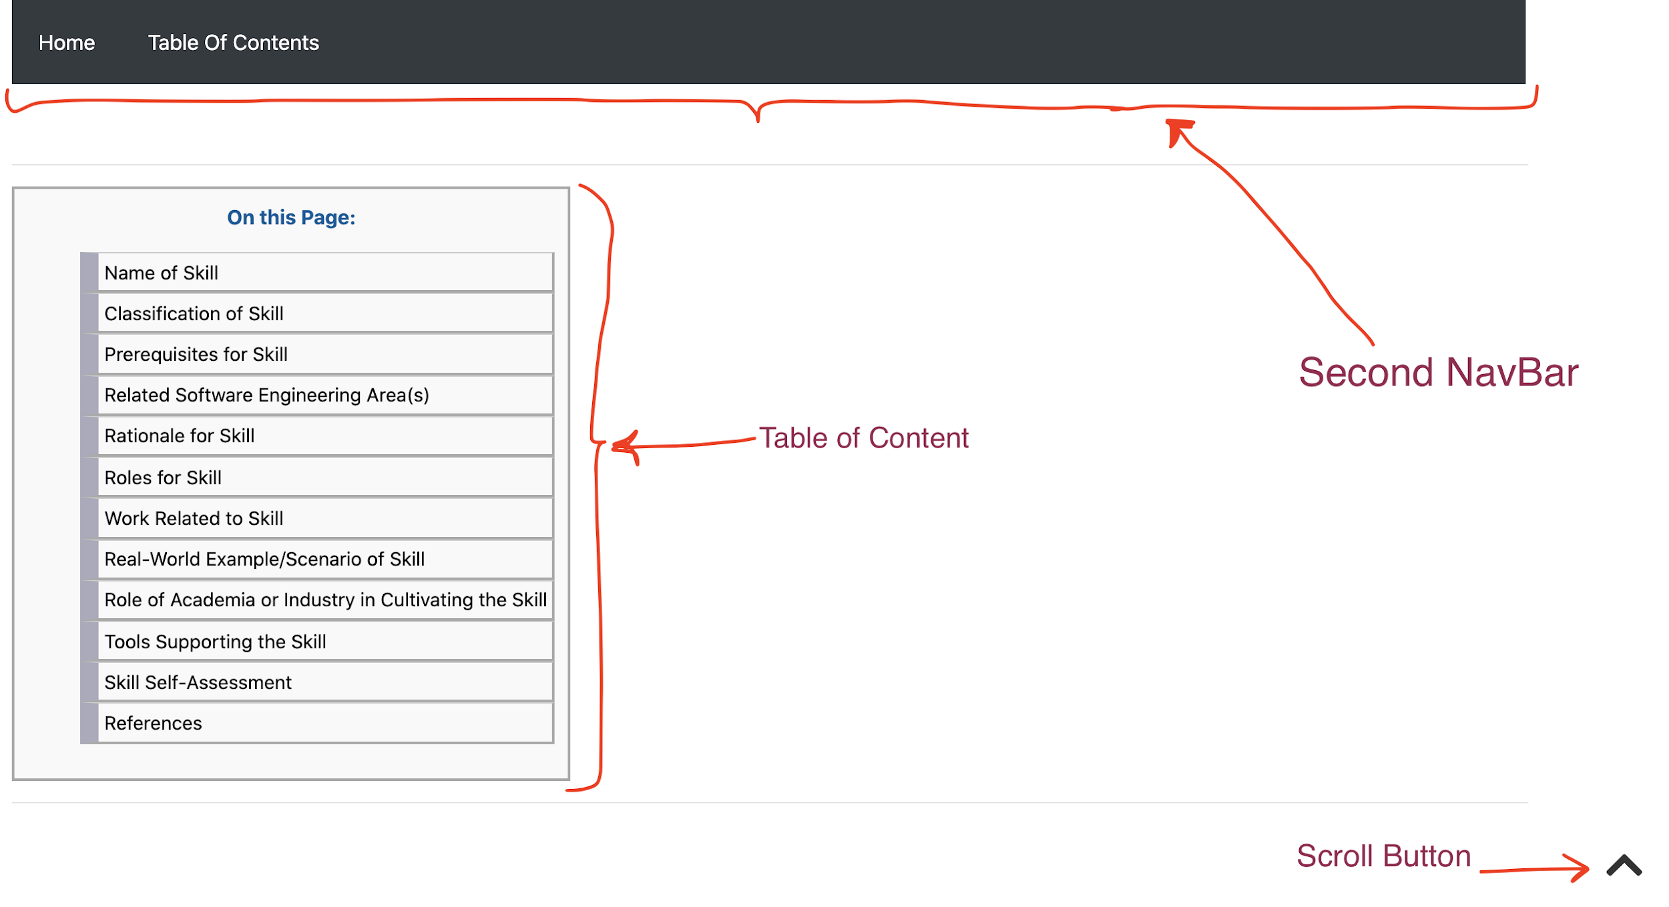
Challenges Cont’d (Navigability)
We use some methods such as Scroll Button, Second Navbar and Table of Content to provide good navigability and accessibility in our website, as you see the below photo is a sample of our website:

Slide 11
Lessons Learnt
Adopting to virtually pair programming style as we have 8 members in a team with consistent meetings.
Understanding of project description much thoroughly before deciding the template and start coding
Having Many short meetings with clear agenda instead of having long status update meetings
Performing a root cause analysis on project problems and engage the appropriate team member to implement solutions.

Slide 12
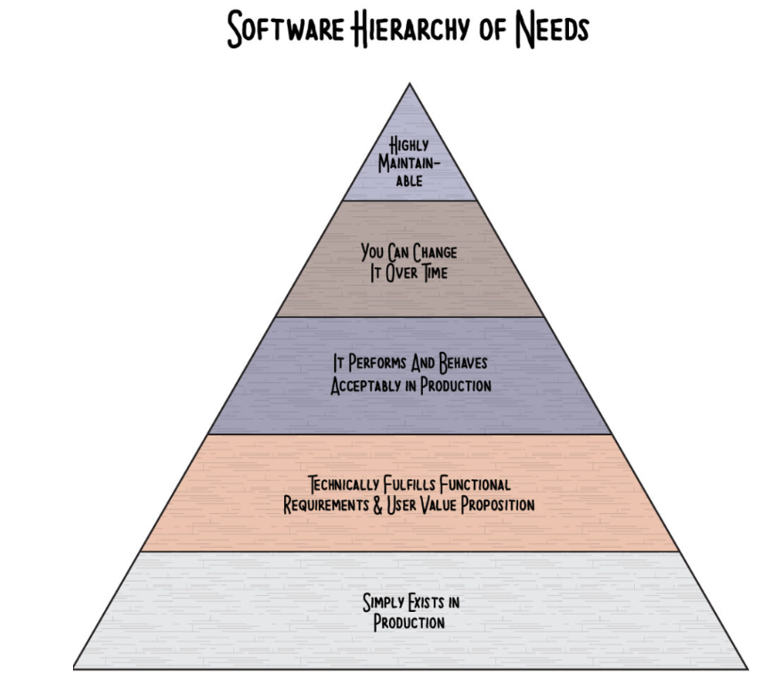
Most important lesson learnt

Slide 13
Project Retrospective
What went wrong
Team member schedules didn't always match due to time zone differences
Some tasks would pending completion based on lectures (dependence on course theory)
What went right
Working productively, virtually, no in-person interactions (COVID-19)
What can be improved
Proper commit messages
Change management control to avoid code conflict

Slide 14
Acknowledgements
We would like to acknowledge and thank:
Professor Dr. Kamthan for explanations on the project and correlation with course material.
Our TA’s for their continuous guidance and support via P.O.D sessions and email.

Slide 15
References
[1] https://www.potential.com/articles/project-scope/
[2] https://www.pmi.org/learning/library/five-elements-process-oriented-project-6946
[3] https://en.wikipedia.org/wiki/HTML
[4] https://en.wikipedia.org/wiki/Font_Awesome
[5]https://blog.lucidmeetings.com/blog/how-to-lead-a-successful-project-retrospective-meeting
[6] http://s3.sitepoint.com/examples/git-project-changes.pdf

Slide 16
Thank you

