Slide 1

Software Engineering Processes SOEN 6011
Prof. Dr. Kamthan Summer 2020
GitHub URL: https://github.com/Saicharanduduka/SOEN-6011-TEAM-D SESTOPIA URL: http://sestopia-d.epizy.com/?i=1
Team D - SESTOPIA

Slide 2
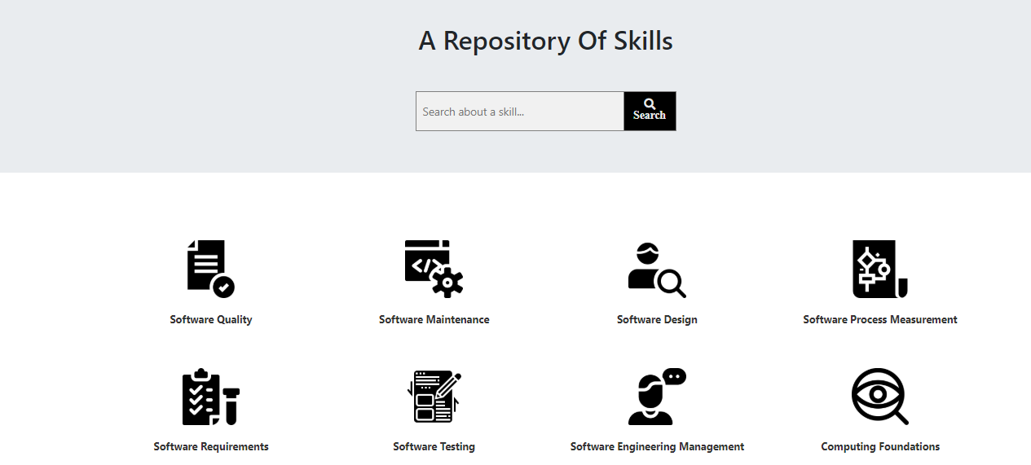
SESTOPIA User Interface (UI)

Slide 3









Risk & Cont’d (Misunderstanding the Scope)
We held many meetings with all team members and followed the agile process to avoid any misleading during the project.
We kept discussion on the meetings on a daily base sharing any issues that we faced with and resolving them.
Risk & Cont’d(Tools)

Slide 4
Risk Cont’d (Technology)
At first, we used JavaScript solely for handling the functionalities of the website, that lead us to some downsides, then we change the approach to use PHP for backend and a database (MySQL) to handle the skill content instead of a JavaScript file.
Risk (Compatibility)
We had the concern of making SESTOPIA website compatible with most of the common browsers such as Google Chrome, Mozilla Firefox, Safari, Internet Explorer (IE).

Slide 5
Challenges
Responsive design
Navigability
Accessibility
Design
Quality
Time
Web developing knowledge
Testing

Slide 6
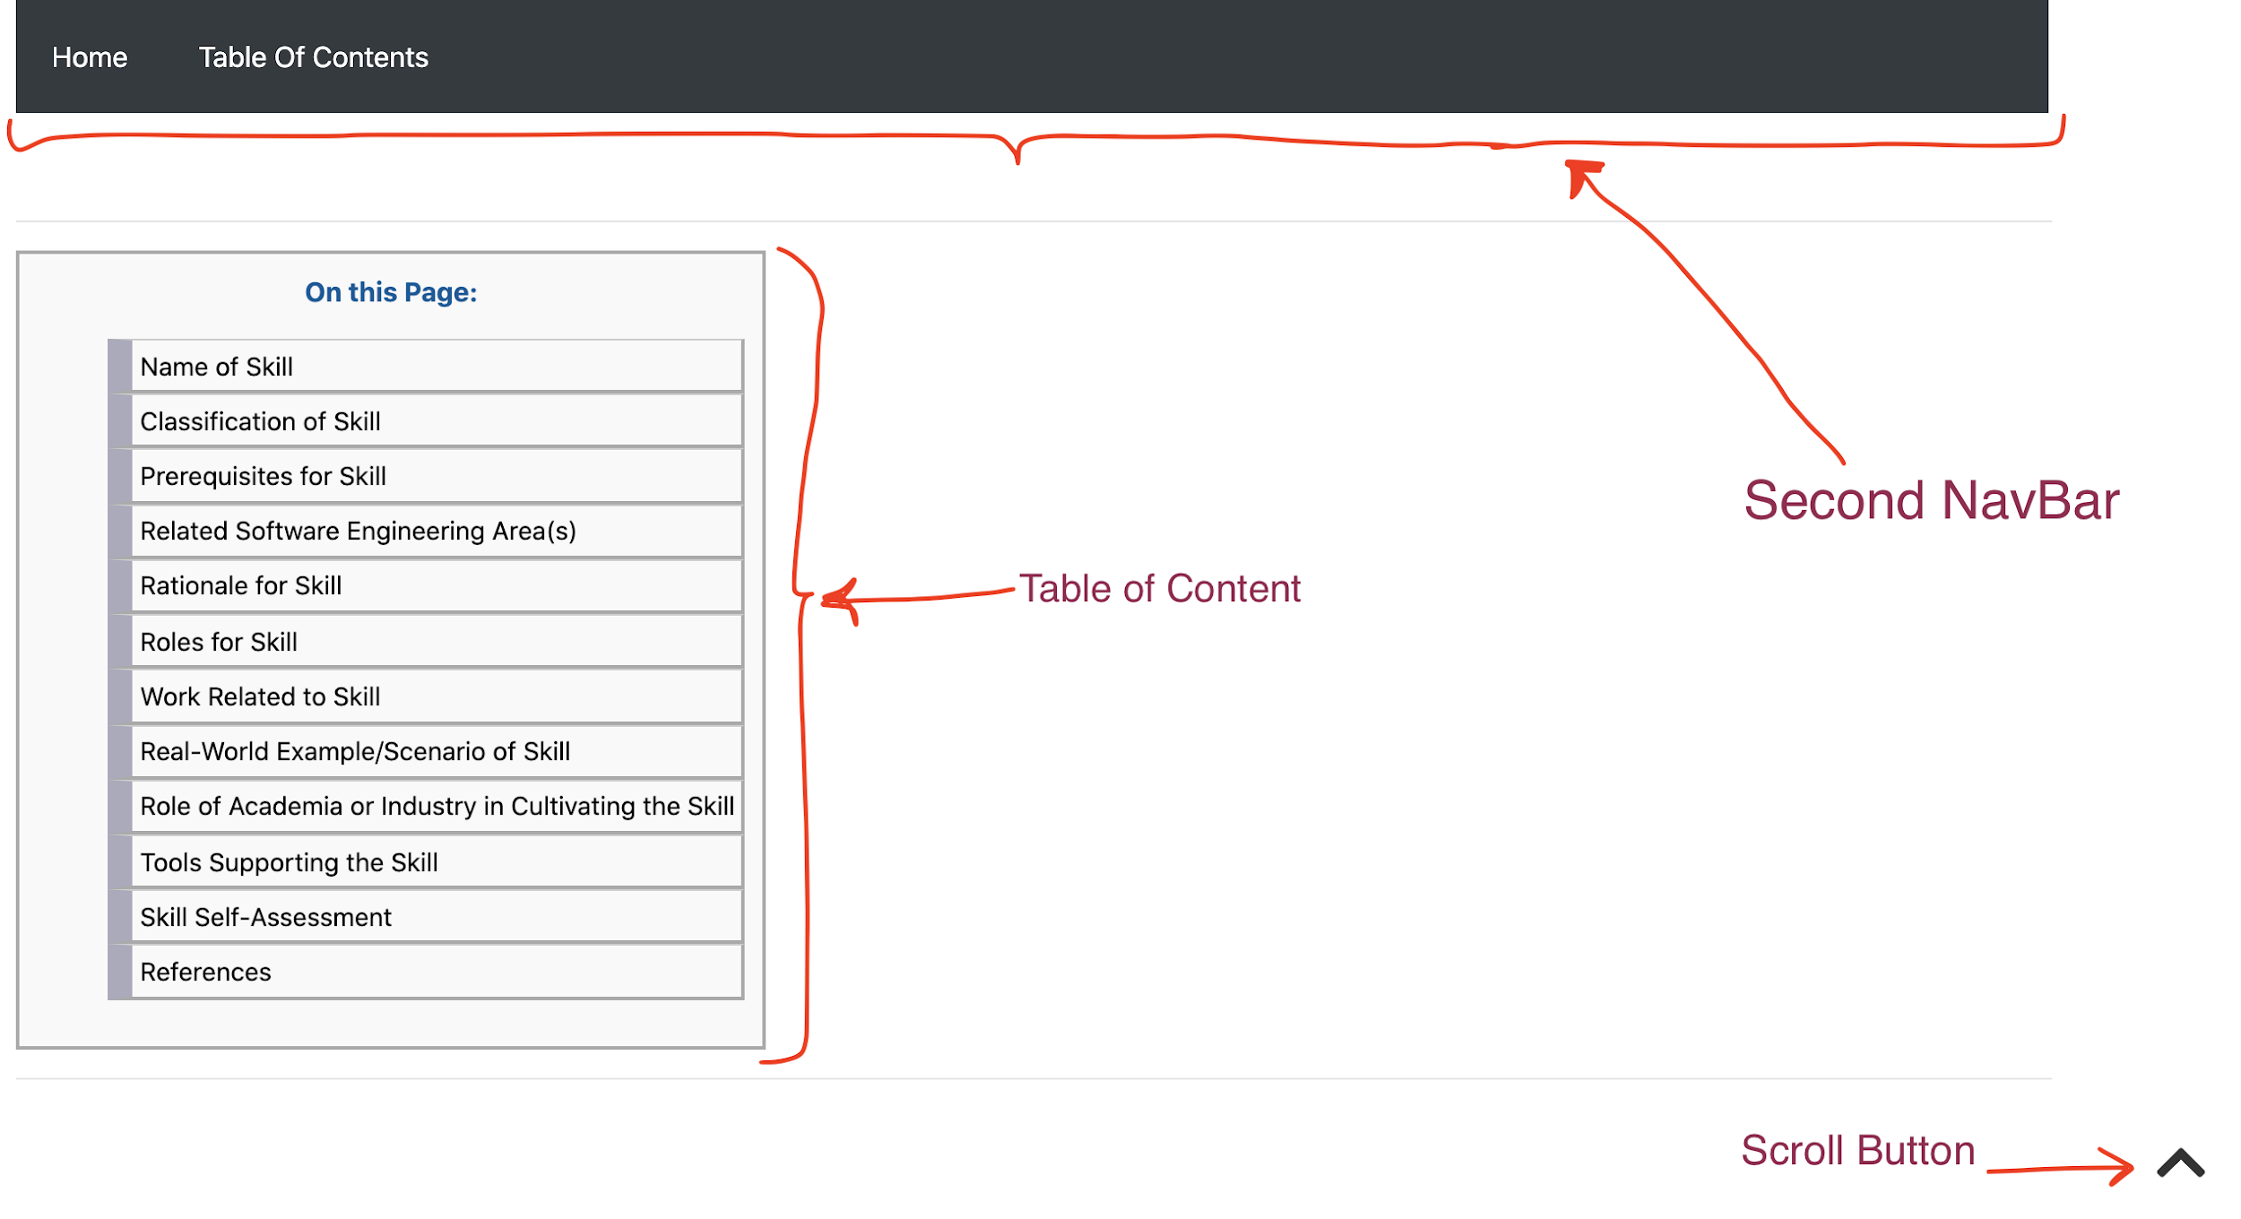
Challenges Cont’d (Navigability)

Slide 7
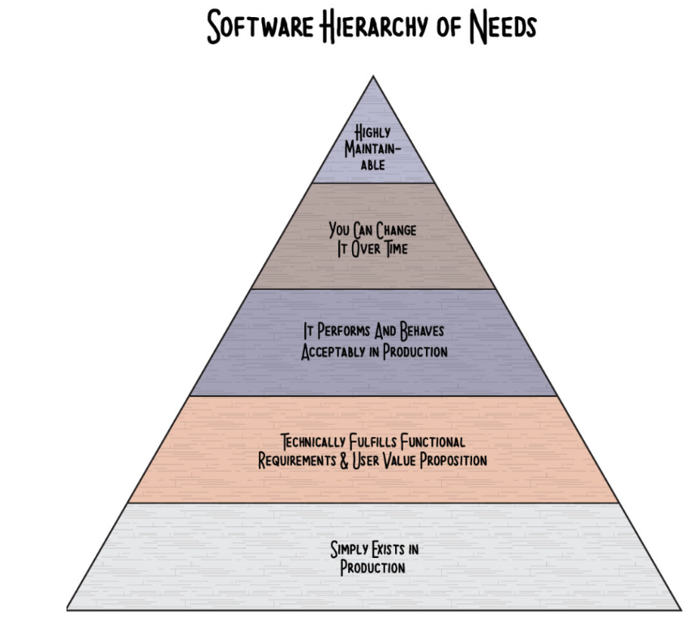
Most important lesson learnt

Slide 8
Project Retrospective
What went wrong
Team member schedules didn't always match due to time zone differences
Some tasks would pending completion based on lectures (dependence on course theory)
What went right
Working productively, virtually, no in-person interactions (COVID-19)
What can be improved
Proper commit messages
Change management control to avoid code conflict

Slide 9
Acknowledgements
We would like to acknowledge and thank:
Professor Dr. Kamthan for explanations on the project and correlation with course material.
Our TA’s for their continuous guidance and support via P.O.D sessions and email.

Slide 10
References
[1] https://www.potential.com/articles/project-scope/
[2] https://www.pmi.org/learning/library/five-elements-process-oriented-project-6946
[3] https://en.wikipedia.org/wiki/HTML
[4] https://en.wikipedia.org/wiki/Font_Awesome
[5] https://blog.lucidmeetings.com/blog/how-to-lead-a-successful-project-retrospective-meeting
[6] http://s3.sitepoint.com/examples/git-project-changes.pdf

Slide 11
Thank you

