Slide 1

// NATIONAL DISASTER RESPONSE COMMAND
RESCUENAV SYSTEM
Graph-Based Emergency Pathfinding Engine & Interactive Web Dashboard.
DEVELOPED BY: Parasa Bhavyaswi (12502256) Pudi Sai Charan Teja (12507339)
TEAM 9PV33: Ganta Gangadhar (12523696) Kola Midhun Kumar (12524467)
LPU • DEPT. OF CSE (AI & ML) • 2026-27

Slide 2
PROJECT OVERVIEW
PROBLEM
• Natural disasters cause severe transport blockages, cutting off critical road links.
• Rescue coordinators lack visibility on road passability and dynamic safety levels.
• No existing open-source tool integrates routing with local hospital bed and shelter capacities.
OBJECTIVES
• Model 36 cities as weighted graphs using adjacency lists for memory efficiency.
• Implement and compare BFS, DFS, Dijkstra, and A* algorithms for optimal route planning.
• Provide interactive web visualization of shortest rescue routes and resource locations.
KEY NEEDS
• India faces 27+ disaster types annually, requiring rapid emergency response.
• Manual routing and coordination fail under high-stress crisis scenarios.
• An integrated, DSA-powered navigation system is a national necessity for safety and efficiency.

Slide 3
TECHNOLOGY STACK
FRONTEND & VIZ
• HTML5 / CSS3 / JavaScript (ES6+): Built a clean, responsive, dark-themed user dashboard.
• Leaflet.js & OpenStreetMap: Renders interactive map canvas, route polylines, and dynamic resource markers.
• Operations Dashboard: Unified control center for disaster toggles and routing selections.
BACKEND ENGINE
• C++ STL (Min-Heap, Priority Queue): Executes core routing and connectivity calculations.
• Node.js & Express REST API Layer: Standardizes communications between client and database/engine.
• Compiled C++ Binary Bridge: Direct stdin/stdout execution bridge (DisasterSystem.exe) for local speed.
DATA STORAGE: CSV / JSON | DEV TOOLS: VS CODE / GIT | API TYPE: RESTful

Slide 4
SYSTEM ARCHITECTURE
User Layer:
Emergency Responders & Coordinators input disaster details and request routing via the web dashboard.
API Layer:
Node.js & Express server receives client inputs, parses JSON data, and handles command-line arguments.
C++ Pathfinding Engine:
Core algorithmic module utilizing optimized C++ structures to compute shortest path in sub-milliseconds.
Data Layer:
Loads and updates CSV/JSON databases for road maps, hospitals (bed counts), shelters, and active response teams.
USER LAYER
Web Dashboard • Emergency Responders • Coordinators
API LAYER
Node.js + Express • REST Endpoints • Request Routing
C++ PATHFINDING ENGINE
BFS • DFS • Dijkstra • A* • 36-Node City Graph
DATA LAYER
Hospitals • Shelters • Rescue Teams • Live Locations

Slide 5
PATHFINDING ALGORITHMS
BFS / DFS
• Used for Connectivity Analysis of the road network.
• BFS explores level-by-level (using a Queue) to find shortest path in terms of hops.
• DFS explores recursively (using a Stack) to check overall graph connectivity.
• COMPLEXITY: O(V + E)
DIJKSTRA
• The Shortest Path specialist for weighted graphs.
• Computes safety-aware paths utilizing a Min-Heap priority queue to fetch the lowest cost node.
• Safety Weight Formula: Edge Cost = Distance * (1.0 + (Danger Level - 1) * 0.3)
• COMPLEXITY: O(E log V)
A* SEARCH
• Goal-directed pathfinding utilizing heuristic search f(n) = g(n) + h(n).
• Heuristic h(n) uses the Haversine formula to compute great-circle distance using city coordinates.
• Reduces search space and expanded nodes by up to 56% compared to Dijkstra.
• COMPLEXITY: O(E log V)

Slide 6
DATA STRUCTURES
GRAPH REPRESENTATION
• Adjacency List: Models the transportation network of 41 cities and 69 connecting highways.
• Highly memory-efficient O(V + E) storage structure, ideal for sparse road systems.
• Dynamically scalable: Allows instant modification of edge weights and danger ratings.
• Alphabetical sorting of adjacency lists ensures determinism in traversals.
MEMORY MANAGEMENT
• Vector: Used for dynamic path storage, offering contiguous memory and O(1) random access.
• Priority Queue: Backed by binary min-heap for O(log V) retrieval of minimum-distance node.
• Hash Maps (unordered_map): Provides O(1) average lookup for city coordinates and metadata.
• Stack & Queue: Standard DFS recursion stack and BFS level-order queues.
Distance Formula (u, v) = √[(x_v - x_u)² + (y_v - y_u)²]

Slide 7
CORE MODULES
Operations Dashboard
• Live statistics loaded from JSON datasets.
• Provides dynamic weather info, routing toggles, and algorithm selection panels.
• Visualizes active disaster zones and affected highway coordinates.
Route Planning
• Selects source and destination cities interactively.
• Executes C++ engine pathfinders locally or falls back to serverless JS router.
• Supports dynamic road blockage simulation by setting safety danger scores.
Emergency Resources
• Scans for nearby hospitals and lists active phone lines and bed counts.
• Identifies designated emergency shelters with capacities and occupancy levels.
• Matches and details local search-and-rescue teams (SDRF) for immediate dispatch.
Dataset Management
• Manages files in comma-separated values (CSV) formats.
• Reads and writes new data, updates road maps, and auto-rebuilds the graph.
• Integrates hierarchical JSON datasets for active disaster alerts.

Slide 8
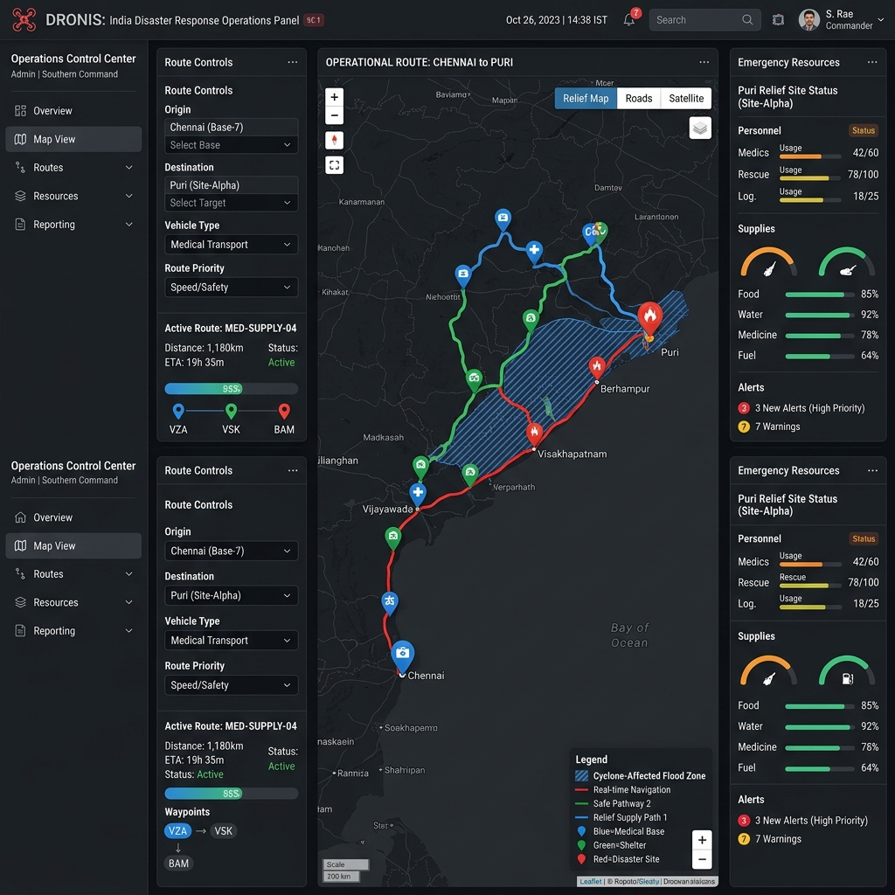
EXECUTION RESULTS
Optimal Routing:
Successfully calculated Jammu to Bengaluru route (2790 km) in 3350 mins. The engine bypassed active flood zones dynamically.
Latency:
Core C++ engine average pathfinding latency: 0.04 ms. Serverless cloud fallback execution latency: under 12 ms.
Adaptability:
System dynamically recalculates alternative paths when specific highways are blocked (e.g., Patna-Kolkata corridor).
CITIES: 36 | ACCURACY: 100%

Slide 9
PERFORMANCE METRICS
ALGORITHM | COMPLEXITY | EXEC TIME | OPTIMAL PATH | VISITED NODES
BFS | O(V + E) | 48 ms | NO | 30 Nodes
DFS | O(V + E) | 31 ms | NO | 27 Nodes
Dijkstra | O(E log V) | 12 ms | YES | 25 Nodes
A* Search | O(E log V) | 8 ms | YES | 19 Nodes

Slide 10
SYSTEM STRENGTHS
Instant Pathfinding
• Dijkstra/A* execute in milliseconds across 36 nodes for emergency response.
Dynamic Obstacles
• Real-time road blockage management dynamically bypasses danger zones.
Resource Mapping
• Locates hospitals (beds available) and emergency shelters along the route.
Modular Design
• High-performance C++ backend bridged to Node.js handles scalability and cloud fallback.
Interactive UI
• Real-time route polyline and resource markers rendered dynamically via Leaflet.js.
Validated
• System passed all test cases (TC-01 to TC-09) with a 100% success rate in validation.

