Slide 1
LOVELY PROFESSIONAL UNIVERSITY • INT396 UNSUPERVISED LEARNING • PROBLEM STATEMENT SIH26056
Historical Airfare Route Profiles Through Regional Price Behaviour Clustering
AeroCluster: Multi-Algorithm Clustering (K-Means, Ward, DBSCAN), L2/L1 Geometry, 3D PCA & Production Deployment
Candidate & Effort: Pudi Sai Charan Teja | Reg No: 12507339 | Roll: RK3P24XCB35 | Section: K3P24XC (100% Individual — Sr. No. 26)
Course Outcomes: CO2 (Partition & Density Clustering) • CO3 (Hierarchical & Distance Metrics) • CO5 (PCA Dimensionality Reduction)
GitHub Repository: https://github.com/Saicharantejapudi/airfare-route-clustering
Live Production App: https://aerocluster.onrender.com (API Docs: /docs | Streamlit Mirror: airfare-route-clustering.streamlit.app)

Slide 2
SECTION 2 • INTRODUCTION & PROBLEM STATEMENT
Dynamic Airfare Volatility Across Domestic Aviation
300,153
Flight Records Analyzed
6 Cities / 6 Carriers
Indian Domestic Network
₹1,105 – ₹123,071
Fare Spread (Unscaled)
Zero Labels
Pure Unsupervised Discovery
Real-World Domain Challenges
• Revenue management engines re-price identical seats continuously based on scarcity, carrier, and booking horizon.
• 96-Hour Surge Trap: Departures within 4 days trigger up to +120% algorithmic fare multipliers.
• Layover Discount Illusion: Low ticket prices often conceal 14–24 hour connecting transits rather than real deals.
• Passengers & aviation analysts lack transparent benchmarks distinguishing fair value from surge gouging.
Formal Unsupervised Problem Formulation (SIH26056)
• Input Corpus: Unlabeled booking records pairing continuous metrics (price, duration, days_left) with categorical metadata.
• Task 1: Build an unbiased 26-dimensional orthogonal vector space via scaling and one-hot encoding.
• Task 2: Discover optimal route-pricing clusters without ground-truth labels and verify across algorithms.
• Task 3: Isolate surge/flash anomalies via density reachability and deploy live passenger inference via REST API.
INT396 (Unsupervised Learning) • SIH26056 • Pudi Sai Charan Teja (12507339) • aerocluster.onrender.com
2 / 14

Slide 3
SECTION 3 • OBJECTIVES & NEED
Academic Alignment (CO2, CO3, CO5) & Practical Need
Objective 1: Data & Scaling
• Ingest 300,153 Kaggle Clean_Dataset records across 10 features.
• Execute IQR diagnostics on ticket fares without destroying valid Business tails.
• StandardScaler (z-score) on duration, days_left, and price so high INR fares do not eclipse time dimensions.
• OneHotEncoder(drop='first') preventing dummy multicollinearity → 26 features.
• Serialize artifacts via joblib for inference.
Objective 2: Modeling & Validation
• CO2: K-Means sweep across k ∈ [2, 10] using k-means++ seeding (n_init=10).
• CO2: DBSCAN density clustering (ε=1.65, MinPts=15) isolating extreme gouging.
• CO3: Euclidean (L2) vs. Manhattan (L1) geometric sensitivity benchmarking.
• CO3: Agglomerative Ward linkage dendrogram & ARI / NMI cross-validation.
• CO5: PCA eigen-decomposition, Scree variance analysis & 3D projections.
Objective 3: Consumer & Analyst Need
• Inverse-transform standardized centroids back to real INR, hours, and booking days.
• Deliver Consumer Mode: Instant Deal Verdict, Value Score, Surge Curve & PDF Certificate.
• Deliver Analyst Lab: Diagnostics Console, Route Corridor Network Map & 3D PCA Sphere.
• Audit dataset sampling biases and formulate ethical dynamic-pricing guidelines.
INT396 (Unsupervised Learning) • SIH26056 • Pudi Sai Charan Teja (12507339) • aerocluster.onrender.com
3 / 14

Slide 4
SECTION 4 • PROJECT OVERVIEW & ARCHITECTURE
AeroCluster Full-Stack Architecture & REST API Flow
1. Data Pipeline (src/)
• Clean_Dataset.csv (300,153)
• IQR Outlier Audit
• ColumnTransformer (26D)
• Serialized via Joblib
2. ML Engine (src/)
• K-Means++ Optimal k = 4
• Euclidean L2 vs. Manhattan L1
• Ward Linkage (ARI 0.6522)
• DBSCAN Outliers (3.80%)
• PCA 3D (54.81% Var)
3. FastAPI Backend (api/)
• GET /api/v1/health & /summary
• GET /api/v1/metrics/k-sweep
• GET /metrics/dbscan-anomalies
• GET /api/v1/pca/projections
• POST /predict/route-cluster
4. React 19 UI (frontend/)
• Consumer Verdict + Surge SVG
• Iframe Print Certificate PDF
• 6-Hub Route Corridor SVG Map
• 1,000-pt WebGL 3D PCA Sphere
• Deployed: aerocluster.onrender.com
Deployment, Security & Performance Engineering
• Unified Docker Multi-Stage Build (Node 20 builds React Vite dist → Python 3.13 slim serves static SPA + FastAPI REST routes on Render Cloud).
• Client sessionStorage caches 1,000 PCA coordinates for instant rendering; Pydantic v2 validates API payloads cleanly with zero exposed credentials.
INT396 (Unsupervised Learning) • SIH26056 • Pudi Sai Charan Teja (12507339) • aerocluster.onrender.com
4 / 14

Slide 5
SECTION 5 • TECH STACK & FRAMEWORKS
Production Tooling Across ML, Backend, Frontend & DevOps
Layer | Technologies Used | Engineering Role
Core ML & Scientific | Python 3.13, scikit-learn, scipy, numpy, pandas, joblib | ColumnTransformer, K-Means++, Ward linkage, DBSCAN, PCA, cdist
REST API & Contracts | FastAPI, Uvicorn, Pydantic v2, CORS Middleware | Typed JSON inference, health checks, unified static SPA routing
Frontend Application | React 19, Vite 8, Tailwind CSS v4, Axios, Lucide Icons | Dual-mode UX (Passenger + Analyst Lab), iframe PDF print engine
Visualizations | Plotly.js (WebGL 3D), Recharts, Custom SVG, Matplotlib/Seaborn | 3D PCA scatter, Elbow/Silhouette plots, Surge curve, Route Network
QA & Cloud Ops | pytest (7 integration tests), Docker Multi-Stage, Render, GitHub | Automated verification & continuous cloud deployment
INT396 (Unsupervised Learning) • SIH26056 • Pudi Sai Charan Teja (12507339) • aerocluster.onrender.com
5 / 14

Slide 6
SECTION 6 • METHODOLOGY & GEOMETRY
Feature Engineering & Euclidean (L2) vs. Manhattan (L1) Norms
Preprocessing & Mixed Feature Manifold
• Dataset: Kaggle Clean_Dataset.csv (300,153 records, 10 attributes).
• StandardScaler (z = (x - μ)/σ) prevents high INR prices from dwarfing flight duration (0.8–49.8h) and days left (1–49d).
• OneHotEncoder(drop='first') encodes airline, source/destination cities, stops, departure window, and cabin class into orthogonal binaries.
• Final Matrix Shape: 300,153 × 26 orthogonal dimensions.
• PCA compresses 26D space to 3 orthogonal axes (54.81% cumulative variance).
Distance Metric Sensitivity (L2 vs. L1)
• Euclidean (L2): d = sqrt(Σ(ui - vi)²) — squares continuous price deviations, strongly penalizing extreme fare spikes.
• Euclidean Silhouette: 0.1512 | Mean Intra-Cluster Distance: 2.7377.
• Manhattan (L1 / Taxicab): d = Σ|ui - vi| — traces rectilinear steps along sparse one-hot binary dimensions linearly.
• Manhattan Silhouette: 0.1555 | Mean Intra-Cluster Distance: 7.4175.
• Finding: L1 achieves crisper separation (+0.0043) on sparse mixed binary spaces; L2 aligns cleanly with K-Means variance minimization.
INT396 (Unsupervised Learning) • SIH26056 • Pudi Sai Charan Teja (12507339) • aerocluster.onrender.com
6 / 14

Slide 7
SECTION 7 • QUANTITATIVE RESULTS
K-Means Sweep (k=2..10) & Hierarchical Stability Benchmarks
k | WCSS (Inertia) | Silhouette | Davies-Bouldin | Evaluation Summary
k = 2 | 243,608.19 | 0.2079 | 1.7936 | Coarse Economy vs. Business binary split
k = 3 | 215,854.88 | 0.1615 | 2.0268 | Transitional stage mixing short/planned flights
k = 4 (Opt) | 196,078.81 | 0.1507 | 1.9156 | Elbow inflection & 4 clean commercial archetypes
k = 5 | 185,559.10 | 0.1404 | 2.0849 | Over-splits advance leisure groups
k = 6..10 | 178.6k to 161.4k | 0.121 to 0.095 | 2.16 to 2.44 | Diminishing inertia return & high overlap
Hierarchical Concordance (Ward's Linkage)
• Adjusted Rand Index (ARI) vs. K-Means: 0.6522 (Strong concordance).
• Normalized Mutual Information (NMI): 0.6405 (Consistent cluster entropy).
PCA Explained Variance (26D → 3D)
• PC1 (23.71%): Fare & Premium Class intensity (price +0.717, duration +0.537).
• PC2 (16.25%): Booking horizon (days_left +0.958) | Cumulative 3-PC: 54.81%.
INT396 (Unsupervised Learning) • SIH26056 • Pudi Sai Charan Teja (12507339) • aerocluster.onrender.com
7 / 14

Slide 8
SECTION 7 • MULTI-ALGORITHM COMPARISON
DBSCAN Density Anomaly Detection: Surge Gouging vs. Flash Sales
3.80% (190 pts)
DBSCAN Noise (label = -1)
59 Flights
Price Gouging (≥ ₹35,000)
4 Flights
Flash Glitches (≤ ₹3,000)
+41.6%
Noise vs. Core Mean Fare
Why Contrast K-Means with DBSCAN?
• K-Means mathematically assigns every single record into one of k Voronoi cells.
• Predatory surge spikes (reaching ₹1,14,705) artificially pull Euclidean centroids upward.
• DBSCAN (ε=1.65, MinPts=15) relies on local spatial density rather than centroids.
• Sparsely isolated flights fall into label = -1 without corrupting baseline route means.
Empirical Anomaly Taxonomy (5,000 Sample)
• Core Density Fleet: 4,810 flights (96.2%) with mean fare ₹20,551.01.
• Unclustered Noise Manifold: 190 flights (3.8%) with mean fare ₹29,103.77.
• Upper Tail Anomalies: 59 flights showing severe surge multipliers / gouging.
• Lower Tail Anomalies: 4 promo / fare-glitch bargains down to ₹1,105.
INT396 (Unsupervised Learning) • SIH26056 • Pudi Sai Charan Teja (12507339) • aerocluster.onrender.com
8 / 14

Slide 9
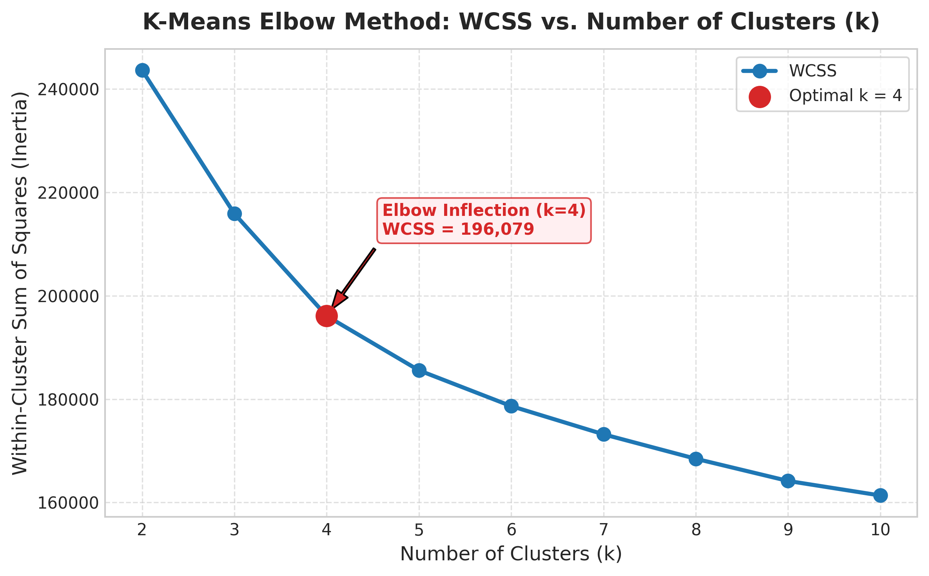
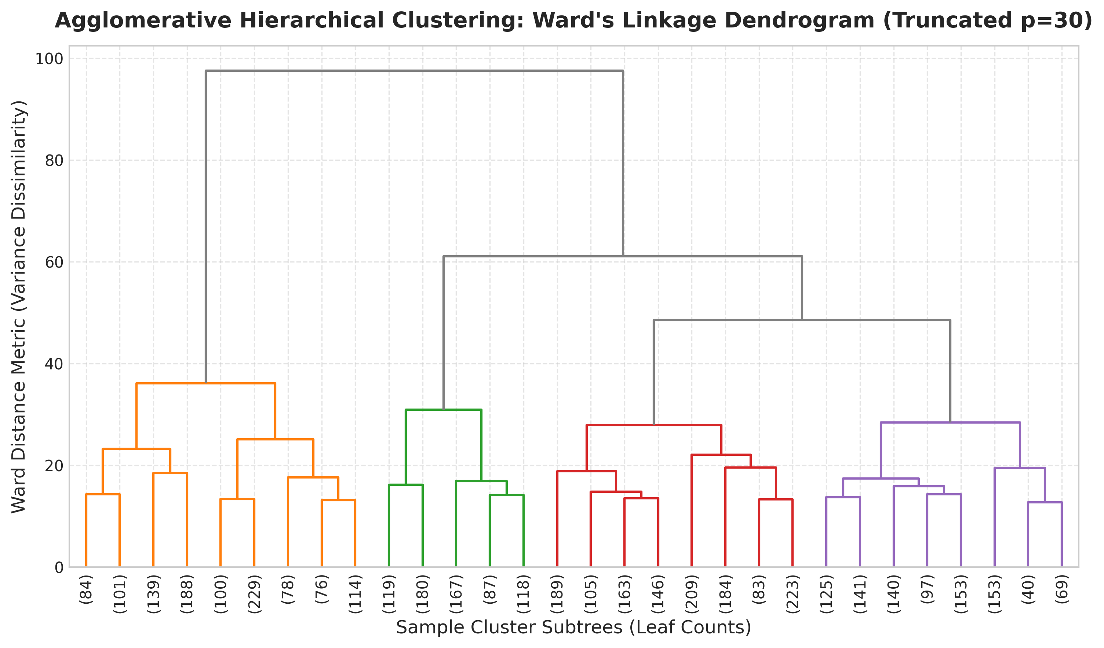
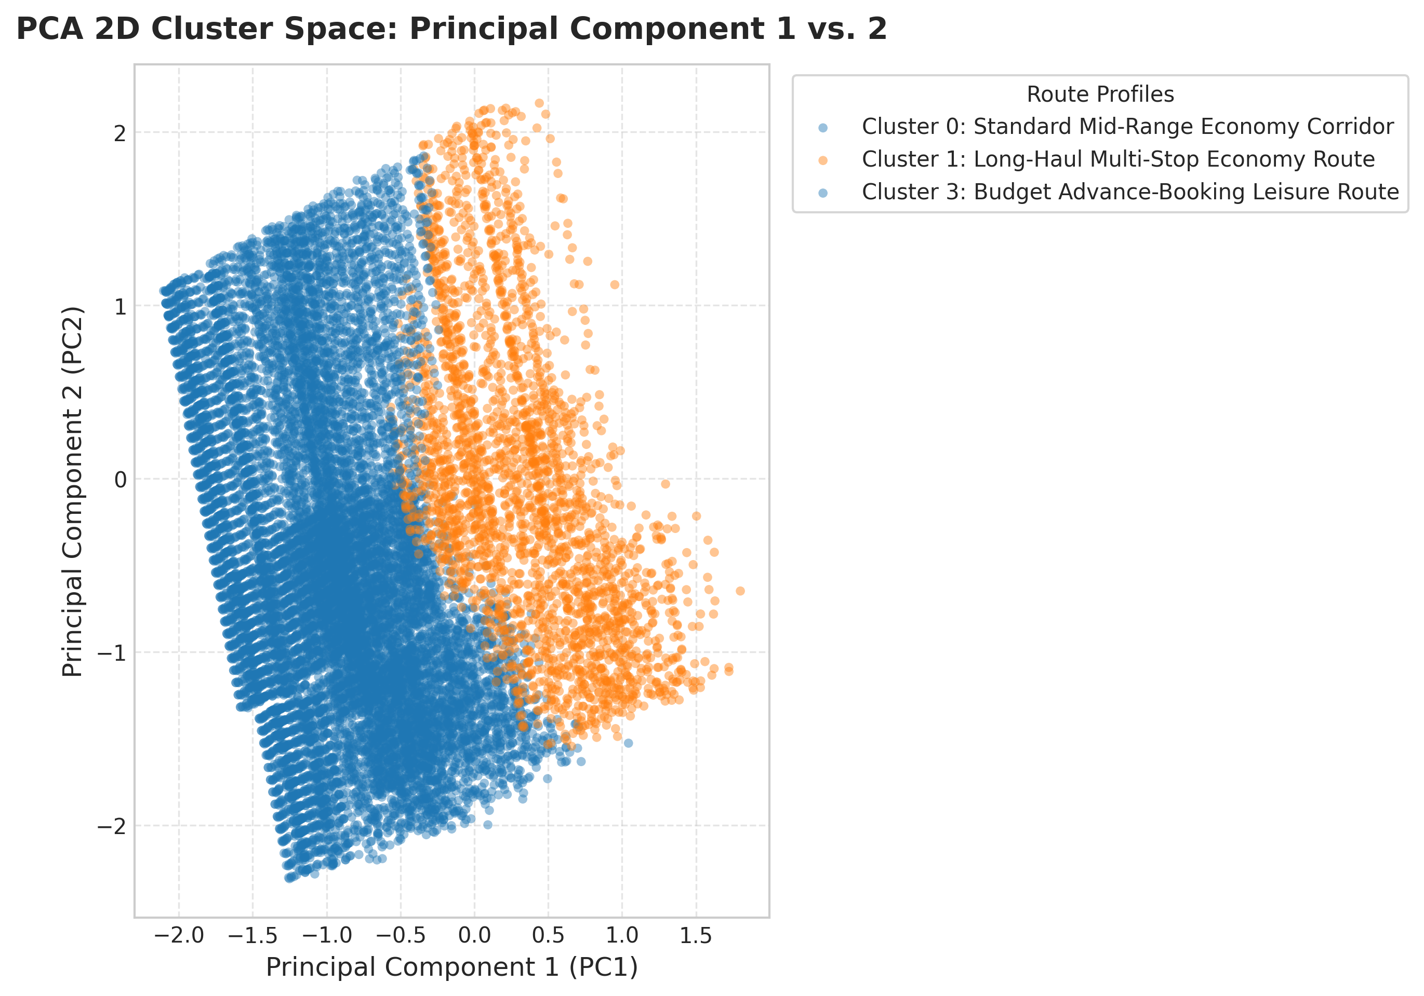
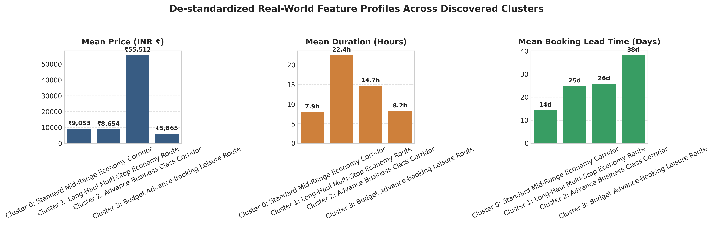
SECTION 7 • ACADEMIC FIGURES (300 DPI)
Quantitative Validation Plots (outputs/figures/)
Fig 1: Elbow Curve (Inflection k=4)
Fig 4: Ward Linkage Dendrogram
Fig 5: 2D PCA Cluster Boundaries
Fig 7: De-Standardized Centroids
INT396 (Unsupervised Learning) • SIH26056 • Pudi Sai Charan Teja (12507339) • aerocluster.onrender.com
9 / 14

Slide 10
SECTION 7 • COMMERCIAL PROFILING
4 Discovered Commercial Airfare Route Archetypes (k = 4)
Cluster 0: Standard Mid-Range Economy
• Mean Fare: ₹9,053 | Duration: 7.95 hrs
• Lead Time: 14.34 days before departure
• Profile: Planned domestic trunk commuters booking ~2 weeks out with steady inventory.
Cluster 1: Long-Haul Multi-Stop Route
• Mean Fare: ₹8,654 | Duration: 22.45 hrs
• Lead Time: 24.71 days before departure
• Profile: Connecting layover routes bridging tier-2 airports; cheaper due to long transit time.
Cluster 2: Advance Business Corridor
• Mean Fare: ₹55,512 | Duration: 14.67 hrs
• Lead Time: 25.76 days before departure
• Profile: High-yield corporate class (Vistara / Air India Business); highly price-inelastic.
Cluster 3: Budget Leisure Early-Bird
• Mean Fare: ₹5,865 | Duration: 8.20 hrs
• Lead Time: 38.13 days before departure
• Profile: Optimal 30–45d booking window securing lowest promotional LCC deals.
INT396 (Unsupervised Learning) • SIH26056 • Pudi Sai Charan Teja (12507339) • aerocluster.onrender.com
10 / 14

Slide 11
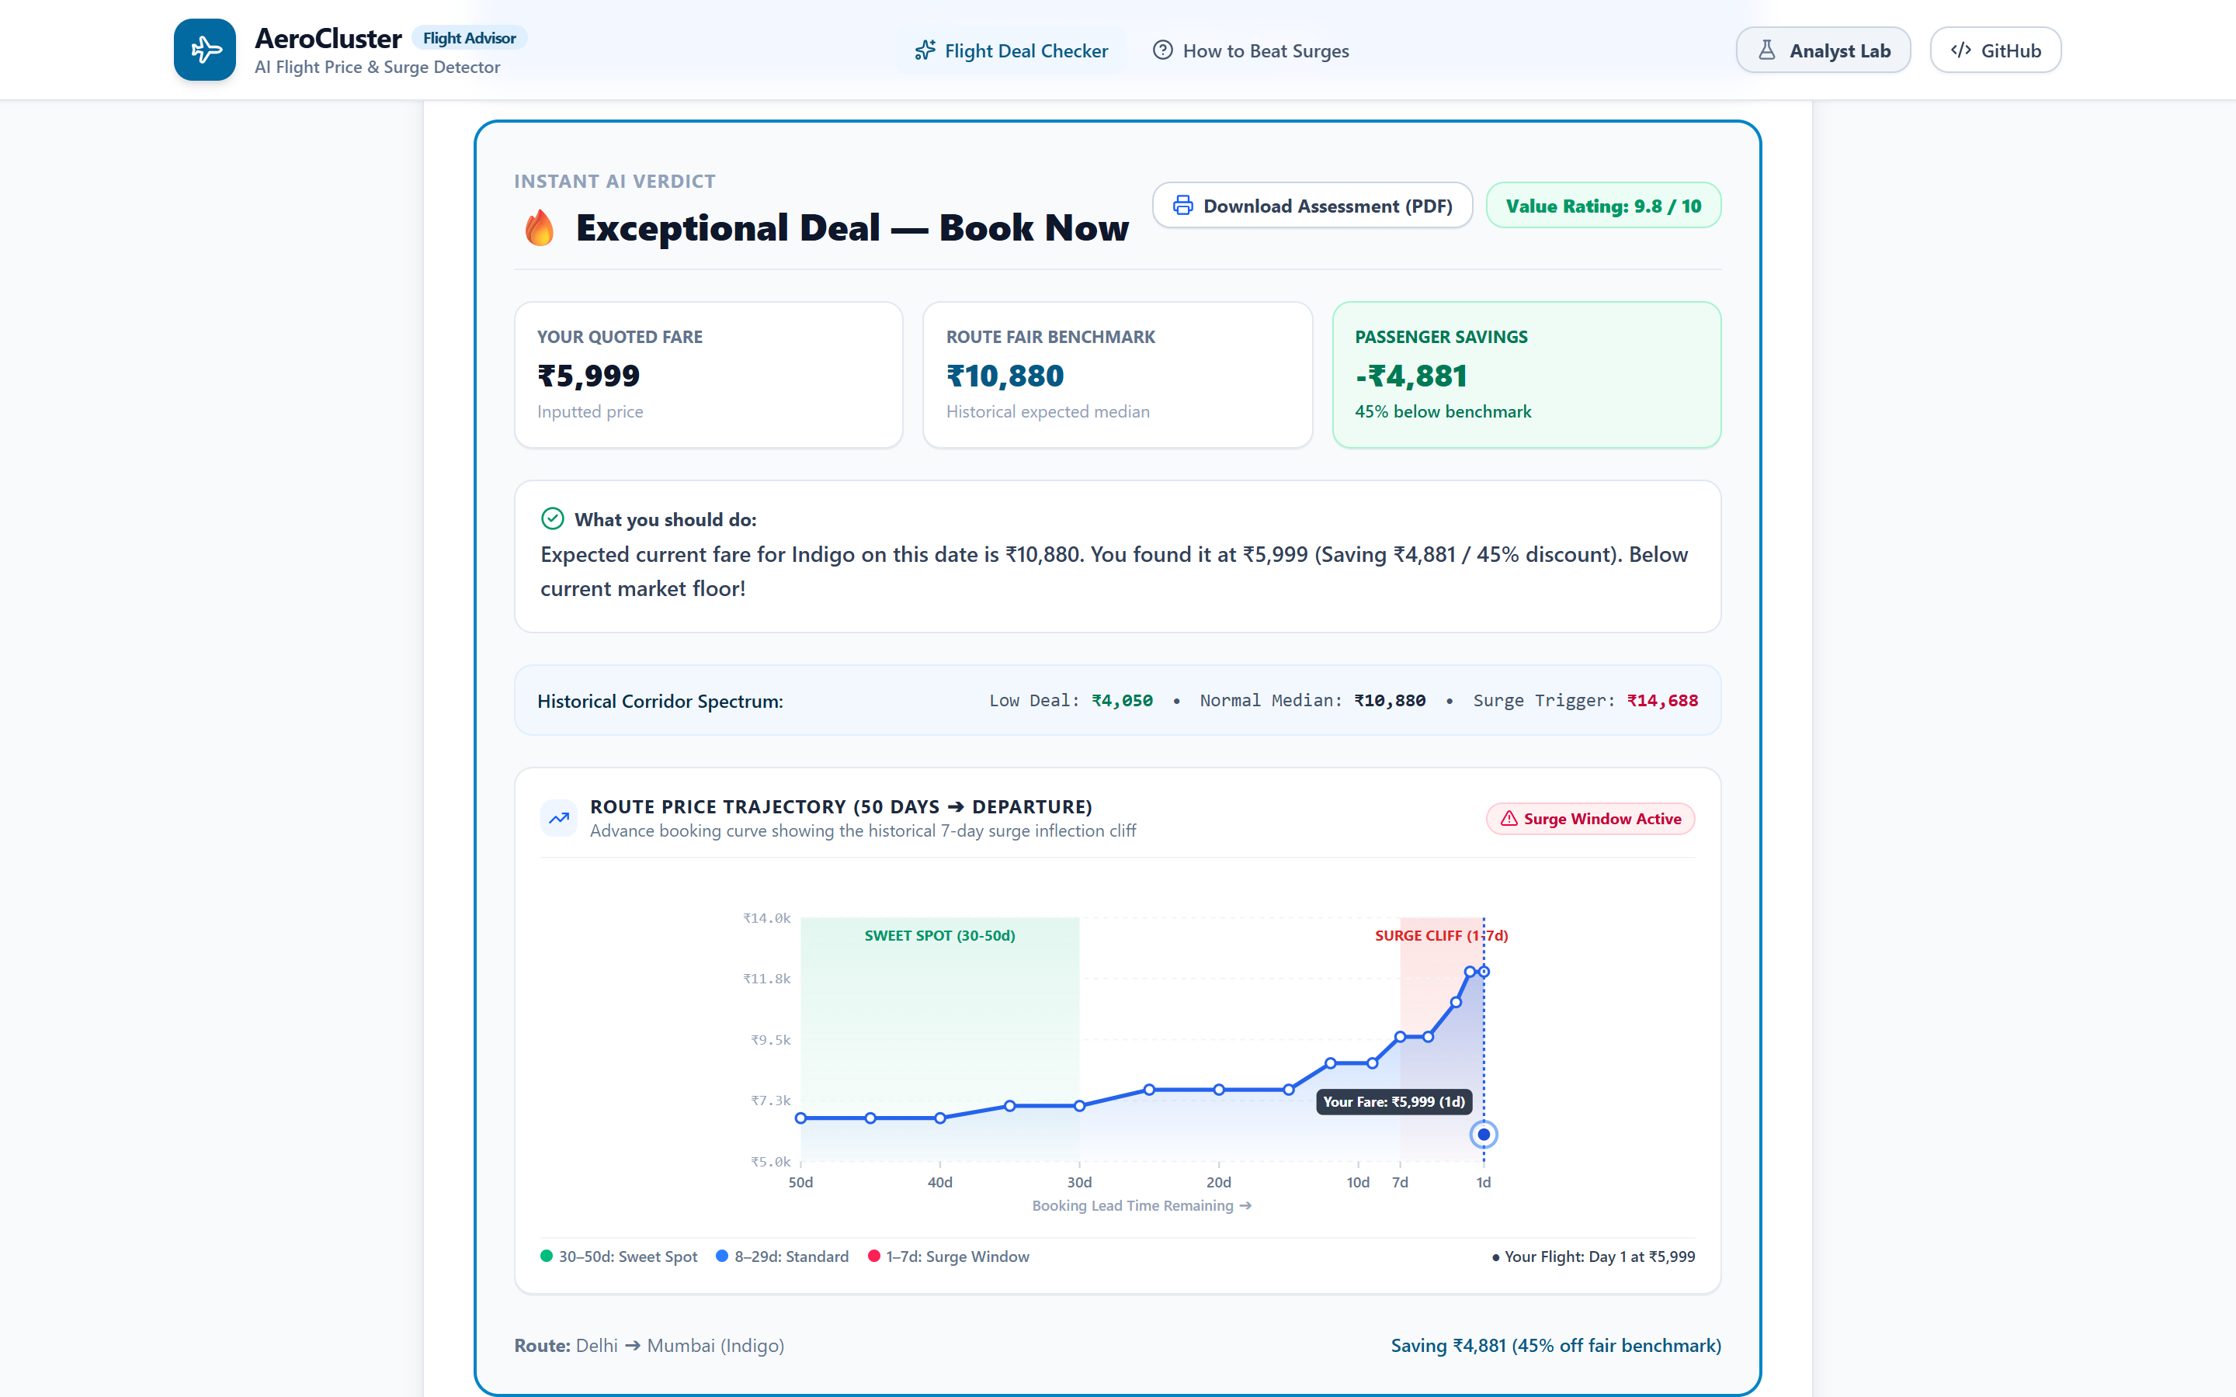
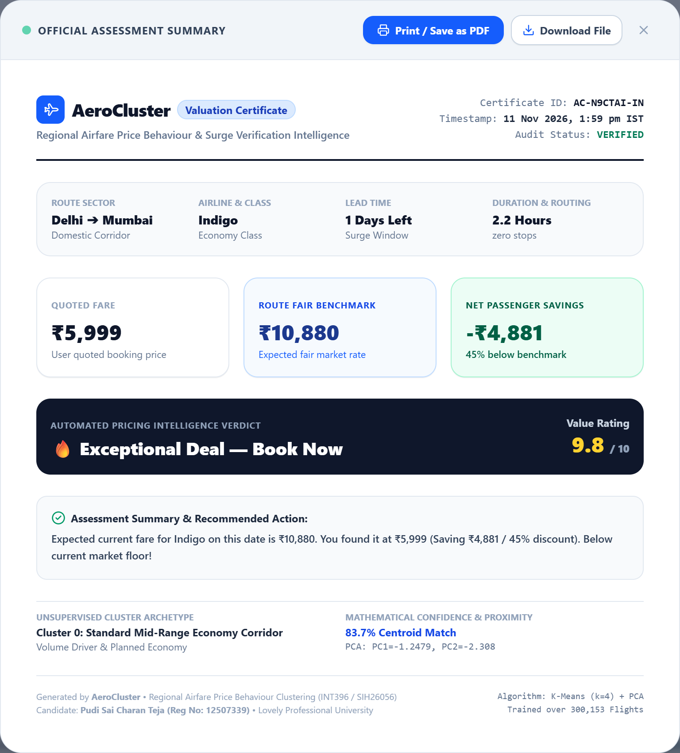
SECTION 7 • LIVE WEB DEMO & SCREENSHOTS
Consumer Verdict, Surge Curve SVG & Printable Valuation Certificate
Home Verdict Card: Fair Benchmark, Savings & 50-Day Surge Trajectory Curve
Valuation Certificate Modal: Unique ID, Isolated Iframe Print & HTML Export
INT396 (Unsupervised Learning) • SIH26056 • Pudi Sai Charan Teja (12507339) • aerocluster.onrender.com
11 / 14

Slide 12
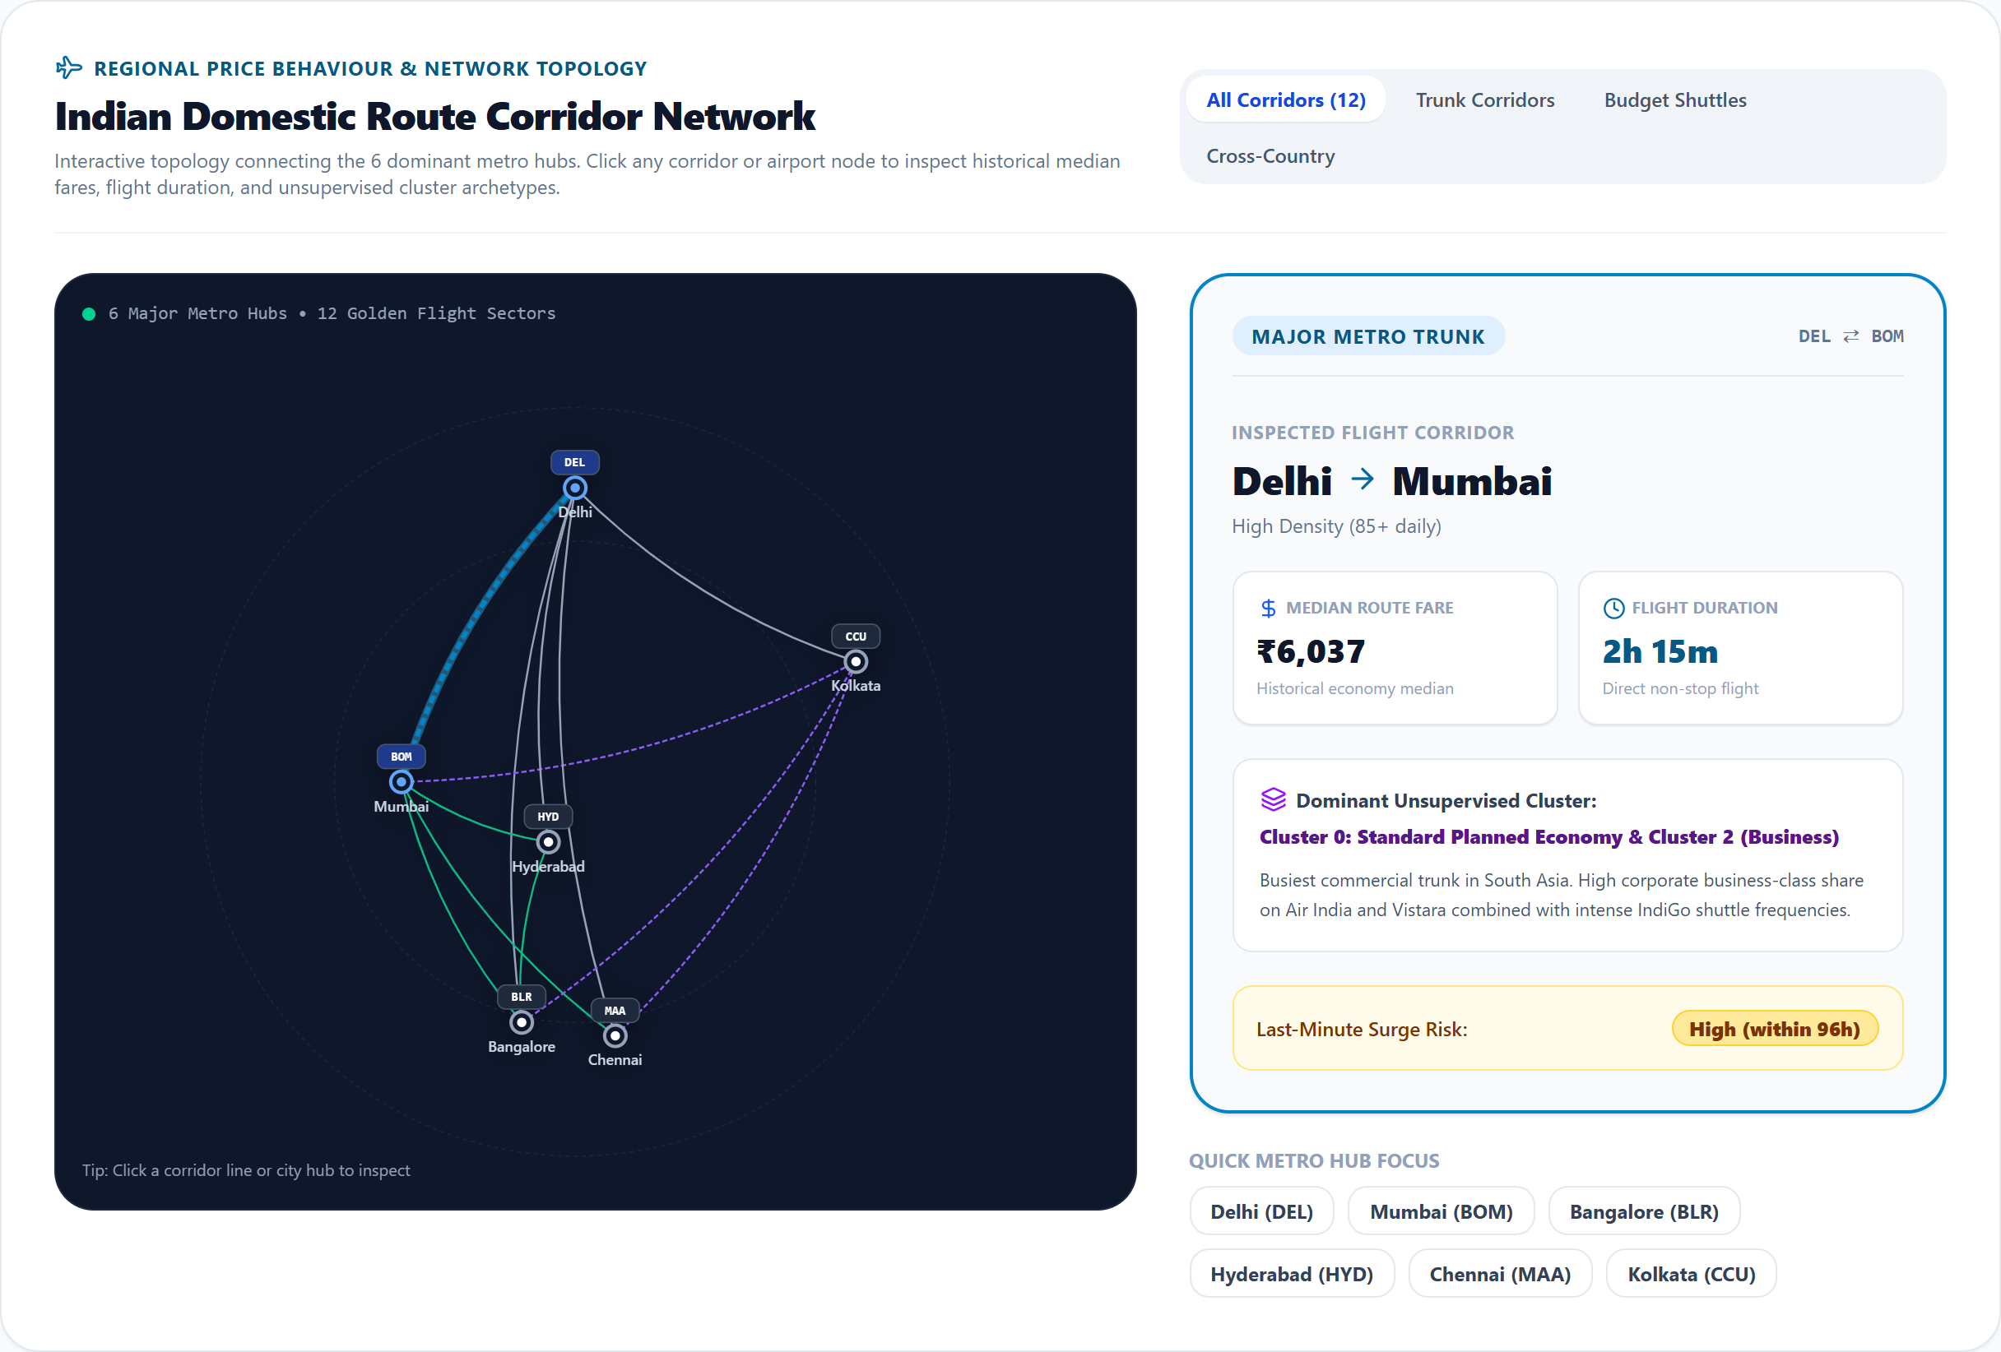
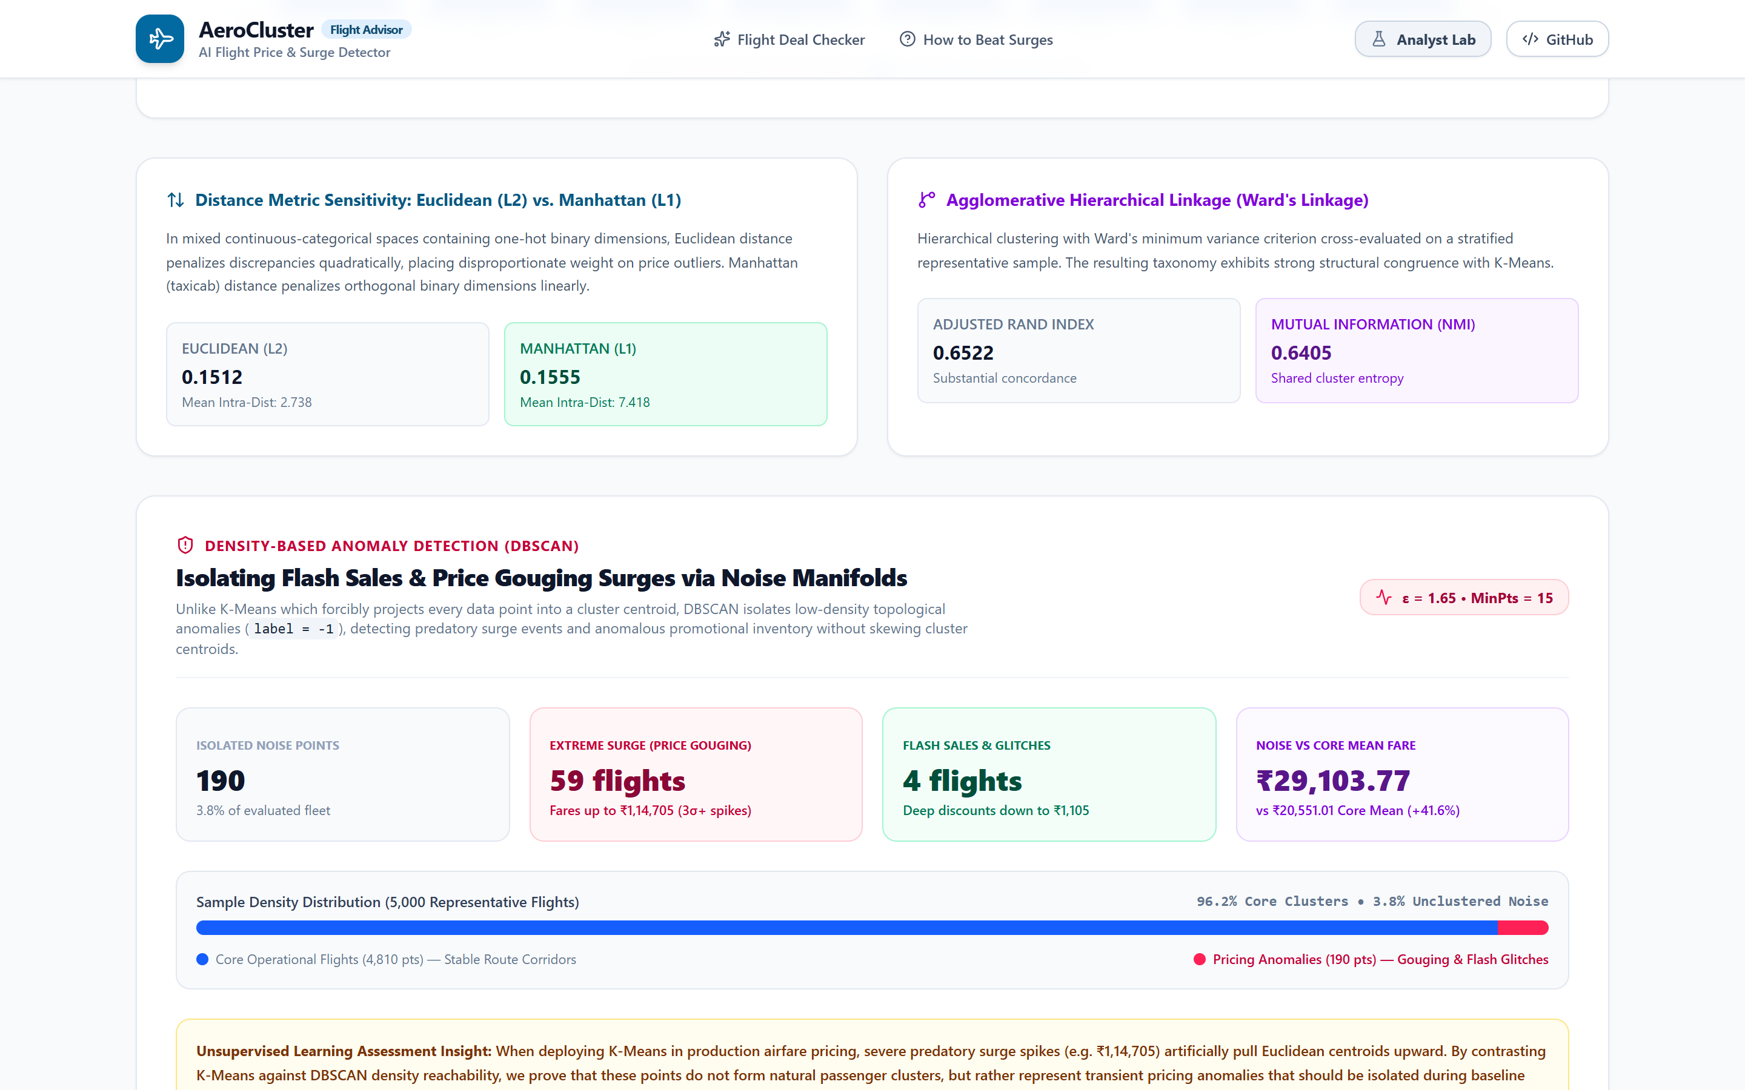
SECTION 7 • LIVE WEB DEMO & TESTING (PYTEST 7/7)
Route Corridor Network Map, 3D PCA Sphere & DBSCAN Console
Interactive 6-Hub SVG Route Corridor Map (12 Flight Sectors)
DBSCAN Anomaly Console (3.80% Noise / Price Gouging Isolation)
Automated Verification (pytest tests/ -v)
• 7 / 7 Unit & Integration Tests PASSED (Data Cleaning/IQR, Preprocessor, K-Means Sweep, L2/L1, Ward Stability, PCA, DBSCAN). Render Cloud verified HTTP 200.
INT396 (Unsupervised Learning) • SIH26056 • Pudi Sai Charan Teja (12507339) • aerocluster.onrender.com
12 / 14

Slide 13
SECTION 8 • INDIVIDUAL CONTRIBUTIONS
100% Individual Effort — Pudi Sai Charan Teja (12507339)
Machine Learning & Backend API Ownership
• Data Pipeline (src/data_loader.py, preprocessor.py): Cleaning 300,153 records, IQR analysis, StandardScaler + OneHotEncoder.
• Clustering Engine (src/clustering.py): K-Means sweep, L2 vs. L1 comparison, Ward Hierarchical linkage, DBSCAN Anomaly Detector.
• PCA & Metrics (src/dimensionality.py, metrics.py): Scree variance, 3D coordinates, WCSS, Silhouette, DBI, ARI/NMI.
• FastAPI Service (api/main.py, model_service.py, schemas.py): All 7 endpoints, centroid proximity confidence, SPA static serving.
Frontend UI, Testing, Deployment & Docs Ownership
• React 19 Web Application (frontend/src/): Consumer Deal Checker, Surge Trajectory SVG, Valuation Certificate Modal & Print Engine.
• Analyst Lab UI: Interactive Route Corridor Network Map SVG, 3D WebGL Plotly PCA Sphere, 1-Click Predictor Presets.
• Automated Testing (tests/test_modules.py): 7/7 pytest verification suite.
• Cloud Deployment & Documentation: Multi-stage Dockerfile, Render live deployment, README, Report PDF & Presentation.
INT396 (Unsupervised Learning) • SIH26056 • Pudi Sai Charan Teja (12507339) • aerocluster.onrender.com
13 / 14

Slide 14
SECTIONS 9 & 10 • IMPACT, ETHICS & REFERENCES
Societal Impact, Limitations, Future Scope & Literature
Practical Applications & Societal Impact
• Empowers travelers to detect 96-hour surge penalties and counterfeit layover deals.
• Provides regulators DBSCAN mathematical triggers to audit algorithmic price gouging.
• Guides corporate travel managers toward optimal 30–45 day booking horizons.
Key Academic & Dataset References
• MacQueen (1967): K-Means multivariate classification (5th Berkeley Symp.).
• Arthur & Vassilvitskii (2007): k-means++ careful seeding (ACM-SIAM SODA).
• Rousseeuw (1987): Silhouette graphical cluster validation (J. Comput. Appl. Math.).
• Davies & Bouldin (1979): Cluster separation measure (IEEE TPAMI).
• Ward (1963): Hierarchical grouping minimum variance objective (JASA).
• Ester et al. (1996): Density-based clustering with noise — DBSCAN (KDD-96).
• Jolliffe (2002): Principal Component Analysis (Springer).
• Bathwal (2022): Kaggle Flight Price Prediction Dataset (300,153 records).
Limitations, Ethics & Future Scope
• Window Bias: Feb–Mar 2022 EaseMyTrip snapshot omits Diwali/Summer peak spikes & fuel costs.
• Ethics: Exploratory clusters describe patterns—never justify predatory emergency pricing.
• Future: Live Amadeus/Skyscanner GDS streaming + HDBSCAN on UDAN regional routes.
INT396 (Unsupervised Learning) • SIH26056 • Pudi Sai Charan Teja (12507339) • aerocluster.onrender.com
14 / 14

