Slide 1
UNIT-IV Advanced Perl

Slide 2
Finer points of looping
- Perl provides 3 loop control commands
Last,next,redo
-Perl enables you to define an exit point anywhere in the loop using a special last statement.
The syntax for the last statement is simple:
last;
or last if (cond.)

Slide 3
-To terminate a particular iteration of a loop, use the next statement.
Like last, the syntax for the next statement is simple:
next;
-The redo Statement
repeats the current iteration from the beginning.
redo;
redo if (cond.)

Slide 4
-You can use next and redo with labels as well, as shown in the following example:
next LABEL;
redo LABEL;
-The goto Statement
goto label;

Slide 5
Continue block
-A while loop can have an explicit continue block which is executed at the end of each normal iteration before control returns to re-test the condition.
e.g. while(){
….}
Continue {
…..
}

Slide 6
for ($i = 1; $i <= 10; $i++) {
print ("$i\n");
}
#using continue block
$i = 1;
while ($i <= 10) {
print ("$i\n");
}
continue {
$i++;
}

Slide 7
Pack
This function evaluates the expressions in LIST and packs them into a binary structure specified by EXPR.
commonly used for conversions between ASCII codes & the corresponding characters
pack EXPR, LIST
e.g.
$bits = pack("c", 65);
print "bits are $bits\n"; # prints A, which is ASCII 65.
$bits = pack("cc", 97,98);
print "bits are $bits\n"; # prints ab

Slide 8
Unpack :
reverse of pack
e.g.
$bits = pack("cc", 97,98);
print "bits are $bits\n"; # prints ab
@a=unpack("cc", "$bits");
print "@a"; #prints 97 98

Slide 9
Eval
Syntax
Following is the simple syntax for this function −
eval EXPR eval BLOCK
-This function evaluates expression at execution time as if expression were a separate Perl script.
-This allows you to use a separate, perhaps user-supplied, piece of Perl script within your program.
-An eval EXPR statement is evaluated separately each time the function is called.

Slide 10
The eval operator comes in two forms
-string form
In this eval takes an arbitrary string as an operand & evaluates the string at run-time as a perl script.
-block form
In this eval takes a block as its argument & the block is compiled only once at the same time as the surrounding code.
Syntax of eval
eval EXPR
eval BLOCK

Slide 11
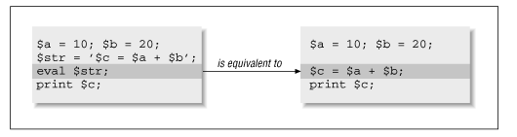
The String Form: Expression Evaluation
E.g.1:
$a = 10; $b = 20;
$str = '$c = $a + $b'; # Perl doesn't care what's inside
eval $str;
print("$c");# Treat $str as code and execute it.

Slide 12
E.g. 2
$a = 10; $b = 20;
$str = '$c = $a + $b ; print ("$c") ; $d=$a*$b ; print ("\n$d")'; # Perl doesn't care what's inside
eval $str;

Slide 13
The Block Form: Exception Handling
-In this form, eval is followed by a block of code, not a scalar containing a string.
-It is used for handling run-time errors, or exceptions . Errors can be internal built-in ones (out-of-memory, divide-by-zero) or user-defined ones .
The following example shows how you can use the block form eval to trap a run-time divide-by-zero error:
eval { $a = 10;
$b = 0;
$c = $a / $b; # Causes a run-time error, which is trapped by eval
};
print $@; # Prints "Illegal division by 0 at try.pl line 3

Slide 14
In the event of a syntax error or a run-time error, eval returns the value 'undefined' and places the error message in the variable $@. (If there is no error, the value of $@ is an empty)
eval {
…. # code which might have errors
}
if ($@ ne ‘ ’) {
... # clean up after error
}

Slide 15
eval {
$a = 10;
$b = 0;
$c = $a / $b; # Causes a run-time error,which is trapped by eval
};
print $@; # Prints "Illegal division by 0 at try.pl line 3
if ($@ ne ' ')
{
$b=2;
$c=$a/$b;
print "$c";
}

Slide 16
Output:
C:\Strawberry>evablock.pl
Illegal division by zero at C:\Strawberry\evablock.pl line 4.
5

Slide 17
Filesystem in Perl
File handling is the most important part in any programming language. A filehandle is an internal Perl structure that associates with a file name.
Perl File handling is important as it is helpful in accessing file such as text files, log files or configuration files.
Perl filehandles are capable of creating, reading, opening and closing a file.
Three basic file handles are - STDIN, STDOUT, and STDERR, which represent standard input, standard output and standard error devices respectively.

Slide 18
The File Mode
There are three different file-access modes (or, simply, file modes) available in Perl:
read mode: Enables the program to read the existing contents of the file but does not enable it to write into the file
write mode: Destroys the current contents of the file and overwrites them with the output supplied by the program
append mode: Appends output supplied by the program to the existing contents of the file

Slide 19
Perl Open File
We can open a file in following ways.
The < sign is used to open an already existing file. It opens the file in read mode.
open FILE, "<", "fileName.txt" or die $!
The > sign is used to open and create the file if it doesn't exists. It opens the file in write mode.
open FILE, ">", "fileName.txt" or die $!
The “>" sign will empty the file before opening it. It will clear all your data of that file. To prevent this use (+) sign before ">" or "<" characters.
Syntax
open FILE, "+>", "fileName.txt" or die $!

Slide 20
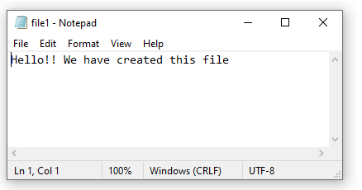
Perl Create File
my $filename = 'file1.txt';
open (my $fh, '>', $filename) or die "Could not open file $filename";
print $fh "Hello!! We have created this file \n";
close $fh;
print "done\n";
o/p
C:\Strawberry\perl>perl f.pl
done

Slide 21
to read Single line at a time
my $filename = 'file1.txt';
open(my $fh, '<', $filename) or die "Could not open file ";
my $row = <$fh>;
print "$row\n";
print "done\n";
C:\Strawberry\perl>perl fileread.pl
Hello!! We have created this file
done

Slide 22
To read Multi lines at a time
my $filename = 'file1.txt';
open(my $fh,$filename)
or die "Could not open file '$filename' $!";
while (my $row = <$fh>) {
chomp $row;
print "$row\n";
}
print "done\n";
C:\Strawberry\perl>perl fileread1.pl
Hello!! We have created this file
this is 2nd line
this is 3rd line
done

Slide 23
if (open(MYFILE, "file1.txt"))
{
@a = <MYFILE>;
print (@a);
}

Slide 24
The read Function
read (filevar, result, length, skipval);
-It enables you to read an arbitrary number of characters (bytes) into a scalar variable.
-Here, filevar is the file variable representing the file to read, result is the scalar variable (or array variable element) into which the bytes are to be stored, and length is the number of bytes to read.
-skipval is an optional argument which specifies the number of bytes to skip before reading.
For example:
read (MYFILE, $scalar, 80);

Slide 25
my $filename = 'file1.txt';
open(my $fh, '<', $filename) or die "Could not open file";
read ($fh, $result, 100);
print "$result";
o/p:
C:\Strawberry\perl>perl fileread3.pl
Hello!! We have created this file
this is 2nd line
this is 3rd line
This line is added in the file1

Slide 26
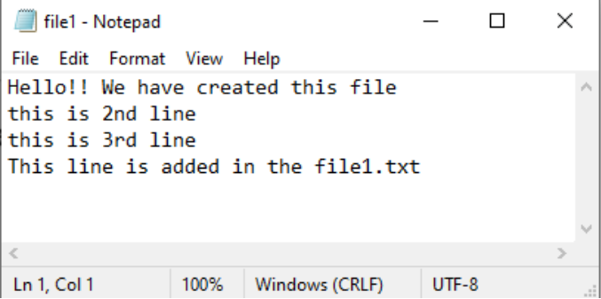
Perl Write File
Through file writing, we'll append lines in the file1.txt.
open (FILE, ">> file1.txt") || die "problem opening \n";
print FILE "This line is added in the file1.txt\n";
print “writing completed”
o/p
C:\Strawberry\perl>perl fwrite.pl
writing completed

Slide 27
Listing 6.4. A program that opens two files and copies one into another.
unless (open(INFILE, "file1.txt")) {
die ("cannot open input file file1\n");
}
unless (open(OUTFILE, ">outfile.txt")) {
die ("cannot open output file outfile\n");
}
$line = <INFILE>;
while ($line ne "") {
print OUTFILE ($line);
$line = <INFILE>;
}
print “Contents copied successful”;

Slide 28
Closing a File
Syntax: close (filehandle);
- Note that you do not have to call close when you are finished with a file: Perl automatically closes the file when the program terminates or when you open another file using a previously defined file variable.

Slide 29
File status check
Perl provide following operators
-e: file exist -s: file has non-zero size
-z: file has zero size -r: file is readable
-w: file is writable -x: file is executable
-f: file is plane file not a dir
-d: is a directory
e.g. if -w “c:\f.txt” or die “cant write to file”;

Slide 30
- tell function returns the current file pointer offset
e.g. $position= tell filehandle;

Slide 31
Random access to files
Syntax:
Seek filehandle,offset,position;
Position can be
0:from beginning
1: from current position
2:from end
e.g. $n=-10;
seek FILE,$n,2;

Slide 32
Navigating the file system

Slide 33
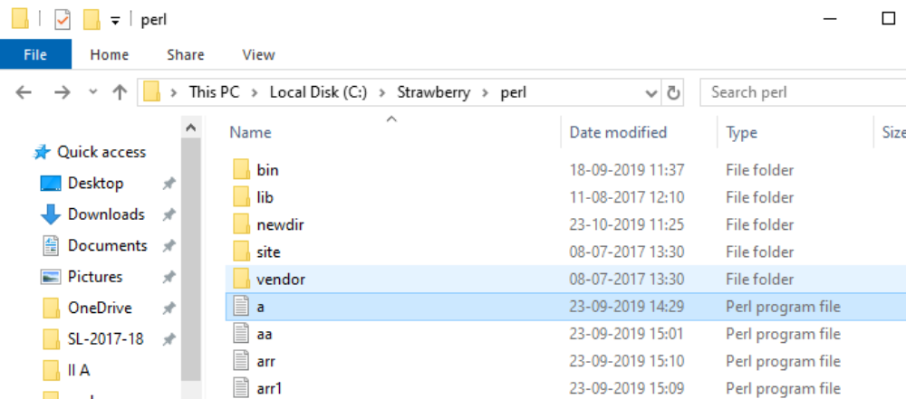
Directory-Manipulation Functions
The mkdir Function
To create a new directory, call the function mkdir.
mkdir (dirname, permissions);
e.g. mkdir ("newdir", 0777);

Slide 34
The opendir/closedir Function
The syntax for the opendir function is
opendir (dirvar, dirname);
closedir (dirvar);
e.g. opendir (DIR, "mydir");
closedir(DIR);

Slide 35
The readdir Function
-After opendir has opened a directory, you can access the name of each file or subdirectory stored in the directory by calling the function readdir.
Syntax: readdir (mydir);
e.g $filename = readdir(MYDIR);
readdir returns the name of the first file or subdirectory stored in the directory.

Slide 36
mkdir ("newdir", 0777);
opendir (DIR, "newdir");
foreach $entry (readdir DIR)
{
print "$entry\n";
}
closedir DIR;
C:\Strawberry\perl>perl mkd.pl
.
..
New Bitmap Image.bmp
New Microsoft Excel Worksheet (2).xlsx
New Microsoft Excel Worksheet.xlsx
New Rich Text Document.rtf
New Text Document.txtdir TEMPDIR

Slide 37
Packages
- A Perl package is a collection of code which resides in its own namespace.
-Package is introduced by package declaration & extends to the end of the innermost enclosing block or until another package declaration is encountered.
-e.g.
package A;
$x=0;
…..
package B;
$x=1;
…....
package A;
Print $x;

Slide 38
package mypack;
-This statement creates a new package named mypack.
- All variable and subroutine names defined from this point in the program are stored in the symbol table associated with the new package.
-This process continues until another package statement is encountered.
-Each symbol table contains its own set of variable and subroutine names, and each set of names is independent. This means that you can use the same variable name in more than one package.
$var = 14;
package mypack;
$var = 6;

Slide 39
The main Package
-The default symbol table, in which variable and subroutine names are normally stored, is associated with the package named main.
-If you have defined a package using the package statement and you want to switch back to using the normal default symbol table, specify the main package as shown here:
package main;
-When this statement is executed, your program resumes behaving as though no package statements have ever been seen. Subroutine and variable names are stored as they normally are.

Slide 40
-package statement switches the current naming context to a specified namespace (symbol table) If the named package does not exists, a new namespace is first created.
$i = 1;
print "$i\n";
package foo;
$i = 2; print "$i\n";
package main;
print "$i\n";
- The package stays in effect until either another package statement is invoked, or until the end of the current block or file.

Slide 41
You can explicitly refer to variables within a package using the :: package qualifier
$PACKAGE_NAME::VARIABLE_NAME
For Example: pk.pl
$i = 1;
print "$i\n";
package foo;
$i = 2;
print "$i\n";
package main;
print "$i\n";
print "$foo::i\n";
Output:
C:\Strawberry>pk.pl
1
2
1
2

Slide 42
package mypack;
$var = 26;
@a=(1,2,3);
package main;
$var=8;
print "$var\n";
print ("$mypack::var\n");
print "@mypack::a\n";

Slide 43
Switching Between Packages
-You can switch back and forth between packages at any time.
#!/usr/local/bin/perl
package pack1;
$var = 26;
package pack2;
$var = 34;
package pack1;
print ("$var\n");

Slide 44
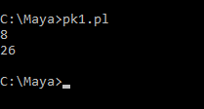
Referring to One Package from Another
-To refer to a variable or subroutine defined in one package from inside another package, precede the variable name with the package name followed by a single quotation-mark character. For example:
pk1.pl
package mypack;
$var = 26;
package main;
$var=8;
print "$var\n";
print ("$mypack’var\n");
Here, $mypack'var refers to the variable named $var located in the package mypack.

Slide 45
Packages and Subroutines
package mypack;
subroutine mysub {
local ($myvar);
# stuff goes here
}
-To call the subroutine mysub from outside the package mypack, specify &mypack::mysub or &mypack'mysub.

Slide 46
-You can change packages in the middle of a subroutine:
package pack1;
sub mysub {
$var1 = 1;
print "$var1";
package pack2;
$var1 = 2;
}
&pack1'mysub;
-This code creates two copies of $var1, one in pack1 and one in pack2.

Slide 47
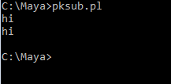
#pksub.pl
package mypack;
sub mysub {
print("hi");
}
package main;
&mypack'mysub;
mypack::mysub;

Slide 48
sub hi {
print "\nmain";
}
package Foo;
sub hi {
print "\nFoo";
}
main::hi(); # main
Foo::hi(); # Foo
hi(); # Foo
package main;
main::hi(); # main
Foo::hi(); # Foo
hi(); # main

Slide 49
Libraries
-A library is a collection of subroutines that can be used in some specific area, e.g. a collection of mathematical functions.
-A library is usually declared as a package to give it a private namespace, and is stored in a separate file with an extension .pl .
- Thus we might have a library of arithmetic operations in a library stored in a file arith.pl.

Slide 50
- These subroutines can be loaded into a program by placing the statement
require “arith.pl";
at the head of the program.
-If the library is declared as a package called arithmatic, we can call its functions using fully qualified names, e.g.
$s=arithmatic: :add(4,6) ;

Slide 51
use strict;
package arithmatic;
my $c;
sub add
{
$c=$_[0]+$_[1];
return $c;
}
sub subt
{
$c=$_[0]-$_[1];
return $c;
}

Slide 52
sub mul
{
$c=$_[0]*$_[1];
return $c;
}
sub div
{
$c=$_[0]/$_[1];
return $c;
}
sub sqr
{
print "\nenter number";
$a=<>;
$b=$a*$a;
return $b;
}
1;

Slide 53
use lib "c:/strawberry";
require "arith.pl";
$a=arithmatic::add(67,98);
print "\nAddition is $a";
$a=arithmatic::subt(98,34);
print "\nSubtraction is $a";
$a=arithmatic::mul(9,3);
print "\nMultiplication is $a";
$a=arithmatic::div(9,3);
print "\nDivision is $a";
$c=arithmatic::sqr();
print "\nsquare is $c“;

Slide 54
C:\Strawberry>uselib.pl
Addition is 165
Subtraction is 64
Multiplication is 27
Division is 3
enter number8
square is 64

Slide 55
Modules
- Most large programs are divided into components, each of which performs a specific task or set of tasks.
- Each component normally contains one or more executable functions, plus the variables needed to make these functions work.
-The collection of functions and variables in a component is known as a program module.
-One module can appear in a variety of programs.
-A Perl module is a reusable package defined in a library file whose name is the same as the name of the package (with a .pm on the end).

Slide 56
Creating a Module
-Perl 5 enables you to use packages to define modules.
-To define a module in Perl 5, create the package and store it in a file of the same name with extension .pm .
-For example, a package named Mymodule would be stored in the file Mymodule.pm. (The .pm suffix indicates that the file is a Perl module.)

Slide 57
Listing 20.6 creates a module named Mymodule, containing subroutines myfunc1 and myfunc2, and variables $myvar1 and $myvar2. This code should be stored in the file Mymodule.pm.

Slide 58
e.g. Code that creates a Perl module.
#creating module
#using package
3: package Mymodule;
4: require Exporter;
5: @ISA = qw(Exporter);
6: @EXPORT = qw(myfunc1 myfunc2);
7: @EXPORT_OK = qw($myvar1 $myvar2);
8: sub myfunc1 {
9: $myvar1 += 1;
10: }
11: sub myfunc2 {
12: $myvar2 += 2;
13: }
1;

Slide 59
-Lines 3-7 use the standard Perl module definition conventions. Line 3 defines the package.
-Line 4 includes a built-in Perl module, Exporter, which implements an import method and allows modules to "export" identifiers (i.e., variable and subroutine names) into the calling program's namespace.
-Once exported, an identifier has two names—one in the module's package and another in the importing program's package.
-Lines 6 and 7 define the subroutines and variables that are to be made available to the outside world.

Slide 60
Line 6 creates a special array named @EXPORT. This array lists the subroutines that can be loaded by default .
Any subroutine defined inside a module that is not included in the list assigned to @EXPORT is a private subroutine, and can only be called inside the module.
Line 7 creates another special array, called @EXPORT_OK, that lists the variables and subroutines that will be loaded only if requested.

Slide 61
Few notable points about modules
-The functions require and use will load a module.
-Both use the list of search paths in @INC to find the module. @INC is a built-in array in perl which contains a list of directories from which Perl modules and libraries can be loaded.
-Both call the eval function to process the code
-The 1; at the bottom causes eval to evaluate to TRUE (and thus not fail)

Slide 62
A Perl module file called “Hello.pm" might contain statements like this.
package Hello;
use Exporter;
@ISA = qw(Exporter);
@EXPORT = qw(myfunc1 myfunc2);
@EXPORT_OK = qw($myvar1 $myvar2);
sub myfunc1 {
$myvar1=5;
$myvar1 += 1;
print"\n$myvar1";
}
sub myfunc2 {
$myvar2=10;
$myvar2 += 2;
print"\n$myvar2";
}
1;

Slide 63
The Require Function
A module can be loaded by calling the require function in any .pl file
e.g. test.pl
use lib"C:/Strawberry";
require Hello;
Hello::myfunc1();
Hello::myfunc2();
-Notice above that the subroutine names must be fully qualified (because they are isolated in their own package)

Slide 64
Use statement
To import a module into your Perl program, use the use statement. For example, the following statement imports the Hello module into a program:
e.g. test2.pl
use lib"C:/Strawberry";
use Hello;
myfunc1();
myfunc2();
To undefine a previously imported module, use the no statement. For example, the following statement undefines the foo module:
no Hello;

Slide 65
A Perl module file called “f.pm" might contain statements like this.
package f;
require Exporter;
@ISA = qw(Exporter);
@EXPORT = qw(bar);
sub bar {
print "Hello $_[0]\n";
}
sub blat {
print "World $_[0]\n";
}

Slide 66
usef.pl
use lib"C:/Strawberry";
use f;
bar( "a" );
blat( "b" );
C:\Strawberry>usef.pl
Hello a
Undefined subroutine &main::blat called at C:\Strawberry\usef.pl line 4.

Slide 67
Data structures
Arrays of arrays In C, a two-dimensional array is constructed as an array of arrays, reflected in the syntax for an element, e.g. a [0] [1] .
This technique does not work in Perl, since it is not possible to create a LISP-like list of lists.
However, a similar effect can be obtained by creating an array of references to anonymous arrays.

Slide 68
Suppose we write
@colours = ([42, 128, 244], [24, 255, 0], [0, 127, 127]);
The array composer converts each comma-separated list to an anonymous array in memory and returns a reference to it, so that @colours is in fact an array of references to anonymous arrays.
When we write an expression like
$colours[0] [1]= 64; then
$colours [0] is a reference to an array, and applying a subscript to it forces dereferencing, the anonymous array from which an element is selected by the second subscript. (In fact, Perl inserts a dereferencing operator -> between an adjacent] and [.)

Slide 69
Complex data structures
By analogy with the array of arrays, which is an array of references to arrays, we can create hashes of (references to) hashes.
This is a very common data structure in Perl, since the anonymous hash provides a way of providing the capability of records (structs) in other languages.
Likewise, we can create arrays of (references to) combining all these possibilities data structures of immense complexities can be created.

Slide 70
Doubly link list can be implemented by using array of hashes where each element of array is a hash with three fields with Keys ‘L' (left neighbor) 'R' (right neighbor ) and 'C' (content).
The values associated with L and R are references to element hashes (or undef for non-existent neighbors): the value associated with C can be anything – scalar, array, hash or reference to some complex structure.
Typically we will have two scalar variables containing references to element hashes: $head, a reference to the first element in the list and $current, a reference to the element of current interest: the content of
$current-> { 'C' }.

Slide 71
We can move forwards the list with
$current = $current->{'R'};
and backwards with
$current =$current-> { 'L' };

Slide 72
Objects in PERL
Object –
An object is an instance of a class with some characteristics and behavior.
For Example, we say an “Apple” is an object. Its characteristics are:it is a fruit, its color is red etc. Its behaviour is:”it tastes good“.
In the concept of OOPs, the characteristics of an object are represented by its data and the behavior is represented by its associated functions.
Thus an object is an entity that stores data and has its interface through functions.

Slide 73
Class –
A class is an expanded concept of data structures.
It defines a prototype blueprint of objects comprising of data.
And an object is an instance of a class.
A class comprises of the data members and data functions and it is a pre-defined data type made as per the user’s requirements which can be accessed and used by creating an instance of that class.

Slide 74
Example:
Consider a class of School. There may be schools with different names and structure but all of them share some common characteristics like students, teachers, staff, etc.
So here school is the class with teachers, students, and Parents as the data members and the member functions can be calculate_students_marks(), calculate_teachers_salary() and Parents_Database().
Data Member: Data members are the data variables and member functions are the functions used to manipulate these variables and together these data members and member functions define the properties and behavior of the objects in a Class.

Slide 75
Defining a Class –
In Perl, a package is itself a Class .
To define a class we first load and build a package.
A Package is a pre-contained unit of user-defined variables and subroutines, which can be used throughout the program.
Syntax:
package Class_name

Slide 76
Creating Class and Using Objects
A class in Perl can be created by using the keyword package but to create an object, a constructor is called.
To create an object a function having array reference or hash reference is created.
A constructor is defined in a class as a method.
Creating an instance of a class
-A class name and a constructor name can be as per user’s requirement.
-Most of the programmers prefer to use ‘new’ as a constructor name for their programs as it is easy to remember and is more feasible to use than any other complex constructor name.

Slide 77
e.g.
package student // This is the class student
sub Student_data // Constructor to class
{
my $class = shift; # shift will take package name 'student‘ and assign it to
#variable 'class‘
#defining a simple hash reference $self to design our object.
my $self = {
StudentFirstName => shift;
StudentLastName => shift;
};
bless $self, $class;
return $self;
}

Slide 78
In the above example code, a function named bless is used.
This function is used to attach an object to a class which is passed to it as an argument.
bless function is used to return a reference which ultimately becomes an object.
Syntax:
bless Object_name, Class Name

Slide 79
Creating an Object
-An object in Perl is instantiated by using the constructor defined in the class.
-An object name can be any variable as per user’s requirement, but it is conventional to name it with respect to the relevancy with the class.
Syntax: objname=constructor name class name()
$Data = Student_data student( “Maya", “Dhone");

Slide 80
use strict;
use warnings;
package student;
# constructor
sub student_data
{
# shift will take package name 'student'
# and assign it to variable 'class'
my $class_name = shift;
my $ref = {
'StudentFirstName' => shift,
'StudentLastName' => shift
};

Slide 81
# Using bless function
bless $ref, $class_name;
# returning object from constructor
return $ref;
}
# Object creation and constructor calling
my $obj = student_data student("Maya","Dhone");
# Printing the data
print "$obj->{'StudentFirstName'}\n";
print "$obj->{'StudentLastName'}\n";

Slide 82
use strict;
use warnings;
# class with the name Employee
package Employee;
# constructor with the name new
sub new
{
# shift will take package name
# and assign it to variable 'class'
my $class = shift;
# defining the hash reference
my $self = {
serialNum => shift,
firstName => shift,
lastName => shift,
};

Slide 83
# Attaching object with class
bless $self, $class;
# returning the instance of class Employee
return $self;
}
# Object creation of the class
my $object = new Employee(1, “Ananya", “Sharma");
# object here is a hash to a reference
print("$object->{firstName} \n");
print("$object->{serialNum} \n");

Slide 84

If a class is used to invoke the method, that argument will be the name of the class.
If an object is used to invoke the method, that argument will be the reference to the object.
Whichever it is, we'll call it the method's invocant. For a class method, the invocant is the name of a package. For an instance method, the invocant is a reference that specifies an object.
We mentioned that there are two styles of method invocation. The first style for invoking a method looks like this:
INVOCANT->METHOD(LIST)
INVOCANT->METHOD
When executed, the invocation first locates the subroutine determined jointly by the class of the INVOCANT and the METHOD name, and then calls that subroutine, passing INVOCANT as its first argument.
When INVOCANT is a reference, we say that METHOD is invoked as an instance method, and when INVOCANT is a package name, we say that METHOD is invoked as a class method.
For example, to construct an object using the class method summon and then invoke the instance method speak on the resulting object, you might say this:
$mage = Wizard->summon("Gandalf"); # class method
$mage->speak("friend"); # instance method

Slide 85
Method Invocation Using Indirect Objects
The second style of method invocation looks like this:
METHOD INVOCANT (LIST)
METHOD INVOCANT LIST
METHOD INVOCANT
The parentheses around LIST are optional; if omitted, the method acts as a list operator. So you can have statements like the following, all of which use this style of method call:
$mage = summon Wizard "Gandalf";
speak $mage "You cannot pass";

Slide 86
Test.pm file to create object and methods
package test;
sub new{
$clsname=shift;
$ref={skillname=>shift};
bless $ref,$clsname;
return $ref;
}
sub setskill{
my ($ref,$skillname)=@_;
$ref->{ skillname}=$skillname;
return $ref->{$skillname};
}
sub getskill{
my ($ref)=@_;
return $ref->{skillname};
}
1;

Slide 87
Testob.pl flie to access methods from .pm file
use lib"C:/Strawberry";
use Data::Dumper;
use test;
my $obj=new test("perl");
$obj->setskill("phython");
print $obj->getskill,"\n";
C:\Strawberry>perl testob.pl
phython

Slide 88

Inheritance is realized by including a special array @ISA in the package that defines the derived class.
For single inheritance @ISA is an array of one element, the name of the base class.
@ISA is an array of more than one element then multiple inheritance can be realized.
If @ISA contains more than one package name, the packages are all searched in left-to-right order. The search is depth-first, so if you have a Mule class set up for inheritance this way:
package Mule;
our @ISA = ("Horse", "Donkey");
Perl looks for any methods missing from Mule first in Horse (and any of its ancestors) before going on to search through Donkey and its ancestors.

Slide 89
Parent class to implement single inheritance,and save file with test1.pm
package test1;
sub new{
$clsname=shift;
$ref={skillname=>shift};
bless $ref,$clsname;
return $ref;
}
sub setskill{
my ($ref,$skillname)=@_;
$ref->{ skillname}=$skillname;
return $ref->{$skillname};
}
sub getskill{
my ($ref)=@_;
return $ref->{skillname};
}
1;

Slide 90
child class to implement single Inheritance, and save file with test1child.pm
package test1child;
use test1;
our @ISA=qw(test1);
Note: A variable declared with our keyword declares an alias for a package variable that will be visible across its entire lexical scope, even across package boundaries.

Slide 91
Now we can write Perl script test1obj.pl to implement single inheritance.
use lib"C:/Strawberry";
use test1child;
my $obj=new test1child("java");
print $obj->getskill,"\n";
Output:C:\Strawberry>perl test1obj.pl
java

Slide 92
Interfacing to the operating system
Perl is a popular language for system administrators and programmers who have to work with files and directories due to the fact that there are many built-in functions to perform sys admin activities.
These activities include creating directories, changing the names of files, creating links, and executing programs in the operating system.

Slide 93
Interfacing to the operating system
In Unix platform, Perl is used as an alternative to writing shell scripts.
Perl uses the system calls as built in functions which were used in shell scripts
Here we are going to discuss about the collection of facilities that are common to both NT and UNIX in implementation of Perl.

Slide 94
Environment Variables
-Environment variables are used to set user preferences.
-Individual Perl modules or programs are always free to define their own environment variables, and there is also a set of special environment variables that are used in the CGI environment for e.g $PATH,$HOME etc
-Stored in special hash %ENV.
-Script can read them or change them by accessing this hash.

Slide 95
The “local” operator can give just one element of an array or hash a temporary value,
e.g
{local $ENV {“path”}=…….;
……
…..
}
Commands inside the block are executed with the new path variable , again it is replaced by the original one on exit from the block.

Slide 96
File System Calls
-All return a value indicating success or failure.
Chdir $x or die “cannot chdir to $x\n”;
-or is ultra low precedence operator. We can replace it with “||”.
Chdir $x || die “cannot chdir ”;
Here chdir have high precedence,hence it is better to stick to “or” in this context.

Slide 97
More common calls for manipulating file system:
Chdir $x : change directory
Unlink $x : Same as rm in UNIX or delete in NT
Rename($x ,$y): Same as mv in UNIX
Link($x ,$y) : Same as In in UNIX. Not in NT
Symlink($x ,$y) : Same as ln -s in UNIX. Not in NT
Mkdir($x,0755) :Create directory and set modes
Rmdir $x : remove directory
Chmod(0644 ,$x) : set file permissions

Slide 98
Shell commands
In perl shell commands are executed in two ways
1.System function:The system() function takes an argument and executes that argument. It allows it to go to standard output.
System(“date”);
-The argument is treated as shell command to be run by /bin/sh on unix and by command .exe on NT
e.g. System(“date>datafile”) or die “can’t redirect”;
System(“echo textfiles:*.txt”);
*.txt refers to the text files present in the current directory
-system function returns value 0 on success and on failure it returns non zero value

Slide 99
2.Quoted execution:
-we can capture the output of a command using quoted execution.
-The back quotes allow us to do that.
-The back quotes can be read in either scalar context or in list context:
$output = `command`;
@output = `command`;
Output of shell command can be captured using quoted execution
$date=`date`; or
$date=qx/date/;
qx= quoted execution

Slide 100
exec
-This function terminates the current script and executes the program named as its argument in the same process.
e.g. exec “sort $output” or die “can’t exec sort\n”;
-It can be used to replace the current script with a new script
e.g. exec “perl –w src2.pl” or die “exec failed\n”

Slide 101
Process control in unix
-Perl implements classic Unix process mechanism: Fork function creates a child process as a clone of the current process, it runs in parallel with its parent.
-The value returned in the parent is the process identifier of the child.
-The value returned in the child is 0.

Slide 102
What is the use of having two identical process running in parallel?
-we use the value returned by the fork function to control an if-then-else construct , Providing one block of code to be executed in the parent process and another block of code in the child process.
-child process uses exec to start new program in the same process resulting in two different programs running in separate process

Slide 103
Creating a child process to send data to parent ,using a pipe
Pipe(READHANDLE,WRITEHANDLE);
If($pid=fork)
{
Close WRITEHANDLE;
…………
} elsif($pid==0) {
Close READHANDLE;
} else {
Die” can’t fork\n”
}

Slide 104
The final version of the code
Fork:{
Pipe(READHANDLE,WRITEHANDLE);
If($pid = fork){
Close WRITEHANDLE;
……
} elseif($pid==0){
Close READHANDLE;
…
exit;
}

Slide 105
elsif($!=~/NO MORE PROCESSES/} {
sleep 5
redo Fork
}else {
Die “cannot fork\n”
}
}

Slide 106
Process Control in windows NT
-we can make use of Win32::process module.
-A new process is created by calling a constructor
Win32::process::Create($child, “D:\winnt\\system32\\notepad.exe”,”notepad temp. txt”,0,NORMAL_PRIORITY_CLASS,”.”) or die “cannot create process\n”;

Slide 107
The first argument is a variable to hold the object reference created by the constructor.
The second and third arguments are the full path of the executable and the shell command that the process is to run.
The fourth argument is 1 if the new process is to inherit the open file handles of its parent, and 0 if the filehandles are not to be inherited.
The fifth argument is a constant defining the priority of the child process,
and the final argument specifies the current directory for the child process.

Slide 108
-The child process runs in parallel with the parent, but it is subject to its parent control.
e.g. $child->Suspend();
$child->Resume();
-The parent can wait for the child to terminate
e.g. $child-> wait(INFINATE);
-Specify a maximum waiting time
e.g. $child->($timeout)
-Child process can be forcibly terminated
e.g. $child->kill($exitcode)

Slide 109
Accessing the windows registry
The win32::TieRegistry module provides full access to the Windows Registry.

Slide 110
Controlling OLE Automation Servers
OLE stands for "Object Linking and Embedding.“
It is a windows application which provides an interface by which it can be controlled by other applications.
The interface takes the form of a collection of objects
which have properties and methods.
The win32::OLE module provides an interface to OLE Automation and makes it possible for a Perl script to control an automation server.
The importance of this is that all the components of Microsoft office are implemented as automation servers, so that programs written in Visual Basic Applications (VBA) can control them.
Microsoft Word, Excel, and other Office applications can be used as automation servers.

Slide 111
-Using win32::OLE we can use Perl as an alternative macro language
-The constructor starts up an instance of an automation server and returns a reference to access properties and methods.
x1=win32::OLE->new(“Excel.application”);
This statement starts a new instance of Excel,and the methods of the Excel. Application object are invoked in the usual way, e.g.
Ok=x1.CheckSpelling($word);
Alternatively we can write
x1=win32::OLE-> GetActiveObject(“Excel.application”);
will return reference to currently running version of Excel

Slide 112
Excel with a worksheet preloaded:
X1=win32::OLE->
GetObject(‘c:\\accounts\\sales.xls’);
The properties of an automation object appear to Perl as a hash: for example we can find Excel's default file path with
$filepath = xl->{'DefaultFilePath'};
A new value cannot be set by writing to the hash; instead we have to say
X1->LetProperty(‘default file path’,$newpath};
Writing to the hash performs a 'by reference assignment we want a by value assignment
which is done by LetProperty

Slide 113
Creating internet-aware applications
The Internet is a rich source of information, held on Web servers, FTP servers, POP/lMAP mail servers, News servers etc.
A Web browser can access information on Web servers and FTP servers, and clients access mail and News servers.
However, this is not the only way of to the information: an 'Internet-aware' application can access a server and collect the information without manual intervention.
Example: Web site offers 'lookup' facility in which the user specifies a query by filling in a form then clicks the 'Submit' button. The data from the form is sent to a CGI program on the server , which retrieves the information, formats it as a Web page, and returns the page to the browser.

Slide 114
A Perl application can establish a connection to the server, send the request in the format that the browser would use, collect the returned HTML and then extract the required fields that form the answer to the query.
In the same way, a Perl application can establish a connection to a POP3 mail server and send a request which will result in the server returning a message listing the number of currently unread messages.

Slide 115
Creating internet-aware applications
-LWP stands for “Library for WWW in Perl”
Web access using LWP::simple module
- this module provides a simple interface to web servers.
- using LWP::simple we can retrieve the contents of web page in a single statement.
e.g.
perl -LWP::Simple;
use LWP::simple;
$url=”http://www.somesite.com/index.html
$page= get($url);
the get function retrieves the page content & store it as a character string. If something goes wrong it returns undef.
Note that LWP: : Simple does not use objects: it provides a procedural interface for Web access.

Slide 116
$rc=getstore($url,”page.html”);
-retrieves that page & store its contents in the file page.html
$rc=getprint($url);
- sends the page content to STDOUT.
-$rc contains the code returned by HTTP server (e.g. 200 for success, 404 if the page is not found)
-The is_success () and is_error () functions provided by LWP: : Simple take this code as an argument and return a Boolean value.

Slide 117
perl -LWP::Simple;
use LWP::simple;
$url=”http://www.somesite.com/index.html“ $rc= getstore($url,”page.html”);
die “page not found” If $rc==RC_NOT_FOUND;
-these constants are defined in HTTP::status package with definitions like
Sub RC_NOT_FOUND () { 404}

Slide 118
perl -LWP::Simple;
use LWP::simple;
$url=”http://.....index.html”;
$rc= mirror($url,”page.html”);
- to fetch the page only if it has been modified since we last fetched it.
-if the page has not been modified $rc is set to RC_NOT_FOUND.
-if the page has been modified $rc is set to RC_OK & the new version of the page is stored in.

Slide 119
head () :
This function returns an array containing
-content type,
-document length
-modification time
-expiry time
-server name.
e.g. print “content type is “, (head ($url))[0],”\n”;

Slide 120
use LWP::Simple;
$page=get("http://www.brecw.ac.in/");
open(FILE,">file.txt") || die "page not found\n" ;
print FILE $page;
print"file copied";
close (FILE);
C:\Strawberry>perl lwp1.pl
file copied

Slide 121
use LWP::Simple;
$url=get("http://www.brecw.ac.in/");
$rc=getstore($url,"C:\Strawberry\page.html") || die "page not found\n" ;
$rc=getprint($url);
open HTML,"C:\Strawberry\page.html";
$line=<HTML>;
while ($line ne "")
{
print $line;
$line=<HTML>;
}
print"page copied";

Slide 122
C:\Strawberry>perl lwp2.pl
400 URL must be absoluteWide character in print at C:/Strawberry/perl/vendor/lib/LWP/Simple.pm line 70.
<URL:
<!DOCTYPE html PUBLIC "-//W3C//DTD XHTML 1.0 Transitional//EN" "http://www.w3.org/TR/xhtml1/DTD/xhtml1-transitional.dtd">
<html xmlns="http://www.w3.org/1999/xhtml">
<head><meta http-equiv="content-type" content="text/html; charset=UTF-8" /><meta http-equiv="X-UA-Compatible" content="IE=edge" /><meta name="viewport" content="width=device-width, initial-scale=1, maximum-scale=1" /><title>
Welcome to BRECW | slv-edu.in
</title><meta name="description" /><link rel="shortcut icon" href="images/fevicon.ico" type="image/x-icon" />
<!-- CSS FILES --> <link rel="stylesheet" href="css/bootstrap.min.css" /><link rel="stylesheet" href="css/style.css" /><link href="css/login.css" rel="stylesheet" type="text/css" /><link rel="stylesheet" type="text/css" href="css/style.css" media="screen" data-name="skins" /><link rel="stylesheet" href="css/layout/wide.css" data-name="layout" /><link rel="stylesheet" href="css/fractionslider.css" /><link rel="stylesheet" href="css/style-fraction.css" /><link rel="stylesheet" href="css/animate.css" />
<script src="css/date_time.js" type="text/javascript"></script>
<link rel="stylesheet" type="text/css" href="css/switcher.css" media="screen" /><link href="css/login.css" rel="stylesheet" type="text/css" />
</head>
<body>
<form method="post" action="./" id="form1">
<input type="hidden" name="__VIEWSTATE" id="__VIEWSTATE" value="/wEPDwUKLTI1NjU3NjY0NmRkHEMsVWyg8lVqOf94dpRV0iBuUQ8FHW4pWYh9R3w7x7Q=" />
<script src="/ScriptResource.axd?d=FIs2Gl1jhjmNhrgH6dzEGQa620Sl8BFa9mLZTh9CDRzZrVnx-iJPb254yGB2U8TJGXLSGC5_7pCQjZHLoom0C5BI6dalXEKTBQ-qoLdF975BBbtiV3q7tEB2ggYsfT2YI_vyL1P8rnxa3nc0ixk3iA2&amp;t=23c9c237" type="text/javascript"></script>
<script type="text/javascript">

Slide 123
perl -LWP::Simple;
Use LWP::simple;
$url=”http://www...../lookup?”.”$name”;
$rc= getstore($url,”c:\page.html”);
die “page not found” If $rc==RC_NOT_FOUND;
Open HTML,”c:\page.html”;
$line=<HTML>;
While ($line ne “”) {
Print $line;
$line=<HTML>;
}

Slide 124
Web access using LWP::UserAgent
There are some requirements that are not met by LWP: : Simple. For example,
use LWP:: Simple;
$url = http://www.somesite.com/index.html;
$rc = getstore($url, "page.html");
If the page has been moved, the attempt will fail, with the $rc set to RC_MOVED_PERMANENTLY or RC_MOVED_TEMPORARILY.

Slide 125
Web access using LWP::UserAgent module
-The module uses an object approach, and implements a user-agent object, which makes use of the classes HTTP:: Request and HTTP::Response which act as envelopes for an HTTP request and the corresponding response from the server.
Use LWP::UserAgent;
$agent=LWP::UserAgent->new();
$url=”http://www...../index.html”;
$resp = $agent->get( $url);

Slide 126
Use LWP::UserAgent;
$agent=LWP::UserAgent->new();
$url=”http://www...../index.html”;
$req=HTTP::Request->new(‘GET’,$url);
$response=$agent->request($req);

Slide 127
-The advantage of this over using LWP: : Simple is that the request method performs automatic redirection if required.
-Another advantage is that we can request pages using the 'POST' method: LWP: : Simple is restricted to request using the 'GET' method.

Slide 128
The response object has five commonly-used methods:
content () :the actual contents of the page fetched
is_success () : Boolean denoting success
is_error () : Boolean denoting error
code () : the code returned by the HTTP server
message () : a human-readable string corresponding to the code,
e.g. 'OK' for 200, 'NOT FOUND' for 404.

Slide 129
use strict;
use LWP::UserAgent;
my $ua = LWP::UserAgent->new;
my $resp = $ua->get( "http://www.brecw.ac.in" );
if ($resp->is_success) {
print "page retrieved successfully";
print "$resp->message";
print "$resp->content";
} else {
print "page retrieval failed";
print "$resp->message"; }
C:\Strawberry>perl lwp3.pl
page retrieved successfullyHTTP::Response=HASH(0x2ccc098)->messageHTTP::Response=HASH(0x2ccc098)->content

Slide 130
-The request () method is polymorphic.
-If it is given a second scalar argument, this is
treated as a file path, and the content will be stored
In the file just like getstore () in LWP::simple.
e.g. $response = $agent->request($request,
'page.html') ;

Slide 131
There is yet another form of request method , which allows you to process data before the whole page is loaded:
e.g. $response=$agent->request($request,
\&process, $blocksize)
Each time a chunk of the size specified by the third argument is read, the subroutine referenced by the second argument is called to process it.
This can be very useful when loading large pages, especially over a slow connection.

Slide 132
'Dirty hands' Internet programming
Modules like LWP: : Simple and LWP: : UserAgent meet the needs of most programmers requiring Web access, and there are numerous other modules for other types of Internet access, e.g. Net: : FTP for access to FTP servers.
However, some tasks may require a lower level of access to the network, and this is provided by Perl both in the form of modules (e.g. IO: : Socket) and at an even lower level by built-in functions.
Access to the Internet at this level involves the use of sockets.

Slide 133
Sockets
Sockets are network communication channels, providing a bi-directional channel between processes on different machines .
Sockets were originally a feature of Berkely UNIX:later other UNIX systems adopted them and the socket became the de facto mechanism of network communication in the UNIX world.
From the Perl programmer's point of view a network socket can be treated like an open file it is identified by a filehandle, you write to it with print, and read from it with the angle operator.
The socket interface is based on the TCP/IP protocol.

Slide 134
Client - Server Programming using sockets in Perl.
To Create a Server
Create a socket using socket call.
Bind the socket to a port address using bind call.
Listen to the socket at the port address using listen call.
Accept client connections using accept call.
To Create a Client
Create a socket with socket call.
Connect (the socket) to the server using connect call.

Slide 135
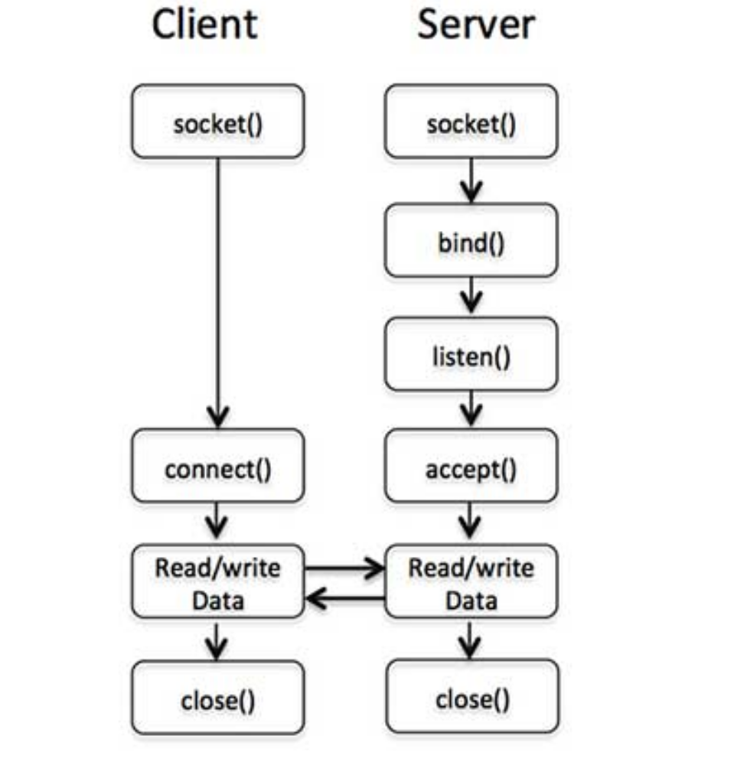
Following diagram shows the complete sequence of the calls used by Client and Server to communicate with each other −

Slide 136
Server Side Socket Calls
The socket() call is the first call in establishing a network connection is creating a socket.
socket( SOCKET, DOMAIN, TYPE, PROTOCOL );
The above call creates a SOCKET and other three arguments are integers which should have the following values for TCP/IP connections.
DOMAIN should be PF_INET. It's probable 2 on your computer.
TYPE should be SOCK_STREAM for TCP/IP connection.
PROTOCOL should be(getprotobyname('tcp'))[2]. It is the particular protocol such as TCP to be spoken over the socket.

Slide 137
So socket function call issued by the server will be something like this −
use Socket # This defines PF_INET and SOCK_STREAM
socket(SOCKET,PF_INET,SOCK_STREAM,(getprotobyname('tcp'))[2]);

Slide 138
The bind() call
The sockets created by socket() call are useless until they are bound to a hostname and a port number.
Server uses bind() function to specify the port at which they will be accepting connections from the clients.
bind( SOCKET, ADDRESS );
Here SOCKET is the descriptor returned by socket() call and ADDRESS is a socket address ( for TCP/IP ) containing three elements:
The address family (For TCP/IP, that's AF_INET, probably 2 on your system).
The port number (for example 21).
The internet address of the computer (for example 10.12.12.168).

Slide 139
use Socket # This defines PF_INET and SOCK_STREAM
$port = 12345; # The unique port used by the sever to listen requests
$server_ip_address = "10.12.12.168";
bind( SOCKET, pack_sockaddr_in($port, inet_aton($server_ip_address)))
or die "Can't bind to port $port! \n";
-The or die clause is very important because if a server dies without outstanding connections, the port won't be immediately reusable unless you use the option SO_REUSEADDR using setsockopt() function.
-pack_sockaddr_in function is used to pack the port no. & IP address into binary format.

Slide 140
The listen() call
If this is a server program, then it is required to issue a call to listen() on the specified port to listen. i.e., wait for the incoming requests.
listen( SOCKET, QUEUESIZE );
The above call uses SOCKET descriptor returned by socket() call and QUEUESIZE is the maximum number of outstanding connection request allowed simultaneously.

Slide 141
The accept() call
If this is a server program then it is required to issue a call to the accept() function to accept the incoming connections.
accept( NEW_SOCKET, SOCKET );
The accept call receive SOCKET descriptor returned by socket() function and upon successful completion, a new socket descriptor NEW_SOCKET is returned for all future communication between the client and the server.

Slide 142
Generally, accept() is used in an infinite loop.
As soon as one connection arrives the server either creates a child process to deal with it or serves it himself and then goes back to listen for more connections.
while(1) {
accept( NEW_SOCKET, SOCKET );
.......
}

Slide 143
Close()
close SOCKET;

Slide 144
Client Side Socket Calls
The connect() call
If you are going to prepare client program, then first you will use socket() call to create a socket and then you would have to use connect() call to connect to the server.
connect( SOCKET, ADDRESS );
Here SOCKET is the socket descriptor returned by socket() call issued by the client and ADDRESS is a socket address similar to bind call, except that it contains the IP address of the remote server.

Slide 145
$port = 21; # For example, the ftp port
$server_ip_address = "10.12.12.168";
connect( SOCKET, pack_sockaddr_in($port, inet_aton($server_ip_address)))
or die "Can't connect to port $port! \n";
If you connect to the server successfully, then you can start sending your commands to the server using SOCKET descriptor, otherwise your client will come out by giving an error message.

Slide 146
Client - Server Example
Following is a Perl code to implement a simple client-server program using Perl socket. Here server listens for incoming requests and once connection is established, it simply replies Smile from the server. The client reads that message and print on the screen.

Slide 147
Script to Create a Server
# Filename : server.pl
use strict;
use Socket;
# use port 7890 as default
my $port = 7890;
my $proto = getprotobyname('tcp');
my $server = "localhost"; # Host IP running the server
# create a socket, make it reusable
socket(SOCKET, PF_INET, SOCK_STREAM, $proto)
or die "Can't open socket $!\n";

Slide 148
# bind to a port, then listen
bind( SOCKET, pack_sockaddr_in($port, inet_aton($server)))
or die "Can't bind to port $port! \n";
listen(SOCKET, 5) or die "listen: $!";
print "SERVER started on port $port\n";
# accepting a connection
while (1)
{
accept(NEW_SOCKET, SOCKET);
# send them a message, close connection
print NEW_SOCKET "Smile from the server";

Slide 149
close NEW_SOCKET;
}
To run the server in background mode issue the following command
C:\Strawberry>server.pl&
SERVER started on port 7890

Slide 150
Script to Create a Client
#!/usr/bin/perl -w
# Filename : client.pl
use strict;
use Socket;
# initialize host and port
my $port = 7890;
my $server = "localhost"; # Host IP running the server
# create the socket, connect to the port
socket(SOCKET,PF_INET,SOCK_STREAM,(getprotobyname('tcp'))[2])
or die "Can't create a socket $!\n";

Slide 151
connect( SOCKET, pack_sockaddr_in($port, inet_aton($server)))
or die "Can't connect to port $port! \n";
my $line;
while ($line = <SOCKET>) {
print "$line\n";
}
close SOCKET or die "close: $!";
-Now let's start our client at the command prompt, which will connect to the server and read message sent by the server and displays the same on the screen as follows −
$perl client.pl
Smile from the server

Slide 152
NOTE: If you are giving the actual IP address in dot notation, then it is recommended to provide IP address in the same format in both client as well as server to avoid any confusion.

Slide 153
IO::Socket
IO::Socket provides an object interface for creating and using sockets.
It is built upon the IO::Handle interface and inherits all the methods defined by IO::Handle.
IO::Socket only defines methods for those operations which are common to all types of socket.
IO::Socket will export all functions (and constants) defined by Socket.

Slide 154
the following are supported IO::Socket methods,
socket
socketpair
bind
listen
accept
send
recv
peername (getpeername)
sockname (getsockname)
shutdown

Slide 155
A socket reference is created by the new function:
$remote =IO: :Socket: :INET->new(Proto => 'tcp', PeerAddr=> $host, PeerPort =>$port ) or die "cannot connect to $host: ($port) \n" )
The new function creates the socket and performs the connect operation.
The object reference returned can be used in any place where a filehandle is valid

Slide 156
All the socket functions are available as methods of the object, e.g. if we want to use the recv function we can call it as
$remote->recv ( ... ) .

Slide 157
Security issues
Languages which provide full access to the underlying operating system open up possibilities for malicious actions.
For example in UNIX passing the string rm - r * in this context will cause the entire file system to be erased
And therefore Perl provides an effective way of maintaining control by a process called taint checking.

Slide 158
Taint checking
The Perl approach to security is based on the premise that data coming from outside is untrustworthy, or 'tainted' , and that such data coming from outside a program cannot be used to affect something else outside the program without some deliberate action on the program's part.
Taint checking is automatically invoked in the UNIX environment when a script is running with more privileges than the owner of the script normally enjoys and it can also be invoked explicitly by invoking the Perl interpreter with the -T option. (CGI scripts are usually run with taint checking enabled in this way.)

Slide 159
When taint checking is active, command-line arguments, environment variables and file(socket) input are marked as tainted.
Perl then performs a flow analysis so that any value derived from a tainted variable is itself marked as tainted.
Such data may not be used (directly or indirectly) in any command that invokes a subshell or in any command that modifies files directories or processes: such use will generate an error (which may of course be trapped in a block eval as described earlier).
The only way to bypass the taint checks is to reference a pattern variable set by a regular expression match.

Slide 160
The 'Safe' module
Taint checking provides security for code you have written which uses potentially unsafe data from outside.
A different situation arises if you have to execute code that comes from an unknown or untrusted source.
The Safe module allows you to set up 'Safe objects': each of these is a compartment (or 'sand box') in which untrusted code can be executed in isolation from the rest of your program.

Slide 161
A Safe object has a namespace which is rooted at a specified level in the package hierarchy, so the code executed cannot access variables declared and used at a higher level in the hierarchy.
In addition, a Safe object can be set up to make a specified Perl operators unavailable, thus adding another level of security.

