Slide 1

DEPARTMENT OF COMPUTER SCIENCE AND ENGINEERING
CS23533- FOUNDATIONS OF ARTIFICIAL INTELLIGENCE
ACY 2026-27
III YEAR- V SEM
PROJECT FINAL REVIEW
RELIEFLINE LIVE
AI DISASTER RELIEF RESOURCE OPTIMIZER
DATE : November 2026
BATCH NO : 15
TEAM
MEMBER 1 REG : 240701456 NAME : SAICHUPAK E
MEMBER 2 REG : 240701444 NAME : RUPAKANTHAN A

Slide 2





ABSTRACT
Reliefline Live is a web-based system that maps live disasters, finds the nearest hospital by road time, and plans shelters, supplies and rescue teams.
AI techniques applied
Rule-Based Classification
High / Medium / Low disaster risk
Hungarian Algorithm
Rescue team assignment
Genetic Algorithm
Warehouse stock allocation
A* Search
Fastest hospital route planning
Application features
Live disaster map
Hospital routing
Shelters & stock
Rescue tickets
Objective: demonstrate how AI algorithms can speed up emergency response and relief planning.

Slide 3







PROBLEM STATEMENT
Key relief factors
Challenges
Where the disaster is and its risk
Nearest hospital in an emergency
The closest hospital on the map is not always the fastest to reach by road.
Number of people affected
Hospital and shelter capacity
Fair supply allocation
Limited food and water must reach the highest-risk areas first.
Warehouse food and water stock
Fastest routes to reach the area
PROBLEM
There is a need for one integrated system that shows live disasters, finds the fastest hospital route, and plans shelters, supplies and rescue teams using AI techniques.

Slide 4







INTRODUCTION
Disasters need fast, well-coordinated decisions to save lives
Relief teams need live data, hospital routes and supply planning
Reliefline Live combines live disaster data with AI-based routing and allocation
Main features
Live disaster map and risk levels
Hospital finder with fastest route
Shelter planner
Warehouse supply allocation
Rescue team dispatch
Tickets: damage and resource needs

Slide 5


LITERATURE REVIEW
1. Disaster Operations Management
Altay and Green (2006) review how operations research supports mitigation, preparedness, response and recovery.
2. Emergency Logistics Models
Özdamar et al. (2004) and Sheu (2007) plan how relief goods reach areas with urgent demand.
3. Optimization Algorithms
Genetic algorithms (Holland, 1975) improve sets of plans; the Hungarian method (Kuhn, 1955) solves assignment.
4. Heuristic Search Algorithms
A* (Hart et al., 1968) adds a heuristic to shortest-path search to find low-cost routes faster.
5. Open Data and Mapping
GDACS, USGS and NASA EONET give live hazards; OpenStreetMap and OSRM give map data and road routes.

Slide 6




EXISTING SYSTEM
In current disaster response
The gap
Alerts are read from separate websites
Live disaster data
Hospital and shelter lists are kept apart
Hospital routing
Supply stock is tracked manually
Resource allocation
Team dispatch
Rescue teams are assigned by phone calls
Routes need separate map applications
No single integrated workflow connects these tasks.

Slide 7


LIMITATIONS
Finding the nearest hospital by hand takes time
Hard to compare many routes and risks together
Supplies are shared without risk priority
Disaster information is not in one place
Separate tools for maps, hospitals and stock
Rescue teams are matched to incidents manually
NEED FOR IMPROVEMENT
An integrated system using AI algorithms can organize these tasks and speed up emergency decisions.

Slide 8

PROPOSED SYSTEM
An integrated web-based application for live disaster mapping and relief planning
1. Disaster Management
2. Hospital Module
Live events from GDACS, USGS and NASA
High / Medium / Low risk and prone zones
Click the map to mark an emergency
Nearest hospitals ranked by road time
Fastest route drawn in blue
3. Shelters and Warehouses
4. Rescue Teams and Tickets
Safe shelters outside the danger zone
Warehouse stock for each area
Genetic algorithm allocates supplies
Teams assigned to incidents
Hungarian algorithm: minimum distance
Tickets track each request
Resolved when relief is complete
Expected outcome: one application for live disaster monitoring, hospital routing and relief planning.

Slide 9
METHODOLOGIES
Four AI methodologies demonstrated in Reliefline Live
01
02
03
04
Rule-Based Classification
Hungarian Algorithm
Genetic Algorithm
A* Search
Rule-based reasoning
Uses severity and population
Gives High, Medium or Low
Assignment problem
Teams matched to incidents
Minimum total distance
Local-search optimization
Evaluates allocation plans
Evolves better plans
Heuristic pathfinding
Path cost + straight-line estimate
Fastest hospital route
Risk Levels
Rescue Teams
Warehouses
Hospital Route

Slide 10




ARCHITECTURE
System architecture
Emergency routing flow
User / Relief Officer
User chooses the Hospitals category
1
Reliefline Web Application
Clicks the map to mark an emergency
2
Application Backend – FastAPI
Nearby hospitals shortlisted (haversine)
3
Database – SQLite
Shortest-path search ranks real road times
4
AI and Planning Modules
Top 3 routes and travel times returned
Rule-Based Risk
Risk levels
Hungarian Algorithm
Rescue assignment
5
Genetic Algorithm
Stock allocation
A* Search
Route planning
Leaflet draws the blue route on the map
6

Slide 11
METHODOLOGY 1
Rule-Based Classification — rules turn event data into risk levels
1
2
3
4
5
Collect event type, severity and people affected
Match the data with risk rules
Apply the rule whose condition is satisfied
Generate the risk level and zone
Show the colour and recommended action
rules are applied to every event
Example rule
Application in Reliefline
IF risk score is 0.6 or more
THEN the zone is High risk (red)
ELSE IF risk score is 0.4 or more: Medium (orange)
ELSE the zone is Low risk (green)
Score = 0.6 × severity share + 0.4 × population share. GDACS Red, Orange and Green map to High, Medium and Low.

Slide 12
METHODOLOGY 2
Hungarian Algorithm — assign rescue teams to incidents at minimum distance
Components
1 Build team–incident distance matrix
Rows
Rescue teams
2 Subtract row and column minimums
5 try other zeros
3 Cover all zeros with fewest lines
Columns
Simultaneous incidents
4 Lines = number of teams?
No
6 Adjust: create more zeros
Cost
Distance from each team to each incident
Yes
Skill match breaks ties
No
7 Valid zero pairs found?
Application in Reliefline
Rescue Team Dispatch gives each team one incident so the total travel distance is minimum.
Yes
Minimum-distance assignment found ✓

Slide 13

METHODOLOGY 3
Genetic Algorithm — evolves better stock-allocation plans
1 Create random allocation plans
FITNESS COST (CONCEPTUAL)
Cost = risk × unmet need + distance + stock penalty
2 Calculate the fitness of each plan
3 Select the best plans as parents
Fitness factors
repeat
Unmet need × risk
Delivery distance
4 Crossover and mutation make new plans
Generations left?
Stock limit penalty
Risk priority
Yes
5 Next generation (keep the best)
Application in Reliefline
Allocates warehouse stock to zones; the plan cost was 46.3% lower than a greedy method on sample data.
No
6 Stop: return the best plan

Slide 14
METHODOLOGY 4
A* Search — heuristic search for the fastest route
f(n) = g(n) + h(n)
g(n) actual travel cost from the start to the current node
h(n) straight-line (haversine) estimate to the destination
f(n) estimated total route cost
1
2
3
4
Identify emergency point and hospital
Represent the road network as a graph
Explore possible road connections
Calculate path cost and heuristic estimate
No
7
6
5
Reconstruct the route and draw it in blue on the map
Yes
Destination reached?
Select the node with the lowest f(n)
Application in Reliefline: hospitals are shortlisted by haversine distance, ranked by road travel time, and the fastest route is drawn; A* is implemented in the backend route planner.

Slide 15
RESULTS (VALUES/TABLE)
A. Allocation: GA vs greedy
B. Hospital routing result
Evaluation metric | Observed value
Zones / warehouses | 10 / 3
Total need (3 days) | 101,700 person-days
Genetic algorithm cost | 475,686
Greedy method cost | 886,644
Cost improvement | 46.3%
Hospital (rank) | Time | Distance
1 Deepam Muthu | 1 min | 0.6 km
2 G K M Hospital | 3 min | 2.1 km
3 Vepery Hospital | 3 min | 2.1 km
Ambulance (siren) | ~1 min | 0.6 km
Emergency marked in Chennai; times are by road, without live traffic.
Improvement = (Greedy − GA cost) ÷ Greedy cost
46.3%
0.6 km
83%
lower allocation cost
than greedy, sample data, 120 generations
nearest hospital by road
Deepam Muthu Hospital, 1 min away
Random Forest accuracy
risk classifier, synthetic training data

Slide 16
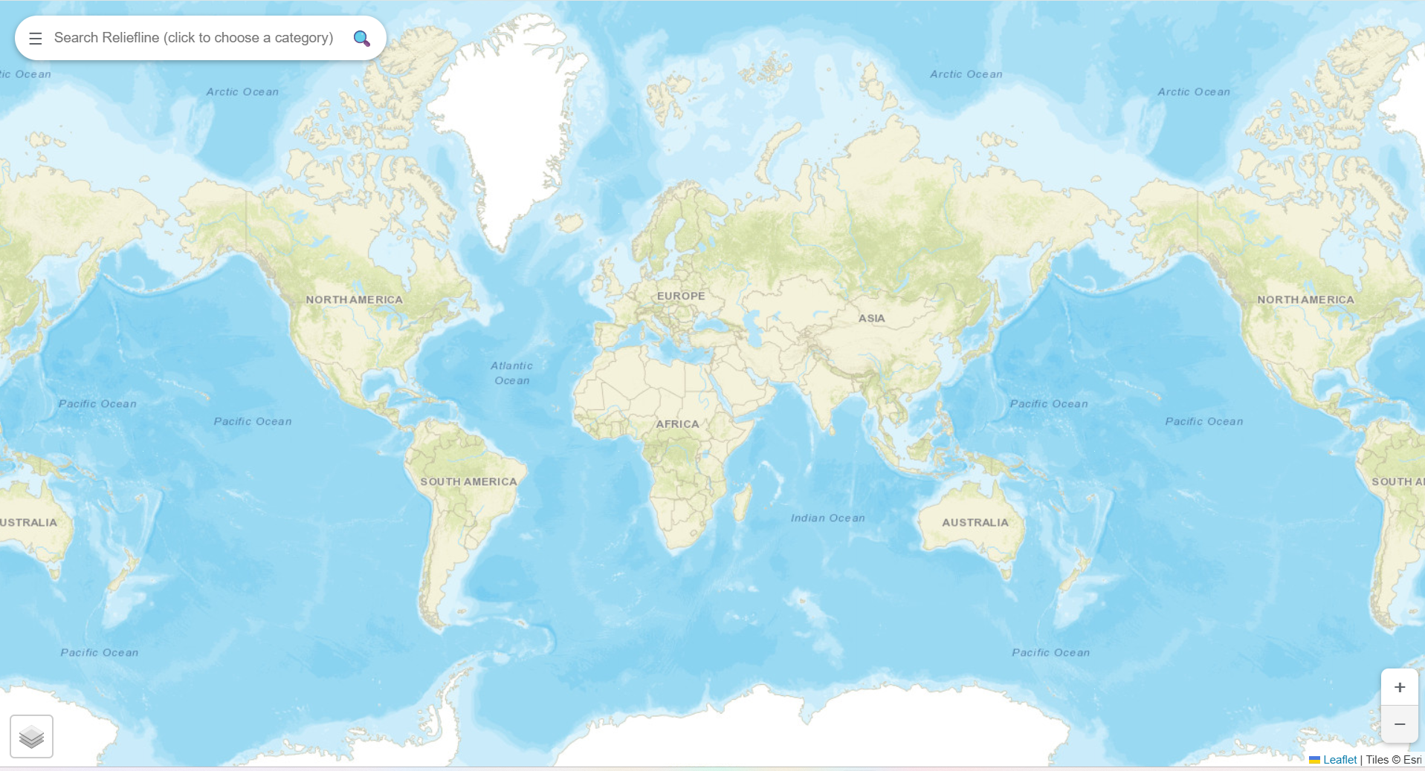
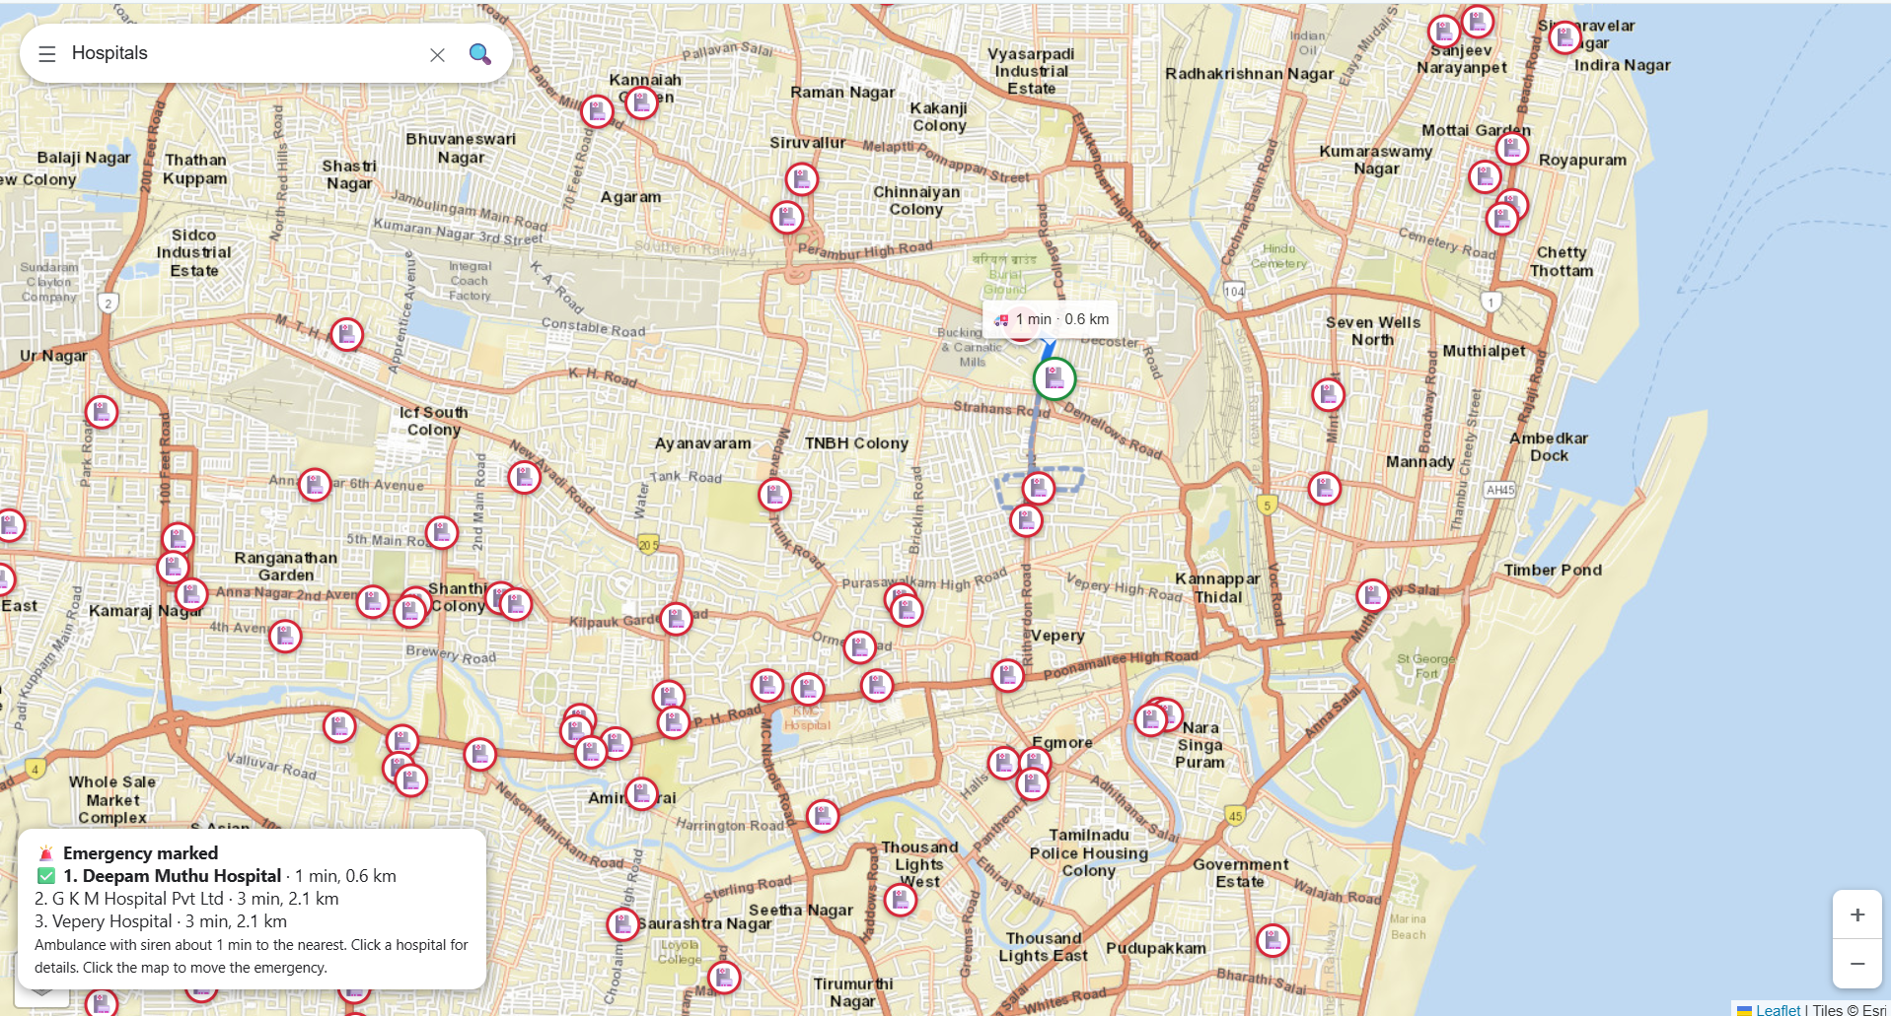
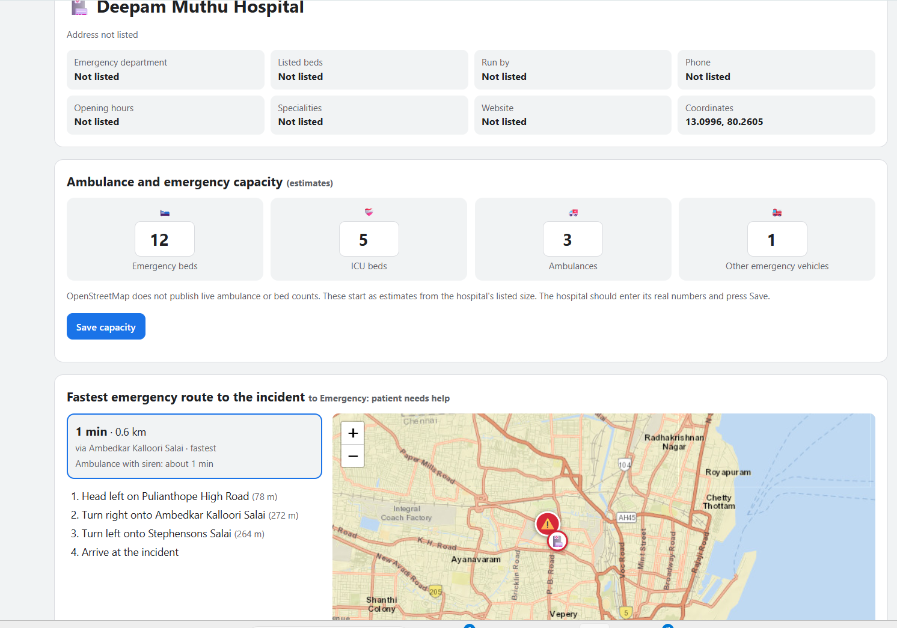
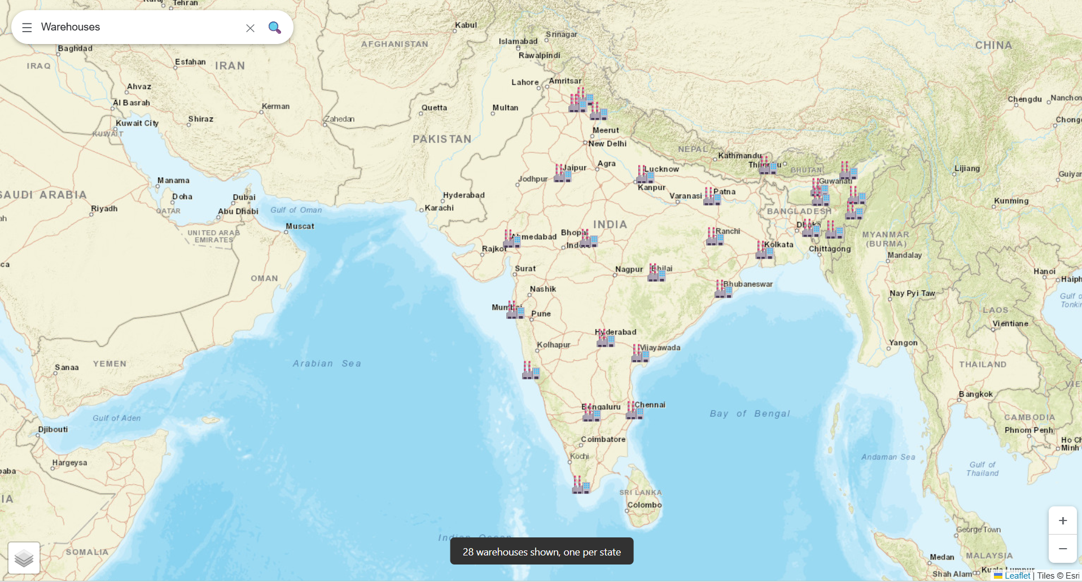
RESULTS – (SCREENSHOT)
Main map — category search
Hospital Module — fastest emergency route
Hospital details — capacity and route
Warehouse Module — 28 state warehouses

Slide 17

CONCLUSION
Reliefline Live applies AI techniques to disaster monitoring, hospital routing, resource allocation and rescue dispatch.
Rule-Based Reasoning
Risk classification
Hungarian Algorithm
Rescue team assignment
Genetic Algorithm
Warehouse allocation
A* Search
Fastest route planning
CONCLUSION
Reliefline Live is an integrated platform showing how AI techniques and free open data can support faster, better-prioritised disaster relief decisions on a single map.

Slide 18








FUTURE ENHANCEMENT
Live traffic and road closures
Real hospital bed and ambulance data
Real-time shelter occupancy
SMS alerts to residents
Multilingual and voice support
Mobile application support
Dynamic route recalculation
Random Forest on real disaster data
Relief analytics and reports

Slide 19
REFERENCES
Altay, N. and Green, W. G. (2006). OR/MS Research in Disaster Operations Management. European Journal of Operational Research, 175(1), 475–493.
Hart, P. E., Nilsson, N. J. and Raphael, B. (1968). A Formal Basis for the Heuristic Determination of Minimum Cost Paths. IEEE Trans. Systems Science and Cybernetics, 4(2), 100–107.
Holland, J. H. (1975). Adaptation in Natural and Artificial Systems. University of Michigan Press.
Kuhn, H. W. (1955). The Hungarian Method for the Assignment Problem. Naval Research Logistics Quarterly, 2(1–2), 83–97.
Luxen, D. and Vetter, C. (2011). Real-time Routing with OpenStreetMap Data. Proc. 19th ACM SIGSPATIAL Int. Conf. on Advances in GIS, 513–516.
Russell, S. and Norvig, P. (2021). Artificial Intelligence: A Modern Approach, 4th ed. Pearson.
GDACS, USGS and NASA EONET (n.d.). Live disaster data: gdacs.org, earthquake.usgs.gov, eonet.gsfc.nasa.gov. OpenStreetMap Contributors and Leaflet (n.d.).

