Slide 1
COMPUTER NETWORKS (CS F303)
Dr. Pranav M Pawar
Department of Computer Science

Slide 2
Basic information
Text book(s) [TB]
James F. Kurose & Keith W. Ross “Computer Networking: A Top-Down Approach Featuring the Internet”, Sixth Edition,Pearson,2013.
Reference book(s) [RB]
Larry L. Peterson & Bruce S. Davie: Computer Networks: A Systems Approach, Fourth Edition, Morgan Kaufmann / Elsevier, New Delhi, 2007
Behrouz A. Forouzan. Data Communications and Networking (3rd. ed.). McGraw-Hill, Inc., USA, 2003.
Behrouz A. Forouzan and Sophia Chung Fegan. TCP/IP Protocol Suite (2nd. ed.). McGraw-Hill Higher Education, 2002.

Slide 3
Evaluation
Sl# | Component | OB/CB | Duration | Weightage | Date &Time
1. | Mid Sem Test | OB* | 90 Minutes | 30% | 05.04.23 FN
2. | Mid Semester Lab Exam | CB | 60 Minutes | 10% | TBA
3 | Quiz (closed book) | CB | 20 Minutes | 5% | TBA
3. | End semester Lab Exam | CB | 90 Minutes | 20% | TBA
4. | Comprehensive Exam | CB | 3 hours | 35% | 31.05.23 AN

Slide 4
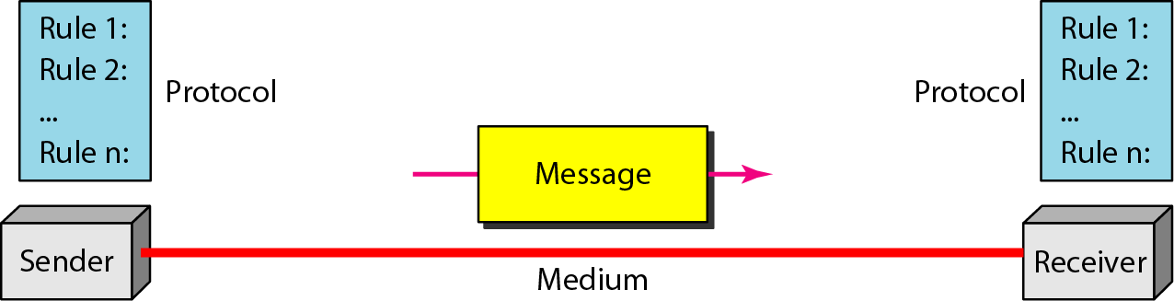
DATA COMMUNICATIONS
The term telecommunication means communication at a distance.
The word data refers to information presented in whatever form is agreed upon by the parties creating and using the data.
Data communications are the exchange of data between two devices via some form of transmission medium such as a wire cable.

Slide 5
Network
A network is a set of devices (often referred to as nodes) connected by communication links.
A node can be a computer, printer, or any other device capable of sending and/or receiving data generated by other nodes on the network.
Network Criteria
  Fault Tolerance
  Scalability
  QoS
  Security

Slide 6
Why we need
Computer networks?
Computer networks help users on the network to share the resources and in communication.

Slide 7
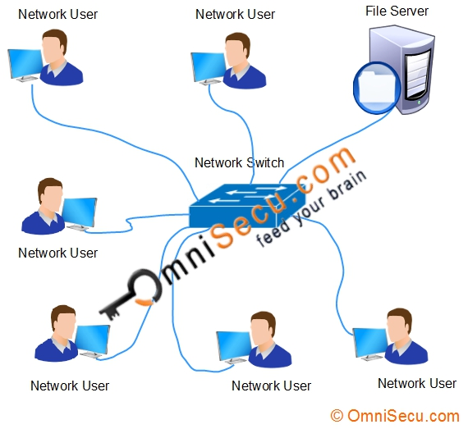
Why we need
Computer networks?
File sharing: Networking of computers helps the network users to share data files.

Slide 8
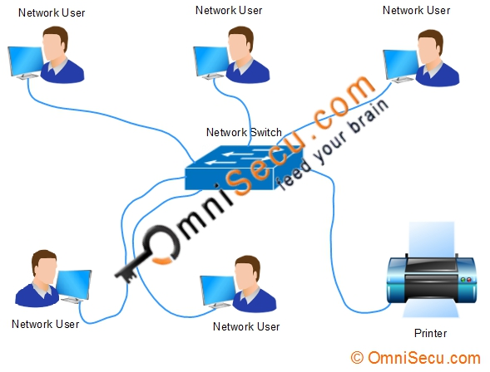
Why we need
Computer networks?
Hardware sharing: Users can share devices such as printers, scanners, CD-ROM drives, hard drives etc.

Slide 9
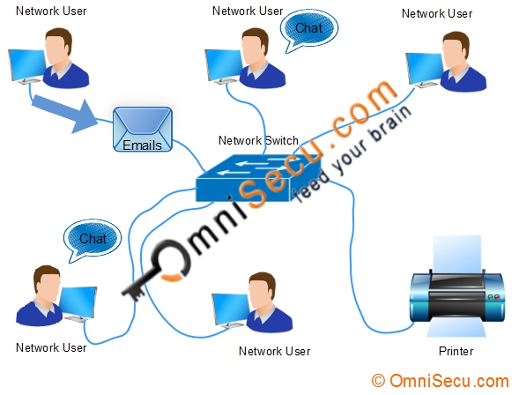
Why we need
Computer networks?
User communication: Networks allow users to communicate using e-mail, newsgroups, and video conferencing etc.

Slide 10
Why we need
Computer networks?
Application sharing: Applications can be shared over the network, and this allows to implement client/server applications.
Network gaming: A lot of network games are available, which allow multi-users to play from different locations.
Voice over IP (VoIP): Voice over Internet Protocol (IP) is a revolutionary change in telecommunication which allows to send telephone calls (voice data) using standard Internet Protocol (IP) rather than by traditional PSTN.

Slide 11
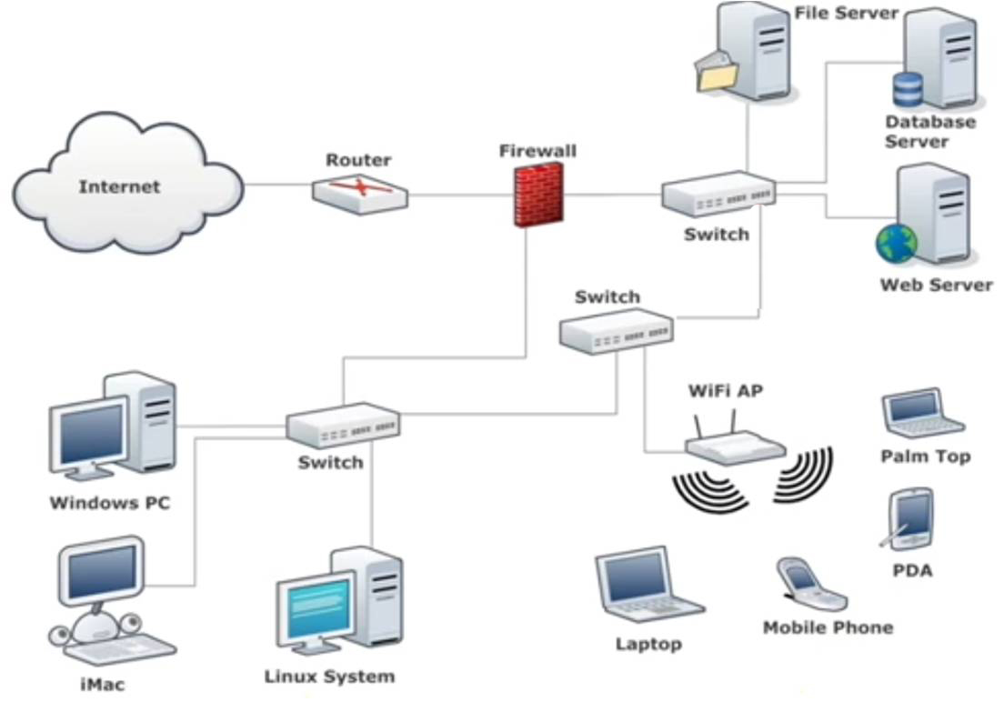
A Simple Network

Slide 12
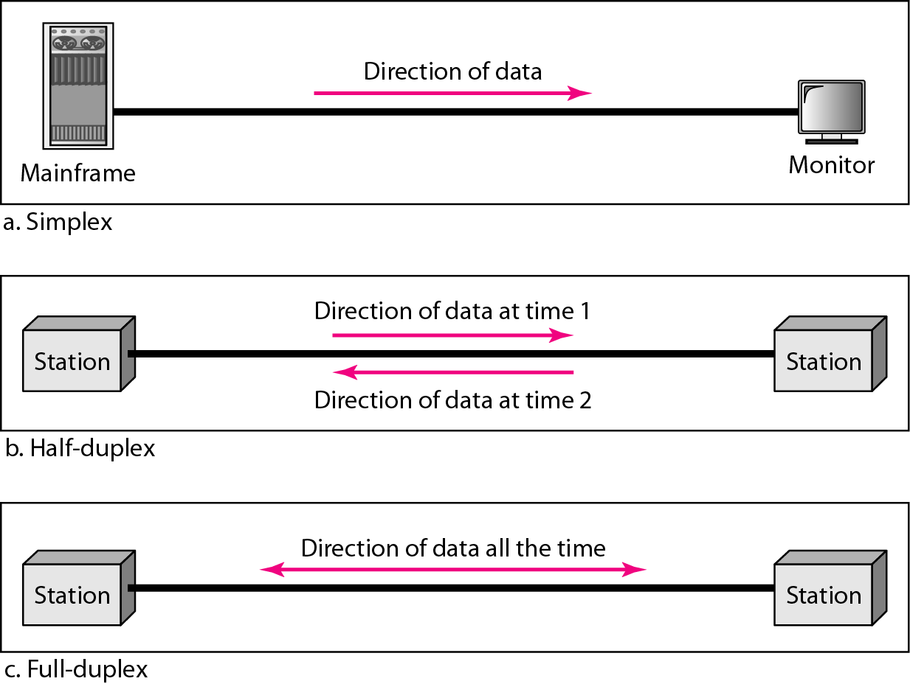
Data Flows

Slide 13
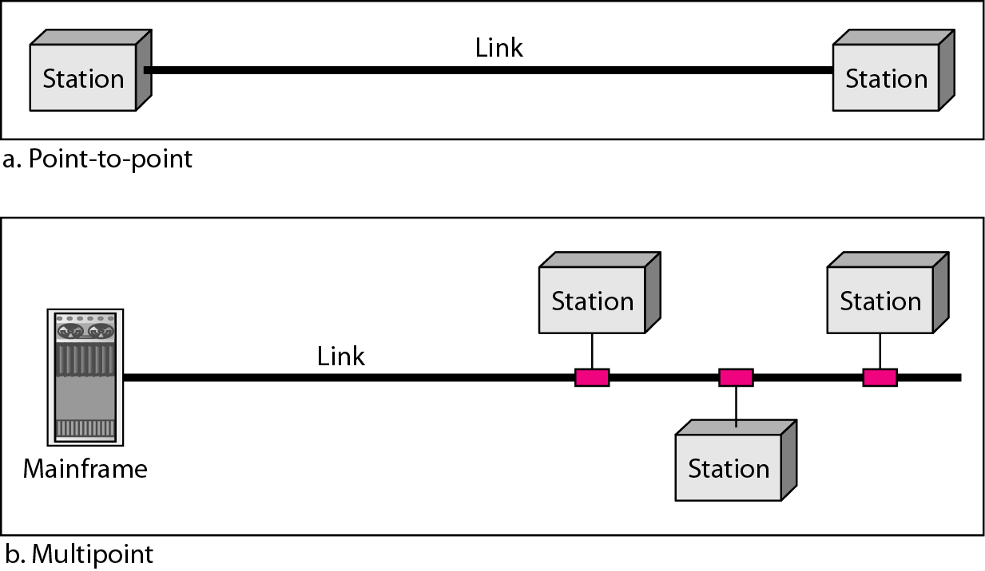
Types of Connections

Slide 14
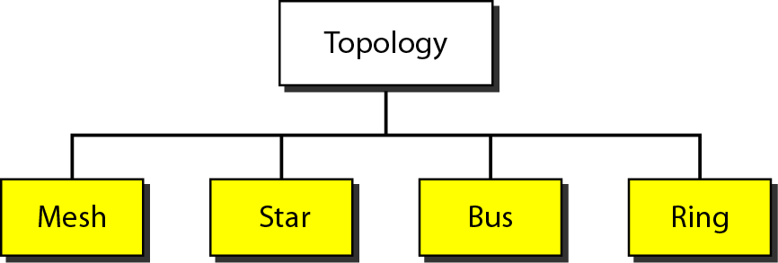
topology
The physical topology of a network refers to the configuration of cables, computers and other peripherals.
Categories of topology

Slide 15
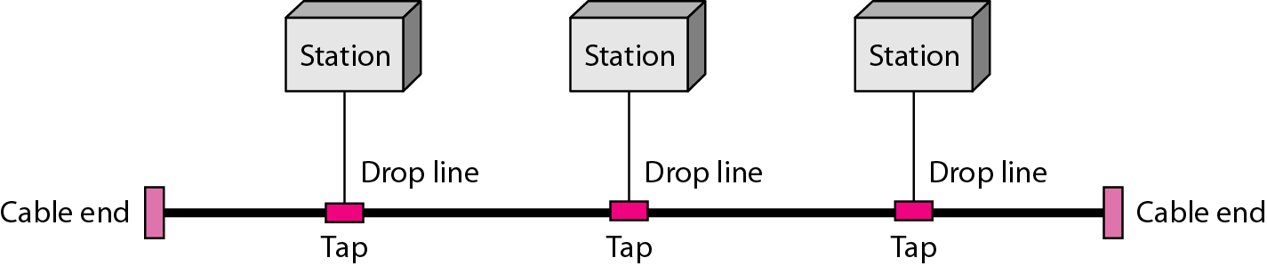
bus topology
Single cable connects all network nodes without intervening connectivity devices
Devices share responsibility for getting data from one point to another
Terminators stop signals after reaching end of wire
  Prevent signal bounce
Two way Comm.
Ethernet (CSMA/CD or CA)

Slide 16
Advantages of Bus Topology
Works well for small networks
Relatively inexpensive to implement
Easy of installation
Node failure does not affect others

Slide 17
Disadvantages of Bus Topology
Not fault tolerant- Reconnection and fault isolation is difficult
Potential for congestion with network traffic
No security

Slide 18
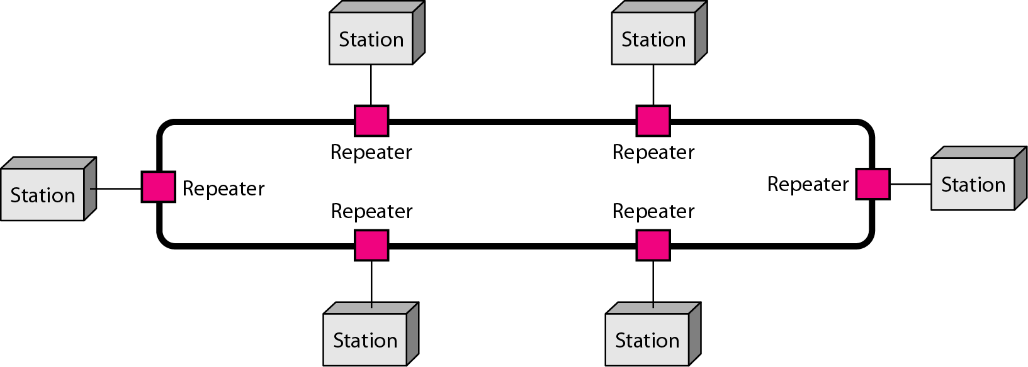
ring topology
In Ring topology each node is connected to the two nearest nodes so the entire network forms a circle
Data only travels in one direction on a Ring network
  One method for passing data on ring networks is token passing
Notes:
Empty information frames are continuously circulated on the ring.
When a computer has a message to send, it inserts a token in an empty frame (this may consist of simply changing a 0 to a 1 in the token bit part of the frame) and inserts a message and a destination identifier in the frame.
The frame is then examined by each successive workstation. If the workstation sees that it is the destination for the message, it copies the message from the frame and changes the token back to 0.
When the frame gets back to the originator, it sees that the token has been changed to 0 and that the message has been copied and received. It removes the message from the frame.
The frame continues to circulate as an "empty" frame, ready to be taken by a workstation when it has a message to send.
The token scheme can also be used with bus topology LANs.
The standard for the Token Ring protocol is Institute of Electrical and Electronics Engineers (IEEE) 802.5. The Fiber Distributed-Data Interface (FDDI) also uses a Token Ring protocol.

Slide 19
How does it work?
Data hops from one device to another until it reaches its destination
Each device communicates its routing information to every device it connects with
Each device then determines what to do with received data- pass it on or keep it
Notes:
Very device intensive

Slide 20
Advantages of Ring Topology
Easier to manage; easier to locate a defective node or cable problem
Well-suited for transmitting signals over long distances on a LAN
Handles high-volume network traffic
Enables reliable communication

Slide 21
Disadvantages of Ring Topology
Expensive
Single point of failure
Requires more cable and network equipment at the start
Not used as widely as bus topology
  Fewer equipment options
  Fewer options for expansion to high-speed communication
No security

Slide 22
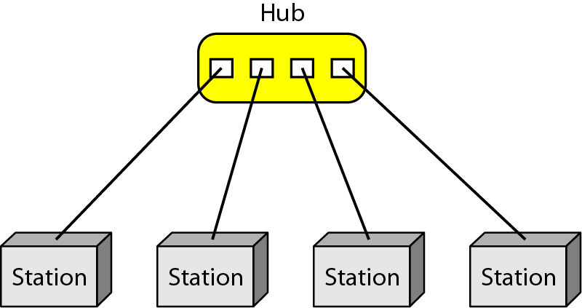
star topology
A star network is designed with each node (file server, workstation, peripheral) connected directly to a central network hub or server

Slide 23
Advantages of Star Topology
Good option for modern networks
Low startup costs
Easy to manage
Offers opportunities for expansion
Most popular topology in use; wide variety of equipment available
Scalable
Security is high

Slide 24
Disadvantages of Star Topology
Hub is a single point of failure.
Requires more cable than the bus.

Slide 25
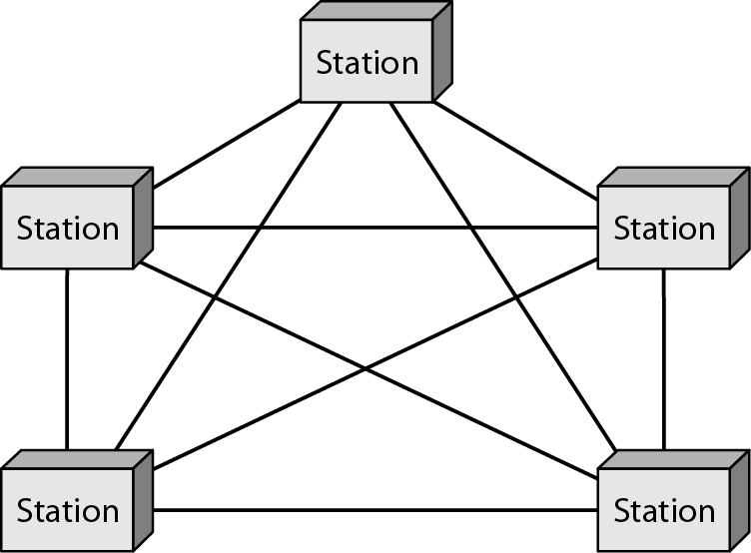
A fully connected mesh topology (five devices)
Every node has a circuit connecting it to every other node in the network
Yields greatest redundancy, so if one node fails, network traffic can be redirected to any of the other nodes
Usually reserved for backbone networks since it is very expensive

Slide 26
mesh topology
Advantages
  No Traffic
  Easy fault identification
  Robust
Disadvantages
  - Expensive- large number of cables, I/O port and connections required.

Slide 27
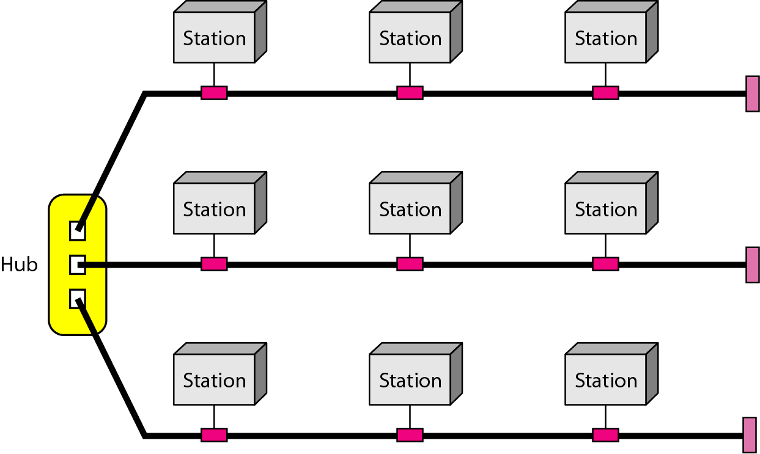
A hybrid topology: a star backbone with three bus networks

Slide 28
Categories of Networks
Local Area Networks (LANs)
  Short distances
  Designed to provide local interconnectivity
  Wifi
Wide Area Networks (WANs)
  Long distances
  Provide connectivity over large areas
  Internet
Metropolitan Area Networks (MANs)
  Provide connectivity over areas such as a city, a campus
  Cable Tv N/W in the city

Slide 29
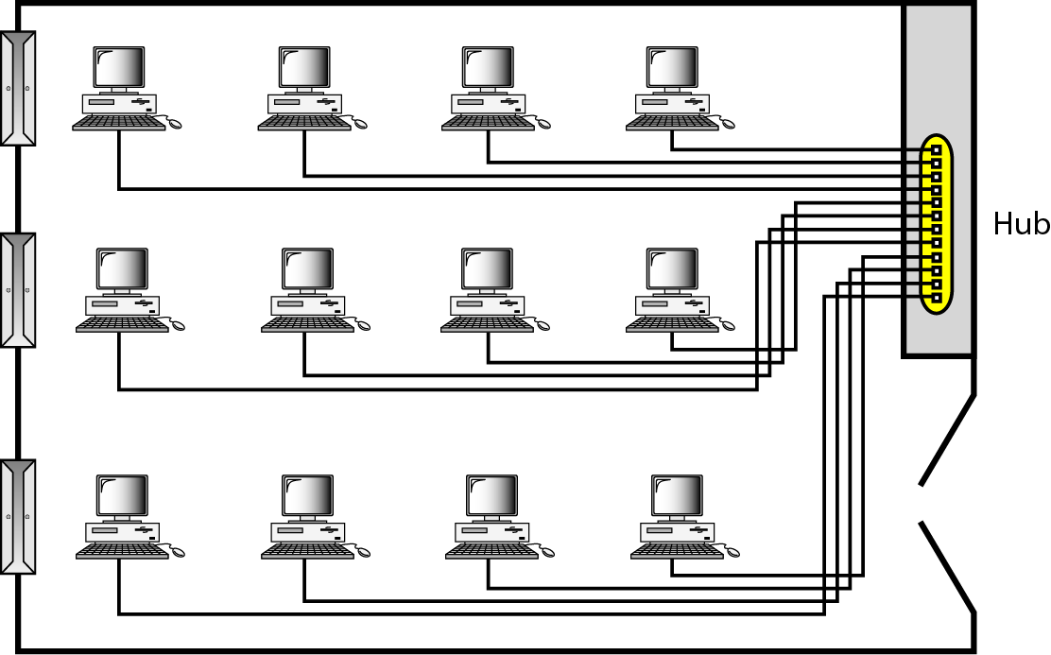
An isolated LAN connecting 12 computers to a hub in a closet

Slide 30
Network Devices and Components
Four major components
  End Points
    PCs, Servers, Printers, Smart Phones, etc
  Interconnections
    NIC cards, Media, Connectors
  Switches
    Connects endpoints to the Local Area Network (LAN)
  Router
    Connect multiple LANs to form Internetworks
    Chooses best path between LAN and Wider Area Networks (WAN)

Slide 31
What’s the Internet: “nuts and bolts” view
millions of connected computing devices: hosts, end-systems
  pc’s workstations, servers
  PDA’s, phones,
  running network apps
communication links
  fiber, copper, radio, satellite
routers: forward packets (chunks) of data thru network
router
workstation
server
mobile
local ISP
regional ISP
company
network

Slide 32
What’s the Internet: “nuts and bolts” view
protocols: control sending, receiving of msgs
  e.g., TCP, IP, HTTP, FTP, PPP
Internet: “network of networks”
router
workstation
server
mobile
local ISP
regional ISP
company
network

Slide 33
What’s the Internet: a service view
communication infrastructure enables distributed applications:
  WWW, email, games, e-commerce, database,
  more?
communication services provided:
  connectionless
  connection-oriented

Slide 34
What’s a network protocol?
all communication activity in Internet governed by protocols
protocols define format, order of msgs sent and received among network entities, and actions taken on msg transmission, receipt
… specific msgs sent
… specific actions taken when msgs received, or other events

Slide 35


What’s a protocol?
a human protocol and a computer network protocol:
Hi
TCP connection
req.
Hi
TCP connection
reply.
Got the
time?
Get http://gaia.cs.umass.edu/index.htm
2:00
<file>
time

Slide 36
Protocols and Standards
Protocols are rules and regulations.
  It defines what is communicated, how it is communicated, and when it is communicated.
  Key elements of protocol are,
    Syntax: Format of data
    Semantics: Meaning of each section of bits
    Timing: When data should sent and how fast?
Standards are agreed rules.
  Essential for creating and maintaining an open and competitive market for equipment manufacturers
  For national and international interoperability.
  De facto standards: Not been approved by an organized body but have been adopted as standards through widespread use.
  De jure

Slide 37
Protocols and Standards
Standard Organizations
  Standard Creation Committees
    ISO (International Standard Organization)
    International Telecommunication Union-Telecommunication Standards Sector (ITU-T)
    American National Standards Institute (ANSI)
    Institute of Electrical and Electronics Engineers (IEEE)
    Electronic Industries Association (EIA)
  Forums
  Regulatory Agencies: FCC (Federal Communications Commissions)
Internet Standards
  Internet draft: Lifetime of only 6 month
  RFC (Request for Comment): After recommendation from internet authorities, draft will be converted to RFC.

Slide 38
A closer look at network structure:
network edge:
applications and hosts
network core:
  routers
  network of networks
access networks
  residential
  institutional
  mobile
physical media
  wire (digital / analog)
  wireless (radio / cellular)

Slide 39
The network edge:
end systems (hosts):
  run application programs
  e.g., WWW, email
  at “edge of network”
client/server model
  client host requests, receives service
  from server
  e.g., WWW client (browser)/ server;
  email client/server
peer-peer model:
  host interaction symmetric
  e.g.: teleconferencing

Slide 40
Network edge: connection-oriented service
Goal: data transfer between end sys.
handshaking: setup (prepare for) data transfer ahead of time
  set up “state” in two communicating hosts
TCP - Transmission Control Protocol
  Internet’s de-facto connection-oriented service
TCP service [RFC 793]
reliable, in-order byte-stream data transfer
  dealing with loss: acknowledgements and retransmissions
flow control:
  sender won’t overcome receiver
congestion control:
  senders “slow down sending rate” when network congestion detected

Slide 41
Network edge: connectionless service
Goal: data transfer between end systems
  same as before!
UDP - User Datagram Protocol [RFC 768]: Internet’s connectionless service
  unreliable data transfer
  no flow control
  no congestion control
App’s using TCP:
HTTP (WWW), FTP (file transfer), Telnet (remote login), SMTP (email)
App’s using UDP:
streaming media, teleconferencing, Internet telephony

Slide 42
The Network Core
mesh of interconnected routers
the fundamental question: how is data transferred through net?
  circuit switching: dedicated circuit per call: telephone net
  packet-switching: data sent thru net in discrete “chunks”

Slide 43
Network Core: Circuit Switching
End-end resources reserved for “call”
link bandwidth, switch capacity
dedicated resources: no sharing
circuit-like (guaranteed) performance
call setup required

Slide 44
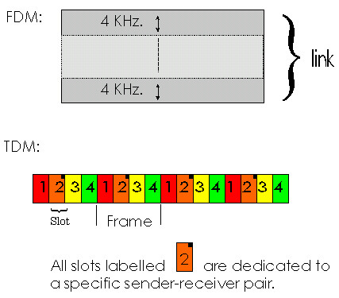
Network Core: Circuit Switching
network resources (e.g., bandwidth) divided into “pieces”
pieces allocated to calls
resource piece idle if not used by owning call (no sharing)
dividing link bandwidth into “pieces”
  frequency division
  time division
  code division

Slide 45
Network Core: Packet Switching
resource contention:
aggregate resource demand can exceed amount available
congestion: packets queue, wait for link use
store and forward: packets move one hop at a time
  transmit over link
  wait turn at next link
each end-end data stream divided into packets
user A, B packets share network resources
each packet uses full link bandwidth
resources used as needed,
Bandwidth division into “pieces”
Dedicated allocation
Resource reservation

Slide 46
Network Core: Packet Switching
10 Mbs
Ethernet
A
C
statistical multiplexing
1.5 Mbs
B
queue of packets
waiting for output
link
45 Mbs
D
E

Slide 47
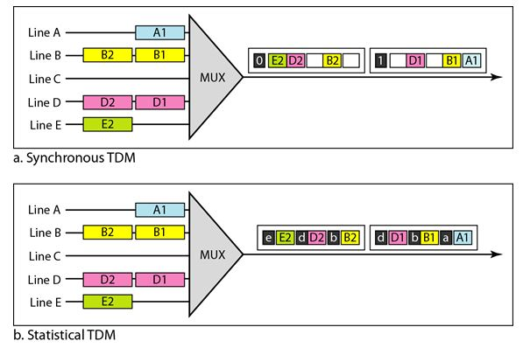

Slide 48
Packet-switched networks: routing
Goal: move packets among routers from source to destination
  we’ll study several path selection algorithms
datagram network:
  destination address determines next hop
  routes may change during session

Slide 49
Access networks and physical media
Q: How to connect end systems to edge router?
residential access nets
institutional access networks (school, company)
mobile access networks
Keep in mind:
bandwidth (bits per second) of access network?
shared (e.g. cable, ethernet) or dedicated (e.g., DSL)?

Slide 50
Residential access: point to point access
Dialup via modem
  up to 56Kbps direct access to router (conceptually)
DSL: digital subscriber line
  up to 1 Mbps home-to-router
  up to 8 Mbps router-to-home

Slide 51
Institutional access: local area networks
company/univ local area network (LAN) connects end system to edge router
Ethernet:
  shared or dedicated cable connects end system and router
  10 Mbs, 100Mbps, Gigabit Ethernet

Slide 52
Wireless access networks
shared wireless access network connects end system to router
wireless LANs:
  radio spectrum replaces wire
  e.g., Wavelan 10 Mbps
wider-area wireless access
  wireless access to ISP router via cellular network
router
base
station
mobile
hosts

Slide 53
Open Systems Interconnection (OSI) Model

Slide 54
HISTORY
Rapid growth of computer networks caused compatibility problems
ISO recognized the problem and released the OSI model in 1984
OSI stands for Open Systems Interconnection and consists of 7 Layers
The use of layers is designed to reduce complexity and make standardization easier

Slide 55
OSI Reference Model
The OSI model is now considered the primary Architectural model for inter-computer communications.
The OSI model describes how information or data makes its way from application programmes (such as spreadsheets) through a network medium (such as wire) to another application programme located on another network.
The OSI reference model divides the problem of moving information between computers over a network medium into SEVEN smaller and more manageable problems .
This separation into smaller more manageable functions is known as layering.

Slide 56
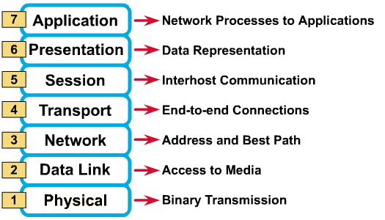
OSI Reference Model : 7 Layers

Slide 57
OSI: A Layered Network Model
The process of breaking up the functions or tasks of networking into layers reduces complexity.
Each layer provides a service to the layer above or below it in the protocol specification.
Each layer communicates with the same layer’s software or hardware on other computers.
The lower 4 layers (transport, network, data link and physical —Layers 4, 3, 2, and 1) are concerned with the flow of data from end to end through the network.
The upper four layers of the OSI model (application, presentation and session—Layers 7, 6 and 5) are orientated more toward services to the applications.
Data is Encapsulated with the necessary protocol information as it moves down the layers before network transit.

Slide 58
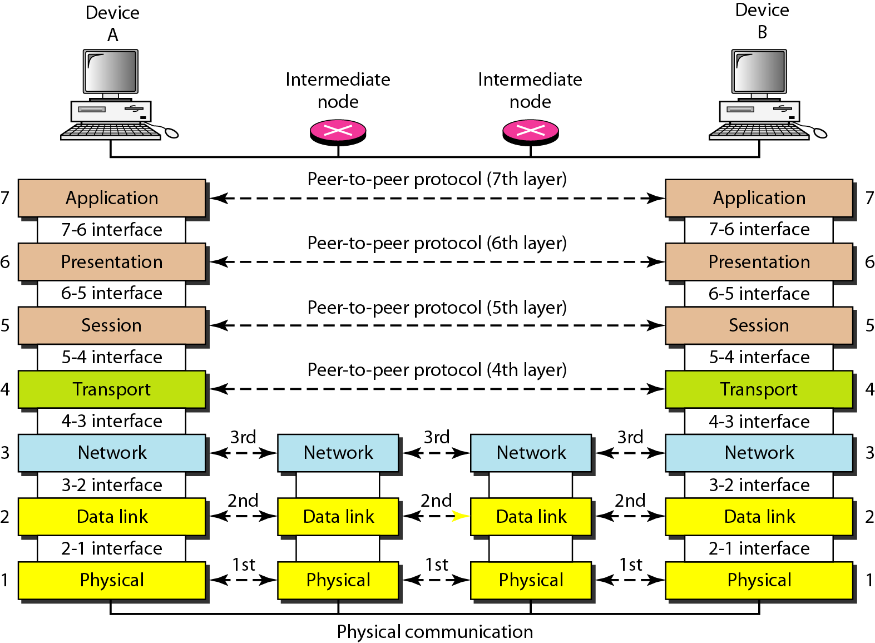
The interaction between layers in the OSI model

Slide 59
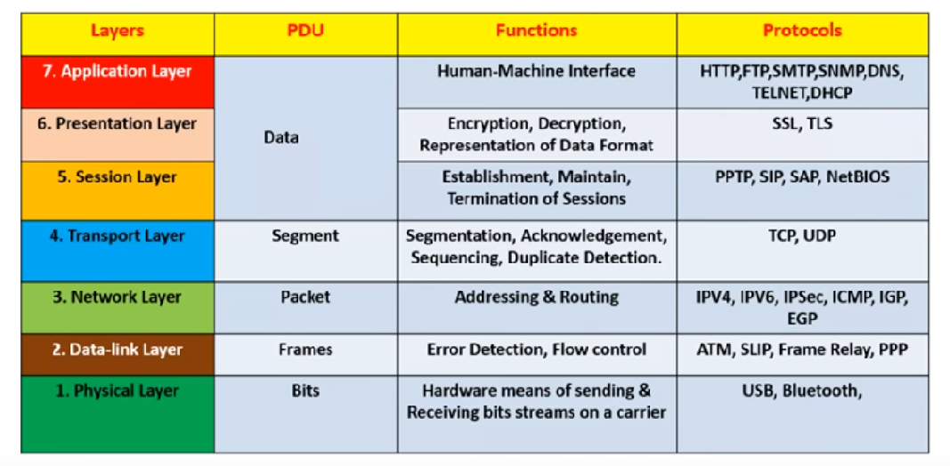

Slide 60
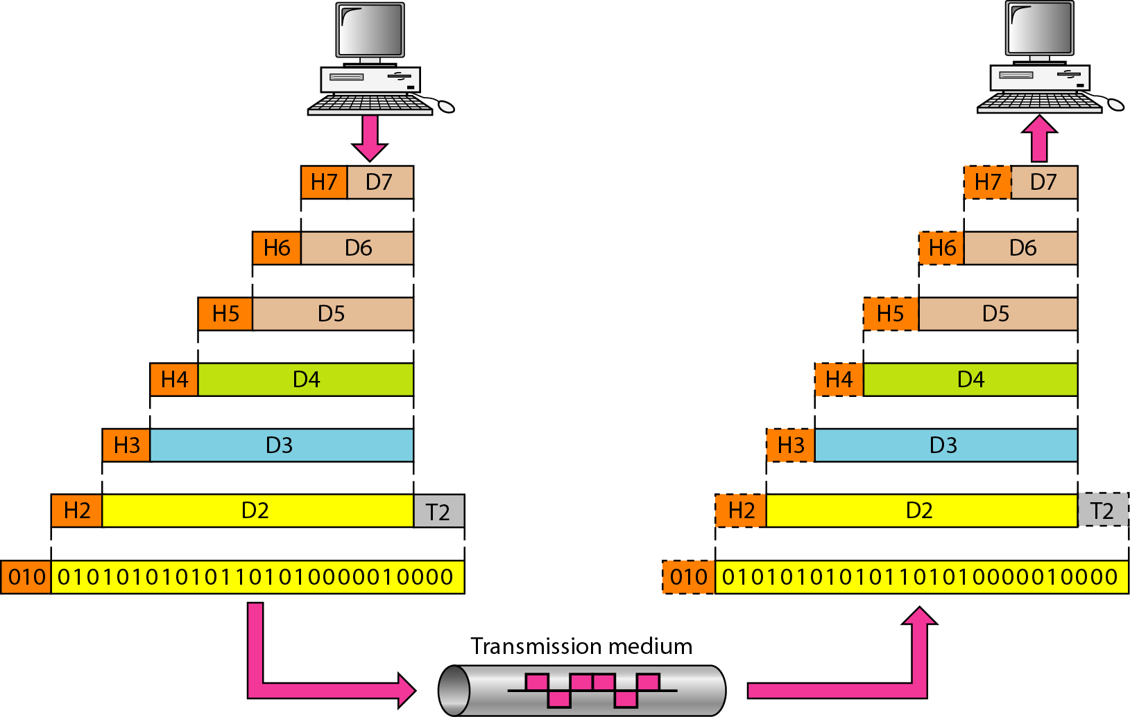
An exchange using the OSI model
Notes:
Headers and trailers are the concepts of OSI model.
Headers are information structures which identifies the information that follows, such as a block of bytes in communication.
Trailer is the information which occupies several bytes at the end of the block of the data being transmitted. They contain error-checking data which is useful for confirming the accuracy and status of the transmission.
During communication of data the sender appends the header and passes it to the lower layer while the receiver removes header and passes it to upper layer. Headers are added at layer 6,5,4,3 & 2 while Trailer is added at layer 2.

Slide 61
APPLICATION Layer
7 Application
Application layer interacts with application programs and is the highest level of OSI model.
Applications are the software programs used by people to communicate over the network
Application layer contains management functions to support distributed applications.
Examples of application layer are applications such as file transfer, electronic mail, remote login etc.
Main Topics
File Transfer Protocol (FTP)
HyperText Transfer Protocol (HTTP)
Simple Mail Transfer Protocol (SMTP)
Simple Network Management Protocol (SNMP)
Network File System (NFS)
Telnet
6 Presentation
5 Session
4 Transport
3 Network
2 Data Link
1 Physical

Slide 62
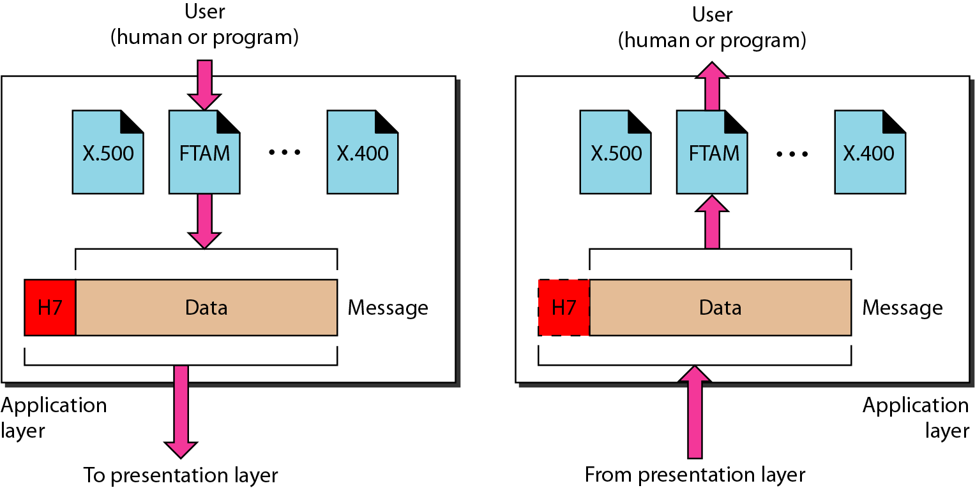
APPLICATION Layer
The application layer is responsible for
providing services to the user.

Slide 63
presentation Layer
7 Application
Presentation layer defines the format in which the data is to be exchanged between the two communicating entities.
Concerned with the syntax and semantics of the information.
Preserves the meaning of the information.
Also handles data compression and data encryption & decryption (cryptography).
Main Topics
Protocol conversion
Data translation
Encryption
Character set conversion
Expansion of graphics command
6 Presentation
5 Session
4 Transport
3 Network
2 Data Link
1 Physical

Slide 64
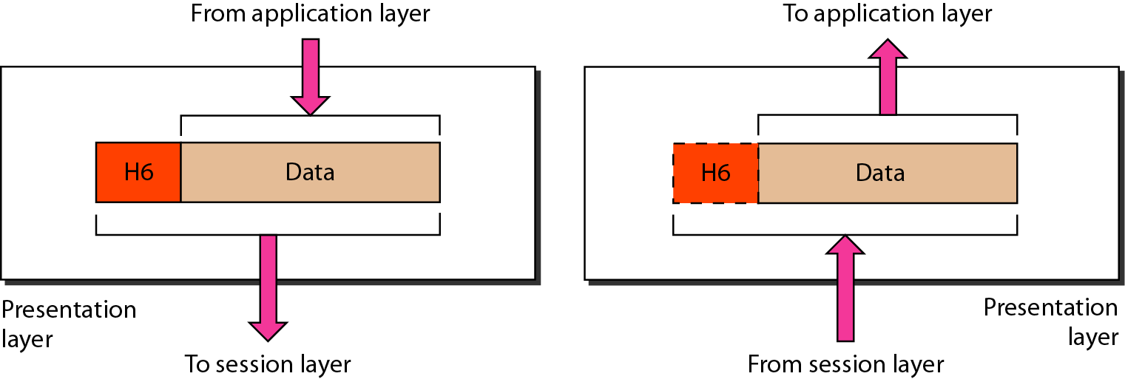
presentation Layer
The presentation layer is responsible for translation, compression, and encryption.

Slide 65
Session Layer
7 Application
Session layer provides mechanism for controlling the dialogue between the two end systems. It defines how to start, control and end conversations (called sessions) between applications.
This layer requests for a logical connection to be established on an end-user’s request.
Any necessary log-on or password validation is also handled by this layer.
Session layer is also responsible for terminating the connection.
This layer provides services like dialogue discipline which can be full duplex or half duplex.
Session layer is responsible for,
  Dialog control
  Token management
  Synchronization and checkpointing
6 Presentation
5 Session
4 Transport
3 Network
2 Data Link
1 Physical
Notes:
This layer allows a process to add checkpoints which are considered as synchronization points into stream of data. Example: If a system is sending a file of 800 pages, adding checkpoints after every 50 pages is recommended. This ensures that 50 page unit is successfully received and acknowledged. This is beneficial at the time of crash as if a crash happens at page number 110; there is no need to retransmit 1 to100 pages.

Slide 66
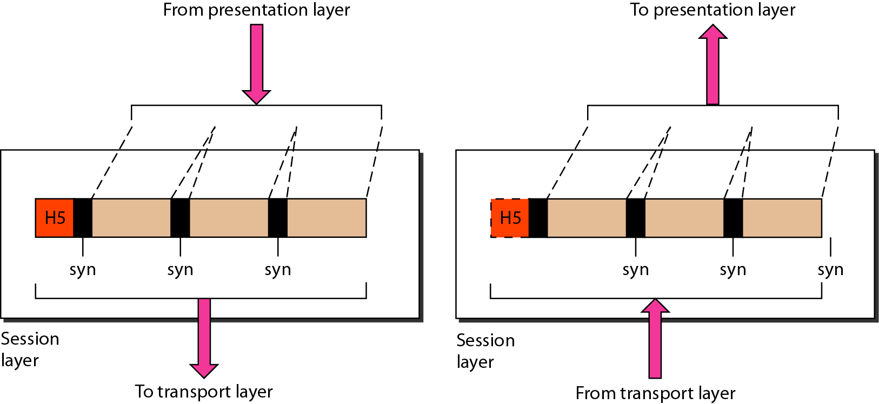
SESSION Layer
The session layer is responsible for dialog
control and synchronization.

Slide 67
Transport Layer
7 Application
Purpose of this layer is to provide a reliable mechanism for the exchange of data between two processes in different computers.
Ensures that the data units are delivered error free.
Ensures that data units are delivered in sequence.
Ensures that there is no loss or duplication of data units.
Provides connectionless or connection oriented service.
Provides for the connection management.
Multiplex multiple connection over a single channel.
Transport layer responsible for,
  Delivery of a message from one process to another, Service point addressing, Segmentation and reassembly, Connection control: Connectionless or connection oriented, Flow control, Error control, Process-to-process delivery
6 Presentation
5 Session
4 Transport
3 Network
2 Data Link
1 Physical
Notes:
Transport layer data could be broken down to many data-link layer frames/packets.
So it is possible that even without any data-link errors the transport layer stream/packet may be corrupt. Edit: This is because a transport layer path is usually composed of many data-link layer hops, for example:
Host1 <----> switch1 <----> switch2 <----> Host2 if a packet was lost between switch1 and switch2 then there would be no errors recorded on the switch2 Host2 link, but the corresponding transport layer stream would be corrupted.

Slide 68
Data link error control checks for error in each router and end-system (frame) (hop to hop), but transport layer error control checks for error only at the end-systems (segments) (source to destination).

Slide 69
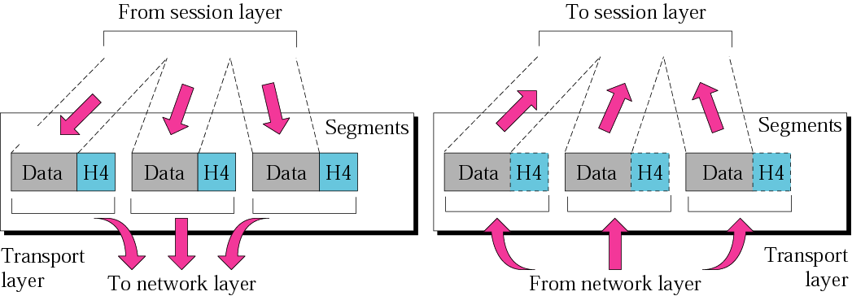
Transport Layer
The transport layer is responsible for the delivery
of a message from one process to another.

Slide 70
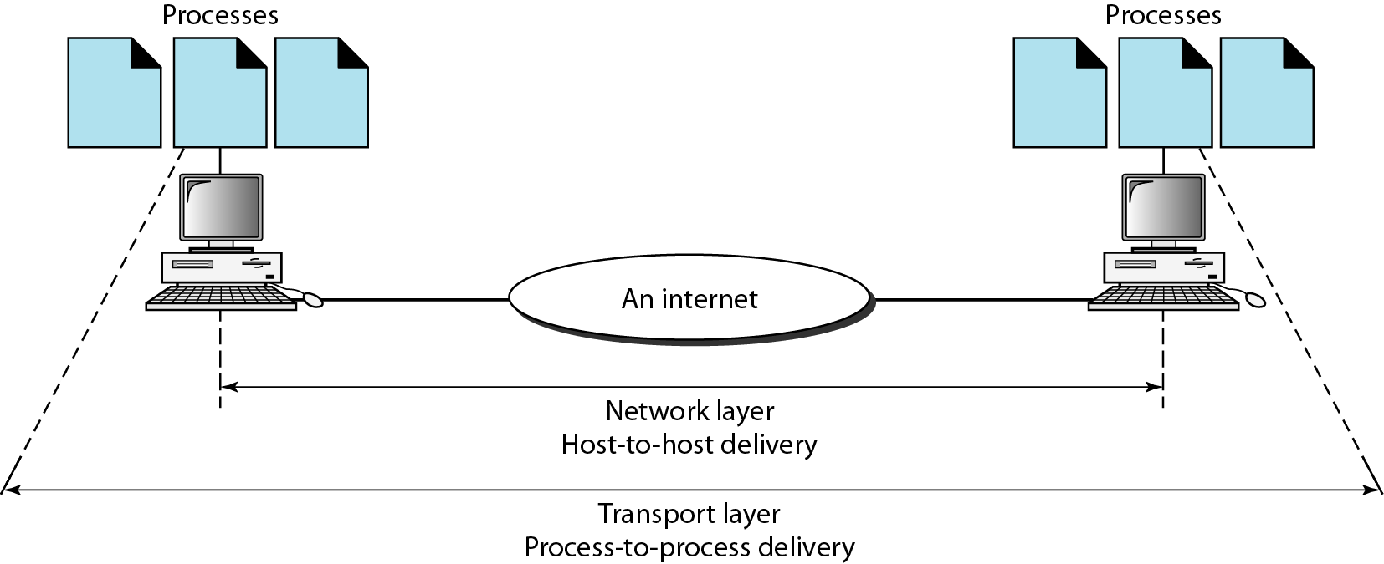
Reliable process-to-process delivery of a message

Slide 71
Network Layer
7 Application
Implements routing of frames (packets) through the network.
Defines the most optimum path the packet should take from the source to the destination
Defines logical addressing (IP address) so that any endpoint can be identified.
Handles congestion in the network.
Facilitates interconnection between heterogeneous networks (Internetworking).
The network layer also defines how to fragment a packet into smaller packets to accommodate different media.
Network layer is responsible for,
  Internetworking
  Routing algorithms
  Internet Protocol (IP) addressing
  Network device: Routers
6 Presentation
5 Session
4 Transport
3 Network
2 Data Link
1 Physical
Notes:
A heterogeneous network is a network connecting computers and other devices with different operating systems and/or protocols. For example, local area networks (LANs) that connect Microsoft Windows and Linux based personal computers with Apple Macintosh computers are heterogeneous.
IP fragmentation is the process of breaking up a single Internet Protocol (IP) datagram into multiple packets of smaller size. Every network link has a characteristic size of messages that may be transmitted, called the maximum transmission unit (MTU).

Slide 72
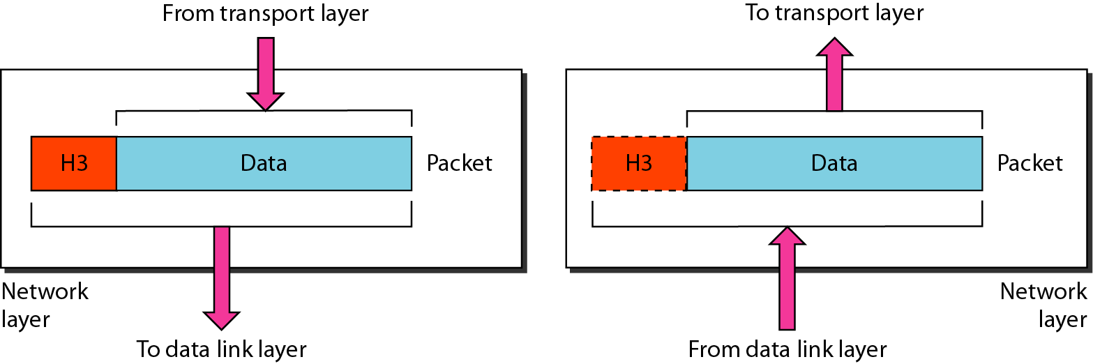
Network layer

Slide 73
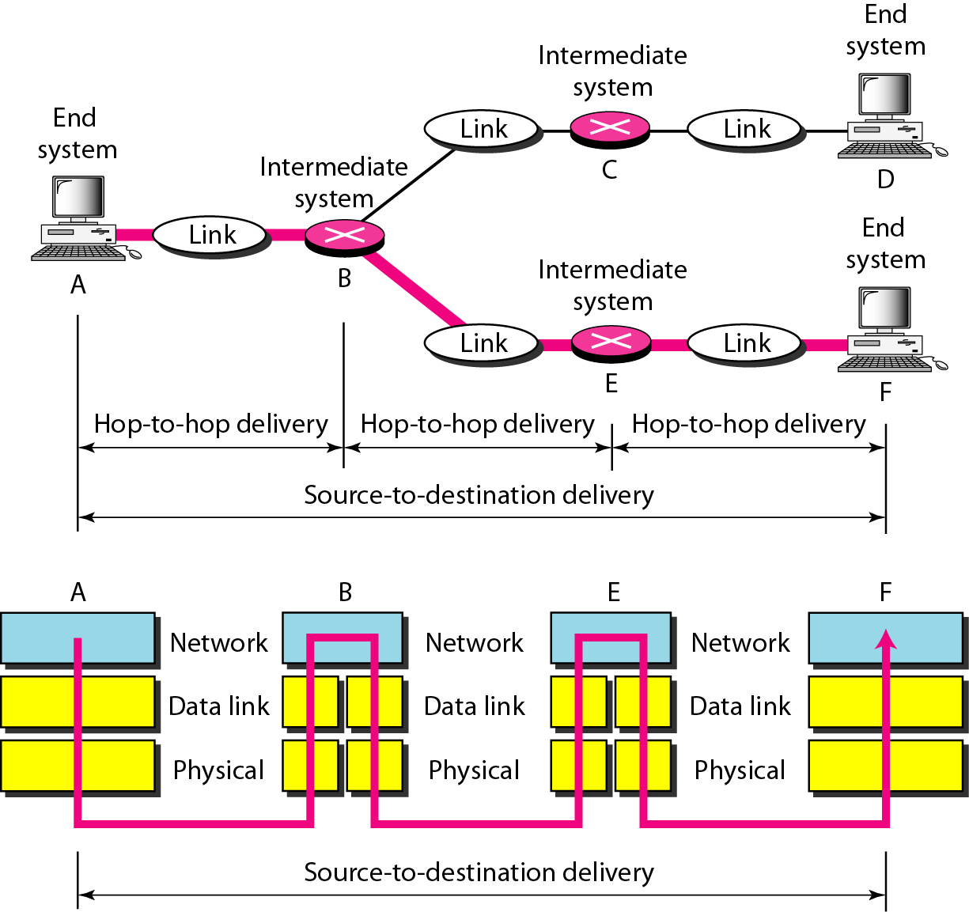
Source-to-destination delivery

Slide 74
Data Link Layer
7 Application
Data link layer attempts to provide reliable communication over the physical layer interface.
Breaks the outgoing data into frames and reassemble the received frames.
Create and detect frame boundaries.
Handle errors by implementing an acknowledgement and retransmission scheme.
Implement flow control.
Add Physical address (MAC)
Supports points-to-point as well as broadcast communication.
Supports simplex, half-duplex or full-duplex communication.
Data link layer is responsible for,
  Framing methods
  Error detection and correction methods
  Flow control
  Frame format
  Access control
  IEEE LAN standards
  Network devices: Bridges,Switches (multi-port bridges)
6 Presentation
5 Session
4 Transport
3 Network
2 Data Link
1 Physical
Notes:
framing is the process of dividing bit stream of information into logical groups of equal size. Framing is done both with asynchronous communication and synchronous communication.
flow control is the process of managing the rate of data transmission between two nodes to prevent a fast sender from overwhelming a slow receiver.

Slide 75
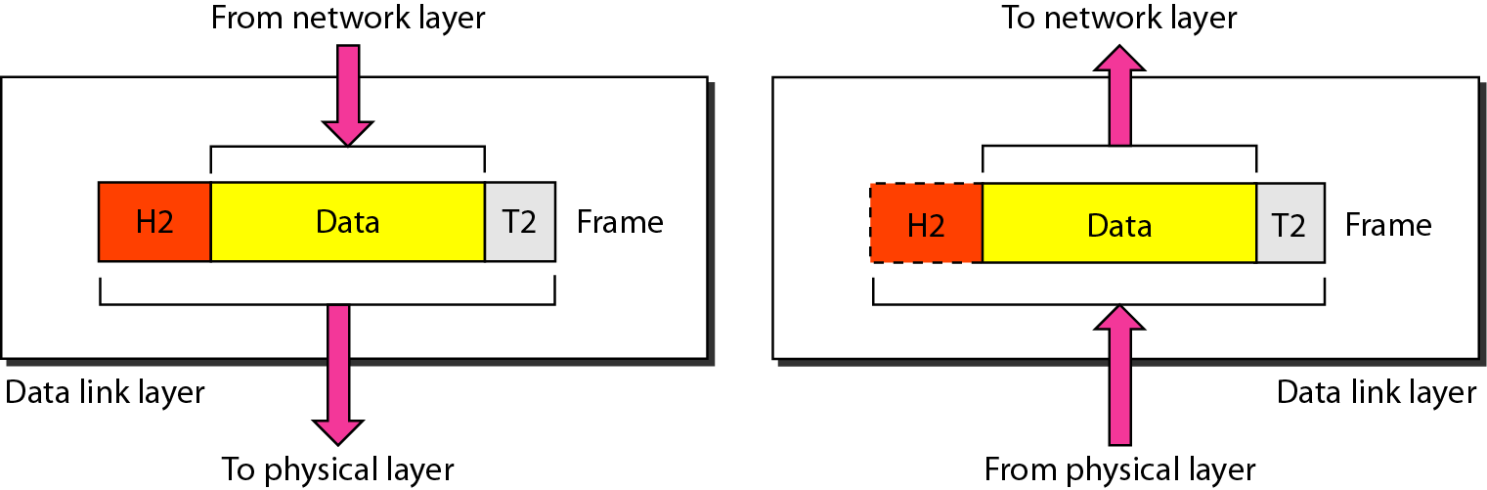
Data Link Layer
The data link layer is responsible for moving
frames from one hop (node) to the next.

Slide 76
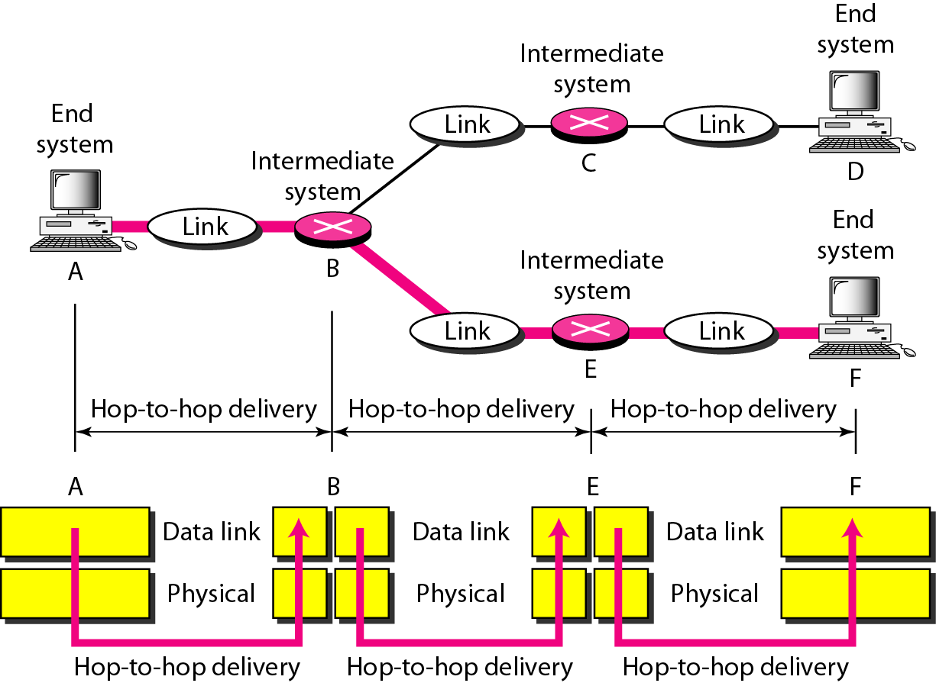
Hop-to-hop delivery

Slide 77
Physical Layer
Provides physical interface for transmission of information.
Convert the logical 1’s and 0’s coming from layer 2 into electrical signals.
Transmission of the electrical signals over a communication channel.
Physical layer responsible for,
  Transmission medium, Representation of bits, Data rate, Synchronization of bits, Encoding, Modulation, Line configuration: Point to point, Multipoint, Physical topology: Bus, Star, Ring, Hybrid, Transmission modes: simplex, half-duplex, full-duplex
  Networking devices: Repeater, Hub (Multi-port repeater)
7 Application
6 Presentation
5 Session
4 Transport
3 Network
2 Data Link
1 Physical

Slide 78
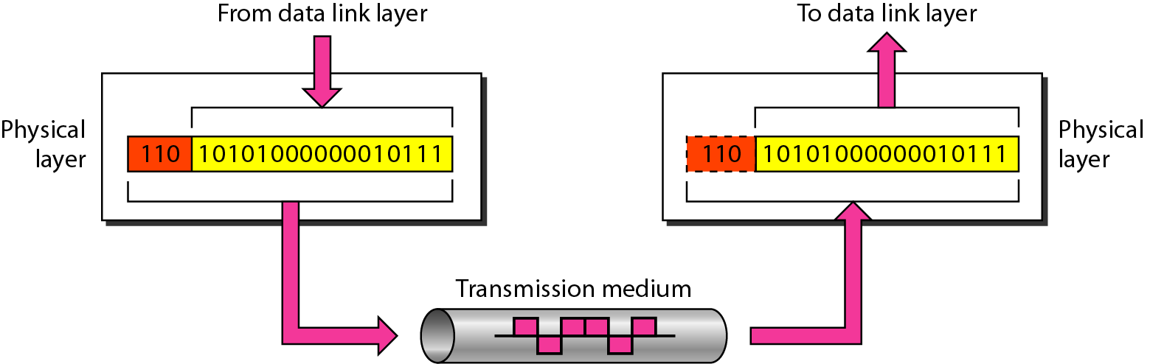
Physical Layer
The physical layer is responsible for movements of
individual bits from one hop (node) to the next.

Slide 79
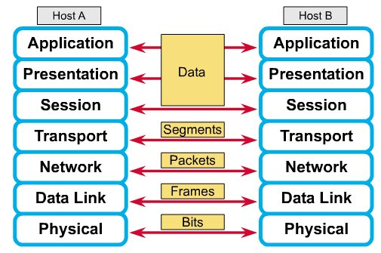
How Does It All Work Together
Each layer contains a Protocol Data Unit (PDU)
PDU’s are used for peer-to-peer contact between corresponding layers.
Data is handled by the top three layers, then Segmented by the Transport layer.
The Network layer places it into packets and the Data Link frames the packets for transmission.
Physical layer converts it to bits and sends it out over the media.
The receiving computer reverses the process using the information contained in the PDU.
²

Slide 80
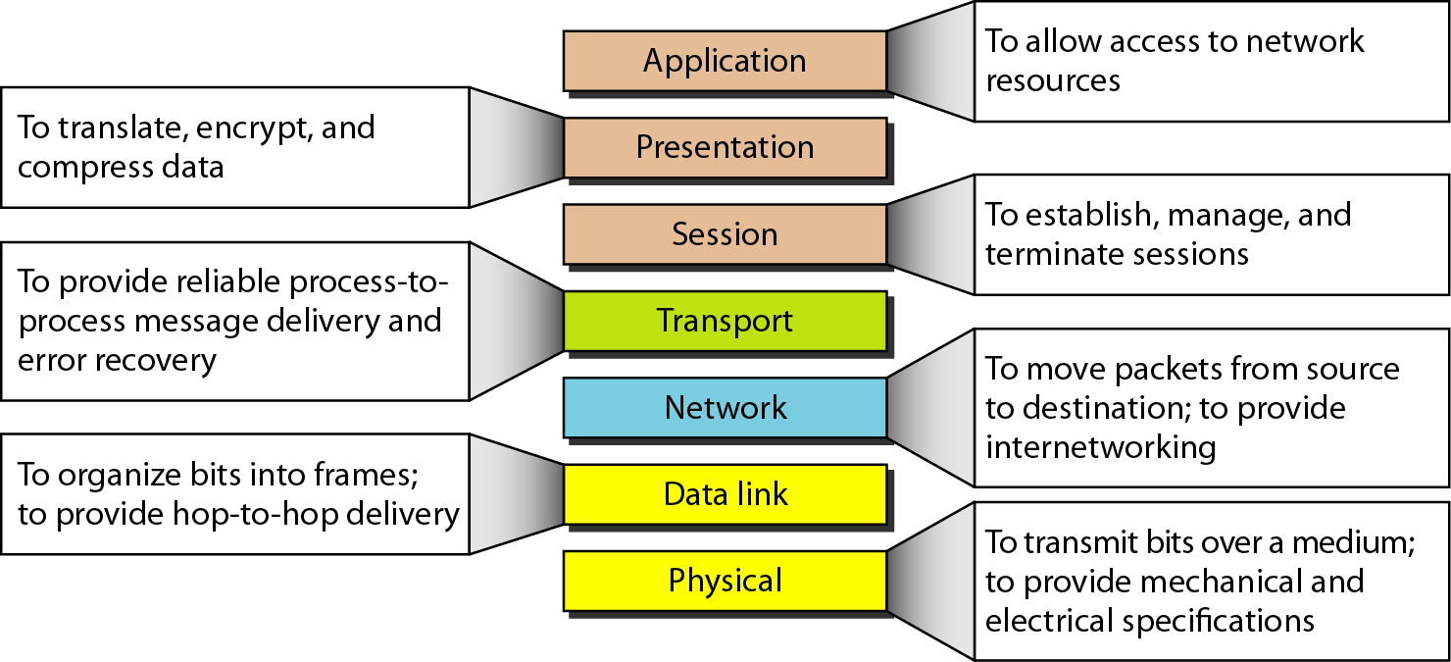
Summary of layers

Slide 81
TCP/IP Protocol Suite
The layers in the TCP/IP protocol suite do not exactly match those in the OSI model.
The original TCP/IP protocol suite was defined as having four layers: host-to-network, internet, transport, and application.
However, when TCP/IP is compared to OSI, the TCP/IP protocol suite is made of five layers: physical, data link, network, transport, and application.

Slide 82
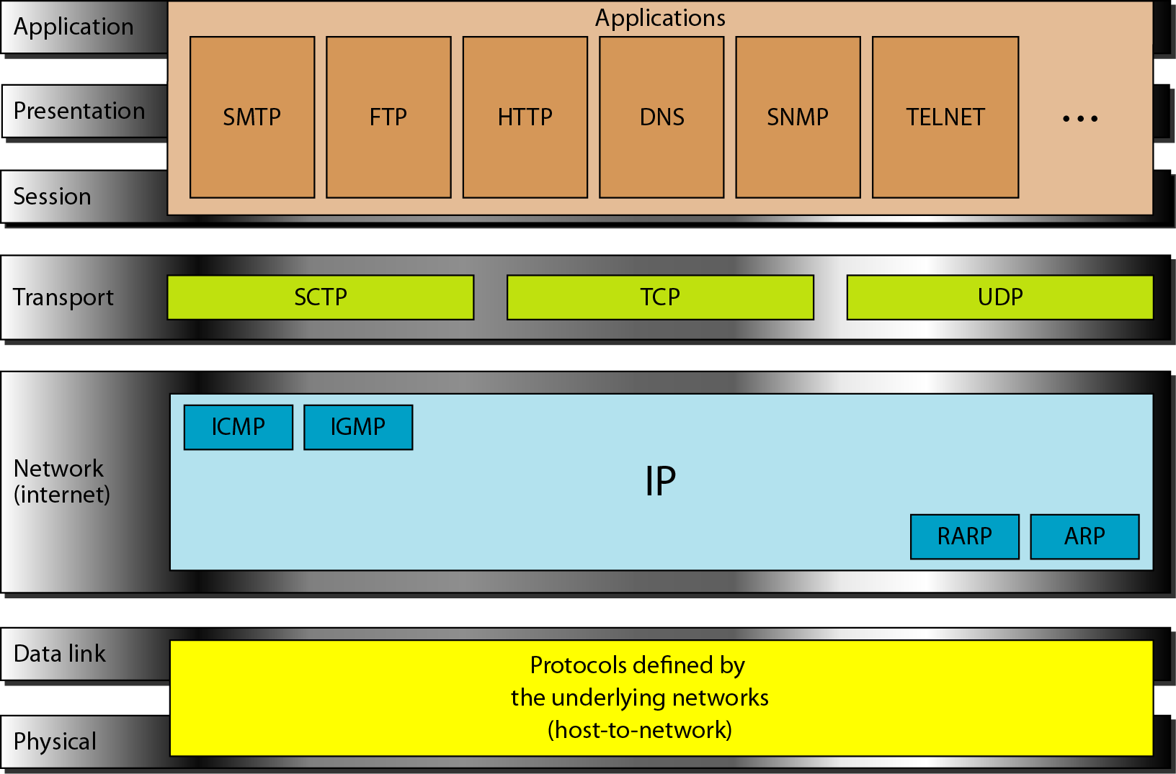
TCP/IP Protocol Suite

Slide 83
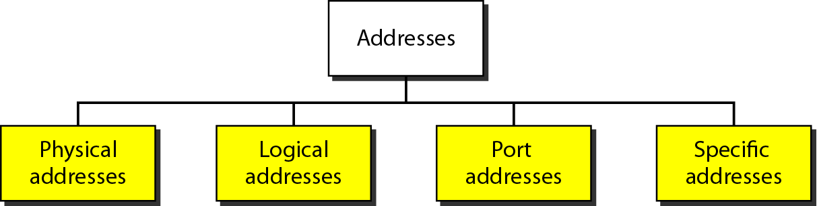
Types of address

Slide 84
Physical addresses
Most local- area networks use a 48-bit (6-byte) physical address written as 12 hexadecimal digits; every byte (2 hexadecimal digits) is separated by a colon, as shown below
07:01:02:01:2C:4B
A 6-byte (12 hexadecimal digits) physical address.
for example, the MAC address 10101010.11110000.11000001.11100010.01110111.01010001 in binary can be represented as shorter hexadecimal equivalent AA.F0.C1.E2.77.51

Slide 85
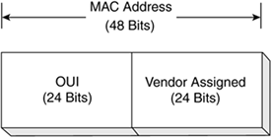
Notes:
. The vendor-assigned portion of the MAC address is just that, the alphanumeric identifier assigned by the vendor. It is the combination of the OUI and the vendor-assigned number that ensures that no two network adapters have the same MAC address.

Slide 86
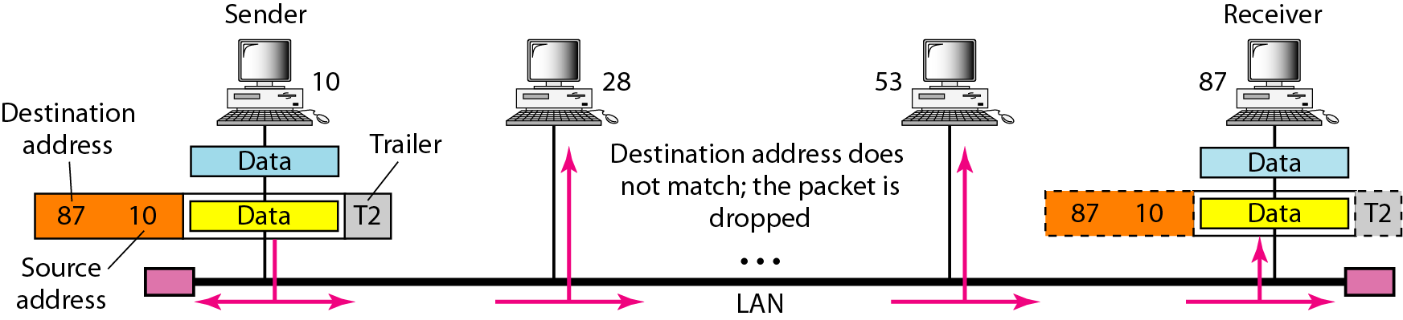
Physical addresses (MAC Addresses)
In a node with physical address 10 sends a frame to a node with physical address 87. The two nodes are connected by a link (bus topology LAN). As the figure shows, the computer with physical address 10 is the sender, and the computer with physical address 87 is the receiver.

Slide 87
IP address
The format of an IP address is a 32-bit numeric address written as four numbers separated by periods. Each number can be zero to 255. For example, 1.160.10.240 could be an IP address.
Format
x x x x x x x x . x x x x x x x x . x x x x x x x x . x x x x x x x x
where x is either 0 or 1
Example 1:
1 1 1 1 1 1 1 1 . 1 1 1 1 1 1 1 1 . 0 0 0 0 0 0 0 0 . 0 0 0 0 0 0 0 0
255.255.0.0
Example 2:
1 1 1 1 1 1 1 1 . 1 1 1 1 1 1 1 1 . 1 0 0 0 0 0 0 0 . 0 0 0 0 0 0 0 0
255.255.192.0

Slide 88
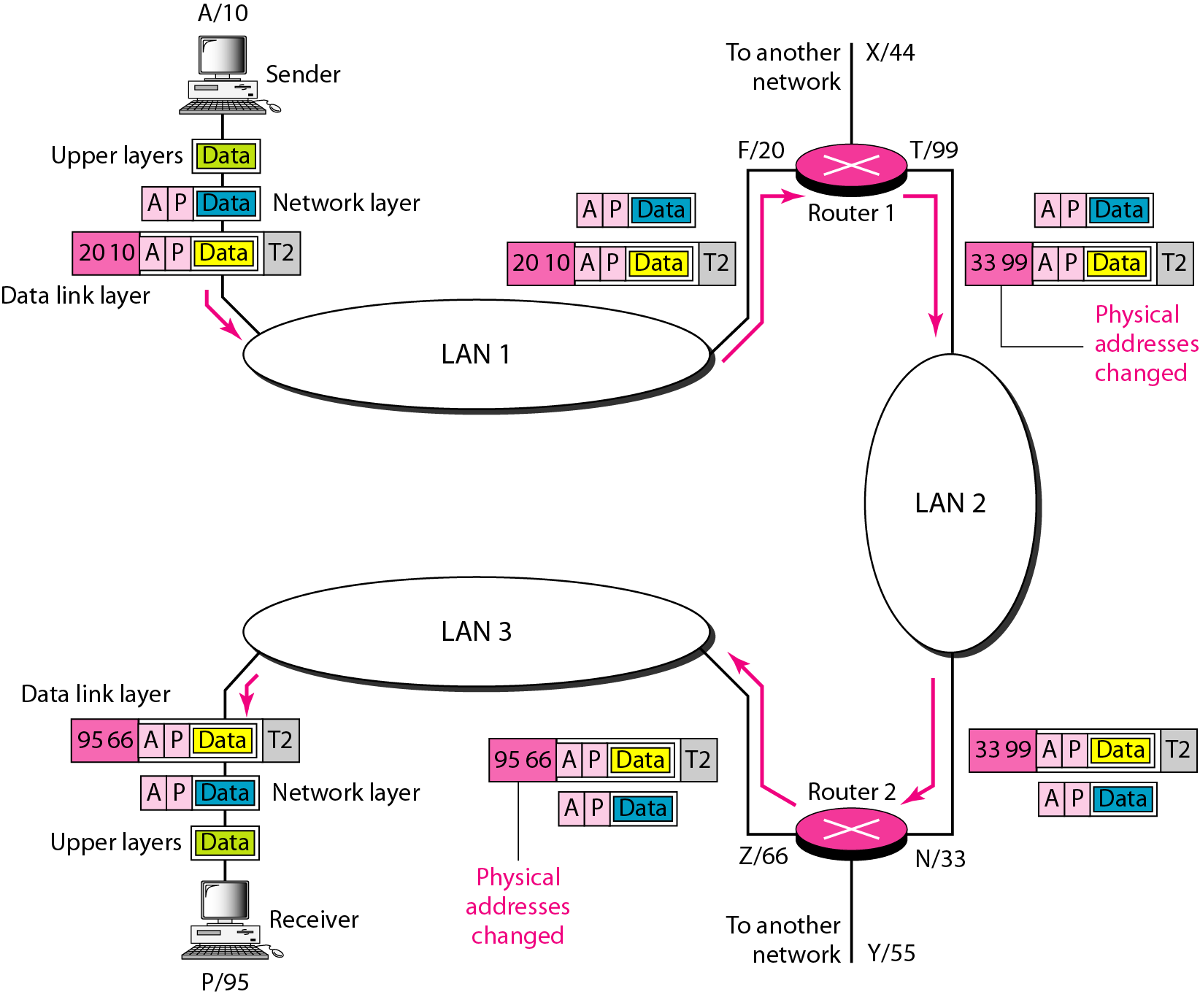
Logical Address (IP addresses)

Slide 89
Example
Figure shows a part of an internet with two routers connecting three LANs. Each device (computer or router) has a pair of addresses (logical and physical) for each connection. In this case, each computer is connected to only one link and therefore has only one pair of addresses. Each router, however, is connected to three networks (only two are shown in the figure). So each router has three pairs of addresses, one for each connection.

Slide 90
Port addresses
Figure shows two computers communicating via the Internet. The sending computer is running three processes at this time with port addresses a, b, and c. The receiving computer is running two processes at this time with port addresses j and k. Process a in the sending computer needs to communicate with process j in the receiving computer.
The physical addresses will change from hop to hop,
but the logical and port addresses usually remain the same.

Slide 91
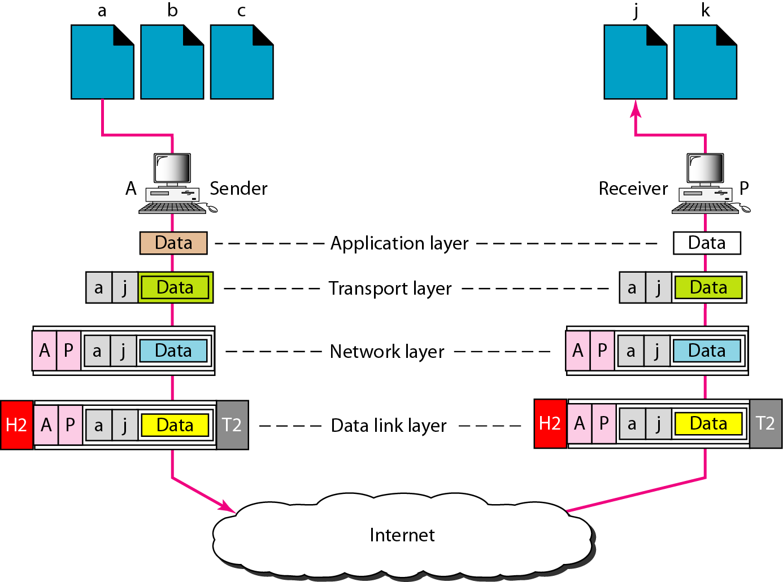
Port addresses

Slide 92
Port addresses
Figure shows two computers communicating via the Internet. The sending computer is running three processes at this time with port addresses a, b, and c. The receiving computer is running two processes at this time with port addresses j and k. Process a in the sending computer needs to communicate with process j in the receiving computer.
The physical addresses will change from hop to hop,
but the logical and port addresses usually remain the same.

Slide 93
Port addresses
A port address is a 16-bit address represented by one decimal number as shown.
753
A 16-bit port address represented
as one single number.
Ports 0 to 1024 are reserved for use by certain privileged services.

Slide 94
Network Criteria
Throughput - actual number of bits it can transfer per second.
Bandwidth- maximum number of bits it can transfer per second.
The latency or delay of a channel is the time that elapses between sending information and the earliest possible reception of it
Notes:
This delay can be calculated by the formula: , where d is the distance between router A and router B, and s is the propagation speed between the two routers. The speed is usually in the range 2 · 10⁸ meter/sec to 3 · 10⁸ meter/sec, which basically is around the speed of light.
Propagation Delay = Distance/Propagation speed
Transmission Delay = Message size/bandwidth bps
Latency = Propagation delay + Transmission delay + Queueing time + Processing time

Slide 95
Example
A network with bandwidth of 10 Mbps can pass only an average of 12,000 frames per minute with each frame carrying an average of 10,000 bits. What is the throughput of this network?

Slide 96

Example
A network with bandwidth of 10 Mbps can pass only an average of 12,000 frames per minute with each frame carrying an average of 10,000 bits. What is the throughput of this network?
Solution
We can calculate the throughput as
The throughput is almost one-fifth of the bandwidth in this case.

Slide 97
End to End Delay
The time required to transmit a packet along its entire path
  Created by an application, handed over to the OS, passed to a network card (NIC), encoded, transmitted over a physical medium (copper, fibre, air), received by an intermediate device (switch, router), analyzed, retransmitted over another medium, etc.
  The most common measurement uses ping for total round-trip-time (RTT).
Notes:
97

Slide 98
Types of Delay in Packet Switching
    Transmission delays
    Propagation delays
    Processor delays
    Buffer delays
Notes:
98

Slide 99
Transmission Delay
The time required to push all the bits in a packet on the transmission medium in use
For N=Number of bits (size of the packet), S=maximum transmission rate (BW) of the network, d=delay
d = N/S
For example, to transmit 1024 bits using Fast Ethernet (100Mbps):
d = 1024/1x10e8 = 10.24 micro seconds
Notes:
99

Slide 100
Propagation Delay
Once a bit is 'pushed' on to the transmission medium, the time required for the bit to propagate to the end of its physical trajectory
The velocity of propagation of the circuit depends mainly on the actual distance of the physical circuit
In the majority of cases this is close to the speed of light.
For d = distance, s = propagation velocity
PD = d/s
Notes:
100

Slide 101
Latency
Latency = Propagation delay + Transmission delay + Queueing time + Processing time

Slide 102
Processing Delay
Required time to analyze a packet header and decide where to send the packet (eg. a routing decision)
Inside a router this depends on the number of entries
in the routing table, the implementation of data
structures, hardware in use, etc.
This can include error verification / checksumming (i.e. IPv4, IPv6 header checksum)
Notes:
102

Slide 103
Queuing Delay
The time a packet is queued until it is transmitted
The number of packets waiting in the queue will depend on traffic intensity and of the type of traffic
Router queue algorithms try to adapt delays to specific preferences, or impose equal delay on all traffic.
Notes:
103

Slide 104
Example
What is the propagation time if the distance between the two points is 12,000 km? Assume the propagation speed to be 2.4 × 10^8 m/s in cable.

Slide 105
Example
What is the propagation time if the distance between the two points is 12,000 km? Assume the propagation speed to be 2.4 × 10^8 m/s in cable.
Solution
We can calculate the propagation time as
The example shows that a bit can go over the Atlantic Ocean in only 50 ms if there is a direct cable between the source and the destination.

Slide 106
Example
What are the propagation time and the transmission time for a 2500byte message (an e-mail) if the bandwidth of the network is 1 Gbps? Assume that the distance between the sender and the receiver is 12,000 km and that light travels at 2.4 × 10^8 m/s.
Solution
We can calculate the propagation and transmission time as shown on the next slide:

Slide 107
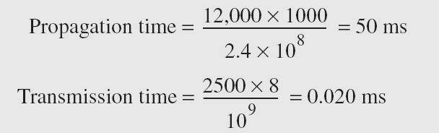
Example
Note that in this case, because the message is short and the bandwidth is high, the dominant factor is the propagation time, not the transmission time. The transmission time can be ignored.

Slide 108
Example
What are the propagation time and the transmission time for a 5000000 byte message (an image) if the bandwidth of the network is 1 Mbps? Assume that the distance between the sender and the receiver is 12,000 km and that light travels at 2.4 × 10⁸ m/s.
Solution
We can calculate the propagation and transmission times as shown on the next slide.

Slide 109
Example
Note that in this case, because the message is very long and the bandwidth is not very high, the dominant factor is the transmission time, not the propagation time. The propagation time can be ignored.

Slide 110
Example
How long does it take to send a file of 640,000 bits from host A to host B over a circuit-switched network?
  All links are 1.536 Mb/s
  Each link uses TDM with 24 slots/sec (TDM = Time Division Multiplexing)
  500 msec to establish end-to-end circuit

Slide 111
Example
Solution:
For a TDM link, time is divided into frames of fixed duration and each frame is divided into a fixed number of time slots. When the network establish a connection across a link, the network dedicates one time slot in every frame to the connection. These slots are edicated for the sole use of that connection, with a time slot available for use (in every frame) to transmit the connection's data.
Each circuit has a transmission rate of (1.536 Mbps)/24 = 64 Kbps, so it takes (640bits)/(64 Kbps) = 10 seconds to transmit the file. To this 10 seconds we add the circuit establishment time, giving 10.5 seconds to send the file. Note that the transmission time is independent of the number links: the transmission time would be 10 seconds if the end-to-end circuit passes through one link or one-hundred links.

Slide 112
Example
Calculate the total time required to transfer a 1.5-MB file in the following cases, assuming a RTT of 80 ms, a packet size of 1 KB and an initial 2×RTT of “handshaking” before data is sent.
The bandwidth is 10 Mbps, and data packets can be sent continuously.
The bandwidth is 100 Mbps, but after we finish sending each data packet, we must wait one RTT before sending the next.

Slide 113
Example
Solution:
(a) The bandwidth is 10 Mbps, and data packets can be sent continuously.
total time = initial handshaking + network delay
initial handshaking = 2*RTT = 2*80 ms = 160 ms.
Delay = propagation delay + transmission delay (assuming processing & queuing
delays are not significant).
= 40 ms + (1.5-MB / 10 Mbps)
= 40 ms + (1.5*1,048,576 B / 10*1,000,000 bps)
= 40 ms + (1.5*1,048,576*8 b / 10*1,000,000 bps)
= 40 ms + (12,582,912 bits / 10,000,000 bps)
= 40 ms + 1.26 s
= 40 ms + 1260 ms
= 1300 ms
» total time = initial handshaking + network delay
= 160 ms + 1300 ms
= 1460 ms
= 1.46 s

Slide 114
(b) The bandwidth is 100 Mbps, but after we finish sending each data packet, we must wait one RTT before sending the next.
First, count number of packets needed to send the file:
1.5-MB / 1 KB = 12,582,912 bits / 1024(8) bits
= 12,582,912 bits / 8192 bits
= 1536
Thus, we need (1536-1) RTTs to be added to the total delay time. (After transmitting a packet, we wait for one RTT. Therefore, since RTT>transmission time+propagation delay, by the time we transmit the next packet, the first packet has already reached the other side. So, we need the transmission time of a packet + one RTT for each of the first 999 packet. For the last packet, we must wait for the propagation delay for the last bit to reach the other side. Therefore, the total time is as before plus 1535 RTTs.)
Second, we need to calculate the network delay in this case:
Delay = propagation delay + transmission delay
= 40 ms + (1.5-MB / 100 Mbps)
= 40 ms + (1.5*1,048,576 B / 100*1,000,000 bps)
= 40 ms + (1.5*1,048,576*8 b / 100*1,000,000 bps)
= 40 ms + (12,582,912 bits / 100,000,000 bps)
= 40 ms + 0.126 s = 40 ms + 126 ms = 166 ms
» total time = initial handshaking + network delay + 1535 (80 ms)
= 160 ms + 166 ms + 122800 ms
= 123,126 ms
= 123.26 s

Slide 115
Example
Calculate the total time required to transfer a 1000-KB file in the following cases, assuming an RTT of 100 ms, a packet size of 1 KB and an initial 2 × RTT of “handshaking” before data is sent.
The bandwidth is 1.5 Mbps, and data packets can be sent continuously.
The bandwidth is 1.5 Mbps, but after we finish sending each data packet we must wait one RTT before sending the next

Slide 116
Solution:
(a) The bandwidth is 1.5 Mbps, and data packets can be sent continuously.
» total time = initial handshaking + network delay
= 200 ms + 5500 ms
= 5700 ms
= 5.7 s
(b) The bandwidth is 1.5 Mbps, but after we finish sending each data packet we must wait one RTT before sending the next.
» total time = handshake + network delay + (number of packets-1) * RTT
= 200 ms + 5700 ms + (1000 - 1)*100 ms
= 105,800 ms
= 105.8 s

