Slide 1
BITS Pilani
Department of Computer Science

Slide 2
Data Link Layer

Slide 3














Link layer: introduction
terminology:
hosts and routers: nodes
communication channels that connect adjacent nodes along communication path: links
  wired links
  wireless links
  LANs
layer-2 packet: frame, encapsulates datagram
global ISP
data-link layer has responsibility of
transferring datagram from one node
to physically adjacent node over a link

Slide 4
Link layer services
framing, link access:
  encapsulate datagram into frame, adding header, trailer
  channel access if shared medium
  “MAC” addresses used in frame headers to identify source, dest
    different from IP address!
reliable delivery between adjacent nodes
  seldom used on low bit-error link (fiber, some twisted pair)
  wireless links: high error rates

Slide 5
Link layer services
flow control:
  pacing between adjacent sending and receiving nodes
error detection:
  errors caused by signal attenuation, noise.
  receiver detects presence of errors:
    signals sender for retransmission or drops frame
error correction:
  receiver identifies and corrects bit error(s) without resorting to retransmission
half-duplex and full-duplex
  with half duplex, nodes at both ends of link can transmit, but not at same time

Slide 6



Where is the link layer implemented?
In each and every host
Link layer is sofware implemented in “adaptor” (aka network interface card NIC) or on a chip
  Ethernet card, 802.11 card; Ethernet chipset
  implements link, physical layer
Attaches into host’s system buses
Combination of hardware, software, firmware
application
transport
network
link
cpu
memory
link
physical
host
bus
(e.g., PCI)
controller
physical
transmission
network adapter
card

Slide 7
Adaptors communicating
datagram
datagram
controller
controller
sending host
receiving host
datagram
frame
sending side:
  encapsulates datagram in frame
  adds error checking bits, rdt, flow control, etc.
receiving side
  looks for errors, rdt, flow control, etc
  extracts datagram, passes to upper layer at receiving side

Slide 8
Why Error Detection and Correction?
No communication channel or storage device is completely error-free
As the number of bits per area or the transmission rate increases, more errors occur.
Impossible to detect or correct 100% of the errors

Slide 9
Type of Errors

Slide 10
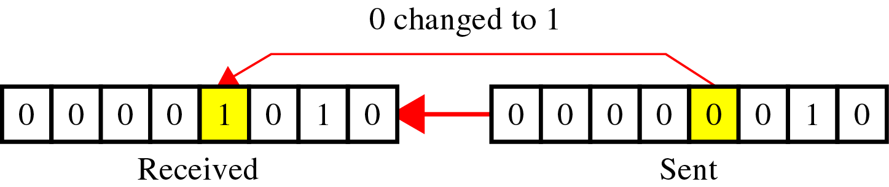
Type of Errors
Single-Bit Error
~ is when only one bit in the data unit has changed

Slide 11
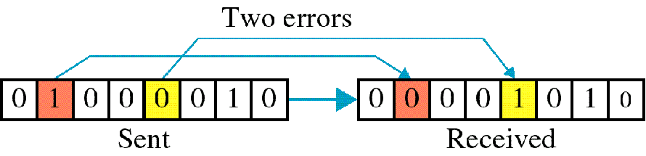
Type of Errors
Multiple-Bit Error
~ is when two or more nonconsecutive bits in the data unit have

Slide 12
Type of Errors
Burst Error
~ means that 2 or more consecutive bits in the data unit have changed

Slide 13
Error Control
Error detection codes
  Detects the presence of an error
Error correction codes, or forward correction codes (FEC)
  Designed to detect and correct errors
  Widely used in wireless networks
Retransmission- Automatic repeat request (ARQ) protocols
  Used in combination with error detection/correction
  Block of data with error is discarded
  Transmitter retransmits that block of data

Slide 14
Flow Control
Handles mismatch between sender’s and receiver’s speed.
  Receiver’s buffer limitation.
Feedback-based flow control.
  Explicit permission from receiver.
Rate-based flow control.
  Implicit mechanism for limiting sending rate.
DLL typically uses feedback-based flow control.

Slide 15
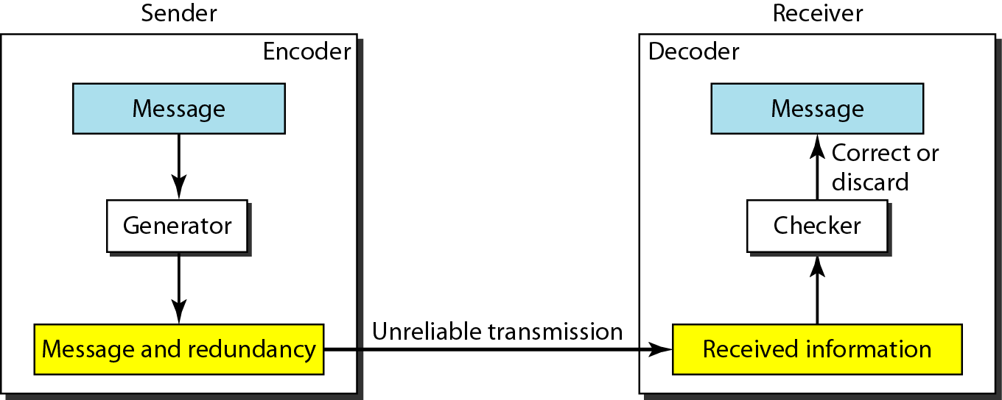
Redundancy
To detect or correct errors, redundant bits of data must be added

Slide 16
Coding
Process of adding redundancy for error detection or correction
Two types:
  Block codes
    Divides the data to be sent into a set of blocks
    Extra information attached to each block
    Memoryless
  Convolutional codes
    Treats data as a series of bits, and computes a code over a continuous series
    The code computed for a set of bits depends on the current and previous input

Slide 17
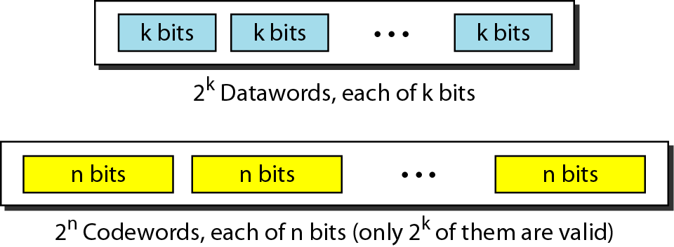
Block Coding
Message is divided into k-bit blocks
  Known as datawords
r redundant bits are added
  Blocks become n=k+r bits
  Known as codewords

Slide 18
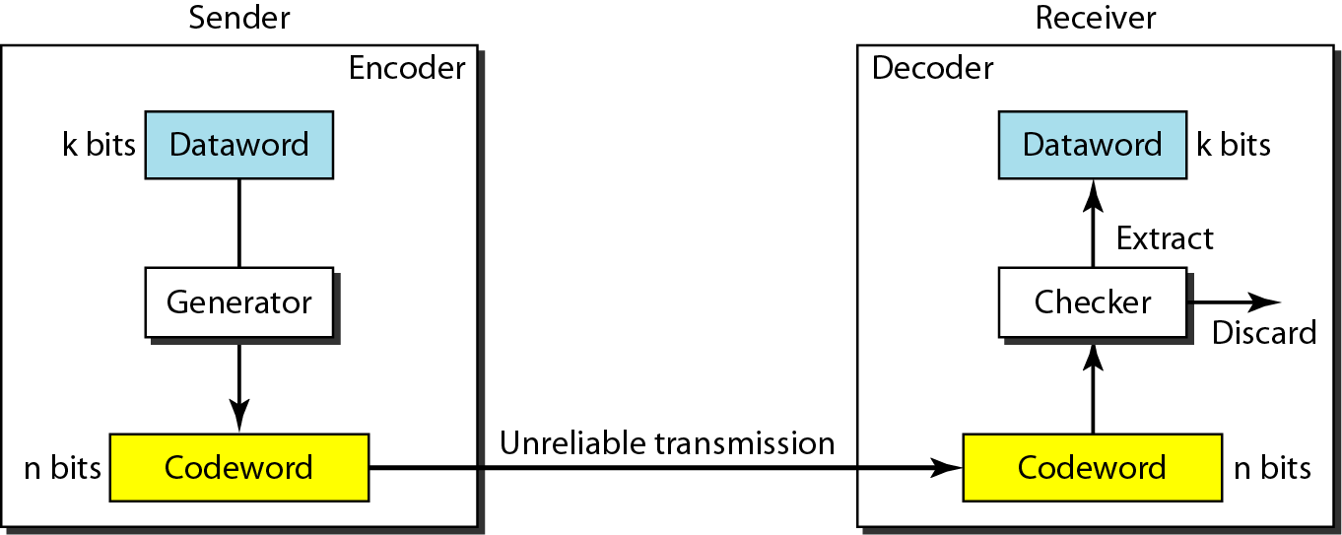
Error Detection in Block Coding

Slide 19
Error Detection in Block Coding
An error-detecting code can detect
only the types of errors for which it is designed
  Other types of errors may remain undetected.
There is no way to detect every possible error

Slide 20
Common Detection Methods
Parity check
Cyclic Redundancy Check (CRC)
Checksum

Slide 21
Parity Codes
Example of a simple block code – Single Parity Check Code
  In this case, n = k+1, i.e., the codeword is the dataword with one additional bit
  For ‘even’ parity the additional bit is,
For ‘odd’ parity the additional bit is 1-q
That is, the additional bit ensures that there are an ‘even’ or ‘odd’ number of ‘1’s in the codeword

Slide 22
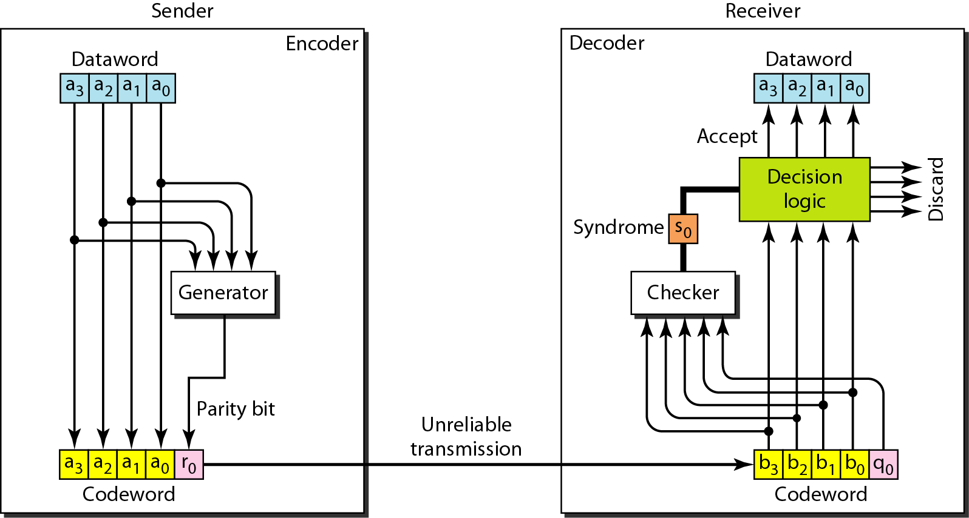
Structure of encoder and decoder in
parity check

Slide 23
Parity Codes – Example 1
Even parity
  (i) d=(10110) so,
  c=(101101)
  d=(11011) so,
  c=(110110)

Slide 24
Parity Codes – Example 2
Coding table for (4,3) even parity code
Dataword
Codeword

Slide 25
Parity Codes
To decode
  Calculate sum of received bits in block (mod 2)
  If sum is 0 (1) for even (odd) parity then the dataword is the first k bits of the received codeword
  Otherwise error
Code can detect single errors
But cannot correct error since the error could be in any bit
For example, if the received dataword is (100000) the transmitted dataword could have been (000000) or (110000) with the error being in the first or second place respectively
Note error could also lie in other positions including the parity bit

Slide 26
Parity Codes – Example 3
Simple parity-check code C(5, 4)

Slide 27
Parity Codes – Example 3
Let us look at some transmission scenarios. Assume the sender sends the dataword 1011. The codeword created from this dataword is 10111, which is sent to the receiver. We examine five cases:
No error occurs; the received codeword is 10111. The syndrome is 0. The dataword 1011 is created.
One single-bit error changes a₁ . The received codeword is 10011. The syndrome is 1. No dataword is created.
One single-bit error changes r₀ . The received codeword is 10110. The syndrome is 1. No dataword is created.
An error changes r₀ and a second error changes a₃ . The received codeword is 00110. The syndrome is 0. The dataword 0011 is created at the receiver. Note that here the dataword is wrongly created due to the syndrome value.

Slide 28
5. Three bits—a₃, a₂, and a₁—are changed by errors. The received codeword is 01011. The syndrome is 1. The dataword is not created. This shows that the simple parity check, guaranteed to detect one single error, can also find any odd number of errors.

Slide 29
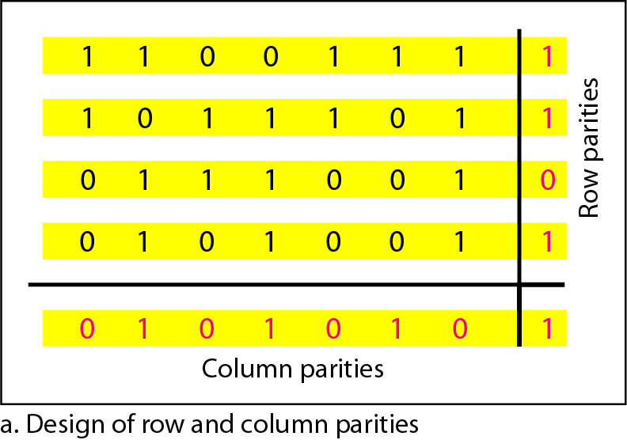
Horizontal and Vertical Parity Check

Slide 30
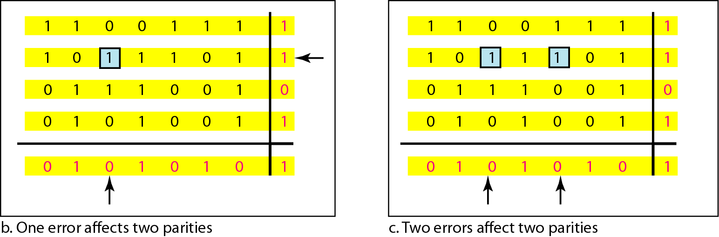
Horizontal and Vertical Parity Check

Slide 31
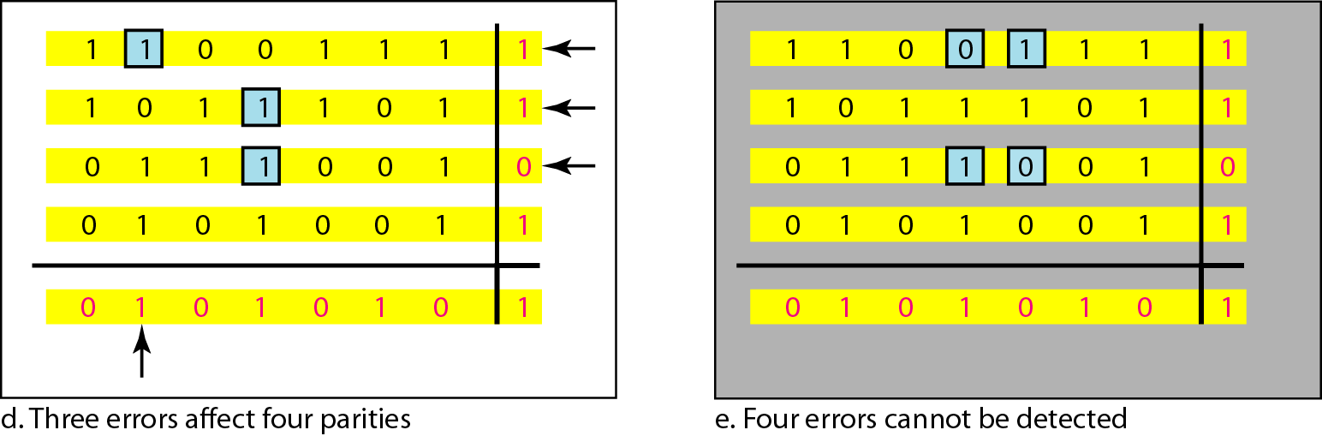
Horizontal and Vertical Parity Check

Slide 32
Code Rate
Code rate
  Code rate increases , error correcting capability decreases
  more bandwidth efficiency
  Code rate decreases , error correcting capability increases
  waste of bandwidth

Slide 33
Cyclic Codes
Cyclic code is a kind of linear block codes.
Any cyclic shift of a code word in the code is also a code word.
Cyclic codes are easy to encode.
Cyclic codes possess a well-define mathematical structure, which has led to the development of very efficient decoding schemes for them.
Linear Property: In a cyclic code, if a codeword is cyclically shifted (rotated), the result is another codeword.
Cyclic property
Notes:
Linear Property
Cyclic property

Slide 34
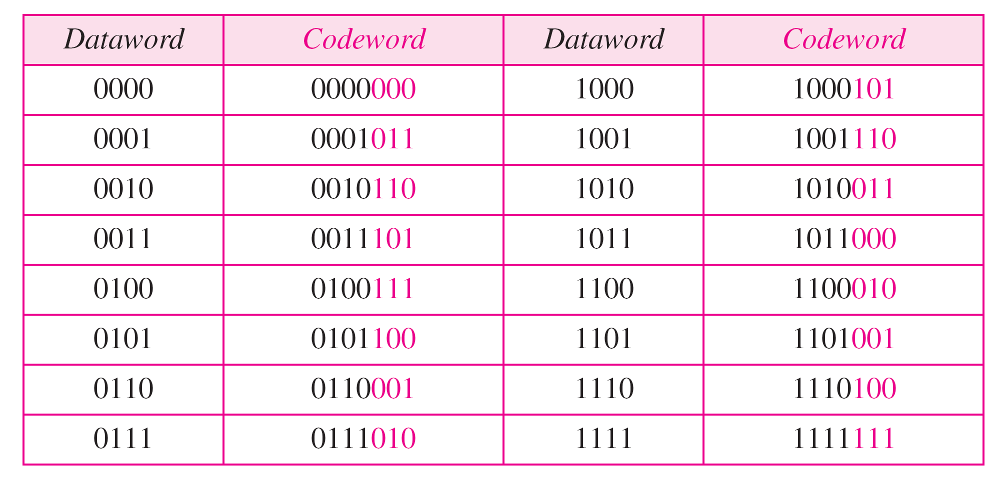
Cyclic Redundancy Check (CRC)
In a cyclic code, rotating a codeword always results in another codeword
Example:

Slide 35
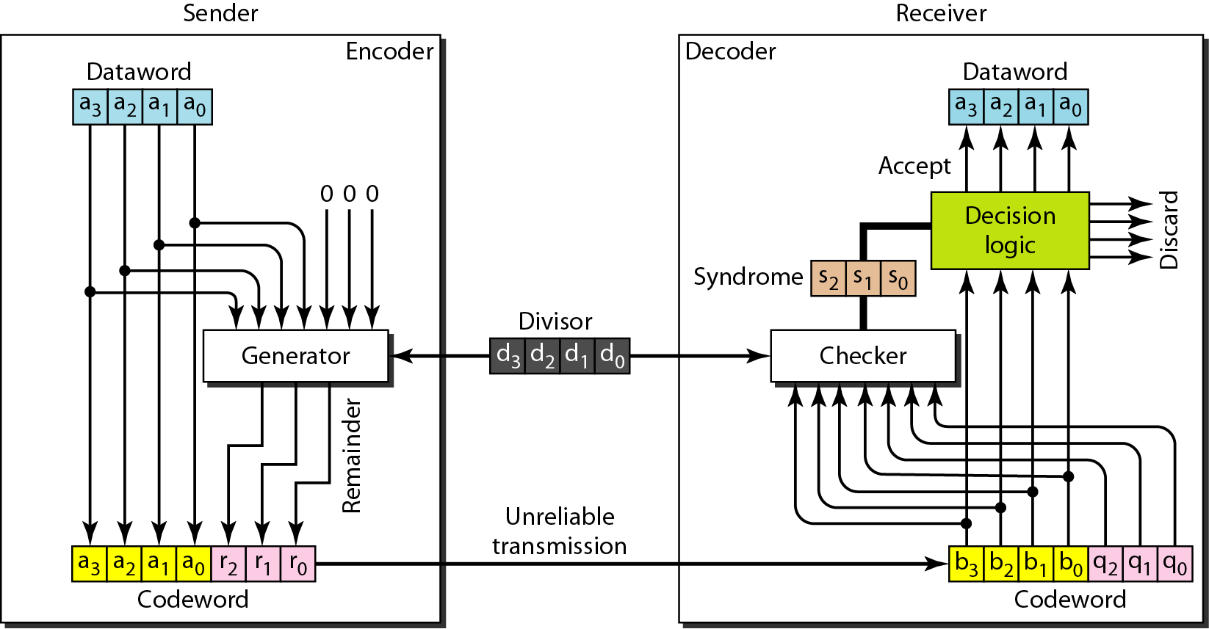
CRC Encoder/Decoder

Slide 36
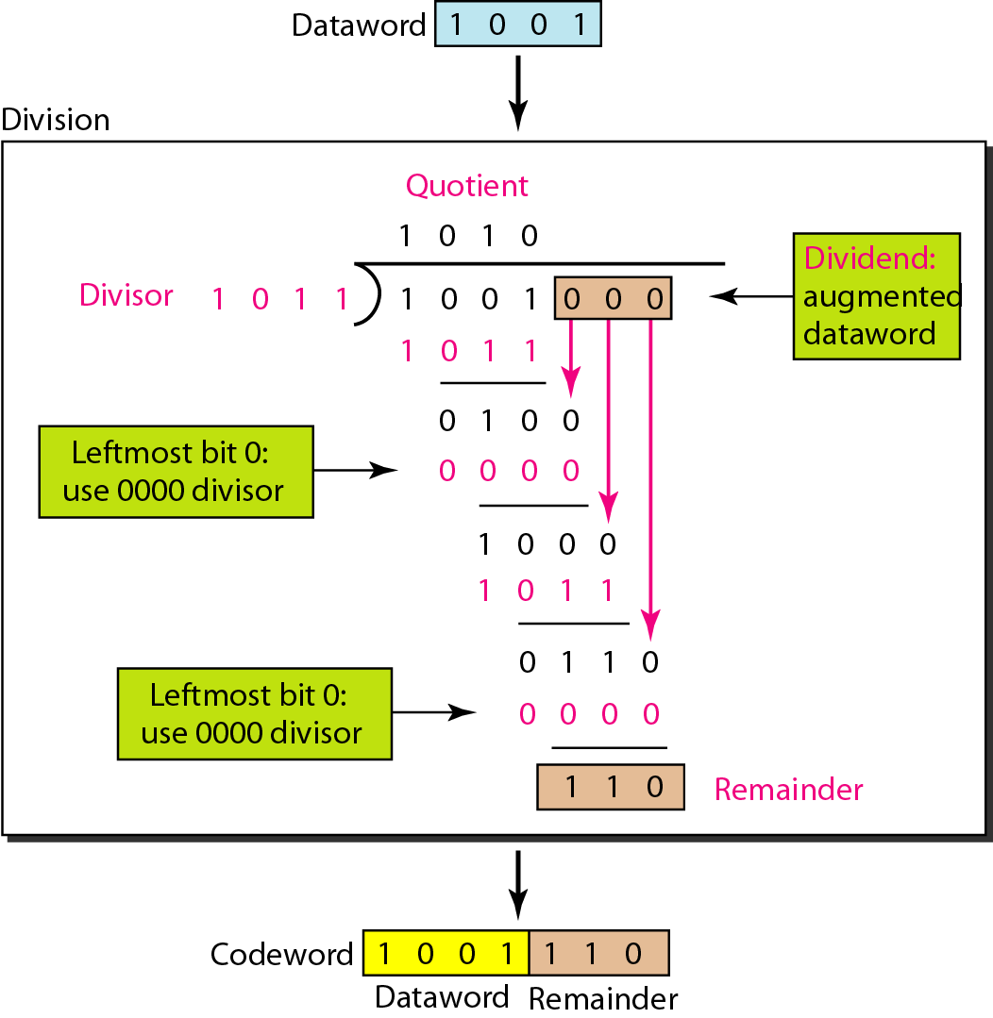
CRC Generator

Slide 37
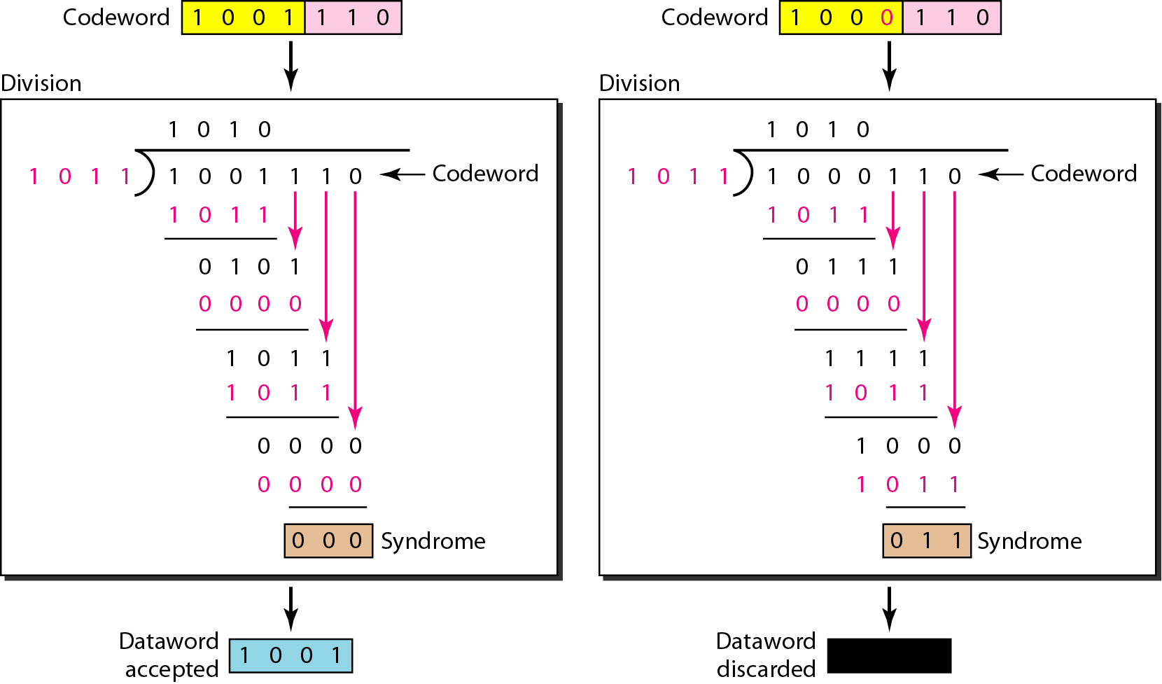
Checking CRC

Slide 38
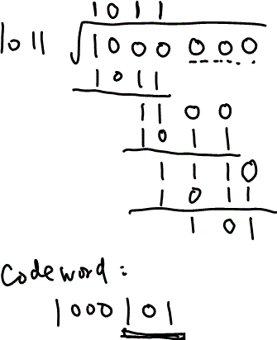
Data: 1000 Divisor: 1011
What is the codeword?

Slide 39
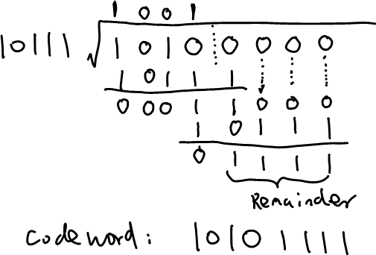
Data: 1010 Divisor: 10111
What is the codeword?

Slide 40
Checksum
The last error detection method to discuss here is called the checksum.
The checksum is used in the Internet by several protocols although not at the data link layer.

Slide 41
Example
Suppose our data is a list of five 4-bit numbers that we want to send to a destination. In addition to sending these numbers, we send the sum of the numbers. For example, if the set of numbers is (7, 11, 12, 0, 6), we send (7, 11, 12, 0, 6, 36), where 36 is the sum of the original numbers. The receiver adds the five numbers and compares the result with the sum. If the two are the same, the receiver assumes no error, accepts the five numbers, and discards the sum. Otherwise, there is an error somewhere and the data are not accepted.

Slide 42
Example
We can make the job of the receiver easier if we send the negative (complement) of the sum, called the checksum. In this case, we send (7, 11, 12, 0, 6, −36). The receiver can add all the numbers received (including the checksum). If the result is 0, it assumes no error; otherwise, there is an error.

Slide 43
Example
How can we represent the number 21 in one’s complement arithmetic using only four bits?
Solution
The number 21 in binary is 10101 (it needs five bits). We can wrap the leftmost bit and add it to the four rightmost bits. We have (0101 + 1) = 0110 or 6.

Slide 44
Example
How can we represent the number −6 in one’s complement arithmetic using only four bits?
Solution
In one’s complement arithmetic, the negative or complement of a number is found by inverting all bits. Positive 6 is 0110; negative 6 is 1001. If we consider only unsigned numbers, this is 9. In other words, the complement of 6 is 9.

Slide 45
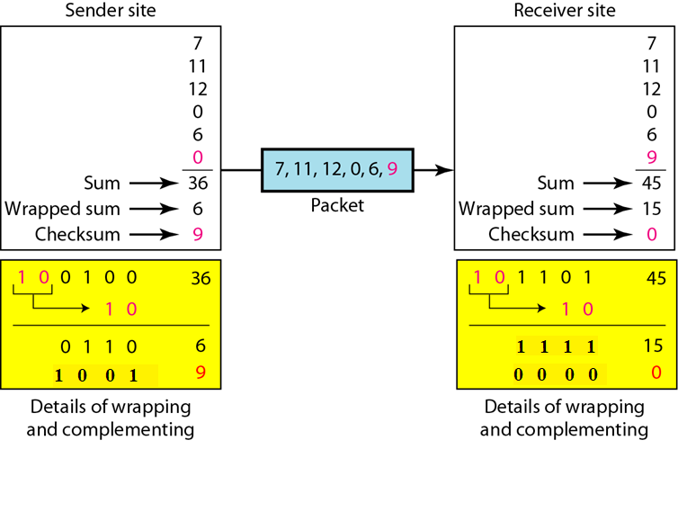
Example

Slide 46
Internet Checksum
Sender site:
  1. The message is divided into 16-bit words.
  2. The value of the checksum word is set to 0.
  3. All words including the checksum are added using one’s complement
  addition.
  4. The sum is complemented and becomes the checksum.
  5. The checksum is sent with the data.
Receiver site:
  1. The message (including checksum) is divided into 16-bit words.
  2. All words are added using one’s complement addition.
  3. The sum is complemented and becomes the new checksum.
  4. If the value of checksum is 0, the message is accepted; otherwise, it is
  rejected.

Slide 47
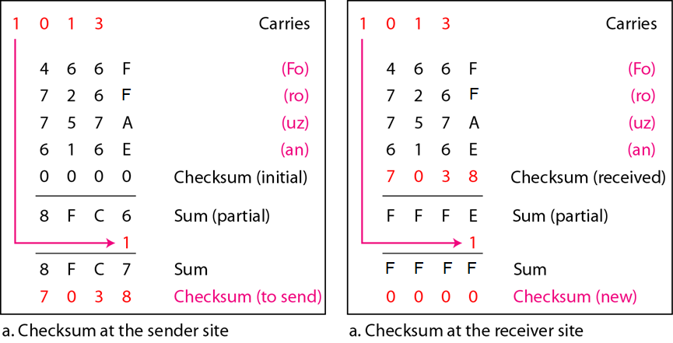
Internet Checksum: Example
0x466F, 0x726f, 0x757A, 0x616E

