Slide 1

WaveSafe
Firearm safety improvement system

Slide 2
What is WaveSafe?
“WaveSafe” is a good example of the technology based firearm safety solutions. It is a non-complex, reliable, rugged piece of technology which sits inside a firearm, makes a firearm more user friendly and not allowing trigger pulls if the owner is not holding it.

Slide 3
The traditional safety measures are just safe to the point which weapons still in officers' hands or holstered on them, when the weapon is held by the bad guy, it is no longer your weapon. So we think of a system that connects a firearm to a single user. A system to keep the firearm functioning only in the operator's hand and not let it fire under the control of unauthorized others.
Why did we created WaveSafe?

Slide 4
How we created WaveSafe?
We implemented a java Project, to simulate the idea of our Project. That java Project includes two GUI components, one is for simulating a firearm, the other is for demonstraining our projects display.

Slide 5
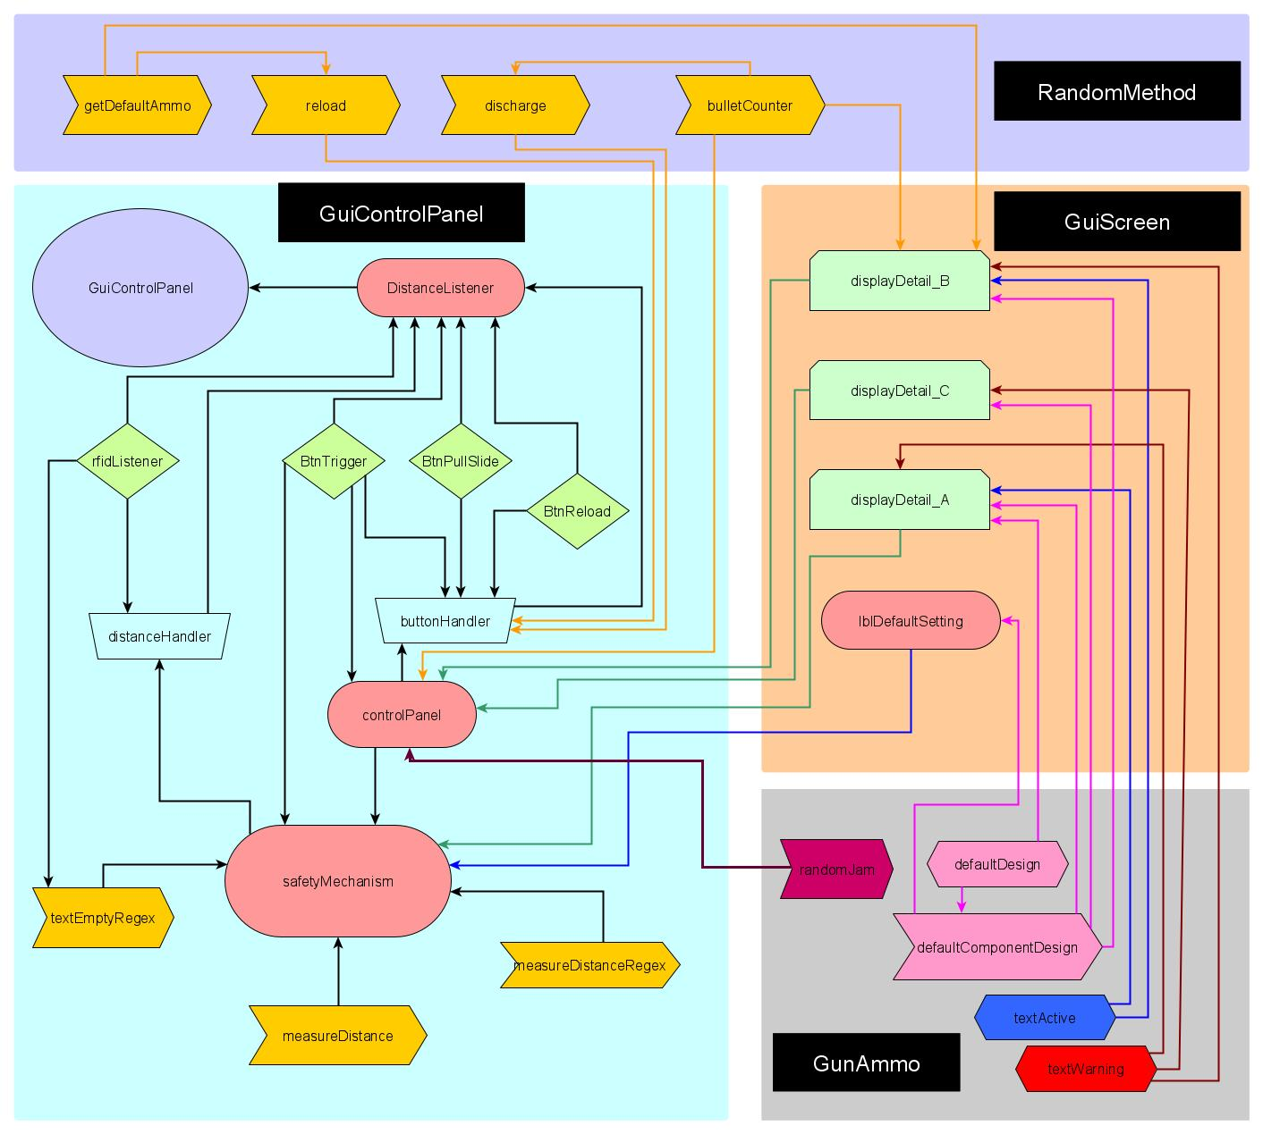
How does
it work?

Slide 6
rfidListener: Gets an ongoing updating input and sends it to “distanceHandler”. BtnTrigger: Acts as a trigger, if the safety is off and the mag is loaded it will decrease the number of bullets left in the mag by one. If safety is on this button will be unclickable. BtnPullSlide: Our aim was to mimic a real firearm so there are jams included, this button will get the firearm in ready to fire state after reloads, and clears any possible jam. Safety will not block this function. BtnReload: If there are no bullets left, this button will set the number of bullets to the maximum count. Safety will not block this function.
Components

Slide 7
displayDetail_A: Visual output of the safety state, whether it is on or off. Called in “safetyMechanism”. displayDetail_B: Updates constantly, output of the remaining ammo. Called in “controlPanel”. displayDetail_C: If there is a jam this method will send a warning text. Called in “controlPanel”. measureDistance: Compares “distance” to “distancelock” and returns true if “distance” is less than or equal to the “distancelock, false if not. Called in “safetyMechanism”. bulletCounter: Returns the remaining bullet count. reload: Sets the bullet count to default count. Called in “buttonHandler”. discharge: Decreases bullet count by one. getDefaultAmmo: Returns the default number of bullets. Called in “reload” and “displayDetail_B”. defaultDesign: Resets the labels. Called in “displayDetail_A”. defaultComponentDesign: Resets two labels at a time called in all methods of “GuiScreen”. textActive: sets text colour to green. textWarning: sets text colour red. controlPanel: Links the buttons to the displays, decides if the trigger button is enabled or not. safetyMechanism: Main control method, gets the inputs and send necessary instructions such as; Whether the trigger button is enabled or not.
Methods:

Slide 8
buttonHandler: Collects data from all of the buttons using action listeners therefore it checks the firearms current state, then give necessary instructions to “guiScreen” in order to be displayed. distanceListener: Reads the text inputs that mimics the RFID readings, sends them to “safetyMechanism”.
Listeners:

Slide 9
Methods to improve the realism of the project
lblDefaultSetting: A special method to minimize the GUI errors. Called in “controlPanel”.
textEmptyRegex: A special method to minimize the GUI errors. Called in “safetyMechanism”.
randomJam: Adds jams randomly to the process in order to be more realistic. Called in “controlPanel”.
measureDistanceRegex: Checks if the inputs are integers, and returns a boolean value. Called in “safetyMechanism”.

Slide 11
USER INTERFACE

Slide 12
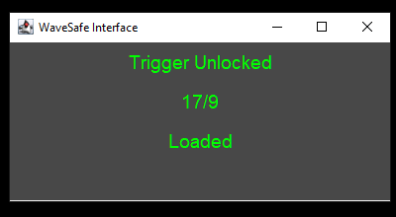
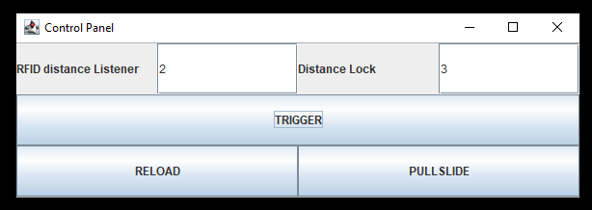
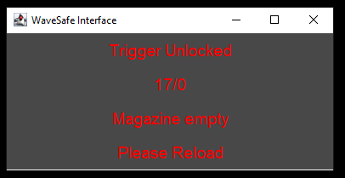

Slide 13
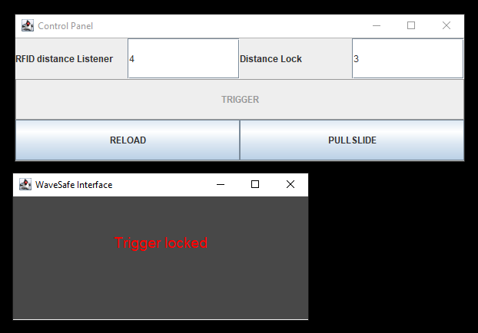

Slide 14
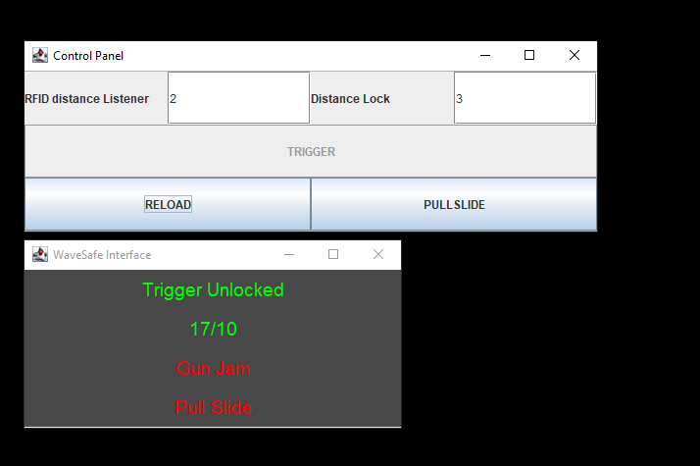

Slide 15
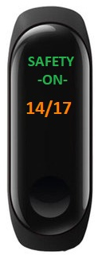
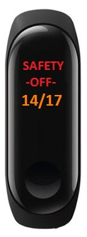
-> Safety is off and ready to fire, 14 bullets left, nothing wrong with the firearm
-> Safety is on, 14 bullets left, nothing wrong with the firearm

Slide 16
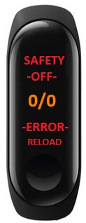
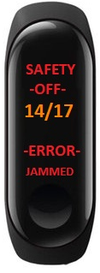
-> Safety is off, will not fire because there is a jam as written in the error message. After clearing the jam by pulling the slide, the flawed bullet will be discharged and the screen will be shoe 13/17 in the middle section, without an error message.
-> Safety is off and ready to fire, zero bullets left, need a reload as written in the error message

