Slide 1
Deep Camera
Android with Machine Learning
Kai Yi
June 30th, 2017

Slide 2
Outline
Introduction
Related Works
Contributions
Implementations
Results
Future Works

Slide 3
Introduction
An android app which has combined android with machine learning(in other words, TensorFlow)
01
Android development has witnessed a booming market and it’s very charming to develop a fancy application.
02
Machine learning is raising a storm of hit and has been applied to many fields concerning NLP, CV, etc. TF is a powerful library for the researcher.
03

Slide 4
Related Works
Android
Navigation Bar and Toolbar, etc. powerful material design methods, are widely used after put forward on Google I/O 2014.
Many projects aimed at providing considerate service and better user experience.
Machine Learning
Machine Learning methods has been used to solve object recognition problems but nearly none of them was implemented by android due to obstacles such as language conflicts and model training problems.

Slide 5
Contributions
First batch of developer trying to combine android and machine learning.
1
Has successfully trained the TF object recognition model and put it into use.
2
Provide a better UI for the current machine learning projects based on android.
3
Experimental results show our model works well.
4

Slide 6
Implementations
STEP1: Preparations
Android NDK -- C++ Support
TensorFlow trained model -- *.pb
Built C++/TensorFlow file -- *.so
C++ support of JAVA API -- *.JAR

Slide 7
Implementations
STEP2: Create ordinary android project
ToolBar, NavigationBar - Basic UI
WebView – Get access to Github, Project page, Weibo.
WelcomeActivity – Show Welcome
CameraView – Take photoes
Information Views -- Private Infomation

Slide 8
Implementations
STEP3: Combine TF with Android
Set standard and put lable into memory
Convert the form of picture into the forms supported by BitMap
Put the data into TensorFlow model
Run inference and get output tensor
Convert the form of output tensor into array
Select the best classifications and output

Slide 9
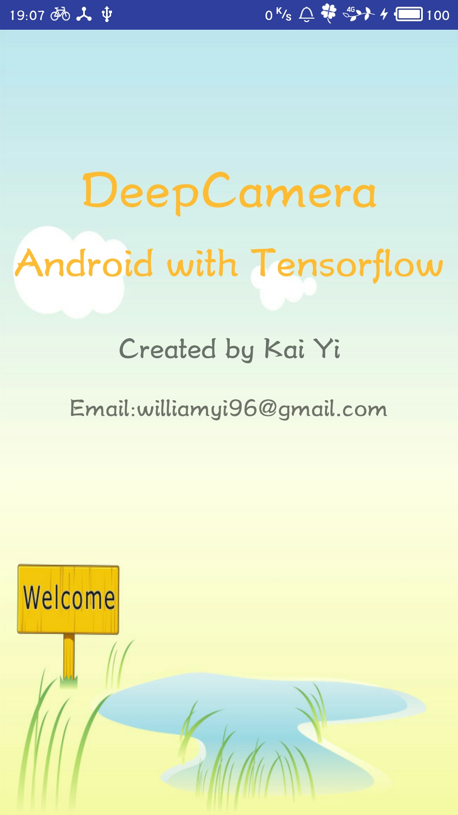
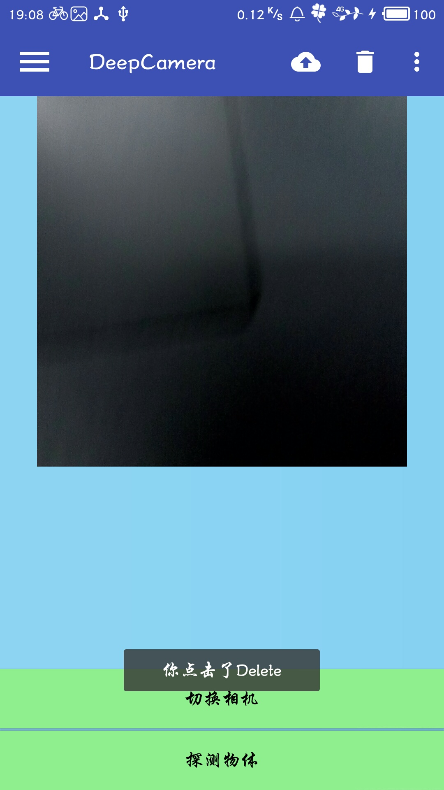
Results
Having tested on many daily items, our application works well. It has both meet the accuracy and richly candidate items.

Slide 10
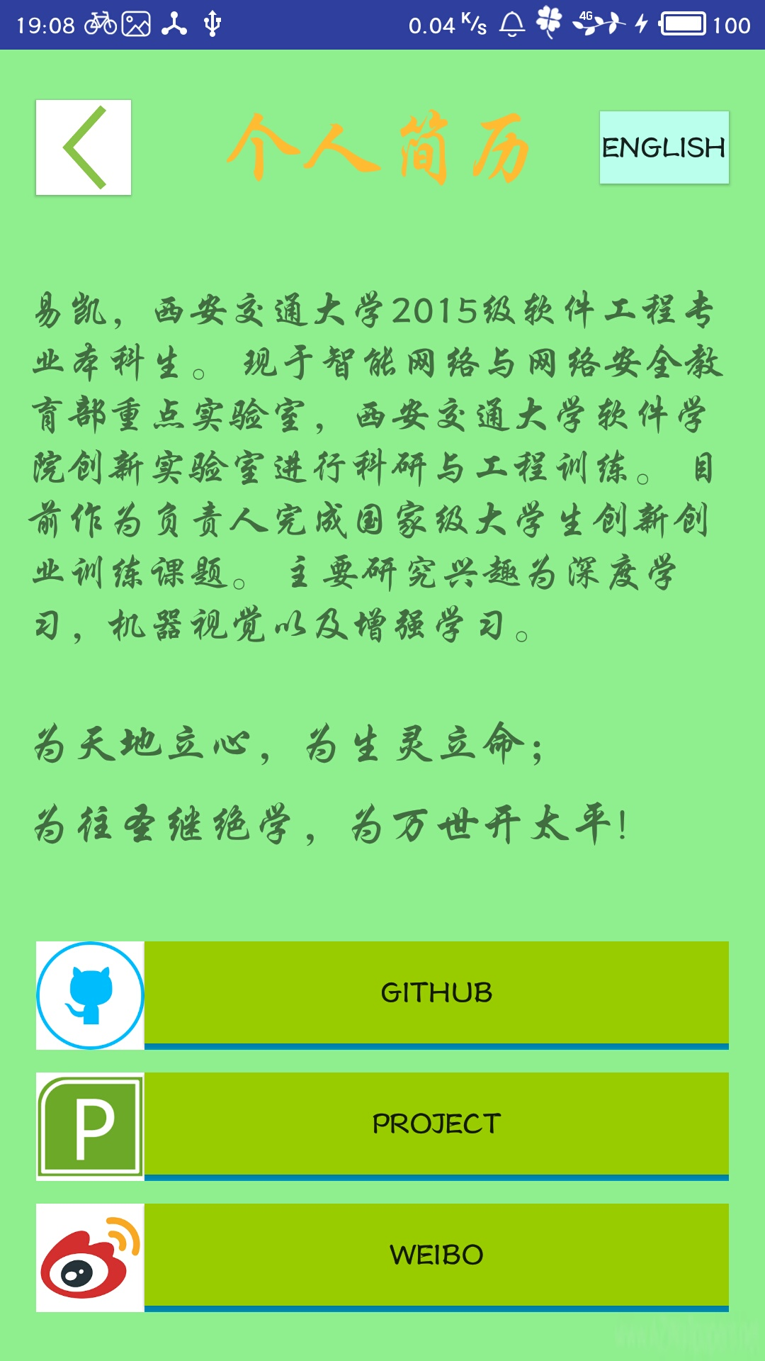
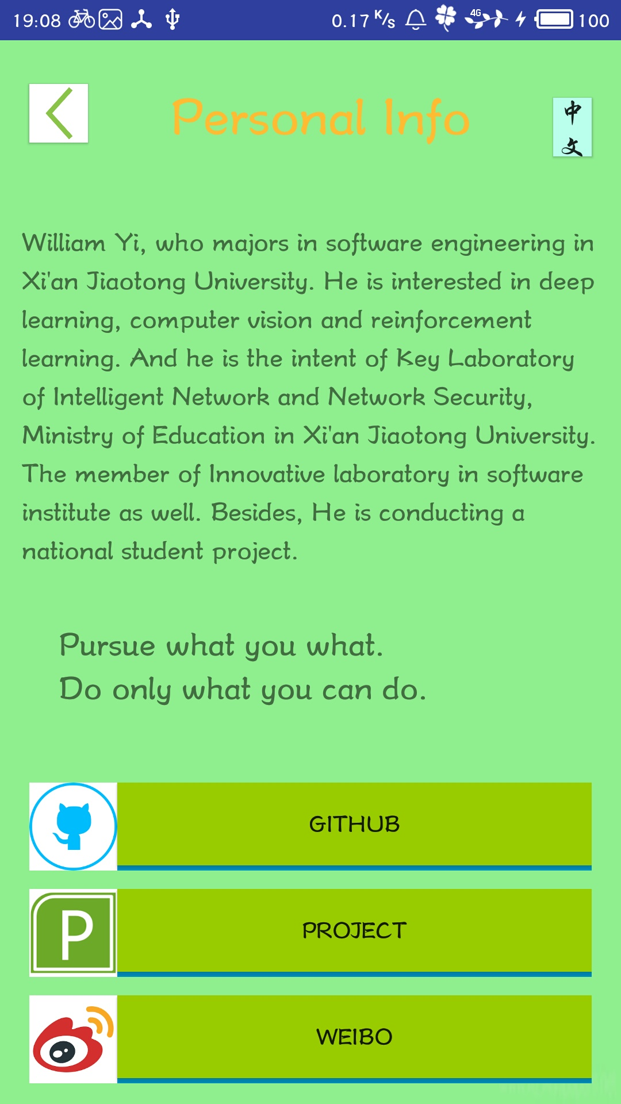

Slide 11
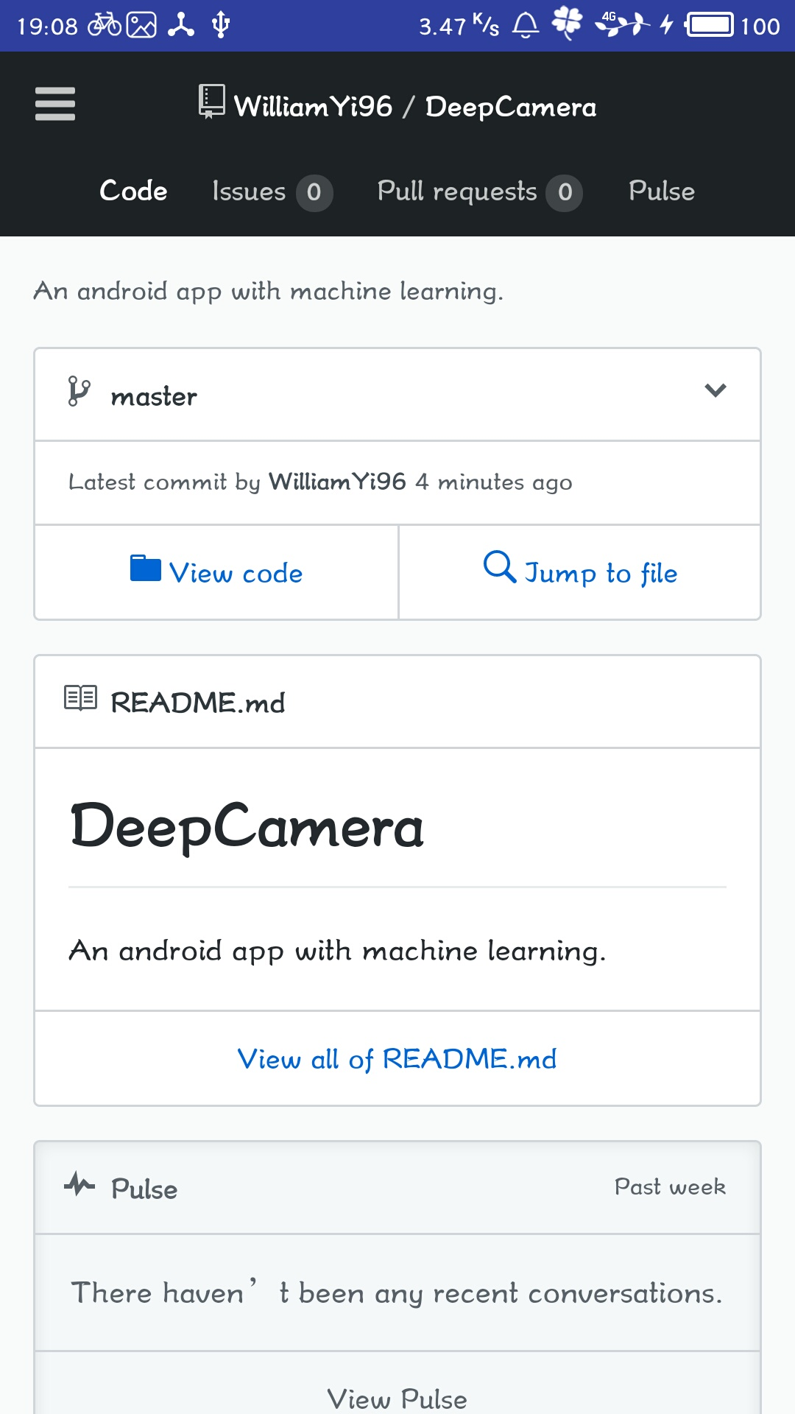
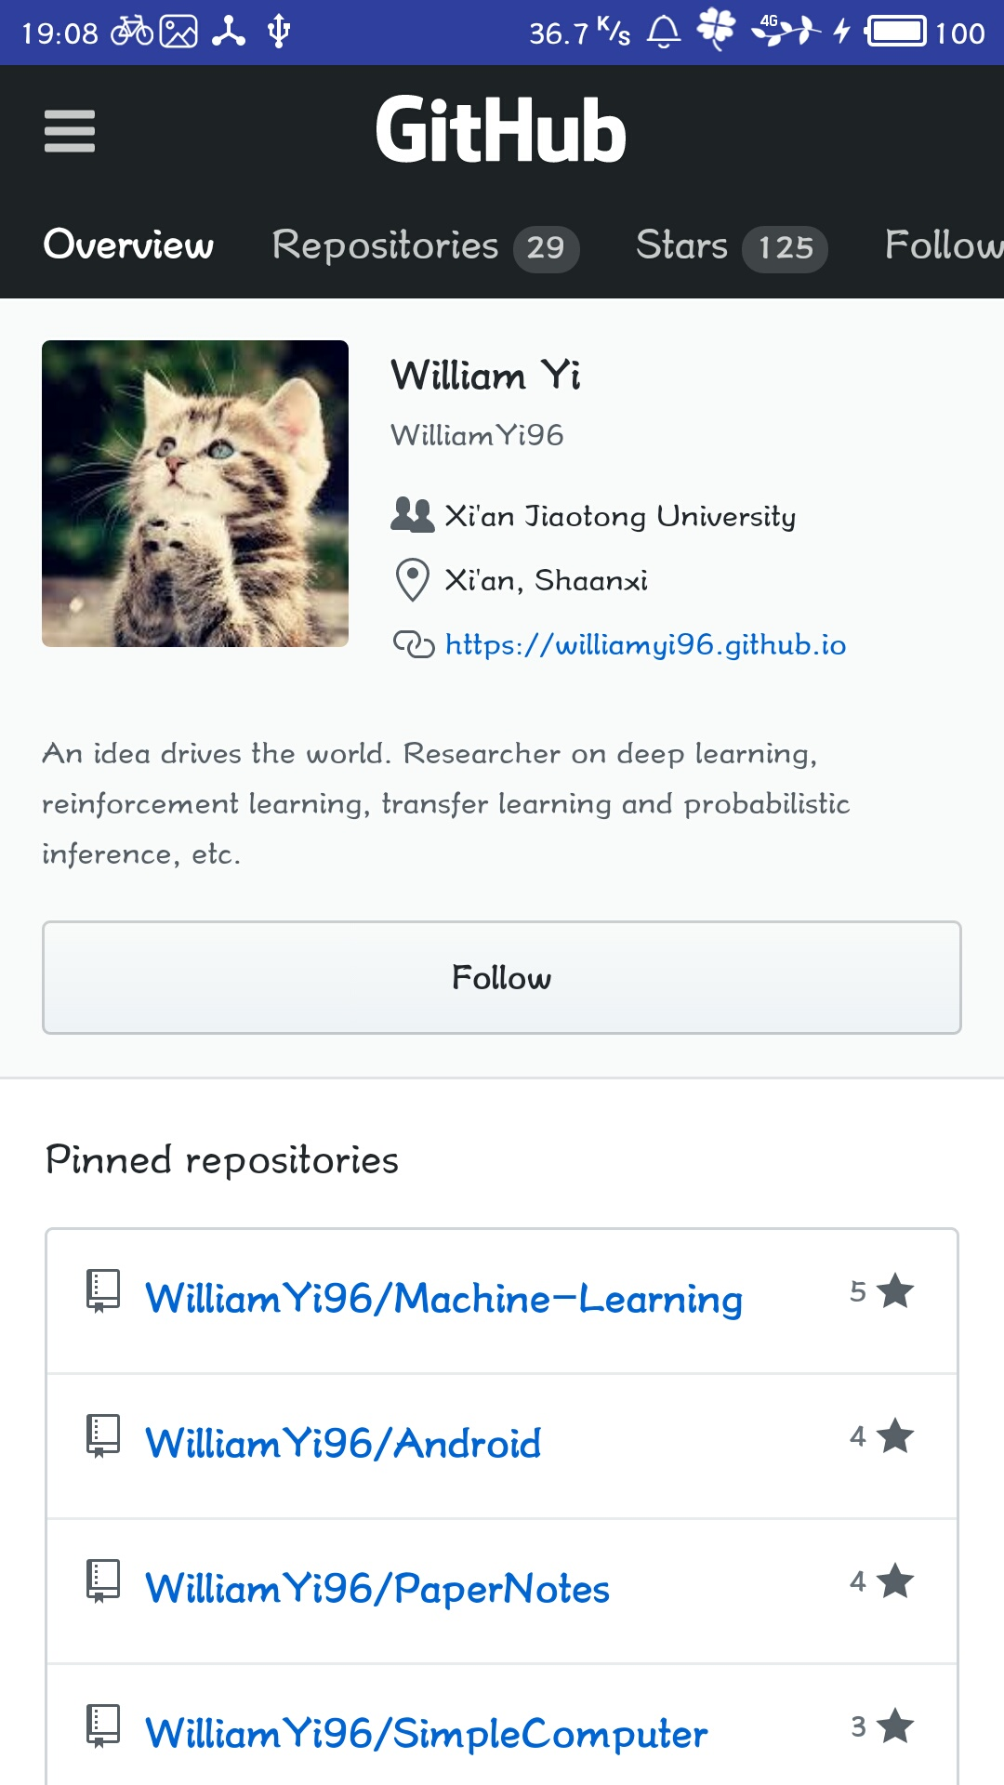
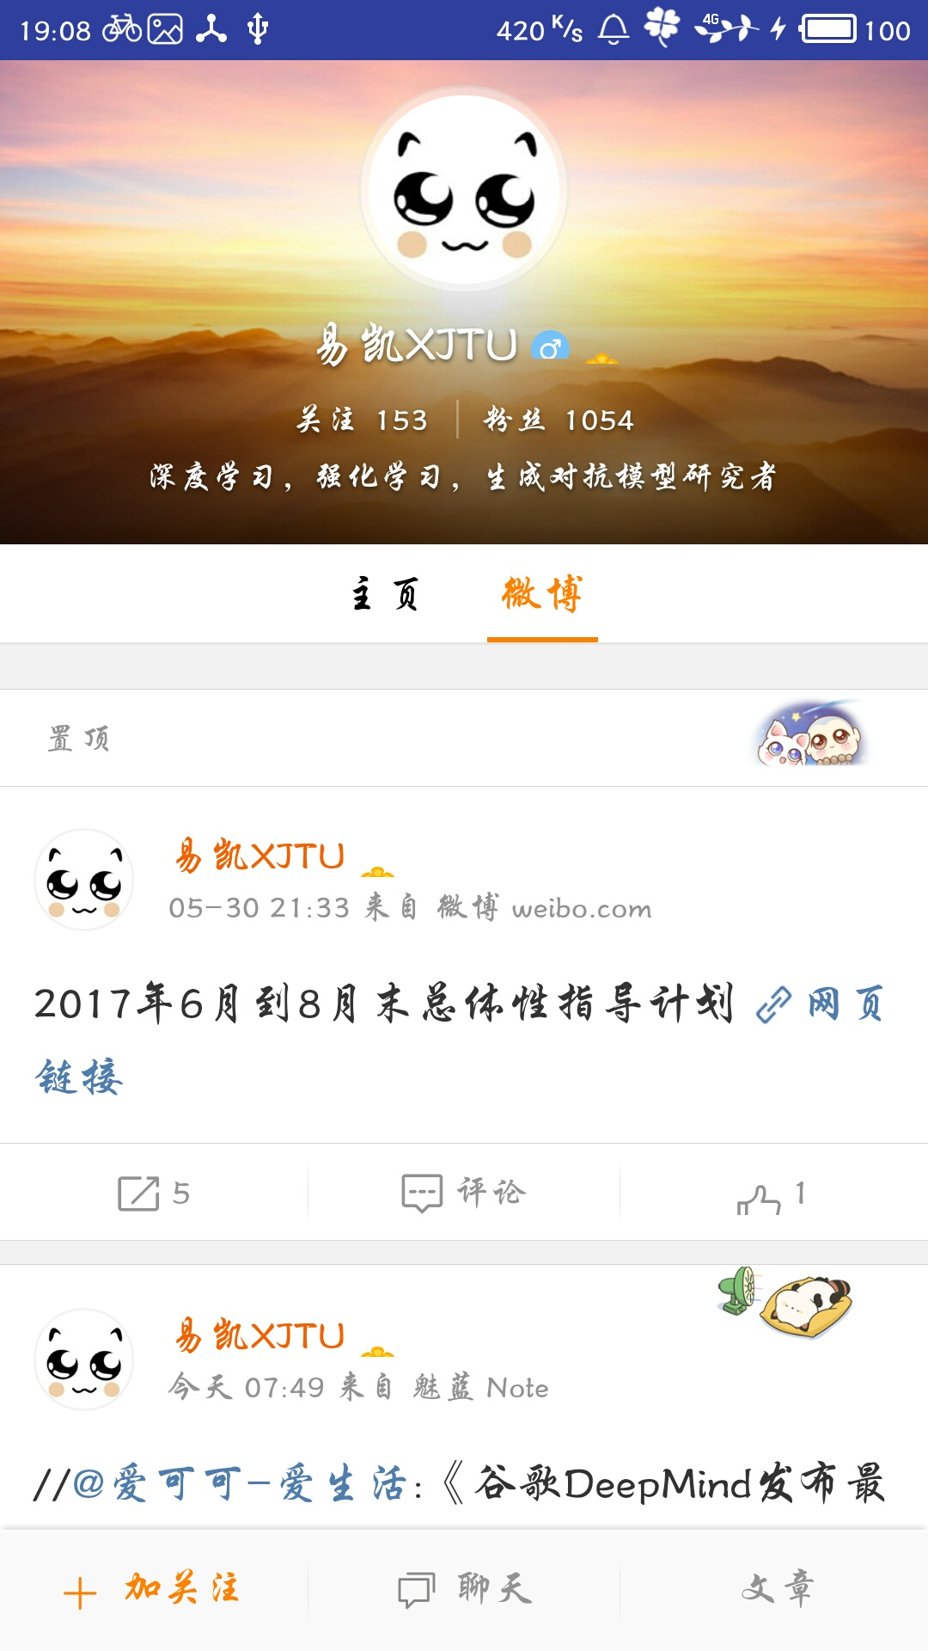

Slide 12
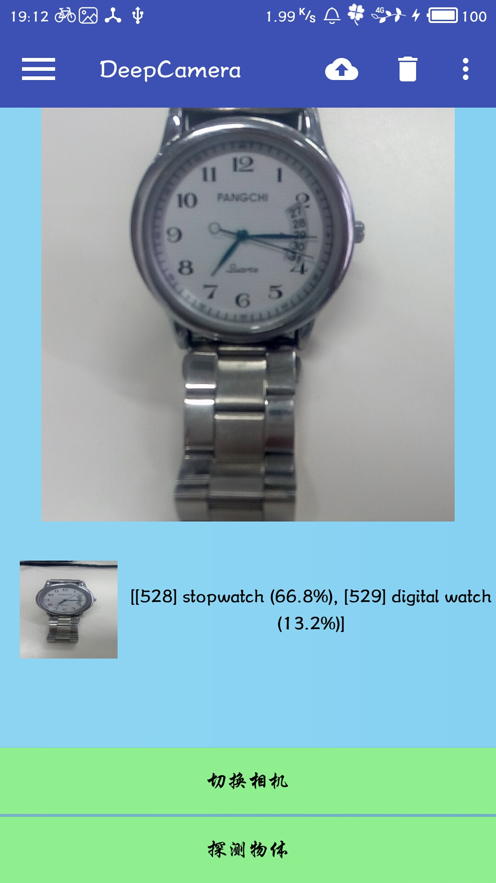
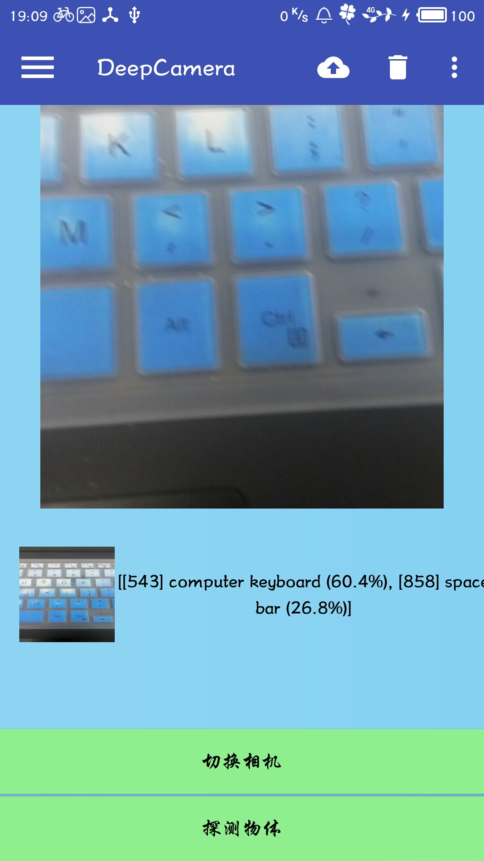

Slide 13
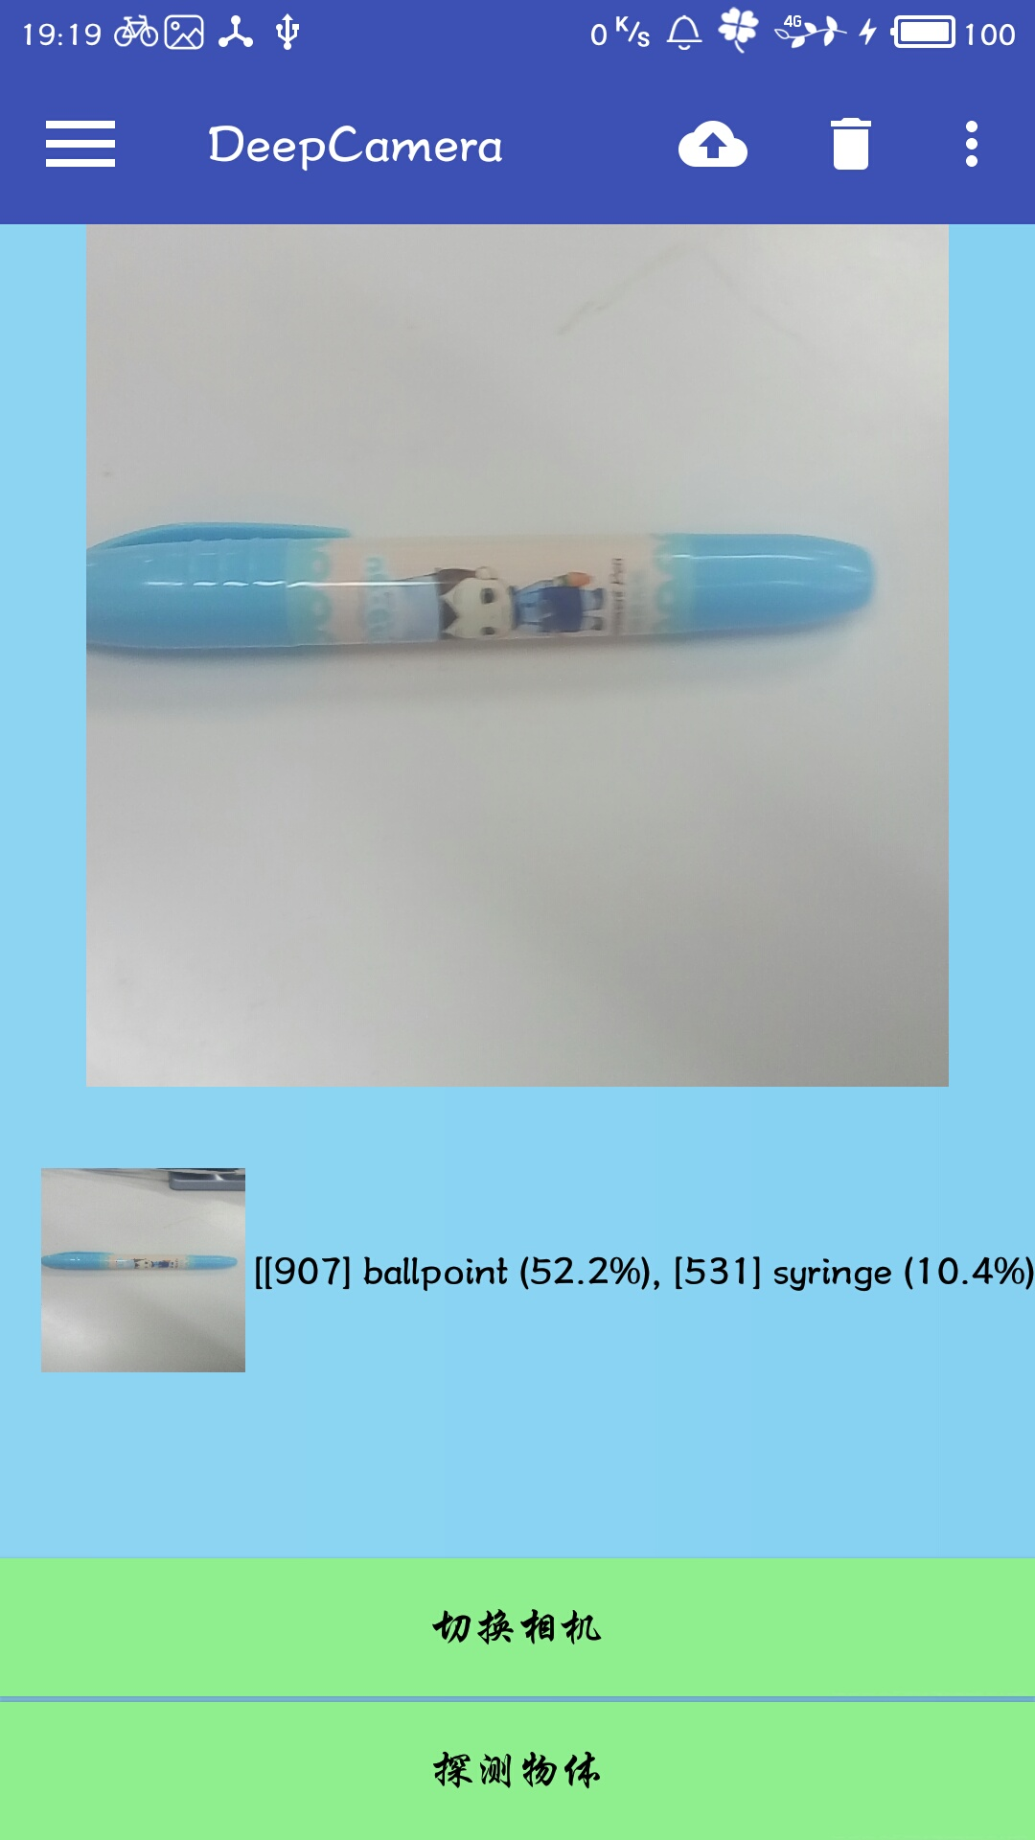
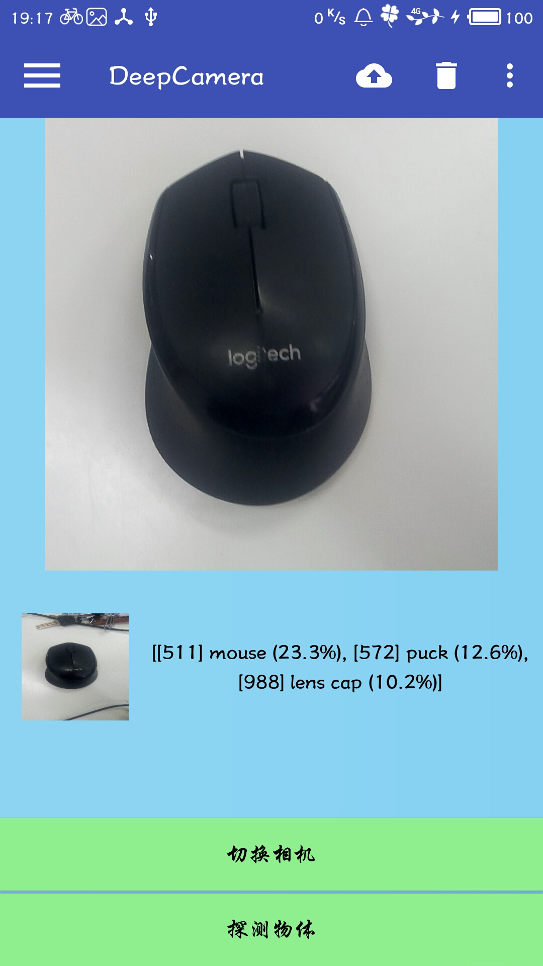
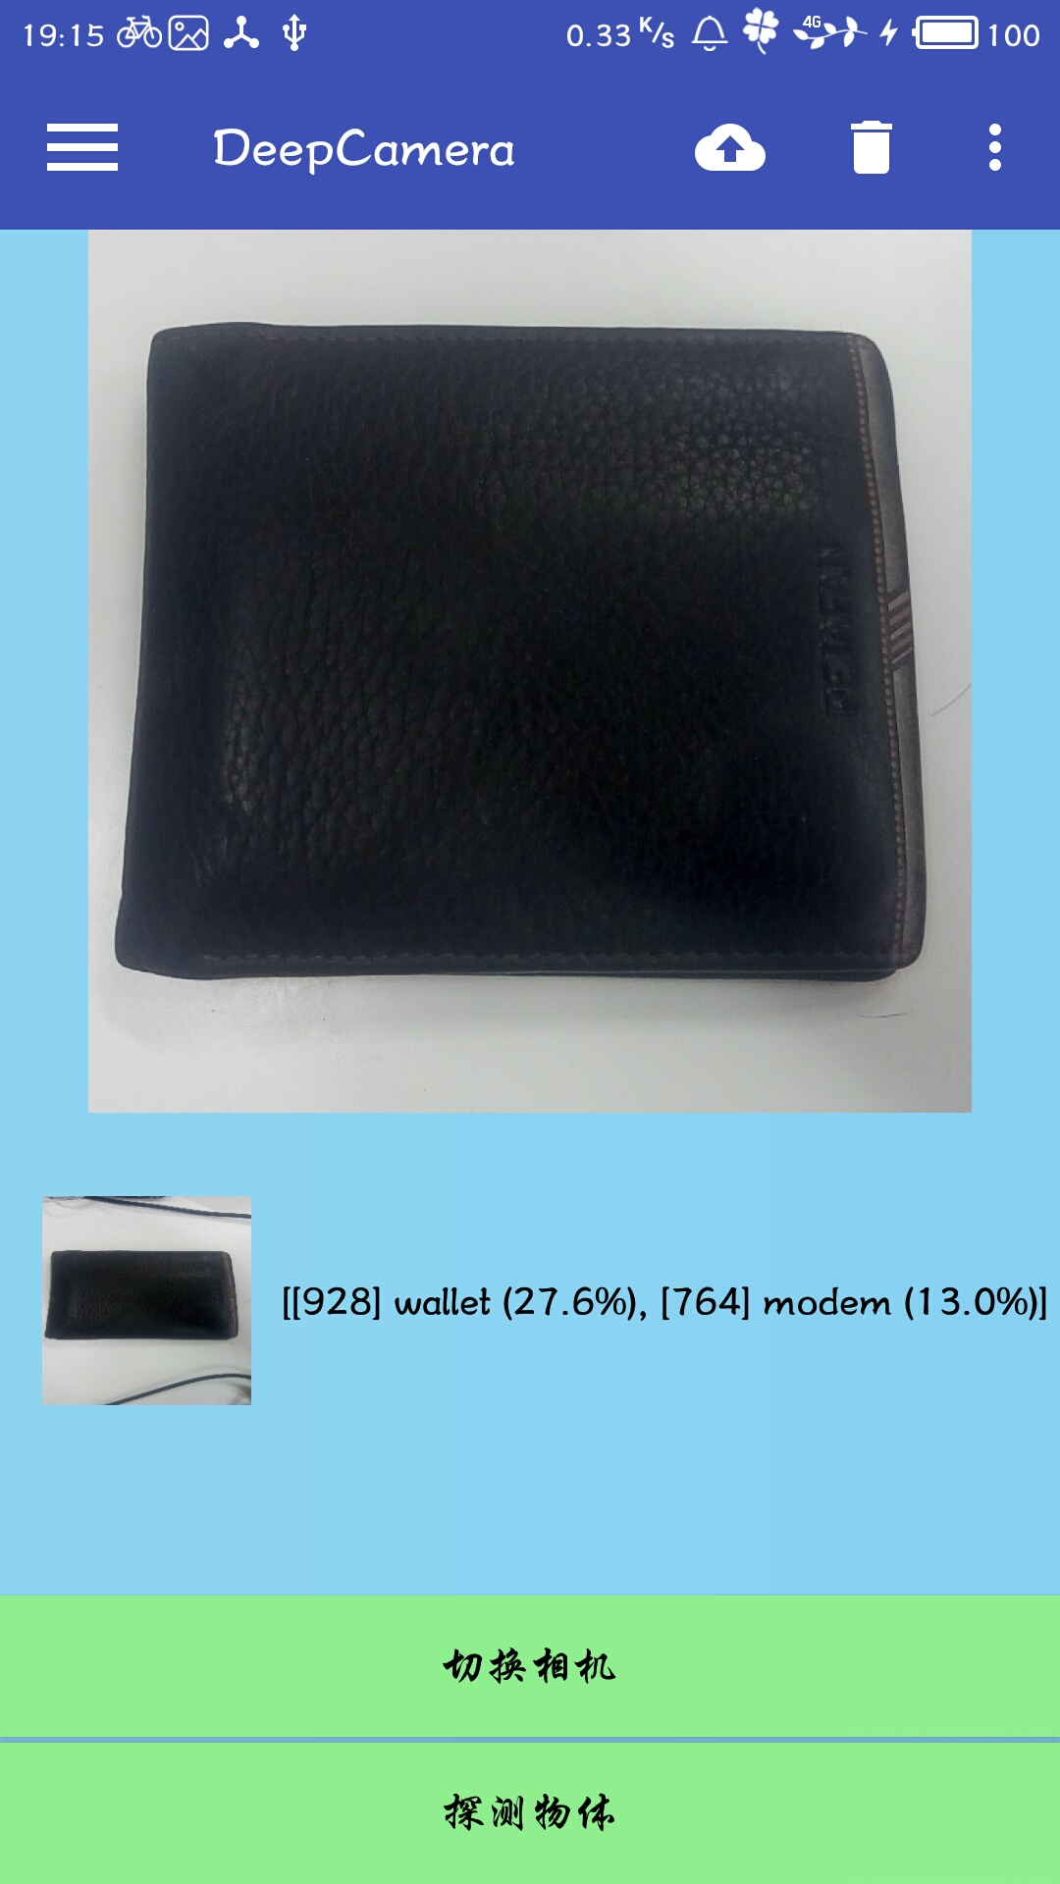

Slide 14
Future Works
Train
Train machine learning model on my own.
Improve
Improve accuracy by implementing the state-of-art methods into object-recognition.
Accelerate
Accelerate the speed of recognize.

Slide 15
Thank You!

