Slide 1
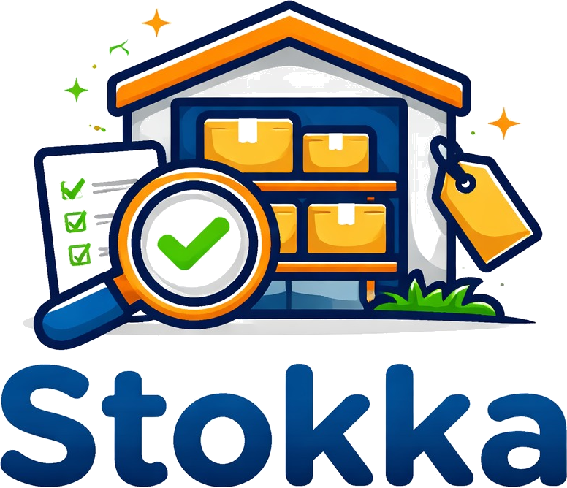




Full Inventory Control
Sales & Purchase Tracking
Reports & Insights
English & Arabic UI
Simple. Offline. Bilingual.
stokka.app

Slide 2




THE CHALLENGE
Managing a small shop is harder than it looks
Most owners rely on notebooks, Excel, or memory — all of which fail them.
Lost track of stock
Unpaid invoices pile up
Over-ordering or running out unexpectedly hurts sales and wastes cash.
No system to track who owes money — cash flow becomes a guessing game.
Excel is error-prone
Cloud tools need internet
Formulas break, files get lost, and no one else knows how the file works.
Power cuts and connectivity issues make cloud-only software unreliable.
Stokka — Inventory Management
The Problem

Slide 3



What is Stokka?
A desktop application designed for small shop owners — no internet needed, no training required.
Desktop App
100% Offline
Bilingual
Licensed
Runs on Windows
No browser needed
Works without
internet, always
Full English
& Arabic (RTL)
Per-machine activation
with 7-day free trial
Stokka — Inventory Management
Product Overview

Slide 4




FEATURES
Everything a shop owner needs
Eight modules — fully configurable, all in one app.
Products
Suppliers
Customers
Track stock, cost & selling prices, barcode labels, CSV import.
Manage supplier contacts, VAT/tax numbers, linked to purchase orders.
Customer profiles, credit balance, full invoice history.
Purchase Orders
Sales Invoices
Quotations
Create POs, receive stock, distribute transport & customs costs.
Configurable series, VAT toggle, discounts, PDF output.
Create quotes, send to customers, convert approved quotes to invoices.
Bundles
Reports
Group products into sellable sets — stock auto-decrements per component.
9 built-in reports: sales, P&L, inventory, customer & supplier statements.
Stokka — Inventory Management
Core Modules

Slide 5

INVENTORY
Never run out of stock again
Real-time inventory tracking with automatic alerts.
Product
Stock
Status
Barcode field + label printing (3 sizes)
Mineral Water 1.5L
80
OK
Cost price vs. selling price — see your margin instantly
Olive Oil 750ml
45
OK
Low-stock badge and dashboard counter
Paracetamol 500mg
12
LOW
Full stock history via linked purchase orders
Latex Gloves M
90
OK
Espresso Beans 1kg
5
LOW
Auto-generated SKU + profit margin per product
A4 Copy Paper
120
OK
Import products, customers & suppliers from CSV
Stokka — Inventory Management
Products & Inventory

Slide 6

SALES
Issue invoices, track payments
Know exactly what's been paid and what's outstanding.
$845
$190
5
4
Total invoiced
Outstanding
Invoices issued
Fully paid
This month
1 unpaid invoice
April 2026
On time
Configurable series
VAT + Discounts
Multiple series with custom prefixes, starting numbers, and counters.
Per-invoice VAT toggle, line & invoice discounts, customer credit balance.
PDF + Notes
Quotations
A4 PDF with logo, full customer details, VAT, discounts, and custom note.
Create quotes, get approval, convert to invoice in one click.
Stokka — Inventory Management
Sales Invoices

Slide 7
PURCHASING
Purchase orders made simple
Order from suppliers and restock in a few clicks.
1
2
3
4
Create PO
Saved as Draft
Mark as Received
Stock Updated
Select supplier
& add products
Edit anytime
before receiving
Confirm delivery
in the app
Transport, customs
& extra costs logged
PO #
Supplier
Date
Items
Total
Status
PO-003
Gulf Products LLC
20 Mar 2026
2
$210.00
RECEIVED
PO-004
EuroGoods Import
05 Apr 2026
3
$280.00
PENDING
Stokka — Inventory Management
Purchase Orders

Slide 8
REPORTS
Insights at your fingertips
Nine built-in reports — all printable, all filterable by date range.
Sales Report
Pending Payments
Customer History
Revenue, invoice count, and per-customer breakdown for any date range.
All unpaid and partial invoices with customer name and outstanding balance.
Every invoice for a specific customer in chronological order.
Inventory Report
Low Stock Alert
Profit & Loss
Full product list with current quantities and stock values.
Products at or below minimum threshold — act before you run out.
Revenue, COGS, gross profit, extra PO costs, and net profit.
Customer Statement
Supplier Statement
Account Statement
Full transaction history: invoices, payments, credits, and running balance.
All purchase orders for a supplier with full cost breakdown.
Combined income and expense view across all transactions in a date range.
Stokka — Inventory Management
Reports

Slide 9
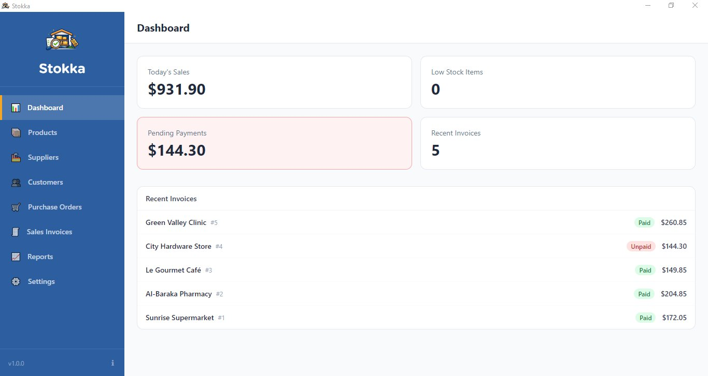
DASHBOARD
Your business at a glance
The dashboard loads in under 1 second — always up to date.
⚙ Settings (6 tabs)
Company Info — name, address, logo, VAT number
Preferences — language, currency, VAT rate
Invoice Series — prefixes, counters, starting numbers
Modules — toggle any module on or off
License & Updates — activation and auto-updates
Stokka — Inventory Management
Dashboard & Settings

Slide 10
Built for reliability.
Technology choices that make Stokka fast, secure, and maintenance-free.
Electron + React
SQLite Database
Native desktop feel with modern web UI technology.
All data stored locally on the machine — no cloud, no breach risk.
License System
i18n / RTL Ready
Per-machine activation key. 7-day free trial included.
Full Arabic support — layout mirrors automatically.
Stokka — Inventory Management
Technology

Slide 11
WHY STOKKA
The right tool for your shop
A focused, affordable alternative to complex ERP systems.
Stokka
Excel
Cloud Apps
Stokka fits if your client:
Works offline
✓
✓
✗
Designed for non-technical users
Arabic UI
✓
Limited
Rare
Setup in under 30 minutes
No training
✓
✗
✗
No internet required — ever
Auto inventory
✓
Manual
✓
One-time cost
✓
✓
✗ Monthly
Bilingual from day one
Print invoices
✓
Manual
✓
Your data stays on your machine
Bundles, quotations & CSV import built-in
Stokka — Inventory Management
Why Stokka

Slide 12
Ready to simplify your
shop management?
Book a free demo — we'll set it up and show you the full workflow in under 20 minutes.
Book a Free Demo →
stokka.app

