Slide 1

DISCOVER
ATYRAU
Where Europe and Asia Meet
A multimedia tourism project
TAUMAN SAIDA • PO 1-24
ATYRAU / TOURISM PROJECT
01 / 09

Slide 2
A CITY WITH TWO CONTINENTS
WESTERN KAZAKHSTAN
Atyrau is a lively city on the Ural River, close to the Caspian Sea.
An important cultural centre
Known for energy and industry
A gateway to regional history
ATYRAU / TOURISM PROJECT
02 / 09

Slide 3
WHY ATYRAU IS SPECIAL
01
02
03
TWO CONTINENTS
RIVER LIFE
LOCAL CULTURE
A symbolic meeting point of Europe and Asia.
Bridges, riverside walks and scenic sunsets.
Traditions, history and warm hospitality.
ATYRAU / TOURISM PROJECT
03 / 09

Slide 4
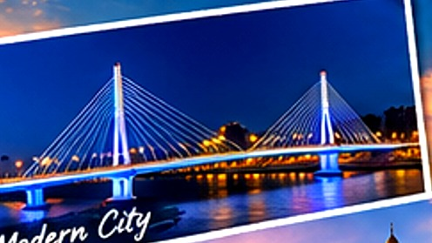

5 PLACES TO EXPLORE
01
Ural River Embankment
02
Regional History Museum
03
Imangali Mosque
04
Pedestrian Bridge
05
Isatay and Makhambet Square
ATYRAU / TOURISM PROJECT
04 / 09

Slide 5
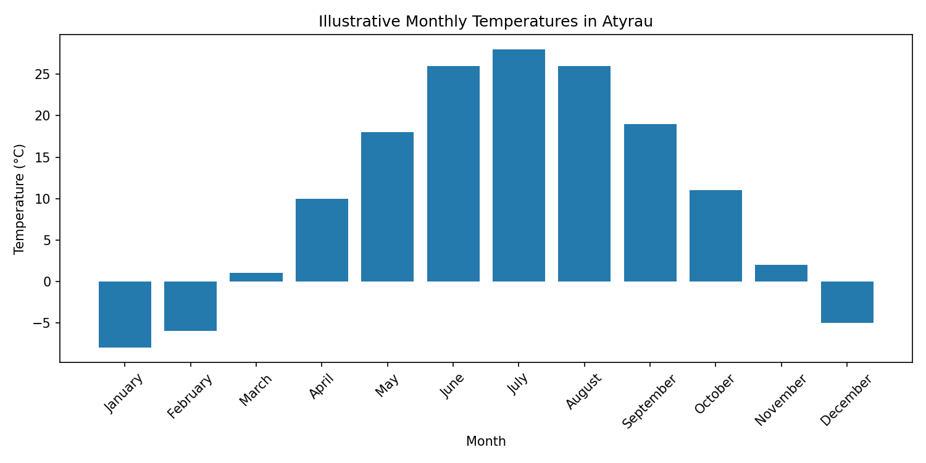
ATYRAU THROUGH THE SEASONS
HOT SUMMERS
COLD WINTERS
The chart shows illustrative monthly temperatures for a classroom exercise, not verified historical observations.
ATYRAU / TOURISM PROJECT
05 / 09

Slide 6
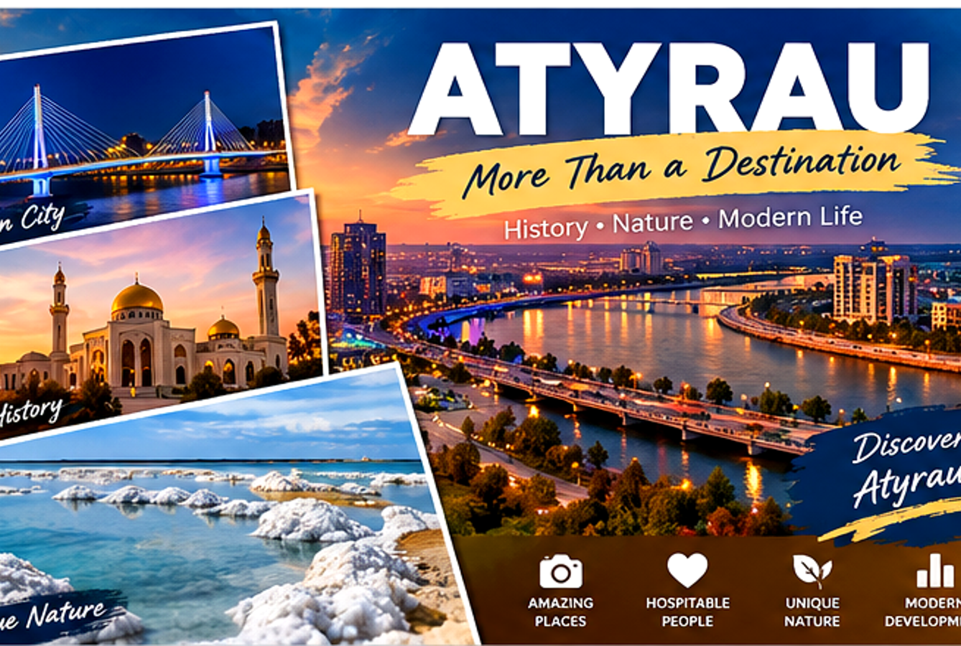
OUR TOURISM POSTER
DISCOVER
ATYRAU!
Blue and gold colours
Photo collage
Strong headline
Visual storytelling
ATYRAU / TOURISM PROJECT
06 / 09

Slide 7
HOW THE PROJECT WAS CREATED
WORD
EXCEL
Brochure, text and table
Formulas and climate chart
IMAGE EDITOR
POWERPOINT
Photo collage and colour effects
Slides and visual storytelling
ATYRAU / TOURISM PROJECT
07 / 09

Slide 8
WHY VISIT ATYRAU?
A CITY WORTH
DISCOVERING
Beautiful river views
Rich culture and history
Modern life and local character
ATYRAU / TOURISM PROJECT
08 / 09

Slide 9
SOURCES & PROJECT NOTES
REFERENCES
Encyclopaedia Britannica — britannica.com
Kazakhstan tourism — visitkazakhstan.kz
Climate chart — illustrative educational values
Poster visuals — AI-generated and edited
Thank you for exploring Atyrau!
ATYRAU / TOURISM PROJECT
09 / 09

