Slide 1

MYSQL vs POSTGRE SQL vs SQL SERVER

Slide 2
Name | Microsoft SQL Server | MySQL | PostgreSQL
Description | Microsoft RDBMS | open source RDBMS | open source RDBMS
Developer | Microsoft | Oracle | PostgreSQL Global Development Group
Current release | SQL Server 2019, November 2019 | 8.0.27, October 2021 | 14.0, September 2021
License | commercial | Open Source (GNU General Public License) | Open Source (MIT-style license)
Known as |  | The world’s most popular open source database. | The world’s most advanced open source database.
Development |  | MySQL is an open-source product. | PostgreSQL is an open source project.

Slide 3
 | Microsoft SQL Server | MySQL | PostgreSQL
Implementation programming language | Mostly C++ with a few exceptions | C/C++ | C
GUI tool |  | MySQL Workbench | PgAdmin
Temporary tables | More functuonality | limited | limited
Indexes | Automated functionality | Tables and clunsters | Flexible Search
 | For entreprise projects | Flexibility, cost-efficiency and innovation

Slide 4
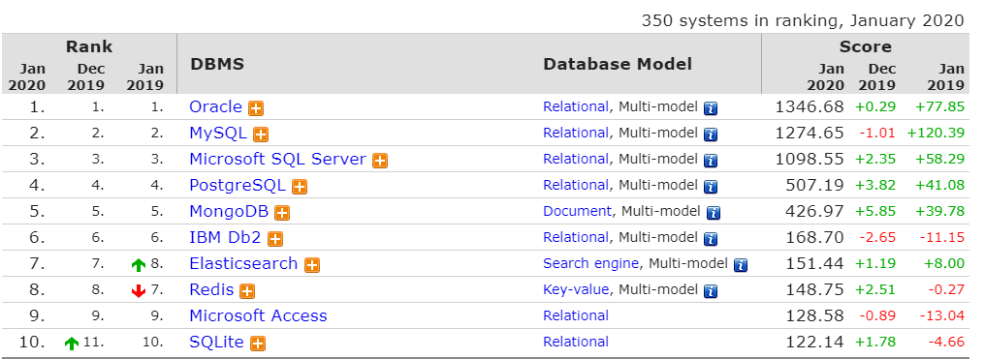
TOP 10 des bases de données en 2020

