Slide 1

Corporate Finance and Investment Analysis

Slide 2
The basic theory of interest

Slide 3

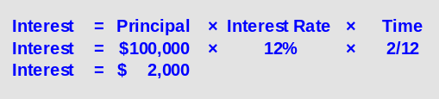
The basic theory of interest
The interest formula includes three variables that must be considered when computing interest:
Interest = Principal × Interest Rate × Time
1.08$=1$ × 8% × 1
When computing interest for one year, “Time” equals 1. When the computation period is less than one year, then “Time” is a fraction.
General Mills borrows $100,000 for 2 months at an annual interest rate of 12%.

Slide 4
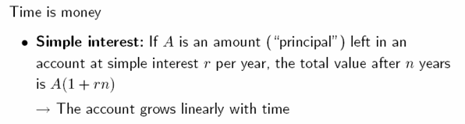
The basic theory of interest
After 1 year: V=A(1+r)
After 2 years: V=A(1+2r)……
Ex. Principal=100$ r=10% n=2 years
Interest=100$*0.10*2=20$ Total amount=100$+20$=120$
The same as: V=A(1+rn)
100(1+0.10*2)=120$
The value is the original amount + the accumulated interest, which is proportional to time!

Slide 5

The basic theory of interest
The basic theory of interest is crucial in investment decisions!
Ex. You are offered for a property 10,000$ from customer A now or 11,424$ from customer B after one year. Annual interest on bank deposits is 12%. Which offer to choose?
V=A(1+rn) 10,000(1+0.12)=11,200$
You will accept the offer from customer B!

Slide 6
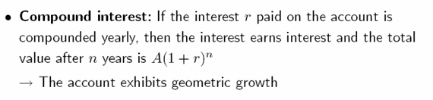
The basic theory of interest
Year Amount Interest Final Amount
1,000 + 1,000x10%=100= 1,100
1,100 + 1,100x10%=110= 1,210
1,210 + 1,210x10%=121= 1,331
1,331 + 1,331x10%=133.1= 1,464.1
1,464.1 + 1,464.1x10%=146.41= 1,610.51
1000(1+0.10)⁵=1,610.51

Slide 7
The basic theory of interest
Ex. 10,000$ invested for 30 years, 12% yearly interest rate
SIMPLE INTEREST
=10,000(1+0.12*30)=46,000$
INTEREST COMPOUNDED ANNUALLY
=10,000(1+0.12)³⁰=299,599$
INTEREST COMPOUNDED QUARTERLY
= 10,000 (1+0.12/4)^{30x4}=347,109$
Compounding can have a big effect on the accumulation of wealth!

Slide 8
The basic theory of interest
Quarterly compounding: at an interest rate r per year, an interest rate of r/4 is applied every quarter
  1 quarter: money grows by (1+r/4)
  2 quarter: money grows by (1+r/4) and so on..
  After 1 year: money has grown by (1+r/4)⁴
Ex. 10,000$, 8% annual rate, compounded quarterly
  =10,000(1+(0.08/4))⁴=10,824$
NOMINAL INTEREST RATE=8%
EFFECTIVE INTEREST RATE=8.24%

Slide 9
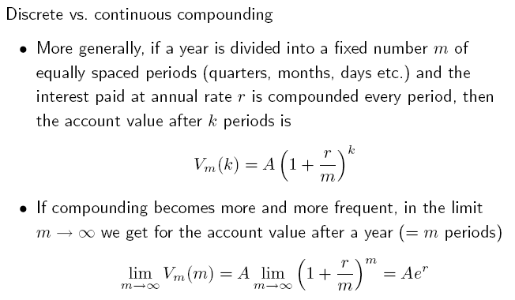
The basic theory of interest
e=2.7818.. The base of the natural algorithm

Slide 10
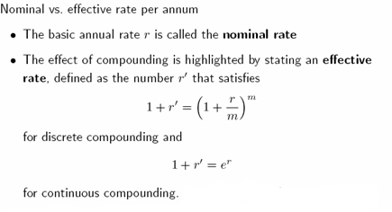
The basic theory of interest
r’=(1+r/m)^{m}-1

Slide 11
The basic theory of interest
Ex. 10,000$, 8% annual stated rate, compounded quarterly
  =10,000(1+(0.08/4))⁴=10,824$
1+r’=(1+r/m)^{m}
r’=(1+r/m)^{m}-1
r’= (1+(0.08/4))⁴-1=0.0824=8.24%

Slide 12
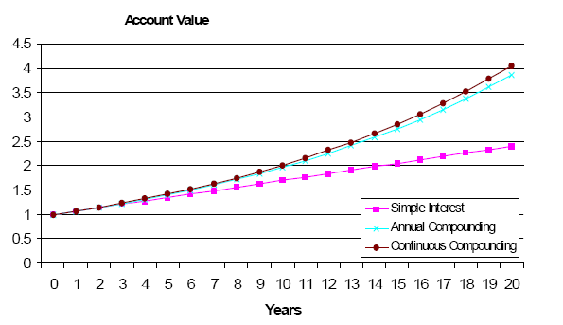
The basic theory of interest

Slide 13
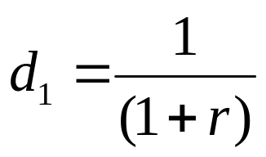
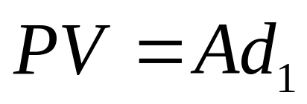
Present Value
To compute the present value of an amount to be received in the future, the future value must be DISCOUNTED by a discount factor
If an amount A is to be received in 1 year, the present value is given by:

Slide 14
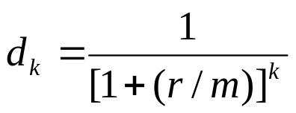
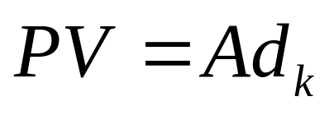
Present Value
If the annual interest rate r is compounded at the end of each m equal periods each year:
If an amount A is to be received at the end of the k^{th} period, the present value is given by:

Slide 15
Present Value
On Jan. 1, 2003 there is an opportunity to receive cash on Dec. 31, 2005 for 1,000$. At an interest rate of 10% per year, how much is the amount worth now?
Year Interest for the year PV
1,000x1/1.10=90.91 1,000-90.91=909.09
909.09x1/1.10=82.65 909.09-82.65=826.44
826.44x1/1.10=75.14 826.44-75.14=751.30
PV=1,000/(1+0.10)³=751.30

Slide 16
Present Value
Ex. Linda wants to invest in a land that costs 85,000$. She is certain that the land will be worth next year 91,000$. r is 10%. Would she undertake the investment?
If she leaves money in the bank account:
After 1 year: V=85,000(1+0.10)=93,500$
The present value of next year sale price:
PV=91,000/(1+0.10)=82,727.27$
→ The present value of next year sale price (82,727.27$) is lower than this year purchase price (85,000$): no investment!

Slide 17
Present Value
NPV=-COST+PV
Net present value of the investment is the PV of future cash flows – the PV of the cost of the investment
-2,273$=-85,000$+82,727.27$

Slide 18
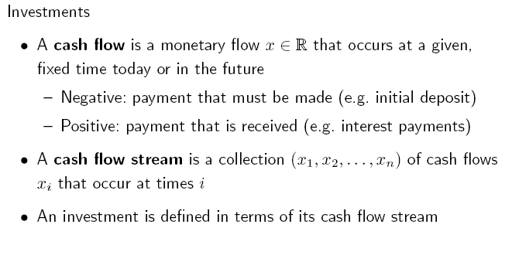
Present and future value of streams
Assumption of certainty!

Slide 19
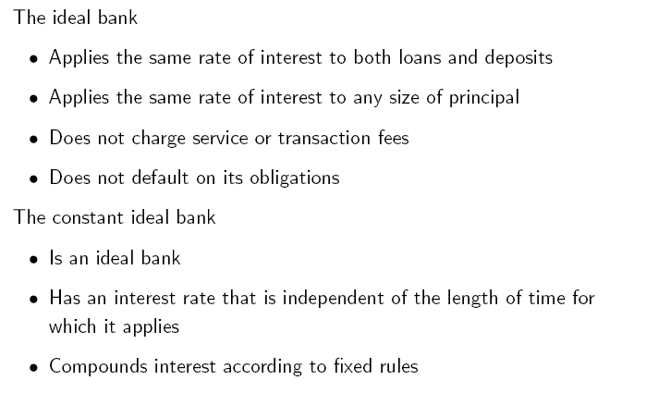
Present and future value of streams

Slide 20
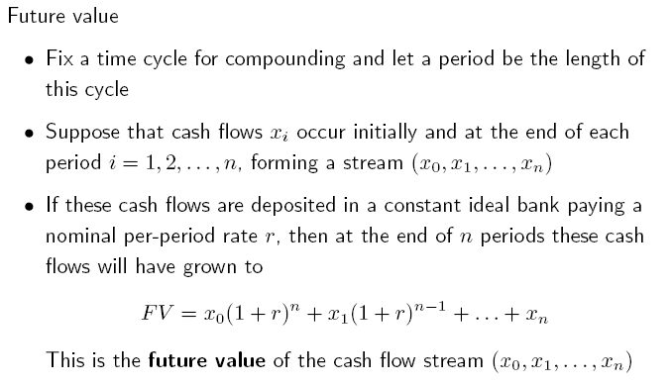
Future value of streams

Slide 21
Future value of streams
At the end of n periods, x₀ will have grown to x₀(1+r)^{n}, the next X₁ will collect interest for only n-1 periods…the final flow x_{n} will not collect any interest!
Ex. CF stream (-2, 1, 1, 1), periods are years and r=10%
FV=-2(1.1)³+1(1.1)²+1(1.1) +1=0.648

Slide 22
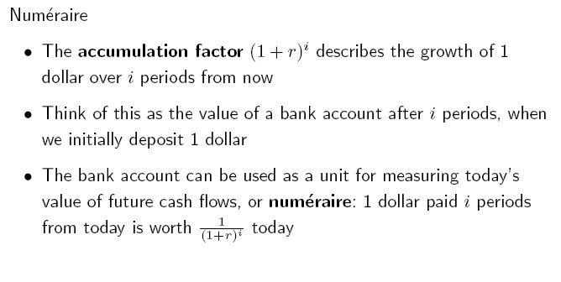
Present and future value of streams

Slide 23
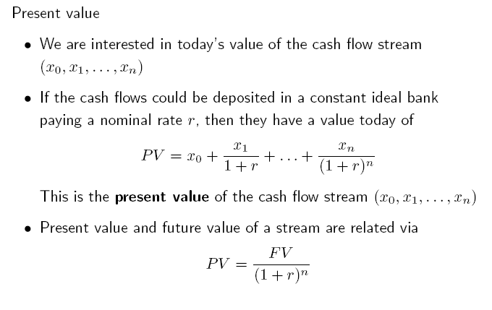
Present value of streams

Slide 24
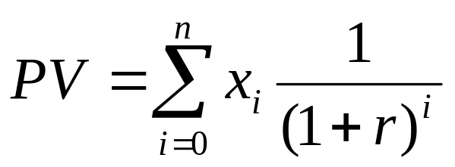
Present value of streams
The PV of x₀ is just the value because no discounting is necessary. The PV of the flow x₁ is x₁/(1+r), because the flow must be discounted by 1 period, PV of the flow x₂ is x₂/(1+r)² ….
Ex. CF stream (-2, 1, 1, 1), periods are years and r=10%
PV=-2+1/(1.1)+1/(1.1)²+1/(1.1)³=0.487
The PV of a cash flow stream is the sum of the present values of the single cash flows:

Slide 25
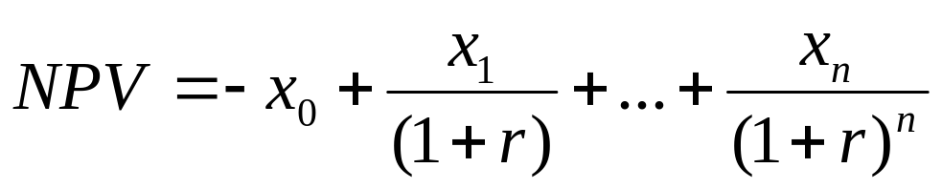
Present value of streams
Ex. Firc Corp. wants to invest in a machinery that costs 50,000$. The machine will generate a CF stream (25,000; 20,000; 15,000) in the next three years. r=7% Will it invest in the machinary?
NPV=-50,000+25,000/(1.07)+20,000/(1.07)²+15,000/(1.07)³=
=-50,000+23,365+17,468+12,244.5= 3,077.5$
The present value of its future cash flows is greater than its cost!

Slide 26
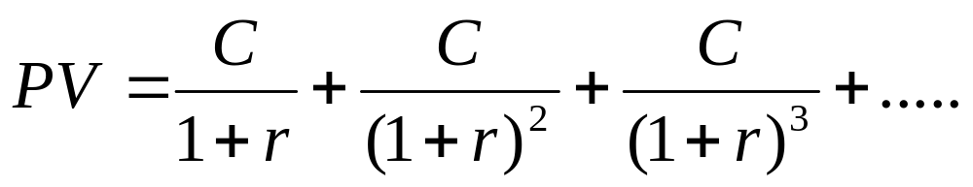
Perpetuity
It is a costant stream of CF without end.
Ex. Consol bond: has no maturity and pays a fixed coupon forever (UK). The principal is never paid back.
Consider a consol that pays a coupon of C dollars each year forever:

Slide 27
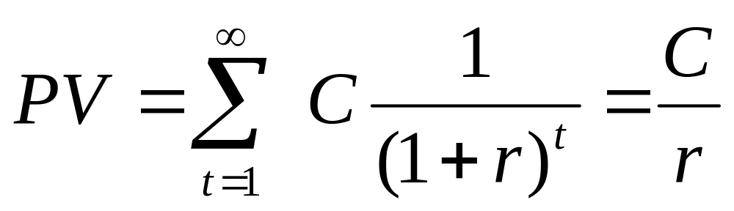
Perpetuity
Geometric series: infinite number of terms but the whole series has a finite sum because each term is only a fraction of the preceding term!

Slide 28
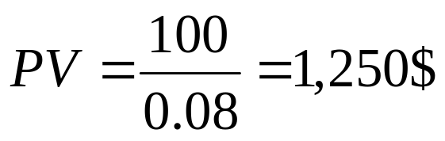
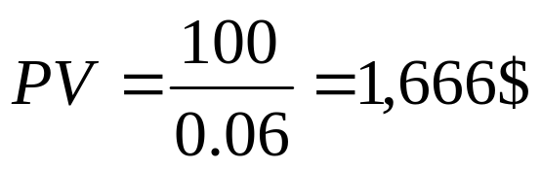
Perpetuity
Ex. A consol paying 100$ a year. Interest rate is 8%. PV of the consol?
The interest rate falls to 6%
The value of the perpetuity rises with a drop in the interest rate!

Slide 29
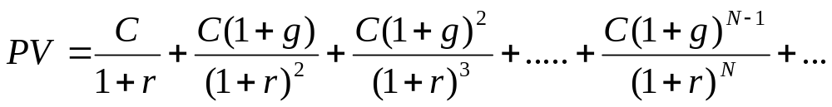
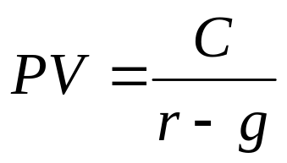
Growing Perpetuity
When cash flows of a perpetuity are expected to rise indefinitely: g is the growth rate (%)
Assumptions:
r>g
CF are received and disbursed at regular and discrete points in time
C is the cash flow to be received next period, not at date 0

Slide 30
Annuity
An annuity is a stream of regular payments that lasts for a fixed number of periods.
→an equal dollar amount each period
interest periods of equal length
an equal interest rate each period
Ex. Monthly payments on a home-automobile mortage

Slide 31
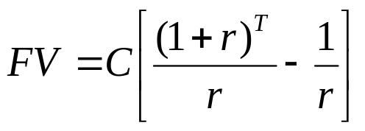
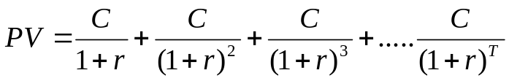
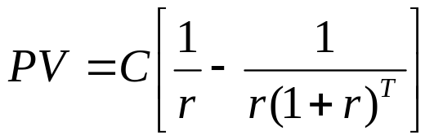
Annuity
FUTURE VALUE OF ANNUITY
PRESENT VALUE OF ANNUITY

Slide 32
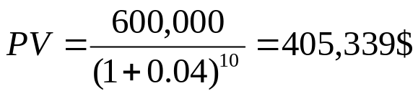
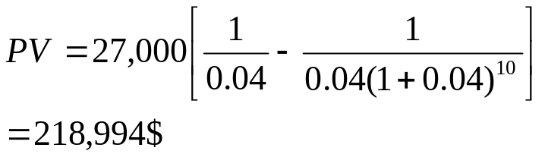
Annuity
Ex. Bonds with maturity value of 600,000$, due in 5 years. r=9% payable semi-annually. Bonds sold at 8% market rate.
PV Principal:
Interest payments: 600,000*9%*1/2=27,000$
PV Interest Payments:
Issue price=405,339+218,994=624,333$

Slide 33
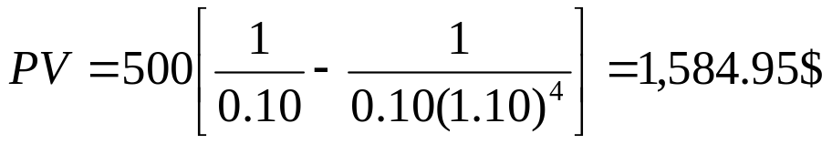
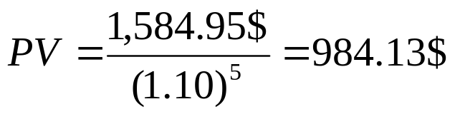
Annuity
Danielle will receive a four-year annuity of 500$ per year, beginning at date 6. r=10% PV of annuity?
PV at date 5
PV at date 0:

Slide 34
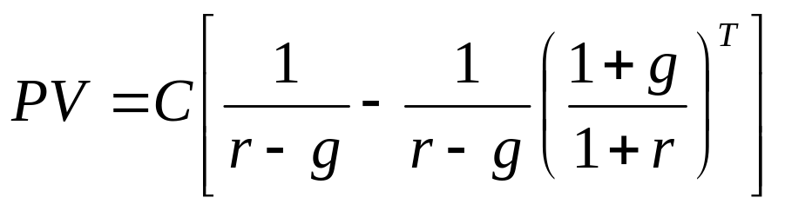
Growing Annuity
A finite number of growing CF

Slide 35
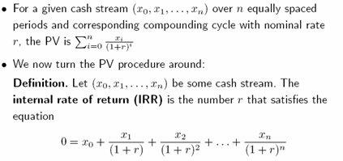
IRR
IRR is the value of of r that makes the PV equal to 0!!!

Slide 36
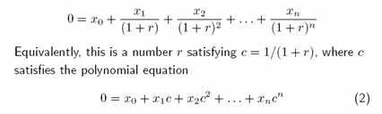
IRR
Eq (2) is a polynomial equation of degree n: it has at least one root and may have as many as n roots (the Fundamental Theorem of Algebra)
This may lead to an IRR problem:
-what if there are several roots? How do we pick a specific one? How do we treat complex roots?

Slide 37

IRR
If the sum of x_{i} is >0, IRR is positive!
Ex. A project (-100$;110$)
NPV=-100+110/1+r
1) We solve for r and set NPV=0
-100+110/1+r=0 r=IRR=10%
2) We solve by trial and error: what is the discount rate to make NPV=0?
Hp1=0.08 -100+110/1.08=1.85$ (POSITIVE NPV=ACCEPT!)
Hp2=0.12 -100+110/1.12=-1.79$ (NEGATIVE NPV=REJECT!)

Slide 38
IRR
When the first CF is negative and all remaining CF are positive:
ACCEPT→ NPV>0 IRR>r* (10%>8%)
REJECT→ NPV<0 IRR<r* (10%<12%)
In case of multiple flows, trial and error method is the most used.

Slide 39
IRR
PROJECT A: (-100$, 130$)
→ most common investment type project
1) Solve for r
0=-100+130/1+r r=0.30 IRR=30%
2) Solve by trial and error
Hp1: r=25% -100+130/1.25=1.04$
Hp2: r=35% -100+130/1.35=-3.70$
NPV positive if IRR>r* (30%>25%)
NPV negative if IRR<r* (30%<35%)

Slide 40
IRR
PROJECT B: (100$; -130$)
→ unusual (conference)
1) Solve for r
0=100-130/1+r r=0.30 IRR=30%
2) Solve by trial and error
Hp1: r=25% 100-130/1.25=-4$
Hp2: r=35% 100-130/1.35=3.70$
NPV positive if IRR<r* (30%<35%)
NPV negative if IRR>r* (30%>25%)

Slide 41

IRR
PROJECT C: (-100$; 230$; -132$)
→ changes in signs
1) Solve by trial and error
Hp1: r=20% -100+230/1.2-132/(1.2)2=0
Hp2: r=10% -100+230/1.1-132/(1.1)2=0
2 IRR, using IRR does not make sense!
NPV is 0 at both r=10% or 20% and negative outside the range
Accept the project if r is between 10% and 20%, reject if it is out of range!

Slide 42
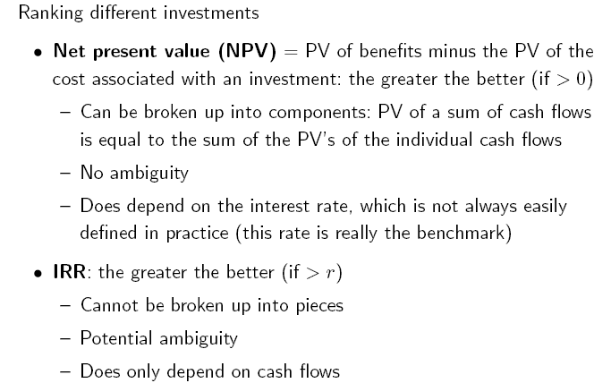
Evaluation criteria

Slide 43
Evaluation criteria
In general:
ACCEPT if NPV>0
ACCEPT if IRR> r*
Usually, most people decide on the basis of NPV!

Slide 44
Payback method
The payback method focuses on the payback period.
The payback period is the length of time that it takes for a project to recoup its initial cost out of the cash receipts that it generates.
The more quickly the cost of an investment can be recovered, the more desirable is the investment.
Used by companies for small decisions
Used by SMEs with good growth opportunities but no limited access to capital markets (quick cash recovery to reinvest money in new investments)

Slide 45
Payback method
Project with initial investment of 50,000$. CF of the first 3 years (30,000; 20,000; 10,000)
Within 2 years the firm has recovered its initial investment
Payback period of the investment is 2 years
If 2 years is a cut off date, all projects that have payback periods of 2 years or less are accepted.

Slide 46
Payback method
Problems:
It does not consider the timing of CF within the payback period
Project A CF increases from 20 to 50, while B/C drop from 50 to 20 but Payback period is always 3 years
NPV discounts the CF properly
year | A | B | C
0 | -100 | -100 | -100
1 | 20 | 50 | 50
2 | 30 | 30 | 30
3 | 50 | 20 | 20
4 | 60 | 60 | 120

Slide 47
Payback method
Problems:
It ignores all CF occuring after the payback period
Project C would be preferred
Some valuable long-term projects are likely to be rejected
NPV uses all the CF of a project
Choosing the payback cut-off date is arbitrary
year | A | B | C
0 | -100 | -100 | -100
1 | 20 | 50 | 50
2 | 30 | 30 | 30
3 | 50 | 20 | 20
4 | 60 | 60 | 120

