Slide 1
Project Title: Failed Banking Transaction Analysis
Presented by Sai deekshitha

Slide 2
ABSTRACT
This project focuses on building a scalable data processing pipeline for analyzing failed banking transactions from multiple branches across different cities. Daily transaction data from 15 bank branches (3 cities × 5 branches) is collected in CSV format, with each file containing 7 days of transaction records. These files are ingested into a Google Cloud Storage bucket using gsutil
A PySpark job running on a single-node Dataproc cluster processes and cleans the raw data by removing null and blank rows, and consolidates all branch files into a single clean CSV file. A subsequent PySpark job filters this consolidated dataset to isolate failed transactions.The filtered records are then written into a Cloud SQL (MySQL) table for structured storage.
Finally, this curated data is used for deeper analysis and visualization in BigQuery, enabling insights into failure patterns, branch performance, and potential operational issues, thereby helping stakeholders make informed decisions.

Slide 3
TOOLS AND TECHNOLOGIES
Google Cloud Platform (GCP) Services:
Google Cloud Storage (GCS):
For storing uploaded CSV files from different bank branches.
Dataproc (Single-node Cluster):
For running PySpark jobs (data cleaning and failed transaction filtering).
Cloud SQL (MySQL):
For storing filtered failed transaction data in a structured table.
BigQuery:
For data analysis, querying, and building visualizations.
Programming & Scripting:
PySpark:
Data processing, cleaning, and filtering.
SQL (MySQL):
Creating and managing Cloud SQL tables, querying filtered data.
gsutil:
Command-line tool for uploading CSV files to GCS.

Slide 4
PROJECT IMPLEMENTATION
Step 1:create a bucket
gsutil mb gs://banking_transaction/
Step 2: Upload Data to Cloud Storage
All CSV files from 15 bank branches (3 cities × 5 branches) are uploaded using gsutil:
Bash
gsutil cp D:/p1-project/*.csv gs://banking_transaction/injection/
Step-3:Uploading script python file to bucket for cleaning
gsutil D:/p1-project/clean_merge_data.py gs://banking_transaction/scripts/clean_merge_data.py
A Dataproc Cluster is a managed service in Google Cloud Platform (GCP) that allows you to easily run Apache Hadoop, Apache Spark, and other big data tools in a cloud environment
Step-4:creating a data proc cluster
gcloud dataproc clusters create training-cluster --region=us-central1 --zone=us-central1-a --single-node
--master-machine-type=n1-standard-2 --image-version=2.0-debian10

Slide 5
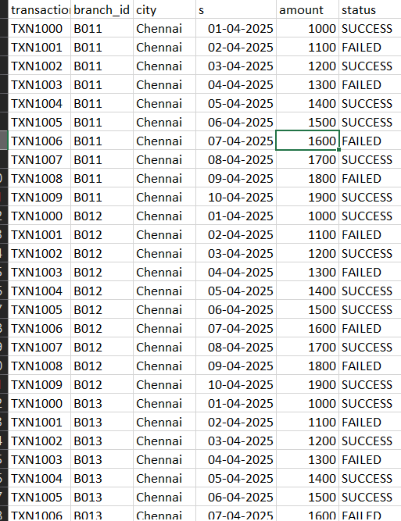
Step-5:submitting the job to retrieve cleaned data into bucket folder
gcloud dataproc jobs submit pyspark gs://banking_transaction/scripts/clean_merge_data.py --cluster=training-cluster --region=us-central1
After submitting the job the cleaned folder is created with merged csv files and cleaned data

Slide 6
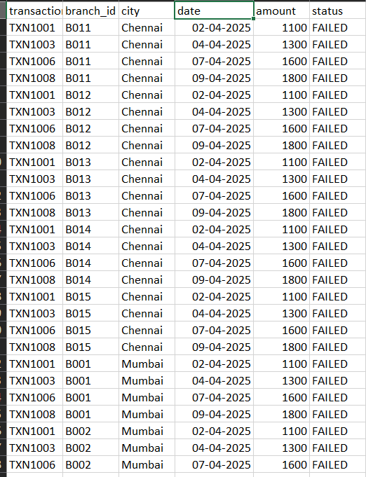
Step-6:Uploading script python file to bucket for filtering failed transactions
gsutil D:/p1-project/filter_failed_txns.py gs://banking_transaction/scripts/filter_failed_txns.py
Step-7:submitting the job to retrieve FILTER data into bucket folder
gcloud dataproc jobs submit pyspark gs://banking_transaction/scripts/filter_failed_txns.py --cluster=training-cluster --region=us-central1
After submitting the job the final folder is created with filtered failed transactions into the bucket

Slide 7
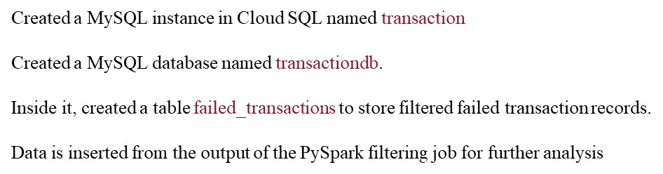
Cloud SQL is a managed database service by Google Cloud that supports MySQL, PostgreSQL, and SQL Server.
Step-8:Created a MySQL instance in Cloud SQL named transaction. Created a MySQL database named transactiondb.Inside it, created a table failed_transactions to store filtered failed transaction records.Data is inserted from the output of the PySpark filtering job for further analysis

Slide 8
Step-9-Create a BigQuery External Connection
Go to BigQuery in the GCP Console.
In the Explorer panel, click your project → Click “Add Data” → “External data source”.
Select:
  Connection Type: Cloud SQL
  Cloud SQL instance: Choose your MySQL instance (e.g., banking)
  Database: projectdb
  Connection ID: test
  Authentication: Use service account or your credentials
This creates a BigQuery connection to your Cloud SQL instance.
Query the External Table
You can now query the Cloud SQL data directly in BigQuery:
SELECT * FROM EXTERNAL_QUERY("dataprop-457706.us-central1.test",
"SELECT * FROM failed_transactions");

Slide 9
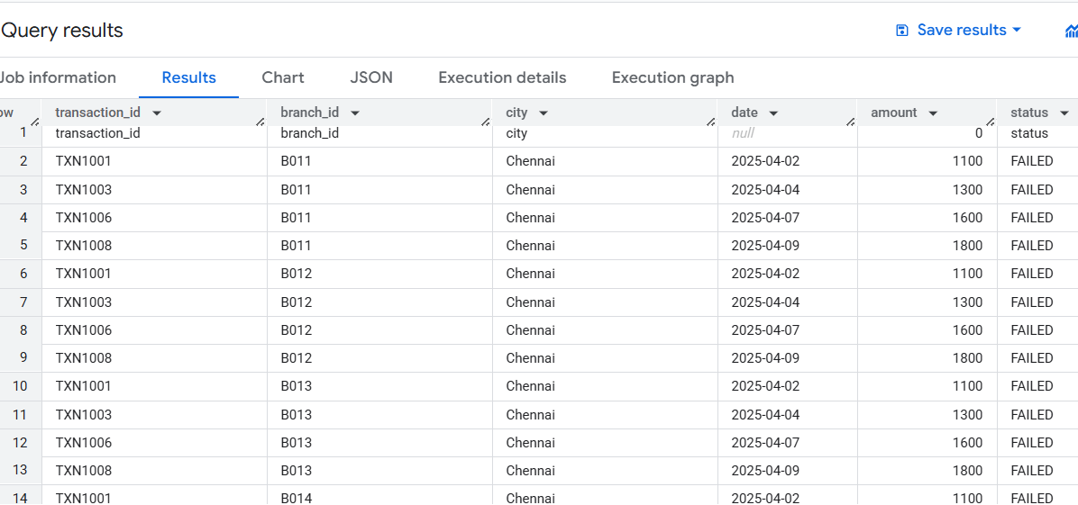

Slide 10
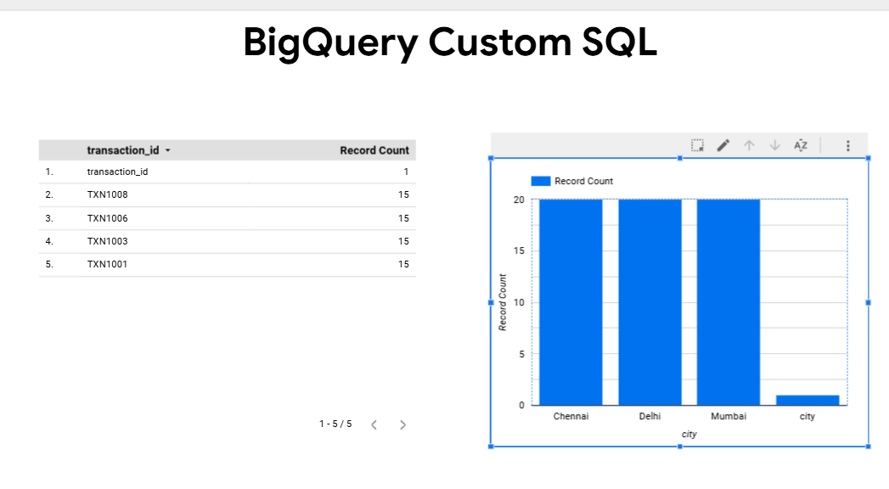
Query on Total Failed Transactions by City
SELECT * FROM EXTERNAL_QUERY(
"dataprop-457706.us-central1.test","SELECT city, COUNT(*) AS failed_count FROM
failed_transactions WHERE status = 'FAILED' GROUP BY city ORDER BY failed_count
DESC"

Slide 11
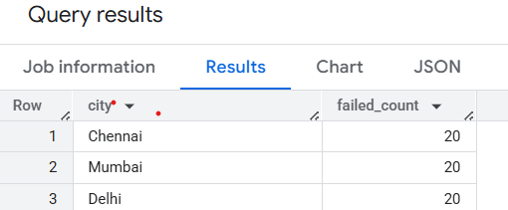
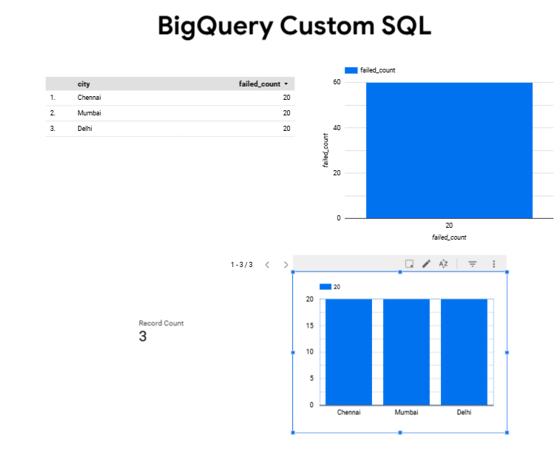
Query on daily failure trend
SELECT * FROM EXTERNAL_QUERY(
“
dataprop-457706.us-central1.test","SELECT date, COUNT(*) AS
daily_failures FROM failed_transactions WHERE status ='FAILED' GROUP BY
date ORDER BY date"
);

Slide 12
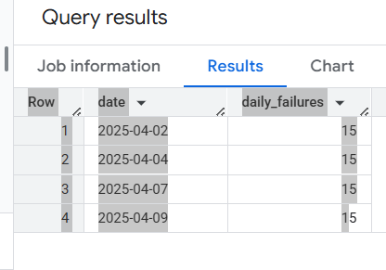
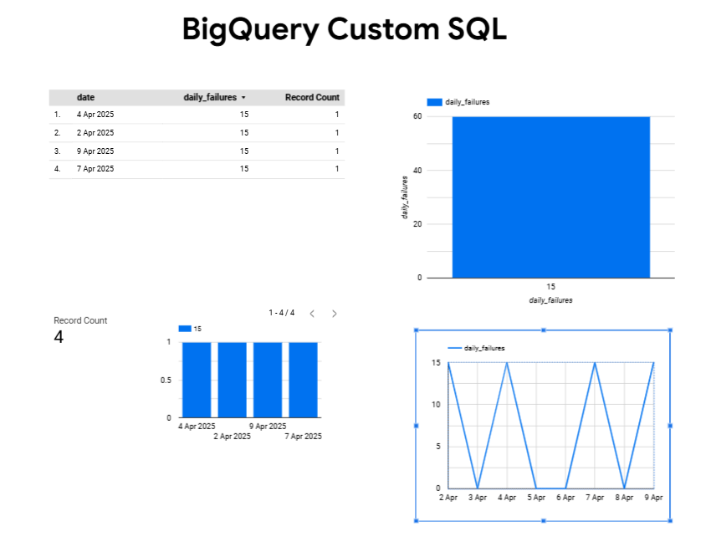
Query on Average Failed Amount per City
SELECT * FROM EXTERNAL_QUERY(
“
dataprop-457706.us-central1.test","SELECT city, AVG(amount) AS
avg_failed_amount FROM failed_transactions WHERE status = 'FAILED’
GROUP BY city ORDER BY avg_failed_amount DESC"
);

Slide 13
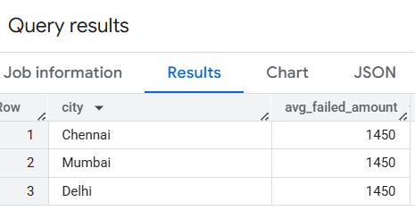
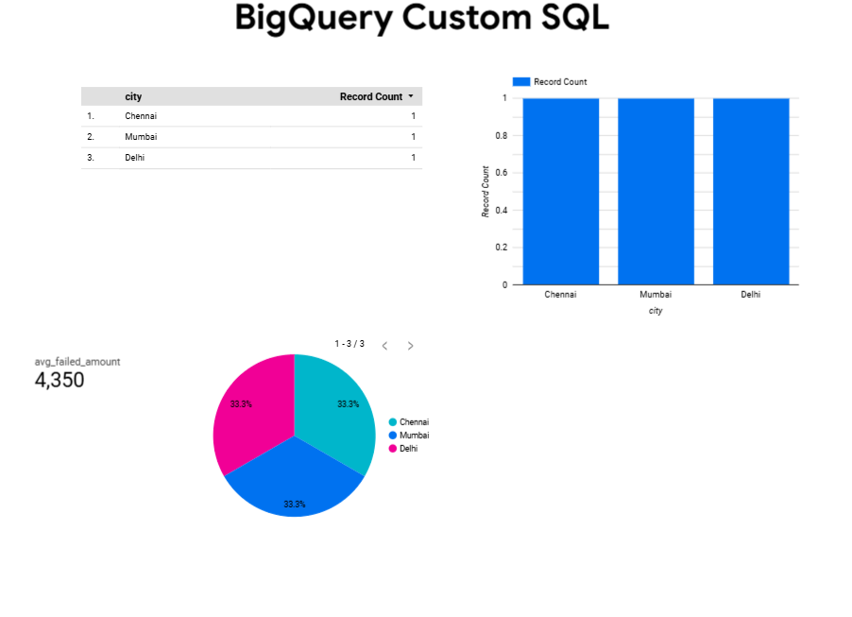

Slide 14
Would you like to add a problem statement or use cases section next?
OBJECTIVES OF THE PROJECT
Automate Data Ingestion
  Collect daily transaction CSV files from multiple bank branches and store them in a centralized cloud storage (GCS).
Clean and Consolidate Data
  Use PySpark on a Dataproc cluster to remove null/blank records and merge all branch data into a single dataset.
Identify Failed Transactions
  Filter out failed transactions based on status codes or failure indicators using PySpark.
Store for Analysis
  Save the filtered failed transaction data into a Cloud SQL (MySQL) database for persistent storage.
Enable Scalable Analysis
  Create an external connection from BigQuery to Cloud SQL for efficient querying and data analysis.
Lay the Foundation for Reporting
  Prepare clean, structured data to support future visualization and dashboarding.

Slide 15


