Slide 1



Product Market Fit Research for Air Purifier Development
AirPure
Innovations
WELCOME TO THE ANALYSIS PRESENTATION ON
Domain - Consumer Appliances
Function – Market Research Analytics
ANALYSIS BY SAIDEEP

Slide 2
PROBLEM STATEMENT
AirPure Innovations is a startup tackling India’s air pollution crisis. With uncertainty around product features, target markets, and consumer demand, the company needs data-driven insights before investing in R&D. Key questions include: which pollutants to target, where demand is highest, and how health impacts vary across cities. This project aims to guide strategic decisions by analyzing severity, health burden, and demand patterns.

Slide 3
DATA SOURCES & METHODOLOGY
📊 Data Sources
Primary Datasets : Air Quality Index (AQI) data (2022–2025),
Secondary Datasets : Health impact data, Vehicle registration data, Population data – Dataful
Additional Data Sourced from Google Trends data, Expert Market Research
⚙️ Methodology and Tools
Cleaned and integrated datasets in Power BI.
Designed interactive dashboards to visualize – Severity Mapping, Market demand, Health impact, Competitor Analysis.
Created calculated fields and key KPI’s.
Tools used Excel and Power BI

Slide 4
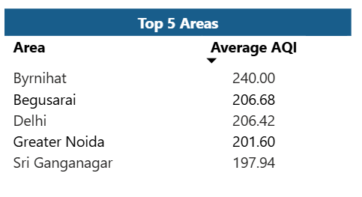
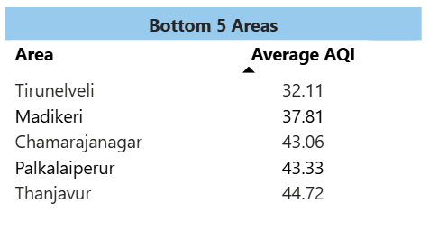
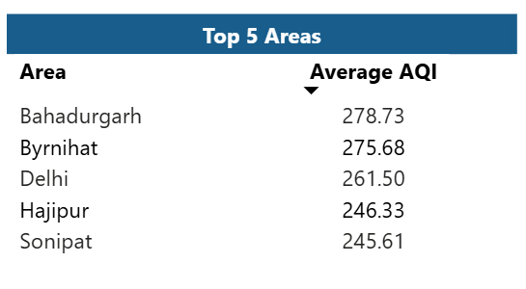
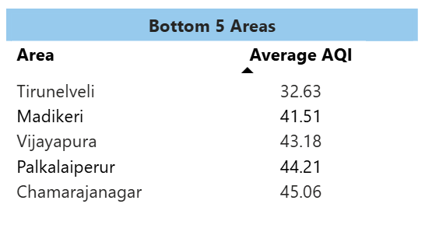
Areas with Highest average AQI
Last 6 months - November 2024 to April 2025

Slide 5
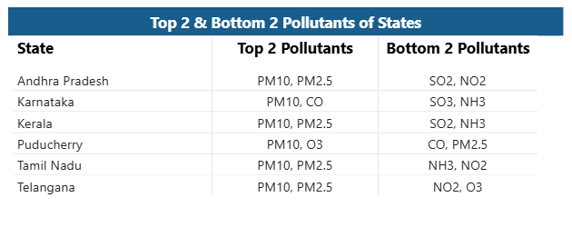
Prominent pollutants for each state of southern India
Most states are struggling with elevated PM10 levels, primarily due to rapid urbanization, increased construction activities, and rising road traffic — all of which contribute significantly to dust and other coarse particulate matter in the air.

Slide 6
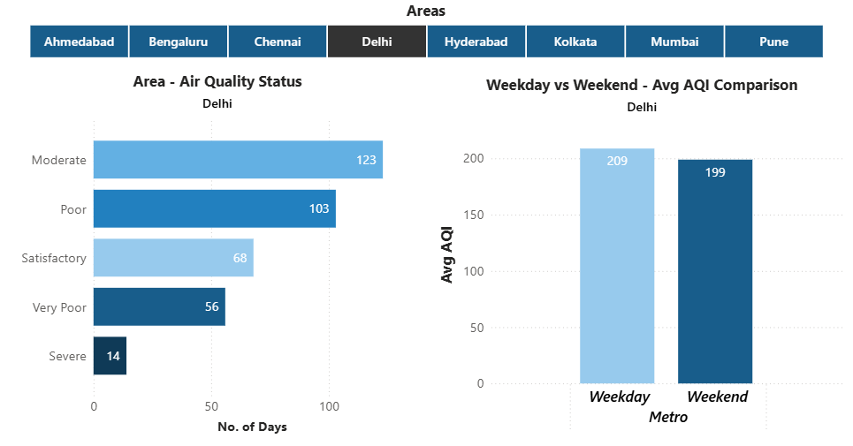
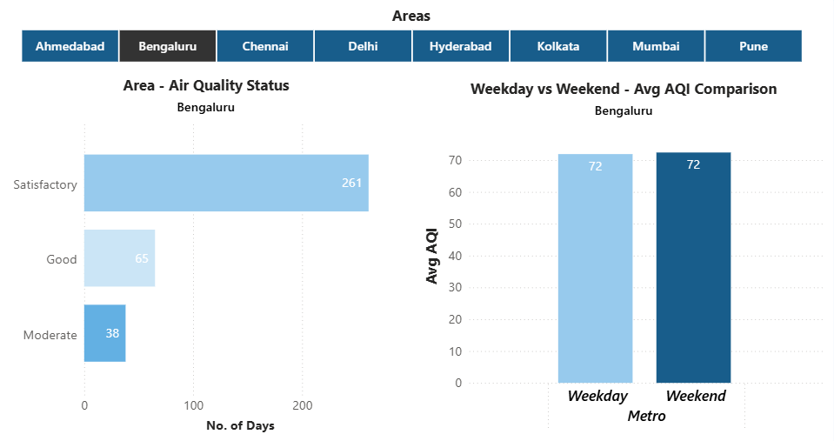
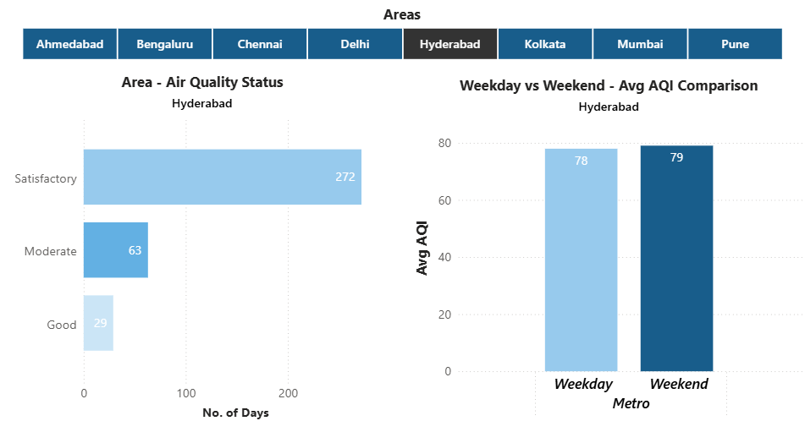
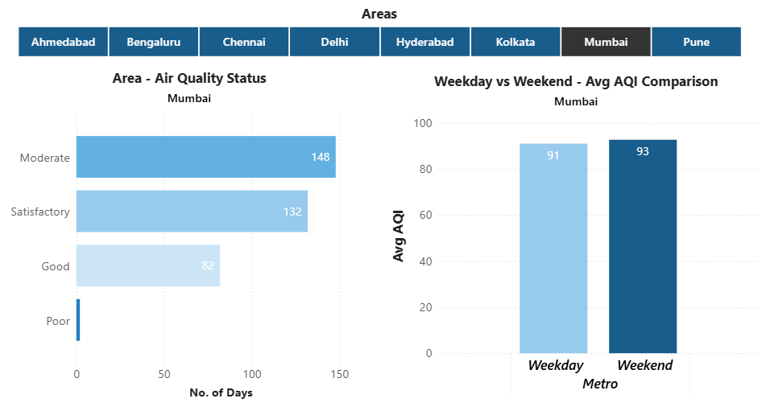
AQI on Weekdays vs Weekends in Indian metro cities
In metro cities, air quality doesn’t improve much on weekends, possibly because pollutants take longer to fade from the environment

Slide 7
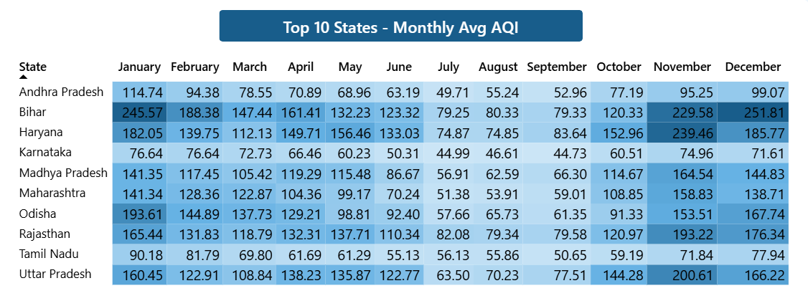
Months consistently showing the Worst air quality across Indian states —
(Top 10 states with high distinct areas)
During the winter months, most states in India experience significantly poor AQI levels, primarily due to climatic conditions such as temperature inversion, low wind speeds, and increased pollutant accumulation in the atmosphere

Slide 8
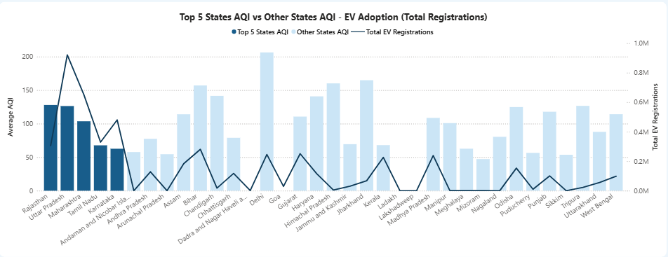
Top 5 states vs Other states EV adoption and their average AQI
Except for the top 5 states, EV adoption across India remains low — even in regions with poor air quality — revealing a significant gap between pollution levels and clean mobility uptake.

Slide 9
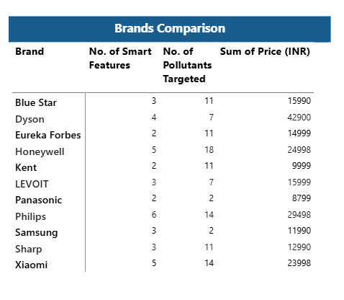
Major Competitors and their Key Differentiators - Indian air purifier market
Almost every brand offers a comparable set of smart features and targets a similar range of pollutants - with variations primarily based on product pricing and segment.

Slide 10
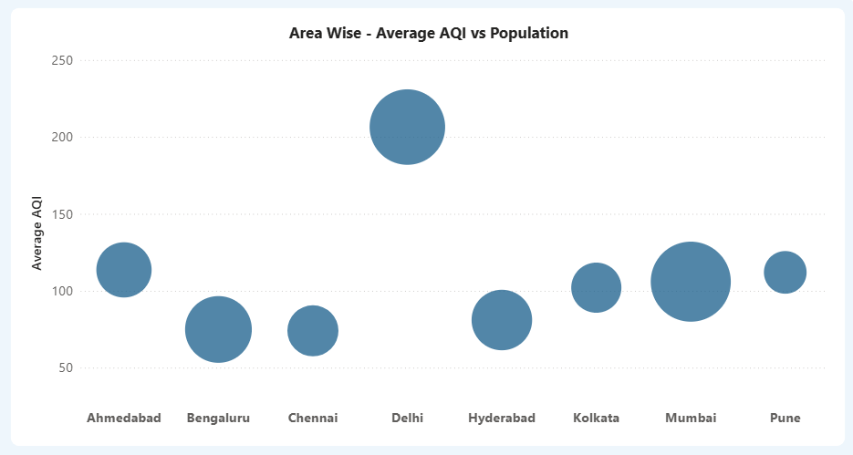
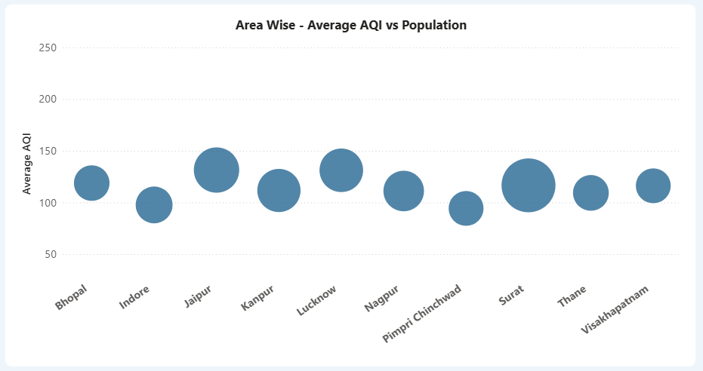
Relationship between City’s population size and its Average AQI
Non Metro Cities
Metro Cities

Slide 11
Key Pollution Control Policies (India, Past 5 Years)
National Clean Air Programme (NCAP, 2019)
CAQM & GRAP (Delhi-NCR, 2021)
Stubble Burning Control Measures
BS-VI Vehicle Emission Norms (2020)
Surat Emission Trading Pilot (2019)

Slide 12
RECOMMENDATIONS
Target the Most Critical Pollutants in India - The air purifier must effectively filter the most common and harmful pollutants in Indian cities — particularly PM2.5 and PM10 — which are directly linked to severe health issues and dominate AQI readings across India.
Adopt Standard Filters: Pre-Filter + HEPA - These two filters are essential for removing fine and coarse particulate matter. All leading brands use these as the foundation of their product, making them a non-negotiable component for product success.
Use the Third Stage Filter Strategically Based on Region - While most brands include a third-stage filter, AirPure can differentiate by making this region-specific:
Activated Carbon Filter: Ideal for urban and industrial areas with high VOCs, NO₂, and SO₂.
UV-C Filter: Suitable for indoor spaces prone to bacteria and viruses.
This allows flexibility and localization in product variants.

Slide 13
RECOMMENDATIONS
Balance Between Affordability and Quality - In the Indian market, pricing heavily influences consumer choice. Product features matter, but only when they come at a reasonable price. A balance of quality and cost will be the key to product adoption.
Target Price Range and Tiered Product Variants - The average market price for air purifiers in India is around ₹15,000 (based on 14 models from 11 brands). Introduce Basic, Premium, and Smart models based on - Number of filtration stages, Type of pollutants targeted, Availability of smart features (like AQI display, auto mode, app support). This helps cater to different income groups and user needs.
Focus Initial Launch on High-Demand Regions, Start with Delhi-NCR and surrounding areas, where demand is highest due to consistently hazardous AQI levels. Keep a close watch on fast-growing urban cities that are showing rising air quality concerns and growing health awareness.

Slide 14
CONCLUSIONS – Key Takeaways from the Project
In conclusion, the overall AQI status in India falls under the ‘Moderate’ category, but this masks a much more serious problem. Many cities — especially metros — experience ‘Poor’ to ‘Severe’ air quality during the winter months, driven by rapid urbanization, industrial emissions, stubble burning, and low EV adoption.
These seasonal spikes in pollution also correlate with a sharp surge in air purifier demand, particularly during festive seasons. This presents a clear opportunity to align product offerings with regional and seasonal needs.

Slide 15
THANK YOU

