Slide 1
PROJECT – 01
TITTLE : IPL DATA ANALYSIS USING HDFS AND HIVE.

Slide 2
Client name : Vivo Indian premier league.
Problem statement : we are having the record of the whole Indian premier league . we need some insights from that. The insights are given below . Also, we want these insights data to be copied into our database. Our database is MySql. We will let u know our credentials of our database if you are done with those insights.
INSIGHTS NEEDED :
Total number of records in the dataset.
Teams , count(number of times they won the toss).
Teams , count(number of times they won the matches).
Count(number of times umpire1 ‘Ananthapadmaabhan’ is favour for teams).
Number of matches held in each season.
Top 5 man of the match awardees in the season 2019.
Count of man of match awards of each individual in all seasons.
Maximum number of mom’s for every season.
Files with data matches held on each venue.
Into our database we need a file containing the records of man of the match , number of times they got mom’s.

Slide 3
DESCRIPTION :
In this , project I took IPL dataset from Kaggle .
Using the GUI of Ambari I have uploaded the file into HDFS.
Then I wrote the file into a table which was created in hive.
After importing file into the table in hive I performed some queries through which I want to do the analysis.
I took the output of the queries and exported them into HDFS.
From HDFS I exported the output files into database system using Sqoop.

Slide 4
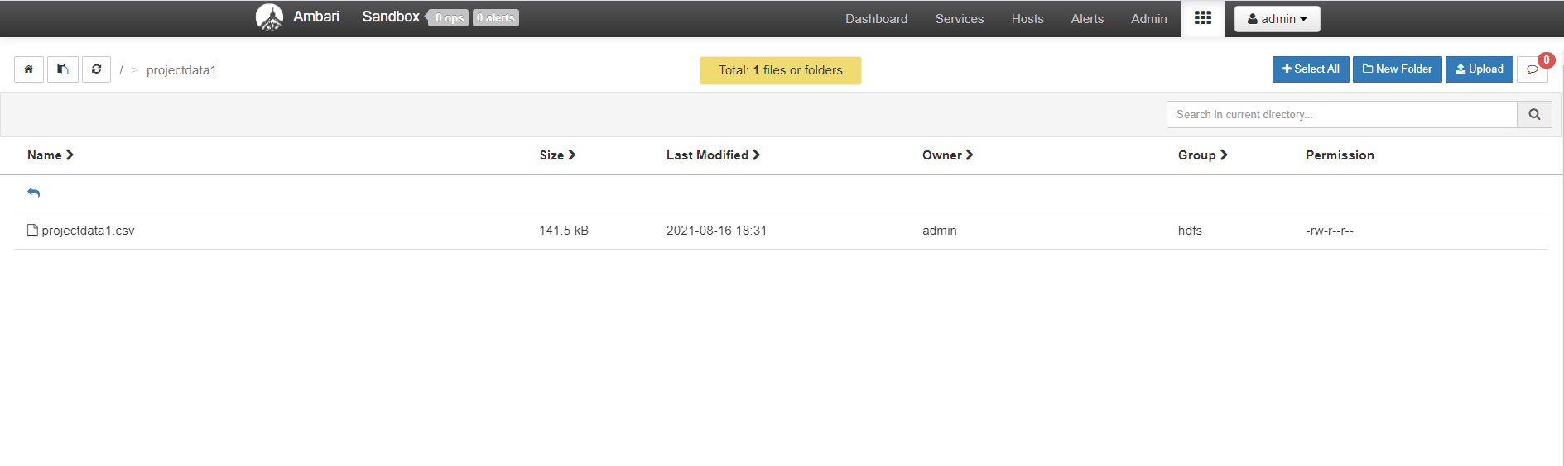
Using Ambari GUI to upload the file into Hdfs.

Slide 5
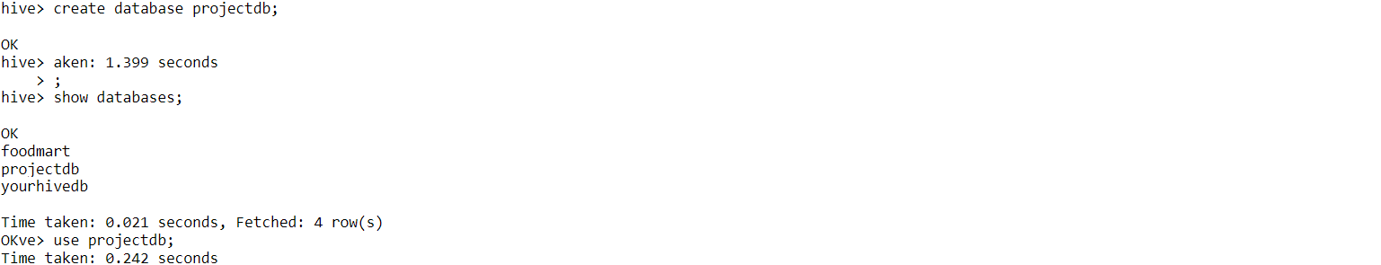
Creating database in hive. Command : create database projectdb;

Slide 6
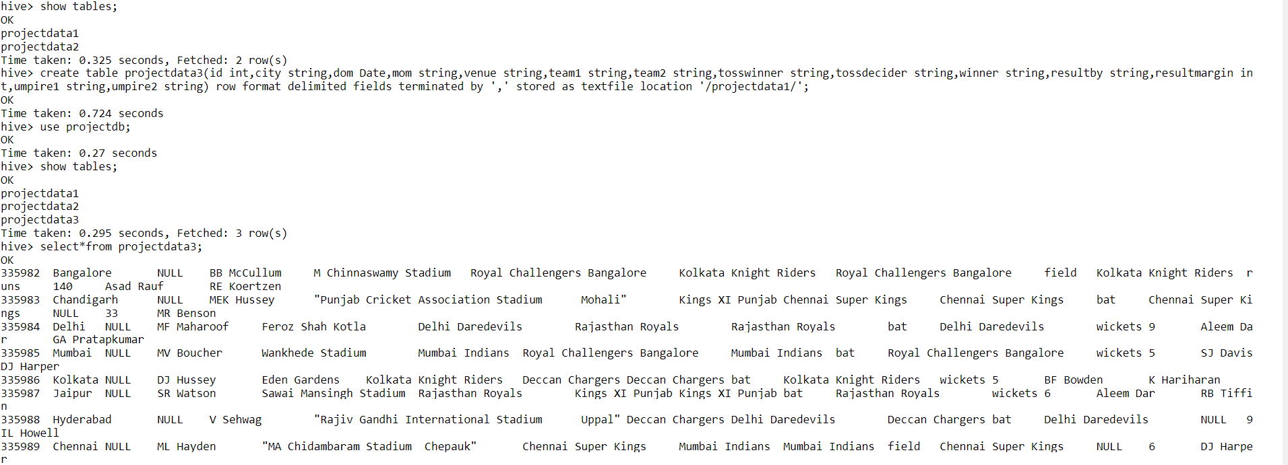
Creating table project data in database ‘projectdb’ in hive. Command : create table projectdata3 (id int,city string,dom date,mom string,team1 string,team2 string,tosswinner string,tossdecider string,winner string,resultby string,resultmargin int,umpire1 string,umpire2 string) row format delimited fields terminated by ‘.’ stored as textfile location ‘/path/’; To verify : select * from projectdata3

Slide 7
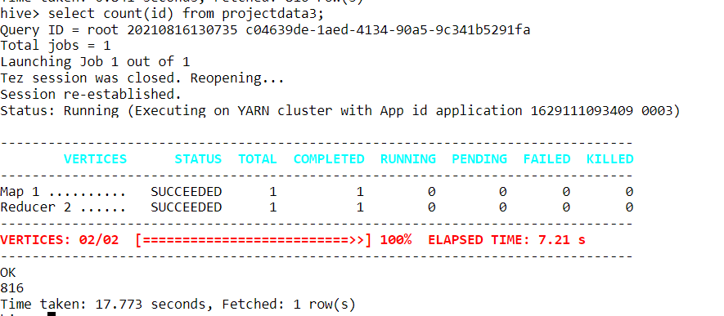
To get the total number of record in the dataset. Syntax : select count(column_name) from tablename;

Slide 8
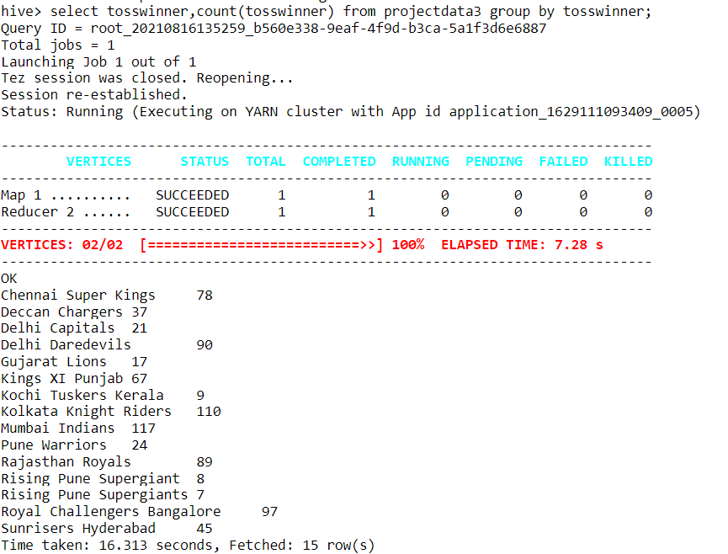
To get the teams on basis of how many times they won the toss. Syntax : select tosswinner,count(tosswinner) from projectdata3 group by tosswinner;

Slide 9
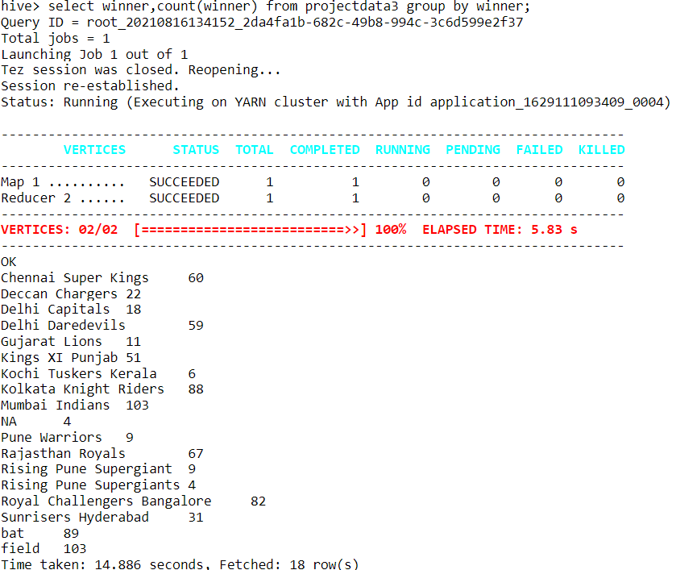
To get the teams on basis of how many times they won the matches. Syntax: select winner,count(winner) from projectdata3 group by winner; To get the that in order; select winner,count(winner) as cw from projectdata3 group by winner order by cw DESC;

Slide 10
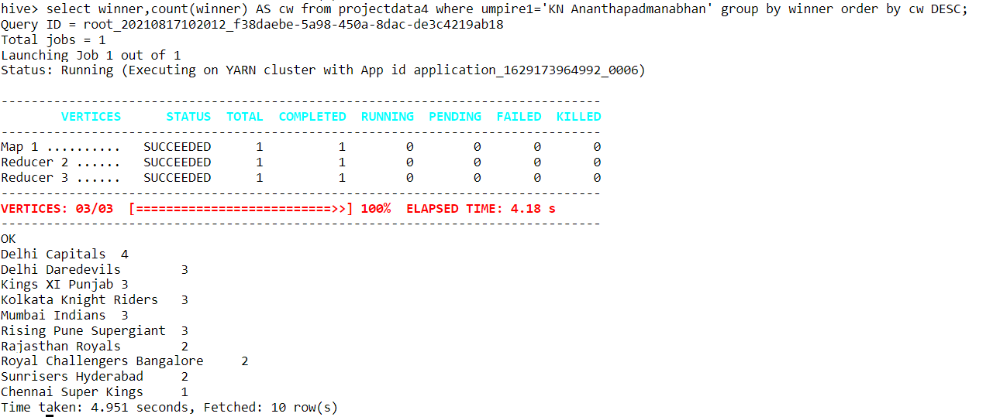
To know the number of times umpire1 ‘KN Ananthapadmaabhan’ is favour for teams. Syntax : select winner,count(winner) AS cw from projectdata4 where umpire=‘KN Ananthapadmanabhan’ group by winner order by cw DESC;

Slide 11
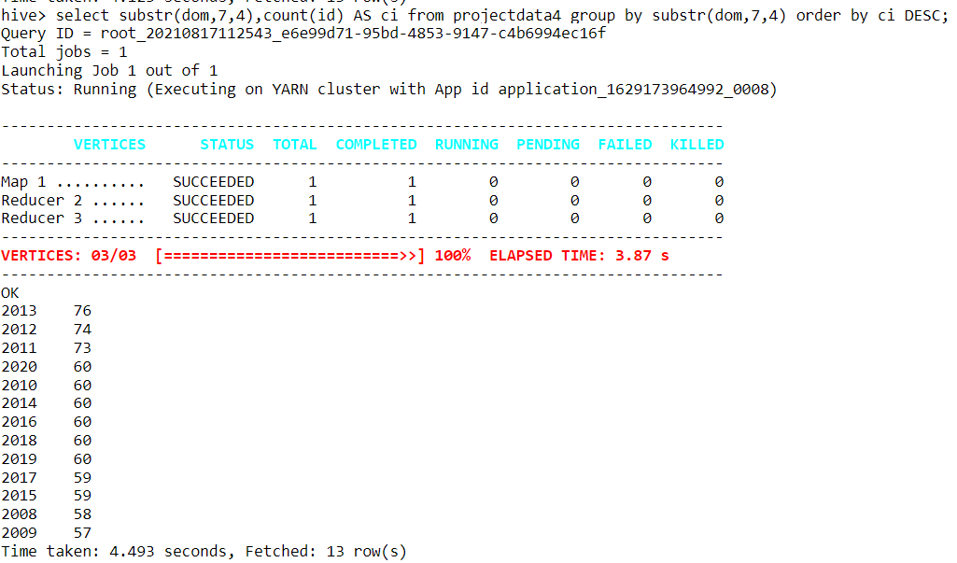
To know the the number of matches held in each season in ipl. Syntax : select substr(dom,7,4),count(id) AS ci from projectdata4 group by substr(dom,7,4) order by ci DESC;

Slide 12
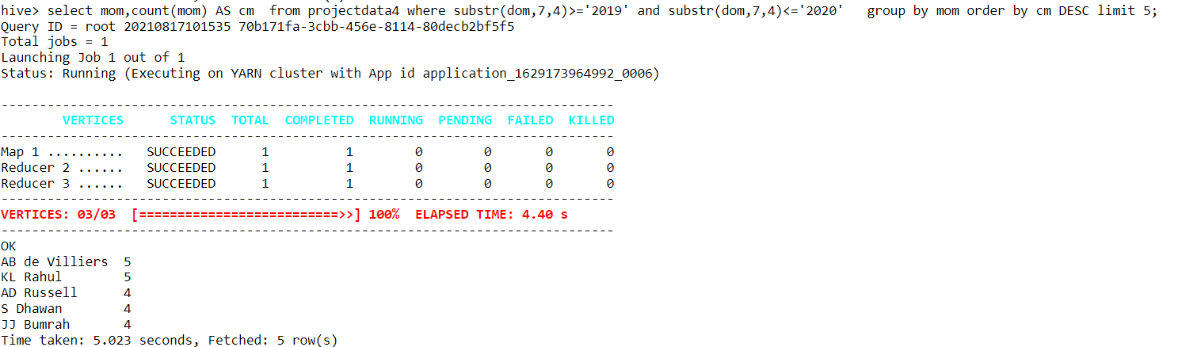
To know the top 5 man of the match awardees in the season 2019. syntax : select mom,count(mom) AS cm from projectdata4 where substr(dom,7,4)>=‘2019’ and substr(dom,7,4)<=‘2019’ group by mom order by cm DESC limit 5;

Slide 13
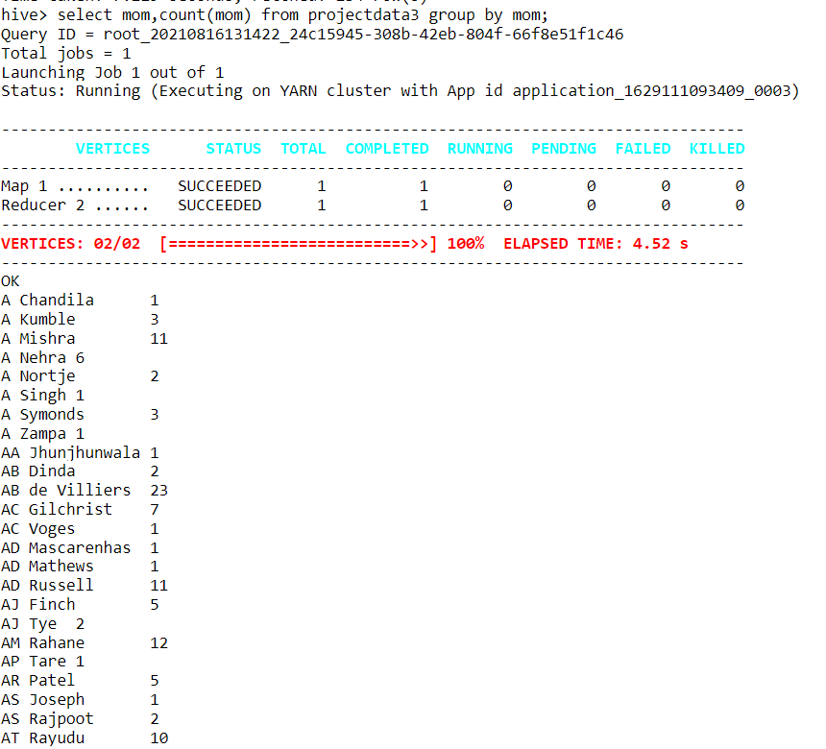
To get the count of man of match awards of each individual in all seasons. Syntax : select mom,count(mom) from projectdata3 group by mom;

Slide 14
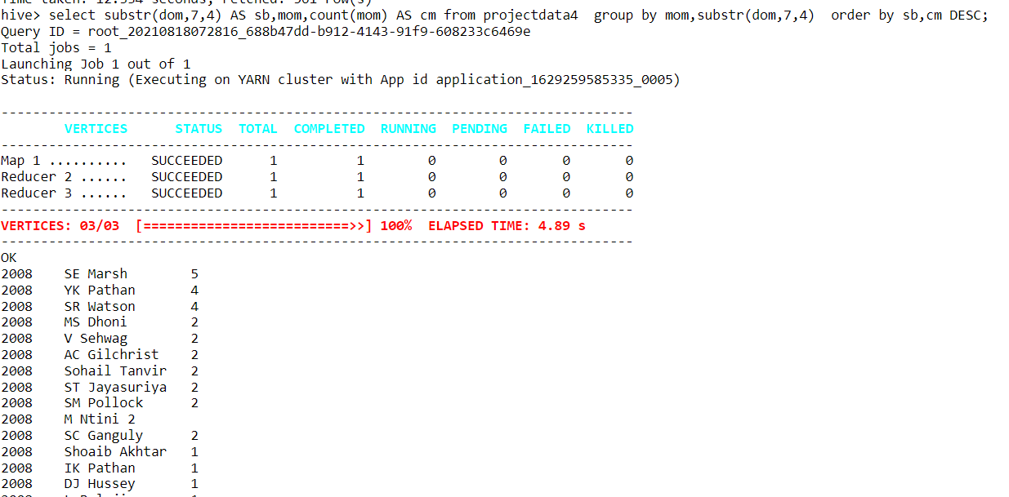
To get the maximum number of mom’s for every season. Here using python as unable to get the only the maximum’s of every season.

Slide 15
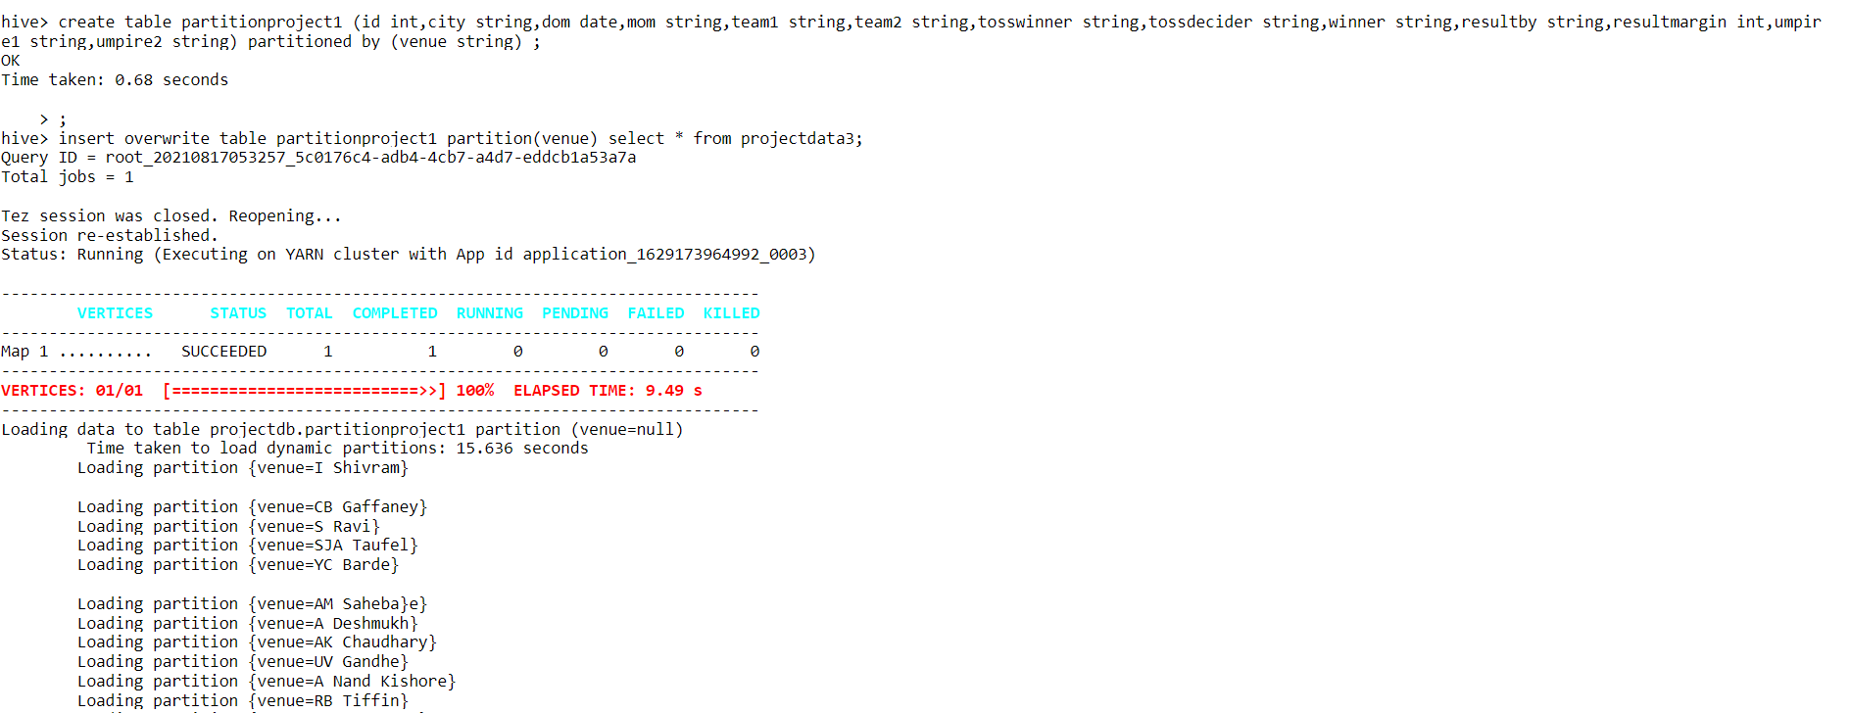
Partitioning table on the basis of venue. Loading the data into partitioned table using insert overwrite.

Slide 16
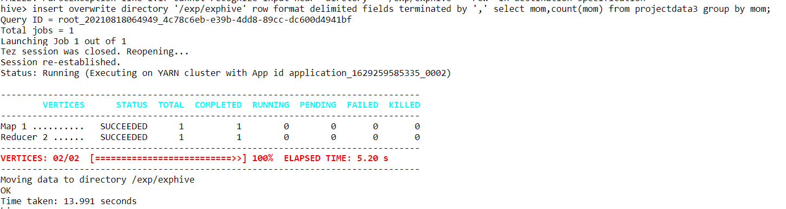
Copying the output of the query into hdfs. Syntax : insert overwrite directory ‘/exp/exphive’ row format delimited fields terminated by ‘,’ select mom,count(mom) from projectdata3 group by mom;

Slide 17
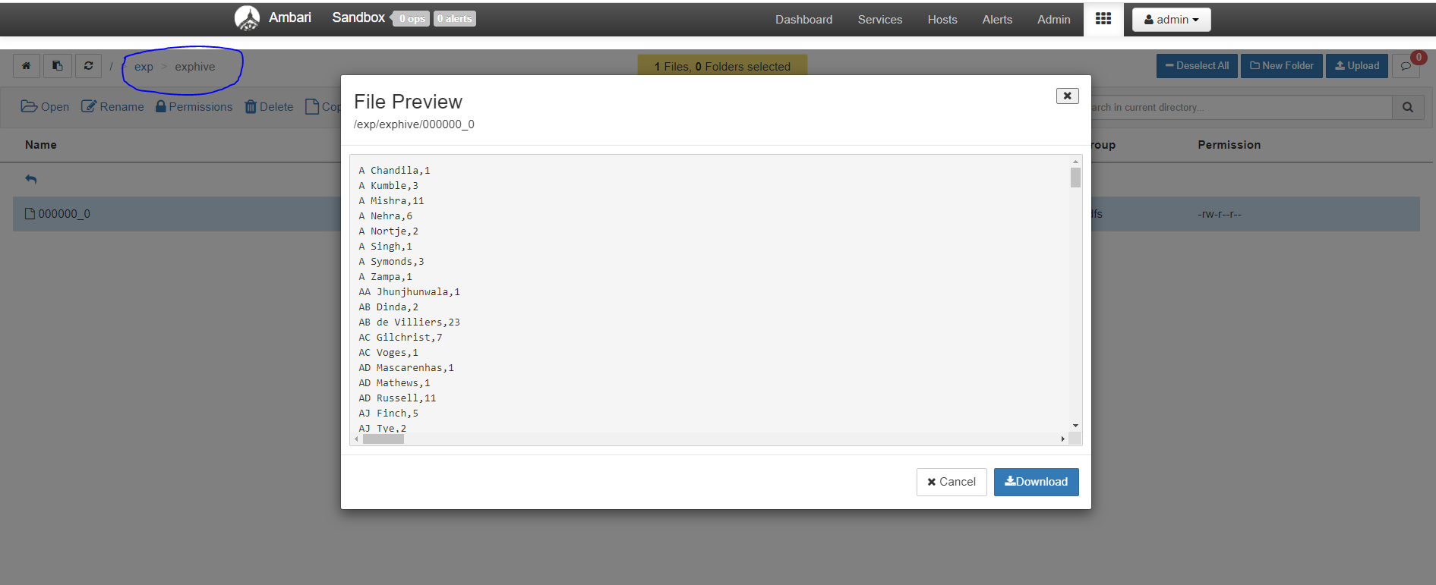

Slide 18
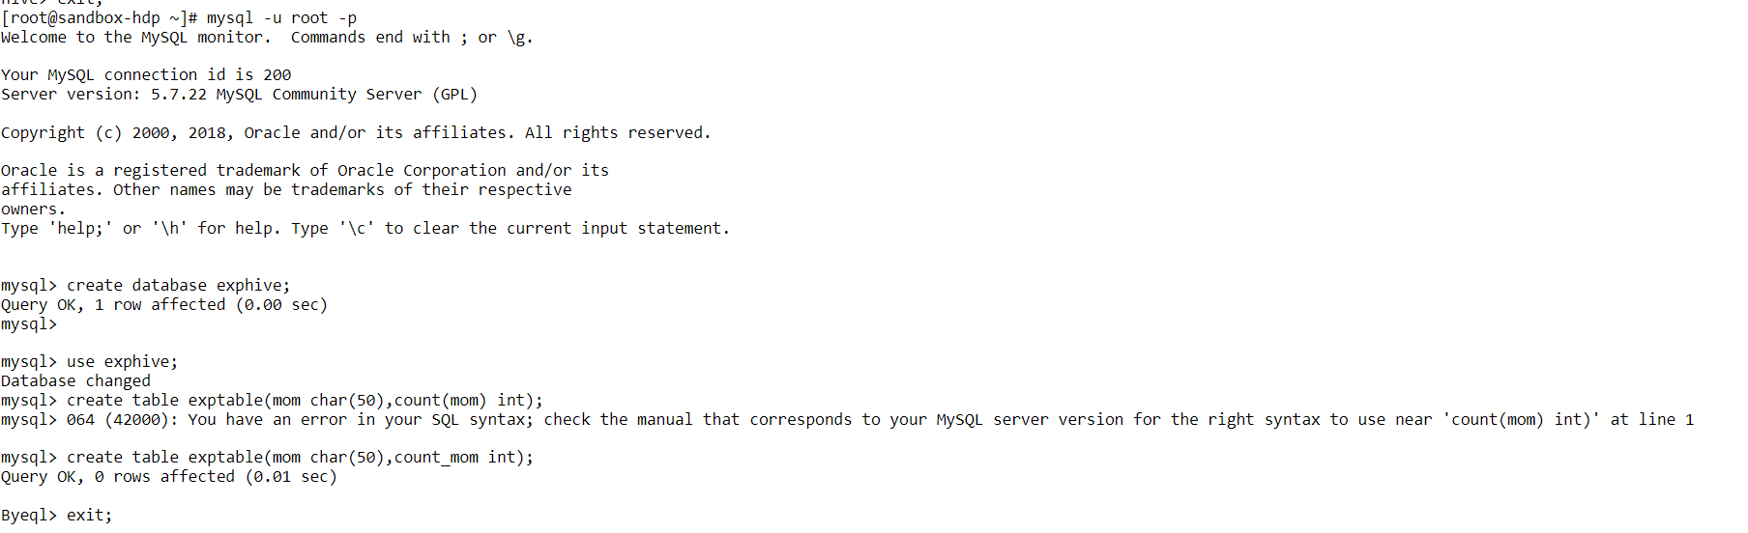
Creation of database and table in mysql for exporting file from hdfs.

Slide 19
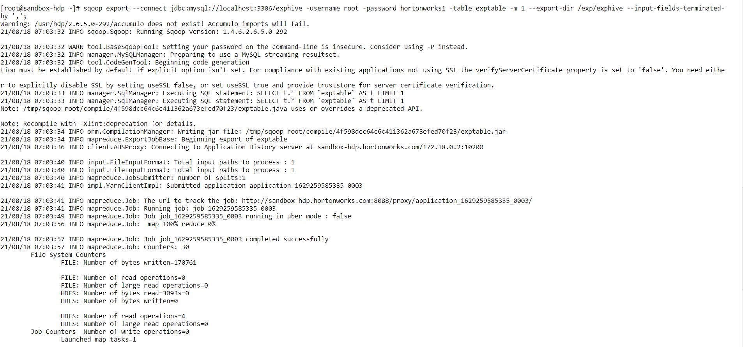
Exporting file from hdfs into mysql using sqoop.

Slide 20
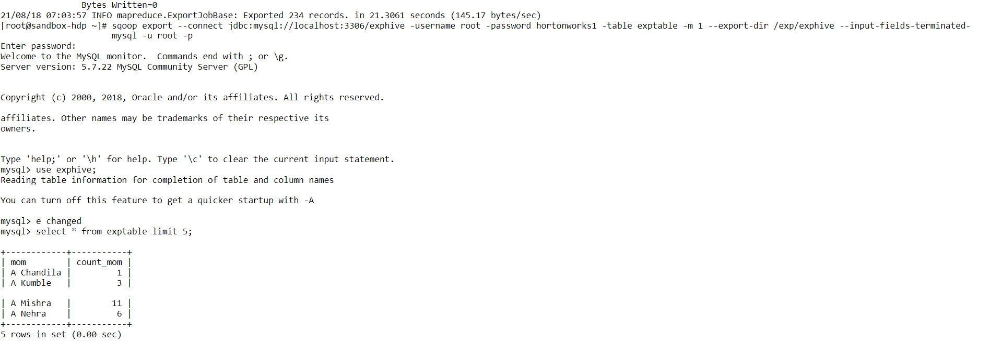
Proof for the data exported into mysql.

Slide 21
GITHUB :
https://github.com/Saidinesh132/project-01
Tiny URL :
https://tinyurl.com/4atfvvj6

