Slide 1
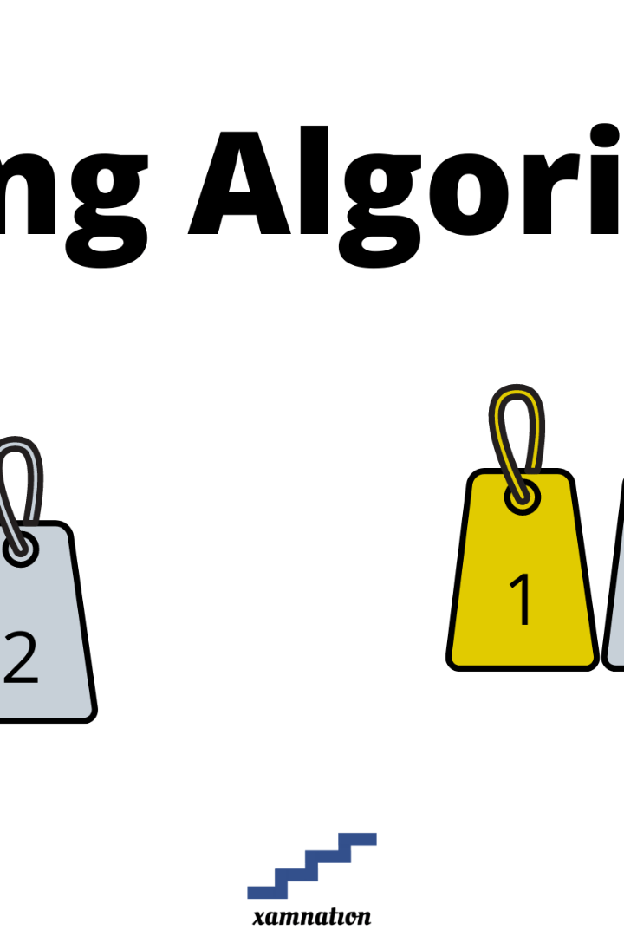

Implementation Of Quick Sort Using 8085 Assembly Language
Saidinesh (RA2211029010016)
Naga kiran (2211028010230)
Rahul (2211029010024)

Slide 2
Overview of 8085 Assembly Language
8085 assembly language is a low-level programming language that is used to program the 8085 microprocessor. It is a machine-dependent language, which means that the instructions are specific to the 8085 microprocessor and cannot be used with other microprocessors.
Assembly language programs are written using mnemonics, which are abbreviations for the machine code instructions. For example, the mnemonic for the MOV instruction, which moves data from one location to another, is MOV.
Assembly language programs are typically written in a text editor and then assembled into machine code using an assembler. The assembler is a program that converts the assembly language instructions into machine code instructions that the 8085 microprocessor can understand.
8085 assembly language programs are typically used for writing low-level software, such as device drivers and operating system kernels. This is because assembly language programs are very efficient and can be used to directly control the hardware. However, assembly language programs are also more difficult to write than high-level language programs, such as C or Java.

Slide 3
Characteristics of 8085 Assembly Language Program
Mnemonics: Assembly language programs for the 8085 use mnemonics to represent the machine instructions. These mnemonics are human-readable and provide a more user-friendly way to program the microprocessor. For example, "LDA" is used to load the accumulator with data, and "ADD" is used to add numbers in the accumulator.
Registers: The 8085 has a set of registers, including the accumulator (A), the general-purpose registers B, C, D, E, H, and L, a stack pointer (SP), and a program counter (PC). These registers are used for data manipulation and control flow in assembly language programs.
Addressing Modes: The 8085 supports various addressing modes, such as immediate, direct, register indirect, and indexed. These modes determine how operands are accessed or addressed in instructions.
Instructions: The 8085-assembly language provides a range of instructions for arithmetic, logic, data transfer, and control operations. Instructions can have one or more operands and are represented using mnemonics. For example, "ADD" adds two numbers, "MOV" transfers data between registers or memory locations, and "JMP" is used for unconditional branching.
Conditional Branching: Assembly language programs for the 8085 often include conditional branching instructions (e.g., "JZ" for jump if zero, "JC" for jump if carry, etc.) to implement decision-making and control flow.
Stack Operations: The 8085-assembly language includes instructions for stack manipulation, such as "PUSH" and "POP," which are used to save and restore data from the stack. The stack is essential for subroutine calls and returns.
Direct Memory Access: The 8085 allows direct access to memory locations, and you can load, store, or manipulate data stored in memory locations using instructions like "LDA" and "STA."
Input and Output Operations: The 8085 provides instructions for input and output operations, which are crucial for interfacing with external devices. "IN" and "OUT" instructions are used for this purpose.
Labels and Comments: Assembly language programs may include labels and comments to make the code more understandable and maintainable. Labels are used for defining addresses or symbols, and comments provide explanations about the code.

Slide 4

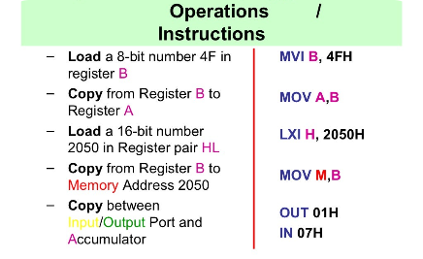
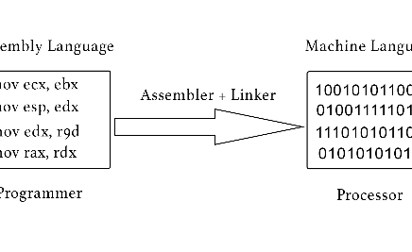
Overview of 8085 Assembly Language
What is assembly language?
The Anatomy of an 8085 Instruction
Assembly language provides a human-readable representation of the machine-level code that a computer CPU understands.
An 8085-assembly code instruction comprises an operation code mnemonic, an operand, and comments.
Assembly Code Examples
A Basic Input/Output Operation, Addition, and Jump Instruction.

Slide 5
The Quick Sort Algorithm
Quicksort is a highly efficient sorting algorithm that works by recursively partitioning the data into smaller and smaller subarrays until the entire array is sorted. It is a divide-and-conquer algorithm, meaning that it repeatedly divides the input array into two smaller subarrays until each subarray contains only one element

Slide 6
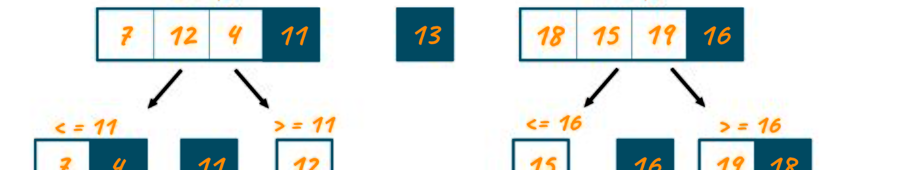
The Quick Sort Algorithm
What is Quick Sort?
Steps in Quick Sort
Applications of Quick Sort
Quick Sort is an in-place sorting algorithm that manages to sort a list in a time complexity of O(nlogn).
The algorithm uses a divide and conquer strategy, thus sorting a list by partitioning it into two subsequences.
Due to its fast and efficient nature, Quick Sort is commonly used as the primary sorting algorithm in many language libraries.

Slide 7
Implementing Quick Sort in 8085 Assembly Language
1
Step 1: Initialization
Initialize the stack pointer and other registers required for the algorithm.
2
Step 2: Divide
Divide the list into two partitions using a pivot value.
3
Step 3: Conquer
Sort each partition recursively using the same algorithm.
4
Step 4: Combine
Combine the results by swapping the values in the list

Slide 8
Initialize variables: number:
number: Constant value 76h (used for generating random numbers)
first: Memory location for storing the first element
pivot: Memory location for storing the pivot element
last: Memory location for storing the last element
i: Counter variable for the quicksort function
j: Counter variable for the quicksort function
temp: Temporary memory location for swapping elements
Generate random numbers:
Initialize variables a and c to 0
Move the value of number to b
Perform bit manipulation to generate random numbers
Store the generated random number in memory locations starting from 2000h
Move generated numbers to 2100h:
Initialize variable a to 0
Initialize variable c to 31
Move the data pointer (h) to 2100h
Exchange the contents of b and memory location pointed to by h
Move the data pointer (h) to 2000h
Break down of Code Algorithm

Slide 9
quicksort function:
Check if c (last element) is less than a (first element)
If yes, go to NOSORT label
Store the value of a (first element) in pivot, i, and first
Move the data pointer (h) to last
Store the value of c (last element) in j and last
5. Main while loop:
Check if i (current element) is less than j
If no, go to MainWhile label
Increment the value of I
Check if i (current element) is equal to pivot
If yes, go to CheckWhile2 label
Check if the value of i (current element) is less than the value of pivot
If no, go to While1Condition2 label
6. While1 loop:
Increment the value of a
Store the value of a in I
Check if the value of pivot is equal to 0
If yes, go to While1Condition2 label
Check if the value of pivot is less than 0
If no, go to CheckWhile2 label
7. CheckWhile2 label:
Go to While2 label

Slide 10
8. While2 loop:
Decrement the value of j
Check if the value of pivot is equal to 0
If yes, go to IF label
Check if the value of pivot is less than 0
If no, go to MainCondition label
9. IF label:
Store the value of j in i
Move the data pointer (h) to last
Check if the value of last is less than a
If yes, go to While1 label
10. MainCondition label:
Check if i (current element) is less than j
If no, go to MainWhile label
Store the value of i in a
Move the data pointer (h) to pivot
Store the value of b in c
Store the value of b in memory location pointed to by h
Move the data pointer (h) to temp
Store the value of b in memory location pointed to by h

Slide 11
Swap i and j:
Move the data pointer (h) to j
Store the value of c in b
Store the value of c in memory location pointed to by h
Exchange the contents of b and memory location pointed to by h
12. Recursive calls to quicksort:
Save the value of c (last element)
Decrement the value of c (last element)
Move the data pointer (h) to first

Slide 12
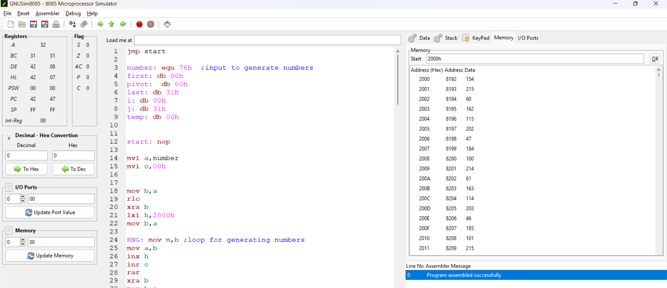
Output
data generated randomly in 2000h memory location

Slide 13
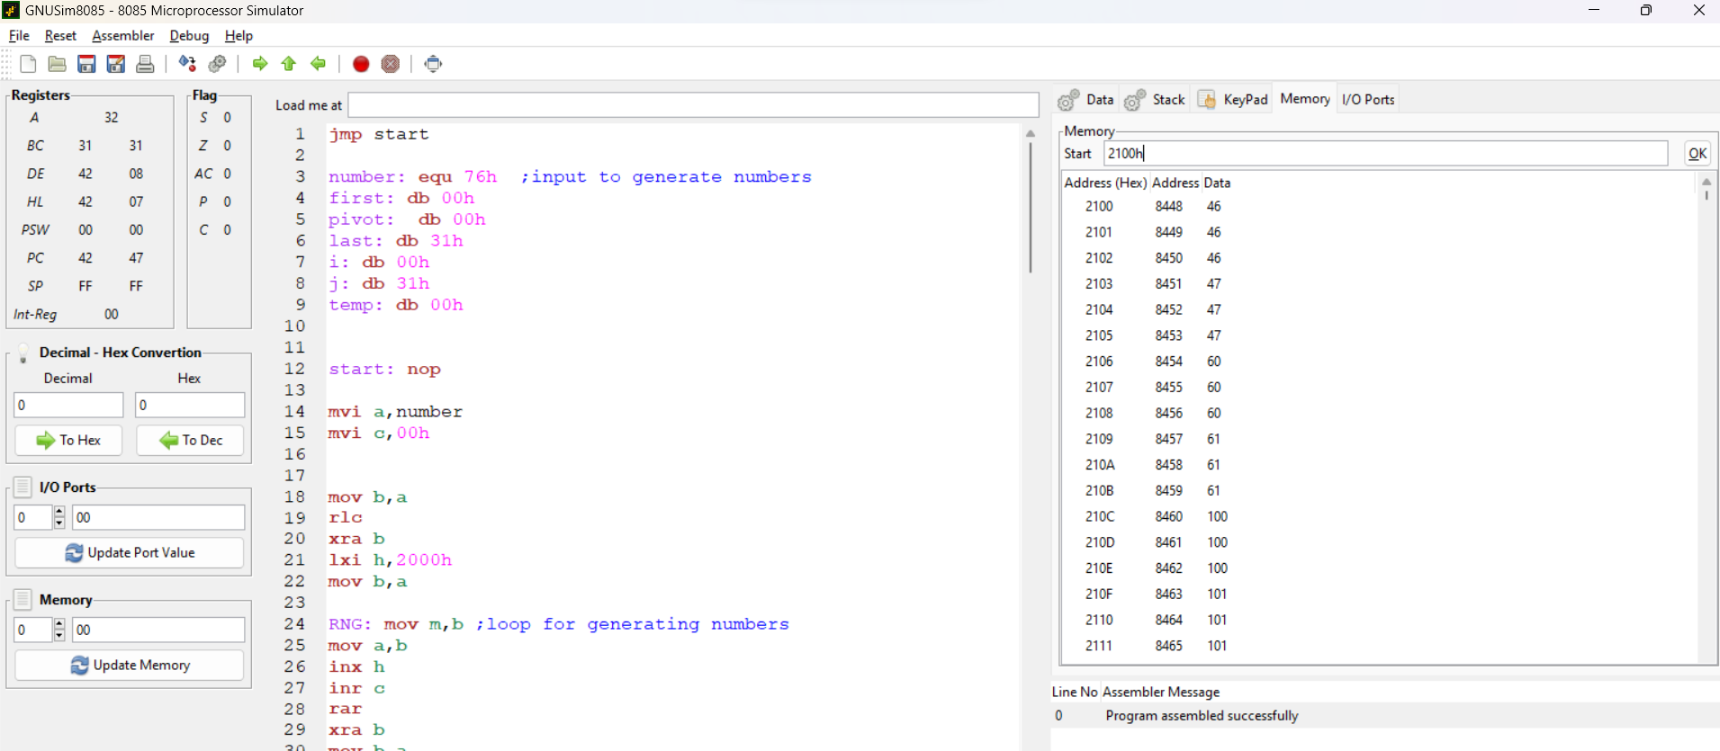
Now data is sorted at 2100h memory location

Slide 14
Testing and Debugging
The testing and debugging phase is a critical part of the software development process. It involves identifying and fixing any issues or bugs in the code to ensure the software functions as intended. During this phase, various testing techniques are used, such as unit testing, integration testing, and system testing.
In addition to testing, debugging is also an important aspect. Debugging involves identifying and fixing errors or unexpected behavior in the code. This can be done using debugging tools, such as breakpoints, stepping through the code, and examining variable values.

Slide 15
Conclusion
Implementing the quicksort algorithm in 8085 assembly language is a challenging but rewarding task. The algorithm requires careful manipulation of memory pointers and stack operations, as well as an understanding of the 8085-instruction set.
Overall, implementing quicksort in 8085 assembly language provides a valuable learning experience in low-level programming, memory management, and algorithm optimization. It also demonstrates the power of assembly language in achieving high-performance code for resource-constrained systems.

