Slide 1
Intelligent Surveillance system with Face Recognition Using FaceNet and SVM
Sai Kumar Dandla
SE (Machine Learning Specialization) | Certified DS Professional

Slide 2
Content:
Face Recognition System
One shot learning
FaceNet
Triplet Loss
Triplet Selection
Data Collection
Summary of Execution
Results

Slide 3
Face Recognition System
Face recognition system has become a integral part of our modern day to day life. Various application of face recognition system are:
Payments
Access and security
Criminal identification
Advertising
Healthcare

Slide 4
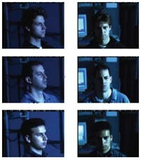
Face Recognition System
Challenges:
Different illumination condition.
Different Pose and orientation of image.
Other variational conditions.
Limited Dataset for training.
Image Source: Schroff, Florian, Dmitry Kalenichenko, and James Philbin. "Facenet: A unified embedding for face recognition and clustering." In Proceedings of the IEEE conference on computer vision and pattern recognition, pp. 815‐823. 2015.

Slide 5
One Shot learning
One‐shot learning is an object categorization problem, found mostly in computer vision.
Most machine learning based object categorization algorithms require training on hundreds or thousands of samples/images and very large datasets,
One‐shot learning aims to learn information about object categories from one, or only a few, training samples/images.

Slide 6
One Shot learning
Face Recognition as a One shot Learning:
Consider a facial recognition system which is used by a small organization for security purpose.
It has one image of every person working in that company.
The network needs to be train using those few images,
It can identify a person who is not working in the company and also the verify who is working currently in the company.
This problem becomes one shot or few shot learning problem.

Slide 7







FaceNet
FaceNet learns a embedding function
)
2
M×N
d;
Take two images
and
i
j
2
i j
Small if and
_{j} are same person
i
Large otherwise

Slide 8
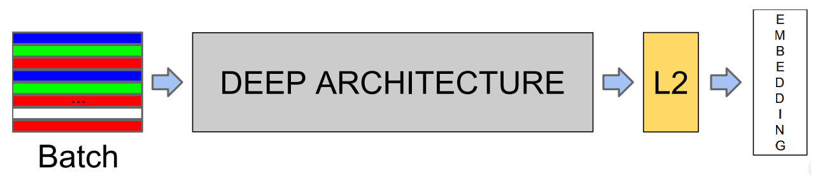
FaceNet
FaceNet uses a deep CNN model to learn the embedding function 𝑓(𝑥).
It consists of a batch input layer and a deep CNN
Followed by L2 normalization, which results in the face embedding.
Image Source: Schroff, Florian, Dmitry Kalenichenko, and James Philbin. "Facenet: A unified embedding for face recognition and clustering." In Proceedings of the IEEE conference on computer vision and pattern recognition, pp. 815‐823. 2015.

Slide 9
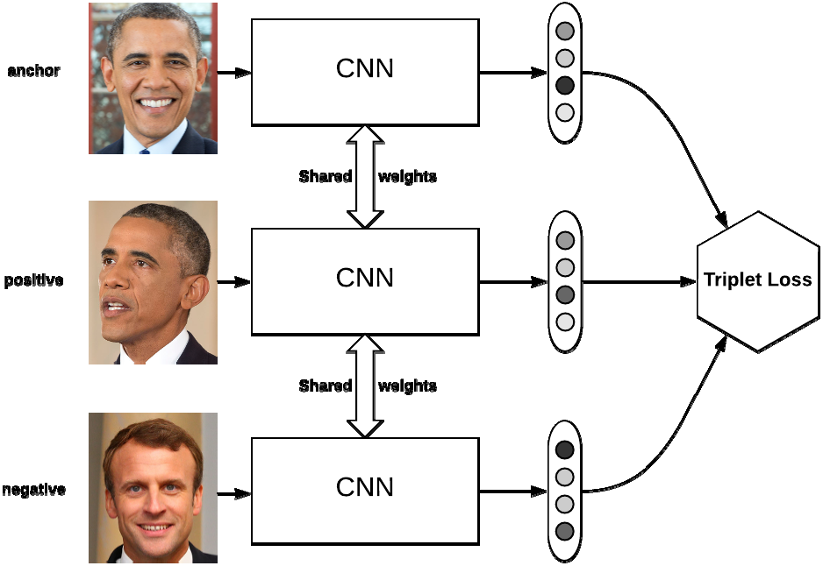
Training/Triplet Loss
Minimize triplet loss function :‐loss function using three images
An anchor image A, a positive image P (same person as the anchor), and a negative image N (different person than the anchor).
Distance d(f(A), f(P)) must be less than or equal to the distance d(f(A), f(N))
Image Source: https://omoindrot.github.io/triplet‐loss

Slide 10
Triplet Loss
Desired:‐
The problem:
2
𝑓(𝑥ª) — 𝑓(𝑥^{p}) ||
<
𝑓(𝑥ª) — 𝑓(𝑥^{n}) ||
2
2
2
The model can learn to ma the same encoding for different images of the same person.
That makes||𝑓(𝑥ª)— 𝑓(𝑥^{p}) || ₂ = 0
Unfortunately, it will satisfy the triplet loss function.
Model stops learning.
Solution: add a margin 𝛼 to always have a gap between A and P versus A and N.

Slide 11
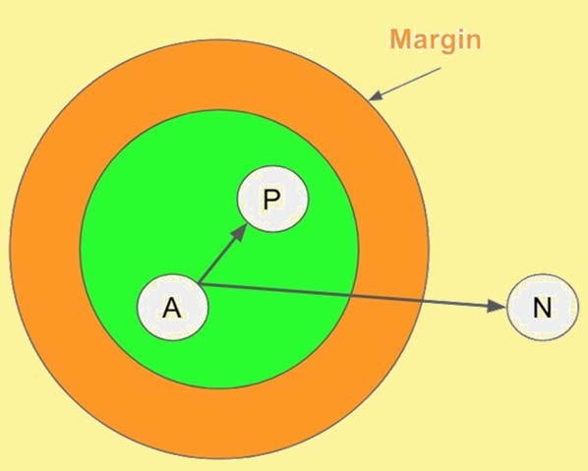
Triplet Loss
Thus :
𝑓(𝑥ª)— 𝑓(𝑥^{p})
² + 𝛼
<
2
2
2
𝑓(𝑥ª)— 𝑓(𝑥^{n})
The loss that is being minimized is then
N
𝐿 = Σ 𝑓(𝑥ª)— 𝑓(𝑥^{p})
i=1
2 —
𝑓(𝑥ª)— 𝑓(𝑥^{n})
² + 𝛼
2
2
Image Source :https://medium.com/@ahmdtaha/facenet‐a‐ unified‐embedding‐for‐face‐recognition‐and‐clustering‐ 7d34abde9

Slide 12
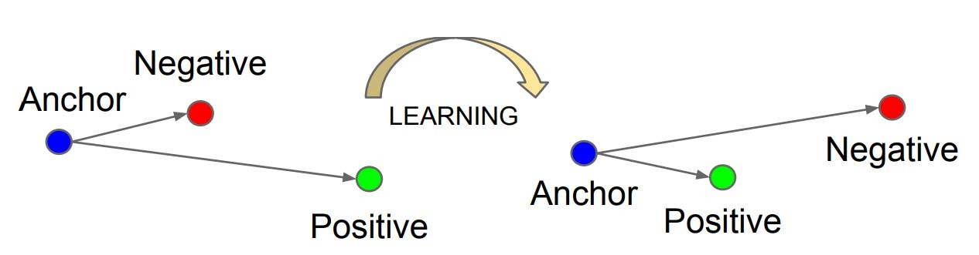
Triplet Loss
The Triplet Loss minimizes the distance between an anchor and a positive.
Maximizes the distance between the anchor and a negative.
Compact clusters of embedding of same person.
Pictures of the same person become close to each other.
Pictures of different persons are far from each other.
Image Source: Schroff, Florian, Dmitry Kalenichenko, and James Philbin. "Facenet: A unified embedding for face recognition and clustering." In Proceedings of the IEEE conference on computer vision and pattern recognition, pp. 815‐823. 2015.

Slide 13
Triplet Selection
Selecting all possible triplets would result in many triplets that satisfy
These triplets would not contribute to the training and result in slower convergence, as they would still be passed through the network.
It is crucial to select hard triplets, that are active and can therefore contribute to improving the model.
𝑓(𝑥ª)— 𝑓(𝑥^{p})
² + 𝛼
<
2
2
2
𝑓(𝑥ª)— 𝑓(𝑥^{n})
Image Source: https://omoindrot.github.io/triplet‐loss

Slide 14
Triplet Selection
In order to ensure fast convergence it is crucial to select triplets that violate the triplet constraint .
Image Source: https://omoindrot.github.io/triplet‐loss

Slide 15
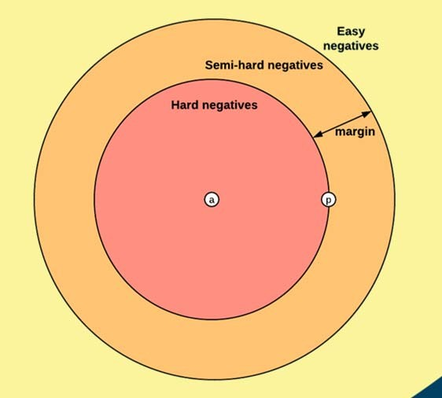
Triplet Selection
Selecting hardest negative may collapse the model: f(x)=0.
Select semi‐hard negative
Image Source: https://omoindrot.github.io/triplet‐loss

Slide 16
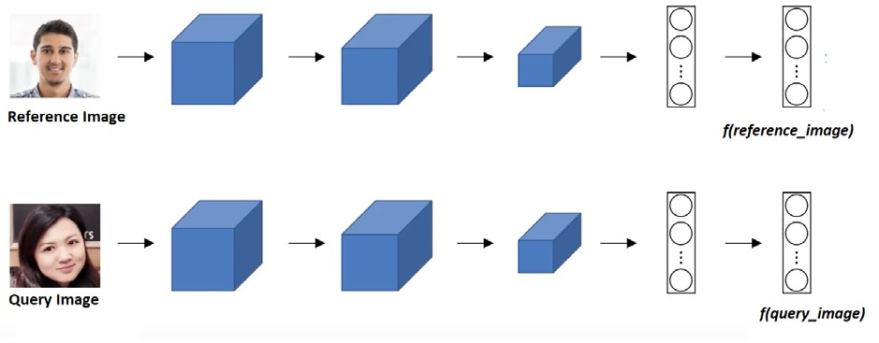
Face Verification
Pass the reference image and the query image through the embedding network.
Use the distance between them for verification.
Image Source : https://www.coursera.org/learn/convolutional‐neural‐ networks?specialization=deep‐learning

Slide 17
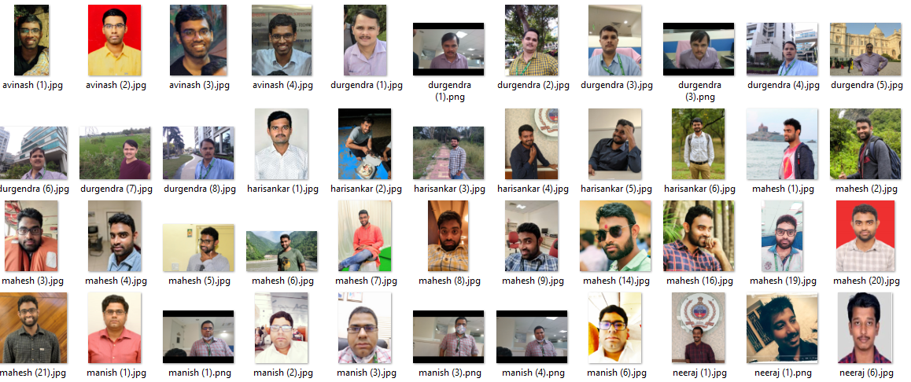
DATA COLLECTION
Sample Data Set for prototype

Slide 18
SUMMARY OF EXCUTION
Complete Code Implementation
RESULT

Slide 19
References:
Schroff, Florian, Dmitry Kalenichenko, and James Philbin. "Facenet: A unified embedding for face recognition and clustering." In Proceedings of the IEEE conference on computer vision and pattern recognition, pp. 815‐823. 2015.
https://omoindrot.github.io/triplet‐loss
http://bamos.github.io/2016/01/19/openface‐0.2.0/

