Slide 1
Ensemble Methods: Bagging, Boosting,
Gradient Boosting, XGBoost
Sai Kumar Dandla
IBM certified DS Professional | Google Certified Tensor flow Developer
AI Engineer/Researcher, DRDO DYSL-CT

Slide 2
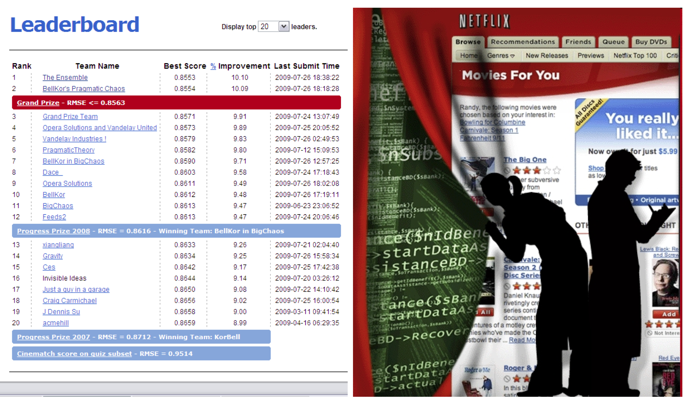

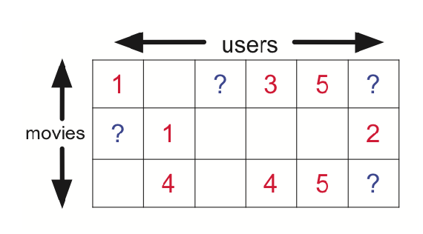
Ensemble methods
Machine learning competition with a $1 million prize

Slide 3
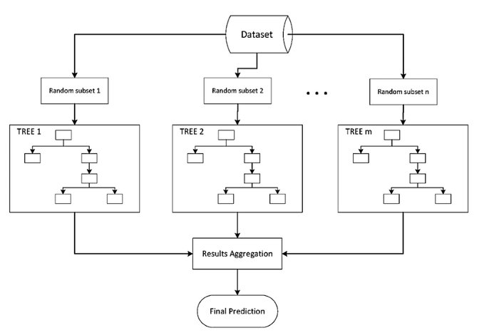
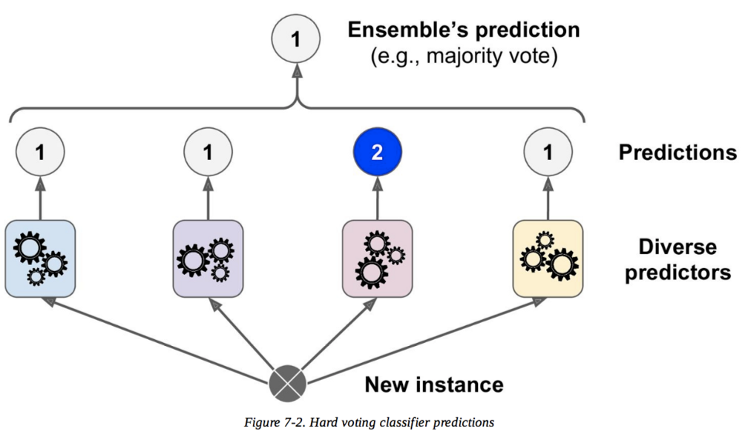

DEFINITION: ENSEMBLE METHODS
Ensemble methods are techniques that aim at improving the accuracy of results in models by combining multiple models instead of using a single model.
The combined models increase the accuracy of the results significantly.
This has boosted the popularity of ensemble methods in machine learning.
Type of Ensemble methods are Bagging, Boosting, Stacking.

Slide 4

Bagging: Bootstrap Aggregation
Leo Breiman (1994)
Take repeated bootstrap samples from training set D.
Bootstrap sampling: Given set D containing N training examples, create D’ by drawing N examples at random with replacement from D.
Bagging:
Create k bootstrap samples D₁ … D_{k}.
Train distinct classiﬁer on each D_{i}.
Classify new instance by majority vote / average.
5

Slide 5




Bagging
Best case:
In practice:
models are correlated, so reduction is smaller than 1/N variance of models trained on fewer training cases
usually somewhat larger
6

Slide 6
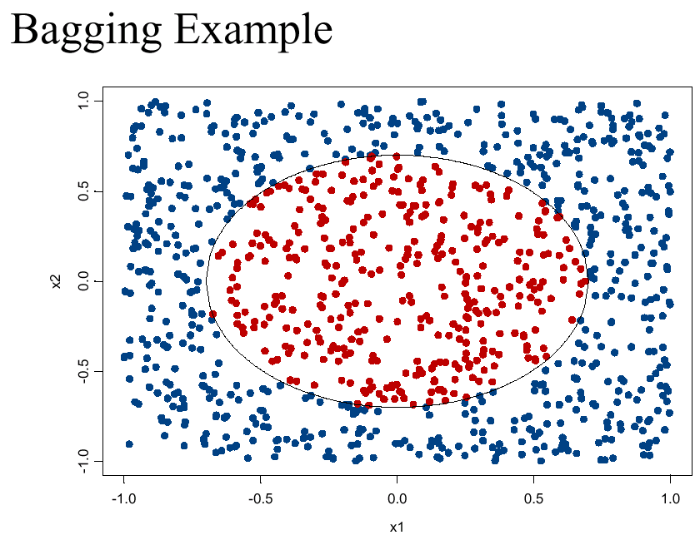
7

Slide 7
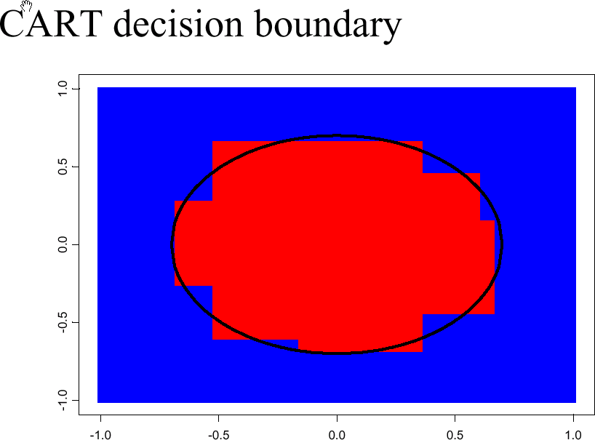
decision tree learning algorithm; very similar to ID3
8

Slide 8
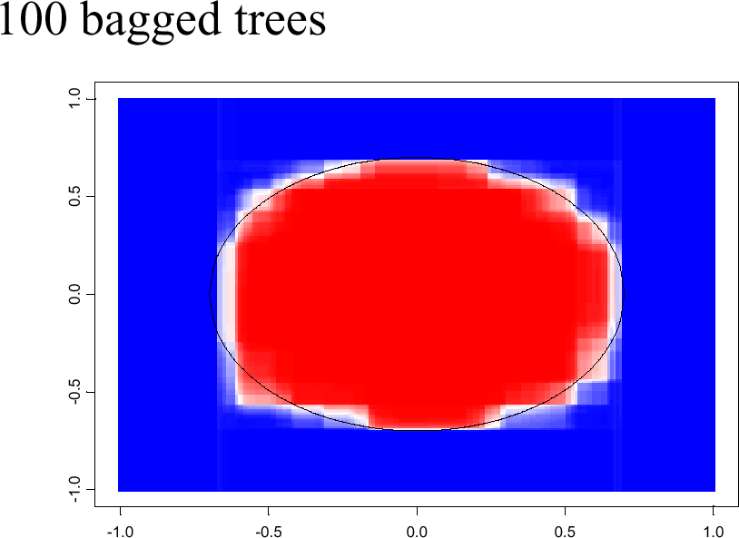
shades of blue/red indicate strength of vote for particular classification

Slide 9
Reduce Bias² and Decrease Variance?
Bagging reduces variance by averaging
Bagging has little eﬀect on bias
Can we average and reduce bias?
Yes: Boosting
10

Slide 10
DEFINITION: BOOSTING
The term ‘Boosting’ refers to a family of algorithms which converts weak learner to strong learners.
Let’s understand this definition in detail by solving a problem of spam email identification:
How would you classify an email as SPAM or not? Like everyone else, our initial approach would be to identify ‘spam’ and ‘not spam’ emails using following criteria. If:
Email has only one image file (promotional image), It’s a SPAM
Email has only link(s), It’s a SPAM
Email body consist of sentence like “You won a prize money of $ xxxxxx”, It’s a SPAM
Email from our official domain “metu.edu.tr” , Not a SPAM
Email from known source, Not a SPAM
Above, we’ve defined multiple rules to classify an email into ‘spam’ or ‘not spam’. But, do you think these rules individually are strong enough to successfully classify an email? No.
Individually, these rules are not powerful enough to classify an email into ‘spam’ or ‘not spam’. Therefore, these rules are called as weak learner.

Slide 11
DEFINITION: BOOSTING
To convert weak learner to strong learner, we’ll combine the prediction of each weak learner using methods like: • Using average/ weighted average • Considering prediction has higher vote
For example: Above, we have defined 5 weak learners. Out of these 5, 3 are voted as ‘SPAM’ and 2 are voted as ‘Not a SPAM’. In this case, by default, we’ll consider an email as SPAM because we have higher(3) vote for ‘SPAM’.

Slide 12
How Boosting Algorithms works?
To find weak rule, we apply base learning algorithms with a different distribution. Each time base learning algorithm is applied, it generates a new weak prediction rule. This is an iterative process. After many iterations, the boosting algorithm combines these weak rules into a single strong prediction rule.
For choosing the right distribution, here are the following steps:
Step 1: The base learner takes all the distributions and assign equal weight or attention to each observation.
Step 2: If there is any prediction error caused by first base learning algorithm, then we pay higher attention to observations having prediction error. Then, we apply the next base learning algorithm.
Step 3: Iterate Step 2 till the limit of base learning algorithm is reached or higher accuracy is achieved.
Finally, it combines the outputs from weak learner and creates a strong learner which eventually improves the prediction power of the model. Boosting pays higher focus on examples which are misclassiﬁed or have higher errors by preceding weak rules.

Slide 13

Types of Boosting Algorithms
Underlying engine used for boosting algorithms can be anything. It can be decision stamp, margin-maximizing classification algorithm etc. There are many boosting algorithms which use other types of engine such as:
AdaBoost (Adaptive Boosting)
Gradient Tree Boosting
GentleBoost
LPBoost
BrownBoost
XGBoost
CatBoost
Lightgbm

Slide 14

Gradient Boosting
In gradient boosting, it trains many models sequentially. Each new model gradually minimizes the loss function (y = ax + b + e, e needs special attention as it is an error term) of the whole system using Gradient Descent method. The learning procedure consecutively fit new models to provide a more accurate estimate of the response variable.
The principle idea behind this algorithm is to construct new base learners which can be maximally correlated with negative gradient of the loss function, associated with the whole ensemble.

Slide 15

Gradient Boosting
Type of Problem – You have a set of variables vectors x1 , x2 and x3. You need to predict y which is a continuous variable.
Steps of Gradient Boost algorithm
Step 1 : Assume mean is the prediction of all variables.
Step 2 : Calculate errors of each observation from the mean (latest prediction).
Step 3 : Find the variable that can split the errors perfectly and find the value for the split. This is assumed to be the latest prediction.
Step 4 : Calculate errors of each observation from the mean of both the sides of split (latest prediction).
Step 5 : Repeat the step 3 and 4 till the objective function maximizes/minimizes.
Step 6 : Take a weighted mean of all the classifiers to come up with the final model.a

Slide 16
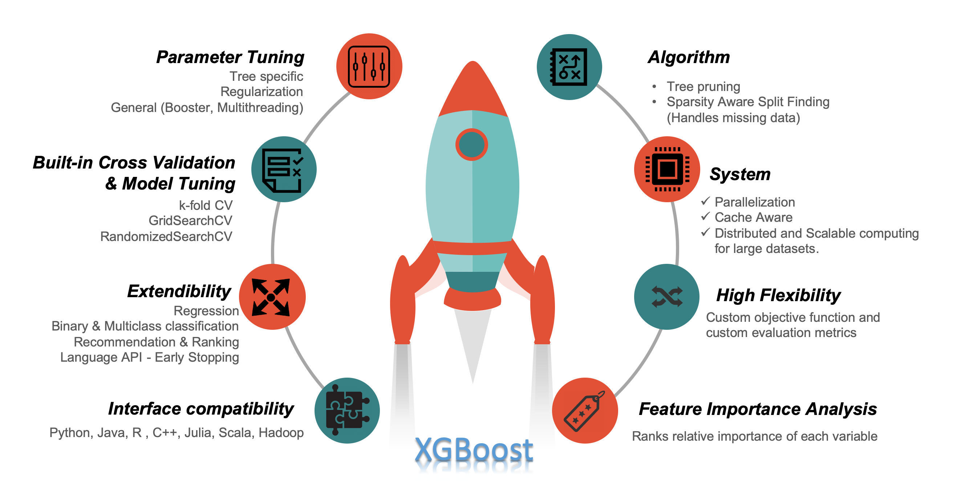
XGBoost Introduction
XGBoost is an optimized distributed gradient boosting library designed to be highly efficient, flexible and portable. It implements machine learning algorithms under the Gradient boosting framework. XGBoost provides a parallel tree boosting (also known as GBDT, GBM) that solve many data science problems in a fast and accurate way. The same code runs on major distributed environment (Hadoop, SGE, MPI) and can solve problems beyond billions of examples.

Slide 17
Key Features of XGBoost Algorithm
The XGBoost (Extreme Gradient Boosting) algorithm is an open-source distributed gradient boosting framework. The significant advantage of this algorithm is the speed and memory usage optimization
Speed and Performance
Portability
Core Algorithm Parallelization
Regularization
Deficient data-friendly
Weighted quantile sketch
Block structure for equal learning
Cache awareness
Out-of-Core Computing
Hyperparameter Tuning

Slide 18
XGBoost Applications
Store sales prediction
High energy physics event classification
Web text classification
Customer behavior prediction
Motion detection
Ad click through rate prediction
Malware classification
Product categorization
Hazard risk prediction
Massive on-line course dropout rate prediction

Slide 19
How XGBoost Works
The XGBoost library implements the gradient boosting decision tree algorithm.
This algorithm goes by lots of different names such as gradient boosting, multiple additive regression trees, stochastic gradient boosting or gradient boosting machines.
Boosting is an ensemble technique where new models are added to correct the errors made by existing models. Models are added sequentially until no further improvements can be made. A popular example is the AdaBoost algorithm that weights data points that are hard to predict.
Gradient boosting is an approach where new models are created that predict the residuals or errors of prior models and then added together to make the final prediction. It is called gradient boosting because it uses a gradient descent algorithm to minimize the loss when adding new models.
This approach supports both regression and classification predictive modeling problems.

Slide 20
Hyper-Parameter Tuning In XGBoost
Hyper-parameter tuning is an essential feature in the XGBoost algorithm for improving the accuracy of the model. There are three different categories of parameters according to the XGBoost documentation.
General parameters
Booster parameters
Task parameters
General Parameters
These parameters guide the functionality of the model.
Booster Parameters
There are two types of boosters.
Tree booster
Linear booster
The booster parameters used would depend on the kind of booster selected. Tree boosters are mostly used because it performs better than the liner booster.

Slide 21
Task Parameters
These parameters are used based on the type of problem. Generally, the parameters are tuned to define the optimization objective.
The booster and task parameters are set to default by XGBoost. There is a bunch of parameters under these three categories for specific and vital purposes. Some of the most commonly used parameter tunings are
booster,
learning_rate,
gamma,
max_depth,
subsample,
colsample_bytree,
n_estimators,
tree_method,
lambda,
alpha,
objective.

Slide 22
When (NOT) To Use XGBoost
When To Use XGBoost
You have a large number of training samples. The definition of large in this criterion varies. Generally, a dataset greater than 1000 training samples and a few features, maybe 100, is considered fair.
In practice, if the number of features in the training set is smaller than the number of training samples, XGBoost would work fine.
XGBoost works when you have a mixture of categorical and numeric features - Or just numeric features in the dataset. ‘
When To Not Use XGBoost
The XGBoost algorithm would not perform well when the dataset's problem is not suited for its features.
More precisely, XGBoost would not work with a dataset with issues such as Natural Language Processing (NLP), computer vision, image recognition, and understanding problems.
These datasets are best solved with deep learning techniques.
XGBoost should not be used when the size of the training dataset is small. If the training set is less than the number of features, XGBoost would not be efficient.

Slide 23
Build the XGBoost model
Import the libraries/modules needed
We imported the required python packages along with the XGBoost library.
Import data
We loaded the iris dataset from the sklearn model datasets.
Data cleaning and preprocessing
We performed the basic data preprocessing on the loaded dataset.
Train-test split
We splitted the data into train and test datasets.
Then we used hyperparameter tuning to get the best parameters to build the model.
XGBoost training and prediction
Using the best parameters, we build the classification model using the XGBoost package.
Model Evaluation
We evaluated the build classification model.

Slide 24
Installing XGBoost Package
How to install XGBoost using Anaconda environment
Open the Anaconda prompt and type the below command.
How to install XGBoost using python virtualenv environment
Inside you virtualenv type the below command
conda install XGBoost
pip install XGBoost

Slide 25
Thank you

