Slide 1
Deep understanding RNN, BiRNN & LSTM

Slide 2
Outline
Why Recurrent Neural Networks (RNNs)?
The Vanilla RNN unit
The RNN forward pass
Backpropagation refresher
The RNN backward pass
Issues with the Vanilla RNN
Applications of RNN
The Long Short-Term Memory (LSTM) unit
The LSTM Forward & Backward pass
LSTM variants and tips
Application of LSTM

Slide 3
Motivation
Not all problems can be converted into one with fixed-length inputs and outputs
Problems such as Speech Recognition or Time-series Prediction require a system to store and use context information
Simple case: Output YES if the number of 1s is even, else NO 1000010101 – YES, 100011 – NO, …
Hard/Impossible to choose a fixed context window
There can always be a new sample longer than anything seen

Slide 4
Recurrent Neural Networks (RNNs)
Recurrent Neural Networks take the previous output or hidden states as inputs. The composite input at time t has some historical information about the happenings at time T < t
RNNs are useful as their intermediate values (state) can store information about past inputs for a time that is not fixed a priori

Slide 5
Sample Feed-forward Network
y₁
h₁
x₁
t = 1

Slide 6
Sample RNN
y₃
y₂
h₃
y₁
h₂
x₃
h₁
t = 3
x₂
x₁
t = 2
t = 1

Slide 7
Sample RNN
y₃
y₂
h₃
y₁
h₂
x₃
h₁
t = 3
x₂
h₀
t = 2
x₁
t = 1

Slide 8
The Vanilla RNN Cell
x_{t}
h_{t-1}
W
h_{t}

Slide 9
The Vanilla RNN Forward
C₁
C₂
C₃
y₁
y₂
y₃
x₁ h₀
x₂ h₁
h₁
x₃ h₂
h₂
h₃

Slide 10
The Vanilla RNN Forward
C₁
C₂
C₃
y₁
y₂
y₃
x₁ h₀
x₂ h₁
h₁
x₃ h₂
h₂
h₃
indicates shared weights

Slide 11
Recurrent Neural Networks (RNNs)
Note that the weights are shared over time
Essentially, copies of the RNN cell are made over time (unrolling/unfolding), with different inputs at different time steps

Slide 12
Sentiment Classification
Classify a restaurant review from Yelp! OR movie review from IMDB OR … as positive or negative
Inputs: Multiple words, one or more sentences
Outputs: Positive / Negative classification
“The food was really good”
“The chicken crossed the road because it was uncooked”

Slide 13
Sentiment Classification
RNN
h₁
The

Slide 14
Sentiment Classification
RNN
RNN
h₁
h₂
The
food

Slide 15
Sentiment Classification
h_{n}
RNN
RNN
RNN
h₁
h₂
h_{n-1}
The
food
good

Slide 16


Sentiment Classification
Linear Classifier
h_{n}
RNN
RNN
RNN
h₁
h₂
h_{n-1}
The
food
good

Slide 17
Sentiment Classification
Ignore
Ignore
Linear Classifier
h₁
h₂
h_{n}
RNN
RNN
RNN
h₁
h₂
h_{n-1}
The
food
good

Slide 18
Sentiment Classification
h = Sum(…)
h₁
h_{n}
h₂
RNN
RNN
RNN
h₁
h₂
h_{n-1}
The
food
good
http://deeplearning.net/tutorial/lstm.html

Slide 19
Sentiment Classification
Linear Classifier
h = Sum(…)
h₁
h_{n}
h₂
RNN
RNN
RNN
h₁
h₂
h_{n-1}
The
food
good
http://deeplearning.net/tutorial/lstm.html

Slide 20
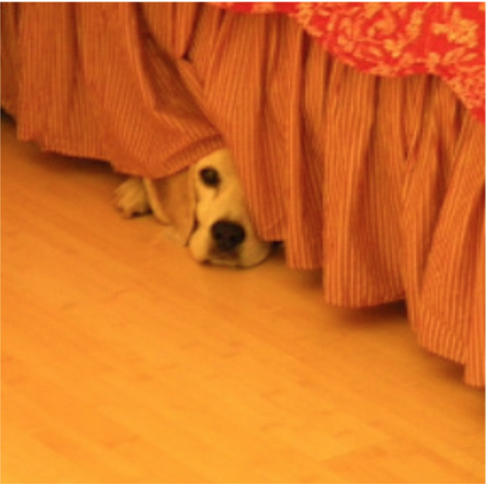
Image Captioning
Given an image, produce a sentence describing its contents
Inputs: Image feature (from a CNN)
Outputs: Multiple words (let’s consider one sentence)
: The dog is hiding

Slide 21
Image Captioning
RNN
CNN

Slide 22
Image Captioning
The
Linear Classifier
h₂
RNN
RNN
h₁
h₂
CNN

Slide 23
Image Captioning
The
dog
Linear Classifier
Linear Classifier
h₂
h₃
RNN
RNN
RNN
h₁
h₂
h₃
CNN

Slide 24
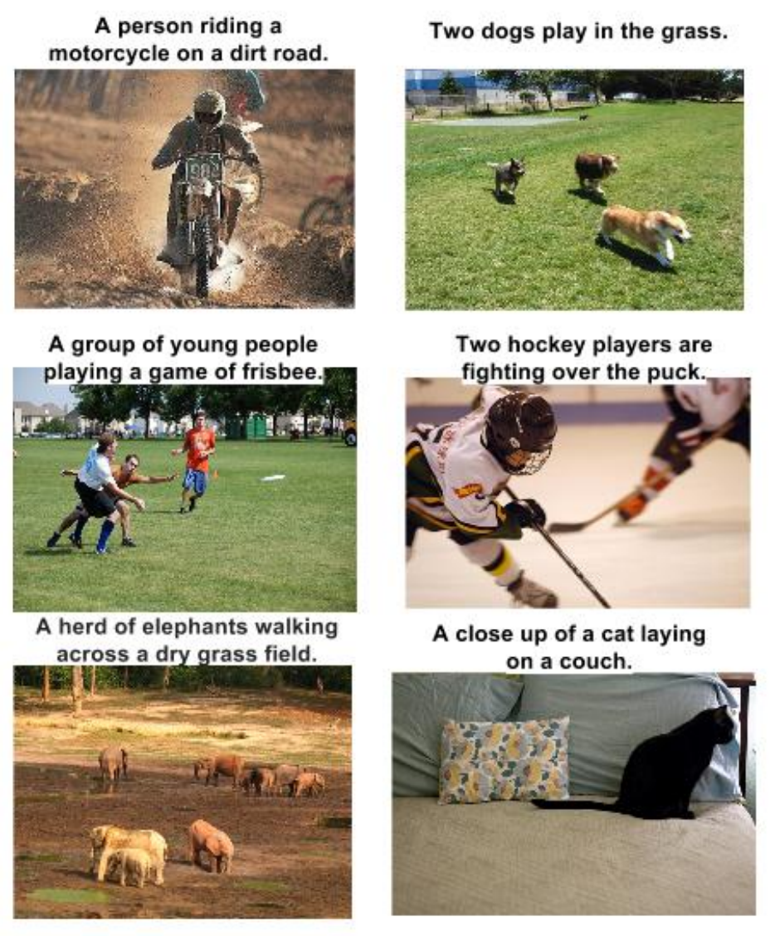
RNN Outputs: Image Captions
Show and Tell: A Neural Image Caption Generator, CVPR 15

Slide 25
RNN Outputs: Language Modeling
VIOLA:
Why, Salisbury must find his flesh and thought
That which I am not aps, not a man and in fire,
To show the reining of the raven and the wars
To grace my hand reproach within, and not a fair are hand,
That Caesar and my goodly father's world;
When I was heaven of presence and our fleets,
We spare with hours, but cut thy council I am great,
Murdered and by thy master's ready there
My power to give thee but so much as hell:
Some service in the noble bondman here,
Would show him to her wine.
KING LEAR:
O, if you were a feeble sight, the courtesy of your law,
Your sight and several breath, will wear the gods
With his heads, and my hands are wonder'd at the deeds,
So drop upon your lordship's head, and your opinion
Shall be against your honour.
http://karpathy.github.io/2015/05/21/rnn-effectiveness/

Slide 26
Input – Output Scenarios
Single - Single
Feed-forward Network
Single - Multiple
Image Captioning
Multiple - Single
Sentiment Classification
Multiple - Multiple
Translation
Image Captioning

Slide 27
Input – Output Scenarios
Note: We might deliberately choose to frame our problem as a
particular input-output scenario for ease of training or
better performance.
For example, at each time step, provide previous word as
input for image captioning
(Single-Multiple to Multiple-Multiple).

Slide 28
The Vanilla RNN Forward
C₁
C₂
C₃
y₁
y₂
y₃
x₁ h₀
x₂ h₁
h₁
x₃ h₂
h₂
“Unfold” network through time by making copies at each time-step
h₃

Slide 29
BackPropagation Refresher
C
y
f(x; W)
x

Slide 30
Multiple Layers
C
y₂
f₂(y₁; W₂)
y₁
f₁(x; W₁)
x

Slide 31
Chain Rule for Gradient Computation
C
y₂
f₂(y₁; W₂)
y₁
f₁(x; W₁)
x
Application of the Chain Rule

Slide 32
Chain Rule for Gradient Computation
Given:
We are interested in computing:
y
Intrinsic to the layer are:
f(x; W)
x

Slide 33
Chain Rule for Gradient Computation
Given:
We are interested in computing:
Intrinsic to the layer are:
f(x; W)
Equations for common layers: http://arunmallya.github.io/writeups/nn/backprop.html

Slide 34
Extension to Computational Graphs
y₁
y₂
y
f₁(y; W₁)
f₂(y; W₂)
f(x; W)
y
y
x
f(x; W)
x

Slide 35
Extension to Computational Graphs
f₁(y; W₁)
f₂(y; W₂)
f(x; W)
f(x; W)

Slide 36
Extension to Computational Graphs
f₁(y; W₁)
f₂(y; W₂)
f(x; W)
Gradient Accumulation
f(x; W)

Slide 37
BackPropagation Through Time (BPTT)
One of the methods used to train RNNs
The unfolded network (used during forward pass) is treated as one big feed-forward network
This unfolded network accepts the whole time series as input
The weight updates are computed for each copy in the unfolded network, then summed (or averaged) and then applied to the RNN weights

Slide 38
The Unfolded Vanilla RNN
C₁
C₂
C₃
y₁
y₂
y₃
Treat the unfolded network as one big feed-forward network!
This big network takes in entire sequence as an input
Compute gradients through the usual backpropagation
Update shared weights
h₁
h₃
h₂
h₂
h₁
h₀
x₁
x₂
x₃

Slide 39
The Unfolded Vanilla RNN Forward
C₁
C₂
C₃
y₁
y₂
y₃
x₁ h₀
x₂ h₁
h₁
x₃ h₂
h₂
h₃

Slide 40
The Unfolded Vanilla RNN Backward
C₁
C₂
C₃
y₁
y₂
y₃
x₁ h₀
x₂ h₁
h₁
x₃ h₂
h₂
h₃
Notes:
refresher for backprop before this

Slide 41
The Vanilla RNN Backward
C₁
C₂
C₃
y₁
y₂
y₃
x₁ h₀
x₂ h₁
h₁
x₃ h₂
h₂
h₃
Notes:
refresher for backprop before this

Slide 42
Issues with the Vanilla RNNs
In the same way a product of k real numbers can shrink to zero or explode to infinity, so can a product of matrices
It is sufficient for , where is the largest singular value of W, for the vanishing gradients problem to occur and it is necessary for exploding gradients that , where for the tanh non-linearity and for the sigmoid non-linearity ¹
Exploding gradients are often controlled with gradient element-wise or norm clipping
¹ On the difficulty of training recurrent neural networks, Pascanu et al., 2013

Slide 43
The Identity Relationship
Recall
Suppose that instead of a matrix multiplication, we had an identity relationship between the hidden states
The gradient does not decay as the error is propagated all the way back aka “Constant Error Flow”

Slide 44
The Identity Relationship
Recall
Suppose that instead of a matrix multiplication, we had an identity relationship between the hidden states
Remember Resnets?
The gradient does not decay as the error is propagated all the way back aka “Constant Error Flow”

Slide 45
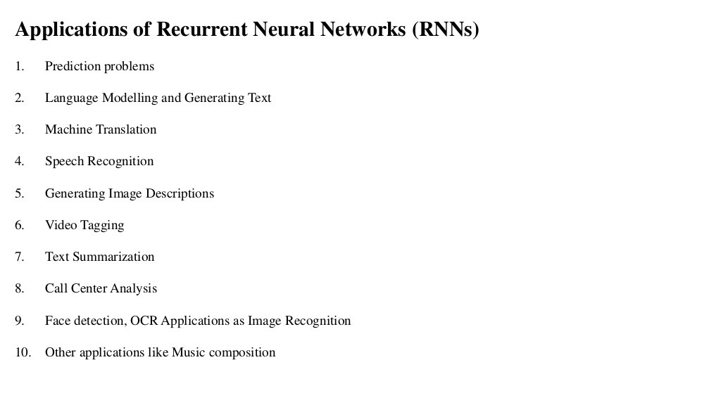

Slide 46
Long Short-Term Memory (LSTM)¹
The LSTM uses this idea of “Constant Error Flow” for RNNs to create a “Constant Error Carousel” (CEC) which ensures that gradients don’t decay
The key component is a memory cell that acts like an accumulator (contains the identity relationship) over time
Instead of computing new state as a matrix product with the old state, it rather computes the difference between them. Expressivity is the same, but gradients are better behaved
¹ Long Short-Term Memory, Hochreiter et al., 1997

Slide 47
The LSTM Idea
x_{t}
h_{t-1}
W
Cell
c_{t}
h_{t}
* Dashed line indicates time-lag

Slide 48
The Original LSTM Cell
x_{t} h_{t-1}
x_{t} h_{t-1}
W_{i}
W_{o}
Input Gate
i_{t}
Output Gate
o_{t}
x_{t}
h_{t-1}
W
Cell
c_{t}
h_{t}
Similarly for o_{t}

Slide 49
The Popular LSTM Cell
x_{t} h_{t-1}
x_{t} h_{t-1}
W_{i}
W_{o}
Input Gate
i_{t}
Output Gate
o_{t}
x_{t}
h_{t-1}
W
Cell
c_{t}
h_{t}
f_{t}
Forget Gate
W_{f}
x_{t} h_{t-1}

Slide 50
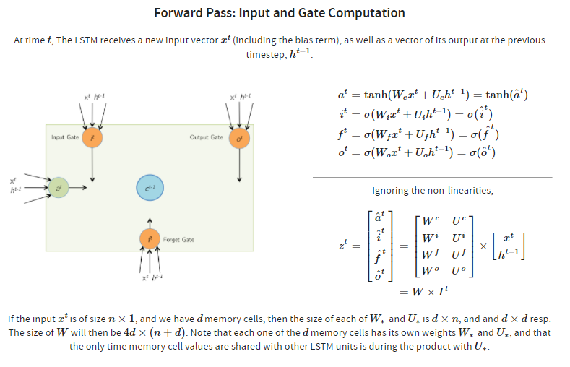

Slide 51
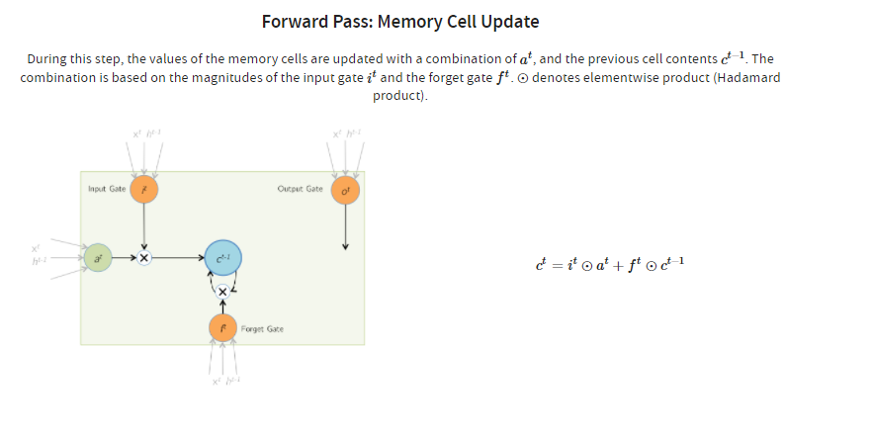

Slide 52
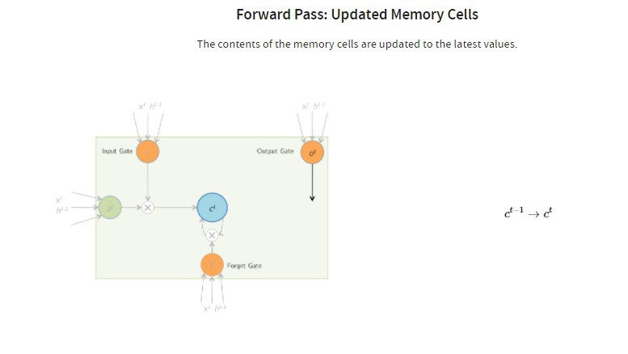

Slide 53
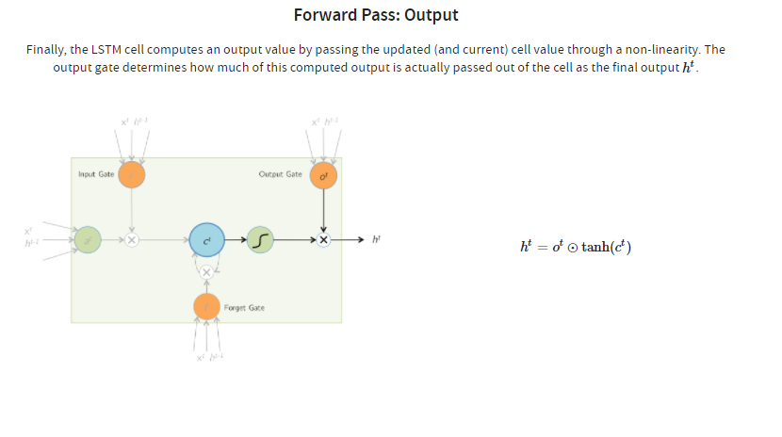

Slide 54
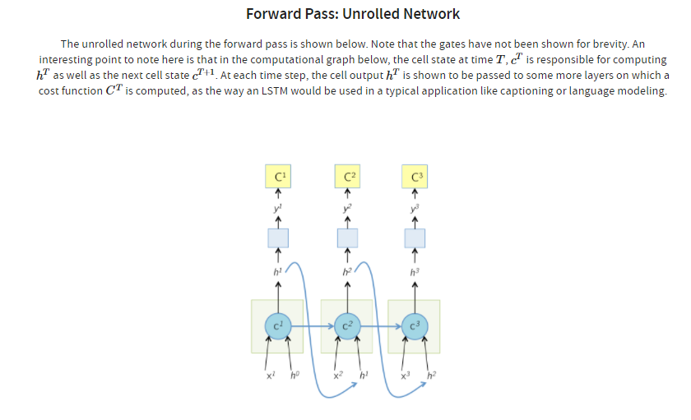

Slide 55
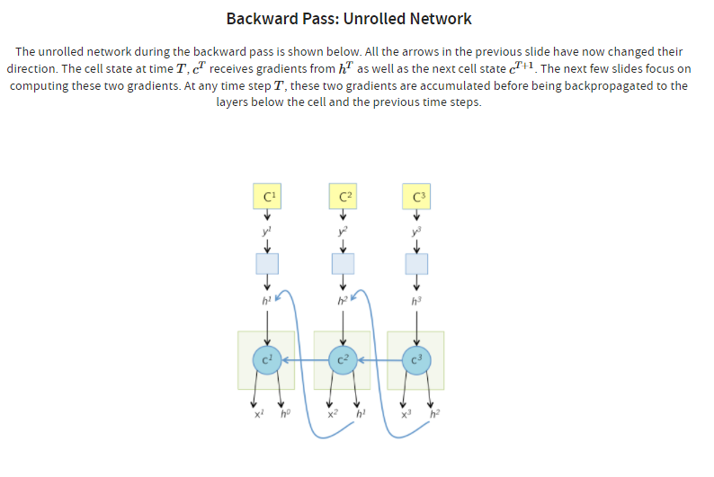

Slide 56
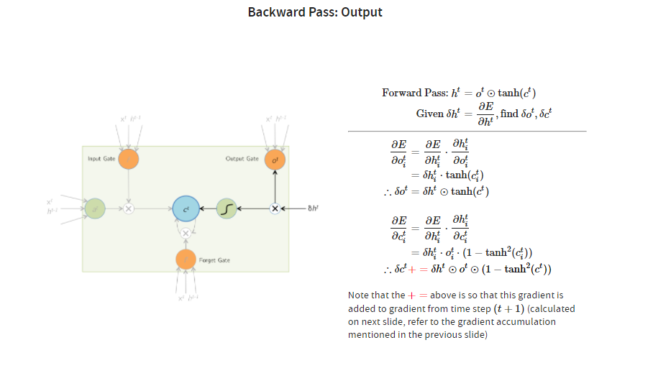

Slide 57
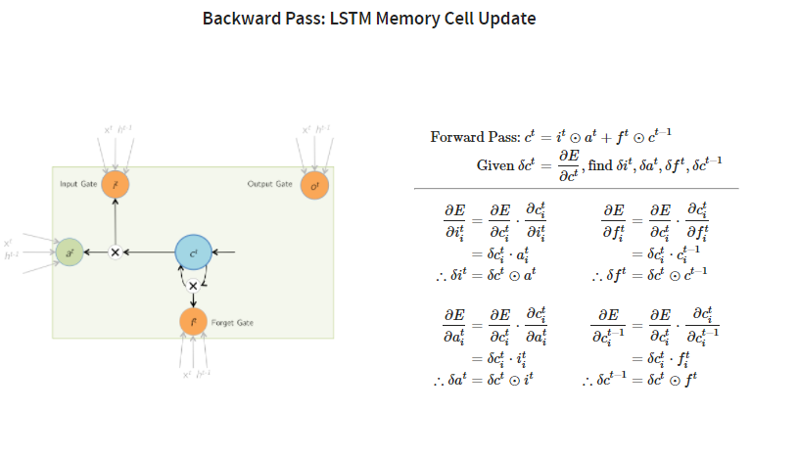

Slide 58
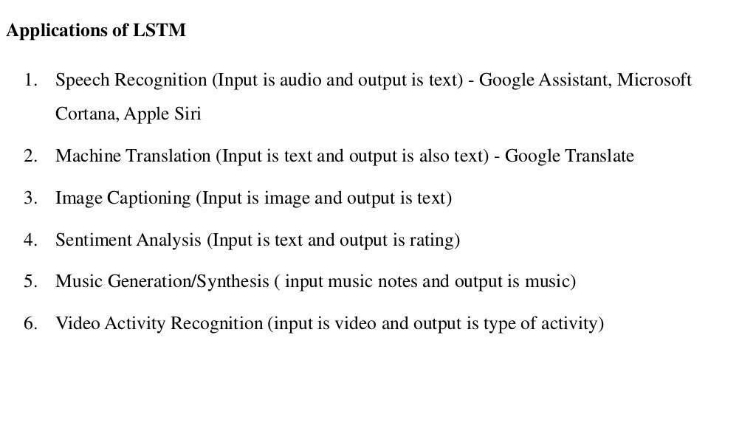

Slide 59
Summary
RNNs allow for processing of variable length inputs and outputs by maintaining state information across time steps
Various Input-Output scenarios are possible (Single/Multiple)
Vanilla RNNs are improved upon by LSTMs which address the vanishing gradient problem through the CEC
Exploding gradients are handled by gradient clipping
More complex architectures are listed in the course materials for you to read, understand, and present

Slide 60
Other Useful Resources / References
https://slazebni.cs.illinois.edu/spring17/ Slides Credit
http://cs231n.stanford.edu/slides/winter1516_lecture10.pdf
http://www.cs.toronto.edu/~rgrosse/csc321/lec10.pdf
R. Pascanu, T. Mikolov, and Y. Bengio, On the difficulty of training recurrent neural networks, ICML 2013
S. Hochreiter, and J. Schmidhuber, Long short-term memory, Neural computation, 1997 9(8), pp.1735-1780
F.A. Gers, and J. Schmidhuber, Recurrent nets that time and count, IJCNN 2000
K. Greff , R.K. Srivastava, J. Koutník, B.R. Steunebrink, and J. Schmidhuber, LSTM: A search space odyssey, IEEE transactions on neural networks and learning systems, 2016
K. Cho, B. Van Merrienboer, C. Gulcehre, D. Bahdanau, F. Bougares, H. Schwenk, and Y. Bengio, Learning phrase representations using RNN encoder-decoder for statistical machine translation, ACL 2014
R. Jozefowicz, W. Zaremba, and I. Sutskever, An empirical exploration of recurrent network architectures, JMLR 2015

