Slide 1
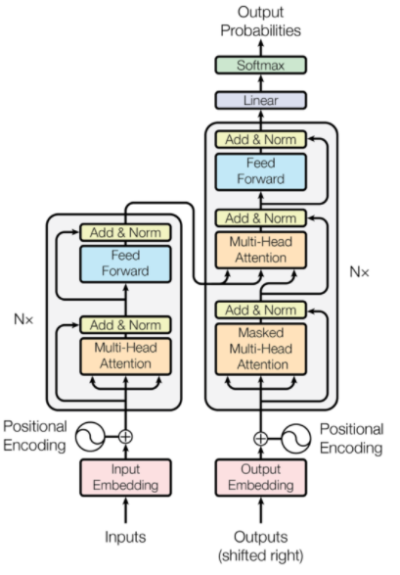
Google Transformer

Slide 2
Outline
Sequence Modeling
Introducing the Transformer model
Key-Query-Value Attention
Multi-headed attention
Residual connections
Layer normalization
Scaled Dot Product
8. Great results with Transformers
9. Drawbacks and variants of Transformers

Slide 3
Sequence Modeling
Challenges with RNNs
Long range dependencies
Gradient vanishing and explosion
Large # of training steps
Recurrence prevents parallel computation
Transformer Networks
Facilitate long range dependencies
No gradient vanishing and explosion
Fewer training steps
No recurrence that facilitate parallel computation

Slide 4




The Transformer Encoder-Decoder [Vaswani et al., 2017]
First, let’s look at the Transformer Encoder and Decoder Blocks at a high level
[predictions!]
Transformer Encoder
Transformer Decoder
[decoder attends to encoder states]
Transformer
Encoder
Transformer Decoder
Word Embeddings
+
Position Representations
Word
Embeddings
+
Position
Representations
[input sequence]
[output sequence]

Slide 5
The Transformer Encoder-Decoder [Vaswani et al., 2017]
Next, let’s look at the Transformer Encoder and Decoder Blocks
What’s left in a Transformer Encoder Block that we haven’t covered?
1. Key-query-value attention: How do we get the 𝑘, 𝑞, 𝑣 vectors from a single word embedding?
2. Multi-headed attention: Attend to multiple places in a single layer!
3. Tricks to help with training!
1. Residual connections
2. Layer normalization
3. Scaling the dot product
4. These tricks don’t improve what the model is able to do; they help improve the training process. Both of these types of modeling improvements are very important!

Slide 6
The Transformer Encoder: Key-Query-Value Attention
• We saw that self-attention is when keys, queries, and values come from the same
source. The Transformer does this in a particular way:
• Let 𝑥₁, … , 𝑥_{𝑇} be input vectors to the Transformer encoder; 𝑥_{𝑖} ∈ ℝ^{𝑑}
• Then keys, queries, values are:
• 𝑘_{𝑖} = 𝐾𝑥_{𝑖}, where 𝐾 ∈ ℝ^{𝑑×𝑑} is the key matrix.
• 𝑞_{𝑖} = 𝑄𝑥_{𝑖}, where Q ∈ ℝ^{𝑑×𝑑} is the query matrix.
• 𝑣_{𝑖} = 𝑉𝑥_{𝑖}, where V ∈ ℝ^{𝑑×𝑑} is the value matrix.
• These matrices allow different aspects of the 𝑥 vectors to be used/emphasized in each of the three roles.

Slide 7
The Transformer Encoder: Key-Query-Value Attention
• Let’s look at how key-query-value attention is computed, in matrices.
• Let 𝑋 = 𝑥₁; … ; 𝑥_{𝑇} ∈ ℝ^{𝑇×𝑑} be the concatenation of input vectors.
• First, note that 𝑋𝐾 ∈ ℝ^{𝑇×𝑑}, 𝑋𝑄 ∈ ℝ^{𝑇×𝑑}, 𝑋𝑉 ∈ ℝ^{𝑇×𝑑}.
𝖳
• The output is defined as output = softmax 𝑋𝑄 𝑋𝐾 × 𝑋𝑉.
First, take the query-key dot products in one matrix
All pairs of attention scores!
= 𝑋𝑄𝐾^{𝖳} 𝑋^{𝖳}
𝑋𝑄
multiplication: 𝑋𝑄 𝑋𝐾
𝖳
_{𝐾}𝖳 _{𝑋}𝖳
∈ ℝ
𝑇×𝑇
Next, softmax, and compute the weighted average with another matrix multiplication.
softmax
𝑋𝑄𝐾^{𝖳} 𝑋^{𝖳}
=
𝑋𝑉
output ∈ ℝ^{𝑇×𝑑}

Slide 8
The Transformer Encoder: Multi-headed attention
• What if we want to look in multiple places in the sentence at once?
• For word 𝑖, self-attention “looks” where 𝑥^{𝖳}𝑄^{𝖳}𝐾𝑥_{𝑗} is high, but maybe we want
𝑖
to focus on different 𝑗 for different reasons?
• We’ll define multiple attention “heads” through multiple Q,K,V matrices
𝑑
• Let, 𝑄_{𝑃}, 𝐾_{𝑃}, 𝑉_{𝑃} ∈ ℝ ^{ℎ}, where ℎ is the number of attention heads, and 𝑃 ranges
from 1 to ℎ.
• Each attention head performs attention independently:
𝑑×
• output_{𝑃} = softmax 𝑋𝑄_{𝑃}𝐾^{𝖳}𝑋^{𝖳} ∗ 𝑋𝑉_{𝑃}, where output_{𝑃} ∈ ℝ^{𝑑/ℎ}
𝑃
• Then the outputs of all the heads are combined!
• output = 𝑌[output₁; … ; output_{ℎ}], where 𝑌 ∈ ℝ^{𝑑×𝑑}
• Each head gets to “look” at different things, and construct value vectors
differently.
29

Slide 9
The Transformer Encoder: Multi-headed attention
• What if we want to look in multiple places in the sentence at once?
• For word 𝑖, self-attention “looks” where 𝑥^{𝖳}𝑄^{𝖳}𝐾𝑥_{𝑗} is high, but maybe we want
𝑖
to focus on different 𝑗 for different reasons?
• We’ll define multiple attention “heads” through multiple Q,K,V matrices
𝑑
• Let, 𝑄_{𝑃}, 𝐾_{𝑃}, 𝑉_{𝑃} ∈ ℝ ^{ℎ}, where ℎ is the number of attention heads, and 𝑃 ranges
from 1 to ℎ.
𝑑×
Single-head attention
(just the query matrix)
Multi-head attention
(just two heads here)
Same amount of computation as single-head self- attention!
𝑋
𝑋𝑄
𝑋
𝑋𝑄₁ 𝑋𝑄₂
=
𝑄₁ 𝑄₂ =
𝑄
30

Slide 10
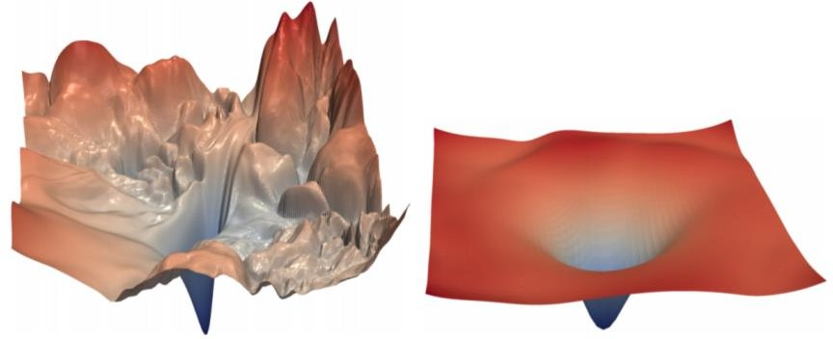
The Transformer Encoder: Residual connections [He et al., 2016]
• Residual connections are a trick to help models train better.
• Instead of 𝑋^{(𝑖)} = Layer(𝑋 ^{𝑖−1} ) (where 𝑖 represents the layer)
_{𝑋}(𝑖−1) _{𝑋}(𝑖)
Layer
• We let 𝑋^{(𝑖)} = 𝑋^{(𝑖−1)} + Layer(𝑋 ^{𝑖−1} ) (so we only have to learn “the residual”
from the previous layer)
_{𝑋}(𝑖−1) _{𝑋}(𝑖)
Layer
+
• Residual connections are thought to make the loss landscape considerably smoother (thus easier training!)
[no residuals] [residuals]
[Loss landscape visualization, Li et al., 2018, on a ResNet]
31

Slide 11
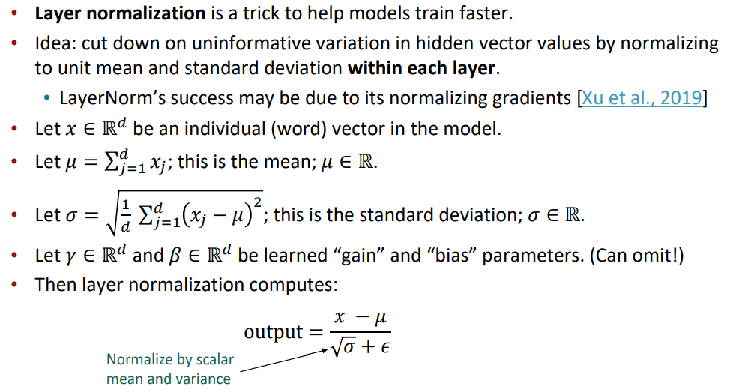
The Transformer Encoder: Layer normalization [Ba et al., 2016]

Slide 12
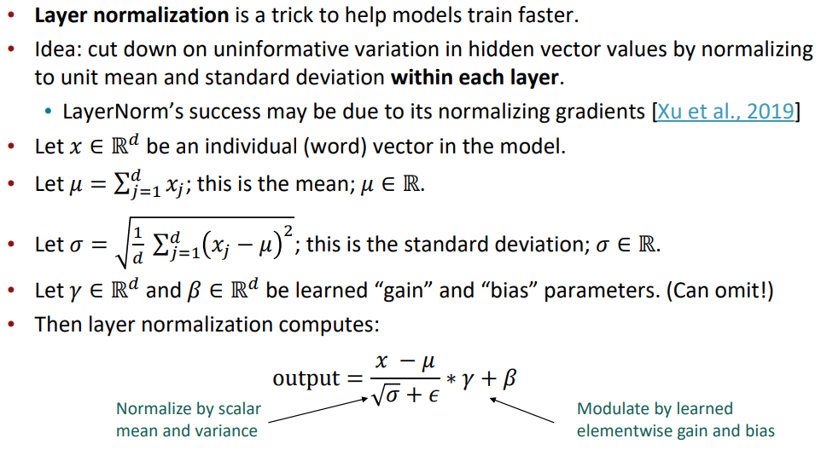
The Transformer Encoder: Layer normalization [Ba et al., 2016]

Slide 13
The Transformer Encoder: Scaled Dot Product [Vaswani et al., 2017]
• “Scaled Dot Product” attention is a final variation to aid in Transformer training.
• When dimensionality 𝑑 becomes large, dot products between vectors tend to become large.
• Because of this, inputs to the softmax function can be large, making the gradients small.
• Instead of the self-attention function we’ve seen:
output_{𝑃} = softmax 𝑋𝑄_{𝑃}𝐾^{𝖳}𝑋^{𝖳} ∗ 𝑋𝑉_{𝑃}
𝑃
• We divide the attention scores by 𝑑/ℎ, to stop the scores from becoming large
just as a function of 𝑑/ℎ (The dimensionality divided by the number of heads.)
output_{𝑃} = softmax
𝑋𝑄_{𝑃}𝐾^{𝖳}𝑋^{𝖳}
∗ 𝑋𝑉_{𝑃}
𝑃
𝑑/ℎ

Slide 14
The Transformer Encoder-Decoder [Vaswani et al., 2017]
Looking back at the whole model, zooming in on an Encoder block:
[predictions!]
Transformer Encoder
Transformer Decoder
[decoder attends to encoder states]
Transformer
Encoder
Transformer Decoder
Word Embeddings
+
Position Representations
Word
Embeddings
+
Position
Representations
[input sequence]
[output sequence]

Slide 15


The Transformer Encoder-Decoder [Vaswani et al., 2017]
Looking back at the whole model, zooming in on an Encoder block:
Transformer
Encoder
[predictions!]
Transformer Decoder
Residual + LayerNorm
[decoder attends to encoder states]
Feed-Forward
Residual + LayerNorm
Transformer Decoder
Multi-Head Attention
Word Embeddings
+
Position Representations
Word
Embeddings
+
Position
Representations
[input sequence]
[output sequence]

Slide 16

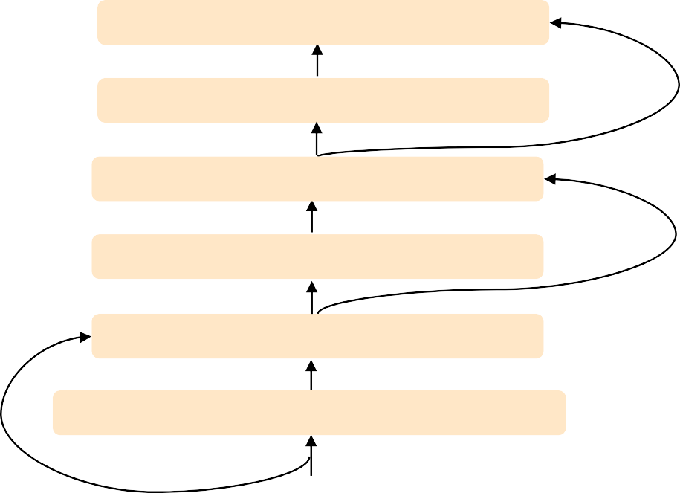
The Transformer Encoder-Decoder [Vaswani et al., 2017]
Looking back at the whole model, zooming in on a Decoder block:
Transformer Encoder
[predictions!]
Transformer Decoder
Residual + LayerNorm Feed-Forward Residual + LayerNorm
Multi-Head Cross-Attention Residual + LayerNorm
Masked Multi-Head Self-Attention
Transformer
Encoder
Word Embeddings
+
Position Representations
Word
Embeddings
+
Position
Representations
[input sequence]
[output sequence]

Slide 17
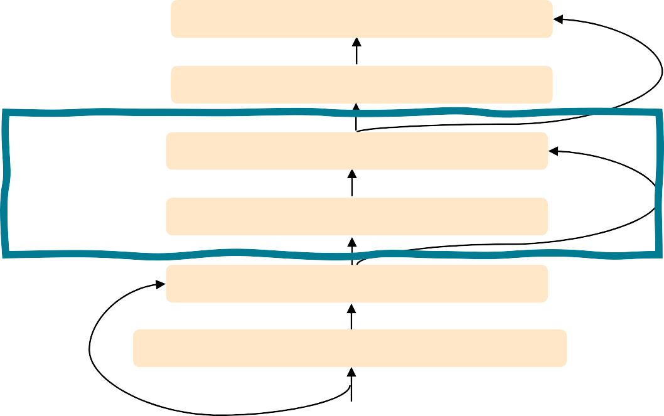
The Transformer Encoder-Decoder [Vaswani et al., 2017]
The only new part is attention from decoder to encoder.
[predictions!]
Transformer Decoder
Transformer
Encoder
Residual + LayerNorm
Feed-Forward
Residual + LayerNorm Multi-Head Cross-Attention
Residual + LayerNorm
Masked Multi-Head Self-Attention
Transformer
Encoder
Word Embeddings
+
Position Representations
Word
Embeddings
+
Position
Representations
[input sequence]
[output sequence]

Slide 18
The Transformer Decoder: Cross-attention (details)
• We saw that self-attention is when keys, queries, and values come from the same
source.
• In the decoder, we have attention that looks more like what we saw last week.
• Let ℎ₁, … , ℎ_{𝑇} be output vectors from the Transformer encoder; 𝑥_{𝑖} ∈ ℝ^{𝑑}
• Let 𝑧₁, … , 𝑧_{𝑇} be input vectors from the Transformer decoder, 𝑧_{𝑖} ∈ ℝ^{𝑑}
• Then keys and values are drawn from the encoder (like a memory):
• 𝑘_{𝑖} = 𝐾ℎ_{𝑖}, 𝑣_{𝑖} = 𝑉ℎ_{𝑖}.
• And the queries are drawn from the decoder, 𝑞_{𝑖} = 𝑄𝑧_{𝑖}.

Slide 19
The Transformer Encoder: Cross-attention (details)
• Let’s look at how cross-attention is computed, in matrices.
• Let H = ℎ₁; … ; ℎ_{𝑇}
• Let Z = 𝑧₁; … ; 𝑧_{𝑇}
∈ ℝ^{𝑇×𝑑} be the concatenation of encoder vectors.
∈ ℝ^{𝑇×𝑑} be the concatenation of decoder vectors.
𝖳
• The output is defined as output = softmax 𝑍𝑄 𝐻𝐾 × 𝐻𝑉.
First, take the query-key dot products in one matrix
All pairs of attention scores!
= 𝑍𝑄𝐾^{𝖳} 𝐻^{𝖳}
𝑍𝑄
multiplication: 𝑍𝑄 𝐻𝐾
𝖳
_{𝐾}𝖳 _{𝐻}𝖳
∈ ℝ
𝑇×𝑇
Next, softmax, and compute the weighted average with another matrix multiplication.
softmax
𝑍𝑄𝐾^{𝖳} 𝐻^{𝖳}
=
𝐻𝑉
output ∈ ℝ^{𝑇×𝑑}

Slide 20
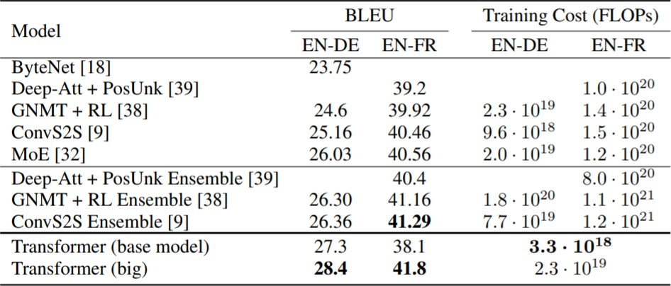
Great Results with Transformers
First, Machine Translation from the original Transformers paper!
Not just better Machine Also more efficient to
Translation BLEU scores train!
[Test sets: WMT 2014 English-German and English-French]
[Vaswani et al., 2017]

Slide 21
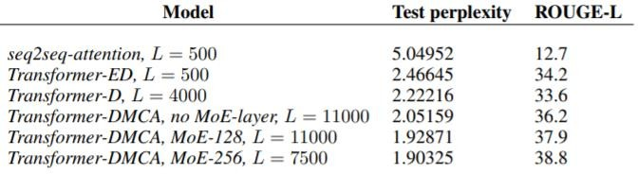
Great Results with Transformers
Next, document generation!
The old standard
Transformers all the way down.
[Liu et al., 2018]; WikiSum dataset

Slide 22
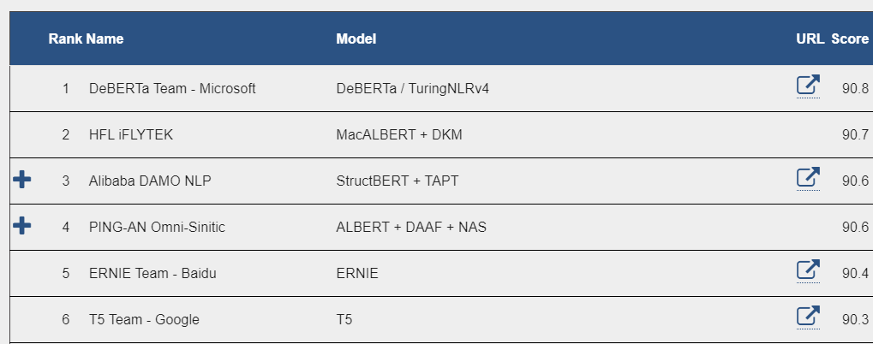

Great Results with Transformers
Before too long, most Transformers results also included pretraining, a method we’ll
go over on Thursday.
Transformers’ parallelizability allows for efficient pretraining, and have made them the de-facto standard.
On this popular aggregate
benchmark, for example:
All top models are Transformer (and pretraining)-based.
More results Thursday when we discuss pretraining.
44
[Liu et al., 2018]

Slide 23
What would we like to fix about the Transformer?
• Quadratic compute in self-attention (today):
• Computing all pairs of interactions means our computation grows
quadratically with the sequence length!
• For recurrent models, it only grew linearly!
• Position representations:
• Are simple absolute indices the best we can do to represent position?
• Relative linear position attention [Shaw et al., 2018]
• Dependency syntax-based position [Wang et al., 2019]

Slide 24
Quadratic computation as a function of sequence length
• One of the benefits of self-attention over recurrence was that it’s highly
parallelizable.
• However, its total number of operations grows as 𝑂 𝑇²𝑑 , where 𝑇 is the sequence length, and 𝑑 is the dimensionality.
= 𝑋𝑄𝐾^{𝖳} 𝑋^{𝖳}
Need to compute all pairs of interactions!
𝑂 𝑇²𝑑
𝑋𝑄
_{𝐾}𝖳 _{𝑋}𝖳
∈ ℝ
𝑇×𝑇
• Think of 𝑑 as around 𝟏, 𝟎𝟎𝟎.
• So, for a single (shortish) sentence, 𝑇 ≤ 30; 𝑇² ≤ 𝟗𝟎𝟎.
• In practice, we set a bound like 𝑇 = 512.
• But what if we’d like 𝑻 ≥ 𝟏𝟎, 𝟎𝟎𝟎? For example, to work on long documents?

Slide 25
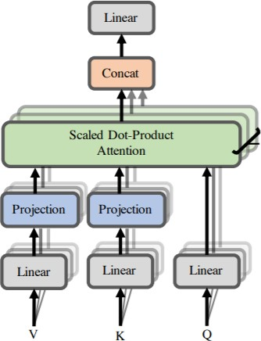
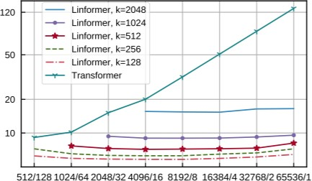
Recent work on improving on quadratic self-attention cost
• Considerable recent work has gone into the question, Can we build models like
Transformers without paying the 𝑂 𝑇² all-pairs self-attention cost?
• For example, Linformer [Wang et al., 2020]
Key idea: map the sequence length dimension to a lower- dimensional space for values, keys
Inference time (s)
Sequence length / batch size

Slide 26
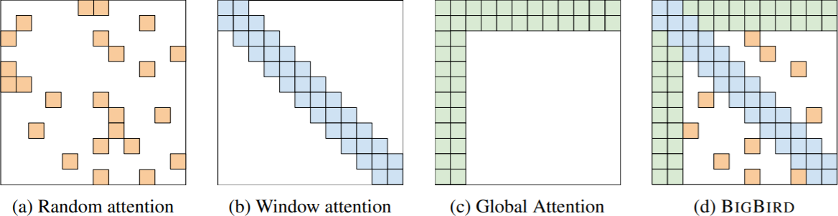
Recent work on improving on quadratic self-attention cost
• Considerable recent work has gone into the question, Can we build models like
Transformers without paying the 𝑂 𝑇² all-pairs self-attention cost?
• For example, BigBird [Zaheer et al., 2021]
Key idea: replace all-pairs interactions with a family of other interactions, like local windows, looking at everything, and random interactions.

Slide 27
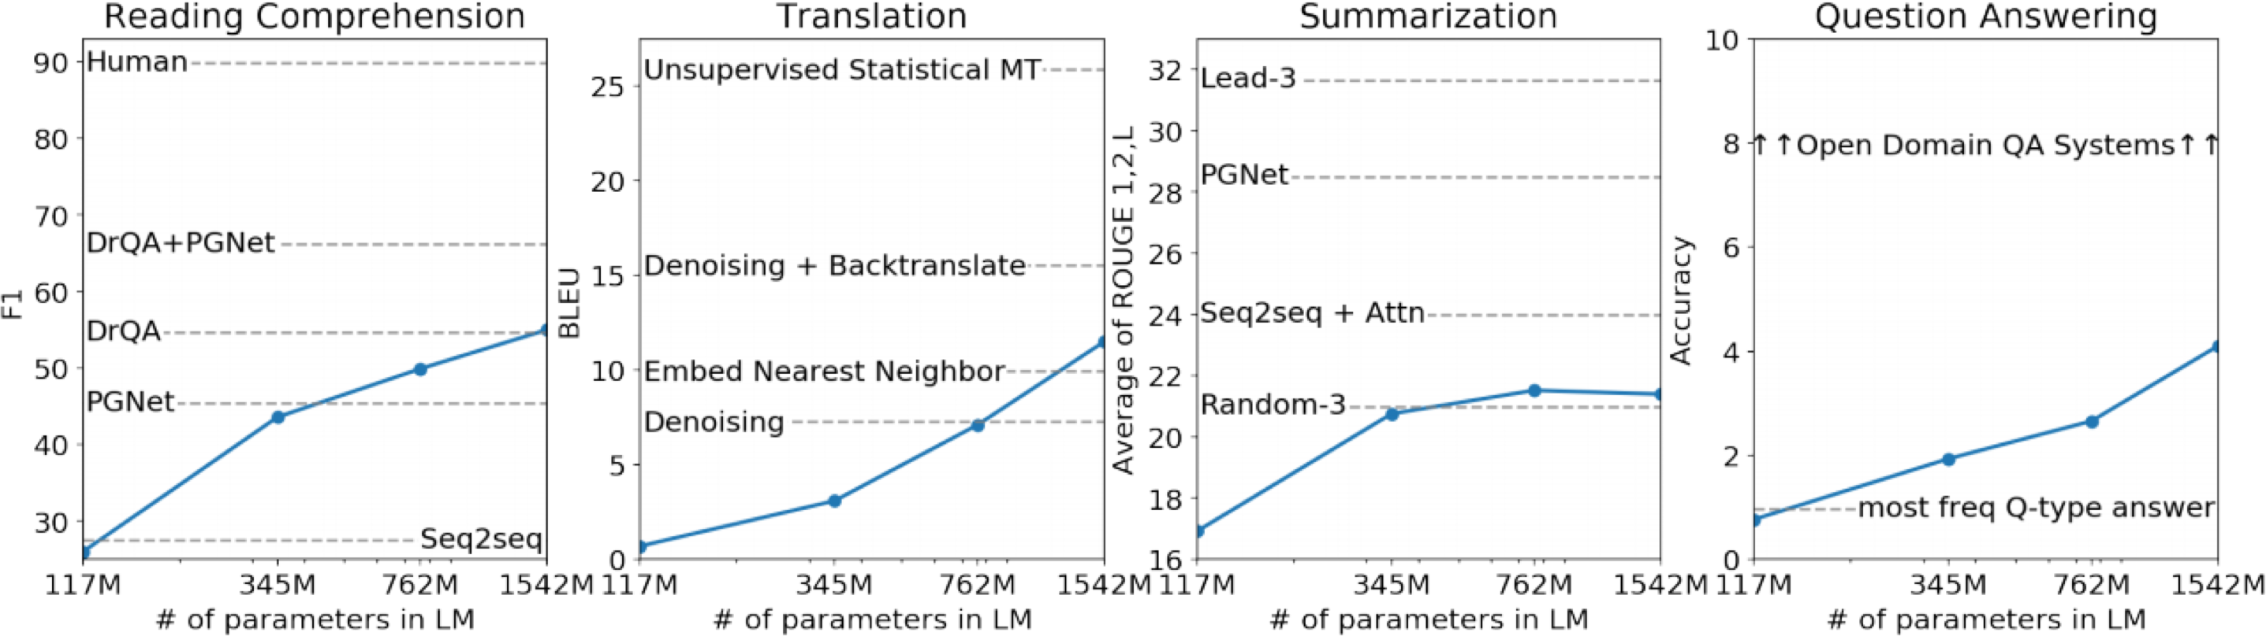
GPT and GPT-2
Radford et al., (2018) Language models are unsupervised multitask learners
Decoder transformer that predicts next word based on previous words by computing !(#$|#_{&..$(&})
SOTA in “zero-shot” setting for 7/8 language tasks (where zero-shot means no task training, only unsupervised language modeling)

Slide 28
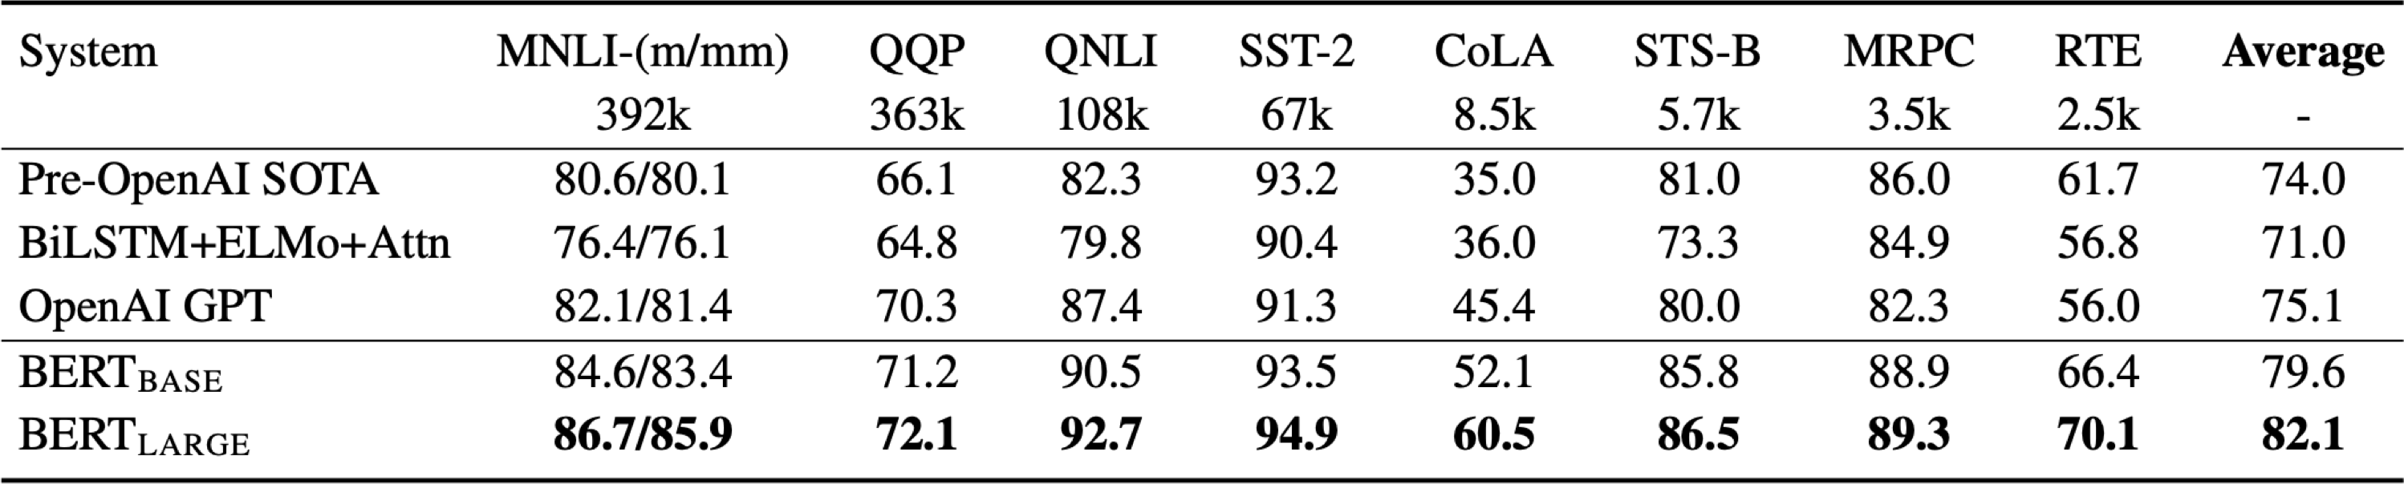
BERT (Bidirectional Encoder Representations from Transformers)
Devlin et al., (2019) BERT: Pre-training of Deep Bidirectional Transformers for Language Understanding
Decoder transformer that predicts a missing word based on surrounding words by computing !(#$|#_{&..$(&,$*&..+})
Mask missing word with masked multi-head attention
Improved state of the art on 11 tasks

